Slide 1
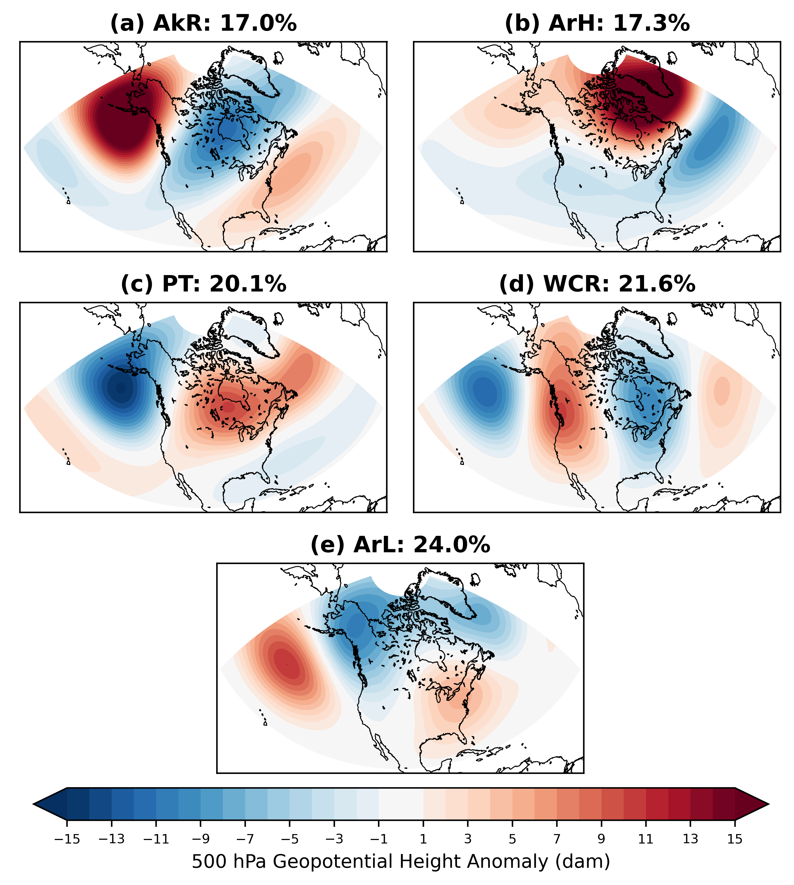
Subseasonal Predictability of North American Winter Weather Regimes
Jason C. Furtado¹, J. Quinting², O. T. Millin¹, F. Mockert²
¹School of Meteorology, University of Oklahoma, Norman, OK, USA
²Karlsruhe Institute of Technology, Karlsruhe, Germany
Award #DE‐SC0024379
Objectives
Quantify the forecast skill of these regimes using hindcasts from the S2S Project Database.
Investigate how the simulation of those processes deemed important for blocking regimes contribute to the S2S forecast skill of those regimes and associated extreme weather events.
Contact jfurtado@ou.edu
https://ifurtado.org
DOE EESM PI Meeting 7 August 2024

Slide 2
Three Key Results
500 hPa GPH/GPH Anomalies
Hindcasts show skillful predictions for all regimes out to about Week 2 on average.
Models dissipate the tropospheric blocks too soon, reducing longevity of subsequent North American winter weather patterns.
A key process for successful forecasts of the Alaskan Ridge and Arctic High regimes is warm conveyor belt (WCB) outflow. Runs with less persistent and/or less strong WCB anomalies have reduced skill.
AkR Regime Onset (Day 0)
8 to 10 Days Later
ERA-5
ECMWF Hindcasts
Shading: 500 hPa GPH Anomalies (m)
Contours: 500 hPa GPH (dam)
Stippling: Significant anomalies (p < 0.05)
Data: ERA-5 and ECMWF Hindcasts
DOE EESM PI Meeting 7 August 2024

