Slide 1
From Data to Decisions: Machine Learning for Water Allocation Amid Hydrologic Extremes
Presenter: Nicole D. Jackson
Team: Kirk Bonney, Thushara Gunda, Stephen Ferencz
EESM PI Meeting
8 August 2024

Slide 2


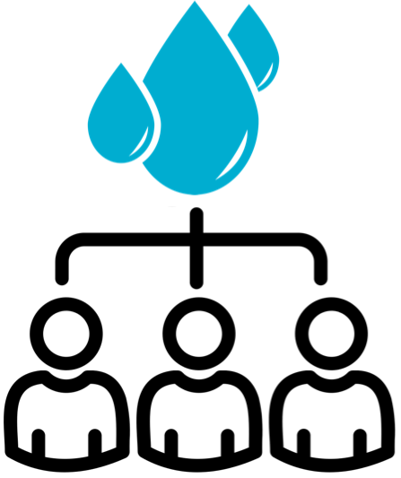
Texas uses the closed source Water Rights Analysis Package (WRAP) for basin-scale water management modeling
Naturalized
flows
Water
Rights
Water Demands
Water Allocation
OVERARCHING GOAL
Use the Colorado River basin to develop an open-source emulator of WRAP to facilitate numerical experiments under diverse climate and operating conditions
Overarching research questions
How effective are LSTMs as serving as surrogate models for water allocation processes?
Under what conditions should the trained model be used?

Slide 3
Texas uses the closed source Water Rights Analysis Package (WRAP) for basin-scale water management modeling
Naturalized
flows
Water
Rights
Water Demands
Water Allocation
OVERARCHING GOAL
Use the Colorado River basin to develop an open-source emulator of WRAP to facilitate numerical experiments under diverse climate and operating conditions
Overarching research questions
How effective are LSTMs as serving as surrogate models for water allocation processes?
Under what conditions should the trained model be used?

Slide 4
Texas uses the closed source Water Rights Analysis Package (WRAP) for basin-scale water management modeling
Naturalized
flows
Water
Rights
Water Demands
Water Allocation
OVERARCHING GOAL
Use the Colorado River basin to develop an open-source emulator of WRAP to facilitate numerical experiments under diverse climate and operating conditions
Overarching research questions
How effective are LSTMs as serving as surrogate models for water allocation processes?
Under what conditions should the trained model be used?

Slide 5
Texas uses the closed source Water Rights Analysis Package (WRAP) for basin-scale water management modeling
Naturalized
flows
Water
Rights
Water Demands
Water Allocation
OVERARCHING GOAL
Use the Colorado River basin to develop an open-source emulator of WRAP to facilitate numerical experiments under diverse climate and operating conditions
Overarching research questions
How effective are LSTMs as serving as surrogate models for water allocation processes?
Under what conditions should the trained model be used?

Slide 6
Texas uses the closed source Water Rights Analysis Package (WRAP) for basin-scale water management modeling
Closed Source Software
Naturalized
flows
Water
Rights
Water Demands
Water Allocation
OVERARCHING GOAL
Use the Colorado River basin to develop an open-source emulator of WRAP to facilitate numerical experiments under diverse climate and operating conditions
Overarching research questions
How effective are LSTMs as serving as surrogate models for water allocation processes?
Under what conditions should the trained model be used?

Slide 7
Texas uses the closed source Water Rights Analysis Package (WRAP) for basin-scale water management modeling
Closed Source Software
Naturalized
flows
Water
Rights
Water Demands
Water Allocation
OVERARCHING GOAL
Use the Colorado River basin to develop an open-source emulator of WRAP to facilitate numerical experiments under diverse climate and operating conditions
Overarching research questions
How effective are LSTMs as serving as surrogate models for water allocation processes?
Under what conditions should the trained model be used?

Slide 8
Texas uses the closed source Water Rights Analysis Package (WRAP) for basin-scale water management modeling
Open
Closed Source Software
Naturalized
flows
Water
Rights
Water Demands
Water Allocation
OVERARCHING GOAL
Use the Colorado River basin to develop an open-source emulator of WRAP to facilitate numerical experiments under diverse climate and operating conditions
Overarching research questions
How effective are LSTMs as serving as surrogate models for water allocation processes?
Under what conditions should the trained model be used?

Slide 9
Texas uses the closed source Water Rights Analysis Package (WRAP) for basin-scale water management modeling
Open
Closed Source Software
Naturalized
flows
Water
Rights
Water Demands
Water Allocation
OVERARCHING GOAL
Use the Colorado River basin to develop an open-source emulator of WRAP to facilitate numerical experiments under diverse climate and operating conditions
Key knowledge gap
Understanding the efficacy of using long short-term memory (LSTMs) neural network as a surrogate model for water allocation processes and the appropriate conditions for using a training model

Slide 10
Texas uses the closed source Water Rights Analysis Package (WRAP) for basin-scale water management modeling
Open
Closed Source Software
Naturalized
flows
Water
Rights
Water Demands
Water Allocation
OVERARCHING GOAL
Use the Colorado River basin to develop an open-source emulator of WRAP to facilitate numerical experiments under diverse climate and operating conditions
Key knowledge gap
Understanding the efficacy of using long short-term memory (LSTMs) neural network as a surrogate model for water allocation processes and the appropriate conditions for using a training model

Slide 11
Developing an LSTM for WRAP requires minimal information about the system
ML-based Emulator
Naturalized
flows
Water
Rights
Water Demands
Water Allocation
Naturalized
flows
Water Allocation
Long short-term memory (LSTMs) neural network

Slide 12
Developing an LSTM for WRAP requires minimal information about the system
ML-based Emulator
Naturalized
flows
Water
Rights
Water Demands
Water Allocation
Naturalized
flows
Water Allocation
Long short-term memory (LSTMs) neural network

Slide 13
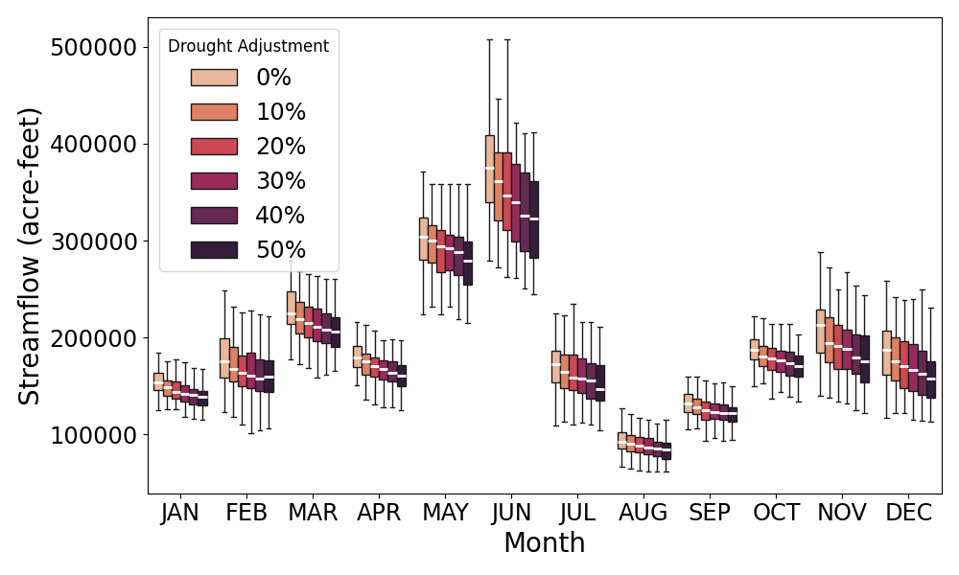
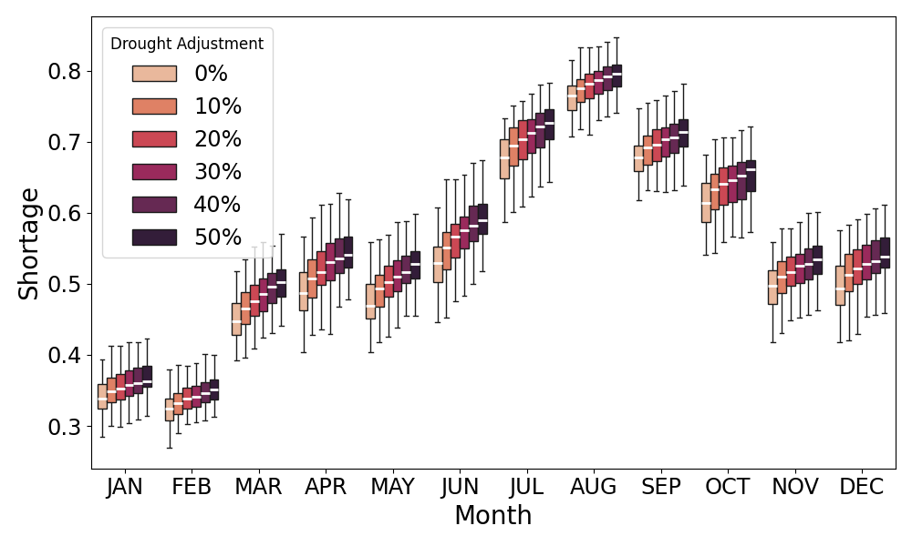

Data gap filled using Hidden Markov Models to generate synthetic streamflows across a variety of drought conditions
$$shortage ratio= \frac{allocation shortage}{allocation target}$$
Purpose | Drought adjustment parameter (a) | Number of realizations
LSTM training | 0 | 1,000
LSTM testing | 0 | 100
Drought testing | [0.1, 0.5] | 100 for each a

Slide 14
Data gap filled using Hidden Markov Models to generate synthetic streamflows across a variety of drought conditions
$$shortage ratio= \frac{allocation shortage}{allocation target}$$
Purpose | Drought adjustment parameter (a) | Number of realizations
LSTM training | 0 | 1,000
LSTM testing | 0 | 100
Drought testing | [0.1, 0.5] | 100 for each a

Slide 15
Data gap filled using Hidden Markov Models to generate synthetic streamflows across a variety of drought conditions
$$shortage ratio= \frac{allocation shortage}{allocation target}$$
Purpose | Drought adjustment parameter (a) | Number of realizations
LSTM training | 0 | 1,000
LSTM testing | 0 | 100
Drought testing | [0.1, 0.5] | 100 for each a

Slide 16
Data gap filled using Hidden Markov Models to generate synthetic streamflows across a variety of drought conditions
$$shortage ratio= \frac{allocation shortage}{allocation target}$$
Purpose | Drought adjustment parameter (a) | Number of realizations
LSTM training | 0 | 1,000
LSTM testing | 0 | 100
Drought testing | [0.1, 0.5] | 100 for each a

Slide 17
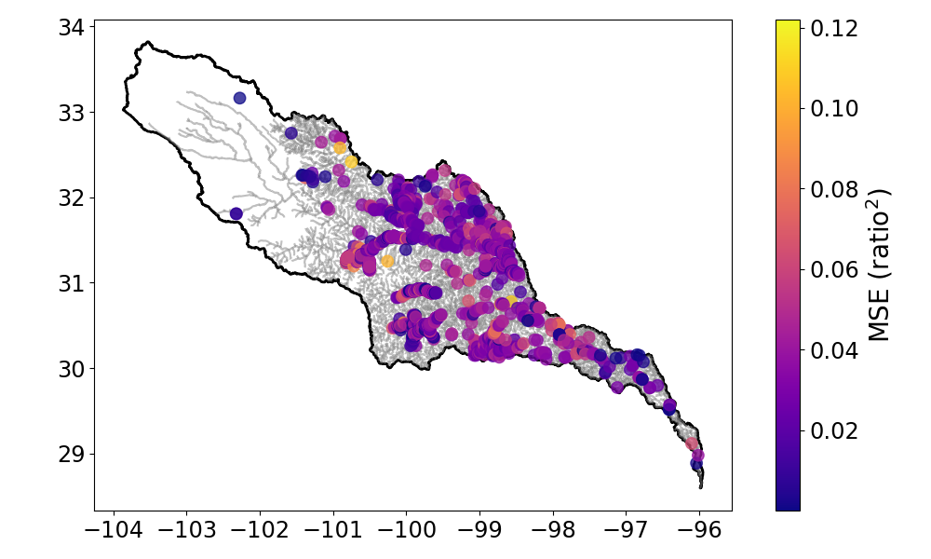
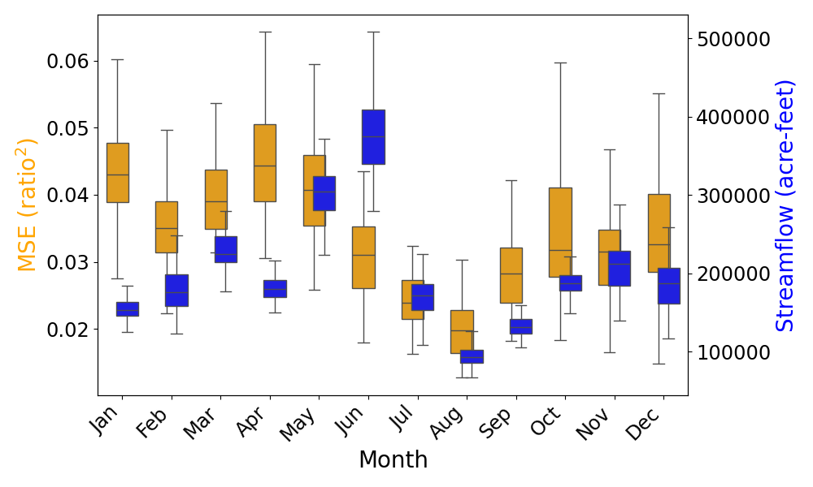
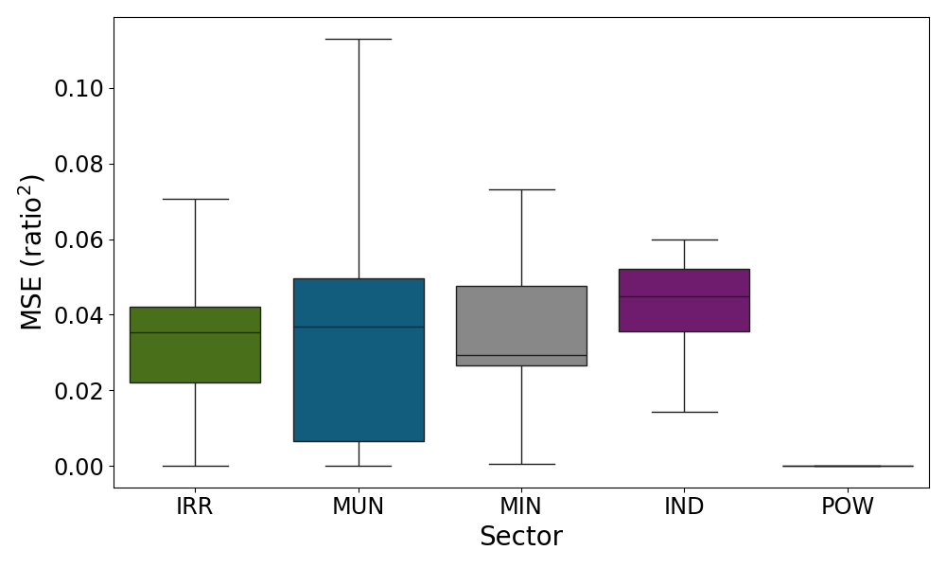
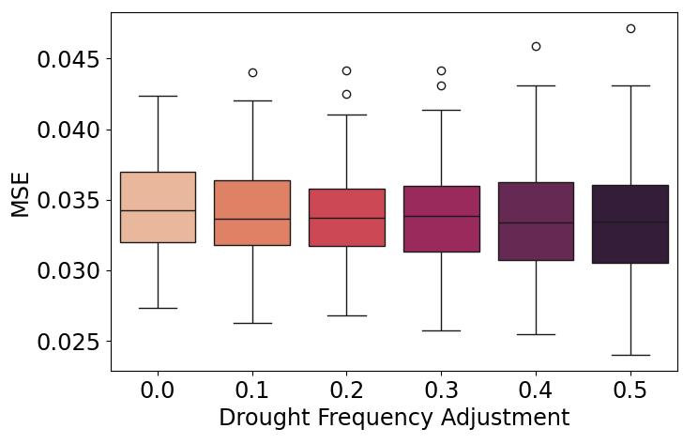
LSTM performance as a WRAP emulator can be evaluated overall as well as across space, time, sector, and drought
MSE across basin
MSE by month
MSE by sector
MSE by drought

Slide 18
LSTM performance as a WRAP emulator can be evaluated overall as well as across space, time, sector, and drought
MSE across basin
MSE by month
MSE by sector
MSE by drought

Slide 19
LSTM performance as a WRAP emulator can be evaluated overall as well as across space, time, sector, and drought
MSE across basin
MSE by month
MSE by sector
MSE by drought

Slide 20
LSTM performance as a WRAP emulator can be evaluated overall as well as across space, time, sector, and drought
MSE across basin
MSE by month
MSE by sector
MSE by drought

Slide 21
LSTM performance as a WRAP emulator can be evaluated overall as well as across space, time, sector, and drought
MSE across basin
MSE by month
MSE by sector
MSE by drought

Slide 22


In conclusion, a high performing water allocation emulator has been developed for the Colorado River Basin in Texas
Key Gap: Data
Leveraging testbeds
How can the testbed framework be advanced to promote coordination across EESM and BER?
  Validated regionally refined models could be support test bed development and facilitate exposure to other types of extreme events
What role could other agencies play in facilitating the efficacy of testbeds in achieving our science?
  Data sharing, co-production of coupled human-natural systems models, development of new, relevant metrics
Opportunity: Gap filled using Hidden Markov Models used to generate synthetic data for LSTM modeling
Challenge: No validation data of historical demands and allocations

Slide 23
In conclusion, a high performing water allocation emulator has been developed for the Colorado River Basin in Texas
Key Gap: Data
Leveraging testbeds
How can the testbed framework be advanced to promote coordination across EESM and BER?
  Validated regionally refined models could be support test bed development and facilitate exposure to other types of extreme events
What role could other agencies play in facilitating the efficacy of testbeds in achieving our science?
  Data sharing, co-production of coupled human-natural systems models, development of new, relevant metrics
Opportunity: Gap filled using Hidden Markov Models used to generate synthetic data for LSTM modeling
Challenge: No validation data of historical demands and allocations

Slide 24
In conclusion, a high performing water allocation emulator has been developed for the Colorado River Basin in Texas
Key Gap: Data
Leveraging testbeds
How can the testbed framework be advanced to promote coordination across EESM and BER?
  Validated regionally refined models could be support test bed development and facilitate exposure to other types of extreme events
What role could other agencies play in facilitating the efficacy of testbeds in achieving our science?
  Data sharing, co-production of coupled human-natural systems models, development of new, relevant metrics
Opportunity: Gap filled using Hidden Markov Models used to generate synthetic data for LSTM modeling
Challenge: No validation data of historical demands and allocations

