Slide 1
Regional Teleconnections and Multisector Dynamics: insights from ongoing research and future directions
Gokul Iyer, Brinda Yarlagadda,
Yang Qiu, Neal Graham, Marshall Wise

Slide 2
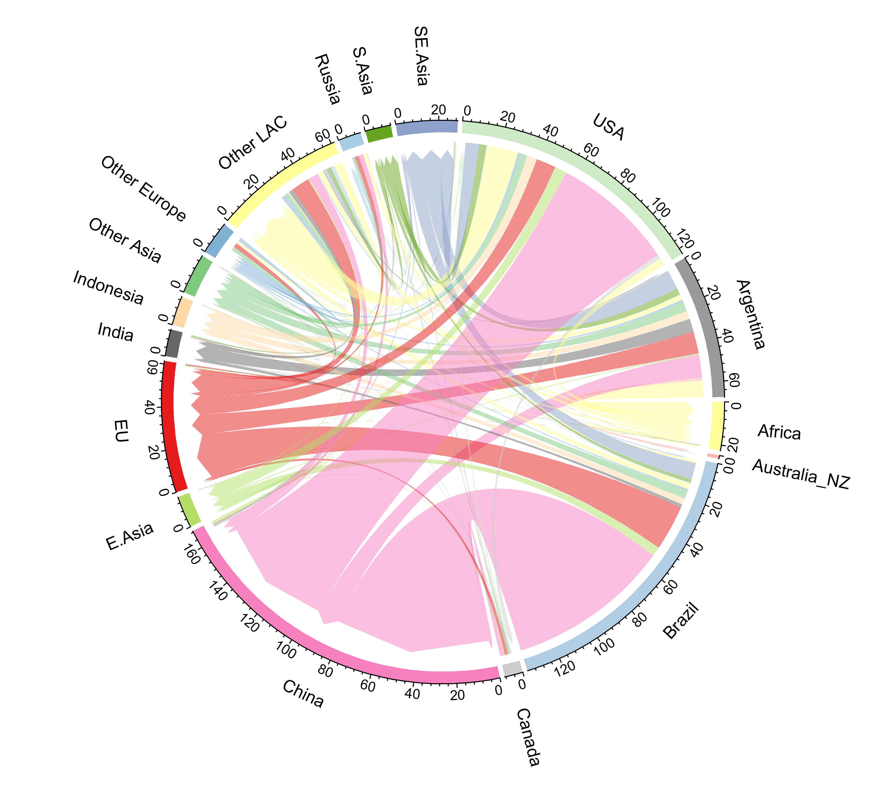
Regional teleconnections are caused by globally traded energy, agricultural, and other commodities
Soybean trade flows in 2050
Regional teleconnections could affect how human and natural systems respond to future stressors
Regional teleconnections link changes induced by stresses in one place to those of another
In other words, regional teleconnections could create, amplify, or attenuate responses of human and Earth systems to different stressors
The ease or difficulty of trade could affect how systems respond to various stressors

Slide 3
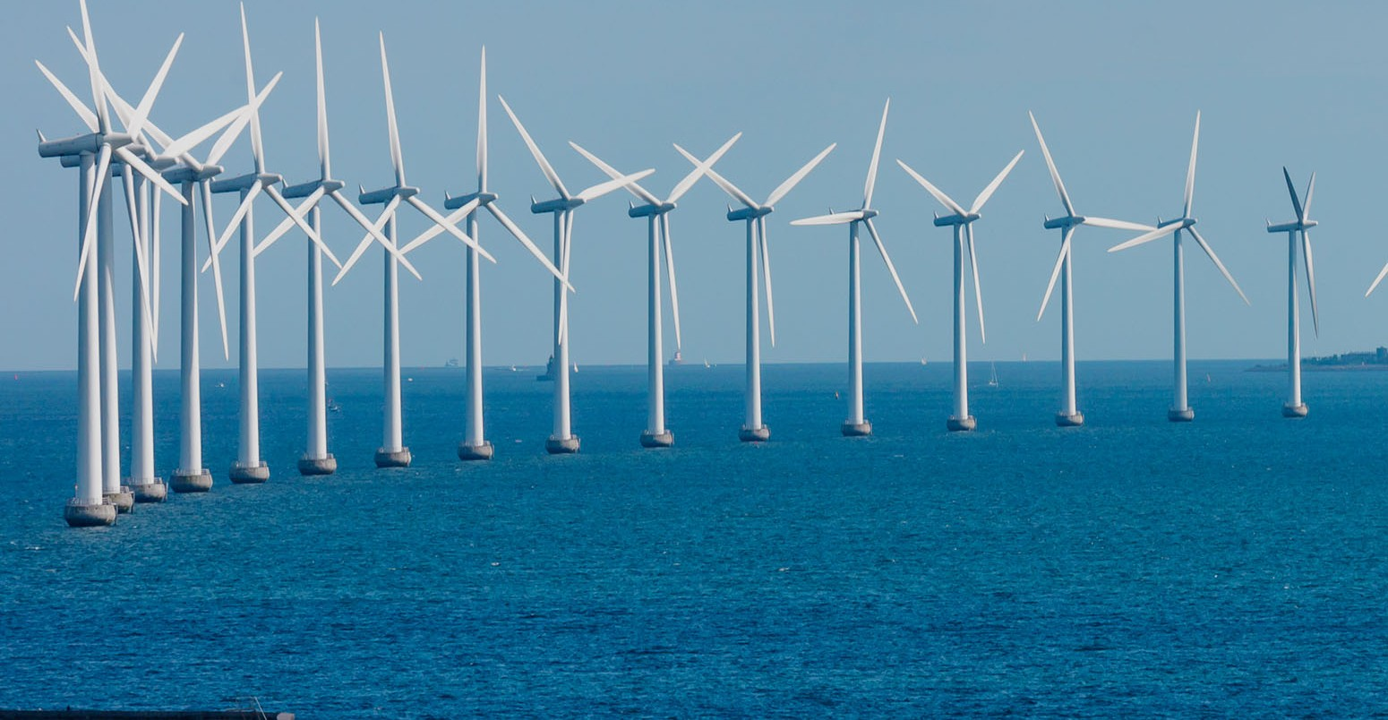
For example, regional teleconnections through minerals trade could affect future evolution of the energy system
Example stresses
Example Energy-system responses
Economic growth
Expansion of solar photovoltaic systems
Economy-wide technology transitions
Expansion of wind technology
Notes:
Transport figure: https://www.policylink.org/resources-tools/all-aboard-making-equity-and-inclusion-central-to-federal-transportation-policy
Minerals map: https://phys.org/news/2020-01-sustainable-minerals-metals-key-low-carbon.html
PV: https://solarfeeds.com/csp-and-pv-differences-comparison/
Offshore wind: https://bluedelaware.com/2019/12/06/support-offshore-wind/

Slide 4
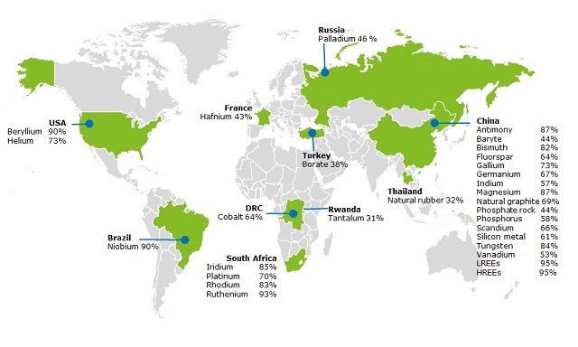
For example, regional teleconnections through minerals trade could affect future evolution of the energy system
Minerals/Elements Availability and Trade Patterns
Example stresses
Example Energy-system responses
Global distribution of minerals and elements
Economic growth
Expansion of solar photovoltaic systems
Economy-wide technology transitions
Expansion of wind technology
Percentage numbers correspond to share of global production
E.g., import reliance of U.S. on rare-Earth elements, indium, gallium is 100%
Notes:
Transport figure: https://www.policylink.org/resources-tools/all-aboard-making-equity-and-inclusion-central-to-federal-transportation-policy
Minerals map: https://phys.org/news/2020-01-sustainable-minerals-metals-key-low-carbon.html
PV: https://solarfeeds.com/csp-and-pv-differences-comparison/
Offshore wind: https://bluedelaware.com/2019/12/06/support-offshore-wind/

Slide 5
GCIMS Major Experiment 2: Science question
How will regional teleconnections via resource supply networks and trade create, amplify, or attenuate responses associated with different influences in the U.S. and other parts of the world, and how will varying assumptions about the ease or difficulty of trade alter these teleconnections?

Slide 6
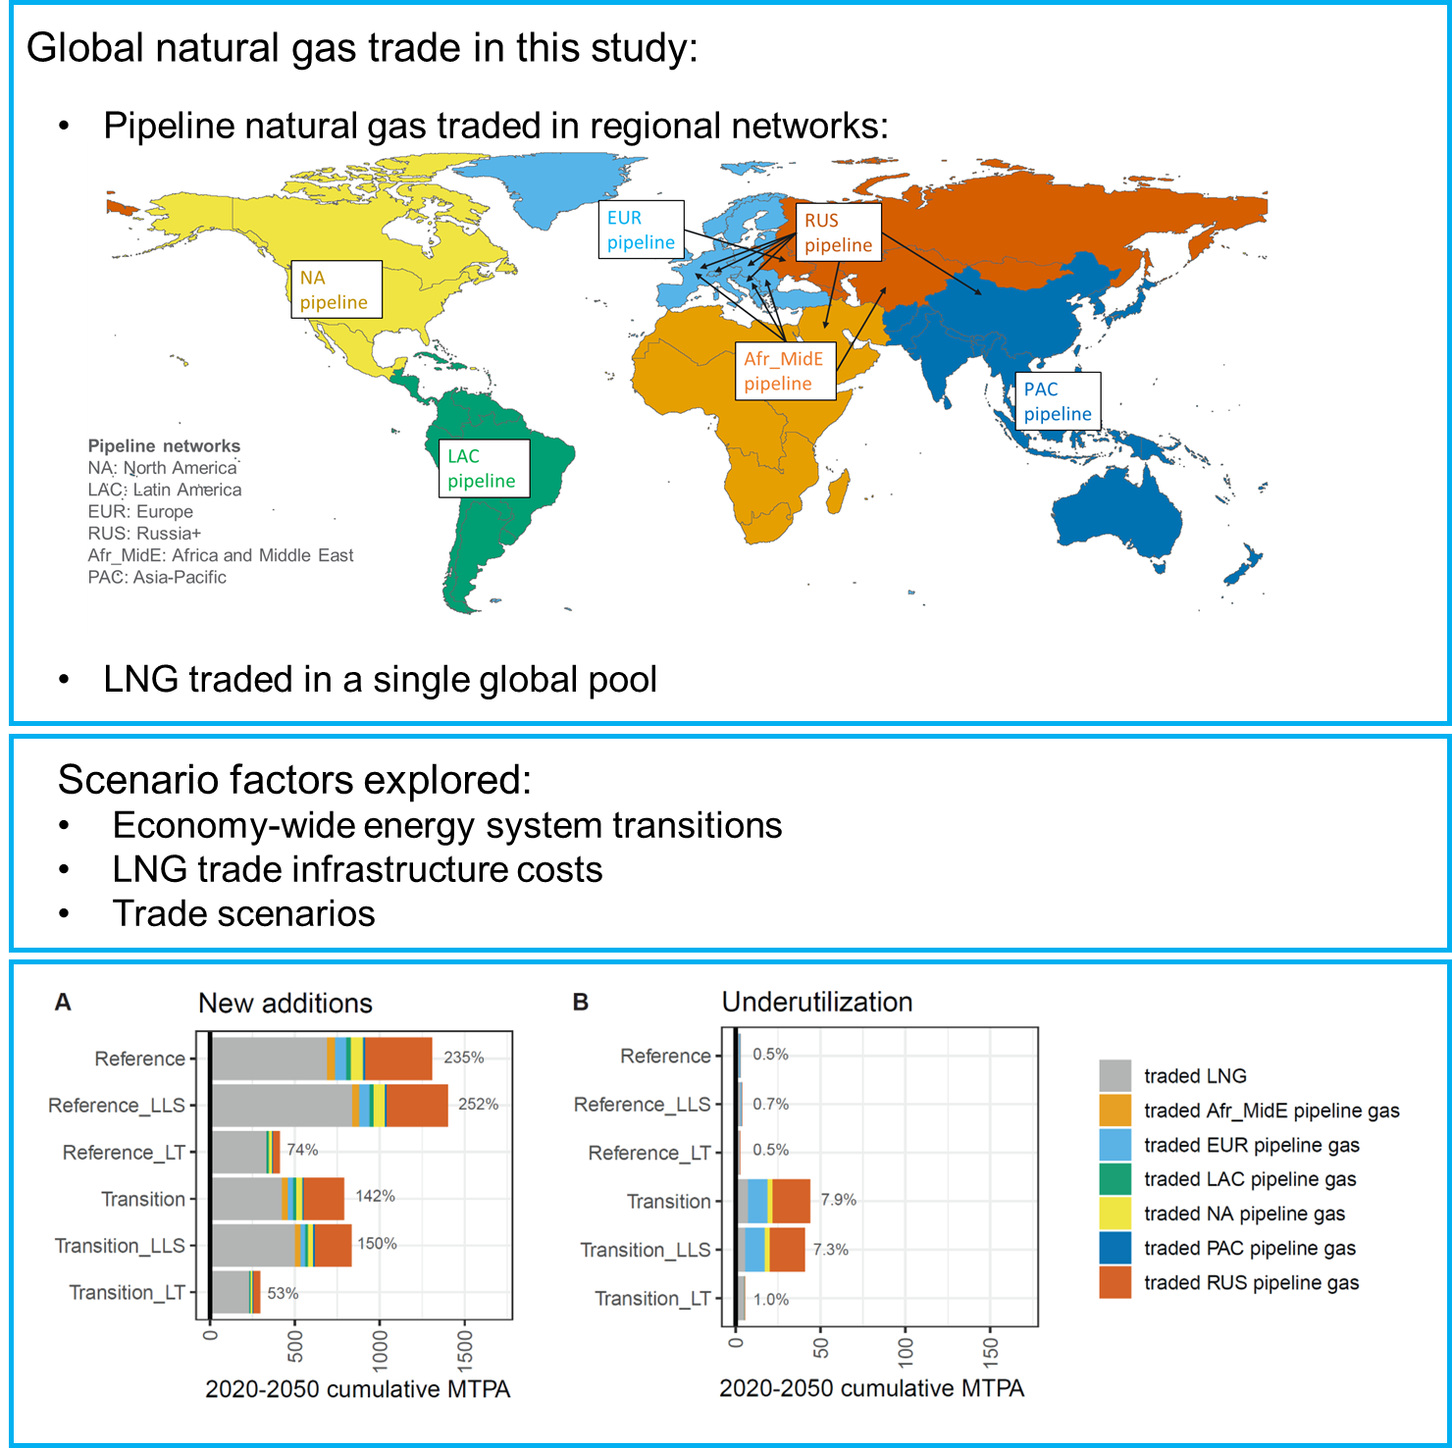
Example 1: Detailed modeling of Natural gas trade within a multisectoral context
Yarlagadda et al. developed capability within the Global Change Analysis Model (GCAM) to differentiate pipeline gas and LNG trade
This capability allows for the tracking of natural gas export and import infrastructure investments
Gas trade is integrated into the broader global energy sector, allowing for competition between these two modes of gas trade with multiple energy supply technologies in meeting multi-sectoral energy demands
In our modeled scenarios, new LNG export infrastructure ranged from 230 to 840 million tons of gas per annum (MTPA) globally by 2050. New pipeline export infrastructure ranged from 70 to 620 MTPA by 2050.
GCAM’s new detailed natural gas trade capability differentiates between pipeline and LNG trade and allows for the quantification of new investments and underutilization of gas trade infrastructure.
Scenario factors: LLS = Low liquefaction and shipping costs; LT = Limited trade. Units: MTPA = million tons of gas per annum (in gaseous form) that can be traded.
Yarlagadda, B., G. Iyer, M. Binsted, P. Patel, M. Wise and J. McLeod (2024). The future evolution of global natural gas trade. iScience. https://doi.org/10.1016/j.isci.2024.108902

Slide 7
Example 2: Modeling and analysis of Virtual water trade
Main Driver of Virtual Blue Water Exports in 2100 under SSP2/RCP6.0 across >7000 simulations
Traded agricultural and energy commodities redistribute water virtually around the world
In a series of studies, Neal Graham et al. have studied water implications of electricity trade within the U.S. and agricultural trade globally
In ongoing research, Graham et al. leverage a scenario discovery framework to understand the main drivers of change for global and regional agricultural water use utilization and future virtual water trade across a large ensemble (>7000 simulations) of uncertain futures
Main Driver of Virtual Blue Water Exports in 2100 under SSP2/RCP2.6 across >7000 simulations
Graham, N., Wild, T., Iyer, G., Lamontagne, J., Patel., P. Uncovering Key Drivers of Future Virtual Water Trade and Global Water Use. In prep

Slide 8
Example 3: Modeling of minerals and materials
In new model development, we are incorporating minerals and materials into GCAM, starting from the power sector and expanding to other sectors
We currently model demands for 12 materials
Our modeling incorporates economic feedbacks of minerals and materials supply chains with technology competition in various sectors within the energy system
Initial research shows that mineral supply constraints could reduce power sector investments and affect their composition
If future supplies of the 12 materials in the global power sector are constrained to historical growth rates (His), investments in the global power sector through 2050 reduce by 12% relative to an unconstrained supply case.
Under a low-carbon transition, investments reduce by 34%
Constraints on different minerals could have different implications
A supply constraint on copper would be impactful since copper is used in all power sector technologies
Supply constraints on lithium and graphite could impact storage technologies
Qiu, Y., Iyer, G., Graham, N., Binsted, M., Wise, M., Patel, P., Yarlagadda, B. Cell Reports Sustainability, Forthcoming

Slide 9
Looking ahead: Priority areas for future research and capability developments
Improved modeling of trade and its multisectoral implications
E.g. Bilateral trade in energy, materials/minerals, and agricultural commodities
E.g. Macroeconomic implications of trade
Improved modeling of emerging supply chains and resources
E.g. Expanded set of minerals and materials (e.g. concrete and lumber, carbon fiber), recycling, substitution across materials and their multisectoral implications
Expanded set of stressors and their interactions with trade
E.g. Extreme events such as droughts, wildfires, etc.

