Slide 1

Integrated Assessment Research
Bob Vallario
ACME PI Meeting
Bolger Center
Potomac, MD
June 2017

Slide 2
Program Goal
Explore the complex interactions and potential co-evolutionary pathways within the integrated Earth-energy-human system, including multi-scale interdependencies among natural, engineered, and economic systems and sectors.

Slide 3
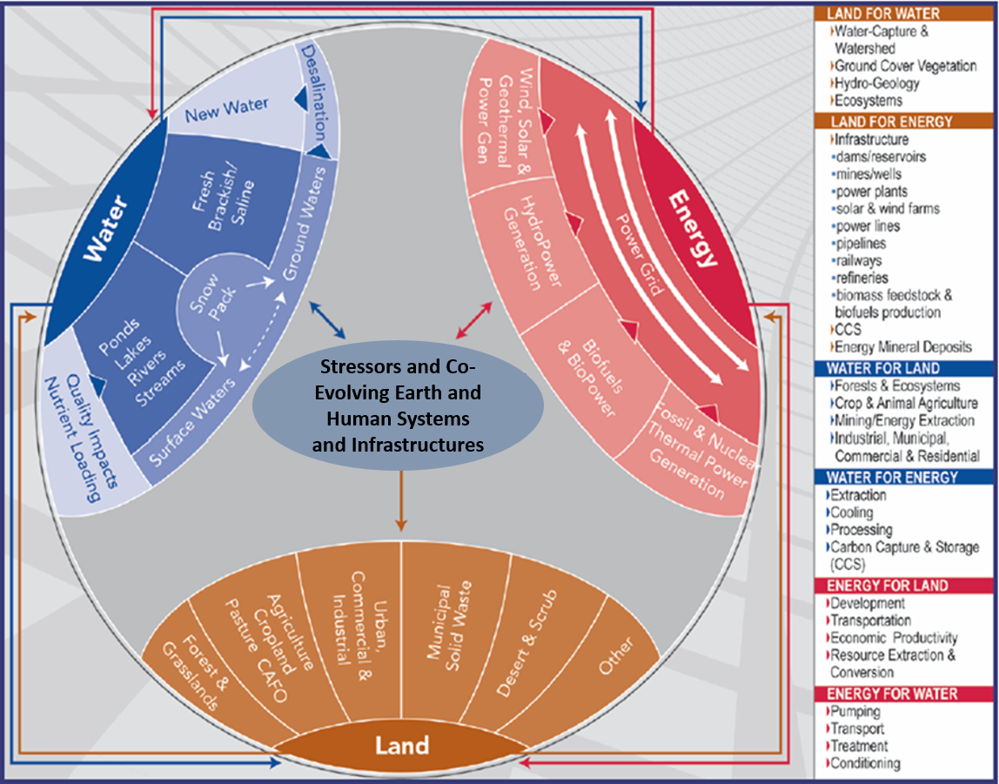
Significant Focus on Energy, Water, and Land Systems

Slide 4
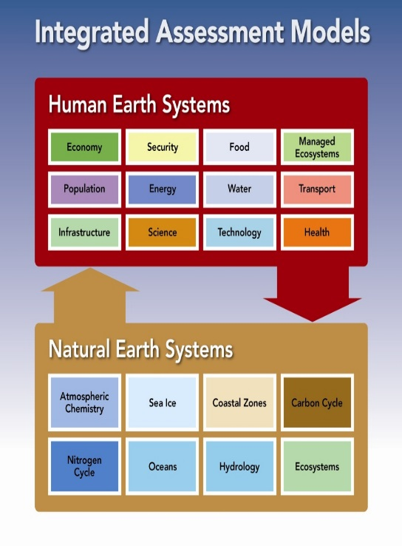
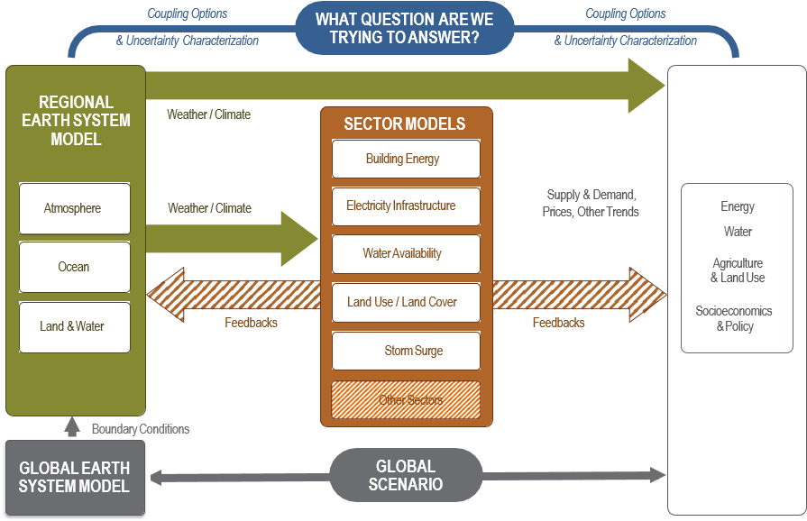
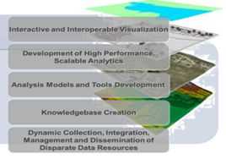
Three Main Capability-Driven Emphases
IAMs
Multi-Model Frameworks
Data-Driven Knowledge Discovery Frameworks

Slide 5
…And More Specific Capability-Driven Emphases
Modular model design, integrative modeling frameworks, software couplers
Test-bed development and design
Representations of stressors, drivers, and influences
Improved temporal and spatial resolutions and scale-aware and/or telescopic capabilities
Simulation of extreme events, system shocks, multiple stressors, and non-linear behaviors
Hindcasting and model evaluation
Emulation of complex processes
Uncertainty characterization/quantification
Scenarios, sensitivity studies, and interpretation of result
Data science, analytics, fusion methods, and machine learning

Slide 6
Coupled System Responses to Stressors, Influences, and Drivers
Compounding stressors, influences, and drivers
  Natural and human-induced
Examples:
  weather patterns and extremes
  population movements and demographics
  regional economies and structural changes
  land-use/land cover (LULC)
  technology evolution
  natural resource transitions (groundwater, energy sources, etc.)
  other natural disturbances;
  infrastructure expansion, connectivity, and urban/rural gradients
  institutional/governance factors
  other
Non-linear behaviors and dynamics: tipping points, thresholds, and feedbacks within the integrated system

Slide 7
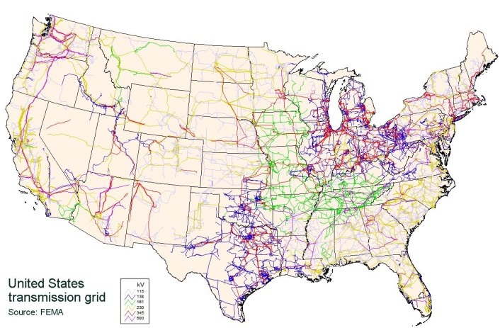
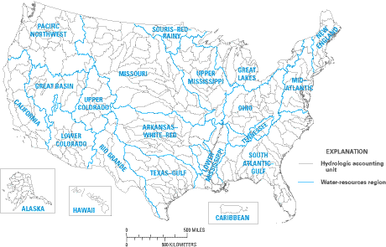
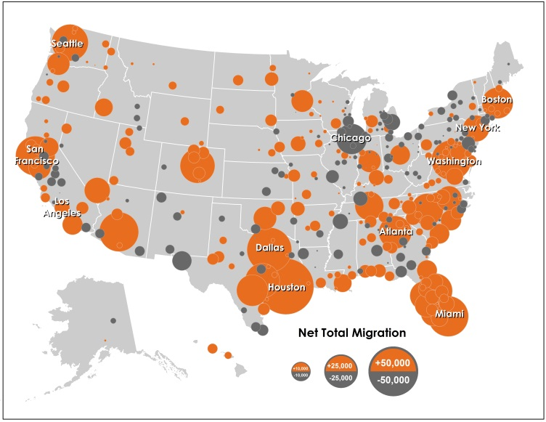
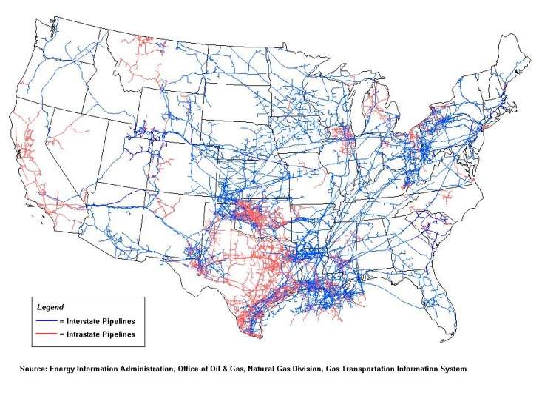
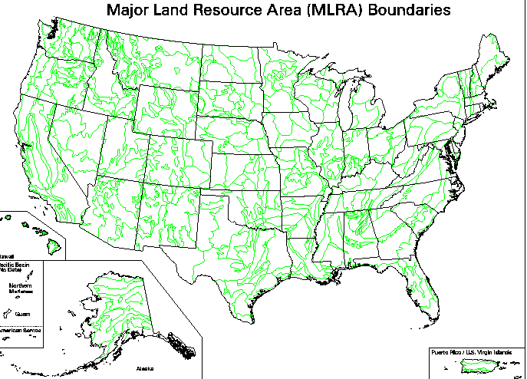
Complexity Across Many Interdependent Systems and Scales
Electricity
Water
Population
Natural Gas
Land

Slide 8























Foundations to Build From
Stanford led-multi-institutional Cooperative Agreement (CA) awarded for multi-scale, -sector modeling framework
SFA established under PNNL with SNL, NREL, UCAR, and other universities on regional scale EWN modeling.
Two new CAs competed and awarded for university led multi-institutional teams addressing fine-scale climate analysis and human feedbacks for EWN
PNNL-JGCRI Scientific Focus Area (SFA) aligned around research in energy, water, land system interactions .
MIT Cooperative Agreement renewal under with focus on energy, water, land system interactions.
New ORNL led data-driven knowledge discovery framework involving ANL, NASA DAAC (Columbia), others
Interagency/intra-agency conceptual development with DHS, DOD, USDA, NASA, NOAA, USGS, others
8

Slide 9
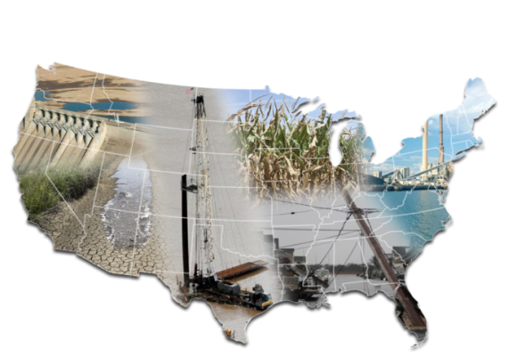
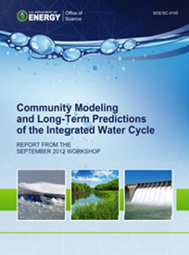
Test Bed Concept
Three test beds within three different U.S. geographic regions to inform capabilities, heterogeneity of data, modeling, and analysis (DMA) challenges, scale-aware interdependencies at regional and sub-regional scales.
Topics aligned with:
    Energy in Water-Stressed Regions
    Connected Infrastructure Vulnerabilities (including but not limited to urban systems
One targeted award for shared knowledge framework, cross-test bed community of practice, and networked capability.
DMA focus with potential evolution into integrated observatories.
Competitive lab-led, multi-institutional teams.
Panel review scheduled for June 14-16.
Funding decisions contingent on budget availability.

Slide 10
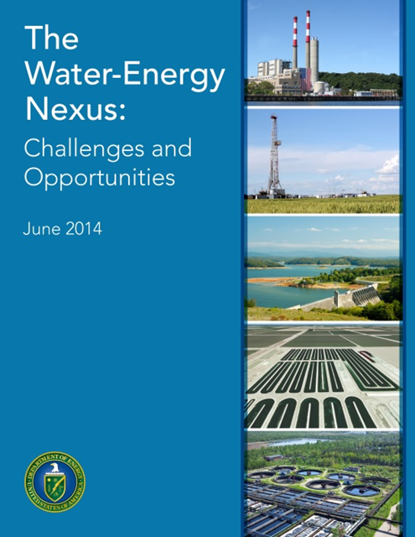

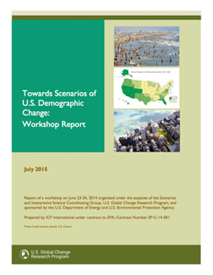
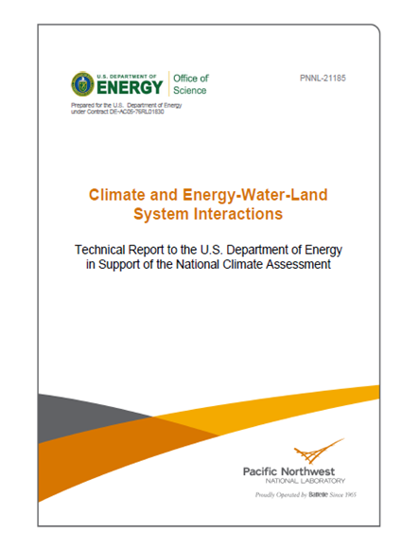

Community Inputs and Motivation

Slide 11
ACME/ESM and IARP Intersections and Opportunities
  Complementary:
    ESM - Models with rich details and resolution for natural systems, exploring human systems affects on natural systems that in turn provide insights for evaluating consequences for human systems.
    IARP - Models with breadth but also details and resolution for human systems affected by natural systems but many other influences and stressors that ultimately play into decision theory, associated uncertainties, and potential co-evolutionary pathways of engineered and socio-economic systems.
  Promising areas of joint opportunity:
    Land-Use and Land-Cover (including crops)
    Water
    Dynamic energy – high res vs. decision options
    Scenarios
    Uncertainty Analysis (natural systems, human systems, joint)
    Emulation

Slide 12
Backup

Slide 13
Questions

Slide 14
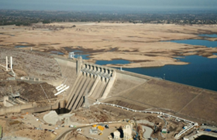
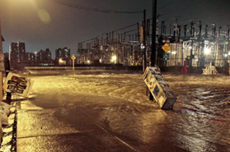
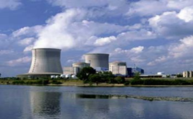
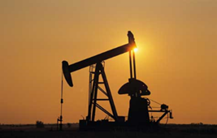
Significance – Implications for Infrastructure and National Security
  Energy uses account for >40% of U.S. river and stream withdrawals
  Energy and water infrastructures are at significant risk from changing weather patterns/extremes, dwindling surface and ground waters, and more
    Water-for-energy - energy system vulnerabilities including thermoelectric cooling, hydropower, oil and gas recovery…
    Energy-for-water - inter-basin transfers, groundwater pumping, treatment of non-traditional waters…
  National Infrastructure Report Card (ASCE): Energy= D+, Water= D, Wastewater= D (For comparison, Bridges= C+)
  DOE, through its National Laboratories, is a recognized leader in relevant areas of modeling and analysis and can contribute to understanding the issues and options for solution.
  Potential high leverage science collaborations – within DOE, across science and mission driven agencies, and with state and local governments, U.S. industry, and strategic international partners
Notes:
I think an additional slide showing a bit more detail about the evolution of this program would be helpful. Maybe split out the background slide and then you’ll be able to incorporate more information about the types of research in each of the predecessor activities and other unique aspects? This might even include the % renewal rate, etc.

