Slide 1
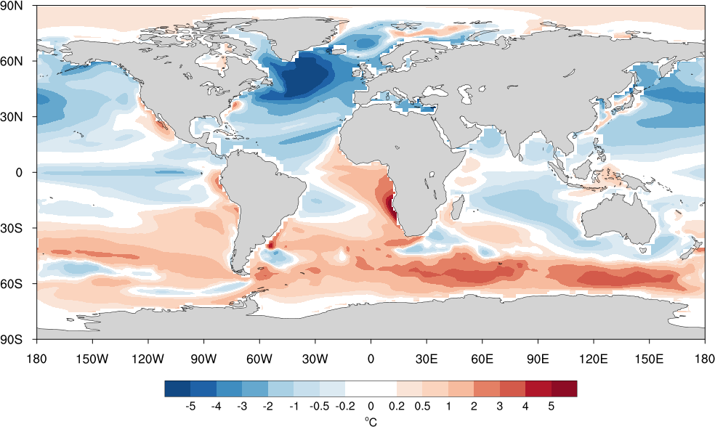
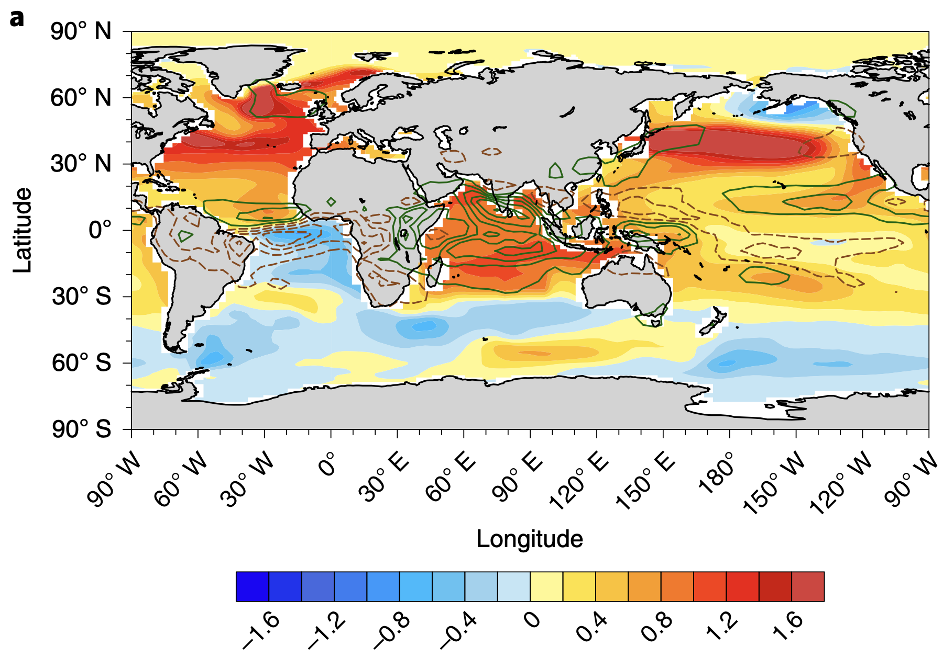
E3SM v2 biases in Atlantic climate mean state, variability, and change
Shineng Hu¹, Xiang Li¹, Alexey Fedorov²
¹Duke University, ²Yale University
E3SMv2 biases in SST (°C)
SST response to Indian Ocean warming (°C)
RGMA project: The Effects of the Tropical Indian Ocean on the Atlantic Climate Mean State, Variability and Change in E3SM and Other Earth System Models
August 8, 2024 @ EESM PI Meeting
Award #: DE-SC0024186

Slide 2
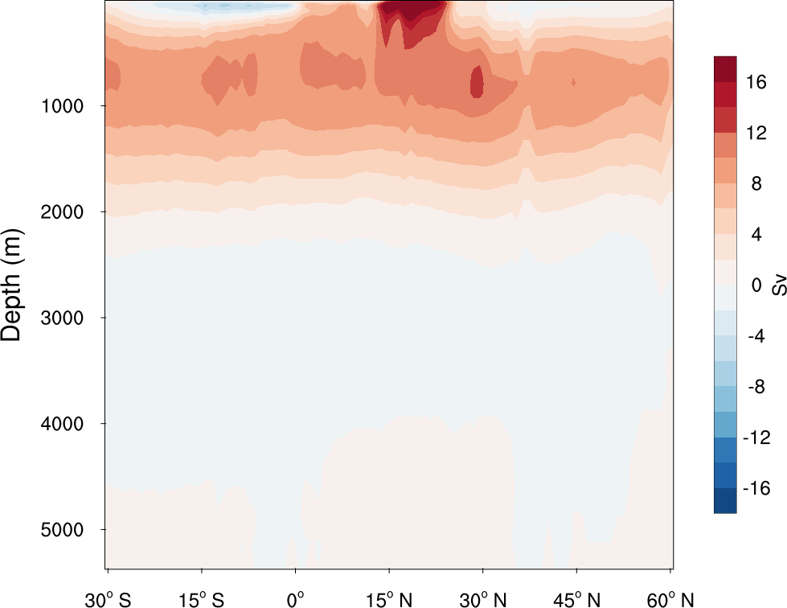
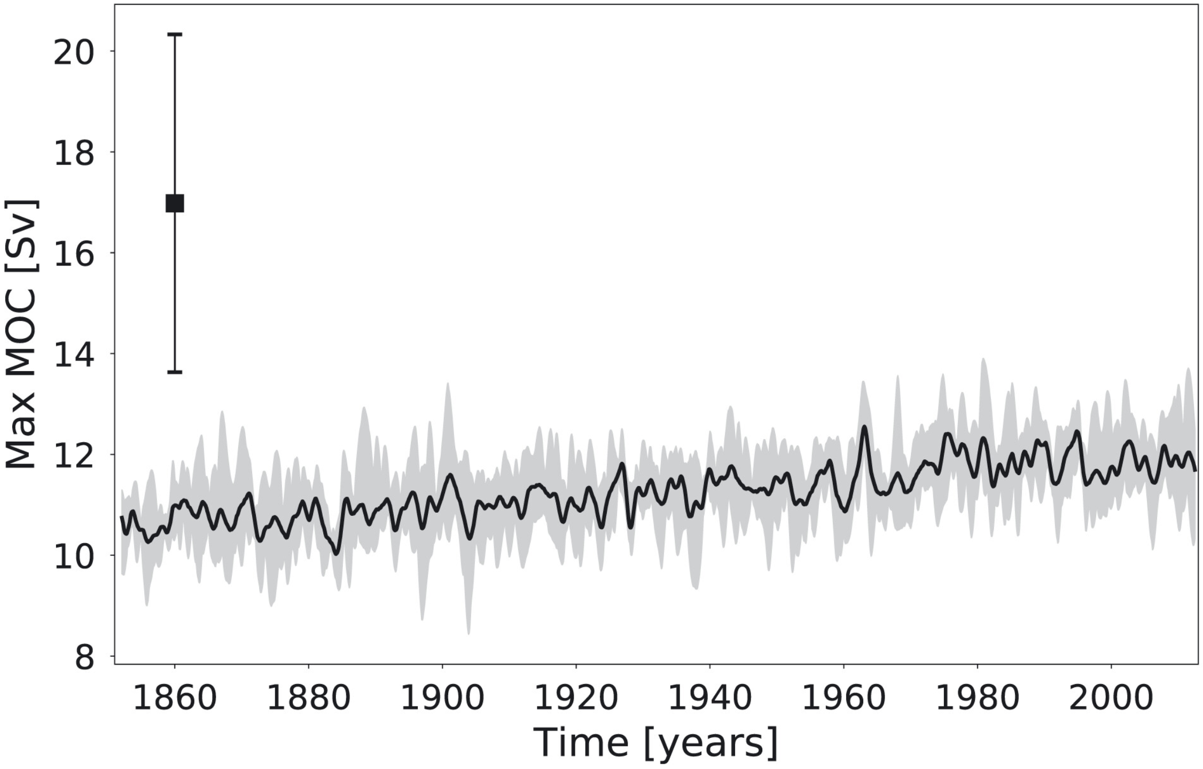
E3SMv2 bias in the Atlantic meridional overturning circulation (AMOC)
E3SMv2
12 Sv
E3SMv1
Golaz et al. (2019)
(ensemble mean 1985-2014)
Too weak AMOC (by ~5 Sv): a persistent bias since E3SMv1

Slide 3
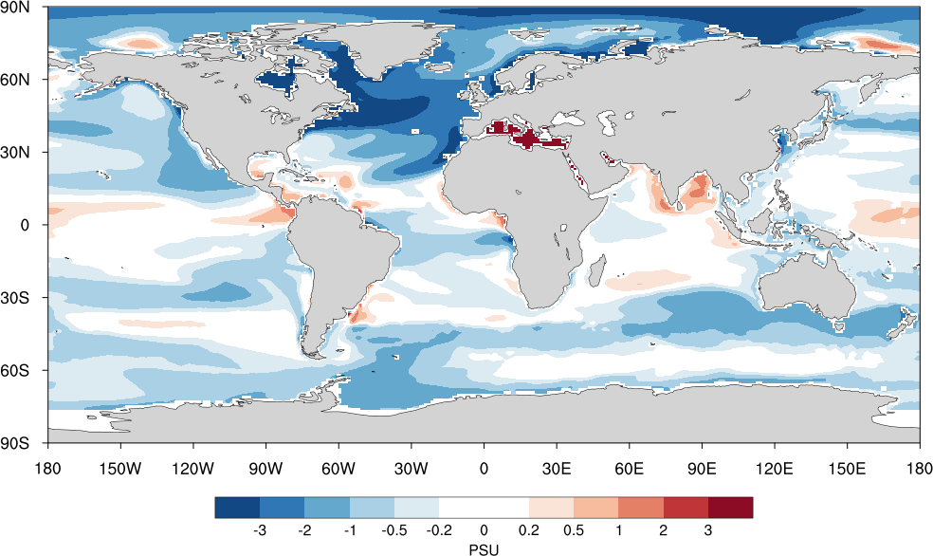
E3SMv2 biases in sea surface temperature (SST) and salinity (SSS)
SST (°C)
SSS (PSU)
SST biases
Too cold North Atlantic
Too warm South Atlantic
Too cold North Pacific
Too warm Southern Ocean
Too cold Indian Ocean
SSS biases
Too fresh North Atlantic
Too fresh S.E. subtropical Atlantic
Too salty Indian Ocean

Slide 4
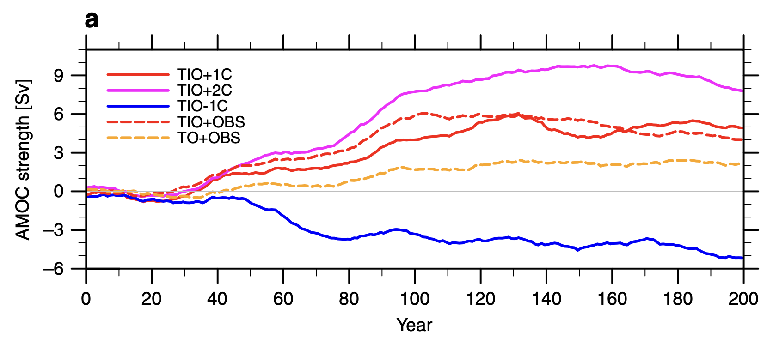
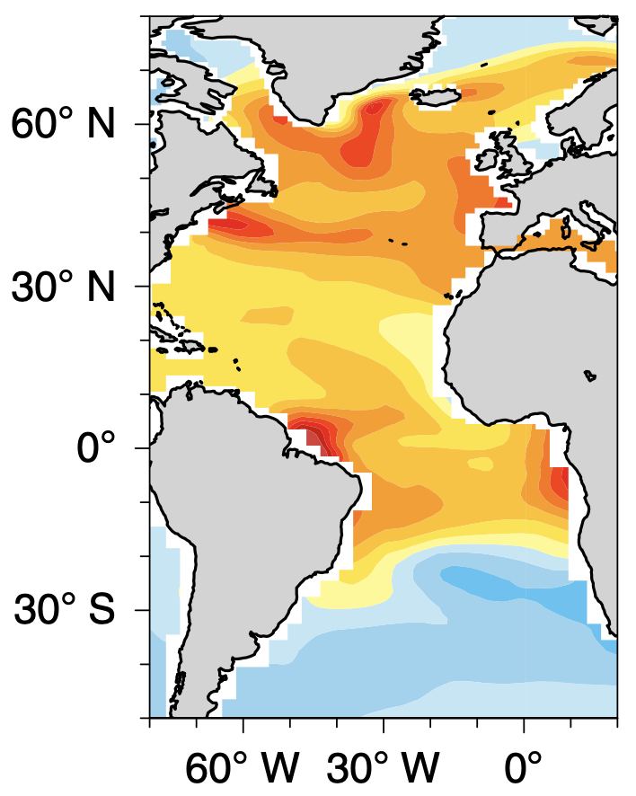
Atlantic climate response to ~1°C Indian Ocean warming in a coupled GCM
AMOC response to ~1°C Indian Ocean warming (red solid)
Modeling results based on CESM1
Hu and Fedorov (2019, 2020)
SST (colors; °C) & rainfall (contour)
SSS (PSU)
Warmer Indian Ocean → rainfall reduction over tropical Atlantic → Saltier Atlantic → AMOC strengthening

Slide 5
A tropical origin of E3SMv2 biases in AMOC and Atlantic mean state?
E3SMv2 biases in SST (°C)
E3SMv2 biases in SSS (PSU)
-0.51°C
Modeling results based on CESM1
(PSU)
Hu and Fedorov (2019, 2020)
(°C)

Slide 6
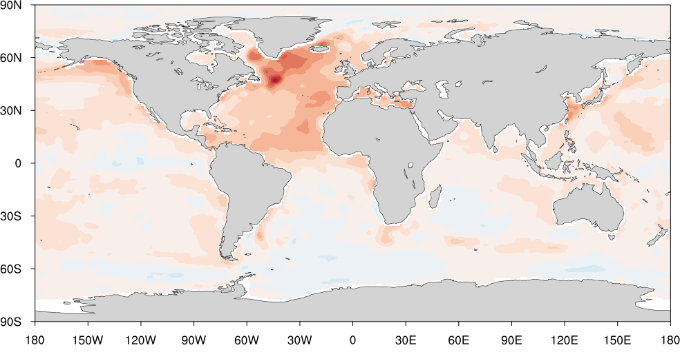
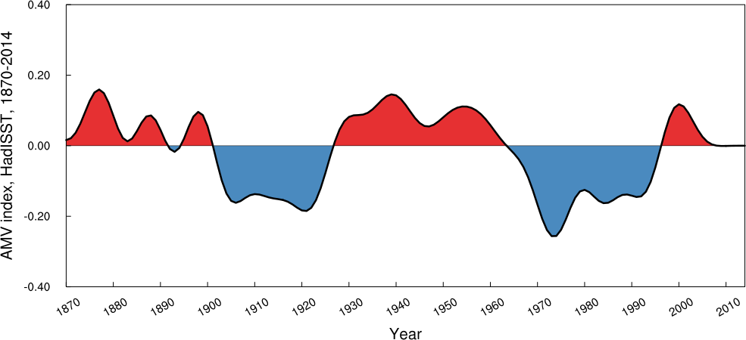
Atlantic multidecadal variability (AMV)
Observed AMV pattern (HadISST)
Observed AMV index (HadISST)
(°C)
AMV index: linear detrended, 10-year low-pass filtered, SST anomaly averaged in the North Atlantic (0°-65°N, 80°W-0°)
AMV pattern: linear detrended, 10-year low-pass filtered SST anomaly regressed on the normalized AMV index

Slide 7
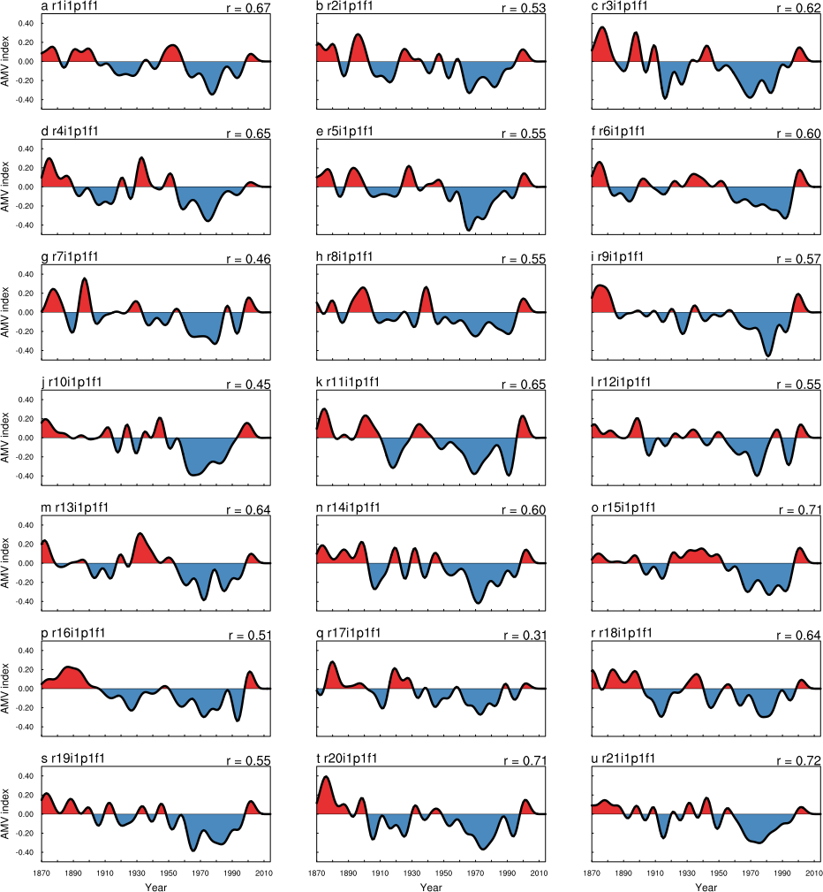
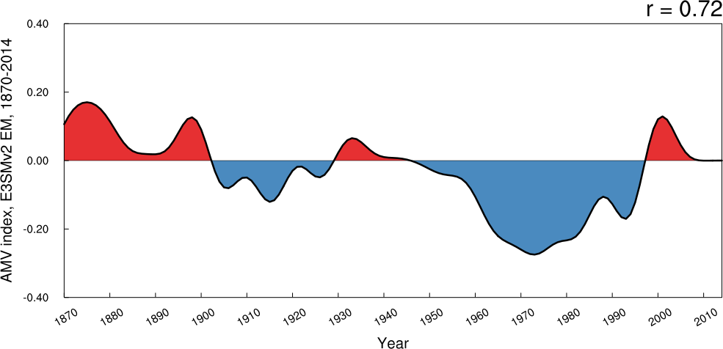
AMV index in E3SMv2
HadISST
E3SMv2 forced AMV
Forced AMV can explain 52% of the observed AMV variations.
Li et al., in prep.
Notes:
Linear detrend

Slide 8
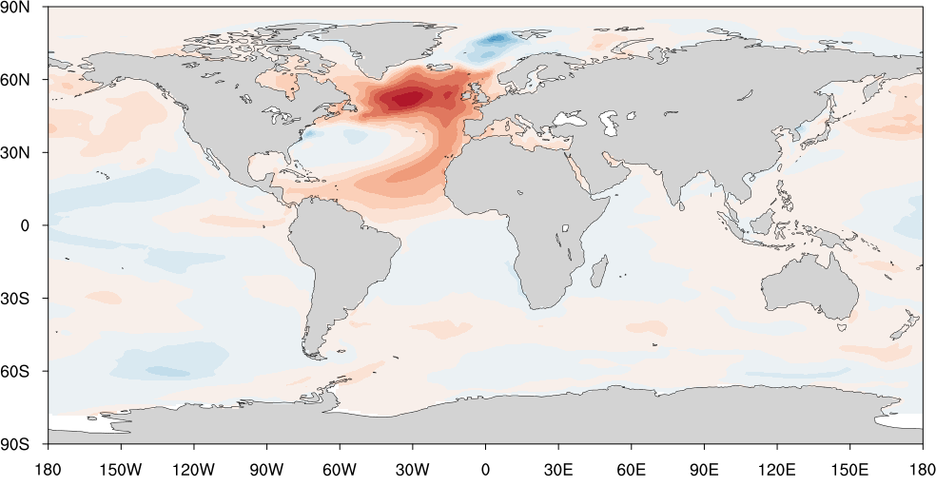
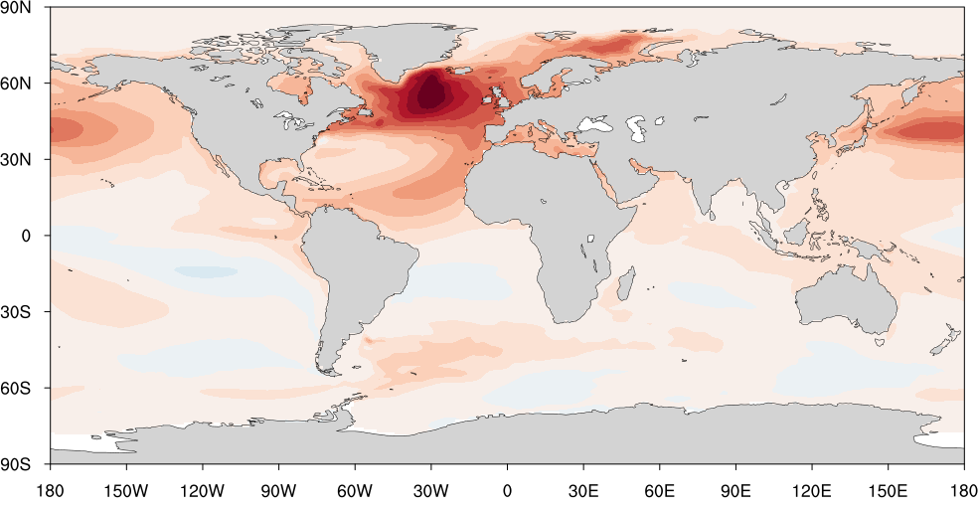
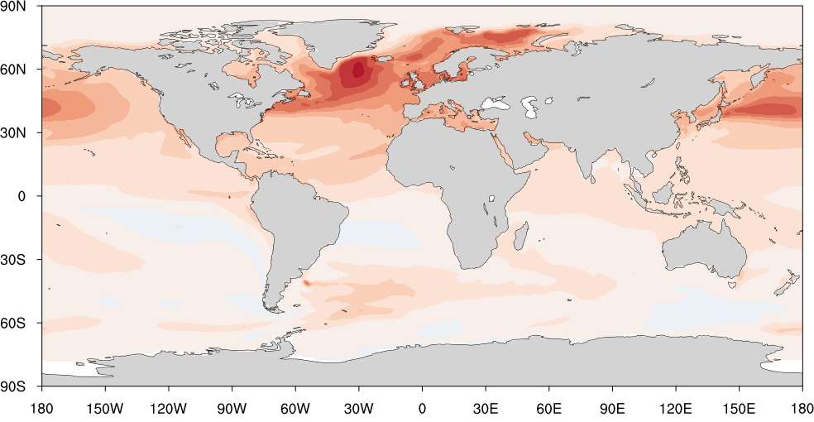
AMV pattern in E3SMv2
(°C)
Observed AMV (HadISST)
E3SMv2 internal AMV
E3SMv2 historical AMV
E3SMv2 forced AMV
Li et al., in prep.
Internal and forced AMVs both explain some features of the observed AMV pattern.
E3SMv2 historical AMV is associated with too strong subpolar ocean warming in the NH.
Notes:
Linear detrend

Slide 9
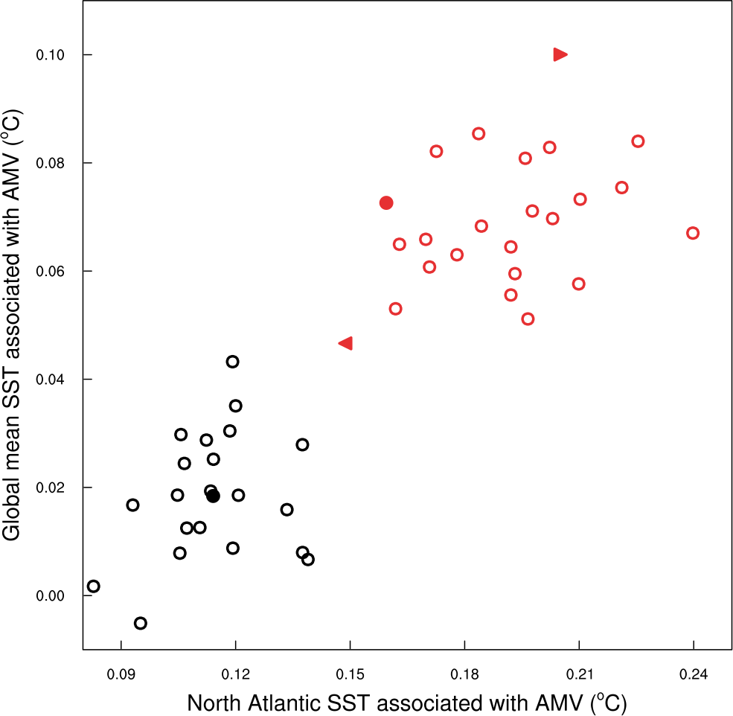
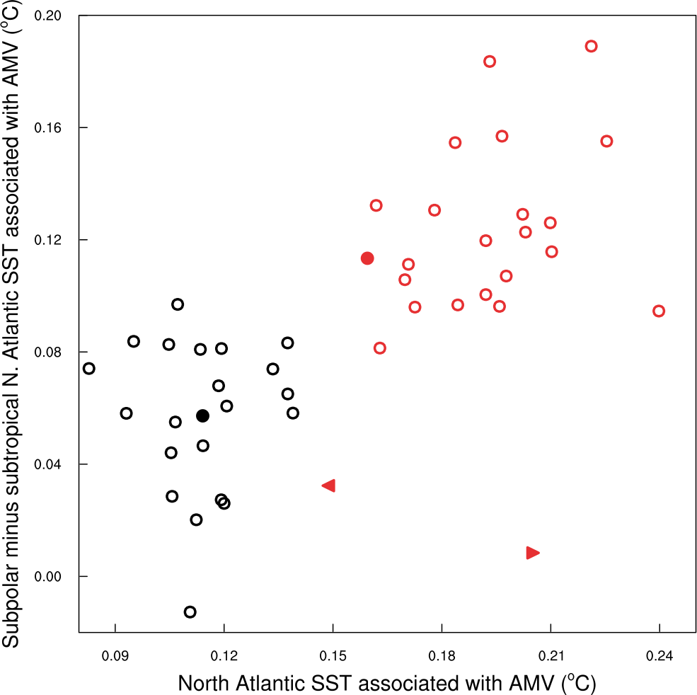
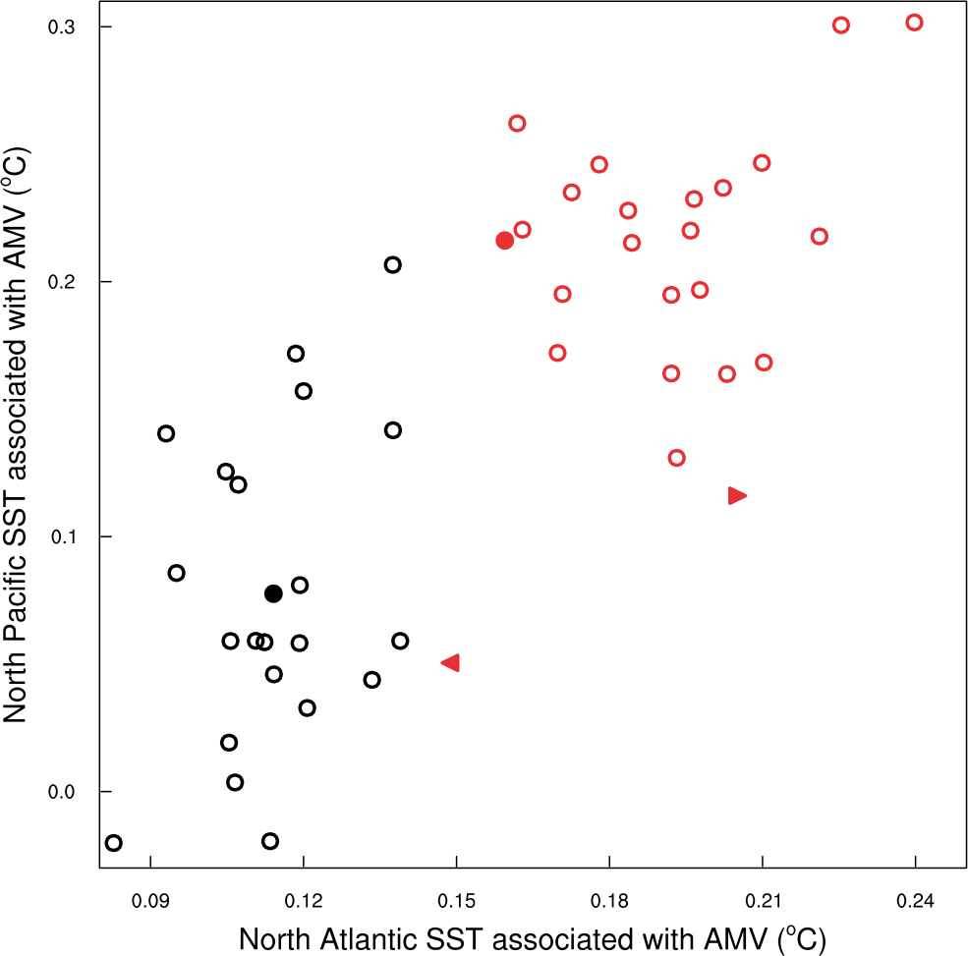
AMV pattern in E3SMv2
Global mean vs N. Atlantic
ERSSTv5
“Subpolar minus subtropical” N. Atlantic
N. Pac. vs N. Atlantic
Forced AMV
Forced AMV
Forced AMV
Historical AMV
HadISST
ERSSTv5
Historical AMV
Historical AMV
HadISST
Internal AMV
ERSSTv5
HadISST
Internal AMV
Internal AMV
Internal and forced AMVs both explain some features of the observed AMV pattern.
E3SMv2 historical AMV is associated with too strong subpolar ocean warming in the NH.
Li et al., in prep.
Notes:
Linear detrend

Slide 10
Summary and conclusions hypotheses
A tropical origin of E3SMv2 mean state biases in the Atlantic
Correcting the Indian Ocean cold bias may strengthen the AMOC (by ~3 Sv, estimated) and lead to a warmer and saltier Atlantic, both contributing to the reduction of Atlantic mean state biases
E3SMv2 performance in AMV
E3SMv2 reasonably captures the observed AMV variations (~52% explained by the forced AMV), but it produces too strong warming in the subpolar Northern Oceans.
Internal and forced AMVs, based on E3SMv2 large ensemble, are associated with distinctive global patterns, both accounting for some features of the observed AMV
Are E3SMv2 biases in AMV pattern inherently connected to the Atlantic mean state biases?
Contact: shineng.hu@duke.edu

