Slide 1
Scenario storyline discovery for multi-actor human-natural systems confronting change
Antonia Hadjimichael, Patrick M. Reed, Julianne D. Quinn, Chris R. Vernon, Travis Thurber

Slide 2
Motivation and links to the session’s central questions
1
3
Framework for the discovery of scenario storylines that can be used in understanding and to inform planning for the future.
Overcome limitations of current approaches by:
  Utilizing exploratory ensembles that broadly explore plausible future conditions
  Discovering system dynamics most relevant to different stakeholders/needs
  Improving the usability of large ensembles in planning for the future
Framework is demonstrated on a water resources system: understanding the impacts of drought extremes in the Upper Colorado River
  What is needed to make climate simulations and model data for planetary tipping points more decision relevant and actionable?
  How can we advance the richness and relevance of scenarios used to understand consequential drivers of resilience?
Tipping Points
Resilient Responses
3
4
1
2
3
2
4
  What is needed to improve the decision relevance of regional projections and better capture system shocks?
  How can ESMD, MSD, RGMA more effectively collaborate to solve these challenges?
1
4
Risks and Impacts
Cross-Program Experiments

Slide 3
FRamework for Narrative Storylines and Impact Classification (FRNSIC)
I
II
Evaluation
Problem
framing
across many
states of
the world
Multi-trait
storyline
IV
III
Multi-trait
discovery
classification
Scenario storylines

Slide 4

FRamework for Narrative Storylines and Impact Classification (FRNSIC)
Formulation of:
Uncertain futures
Impact measures
Key relationships
I
II
Evaluation
Problem
framing
across many
states of
the world
Multi-trait
storyline
IV
III
Multi-trait
discovery
classification
Scenario storylines

Slide 5

FRamework for Narrative Storylines and Impact Classification (FRNSIC)
System simulation across all candidate states of the world
I
II
Evaluation
Problem
framing
across many
states of
the world
Multi-trait
storyline
IV
III
Multi-trait
discovery
classification
Scenario storylines

Slide 6


FRamework for Narrative Storylines and Impact Classification (FRNSIC)
I
II
Evaluation
Problem
framing
across many
states of
the world
Classification of:
dynamic properties
impact groups
Multi-trait
storyline
IV
III
Multi-trait
discovery
classification
Scenario storylines

Slide 7


FRamework for Narrative Storylines and Impact Classification (FRNSIC)
I
II
Evaluation
Problem
framing
across many
states of
the world
Identification of scenario storylines of dynamic states and impacts
Multi-trait
storyline
IV
III
Multi-trait
discovery
classification
Scenario storylines

Slide 8
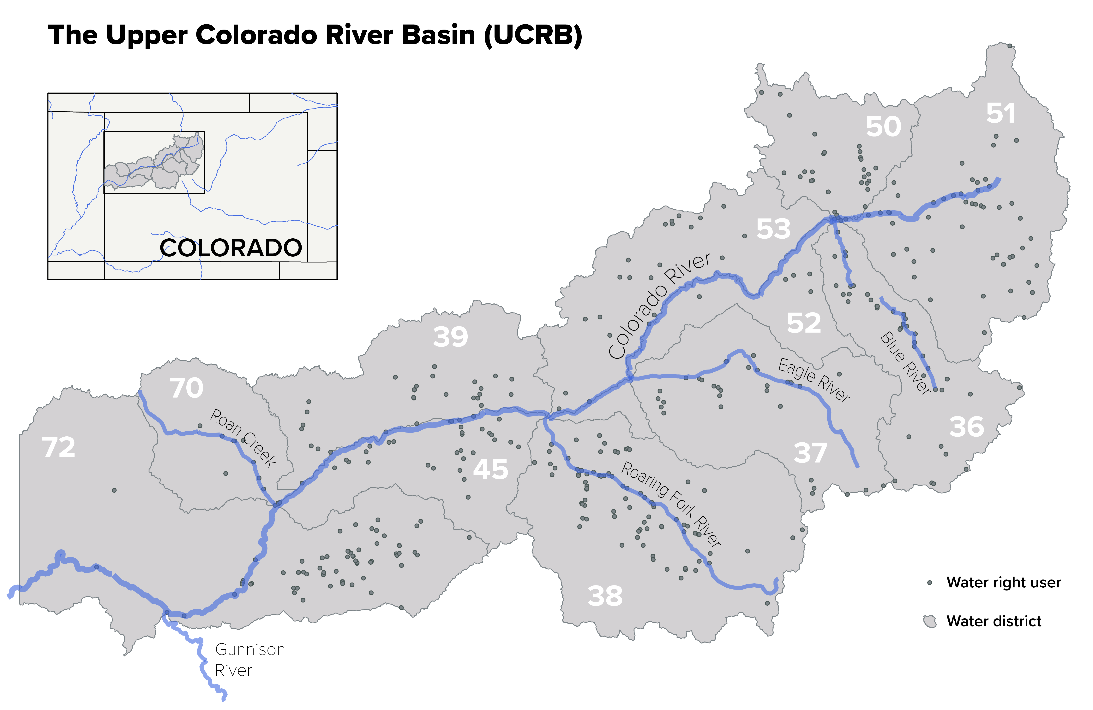
Demonstrate hypothetical planning context where the FRNSIC might be used

Slide 9
Using FRNSIC in a hypothetical planning context for the UCRB
Identify drought planning scenarios that capture key local impacts and their drivers to help inform future adaptation
Consider broad range of plausible drought futures
I
II
Evaluation
Problem
framing
across many
states of
the world
Identify key drivers and impacts on local agricultural users and downstream deliveries
Scenarios are storyline descriptions of both
Multi-trait
storyline
IV
III
Multi-trait
discovery
classification
Scenario storylines

Slide 10
Using FRNSIC in a hypothetical planning context for the UCRB
Identify drought planning scenarios that capture key local impacts and their drivers to help inform future adaptation
Consider broad range of plausible drought futures
I
II
Evaluation
Problem
framing
across many
states of
the world
Identify key drivers and impacts on local agricultural users and downstream deliveries
Scenarios are storyline descriptions of both
Multi-trait
storyline
IV
III
Multi-trait
discovery
classification
Scenario storylines

Slide 11
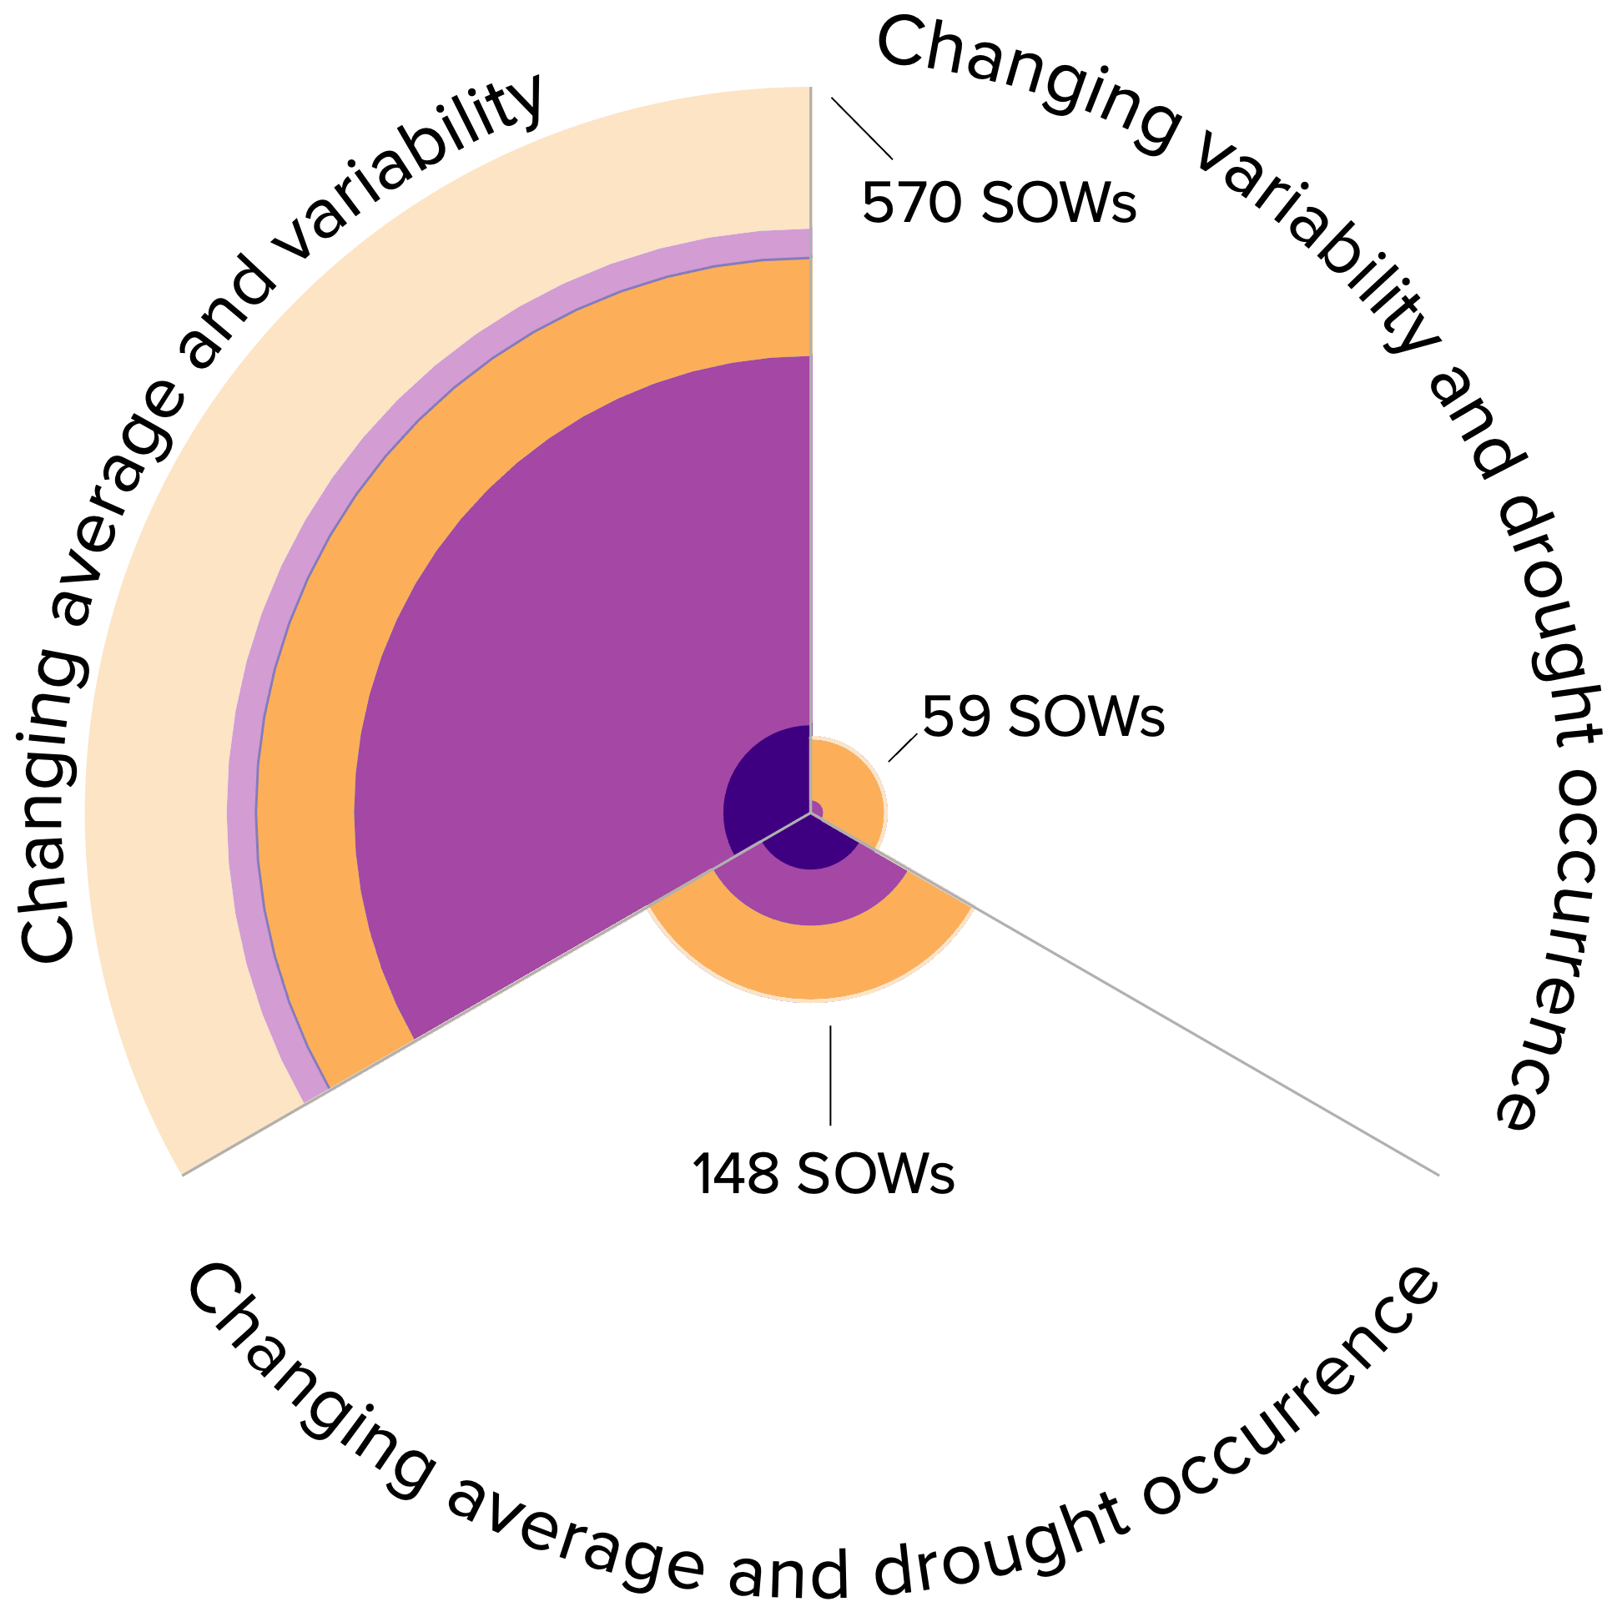
Examining drivers and impacts
III
Define key dynamic properties: mean, variance, drought occurrence
Define conditions: increasing, decreasing, etc.
Create pairs
For each pair, identify states of the word that meet both conditions
This set captures all states in the ensemble with a changing mean and variance of streamflow
Most states meet these conditions

Slide 12
Examining drivers and impacts
III
Every color indicates different impact severity
Define key dynamic properties: mean, variance, drought occurrence
Define conditions: increasing, decreasing, etc.
Create pairs
For each pair, identify states of the word that meet both conditions
Width of band indicates frequency within set
Most severe impact groups drawn in the center
Assess distribution of impacts across each set

Slide 13
Hierarchical impact classification
III
Basin deliveries
N
Y
Three impact categories:
Increased shortages to users
Increased number of users affected
Lower basin deliveries to downstream states
<= P
10
Shortage
Users
>= 10%
>= 50%
Y
Y

Slide 14
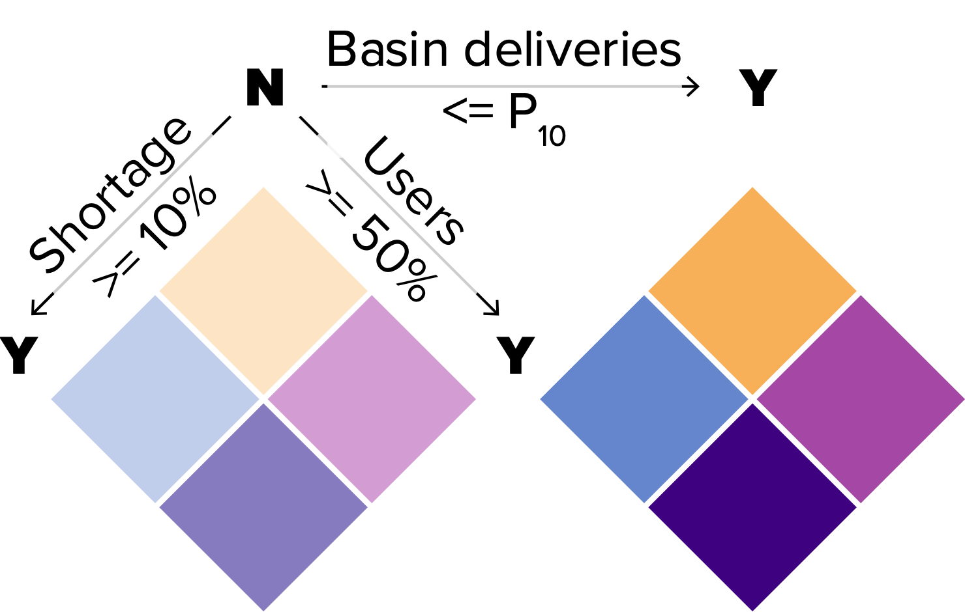
Examining drivers and impacts
III
Some of the explored states affect all impact categories:
>10% of users affected,
experiencing >50% shortages, and
basin deliveries fall below the historical 10th percentile

Slide 15
Examining drivers and impacts
III
Most of them affect two impact categories:
>10% of users affected,
experiencing >50% shortages, and
basin deliveries fall below the historical 10th percentile

Slide 16
FRamework for Narrative Storylines and Impact Classification (FRNSIC)
I
II
Evaluation
Problem
framing
across many
states of
the world
Identification of scenario storylines of dynamic states and impacts
Multi-trait
storyline
IV
III
Multi-trait
discovery
classification
Scenario storylines

Slide 17
What does a storyline look like?
IV
C
h
a
n
g
y
i
Drought period
t
n
i
l
g
i
b
v
a
a
Basin deliveries downstream
(x historical 10th percentile)
i
r
r
i
Downstream deliveries drop below historical worst 10%
Basin shortages accumulate to over 8 times the historical worst 10%
a
a
v
b
d
i
Historical 10th percentile
l
i
n
t
a
y
e
a
g
n
a
d
r
d
e
r
v
o
a
u
Cumulative basin shortages
(x historical 90th percentile)
g
g
n
h
Historical 90th percentile
i
t
g
o
n
c
a
c
h
u
C
r
r
Year
e
n
c
e
C
e
h
c
a
n
n
e
g
r
i
r
n
u
g
c
c
a
o
v
t
e
h
r
g
a
u
g
o
e
r
a
d
n
d

Slide 18
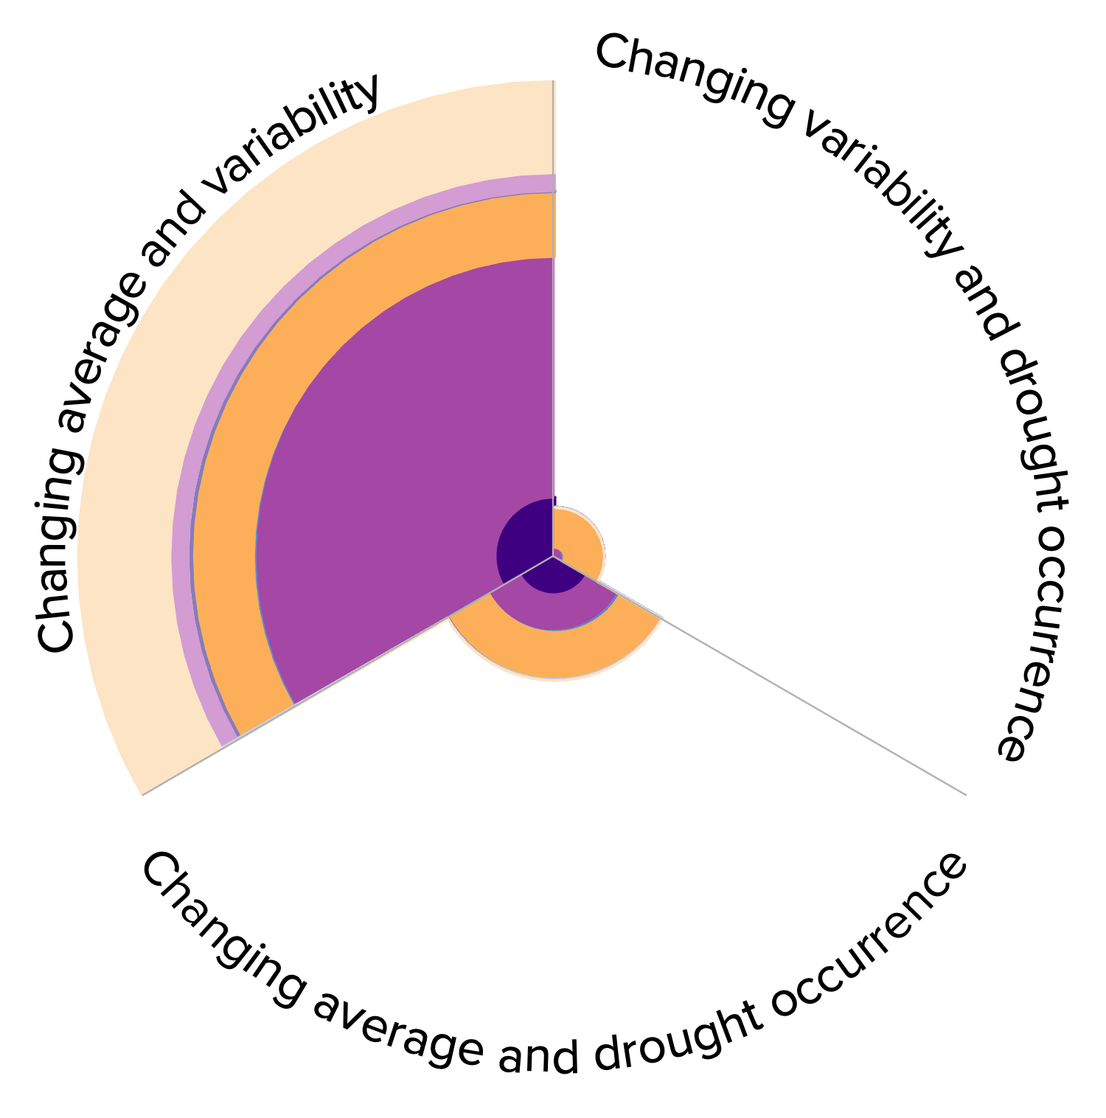
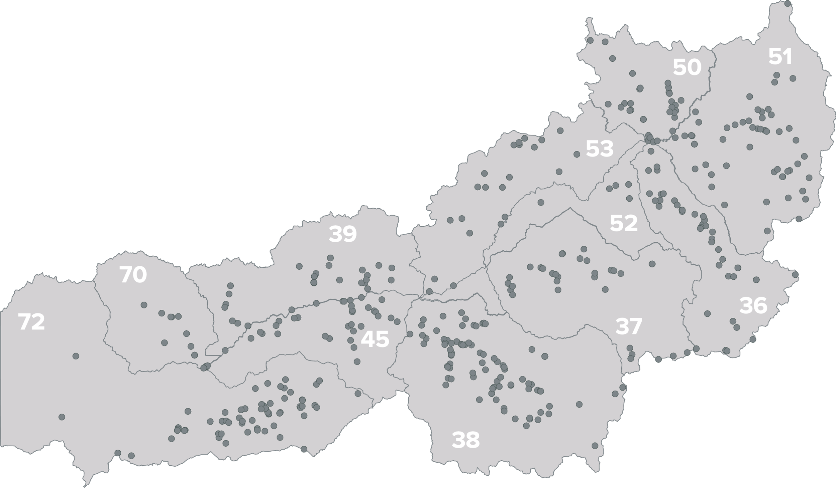
Impacts across scales
IV
Basin deliveries downstream
(x historical 10th percentile)
Cumulative basin shortages
(x historical 90th percentile)
Drought period
Historical 10th percentile
Historical 90th percentile
Year
Year
Shortage as percentage of demand (%)
Shortage as percentage of demand (%)
Year
Year
Diverse drought impacts among users
Year

Slide 19
Take-home messages
1
3
FRNSIC addresses a gap between the rigor of exploratory modeling and the usability of traditional scenario approaches
The scenario storylines identified using FRNSIC:
  Are identified through broad exploration of plausible extremes
  Describe consequential dynamics for diverse stakeholders
1
  What is needed to make climate simulations and model data for planetary tipping points more decision relevant and actionable?
  How can we advance the richness and relevance of scenarios used to understand consequential drivers of resilience?
4
Tipping Points
Resilient Responses
3
2
4
  What is needed to improve the decision relevance of regional projections and better capture system shocks?
  How can ESMD, MSD, RGMA more effectively collaborate to solve these challenges?
4
1
3
Risks and Impacts
Cross-Program Experiments
2

Slide 20



Thank you!
To access these slides:
Come to my poster board on Wednesday: #35
To contact me:
https://www.hadjimichaelgroup.info/
hadjimichael@psu.edu

