Slide 1


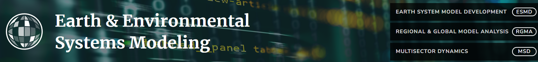
Energy-Water-Land System breakout session
Theme 1 – Understanding Transitions at Different Scales
Future spatially explicit patterns of land transitions in the United States with multiple stressors
Angelo Gurgelª, Kanishka B. Narayan^{b}, John Reillyª, Xiang Gaoª, Chris Vernon^{b}, Adam Schlosserª, Jennifer Morrisª, and Sergey Paltsevª
ª Massachusetts Institute of Technology, Joint Program on the Science and Policy of Global Change
^{b} Joint Global Change Research Institute, Pacific Northwest National Lab

Slide 2
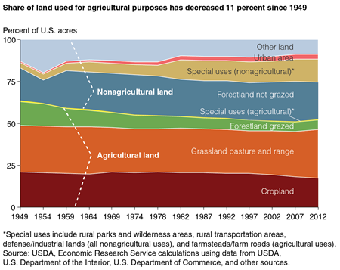
Motivation
Future spatially explicit patterns of land transitions in the United States with multiple stressors
Changes in land use: implications on carbon storage, species habitat, biodiversity, water, and broader ecosystem values!
Multiple forces influencing land use changes at global, regional and local levels:
- income and population growth
- yield and productivity improvements
- climate change
- changing diets
- policies (trade, agricultural, environmental)
How these global forces impact land use at a multiple spatial resolutions?
How to combine and/or reconcile different scales?
Source: Bigelow, 2017

Slide 3
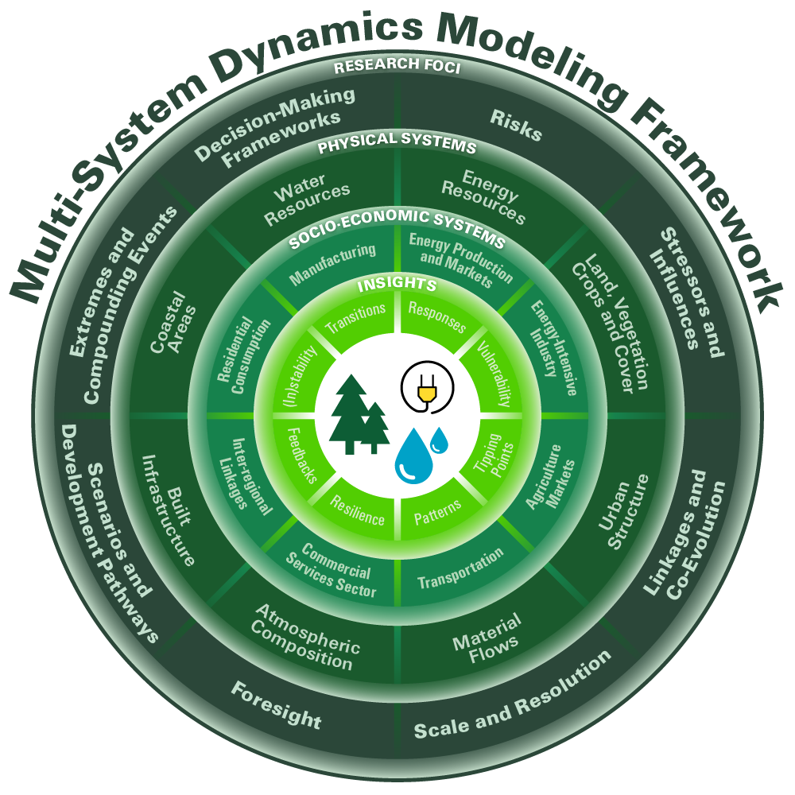
Method
Future spatially explicit patterns of land transitions in the United States with multiple stressors
Multisectoral, multisystem dynamics (MSD) perspective focused on understanding dynamics in complex interdependent systems;
Interaction among economic sectors and natural systems;
Allows investigating vulnerability or resilience of systems to compounding forces and stressors;
Tools: socio-economic-environmental modeling (EPPA-Agriculture) combined with a land-use downscaling tool (Demeter)

Slide 4
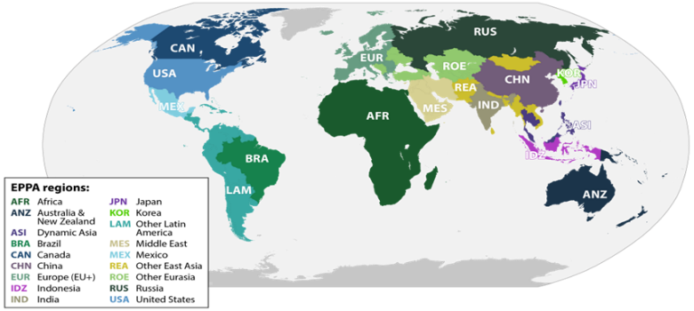
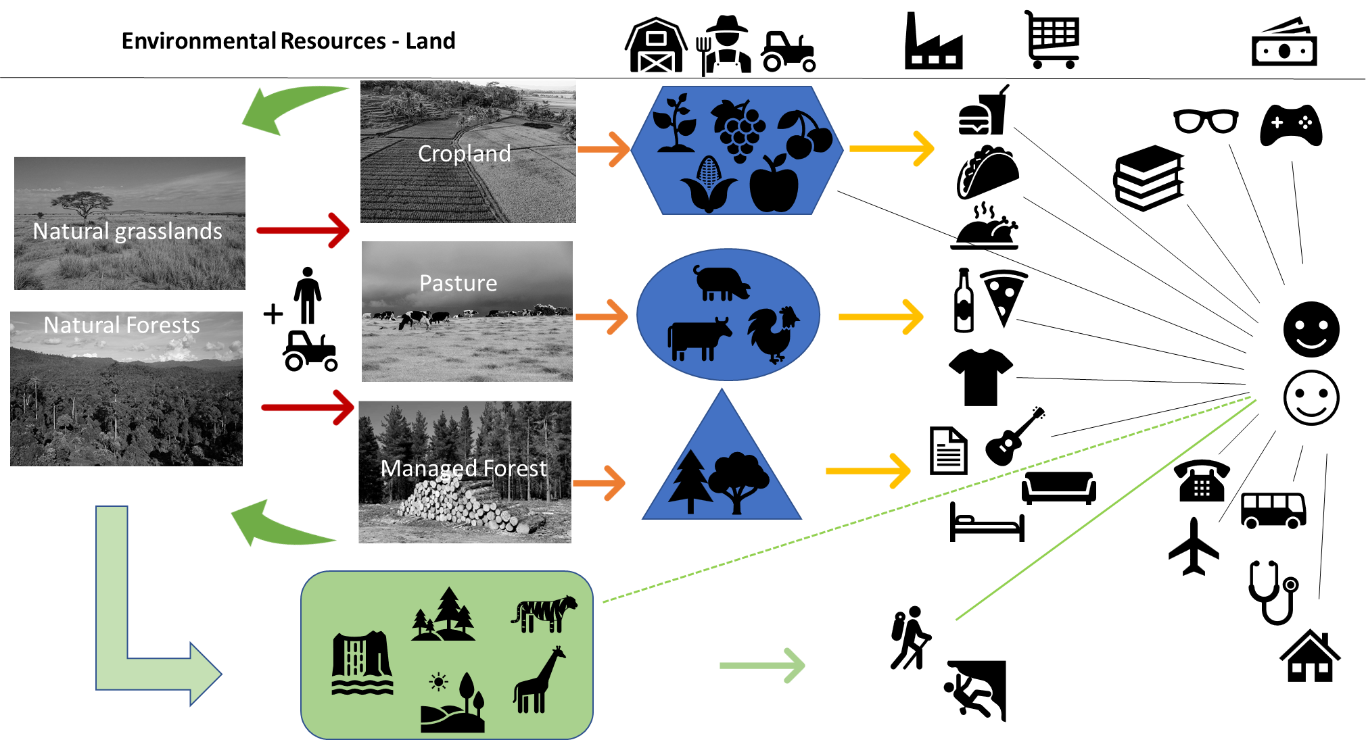
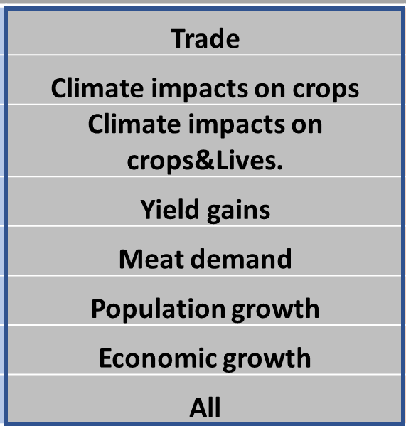
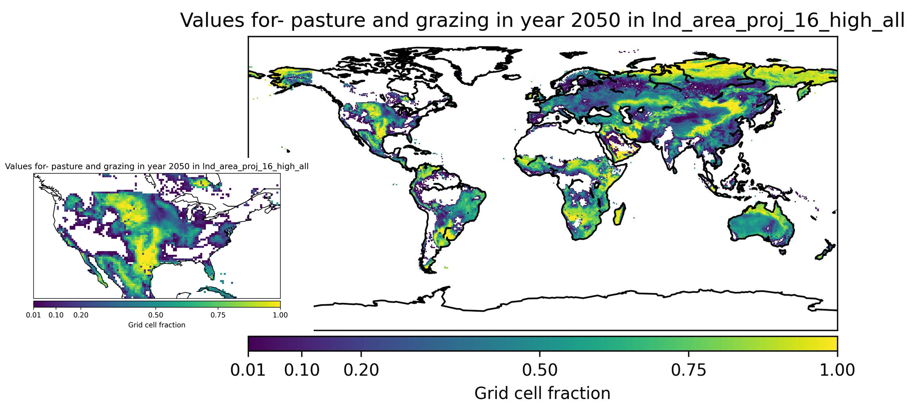
Method
Future spatially explicit patterns of land transitions in the United States with multiple stressors
Dynamic multi-regional multi-sectoral “human-system” modeling
Scenarios (“stressors”)
Low pressures on agricultural expansion
High pressures on agricultural expansion
Land use projections at regional level
Land use downscaling model
Demeter
Base map harmonization, alocation rules, “intensification” x “extensification”
Land use projections at grid level

Slide 5
Method
Future spatially explicit patterns of land transitions in the United States with multiple stressors
Dowscaling model information flow and connections with the economic model

Slide 6
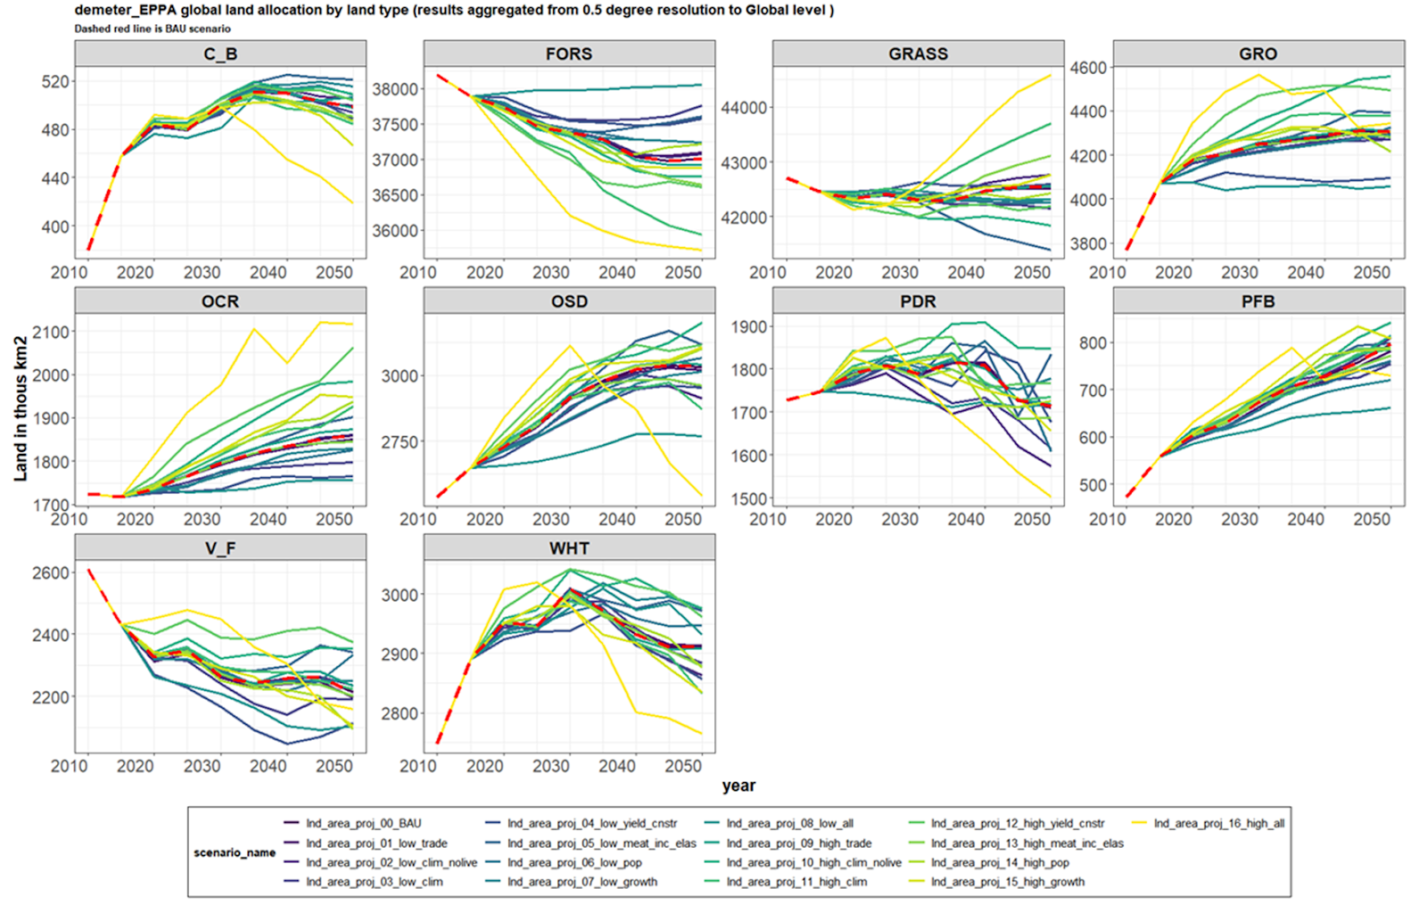
Results
Future spatially explicit patterns of land transitions in the United States with multiple stressors
Trajectories of global aggregated land areas
Differences in Fractional Land Cover between 2050 and 2020 in the BAU and “high all” scenario in the U.S.
high all

Slide 7
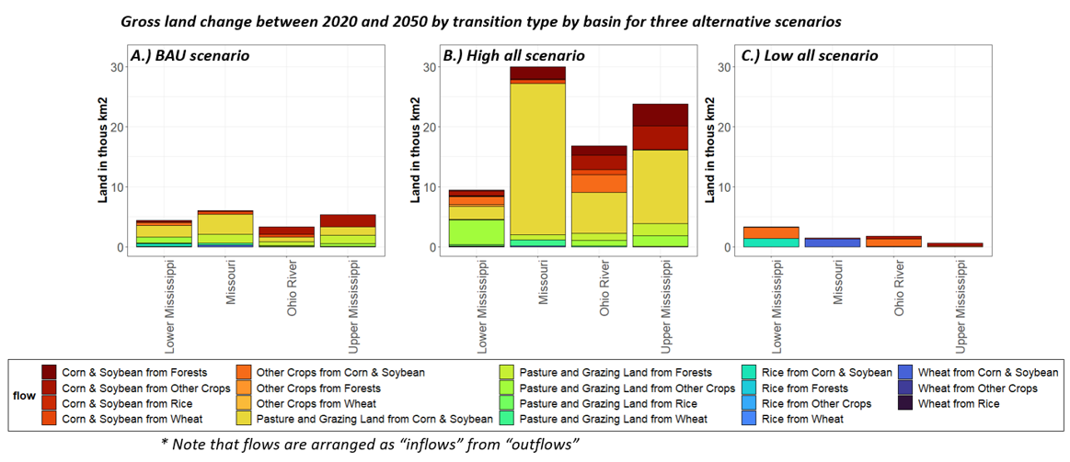
Results
Future spatially explicit patterns of land transitions in the United States with multiple stressors

Slide 8
Final Remarks
Global forces will affect future land use in the U.S. at the regional and local levels: implications to ecosystem services?
Gaps in research: how to represent and combine (feedbacks) key drivers and behavior of human and natural systems in multiple and overlapping dimensions (global, regional and local)?
Socio-economic models: overall macro and sectoral responses at global and regional levels
Downscaling models: bridge regional results to spatial determinants of land use allocation
Ex.: increase in the U.S. comparative advantage in livestock production in the long term: spatial answers in land transitions differs along the Mississippi River Basin
Opportunities to overcome gaps and DOE strengths and capabilities:
Connect different research teams: combine models and tools to overcome the research gaps
Ex.: Economic model (MIT) + downscaling tool (PNNL): dynamic connections between human and natural system models operating across different spatial scales
Outcomes allow further investigation on multi-sector feedbacks and impacts on land-energy-water resources, carbon storage, soil erosion, chemical use, hydrology, and water quality.

Slide 9
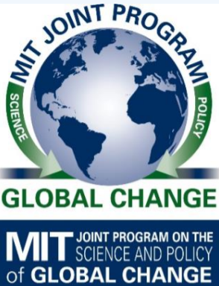
Thanks! gurgel@mit.edu
BIOLOGICAL AND ENVIRONMENTAL RESEARCH
Earth and Environmental System Modeling

