Slide 1
Uncovering Key Drivers of Future Virtual Water Trade and Global Water Use
Neal Graham, Tom Wild, Gokul Iyer,
Jonathan Lamontagne, Pralit Patel

Slide 2
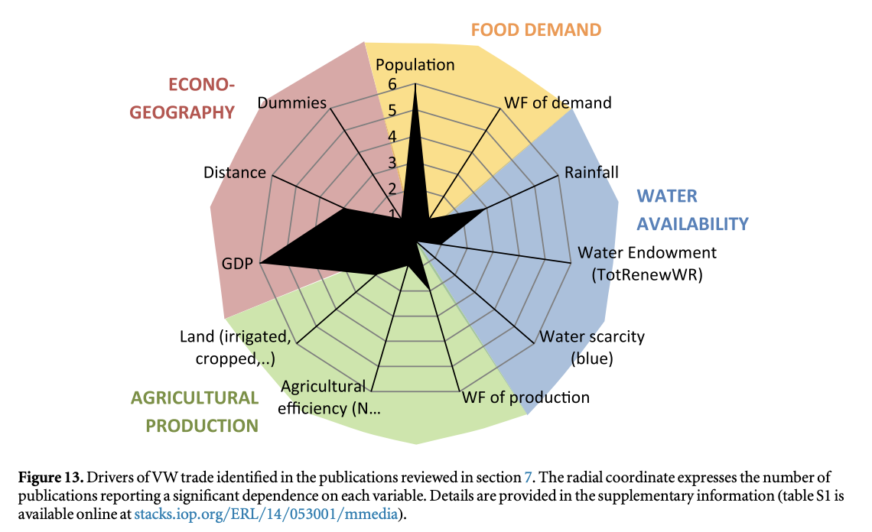
Introduction – Virtual Water Trade in History
International trade redistributes water around the world, virtually, to allow regions to meet demands while having limited internal water resources or inadequate comparative advantages of land and labor productivity.
Projected future growth, globalization, and continued market integration will drive further agricultural trade.
Future projections of change significantly lack in the literature.
D’Odorico et al., 2019, ERL
Soil moisture and evapotranspiration consumed in crop growth
Fresh surface runoff and groundwater consumed in the production of a good or service
Adopted and modified from: watercalculator.org

Slide 3
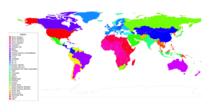

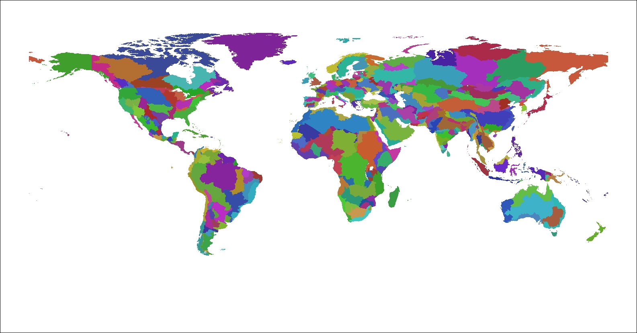
Goal – Increase the Robustness of our Projections using the Global Change Analysis Model
Global Coverage
Leveraging a Scenario Discovery Framework we ask:
  What are the main drivers of change for global and regional agricultural water use utilization and future virtual water trade across a large ensemble of uncertain futures?
GCAM is a multisector, multi-regional, dynamic model that economically and physically links energy, agriculture and water production, consumption, and trade.
GCAM models dynamic demand growth in response to regional population and economic activity.
GCAM includes technology detail in energy production, transformation and final demand sectors.
GCAM includes physical representations of crop management practices in the agriculture sector.
  Includes all commercial and natural lands in each land region.
GCAM includes dynamic economic modeling of the water sector linked to energy and agriculture.
32 Energy & Economy Regions
235 Water Basins
384 Land Regions
32 Energy/Economic regions
384 Land regions based on water basins
GCAM-USA (50 State)

Slide 4
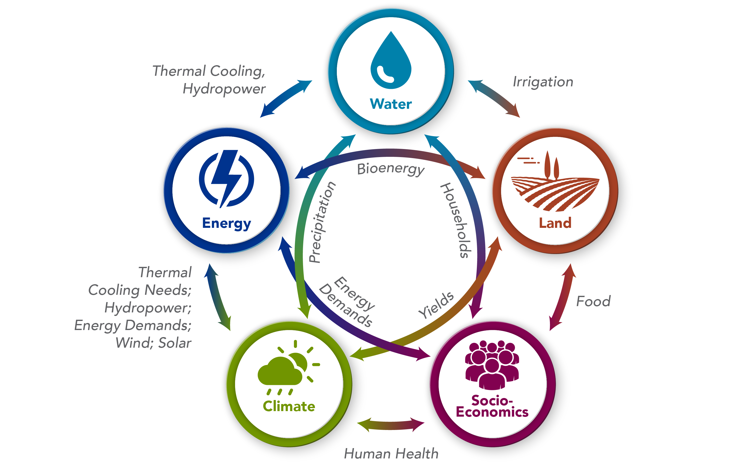
Scenario Discovery Workflow
Pop/GDP
AGLU
12 Socioeconomic Futures
Alter Irrigation Technologies across SSPs
Calvin et al., 2017
SSP1-5
7040 Scenarios
Socioeconomic-Driven Changes
Water Technologies
Graham et al., 2018
GCAM
5 Trade Futures
Future Change
Zhao et al., 2022
Graham et al., 2023
Trade Futures
Trade
Ag Yields
2 Gridded Crop Models
2 RCPs * 4 GCMs * 2 GGCMs
Climate Futures
Climate Impacts
Water
Xanthos
ISIMIP2B impacts derived from CMIP5
8 Energy Transitions
No New Nuclear
Bioenergy Availability
CCS Availability
Future Change
Energy Futures
Energy Transition
Notes:
To address the insufficient complexity of our previous results and increase the robustness within GCAM’s projections, we employ a scenario discovery framework.
“an ensemble of model runs … that encompasses the various uncertainties … in particular situations. The ensemble is subsequently screened to identify runs of interest, and their conditions for occurring are identified through machine learning.” – Kwakkel et al., 2013

Slide 5
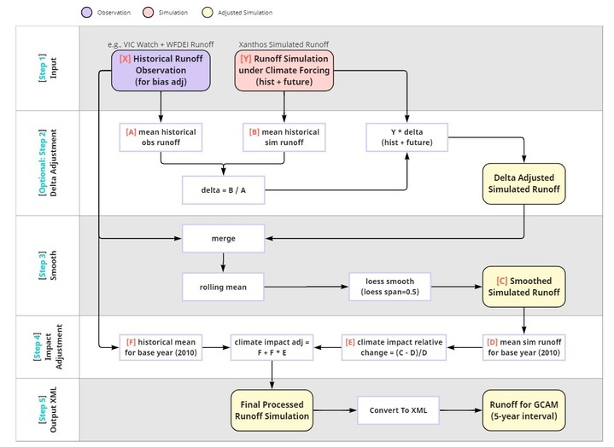
Scenario Discovery Workflow
Pop/GDP
AGLU
12 Socioeconomic Futures
Alter Irrigation Technologies across SSPs
Calvin et al., 2017
SSP1-5
7040 Scenarios
Socioeconomic-Driven Changes
Water Technologies
Graham et al., 2018
GCAM
5 Trade Futures
Future Change
Zhao et al., 2022
Graham et al., 2023
Trade Futures
Trade
Ag Yields
2 Gridded Crop Models
2 RCPs * 4 GCMs * 2 GGCMs
Climate Futures
Climate Impacts
Water
Xanthos
ISIMIP2B impacts derived from CMIP5
8 Energy Transitions
No New Nuclear
Bioenergy Availability
CCS Availability
Future Change
Energy Futures
Energy Transition
Notes:
To address the insufficient complexity of our previous results and increase the robustness within GCAM’s projections, we employ a scenario discovery framework.
“an ensemble of model runs … that encompasses the various uncertainties … in particular situations. The ensemble is subsequently screened to identify runs of interest, and their conditions for occurring are identified through machine learning.” – Kwakkel et al., 2013

Slide 6
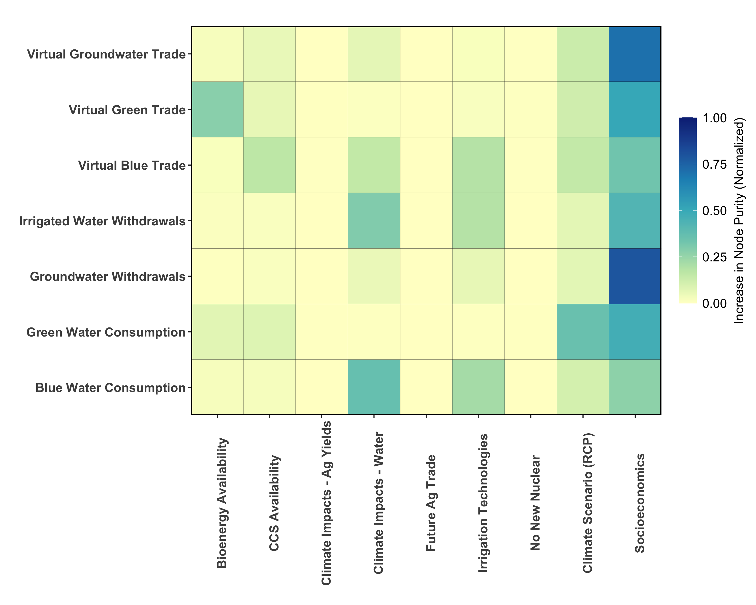
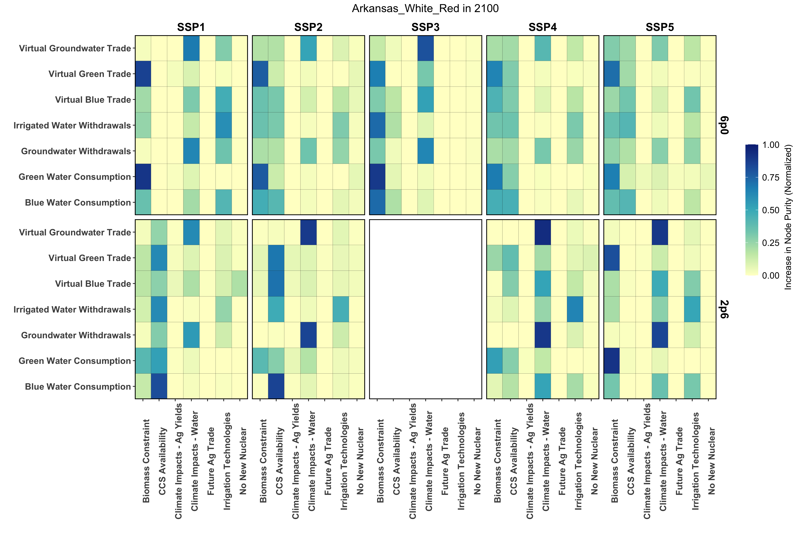
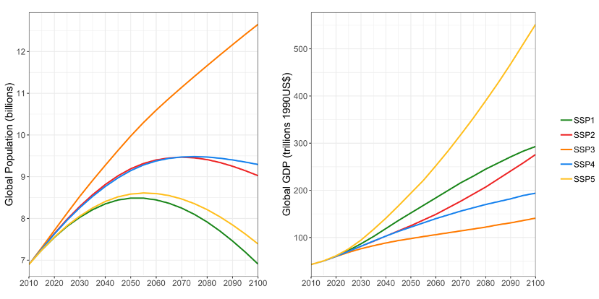
Global drivers of change are dominated by socioeconomic divergences in the SSPs, but the story becomes increasingly complex with more refined scenario selection
2100

Slide 7
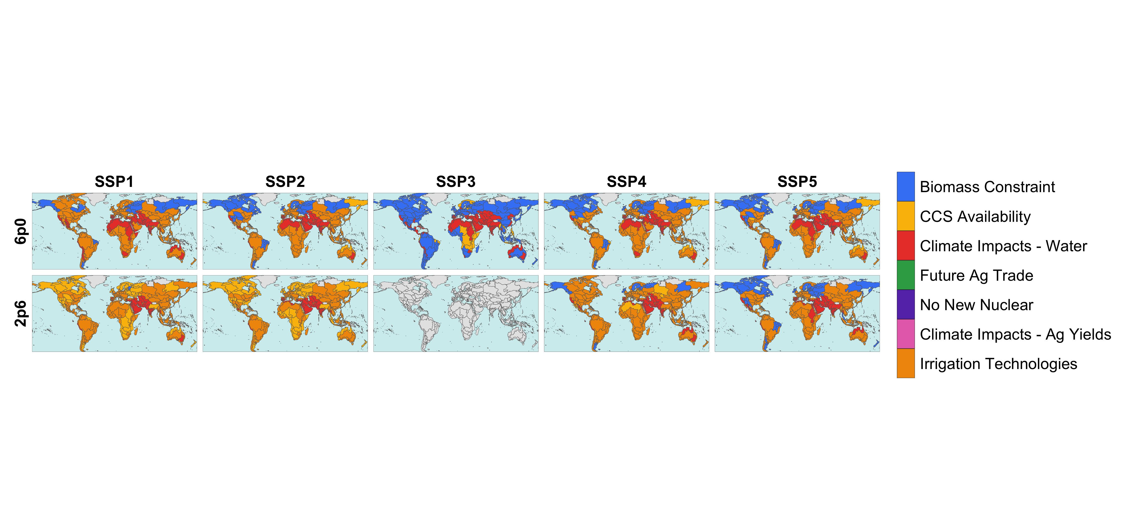
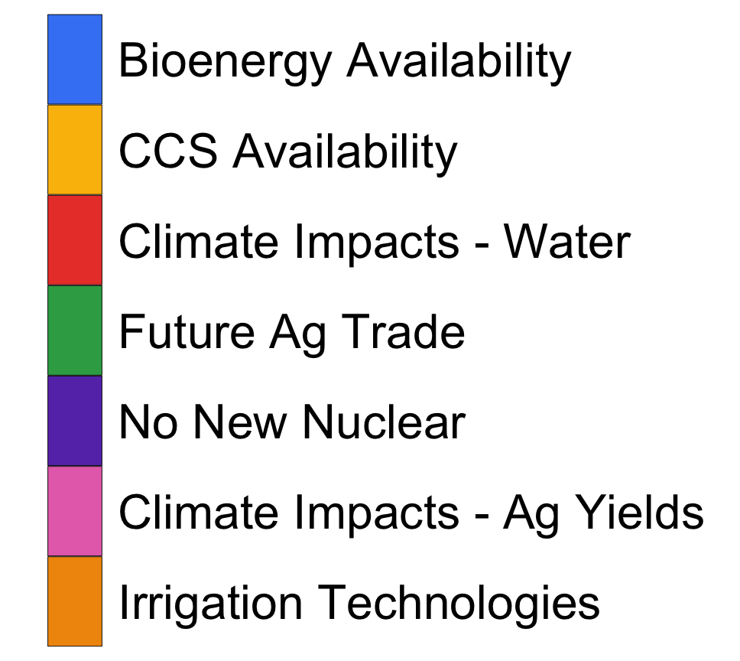
Irrigation Water Withdrawals are largely driven by the accessibility of higher efficiency technologies and the water savings associated with such adoption

Slide 8

In some basins, despite compounding influences, the main drivers of change for multiple metrics remain consistent across SSPs and RCPs, highlighting the importance of select drivers in some regions

Slide 9
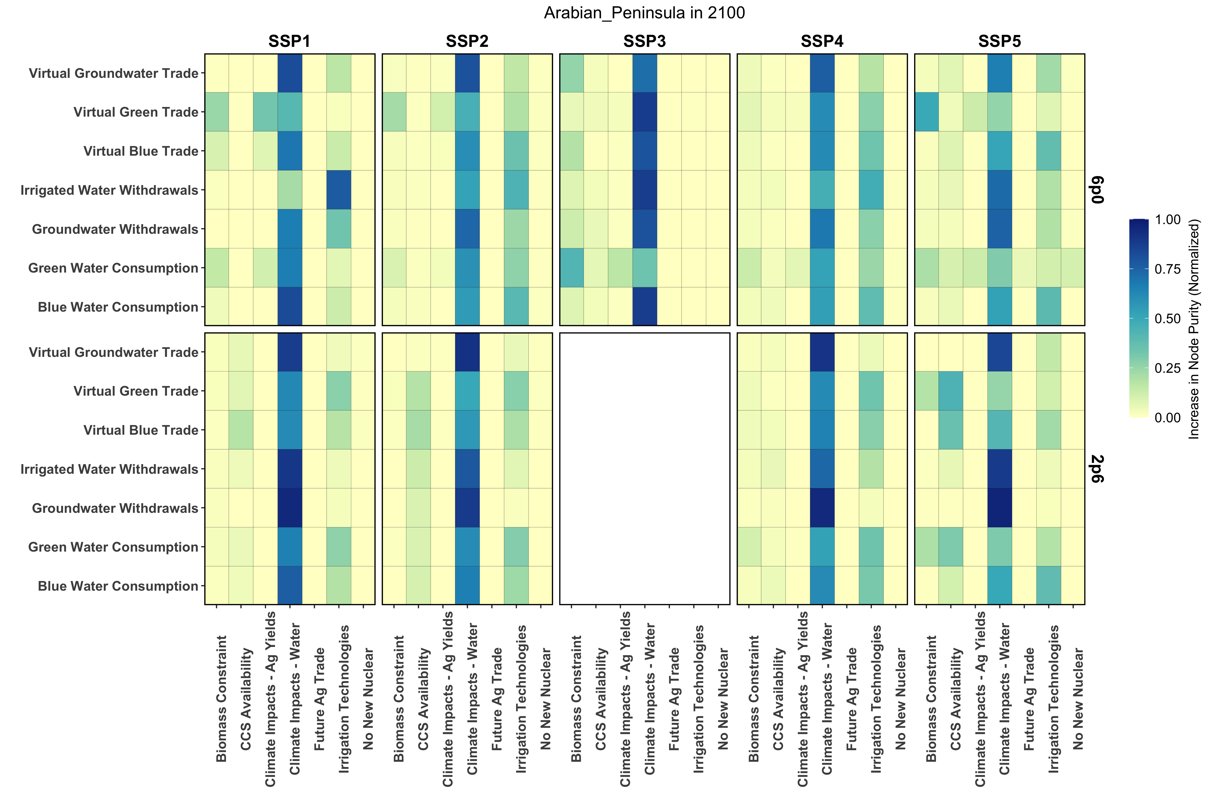
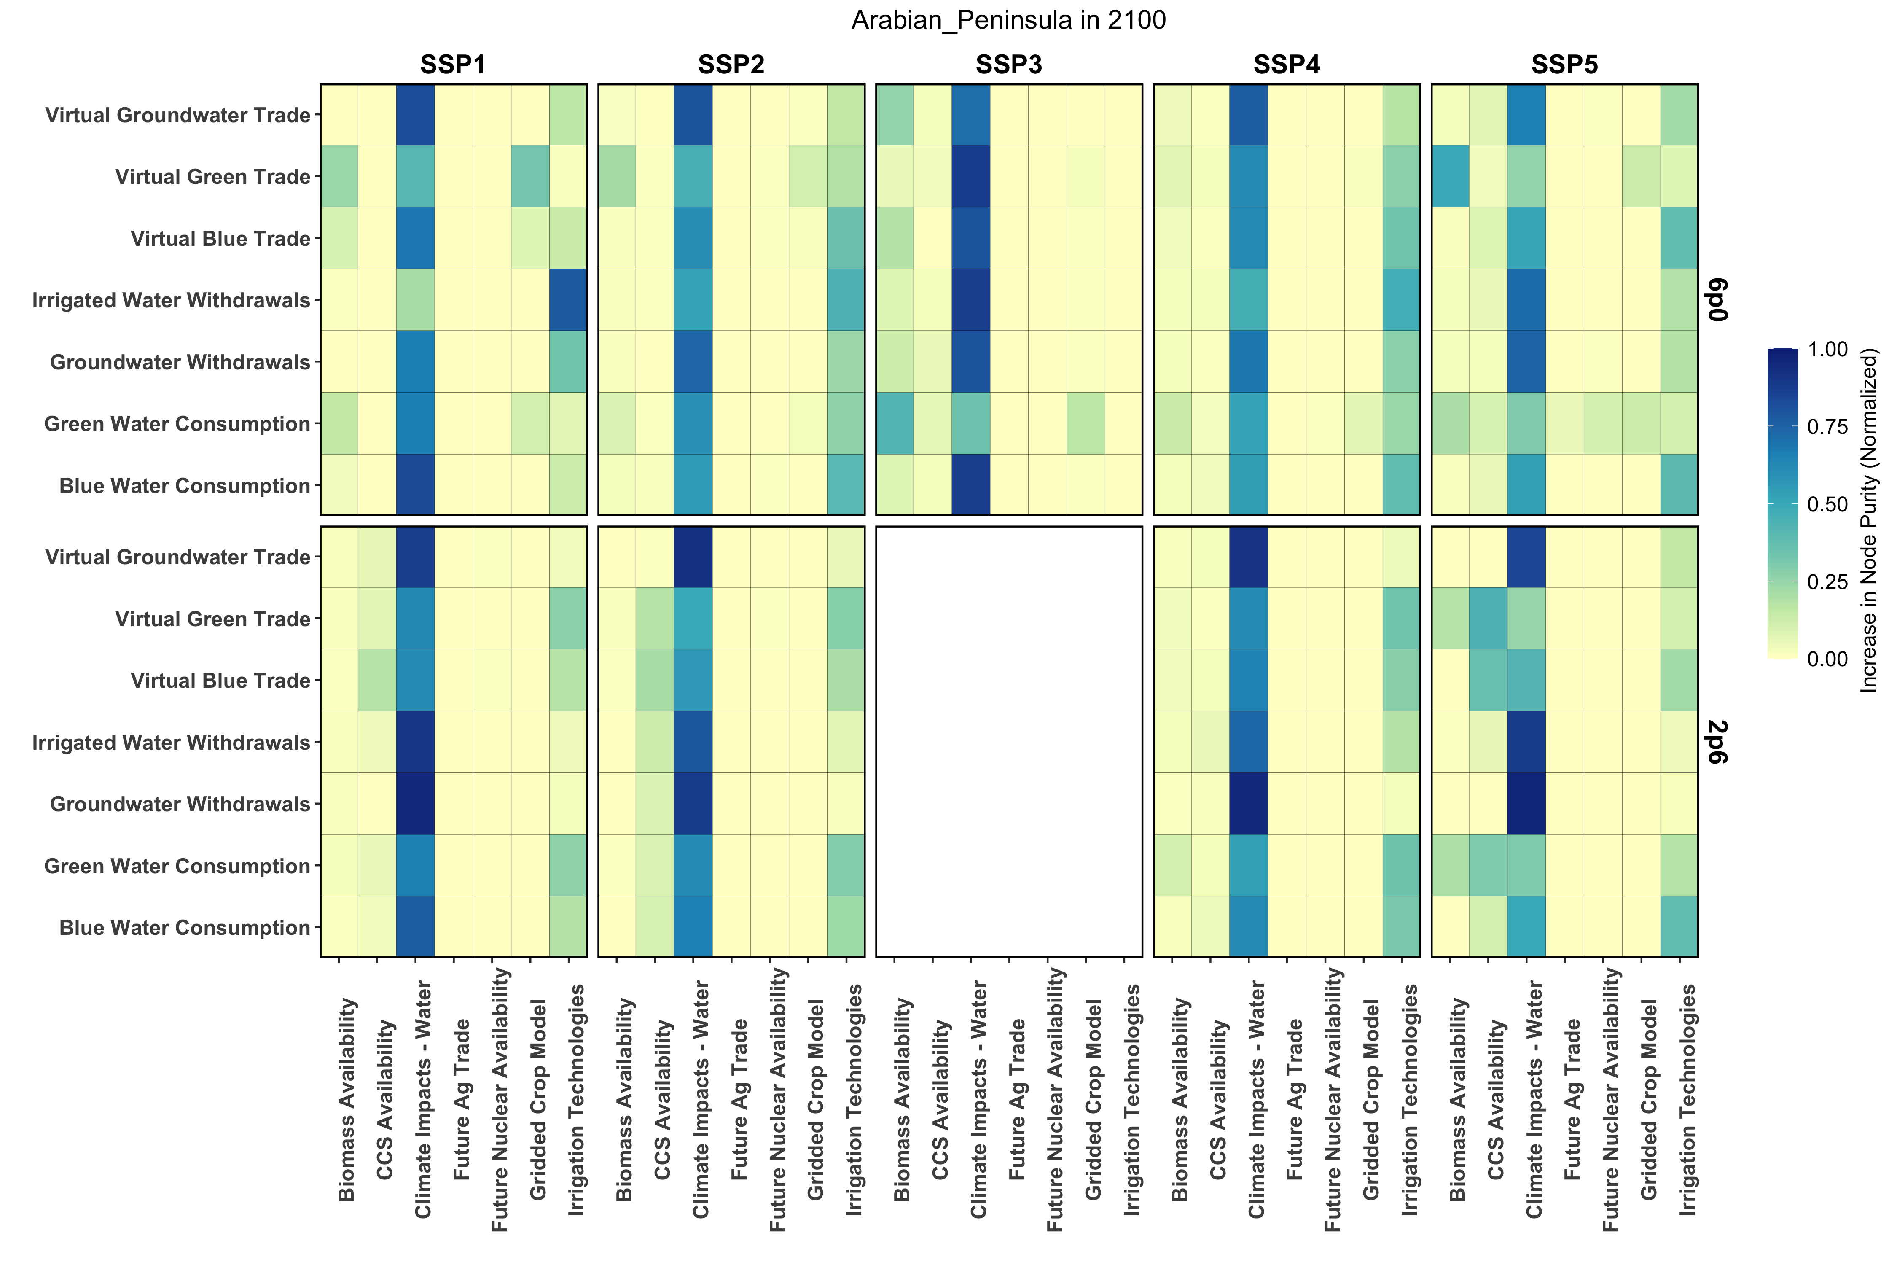
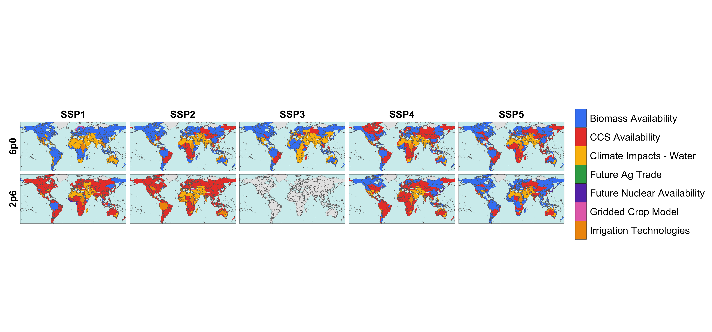
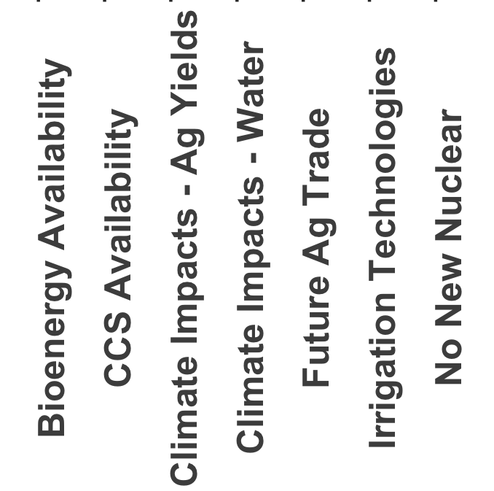
In some basins, despite compounding influences, the main drivers of change remain consistent across SSPs and RCPs, highlighting the importance of certain drivers

Slide 10
Virtual Blue Water Trade can have differing main drivers in a basin, depending on socioeconomic and climatic conditions – highlighting regional sensitivities to such dynamics

Slide 11
Virtual Blue Water Trade can have differing main drivers in a basin, depending on socioeconomic and climatic conditions – highlighting regional sensitivities to such dynamics

Slide 12
Conclusions & Future Work
First such study to examine a large suite of future uncertainty to uncover key drivers in water utilization and trade.
While drivers show regional heterogeneity, dry areas are shown to often be driven by the climate-driven water supply responses while other basins show differences across socioeconomic and climate futures.
Such basin-level differences allows us to further our exploration to understand the multisectoral drivers behind these changes in water.
  Agricultural demand & production
  Energy demand and mix
  Regional trade
Despite the differences across basins at the end of the century, it is important to understand how these drivers change in time.

Slide 13
Neal T. Graham
neal.graham@pnnl.gov

Slide 14
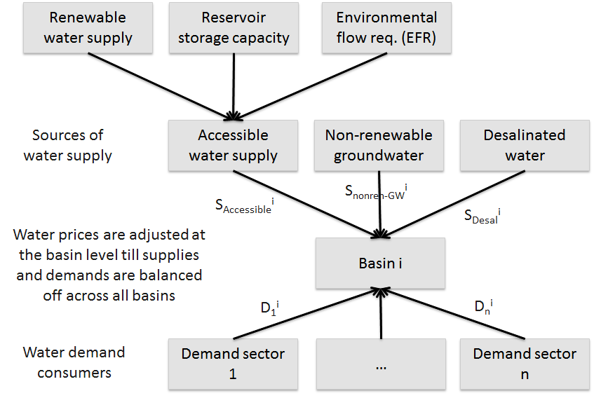
Water Demand and Supply are Balanced Across 235 Global River Basins. Water demands by tech. (incl. hydro) are tracked. Water availability produced by a separate hydrology model.
We have a hydrology model that generates information about renewable water supply, and its implications for hydropower generation (incl. under climate change)
Supply
Use
Equilibrium
Demand
Kim et. al (2016)
Water prices allow us to capture two key dynamics: increasing shadow price with increasing scarcity; and preferential water allocation to classes of users (e.g., agriculture versus electricity)

Slide 15
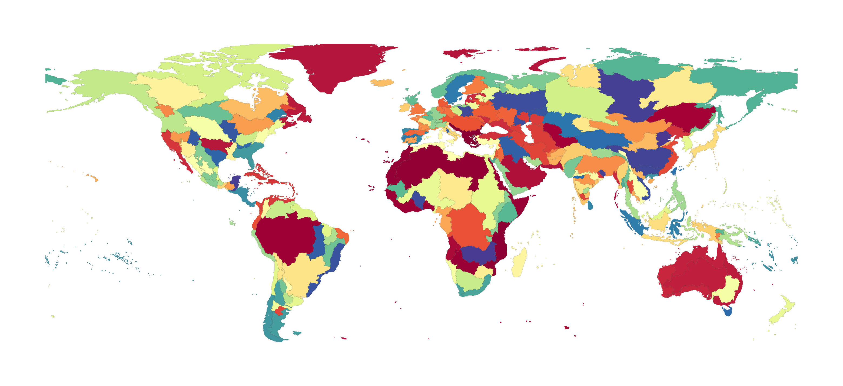
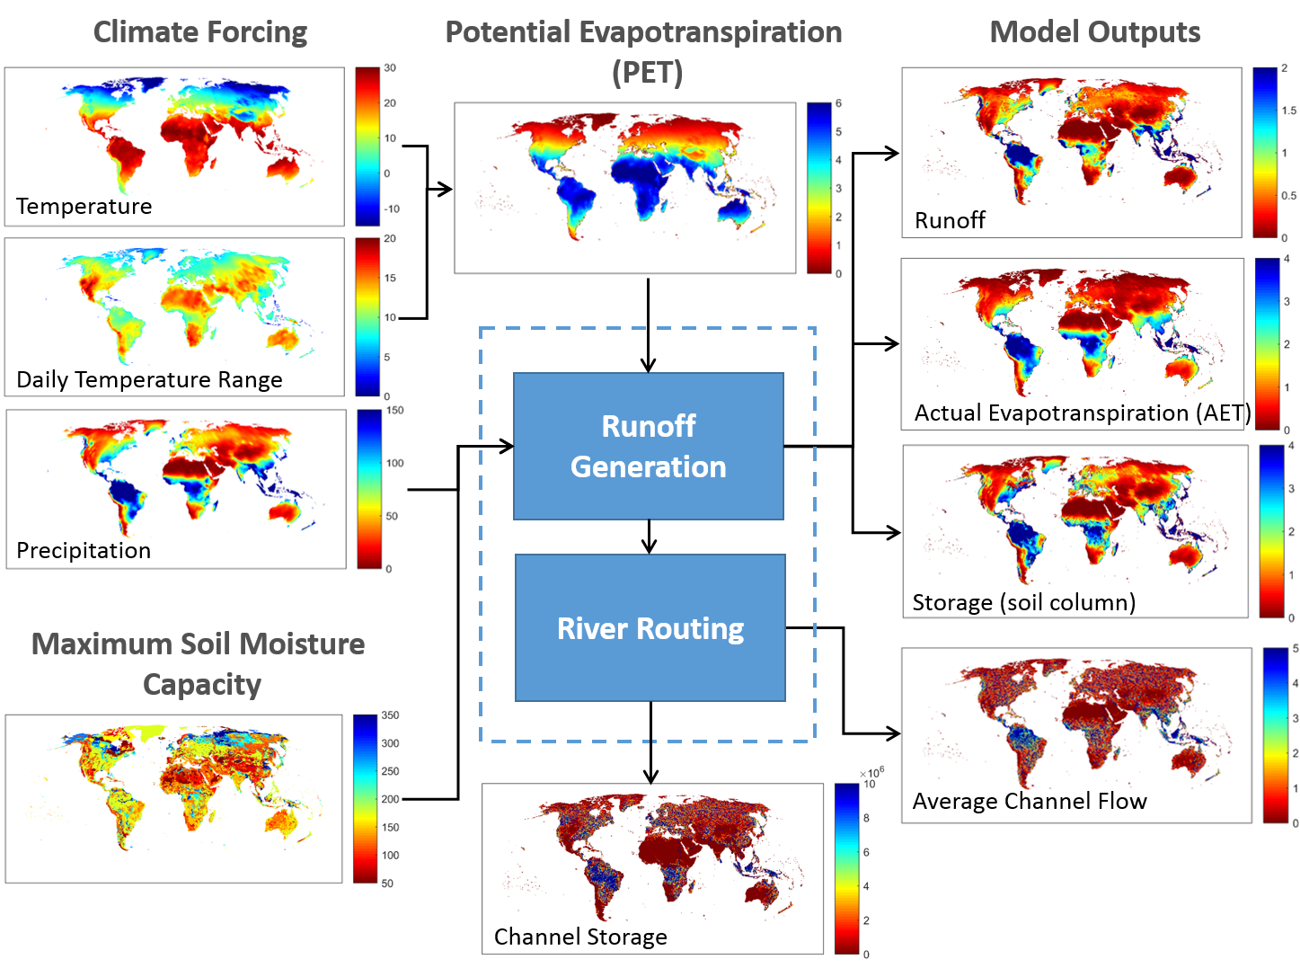
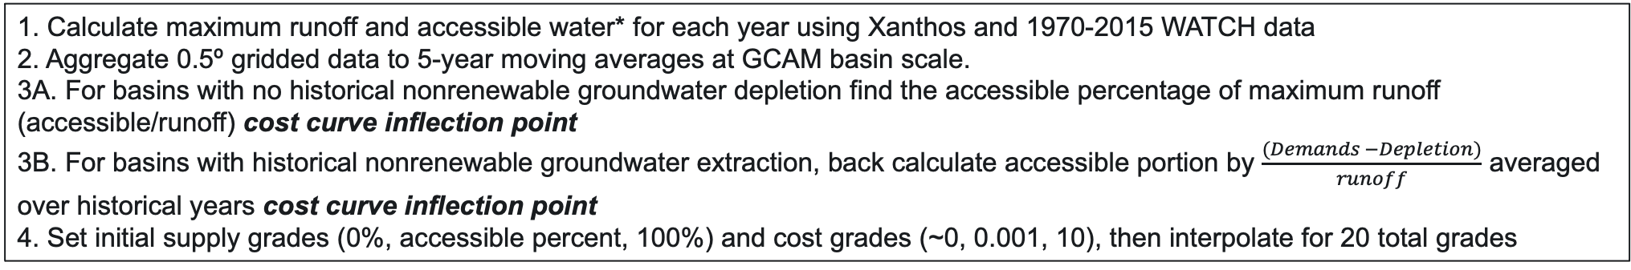
Surface Water Supply and Cost Curves in GCAM
Xanthos Processing
235 GCAM Basins
Price $
Price $
Availability [%]
Availability [%]
1. Calculate maximum runoff and accessible water* for each year using Xanthos and 1970-2015 WATCH data
2. Aggregate 0.5º gridded data to 5-year moving averages at GCAM basin scale.
3A. For basins with no historical nonrenewable groundwater depletion find the accessible percentage of maximum runoff (accessible/runoff) cost curve inflection point
3B. For basins with historical nonrenewable groundwater extraction, back calculate accessible portion by $\frac{(Demands −Depletion)}{runoff}$ averaged over historical years cost curve inflection point
4. Set initial supply grades (0%, accessible percent, 100%) and cost grades (~0, 0.001, 10), then interpolate for 20 total grades

Slide 16

Groundwater Supply and Cost Curves in GCAM
Superwell
Derived unit cost of groundwater extraction over time at 50km grid cells
Estimates of groundwater availability from previous studies on porosity, depth-to-groundwater, and aquifer thickness in addition to WHYMAP
Constrained to only allow for 25% use of all physical water estimated in aquifer
Calculations within require an assumption of confined aquifer, however results assumed to be from unconfined aquifer
Increasing Depth
Price $
$$∆t$$
Cost Grade
Aggregate unit costs from Superwell 50km grid to GCAM basin scale and transform into 24 unique cost grades
Historical groundwater depletion from WaterGap is placed into grade_hist which is pulled during historical calibration
Added to GCAM as a subresource with price interactions with renewable water cost curves.

Slide 17
Surface Water and Groundwater Price Interaction
Renewable Cost Curve
Basin A
Groundwater Cost Curve
Basin A
Water withdrawals come from cheap renewable sources first.
If demands exceed the accessible portion in any given timestep, a price interaction between groundwater and renewable water occurs where water is drawn from the cheaper source first.
Price $
Price $
Availability [%]
Cost Grade
Price $
Price $
Availability [%]
Cost Grade

Slide 18
Surface Water and Groundwater Price Interaction
Renewable cost curve
Basin A
Groundwater cost curve
Basin A
Water withdrawals come from cheap renewable sources first.
If demands exceed the accessible portion in any given timestep, a price interaction between groundwater and renewable water occurs where water is drawn from the cheaper source first.
As groundwater is exhausted in low-cost grades, the point of interaction between renewable and groundwater is pushed to higher prices
More water than is deemed accessible must be pulled in order to start the price interaction with groundwater
Price $
Price $
Availability [%]
Cost Grade
Price $
Price $
Availability [%]
Cost Grade

Slide 19
Sectoral Water Demands in GCAM
Total Water Use
Non-Agricultural Water Use
Irrigation
Livestock
Agricultural Water Use
Domestic
Electricity Generation
Primary Energy
Manufacturing
Hydropower
Wind
PV
CSP
Geothermal
Nuclear
Biomass (+CCS)
Oil (+CCS)
Gas (+CCS)
Coal (+CCS)
Once-Through
Dry Cooling
Cooling Ponds
Wet Towers
Coal
Natural Gas
Conventional Oil
Unconventional Oil
Uranium
Corn
FiberCrop
FodderGrass
FodderHerb
Fruits
Legumes
MiscCrop
NutsSeeds
OilCrop
OilPalm
OtherGrain
Rice
RootTuber
Soybean
SugarCrop
Vegetables
Wheat
Biomas
Beef
Dairy
Pork
Poultry
SheepGoat

Slide 20
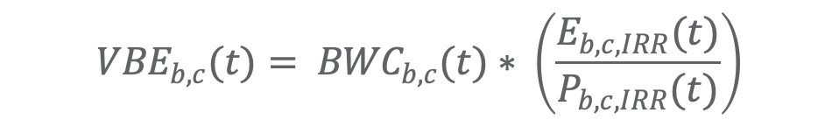
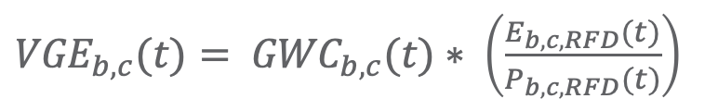
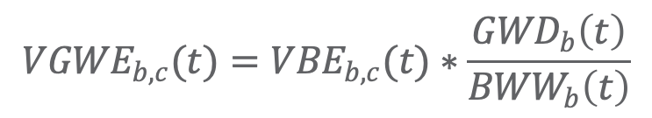
Virtual Water within GCAM
Virtual Water Trade
Ag production is separated into Irrigated (IRR) or Rainfed (RFD) to calculate trade and virtual water trade at the basin level, b, for crop c.
  As demand is calculated at regional scales, proportionate values of production and water are used to downscale to basin level
Groundwater contributions to virtual water trade are calculated based on the proportion of nonrenewable groundwater depletion, GWD to blue water withdrawals, BWW, within the specified basin
$${VBE}_{b,c}(t)= {BWC}_{b,c}(t)∗ \left(\frac{E_{b,c,IRR}(t)}{P_{b,c,IRR}(t)}\right)$$
${VGE}_{b,c}(t)= {GWC}_{b,c}(t)∗ \left(\frac{E_{b,c,RFD}(t)}{P_{b,c,RFD}(t)}\right)$
Virtual Groundwater Trade
$${VGWE}_{b,c}(t)={VBE}_{b,c}(t)∗\frac{{GWD}_{b}\left(t\right)}{{BWW}_{b}\left(t\right)}$$

Slide 21
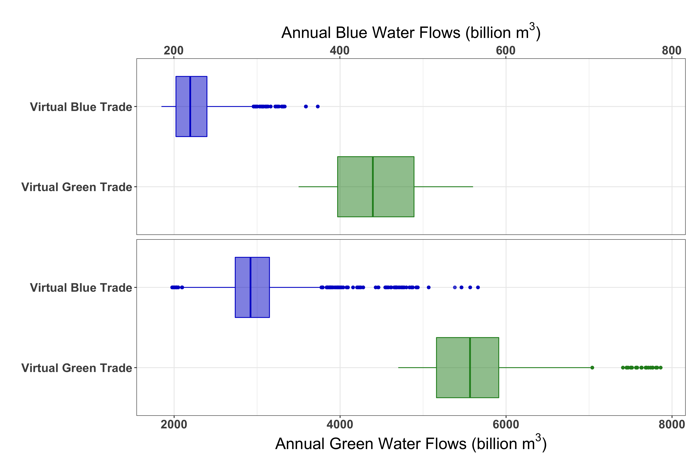
Future Virtual Water Trade Projections
2050
2100

Slide 22
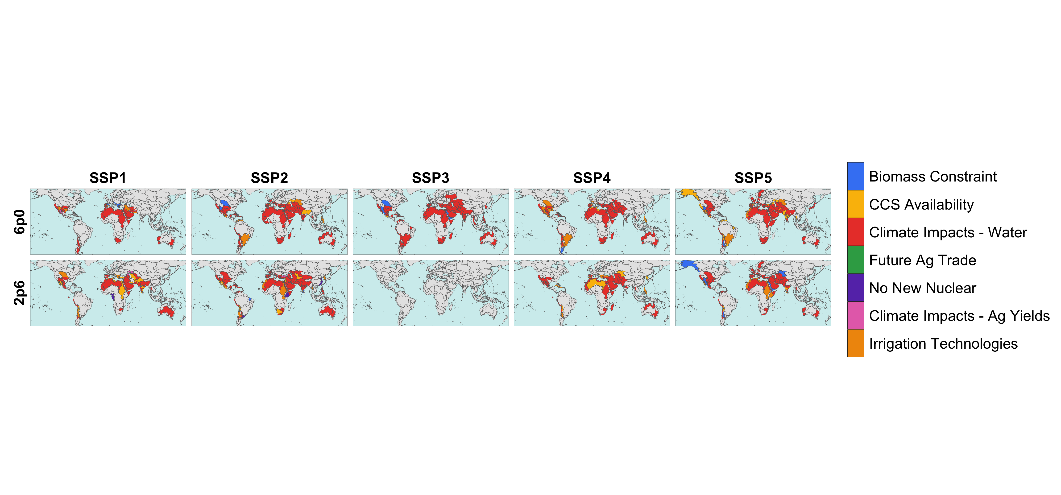
Main Drivers of Nonrenewable Groundwater Withdrawals (2100)

Slide 23
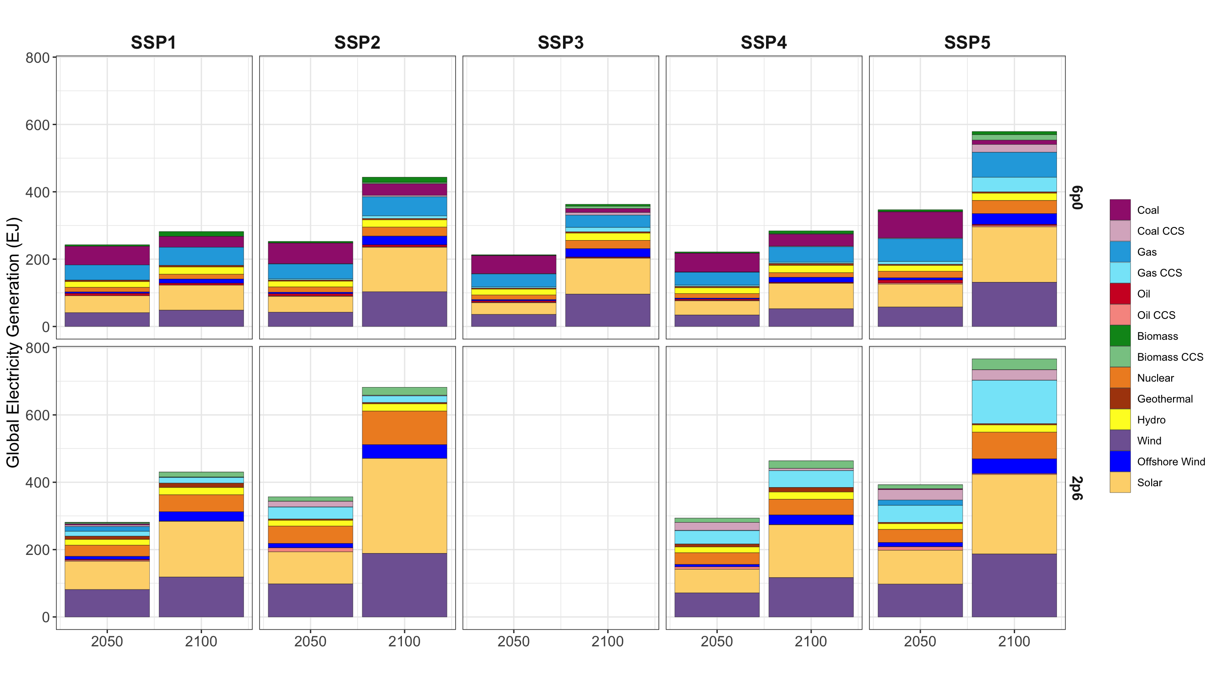
Mean Global Electricity Generation

