Slide 1
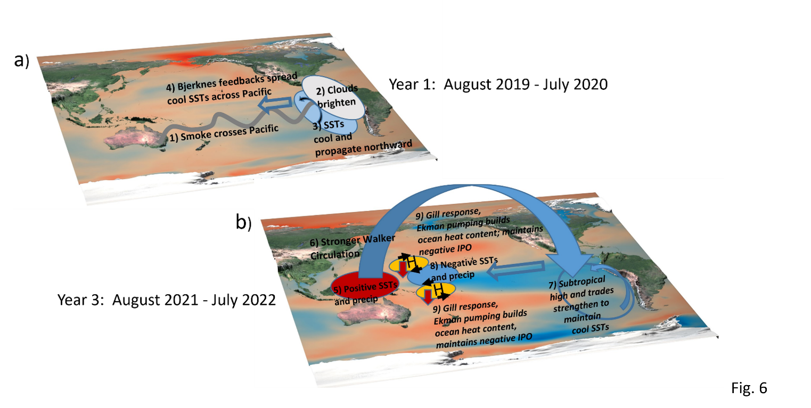
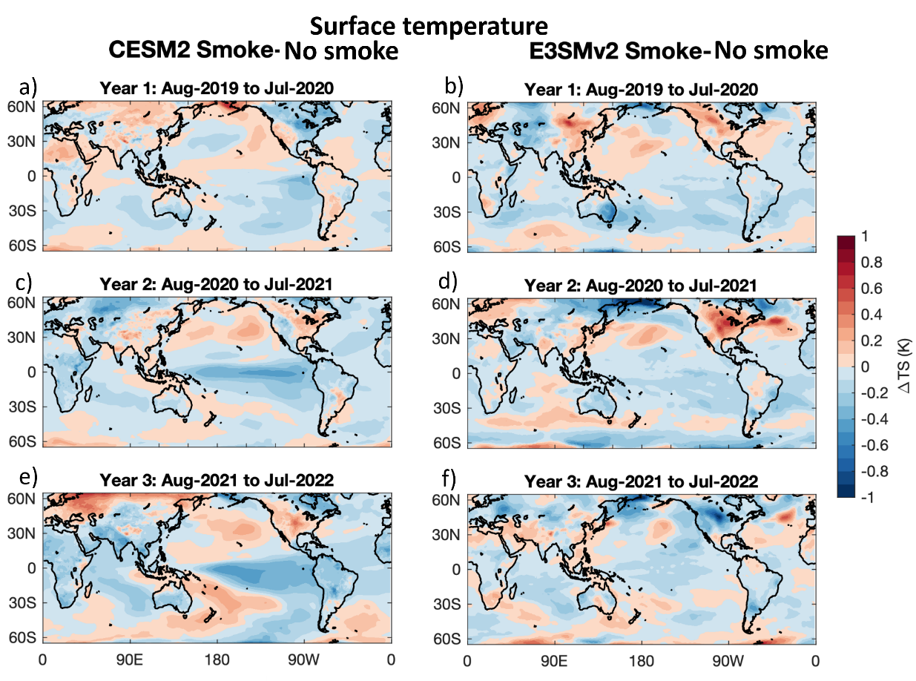
Initialized Earth system predictions with E3SMv2 and CESM2
Gerald Meehl
3-year hindcast case study to determine the effects of the 2019-2020 Australian wildfire smoke on multi-year La Niña
Fasullo et al., 2023, Science Advances
Meehl et al., 2024, Nature Communications, pending
Year 3: Aug. 2021-July 2022
2 sets of coupled feedbacks:
--intensified Walker Circulation drives stronger trades/Bjerknes feedbacks/cooler SSTs
--negative convective heating anomaly in western eq. Pacific
drives Gill-type response, Ekman pumping, and increased off-equatorial ocean heat content

