Slide 1
Sensitivity of Future Regional and Global Economic Activity to Energy Market Disruptions: What If Russia Couldn’t Export Energy?
Jae Edmonds¹, Xin Zhao¹, Pralit Patel¹, Di Sheng¹, Ellie Lochner¹, Christoph Bertram², Gokul Iyer¹, Michael Westphal¹, Allen Fawcett¹, Stephanie Waldhoff¹
¹ Joint Global Change Research Institute, Pacific Northwest National Laboratory | Correspondence: jae@pnnl.gov
² Joint Global Change Research Institute, University of Maryland
06 August 2024
Acknowledgments: This research was supported by the U.S. Department of Energy, Office of Science, as part of research in MultiSector Dynamics, Earth and Environmental System Modeling Program.
PNNL-SA-185625

Slide 2
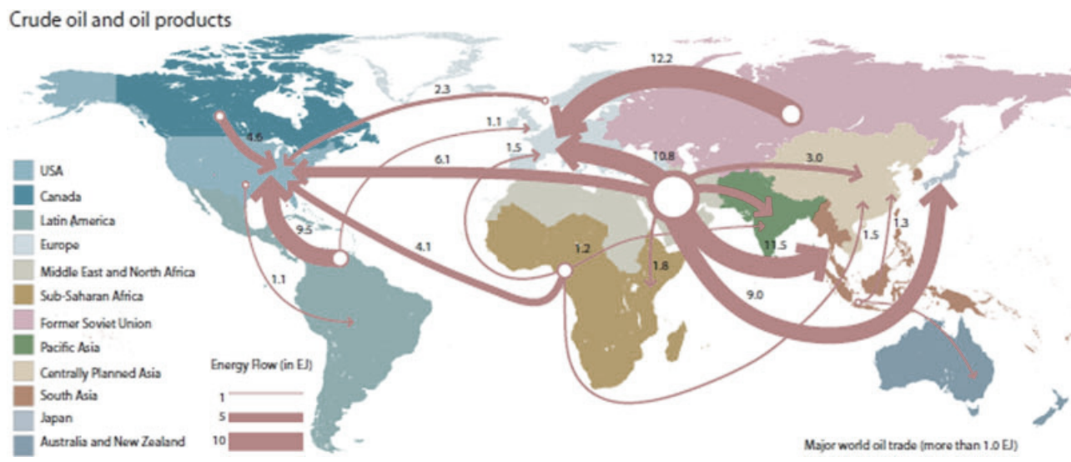
Motivation
The macroeconomy defines the scale of human activity and is one of the most important factors determining the scale of human-physical Earth system interactions.
Individual human activities can have substantial feedback effects on the macroeconomy.
We explore feedback effects from international energy trade on the economies of the world.
Source: Rasha M. Abou Samra, Rasha Eissa & Maie El-Gammal (2018): Applying the environmental sensitivity index for the assessment of the prospective oil spills along the Nile Delta Coast, Egypt, Geocarto International, DOI: 10.1080/10106049.2018.1533592
Research question: How would the world accommodate a major disruption in energy trade such as a cession of energy exports from the Russian economy?
Notes:
Global 2020 GDP = $86 trillion
U.S. 2020 GDP = $21 trillion

Slide 3
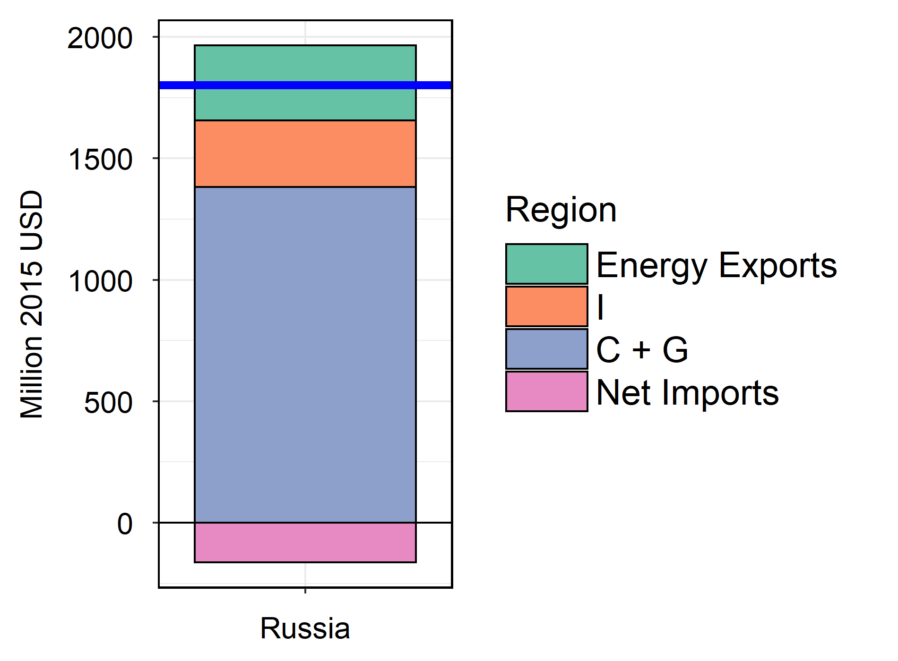
Background—What is GDP?
GDP is the monetary value of new final goods and services produced in a given year
GDP=C+G+Investment+Net Exports (NX)
Russia 2020 GDP
Consumption
Production
C=Consumption
G=Government Spending
I=Investment Spending
NX=Net exports (Exports-Imports)
GDP=Wages+Interest+Rents+Profits
Notes:
Global 2020 GDP = $86 trillion
U.S. 2020 GDP = $21 trillion
China 2020 GDP = $15 trillion

Slide 4
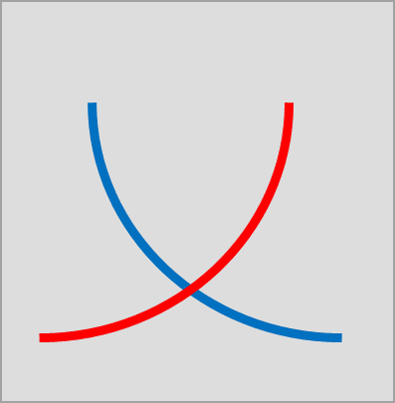
The Global Change Analysis Model (GCAM) v7.0 an MSD Model
MACRO MODULE
SECTOR MODULES
F(X_{KM},X_{LM},X_{EM})
+ Σ_{i} P_{i}X_{i,NX} -Σ_{i} X_{i,M}
AG-LAND
GDP
WATER
Labor Market
X_{L}= X_{L,A} + X_{L,E} + X_{L,M}
P_{L}
X_{E,M}
Energy Service Output
X_{E,NX}
Net Energy Exports
ENERGY
Savings-Investment Market
X_{I}= X_{I,A} + X_{I,E} + X_{I,M}
P_{K}
X_{I,E}
Energy Investment Demands

Slide 5
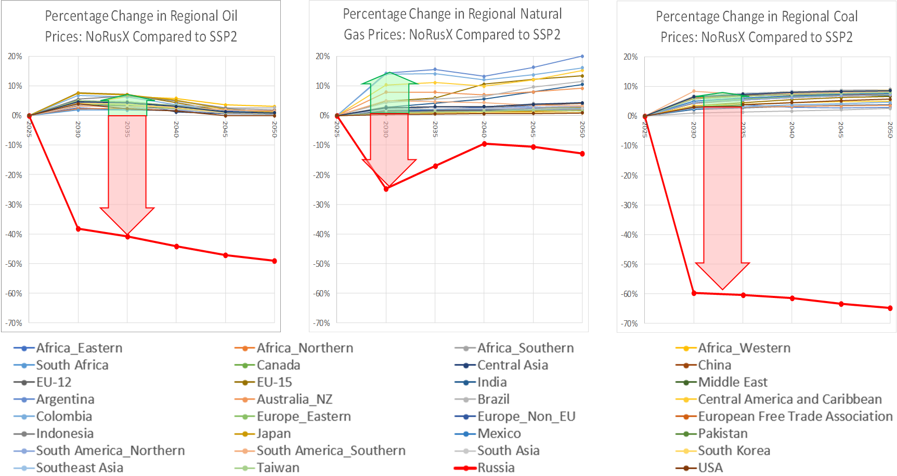
Russian Export Reductions are replaced by NET increases in energy exports in the rest of the world.
Experimental Design
Notes:
Global 2020 GDP = $86 trillion
U.S. 2020 GDP = $21 trillion

Slide 6
GDP Change: Energy Exporters, Importers, and Global: SSP2|NoRusX less SSP2
Net Energy Export Term
Labor Term
Materials Sector Capital Term
Energy Services Term

Slide 7
Insights
Research question: How would the world accommodate a major disruption in energy trade such as a cession of energy exports from the Russian economy?
Energy trade feedback effects on GDP were substantial.
Russian GDP was reduced by $500 billion/year in 2050.
Russian GDP reduction was transferred to the rest of the world as an increase in GDP.
Non-Russian energy exporters received most of the GDP increase.
Energy net importers’ GDPs changed substantially less, and in some cases, suffered reductions.
Balance of Trade Effects were the dominant mechanism changing GDP for energy net exporters. Energy availability was the dominant mechanism changing GDP for energy net importers.
Wages rose in non-Russian energy exporters and fell in energy importing regions and Russia through capital stock interactions.
Our approach can be used to assess a wide range of other feedback effects that operate through a wide range of pathways including energy, land, meteorology, and water.

