Slide 1
The Role of Sulfate Aerosol Forcing and Air-Sea Feedbacks in Generating Strong Seasonality of Climate Change over the
Mid-latitude Oceans
Daniel Vimont¹, Jack Zweifel, Sagar Rathod, Tristan L'Ecuyer, and David Henderson
¹ University of Wisconsin-Madison, Contact: dvimont@wisc.edu
EESD RGMA Project DE-SC0022029
Poster #104

Slide 2
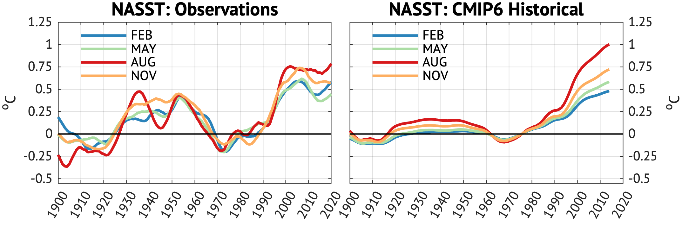
The Role of Sulfate Aerosol Forcing and Air-Sea Feedbacks in Generating
Strong Seasonality of Climate Change over the Mid-latitude Oceans
Daniel Vimont¹, Jack Zweifel, Sagar Rathod, Tristan L'Ecuyer, and David Henderson
¹ University of Wisconsin-Madison, Contact: dvimont@wisc.edu
Since 1970, North Atlantic SST has warmed 50% faster during late SUMMER than late WINTER
Sulfate aerosols are FIVE TIMES more abundant during SUMMER than WINTER despite no seasonality in SO₂ emissions

Slide 3
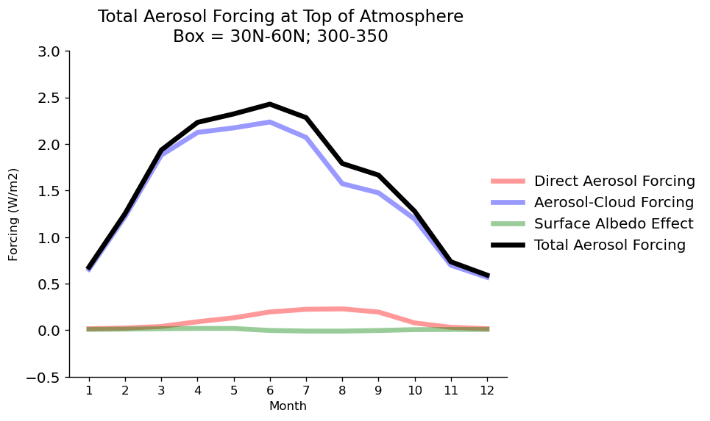
The Role of Sulfate Aerosol Forcing and Air-Sea Feedbacks in Generating
Strong Seasonality of Climate Change over the Mid-latitude Oceans
Daniel Vimont¹, Jack Zweifel, Sagar Rathod, Tristan L'Ecuyer, and David Henderson
¹ University of Wisconsin-Madison, Contact: dvimont@wisc.edu
Why do sulfate aerosols exhibit strong seasonality?
How does sulfate seasonality affect sulfate direct and cloud radiative forcing?
How do the mean state, radiative forcing, and air-sea feedbacks contribute to SST seasonality?
CESM2: SO₄ Burden
1970 – 2010 US SO₂ Emissions
$$\frac{d\left(ρcH(t)T\right)}{dt}=−k(t)T+F(t)$$
JANUARY
W m⁻²
JULY
Month
kg m⁻²

Slide 4
The Role of Sulfate Aerosol Forcing and Air-Sea Feedbacks in Generating Strong Seasonality of Climate Change over the
Mid-latitude Oceans
Daniel Vimont¹, Jack Zweifel, Sagar Rathod, Tristan L'Ecuyer, and David Henderson
¹ University of Wisconsin-Madison, Contact: dvimont@wisc.edu
EESD RGMA Project DE-SC0022029
Poster #104

