Slide 1
Methodological Developments in the International Land Model Benchmarking (ILAMB) Effort
Nathan Collier, Forrest Hoffman, Dave Lawrence
Notes:
This presentation has 5 minutes allotted to it. The video recording show be at most 4 minutes to leave a minute for clarifying questions before proceeding.

Slide 2
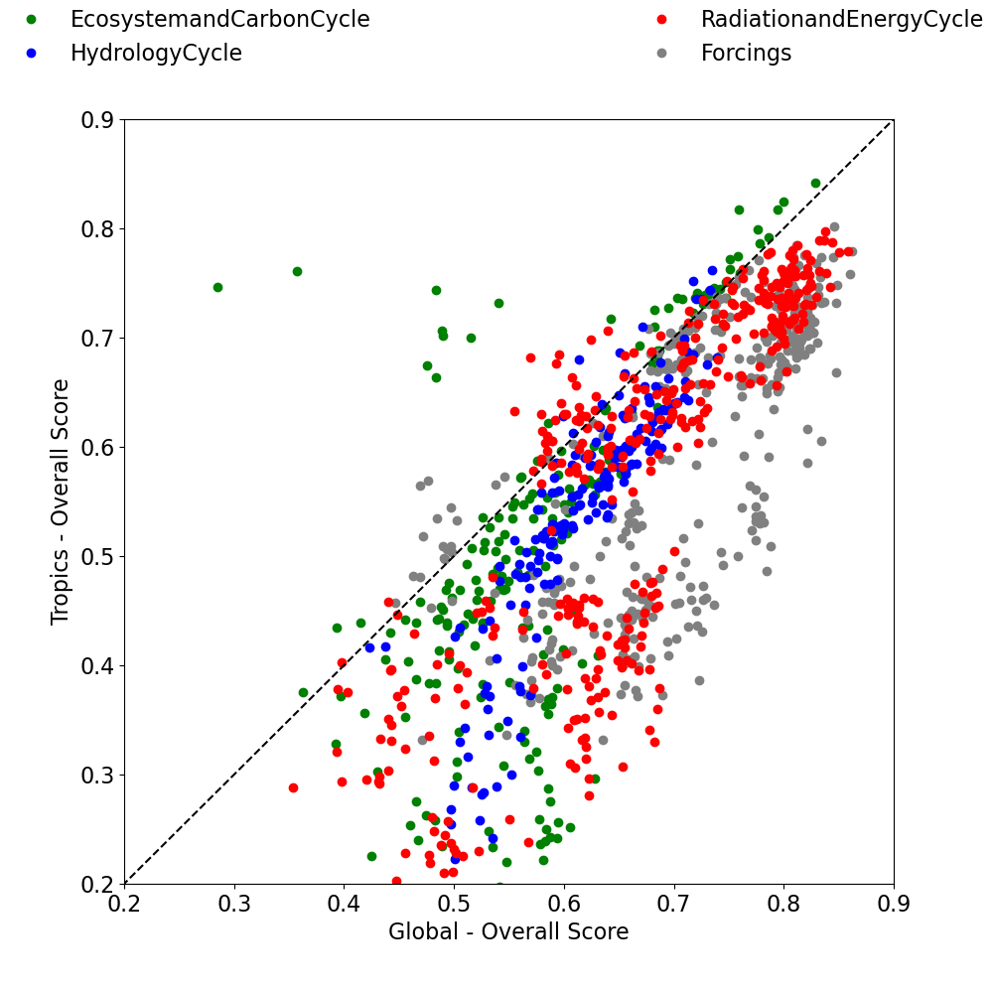
Heavily Influenced by Tropics
We have observed that our current scoring methodology favors performance in the tropics.
Plot shows that for many datasets, the tropics score correlates strongly to the global score
This is due to our choice of normalizing errors by the variability of the reference data and the use of mass weighting

Slide 3
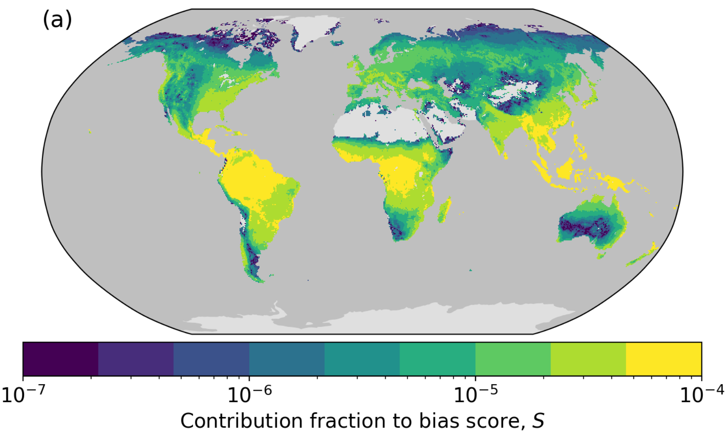
Bias score influence map: gpp | FLUXCOM

Slide 4
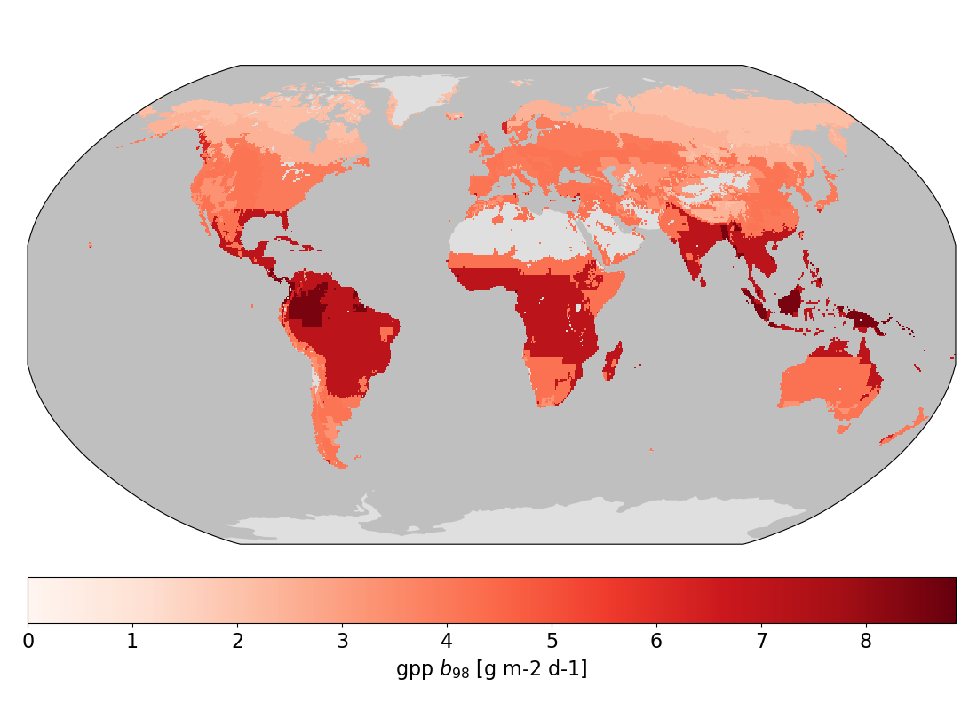
A Change in How We Normalize Errors
The goal is to make errors from different areas of the globe comparable.
Select a set of regions which represent biomes in which errors can be treated as commensurate in order of magnitude.
Inside each region, for each variable, and across a selection of models, compute the 98th quantile of |bias(x)| with respect to all datasets for that variable.
The gpp 98th error quantile within Whittaker biomes across CMIP5v6 models.

Slide 5
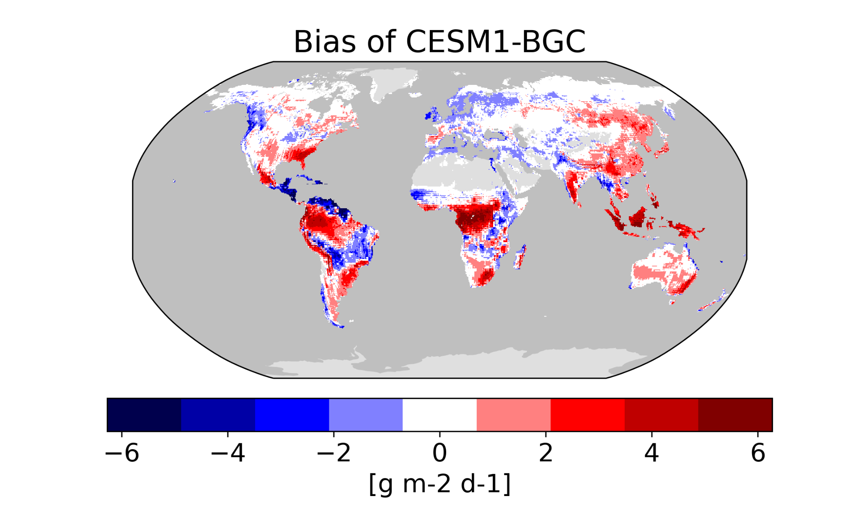
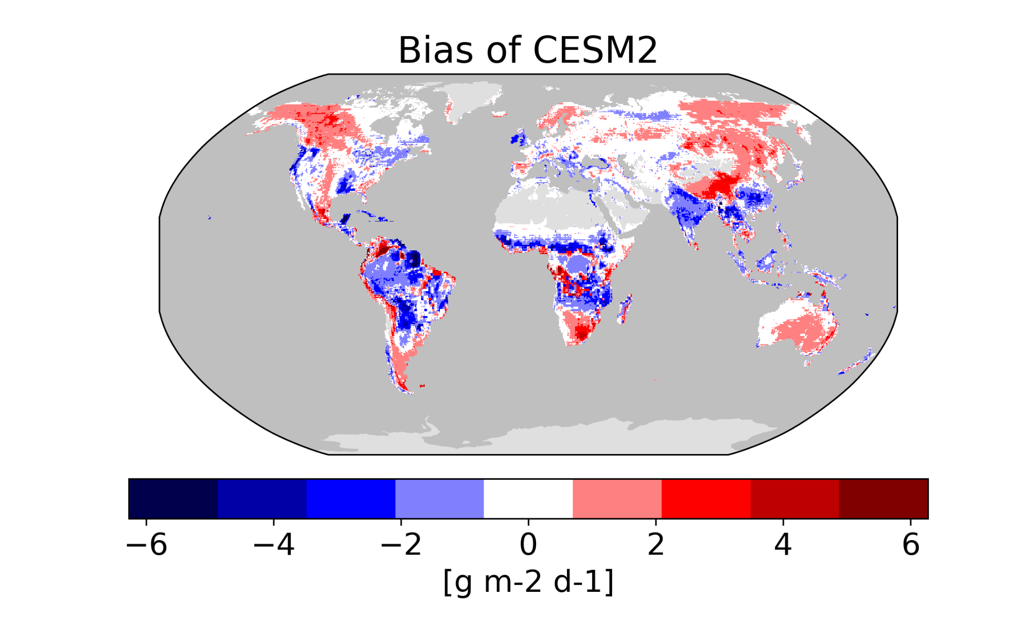
CESM2 | gpp | FLUXCOM
Notice larger bias in high latitudes, anomalous among CMIP models

Slide 6
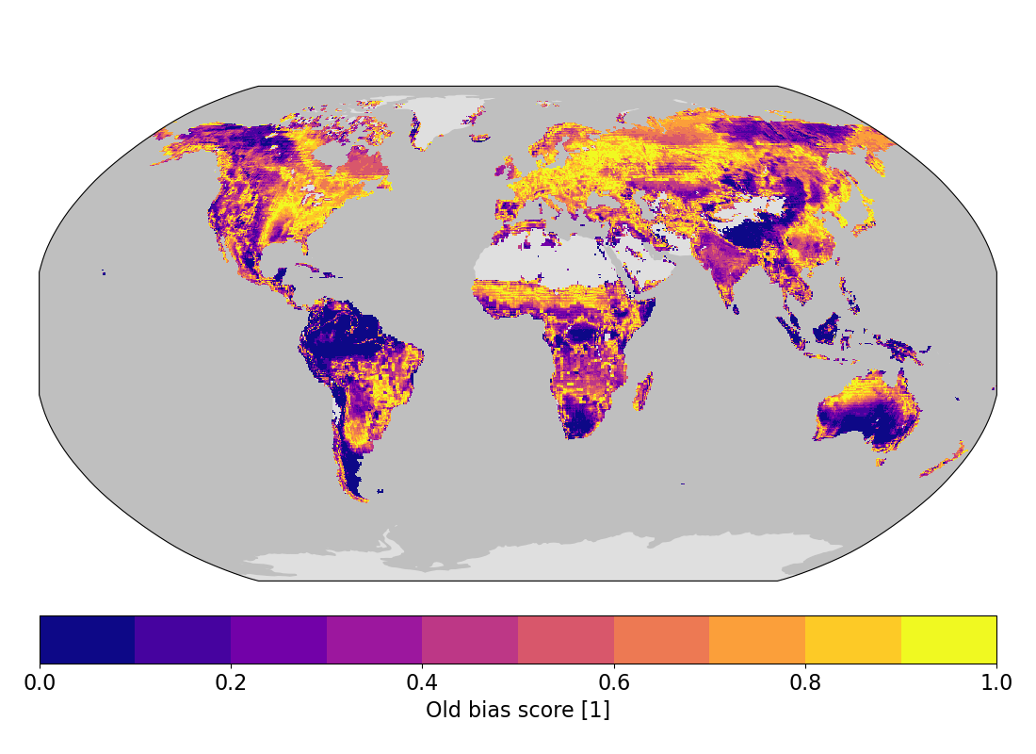
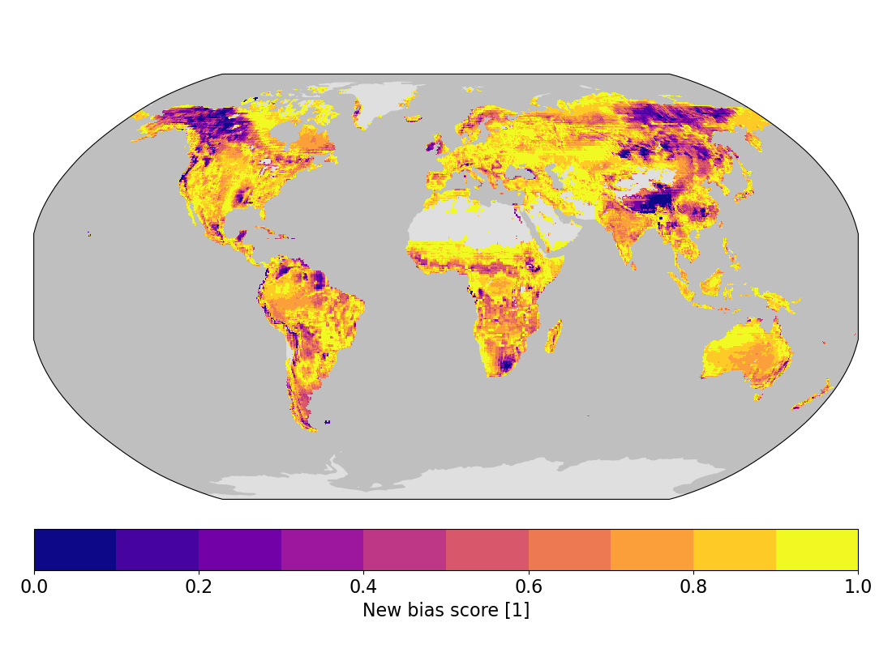
CESM2 | gpp | FLUXCOM
With the new methodology, these areas light up clearly

Slide 7
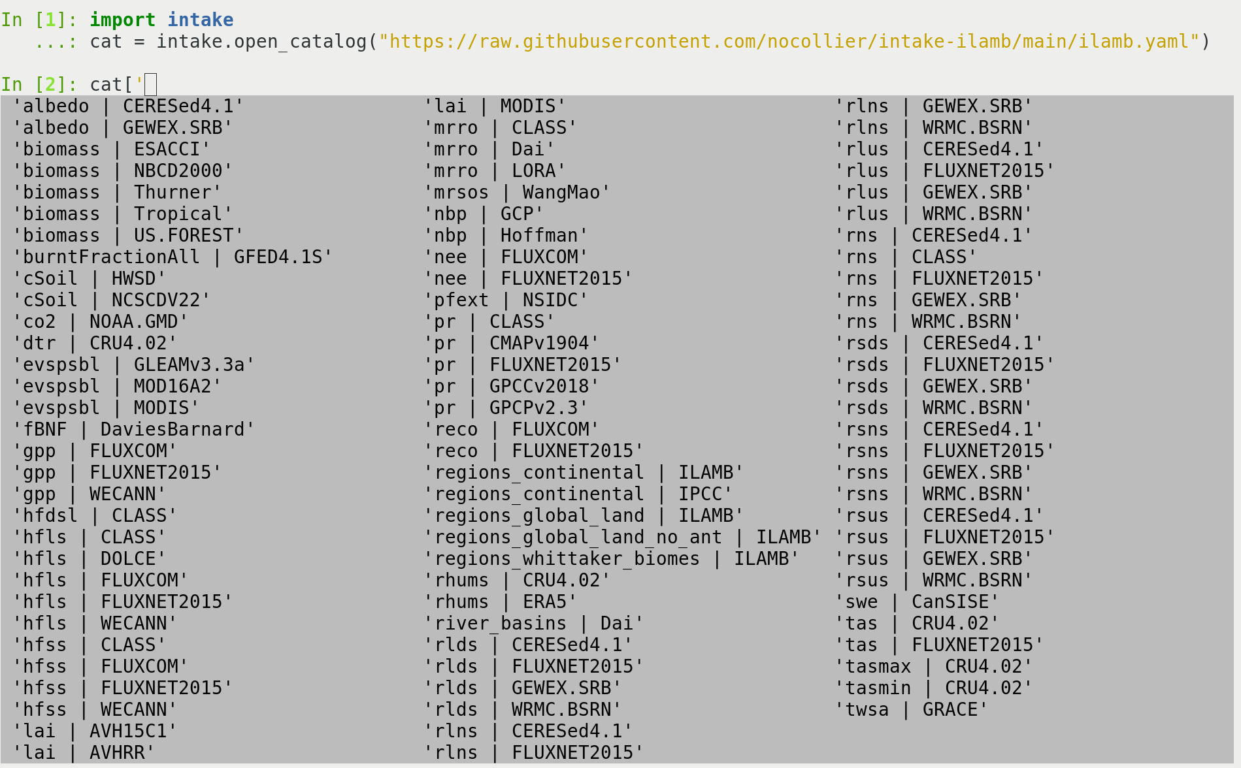
Other Ways to Use ILAMB Data

Slide 8
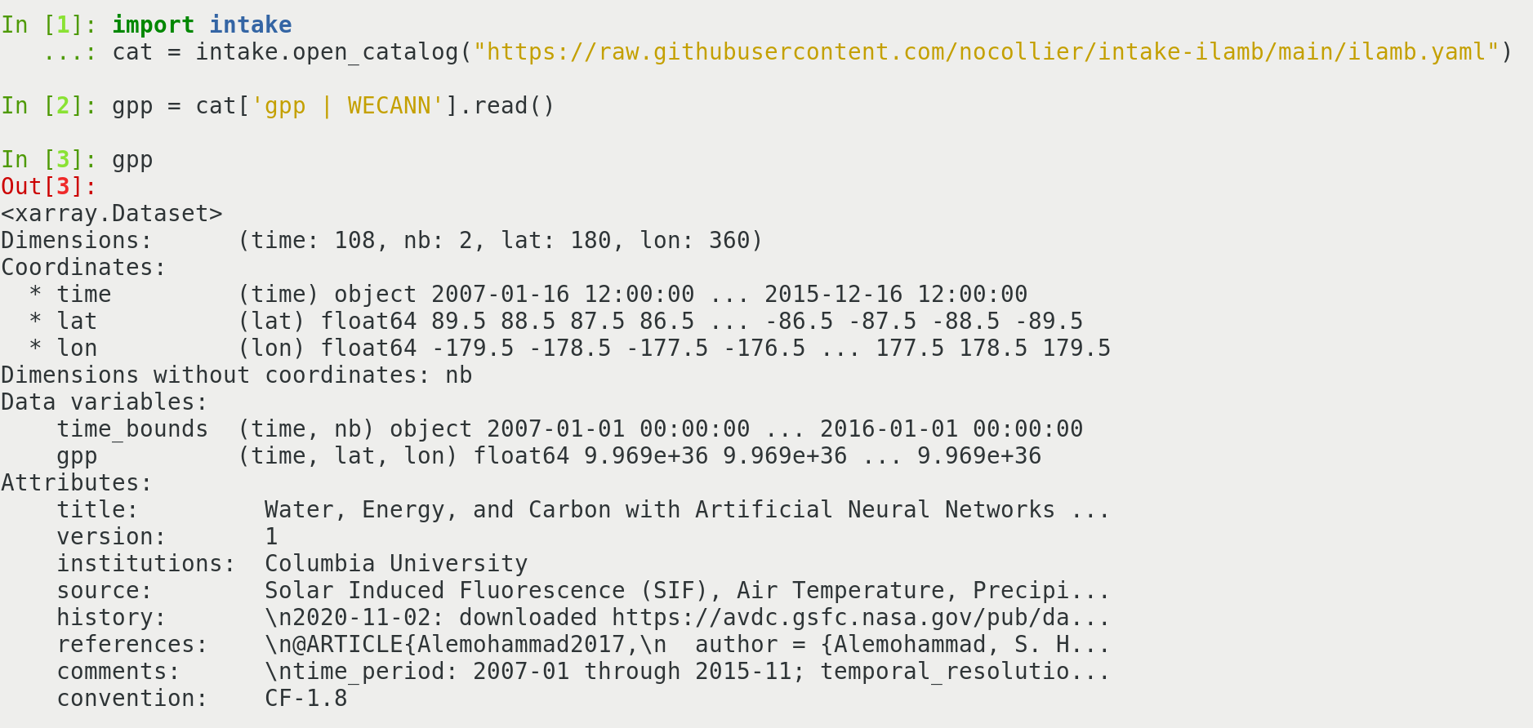
Other Ways to Use ILAMB Data

Slide 9
ILAMB v3: On the Horizon
Shift to xarray as a base object.
Adapt to the way researchers are working.
Working from the bottom up and making soft releases as we go.
Each new capability will be fully documented.
Great time to get me your wish lists.
https://github.com/rubisco-sfa/ilamb3

