Slide 1
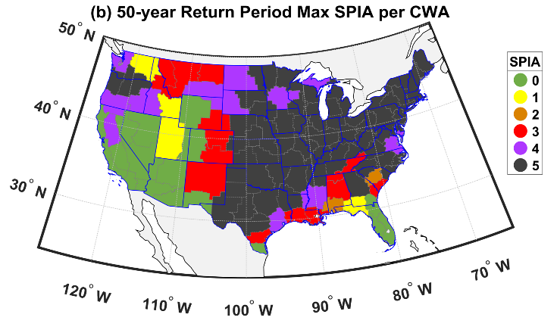
Assessing and Modeling the Compound Hazard of Freezing Rain and Wind Gusts
Jacob Coburn¹, Rebecca Barthelmie¹, and Sara C. Pryor¹, 1. Cornell University
Storyline Overview
Co-occurrence of freezing rain, ice accumulation + wind gusts (FZG) = significant hazard but quantification challenged by lack of ice accumulation measurements.
Methodology
Ice accumulation modeled at 883 ASOS stations (2005-2022). Geospatial atlas of Sperry–Piltz Ice Accumulation Index (SPIA) & 50 yr return period event intensities produced.
Insights Gained
1-3 FZG events yr⁻¹ occur in an arc from Texas over the Midwest into the Northeast
50 yr Return Period values with maximum ice thickness of 3–5 cm and wind gusts > 30 ms⁻¹ (i.e. SPIA = 5) over much of eastern USA
Storylines of FZG identified. Met context: along frontal boundaries of transient midlatitude cyclones or amplification of Rossby waves and associated cold air outbreaks
Workflow and 50-yr RP SPIA by County Warning Area.
From: Coburn, Barthelmie & Pryor 2024 Environ. Res. Lett. 19 044016

