Slide 1
New Observational Constraints for Aerosol and Aerosol-Cloud Interactions in E3SM
Matthew Christensen, Charlotte Beall, Shuaiqi Tang, Adam Varble, Yi Qin, Jerome Fast, and Po-Lun Ma
Notes:
Abstract
New observational constraints for aerosol and aerosol-cloud interactions in E3SM
Matthew Christensen, Charlotte Beall, Shuaiqi Tang, Adam Varble, Yi Qin, Jerome Fast, Po-Lun Ma
Limited observational constraints have been a challenge for understanding the role of aerosol in the Earth system. To ensure model process representations are traceable to real-world features, several new diagnostics containing observational constraints have been developed to evaluate critical processes governing aerosol and aerosol-cloud interactions in E3SM. The open-source Earth System Model Aerosol–Cloud Diagnostics (ESMAC Diags) package includes in situ and remote sensing measurements from aircraft, ship, surface, and satellite platforms at multiple testbed regions around the globe. Lagrangian tools and a contoured frequency by optical depth diagram using multi-sensor satellite observations were developed to evaluate the warm rain processes and the role of aerosols thereof. Direct ARM measurements and satellite retrievals reveal that E3SM exhibits an overly strong increase in cloud optical thickness in response to rising cloud condensation nuclei, attributed to too many simulated sub-adiabatic clouds compared to observations. In this presentation, we will discuss efforts for harmonizing the spatiotemporal scales between model simulations and observations. We will demonstrate how these unique metrics diagnose model deficiencies and advance parameterizations necessary for improving E3SM predictions of aerosol and ACI across scales.

Slide 2
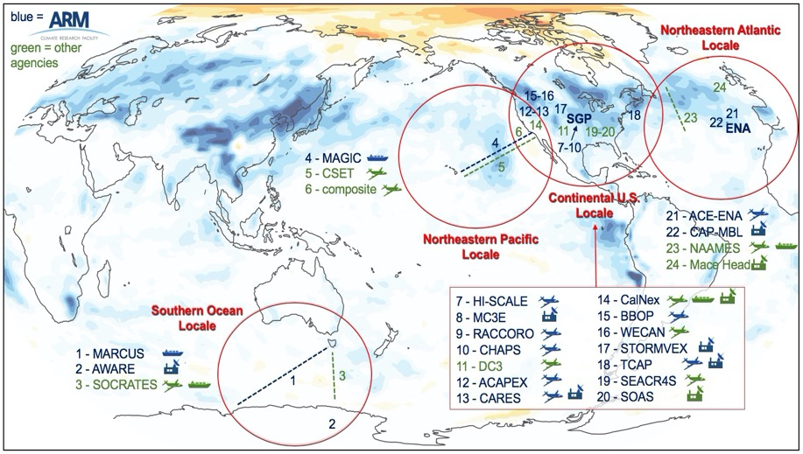
EAGLES Liquid Cloud Testbed
Cover a wide range of cloud/meteorological regimes and aerosol conditions
Abundant observational data
Combine E3SM-RRM, LES, and observational data for model evaluation and analysis

Slide 3
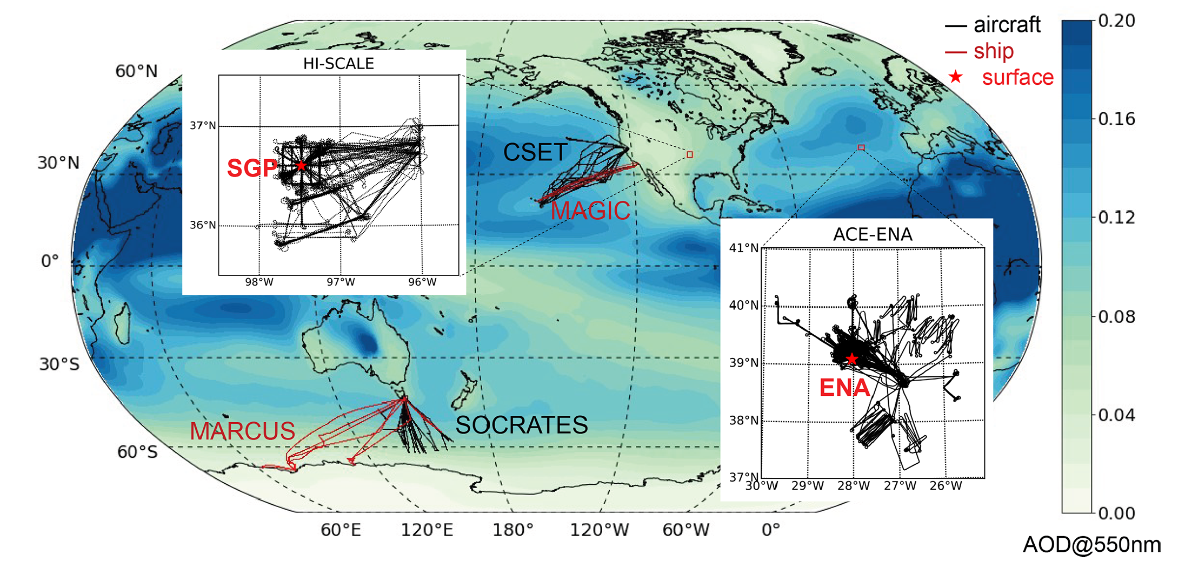
Earth System Model Aerosol–Cloud Diagnostics (ESMAC Diags) package Tang et al., 2022; 2023, GMD
Motivation: The ESMAC Diags package was developed to facilitate routine evaluation of aerosols, clouds, and ACIs simulated in the Energy Exascale Earth System Model (E3SM) from the US Department of Energy (DOE).
Dataset:
Field campaigns
HI-SCALE, ACE-ENA, MAGIC, CSET, MARCUS, SOCRATES
Satellite observations
Geostationary (VISST algorithm)
Permanent ARM sites
Ship – MAGIC & MARCUS
Geographical regions
Eastern North Atlantic (ENA)
Central US
Northeastern Pacific
Southern Ocean
Cloud regimes: Frequent liquid- or mixed-phase clouds with extensive measurements.
Measuremnts: Meteorology, aerosol size distribution, composition, and CCN, cloud properties (droplet size, concentration, geometrical thickness), TOA radiation.
Statistical Outputs: Single-variable & multivariable diagnostics, Percentiles, Histograms, Joint-histograms, Heatmaps
Notes:
ground, ship, and satellite measurements are rescaled to a 1 h frequency to be consistent with the current E3SM output frequency.
bulk cloud properties (e.g.,cloud fraction or liquid water path – LWP), the mean value is computed to be consistent with the grid-mean E3SM output. Interpolation is only used when the input frequency is equal to or coarser than the frequency of model output.
kilometer-scale-resolution ESM simulations, the high variability in aircraft measurements will be better captured. In the current diagnostics, we only focus on the statistics for the entire campaign.

Slide 4
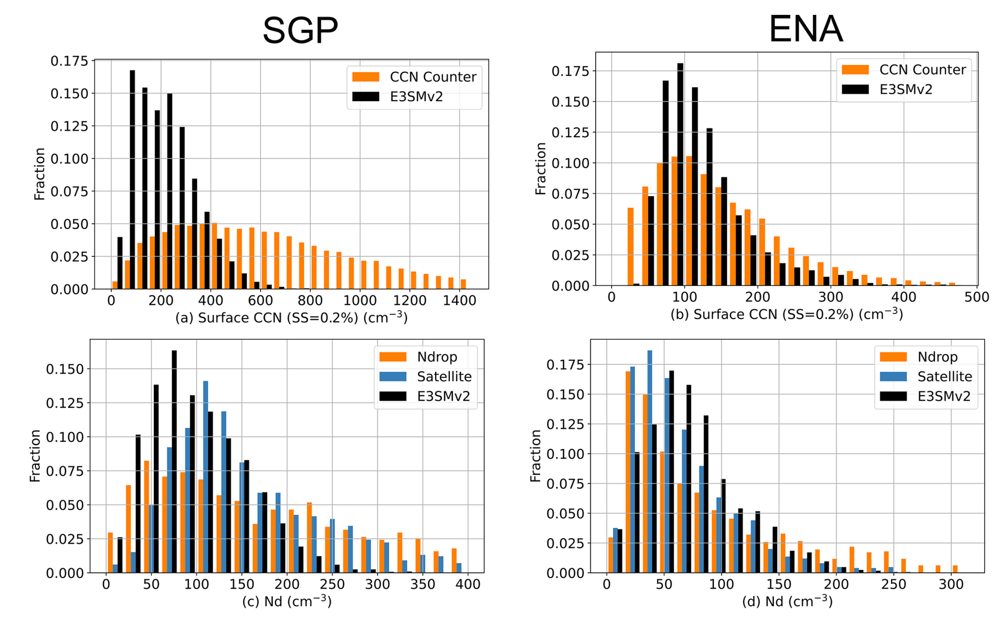
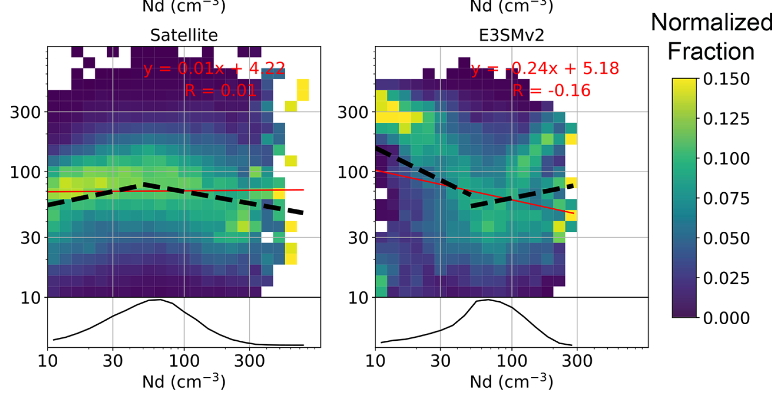
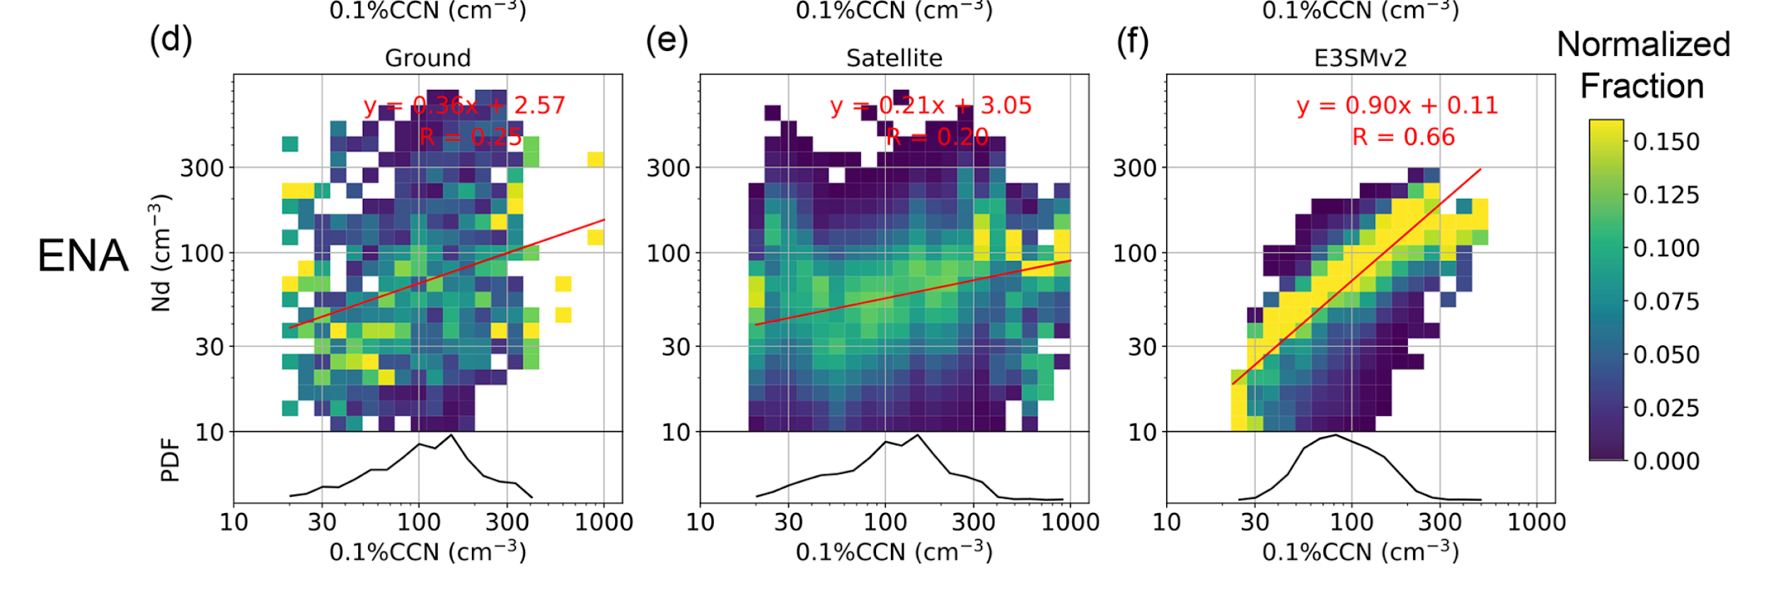
ESMAC Diags provides insights into E3SM state and process deficiencies Tang et al., 2022; 2023, GMD
E3SMv2 reasonably reproduces many observed aerosol and cloud properties
And… liquid water path response to a perturbed cloud droplet number concentration behaves differently in E3SMv2 than in observations.
But… coupling of aerosol & cloud number concentrations is too strong.
Bias in processes which control aerosol activation.

Slide 5
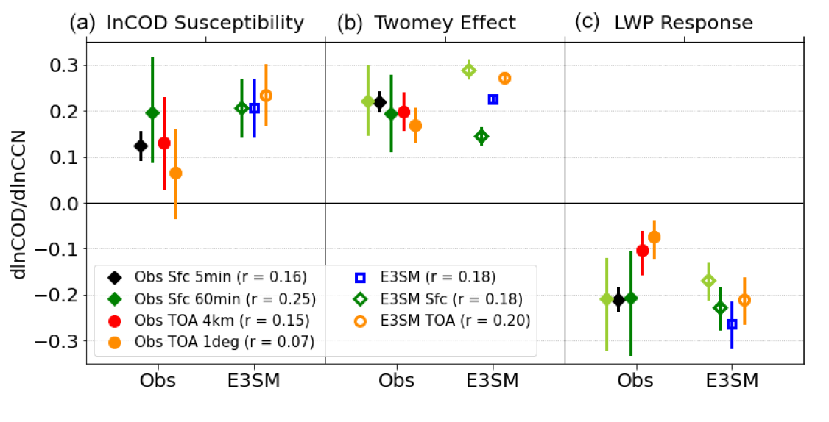
Estimating aerosol radiative forcing from different observations and models depends on assumptions of cloud water holding capacity Varble et al (2023), ACP
Radiative Forcing
Generally good agreement found with regards to the Twomey effect and LWP response albeit with slightly positive bias in E3SM.
Large variability in radiative effect depends on how the data is aggregated.
Cloud adiabaticity generally increases as droplet number concentration increases (in observations).
Cloud adiabaticity in E3SM is too small and there is no dependence on it as a function of Nd.
Observational TOA retrievals assume a constant cloud adiabaticity of 0.8, while surface retrievals do not assume constant adiabaticity.
More work needed to quantify this from space to determine meteorological drivers responsible for sub-adiabatic clouds and implement improvements in E3SM.

Slide 6
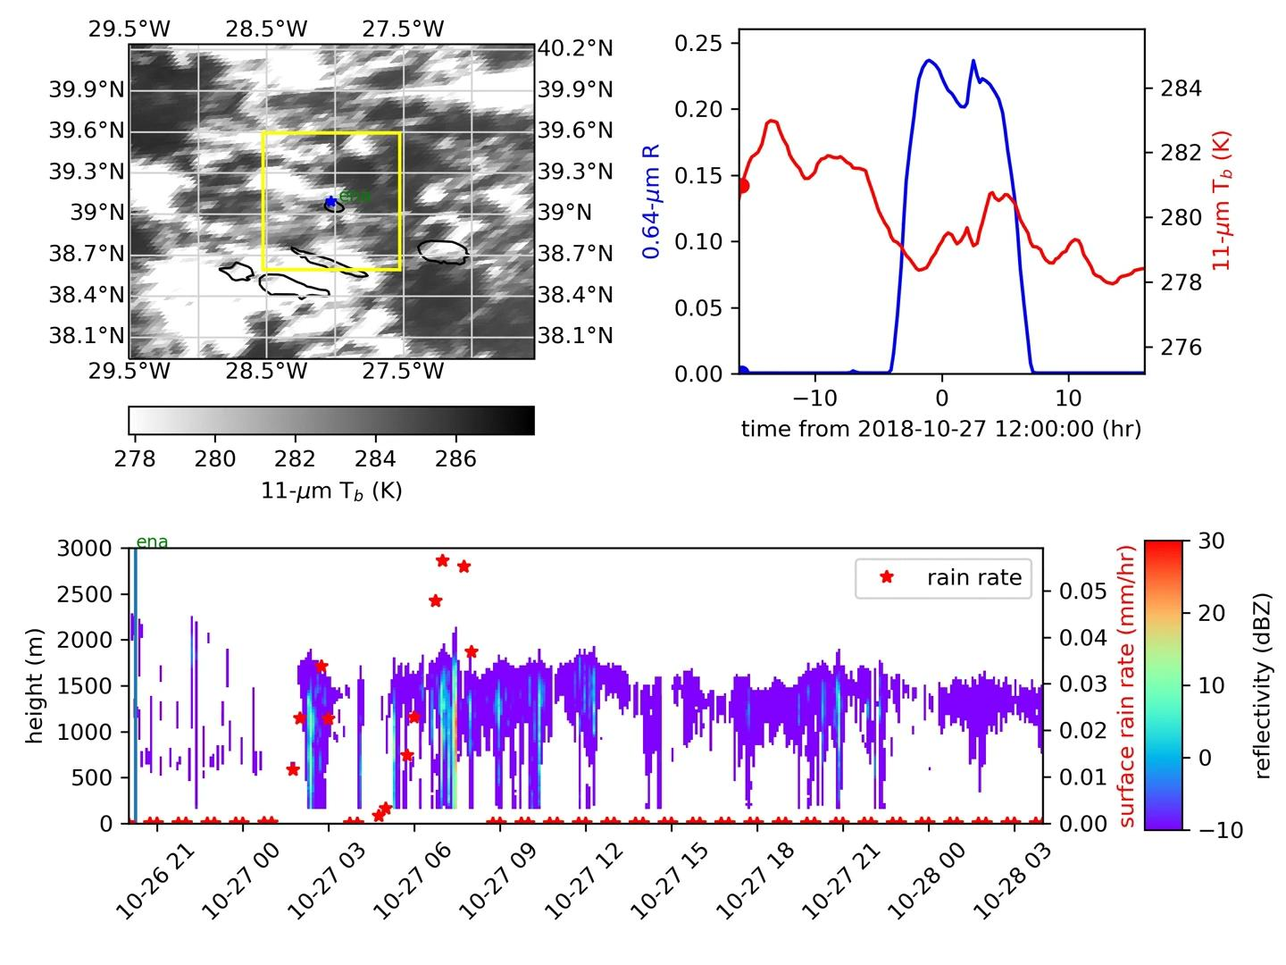
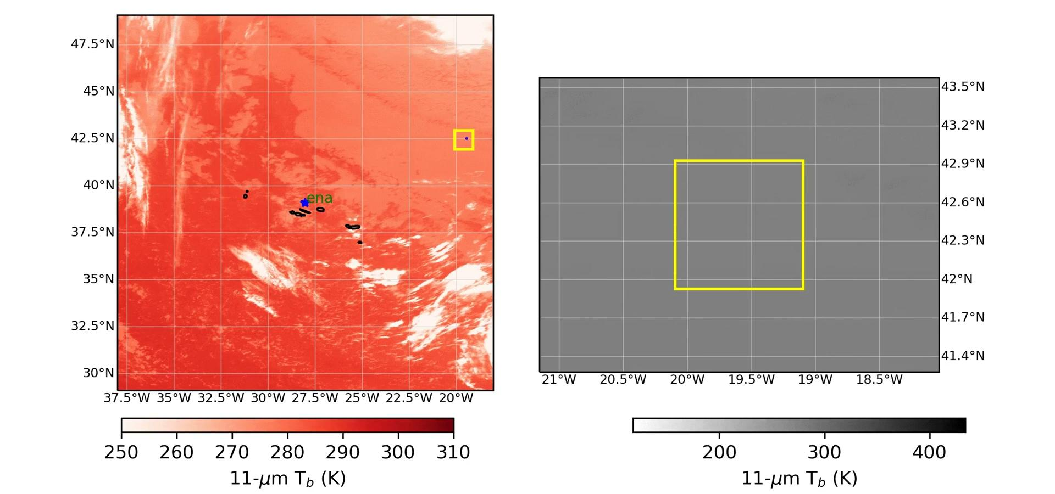
Use Lagrangian framework to quantify ACI throughout cloud lifetime Christensen et al (2023), ACP
Eulerian Framework
Lagrangian Framework
Scientific Questions:
Can changes in surface CCN concentration affect the radiative properties and lifetime of clouds passing by Azores?
How well does E3SMv1 represent aerosol-cloud interactions in a Lagrangian framework?
Clouds are not static and adjust to aerosol and meteorological changes over their lifetime thus necessitating a Lagrangian framework…

Slide 7
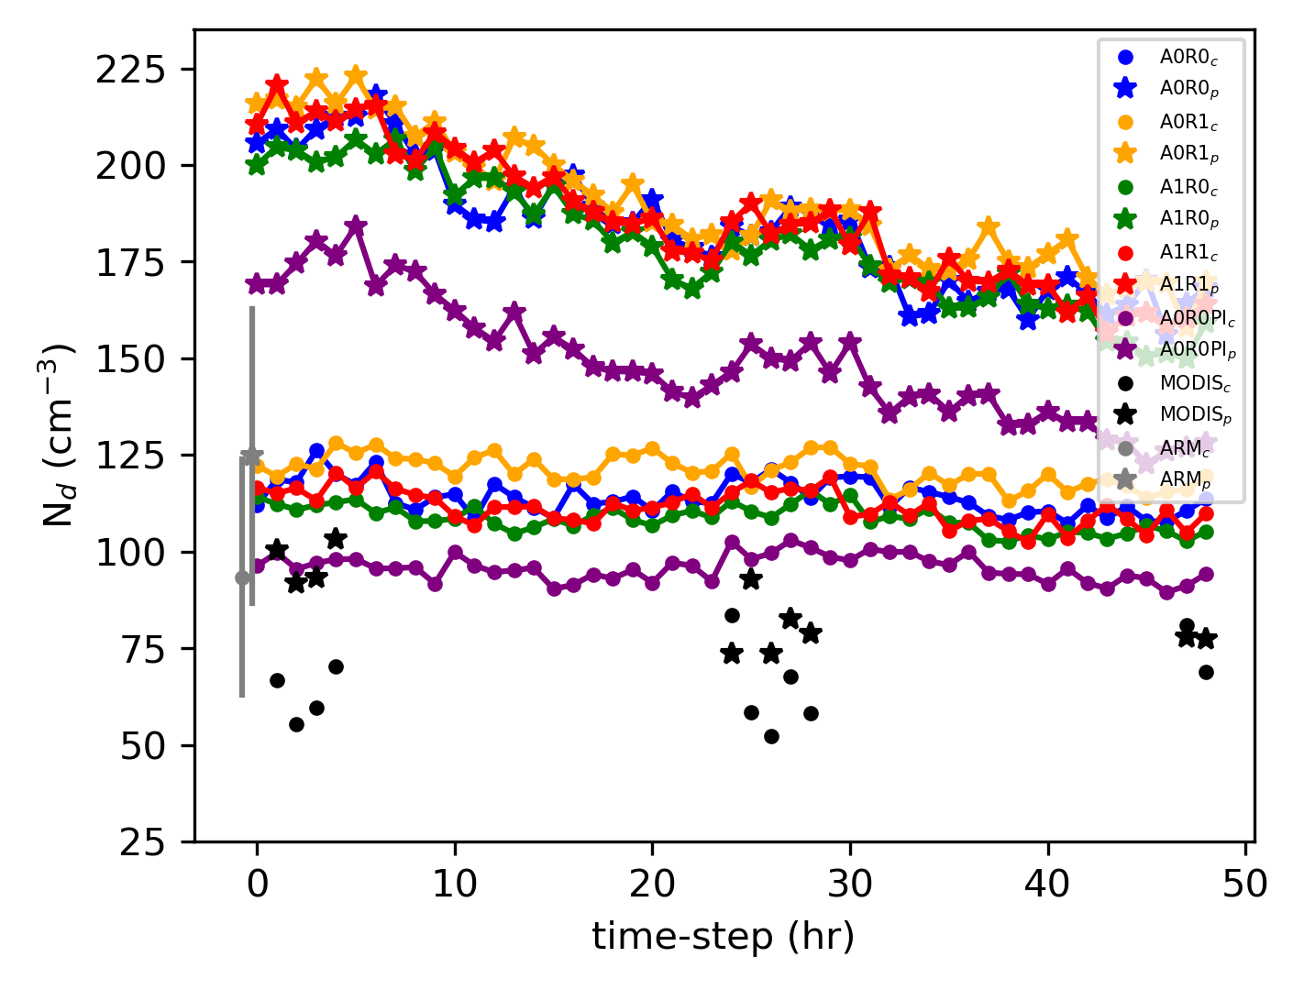
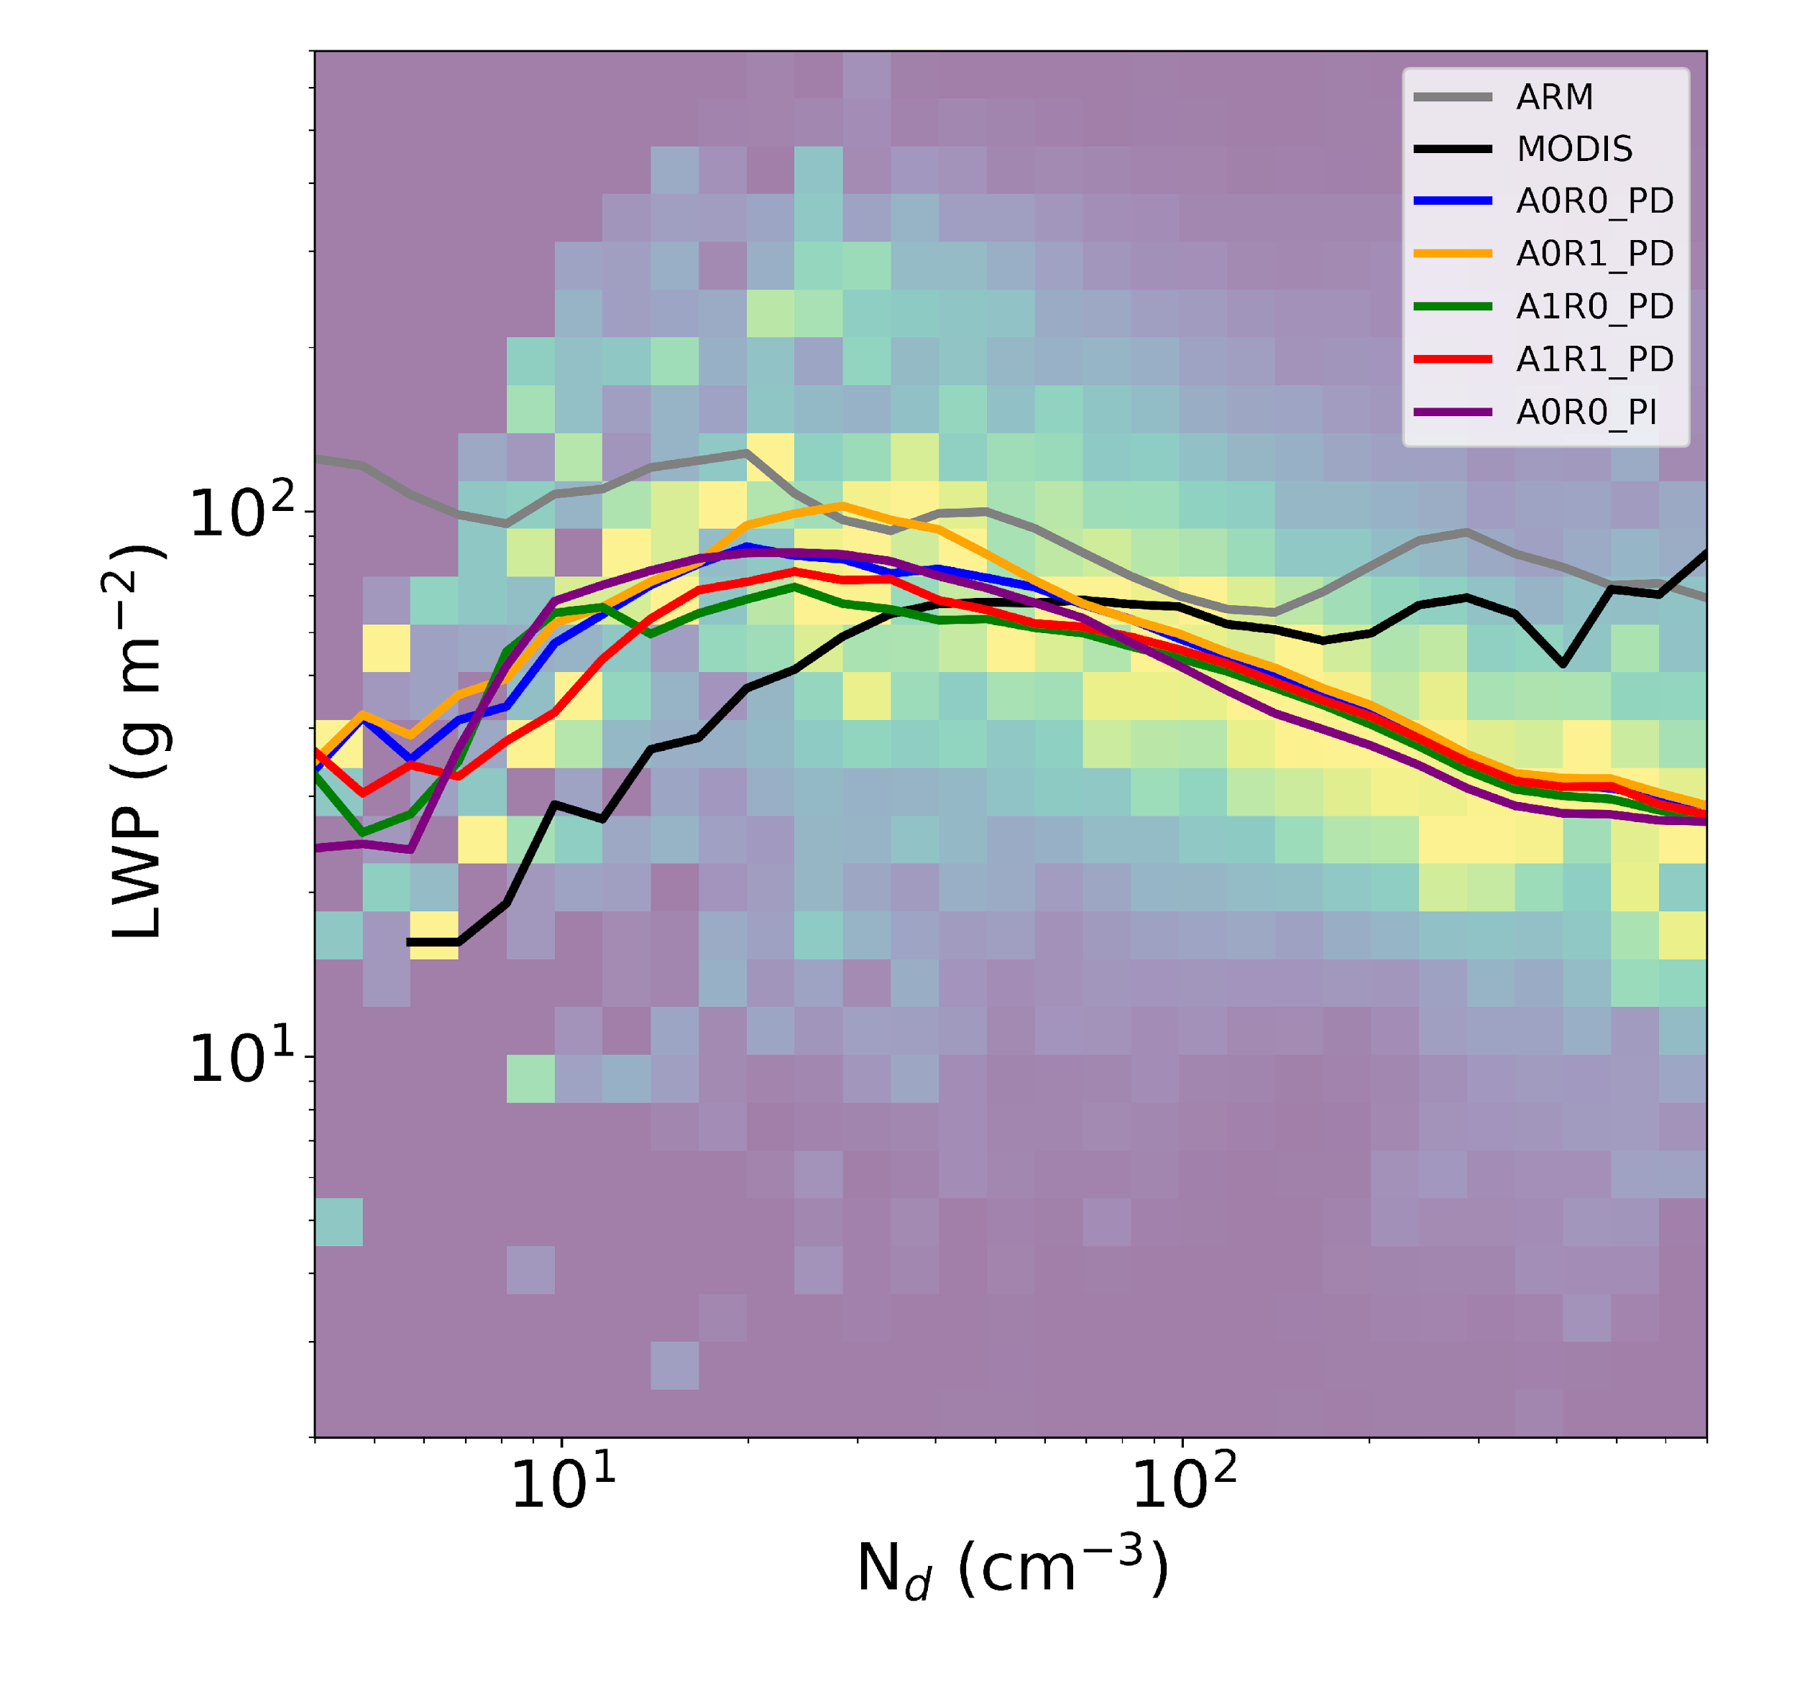
LWP-N_{d} Relationship Christensen et al (2023), ACP
Polluted (p) CCN > 113 #/cm³
Clean (c) CCN < 113 #/cm³
clean
polluted
Polluted clouds have larger droplet concentrations for up to 2-days.
E3SMv1 captures N_{d}-LWP relationship but it is not sensitive to warm-rain experiments.
Positive bias simulated in E3SMv1 N_{d} with respect to observations.
Polluted clouds are too thin in E3SM.

Slide 8
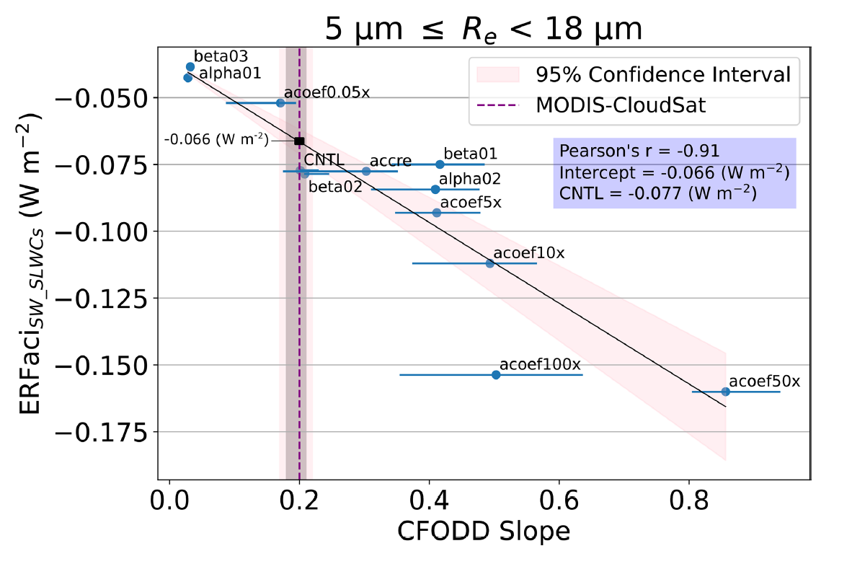
ERFaci Constraint using Contoured Frequency by Optical Depth (CFODD) Analysis Beall et al (2024), ACP
New Constraint for ERFaci
Slope of the CFODD provides and estimate of cloud droplet collection efficiency in single-layer warm liquid clouds.
Derived from millions of retrievals of cloud optical properties from MODIS and CloudSat global observations.
E3SMv2 droplet collection efficiencies and ERFaci are highly sensitive to autoconversion.
E3SMv2 CFODD slope (0.2 ± 0.04) is in agreement with observations (0.2 ± 0.03). The model represents boundary cloud processes with sufficient skill to make accurate predictions of ACI.

Slide 9
Summary
The EAGLES project has created a suite of observational metrics and diagnostics.
ESMAC Diags combining a suite of aircraft, satellite, and ARM data from permanent and mobile sites.
Aggregated ARM and satellite datasets and tools to compute adiabaticity and radiative forcing
Lagrangian tools to evaluate temporal changes in cloud and aerosol processes.
New constraints on ERFaci from A-train satellite sensors.
These new metrics have been used to diagnose model deficiencies and advance parameterizations necessary for improving E3SM predictions of aerosol and ACI across scales.
Polluted clouds have larger droplet concentrations for up to 2-days.
E3SM captures N_{d}-LWP relationship but it is not sensitive to warm-rain experiments.
Positive bias simulated in E3SMv1 N_{d} with respect to observations.
Polluted clouds are too thin in E3SM.
E3SMv2 appears to have opposite liquid water path Nd relationship to v1.
Subadiabatic clouds are highly prevalent compared to observations.

