Slide 1








Can the salt-advection feedback be detected in decadal AMOC variability?
^{1,2}Wei Cheng, ³Wilbert Weijer, ⁴Who Kim, ⁴Gokhan Danabasoglu, ⁴Steve Yeager,
⁴Peter Gent, ^{1,2}Dongxiao Zhang, ⁵John Chiang, ³Jiaxu Zhang
¹ Univ. of Washington/JISAO, ² NOAA/Pacific Marine Environmental Laboratory
³ Los Alamos National Laboratory
⁴ National Center for Atmospheric Research
⁵ University of California Berkeley
funding from NOAA CVP and DOE RGMA programs
AGU ocean science meeting, Feb 14, 2018, Portland, OR

Slide 2
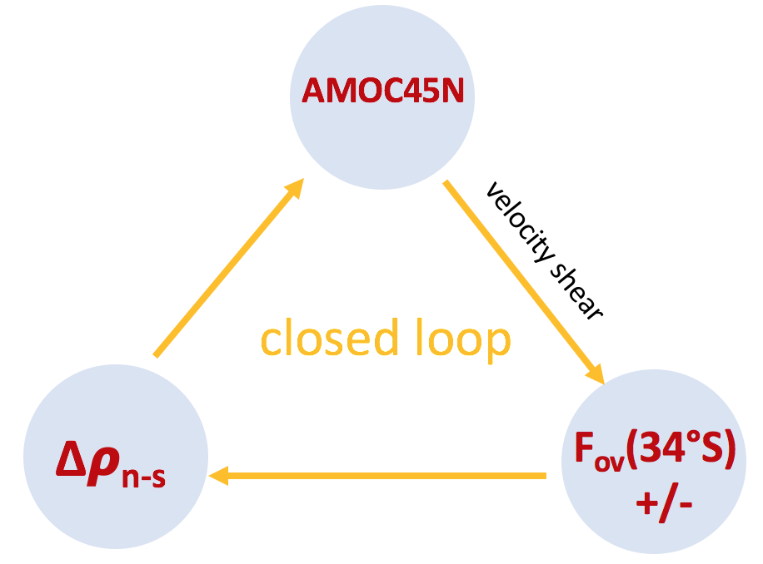
AMOC stability likely involves the salt-advection feedback. Here we examine the key physical links underlying salt-advection feedback in internal variability of the AMOC.

Slide 3
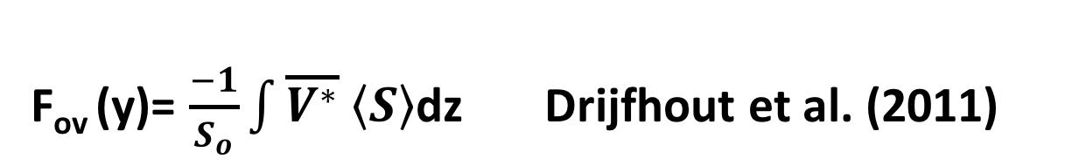
F_{ov} (y)= $\frac{−1}{S_{o}}\int{\overline{V^{∗}} \left\langle S\right\rangle }$dz Drijfhout et al. (2011)
F_{ov}(y) – F_{ov} as a function of latitude
F_{ov}(34°S) – F_{ov} (y) at 34°S, the southern boundary of the Atlantic Ocean
ESMs : GFDL-ESM2M and CESM1, 1° ocean, pre-industrial control simulations in CMIP5 archive, monthly mean fields

Slide 4


Background mean state
$$\overline{V^{∗}}$$
$$\left\langle S\right\rangle −35$$
F_{ov}

Slide 5
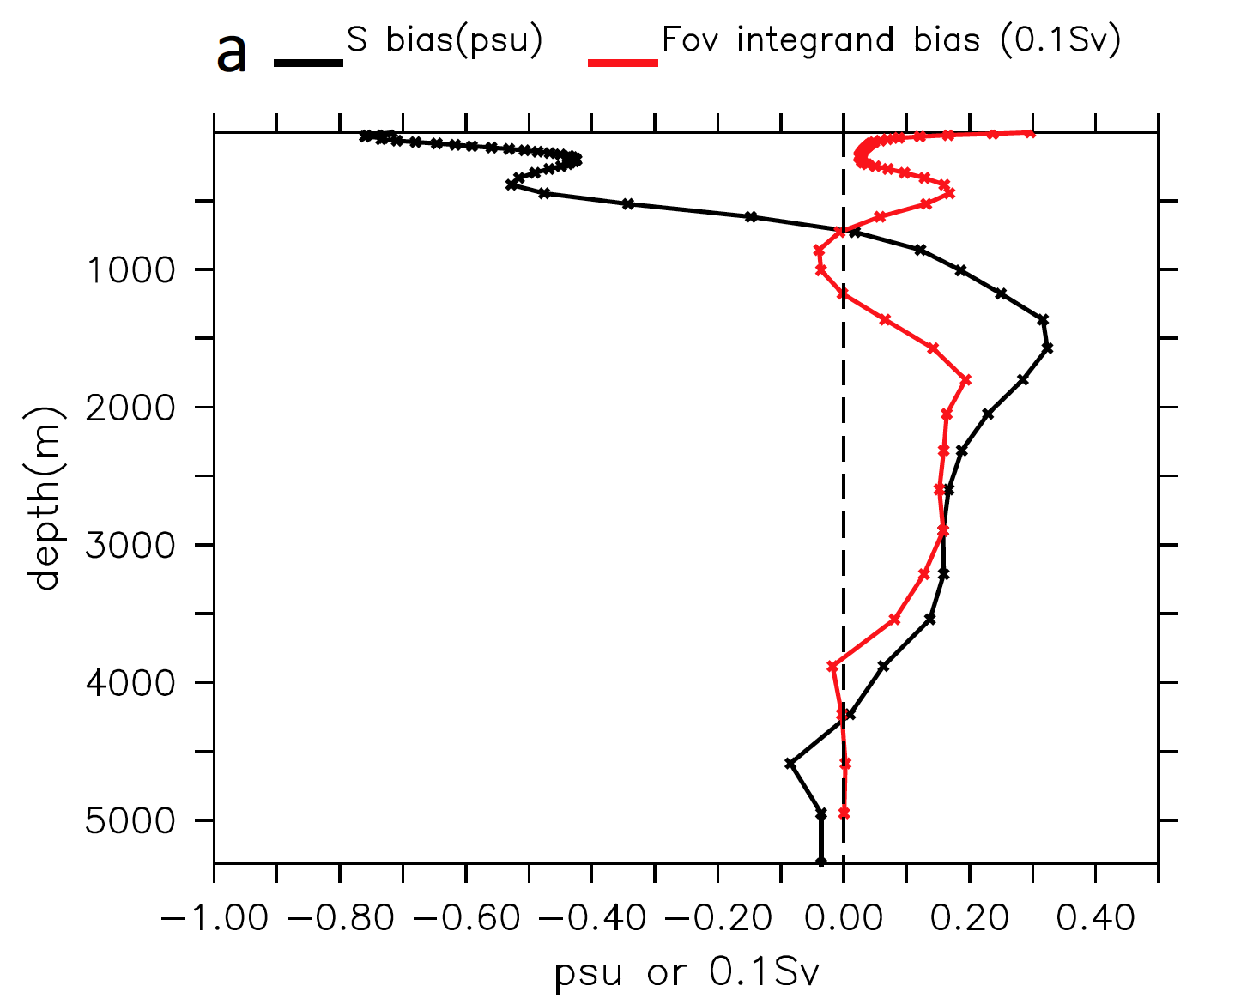

Slide 6
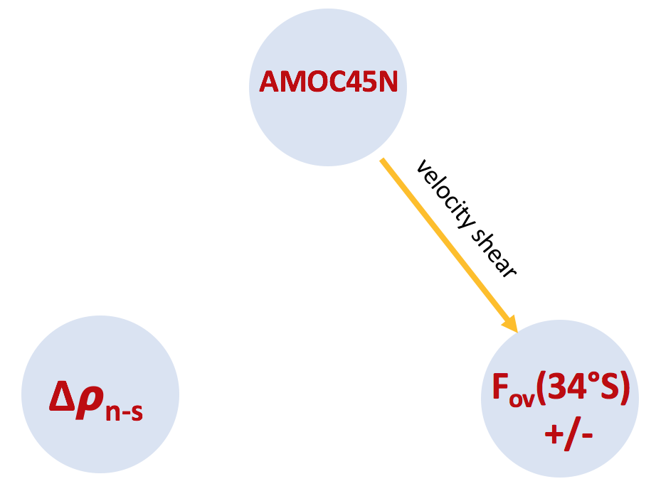
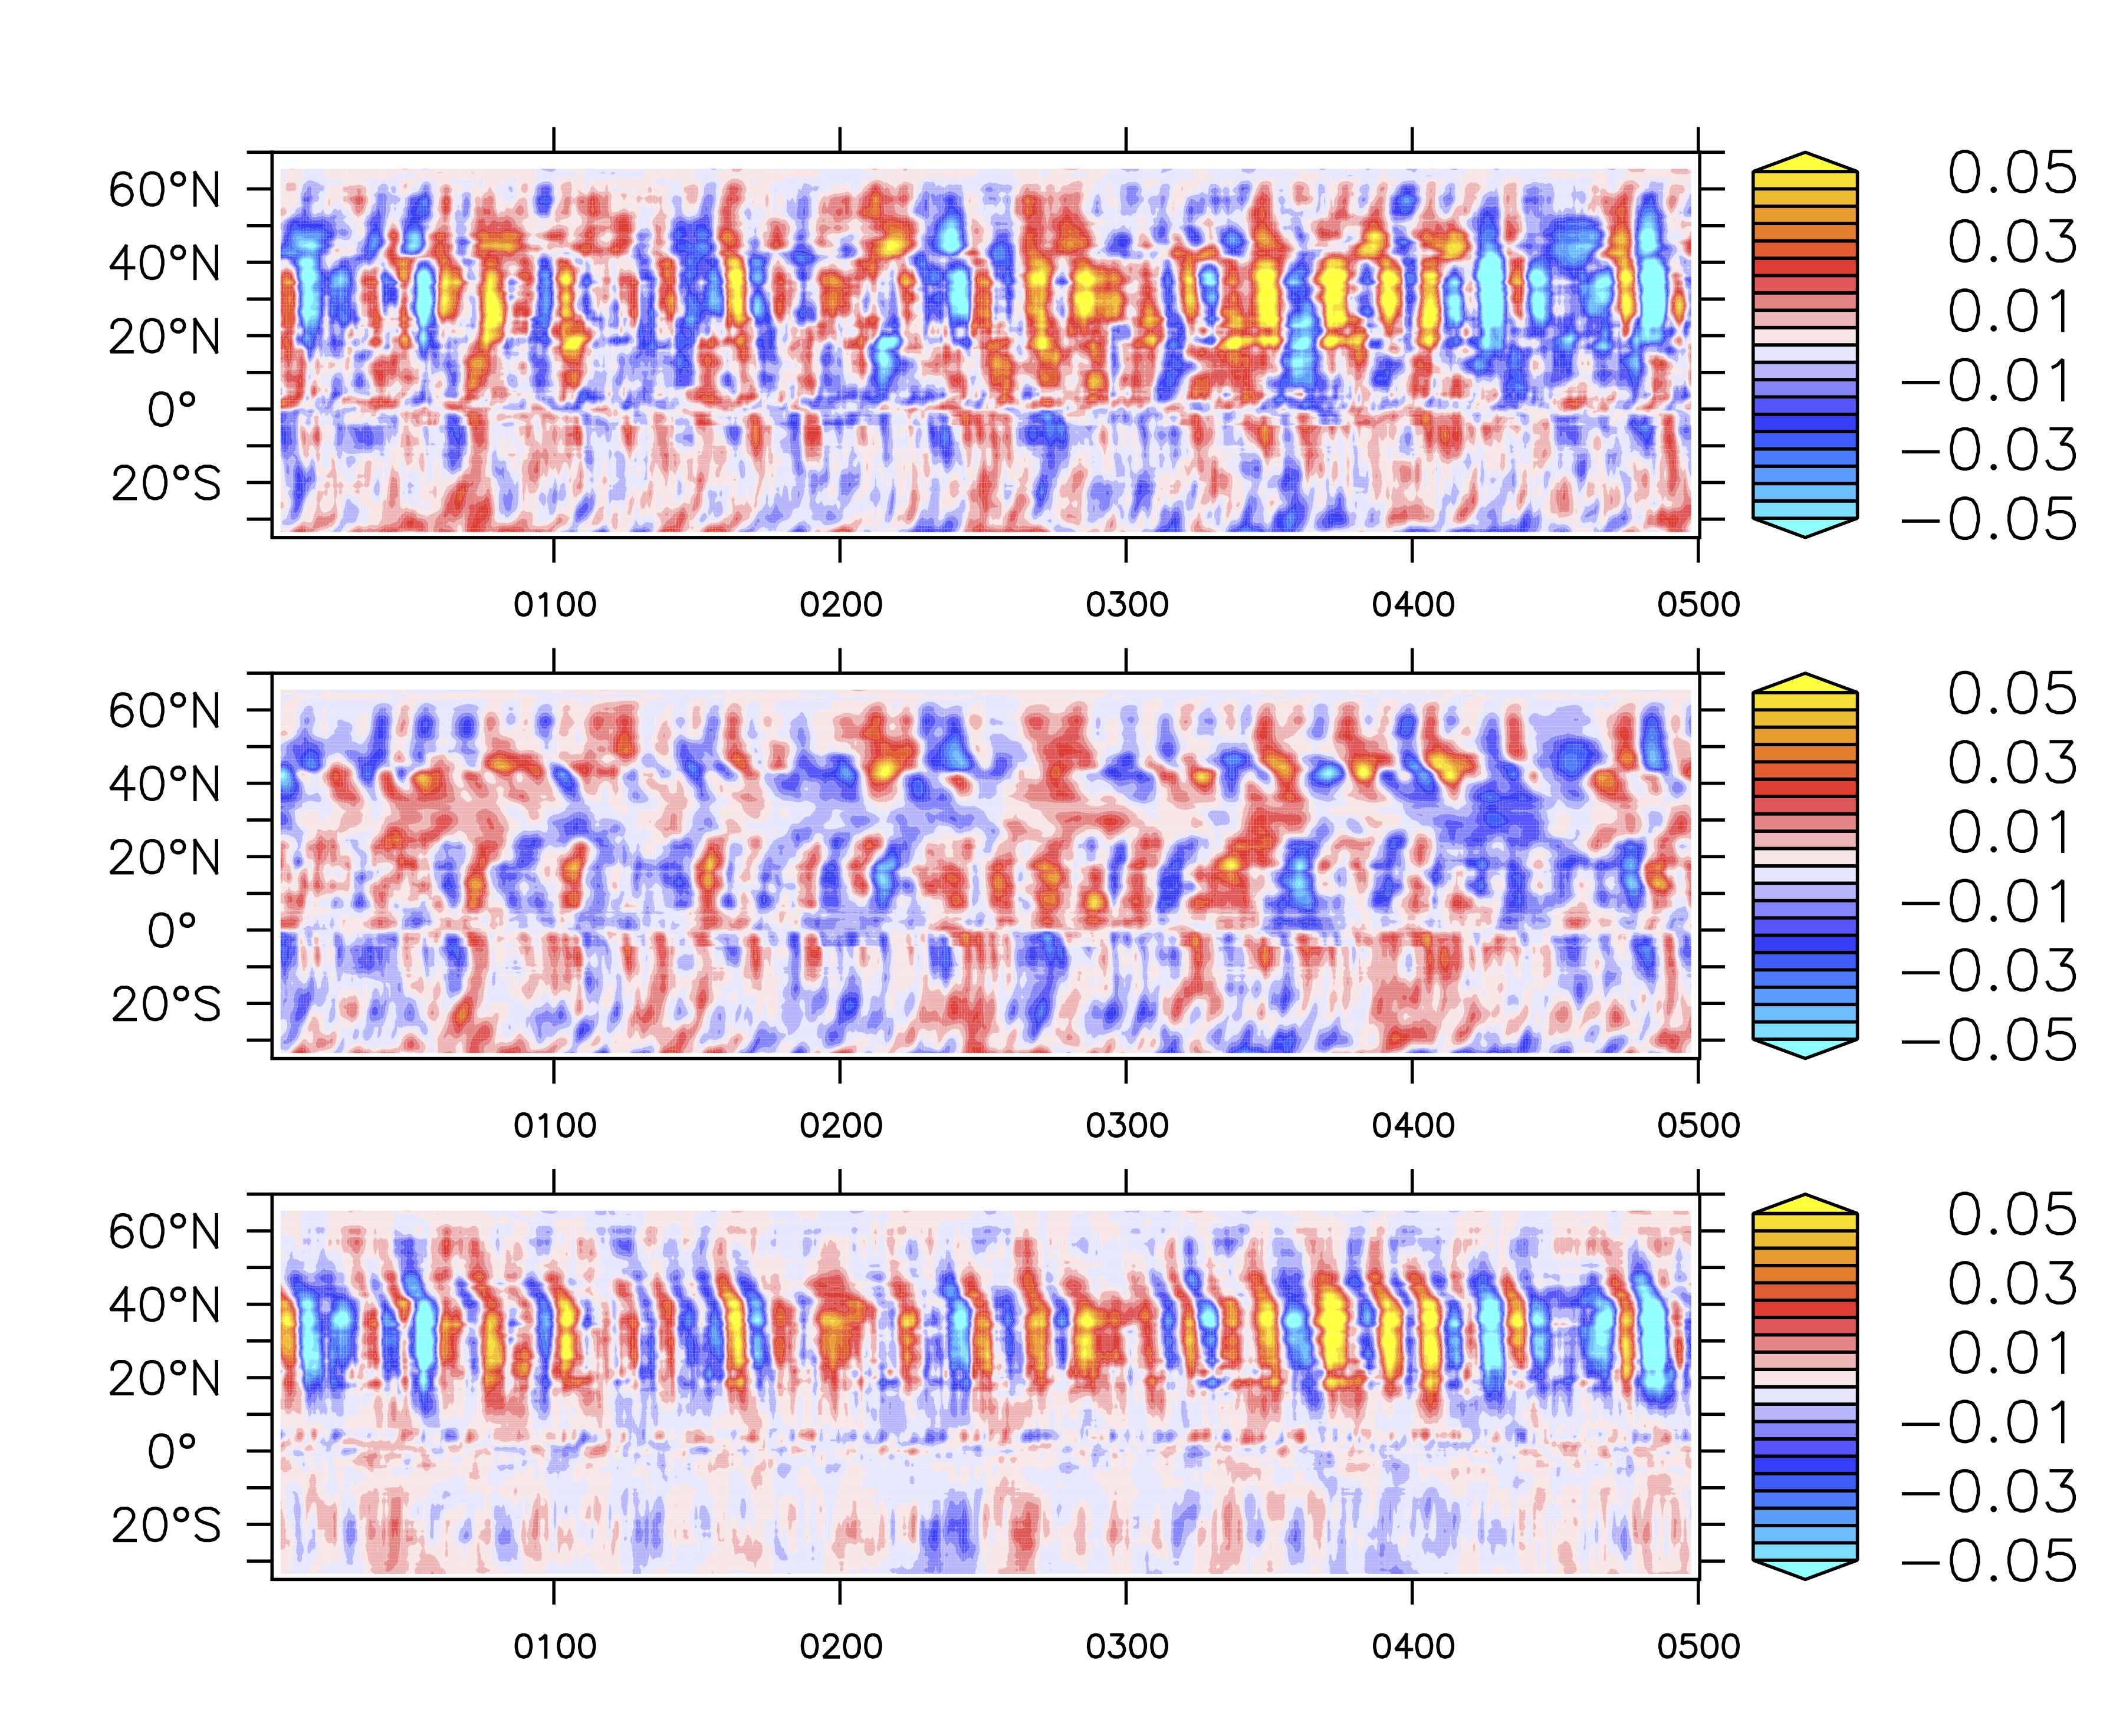
link 1: AMOC controls F_{ov}(34°S) via v
concl: S’ dominates Fov’ except 20°N-45°N
F_{ov}(y) anomaly decomposition
ESM2M
F_{ov}’
from S’
from v’

Slide 7
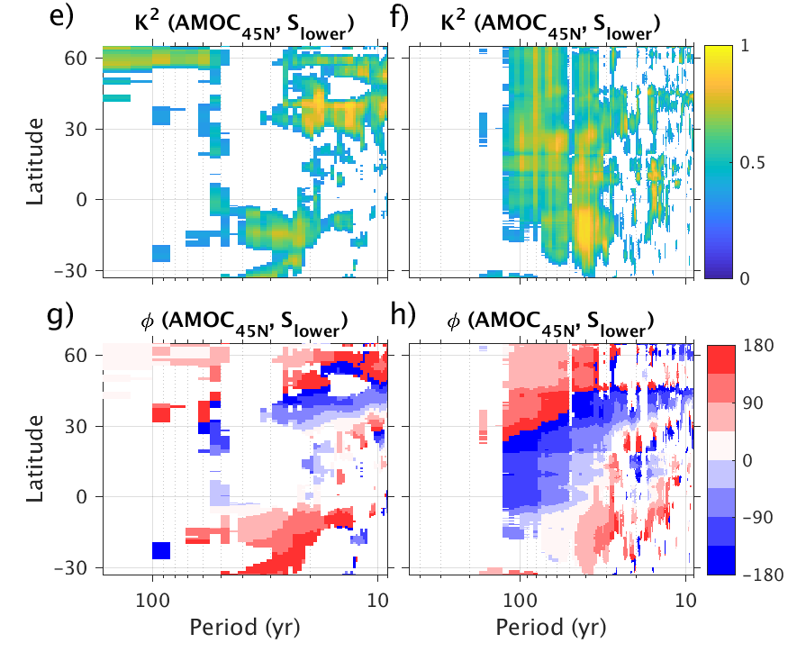
link 1: AMOC controls F_{ov}(34°S) via v
concl: AMOC influences salinity stratification
ESM2M
CESM1
coherence²
(AMOC45N, S_{lower}(y))
phase

Slide 8
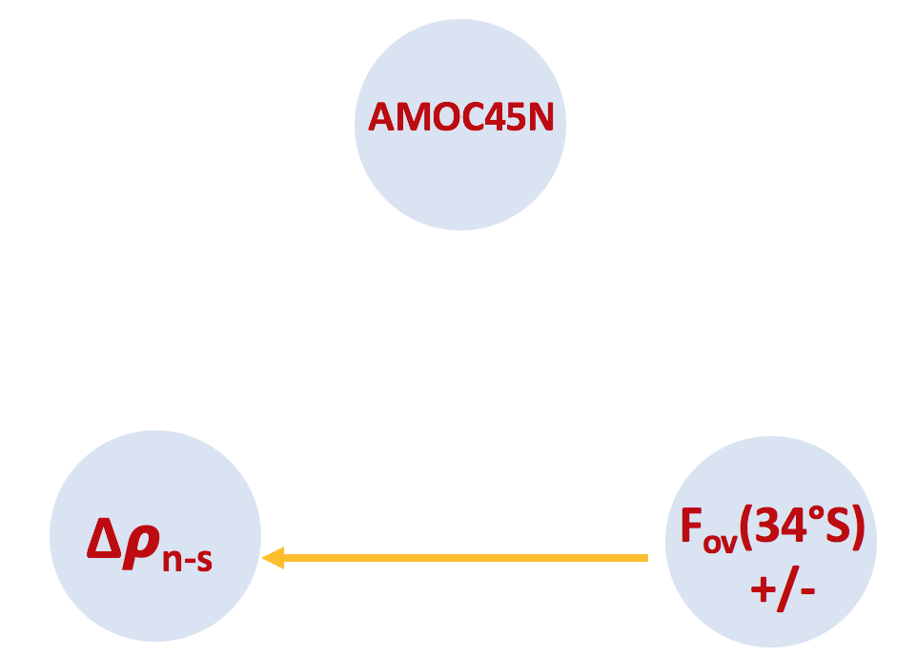
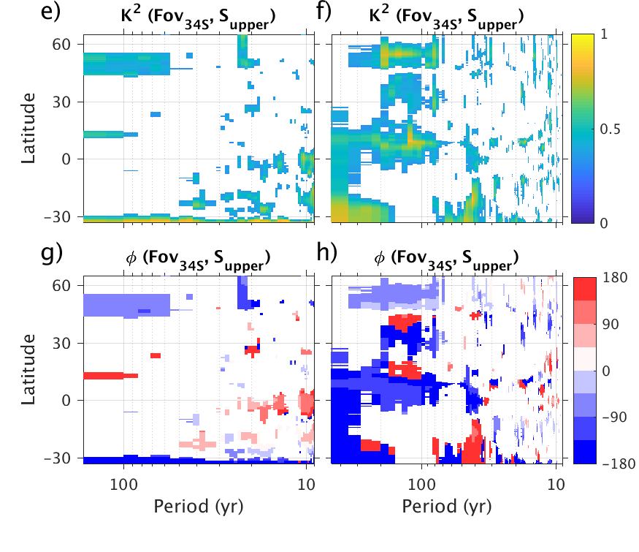
link 2: F_{ov}(34°S) influences Δ𝛒_{n-s}
concl: no such link is detected
ESM2M
CESM1
coherence²
(F_{ov}(34°S), S_{upper}(y))
phase

Slide 9
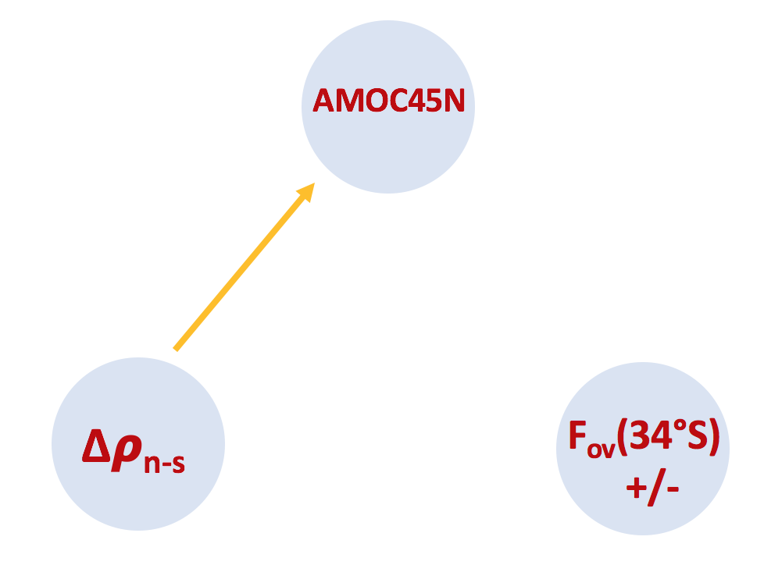
link 3: Δ𝛒_{n-s} influences AMOC variability
0-4km

Slide 10
However, north dominates Δ𝛒_{n-s}
Black line: ΔS_{n-s}
Red line: S_{north}
Red line: S_{south}
ESM2M
CESM
EN4

Slide 11
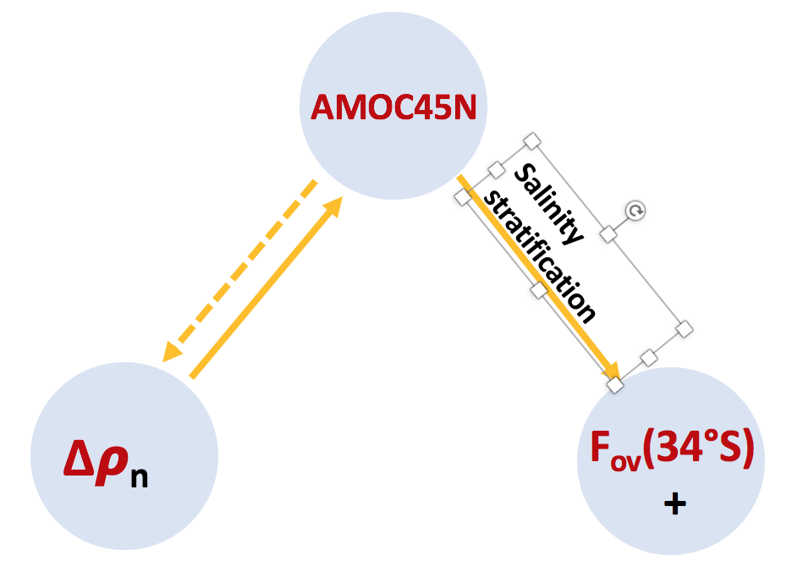
key links of salt-advection
feedback
links found in AMOC decadal and longer variability

Slide 12
Conclusions
As in other ESMs, salinity bias in GFDL-ESM2M and CESM1 causes a positive bias in Fov(34°S). All layers (thermocline, intermediate, deep water) contribute to this positive bias.
Variability in Fov(y) is dominated by salinity variation except in 20°N–45°N. North Atlantic (NA) AMOC impacts Fov in the South Atlantic (SA) through salinity perturbation.
Variability in density difference between NA and SA is dominated by NA density variations, SA contribution is negligible in comparison.
In the context of low frequency internal variability, feedbacks from Fov (34°S) on NA AMOC cannot be detected. This missing link prevents the feedback loop from closing.

Slide 13
link 1: AMOC controls F_{ov}(34°S) via v
concl: S’ dominates Fov’ except 20°N-45°N
F_{ov}(34°S) anomaly decomposition

