Slide 1
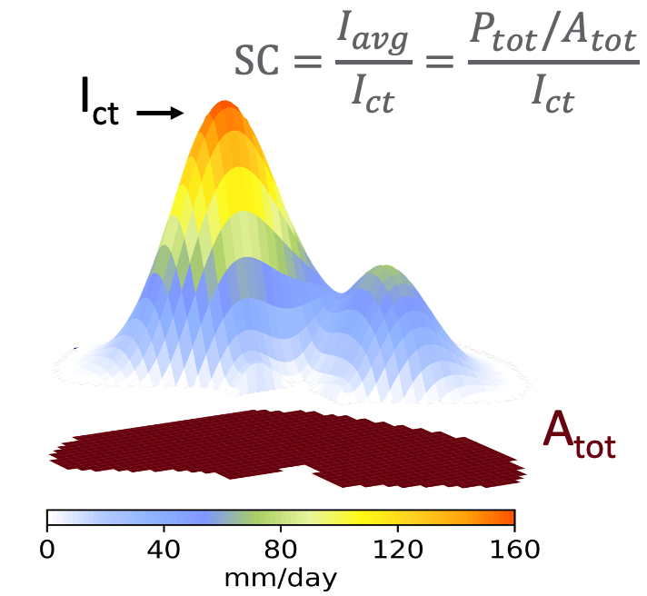
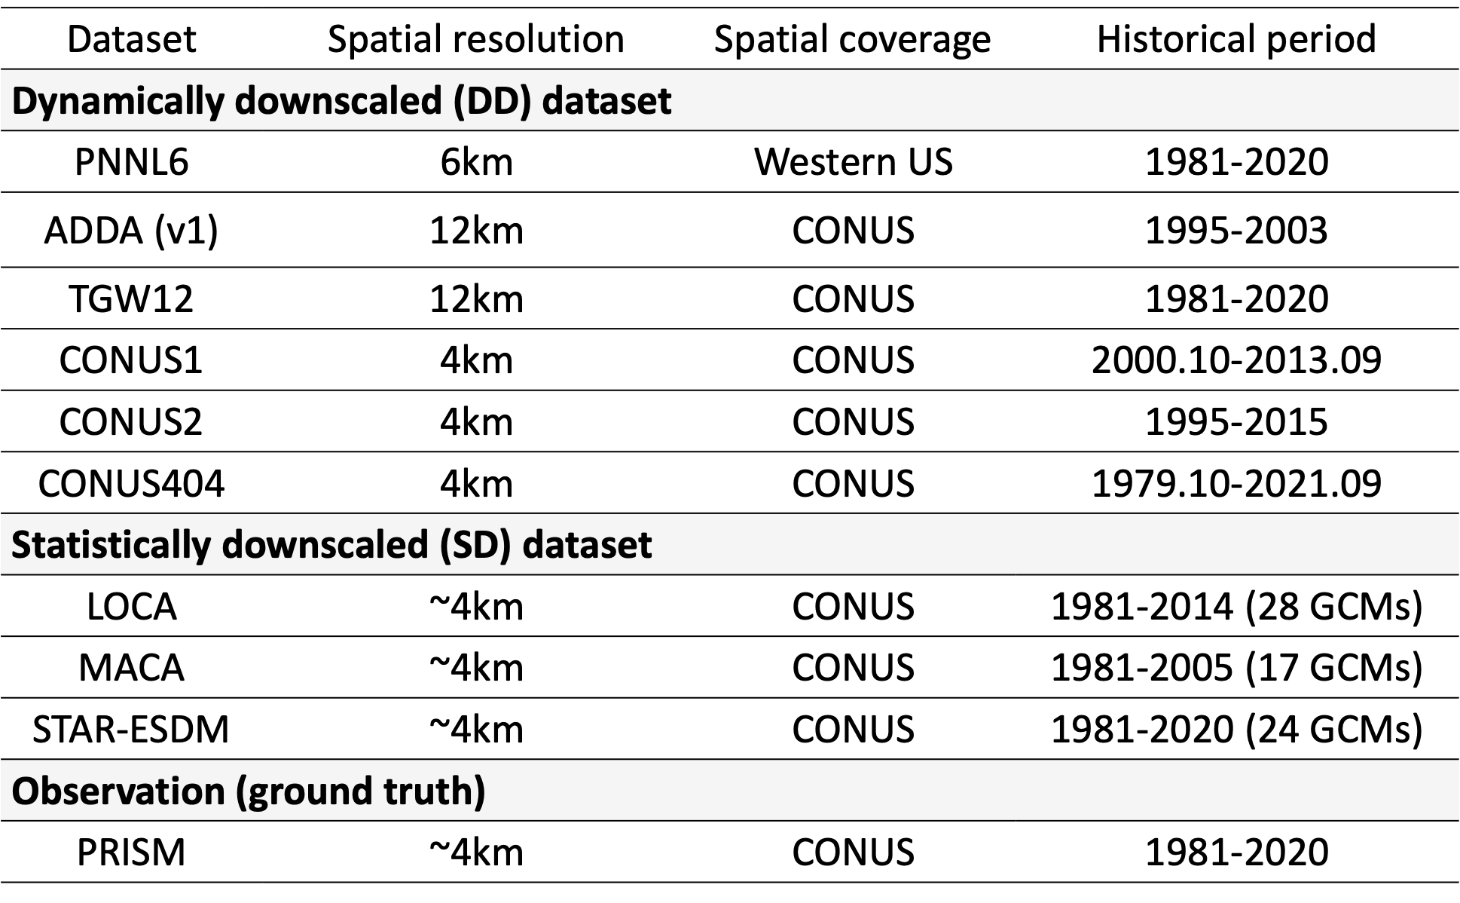
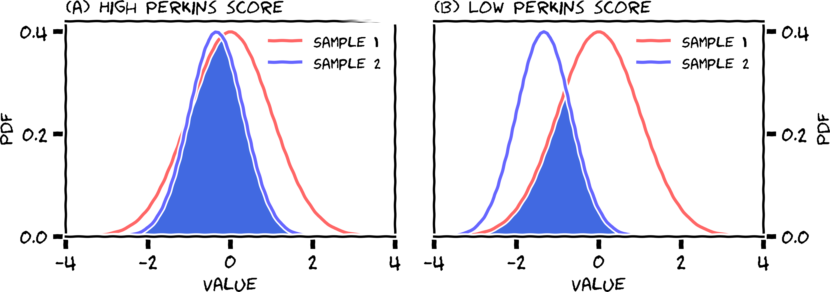
Object-Based Evaluation of Downscaled Precipitation Products Over CONUS – Xiaodong Chen, Ruby Leung, and Paul Ullrich
Precipitation object metrics
Daily precipitation datasets
Perkins score
Performance evaluated across US regions
(Poster Wed-116)

