Slide 1
Do GHG and aerosol forcings influence Pacific decadal variability?
CESM2 full-forcing large ensemble
EOF1: the Pacific Decadal Oscillation (PDO) mode
SST
Chen Xing, Samantha Stevenson, Emanuele Di Lorenzo, Matthew Newman, Antonietta Capotondi, John Fasullo, Nicola Maher
EOF2: the North Pacific Gyre Oscillation (NPGO) mode
SST
Notes:
Pacific Decadal variability impacts global climate and ecosystems,
Understanding its response to anthropogenic forcing is crucial for improving predictions of PDV; however, this response remains unclear.
In this study, we used CESM2 large ensemble in full forcing and single forcing simulations to analysis PDV responses.
The two leading EOF modes in Pacific show a PDO-like mode and a NPGO-like mode, consistent to observation.
Those are the major two PDV modes we are gonna focus on in this study

Slide 2
Do GHG and aerosol forcings influence Pacific decadal variability?
Are there long-term responses in PDV?
PC time series in CESM2 full-forcing
The PDO-like mode
The NPGO-like mode
The PDV definition: Removing global mean SST before applying the EOF
Long-term responses represented by the ensemble mean
Notes:
First, we are curious of whether anthropogenic forcing impact long-term response of PDV.
Here we applied a commonly used PDV definition, by removing global mean SST before the EOF.
We observed strong responses in ensemble mean of both modes.
There is a peak phase around 1980 followed by a decreasing trend
It looks like it is closed to the mean state changes driven by GHGs and anthropogenic aerosols.

Slide 3
Do GHG and aerosol forcings influence Pacific decadal variability?
Are there long-term responses in PDV?
The leading EOF of each single forcing ensemble mean SST to represent the mean state change
PC in CESM2 full-forcing
CESM2- GHG single forcing
SST
CESM2-AAER single forcing
SST
Mean state changes from GHG or aerosol forcing could explain the long-term response changes in PDV
Notes:
Here the single forcing mean state change is represented by the leading EOF pattern of each single forcing ensemble mean SST
It shows strong impact on tropical and North Pacific SST, especially in aerosol simulations.
Based on both time series and SST mean state patterns, we found SST mean state changes from combination of GHG and aerosols could explain the long-term responses
And it is more pronounced in NPGO-ish mode

Slide 4
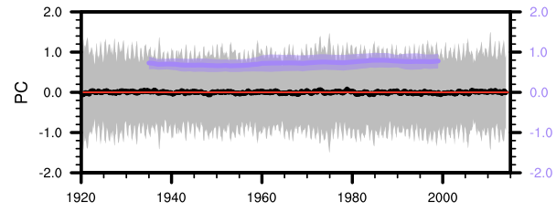
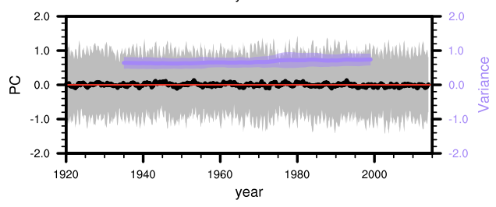
Do GHG and aerosol forcings influence Pacific decadal variability?
Is variability changed?
PC1 in CESM2 full-forcing
CESM2 full-forcing large ensemble
EOF1: the Pacific Decadal Oscillation (PDO) mode
SST
30-year moving variance
PC2 in CESM2 full-forcing
EOF2: the North Pacific Gyre Oscillation (NPGO) mode
SST
30-year moving variance
The variabilities remain unchanged after removing the ensemble mean
Ensemble mean is removed before applying the EOF
Solid line: ensemble mean; Shading: one STD across ensembles
Notes:
In addition to changes in long-term, we also examined PDV variability changes
We removed ensemble mean before applying EOF to get rid of the mean state changes impact.
The results show that no significant changes in the variabilities of both modes, whether in full forcing or single forcing.

Slide 5
Take home message:
PC time series using traditional method
Long-term responses of PDV are related to mean state changes from anthropogenic forcings.
While the variability of Pacific decadal variability is not changing from anthropogenic forcings.
Forced mean-state trends is critical for capturing the historical behavior of PDV in model simulations.
PC time series, ensemble mean removed first
30-year moving variance

