Slide 1
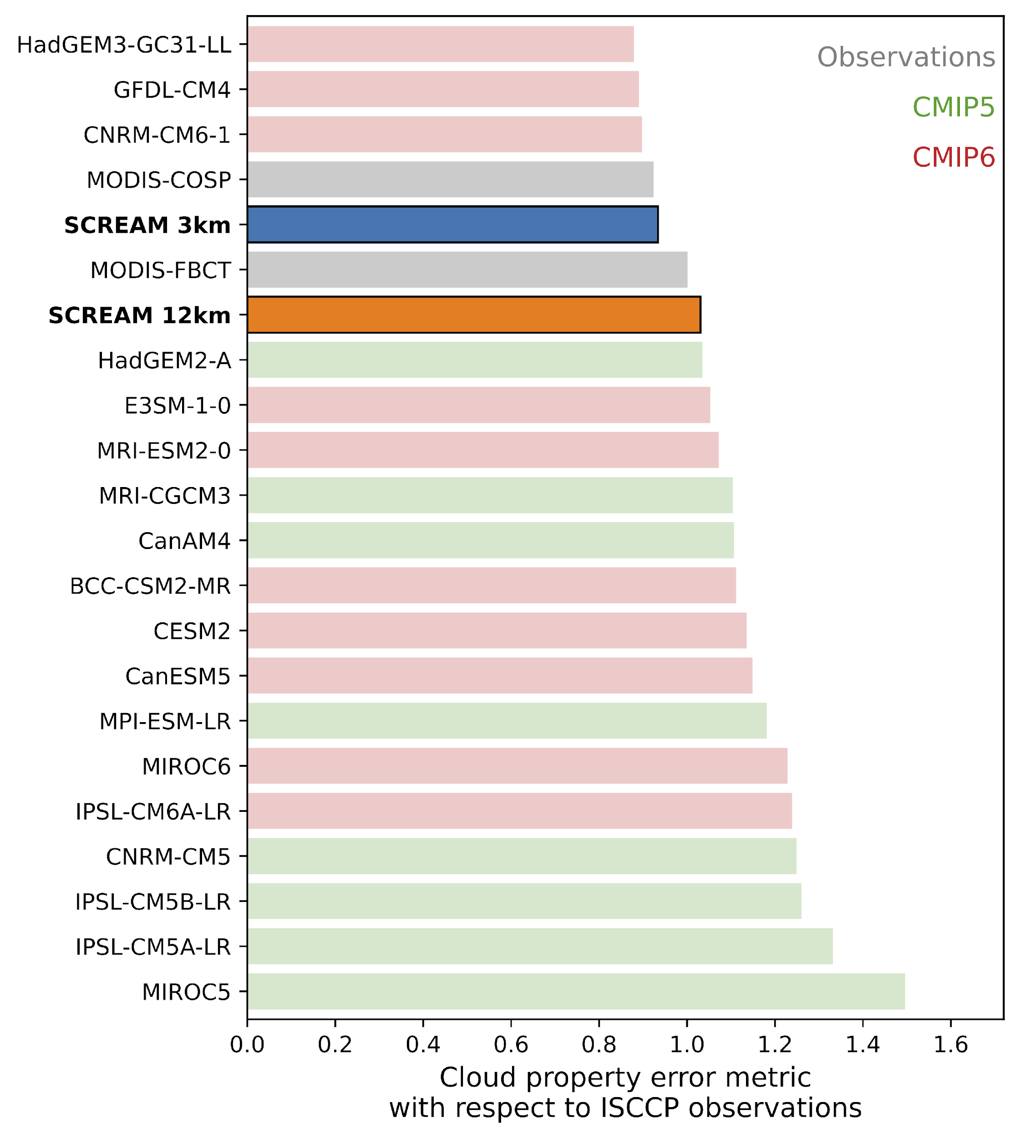
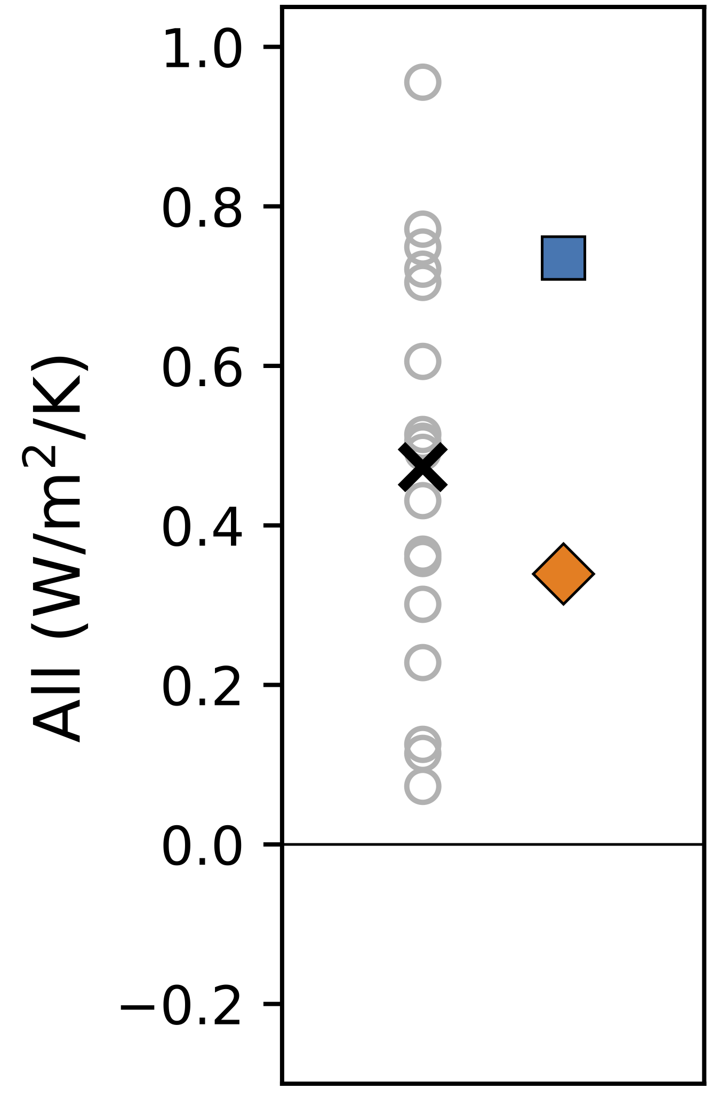
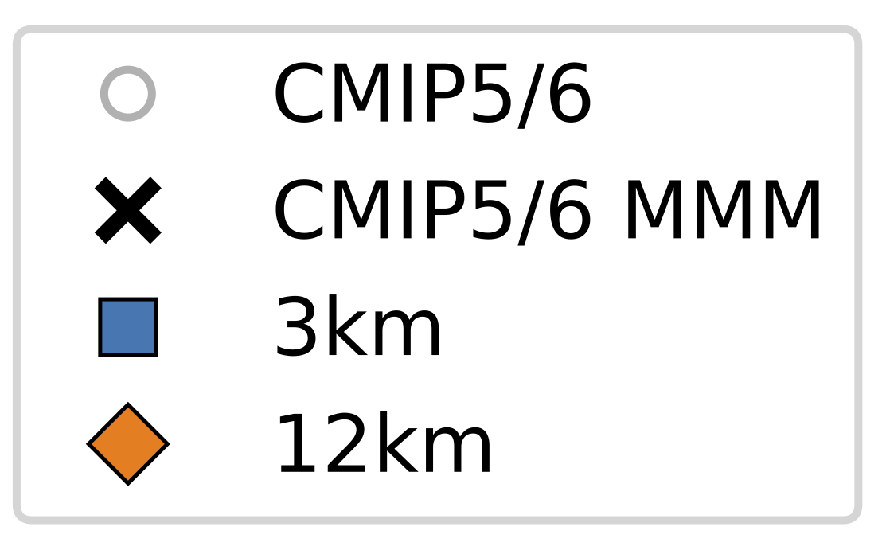
Examining Cloud Properties and Cloud Feedbacks in DOE’s Global Storm Resolving Model (SCREAM)
¹Lawrence Livermore National Laboratory,
²Sandia National Laboratories,
³Lawrence Berkeley National Laboratory
Li-Wei Chao¹, Mark Zelinka¹, Christopher Terai¹, Hassan Beydoun¹, Benjamin Hillman², Noel Keen³, Peter Caldwell¹, Stephen Klein¹
(a)
Motivations:
Cloud feedback may be poorly represented in traditional global climate models due to their coarse resolution
This study examines how and why the cloud feedbacks in the high-resolution Simple Cloud Resolving E3SM Atmosphere Model (SCREAM) differ from coarse climate models.
Key findings:
The present-day mean state of cloud properties is well reproduced in SCREAM, with biases smaller than most CMIP models
SCREAM simulates a positive total cloud feedback that lies within the range of CMIP models
(b)
We thank the Regional & Global Model Analysis Program of the Earth & Environmental Systems Sciences Division of the U.S. Department of Energy for supporting this work. This work was performed under the auspices of the DOE by Lawrence Livermore National Laboratory under Contract DE-AC52-07NA27344. LLNL-POST-867647

