Slide 1
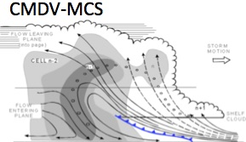
Use of Remote Sensing and In-Situ Observations to Develop and Evaluate Improved Representations of Convection and Clouds for the ACME Model
Climate Model Development and Validation (CMDV)
Steve Ghan and Jiwen FAN
Pacific Northwest National Laboratory
Richland, Washington
Task leaders
M. Ovchinnikov, W. Gustafson, L. Riihimaki, P. Rasch, E. Roesler, S. Giangrande, D. Randall, V. Larson, X. Dong, X. Liu

Slide 2
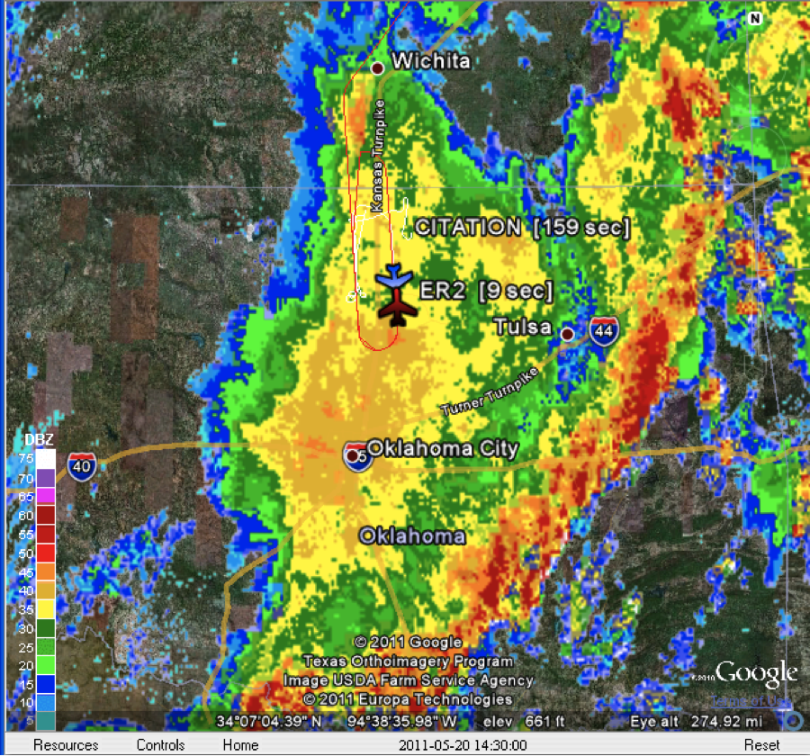




Motivation
Mesoscale convective systems (MCSs) play important roles in the energy and water cycles.
GCMs do not capture MCS features.
The Great Plains of the U.S. provide an excellent venue for studying continental propagating MCSs.

Slide 3
Hypotheses
GCM simulations including horizontal advection of key sub-grid properties of convective cloud systems will simulate MCS propagation better
MCS features, precipitation PDF and extremes, cloud phase, cloud radiative forcing, and aerosol-cloud interactions will be simulated much better with an improved treatment of ice nucleation and variable width of hydrometeor size distribution
Parameterizations tested over the central U.S. and Amazon will simulate clouds better elsewhere

Slide 4
Objectives and deliverables
Goal: Improve understanding and simulations of MCS features in large-scale models
Deliverables: Convection and cloud microphysics parameterizations for GCMs that yield better simulations of meso-scale phenomena

Slide 5
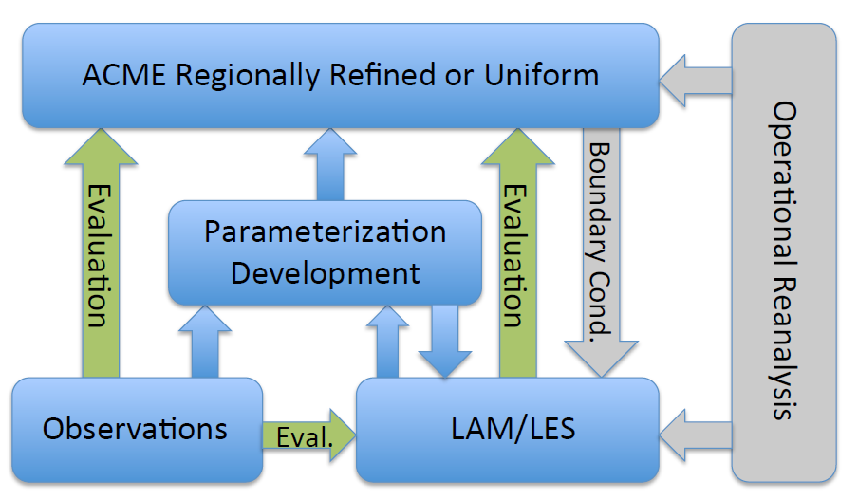
Strategy
Use observations and cloud-resolving and large eddy simulations to develop and evaluate cloud parameterizations.
Evaluate parameterizations using ACME with a regionally-refined grid centered over the ARM SGP site.
Use additional global observational data to evaluate ACME uniform-grid simulations.

Slide 6
Development of convection parameterizations
Convection parameterizations
CLUBB-SILHS
Q3D-MMF

Slide 7
Development of cloud microphysics parameterizations
Cloud microphysics parameterizations
Bulk scheme
Spectral-bin model (SBM)
Ice nucleation

Slide 8
Foundational work for evaluation
Observations from ARM IOPs (MC3E and PECAN), NOAA NEXRAD, and satellites
Develop new retrieved products
Foundational work
Instrument simulators and samplers
LES and LAM simulations
LES/LAM diagnostics

Slide 9
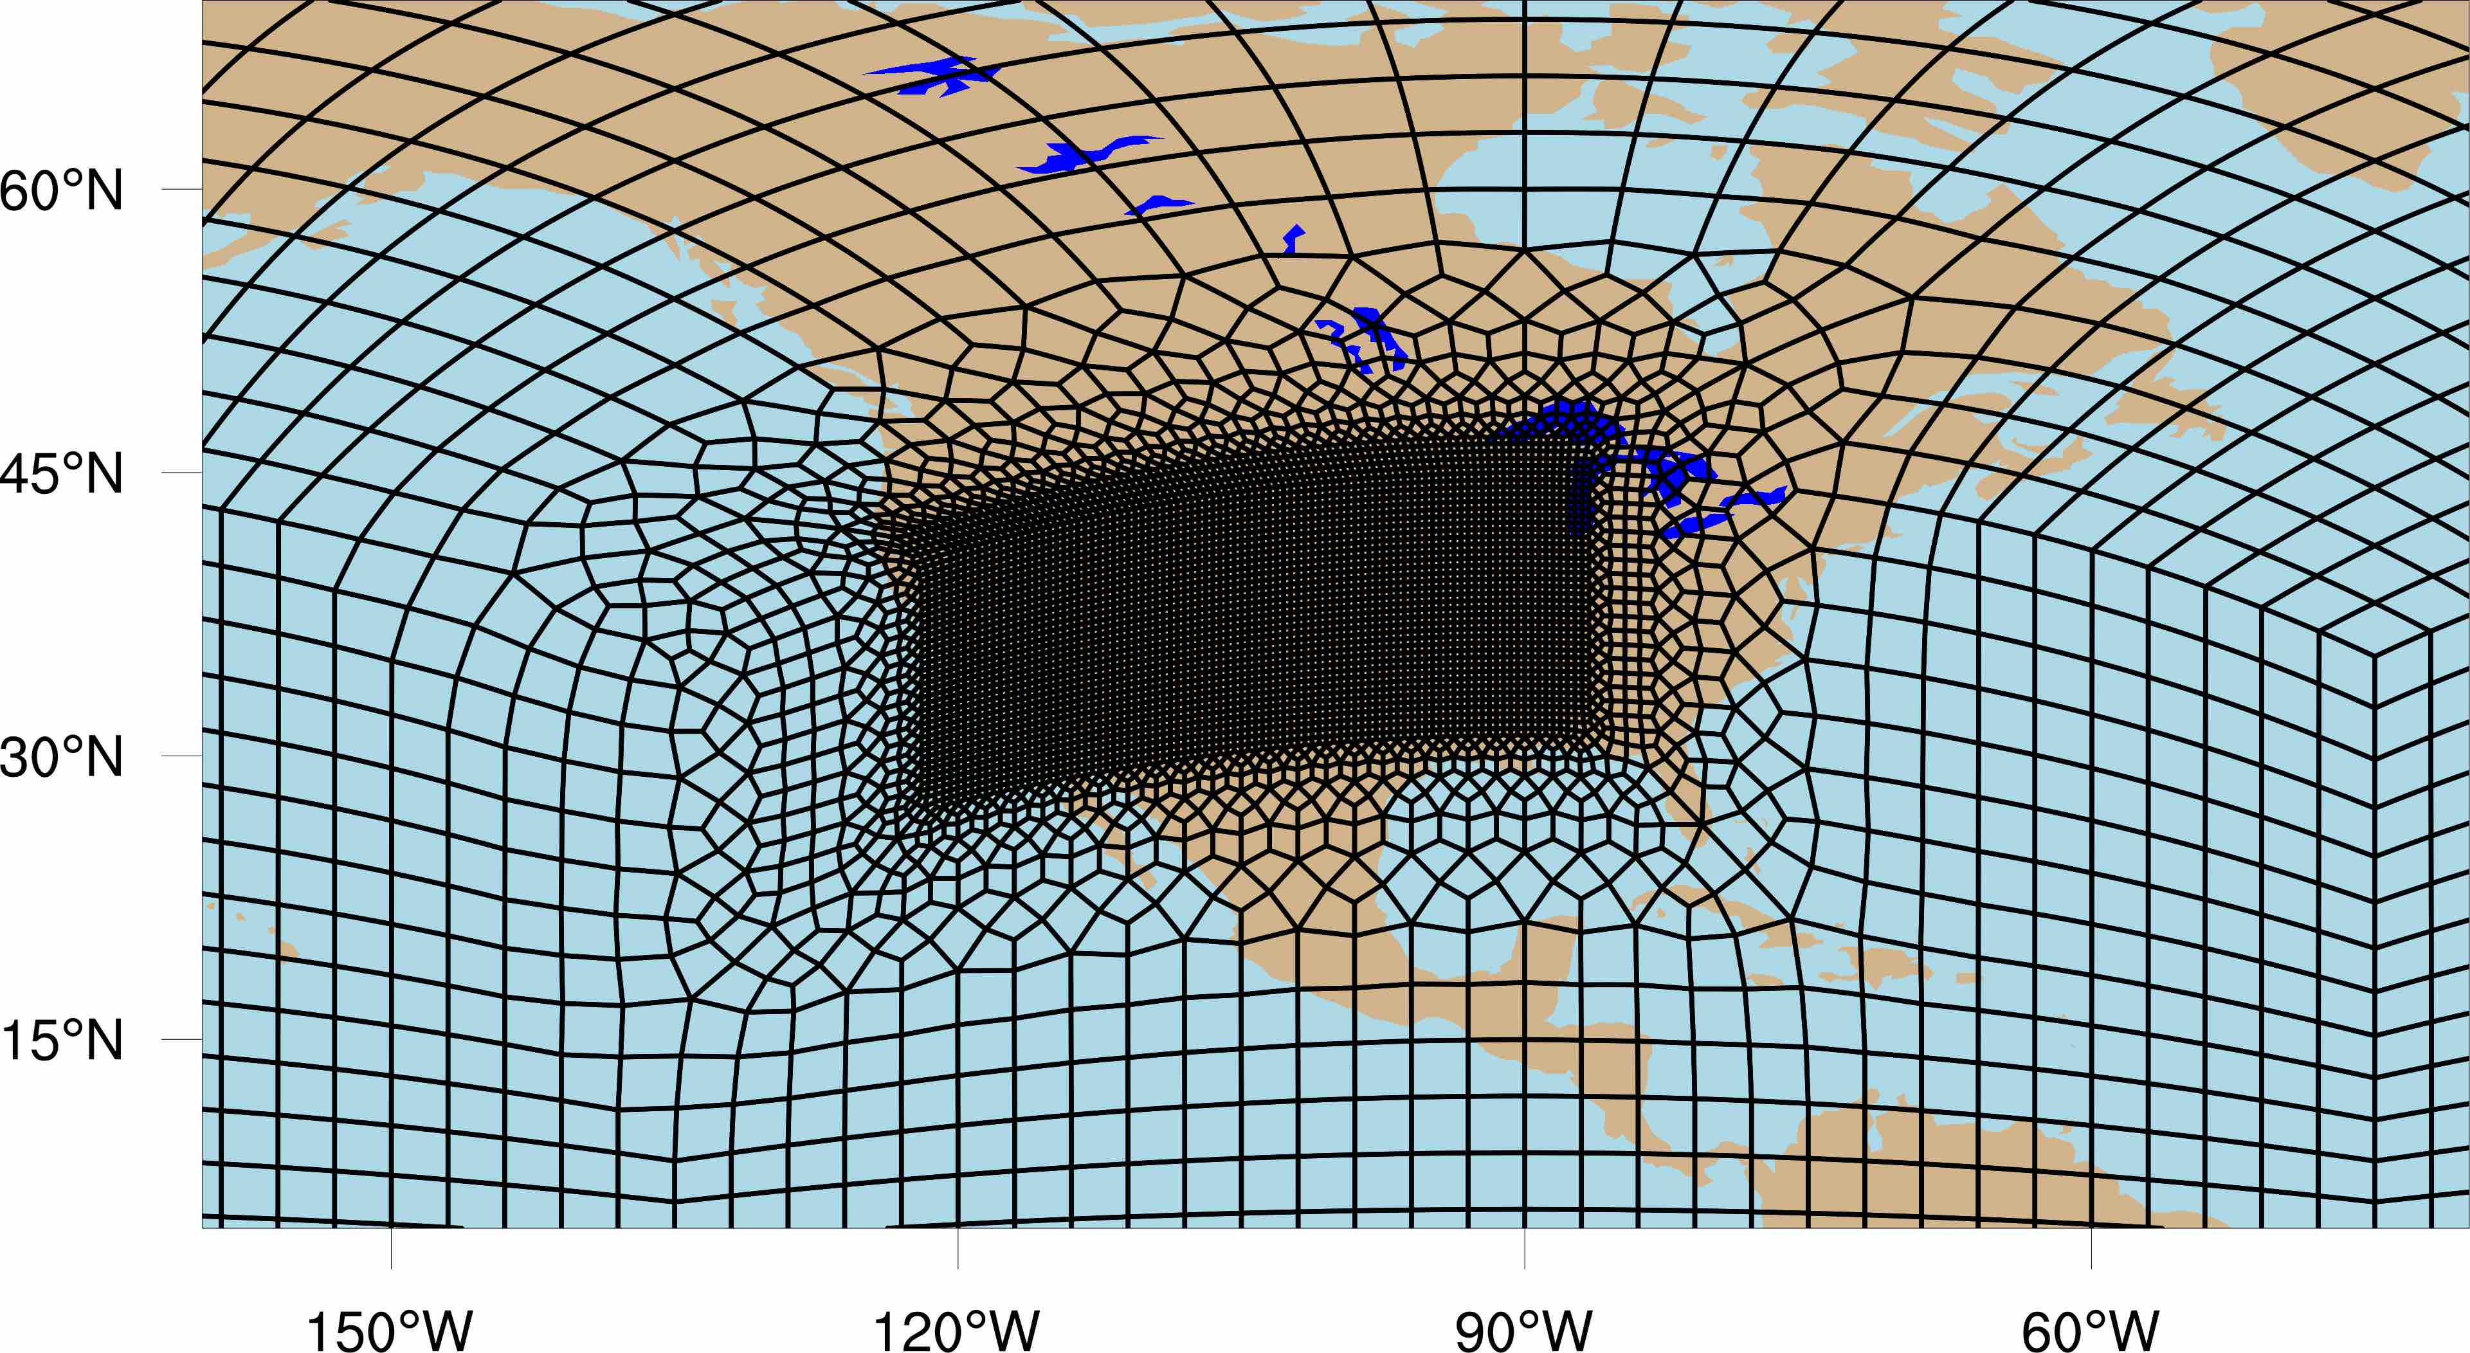
Evaluation: configuration
ACME regionally-refined (RR) simulations
  From 1 degree down to 1/4, 1/8, and 1/16 degrees
ACME uniform-resolution (UR) simulations at 1 and 0.25 degrees
Q3D MMF simulations
  1-mom cloud microphysics
  2-mom cloud microphysics
  Spectral cloud microphysics

Slide 10
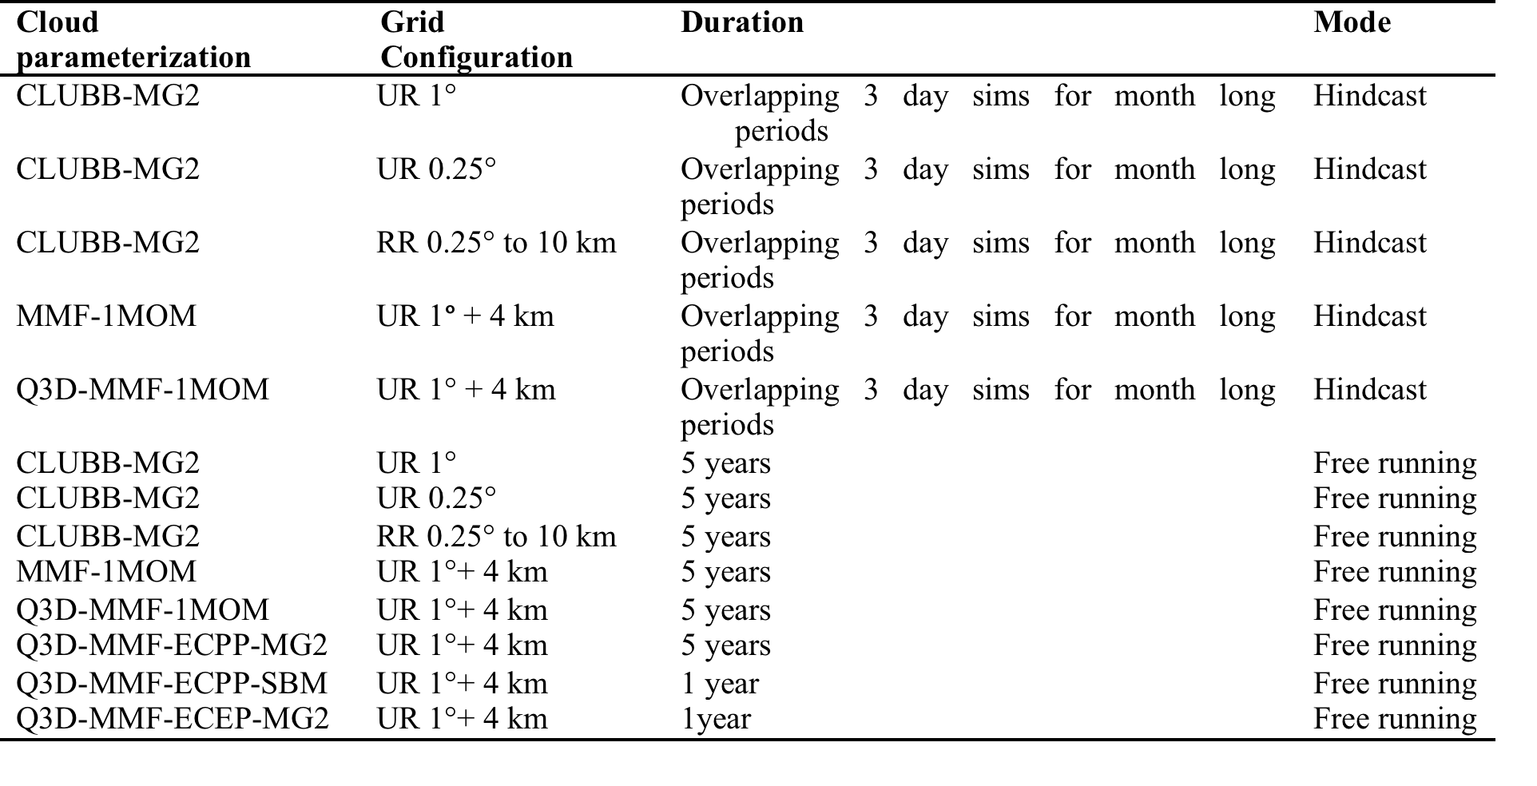
Evaluation: simulations
Focus on the evaluation of CLUBB, Q3D MMF, new MG2, and SBM.

Slide 11
Evaluation: focused properties
Low-level jet (LLJ) and cold pools
Diurnal variation of convection over the U.S. Great Plains
Propagation of convection
Cloud microphysics
MCS structure analysis
Surface radiative fluxes, precipitation, temperature and boundary layer processes
Integrative analysis

Slide 12
Evaluation: observational data
ARM field campaign data
MC3E, PECAN, GoAmazon, and SPARTICUS
Meteorological properties: sounding, radiosonde, variational analysis, Raman lidar, surface met.
Convection and cloud properties: (1) Retrievals from various radars and lidars including KAZR, MMCR, CSPAR, RWP, etc, (2) Aircraft in-situ measurements, (3) Disdrometers measurements
ARM long-term data at the SGP site
Surface met.
Cloud, convection, precipitation: RWP, disdrometers, ARSCL
Radiation and precipitation: surface radiometer measurements, rain gauge
Datasets from other sources
NOAA NEXRAD
NASA GOES, CERES, GPCP, TRMM, GPM
NLDAS, Oklahoma Mesonet

Slide 13
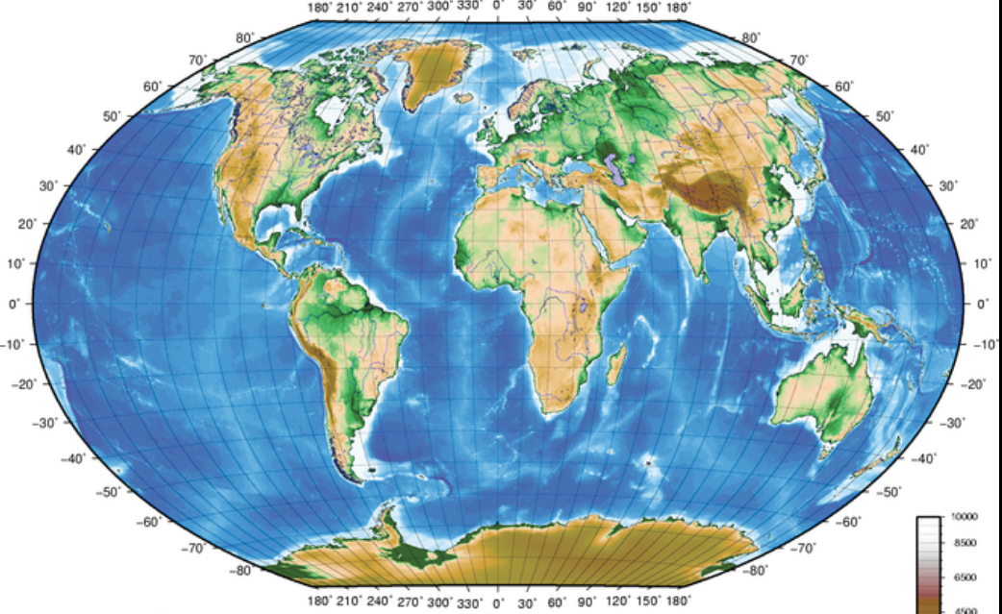
Evaluation: global assessment
free running UR simulations at 1 and 0.25 degrees
Standard ACME diagnostics
Other observational datasets (e.g, NASA CERES cloud and radiation products, and TRMM, GPCP and GPM precipitation products) for other climate regimes such as tropical oceanic and continental convection
Statistics of satellite precipitation radar, cloud radar, and lidar observations from TRMM, GPM, CloudSat, and CALIPSO to evaluate MCS structures and other global features (e.g., MJO, ITCZ)

Slide 14
Impact
Demonstrate a climate model evaluation framework that uses comprehensive observational datasets at different scales to understand meso-scale convective processes and evaluate representations of those processes in state-of-art climate models.
Significantly improve ACME simulations

