Slide 1
A Process-Informed Determination of Credibility Across Different Downscaling Methods
Melissa S. Bukovsky¹,
Seth A. McGinnis², Rachel R. McCrary², Linda O. Mearns²
¹University of Wyoming, Laramie, WY, USA
²NSF National Center for Atmospheric Research, Boulder, CO, USA
DOE EESM PI Meeting

Slide 2
Models/Methods
No downscaling (just GCMs)
Raw
MPI-ESM-LR, GFDL-ESM2M, HadGEM2-ES
Dynamical (NA-CORDEX)
RegCM4
WRF (nudged)
Statistical – spatial
CNN (basic U-Net)*
LOCA*
Statistical – point
SDSM (multivariate regression)*
qdm (quantile delta mapping)
simple (threshold+scale)
“dummy” (shuffle values)
* “complex” statistical methods (relative to the
“simple” methods)

Slide 3
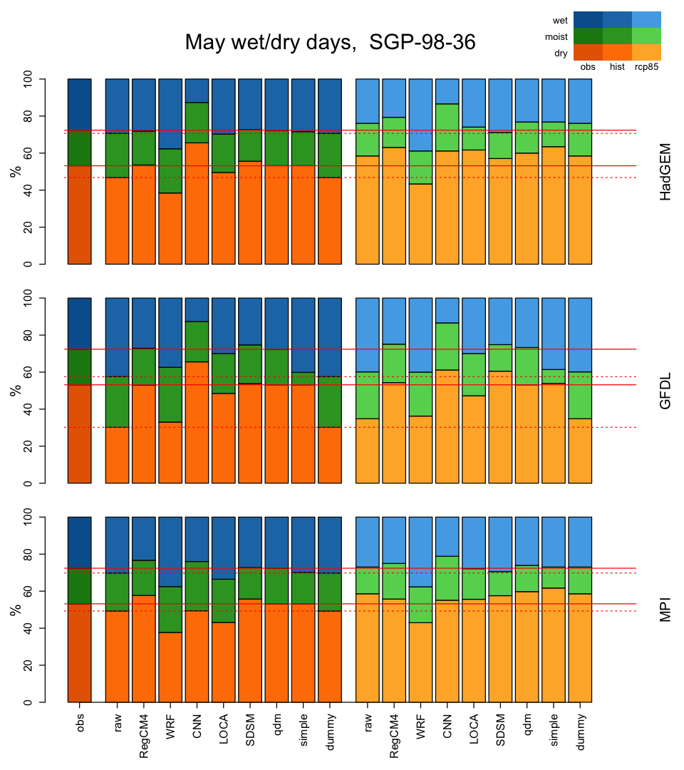
Focus on wet/dry day occurrence & the ‘ingredients’ for precipitation, in May in one location.
May wet / dry days @ 98°W, 36°N
dry
moist
wet
Thresholds:
Wet > 3mm/day
Dry < 0.254mm
obs
hist
rcp85
< trace
> 3mm
This focus:
Simplifies the problem
Reduces influence of model intensity bias
Focuses on atmospheric setup for precipitation
MPI
GFDL
HadGEM
3 CMIP5-era GCMs
Notes:
No mean – intensity problems due to model config, like microphysics or vertical damping strength. And yes, we know many users care about the mean, but we really want to know if the methods are raining for the right reasons.
Future change is mixed, except in MPI.

Slide 4
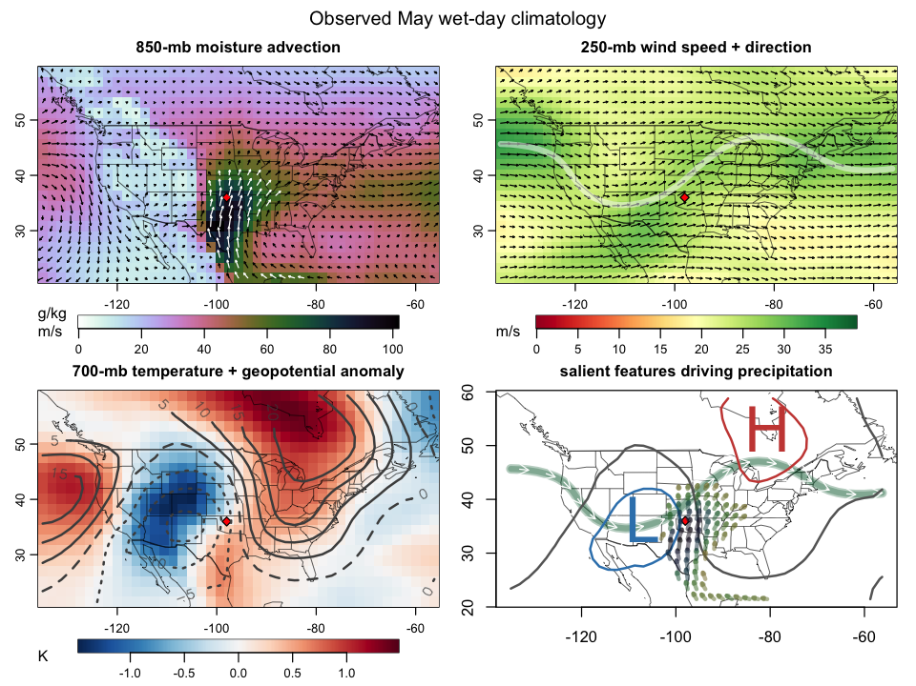
We evaluated precipitation occurrence in May in the Southern Great Plains (SGP)
Observed May Wet-Day Climatology, 1980-2005
a)
b)
Precipitation at this test point ( ) results from a combination of processes that provide moisture & lift:
a) Moisture advection by SGP low-level jet
b) Upstream of an upper-level trough in the jetstream, ahead of a jet max.
c) Upstream of mid-level trough.
d) Diagram view of a-c
Do the downscaling methods rain on days when it makes sense for it to rain?
c)
d)
Notes:
Near DOE ARM site, building on previous credibility assessment for the southern plains, but only for RCMs
Also, it’s flat and this is warm season precipitation, both of which present unique challenges for assessment.
Why May only?
Why the point (point based methods)

Slide 5
Observed May Wet-Day Climatology, 1980-2005
a)
b)
Comparison methods:
GCM large-scale forcing + precipitation in GCMs
GCM large-scale forcing + statistical method wet days
RCM large-scale forcing + RCM wet days
c)
d)

Slide 6
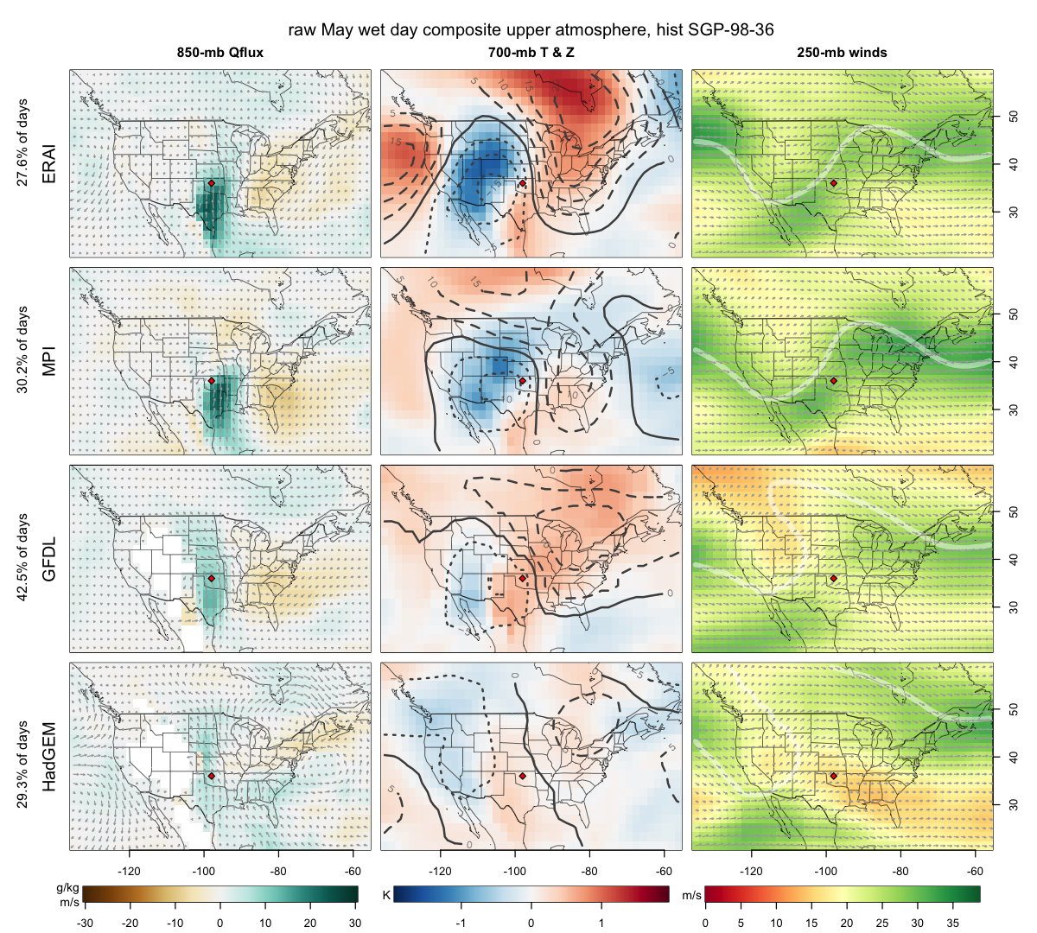
To evaluate credibility, we average upper-level conditions on test-point wet-days.
raw GCM
850-mb Q-flux anomaly
700-mb T & Z anomaly
250-mb winds
MPI (top)
GFDL (middle)
Okay but weak, messy
Note: more wet days
HadGEM (bottom)
Weak moisture flux
Poor mid-level spatial pattern
Jet stream shifted N
This baseline credibility is inherited by all downscaling methods.
Notes:
GCMs vary in how well they capture the climatology.

Slide 7
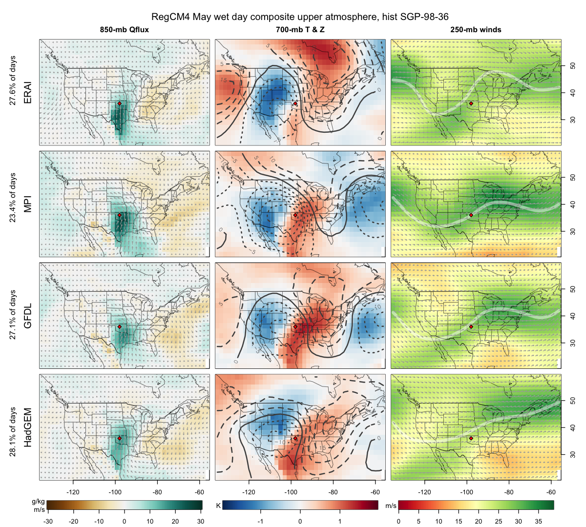
Dynamical downscaling can improve on bad GCM inputs.
RegCM4
850-mb Q-flux anomaly
700-mb T & Z anomaly
250-mb winds
GOOD: ALL
All 3 downscaled GCM simulations now show strong moisture flux anomaly & sensible spatial patterns and magnitudes
Jetstream placement has also been improved
Note: WRF can’t fix the jet stream to the same extent because those simulations are nudged for wavelengths > 2000km

Slide 8
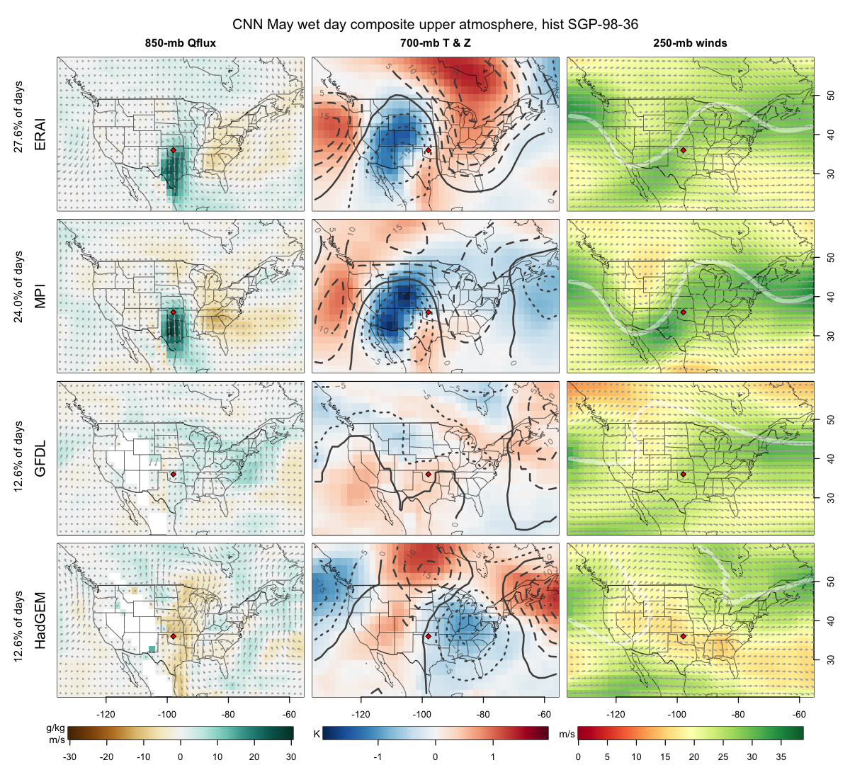
Complex statistical downscaling can make things worse.
CNN
850-mb Q-flux anomaly
700-mb T & Z anomaly
250-mb winds
CNN exaggerates the patterns & inherited credibility.
MPI still GOOD
GFDL now BAD
HadGEM VERY BAD
Statistical methods often do poorly when asked to extrapolate beyond the data they were trained on.

Slide 9
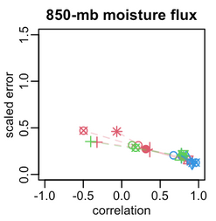
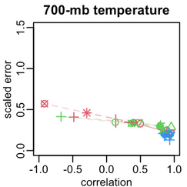
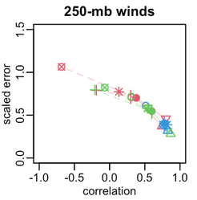
We summarize the wet-day composite plots with spatial correlation and scaled MAE vs obs
All methods perform well (high cor, low MAE) when the GCM is good (blue)
Dynamical methods ( ) can improve on the parent GCMs
Simple point-based statistical methods ( | ~ ) stick close to the parent GCM
When the GCM is bad (red), complex statistical methods (crossed symbols) can reduce already-low credibility
Subset for example purposes, all fields from previous slides completed 🡪
Notes:
We did all the fields in the previous plots, these are just a sample.

Slide 10
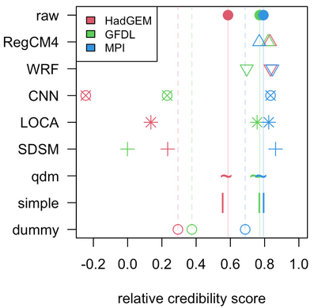
Then we metricized this.
CNN, LOCA, and SDSM can perform worse than random noise (dummy method) when downscaling poorly performing “bad” GCMs (e.g., HadGEM), and often perform considerably worse when downscaling moderately performing “ugly” GCMs (e.g.,GFDL).
However, for well performing GCMs (MPI), they also perform well and are as credible as the dynamical downscaling methods, but only for well performing ”good” GCMs.
Simpler statistical methods, qdm and simple, inherit the credibility of the GCM.
RCMs add value.
Notes:
for each variable in Fig. 8, we sum correlation and (1 - error) to get the (Manhattan) distance from the lower right corner, divide by 2, then average over the variables.

Slide 11
Then we metricized this.
CNN, LOCA, and SDSM can perform worse than random noise (dummy method) when downscaling poorly performing “bad” GCMs (e.g., HadGEM), and often perform considerably worse when downscaling moderately performing “ugly” GCMs (e.g.,GFDL).
However, for well performing GCMs (MPI), they also perform well and are as credible as the dynamical downscaling methods, but only for well performing ”good” GCMs.
Simpler statistical methods, qdm and simple, inherit the credibility of the GCM.
RCMs add value.
Notes:
Fit for purpose must be credible, though credibility does not mean a result is fit for purpose

Slide 12
SUMMARY
The output from a downscaling method can be more or less credible based on how it responds to the input errors. Here:
All methods perform well when the GCM is good.
Dynamical methods can improve on the parent GCM’s credibility.
Simple point-based statistical methods stick close to the parent GCM.
When the GCM has low credibility, complex statistical methods can make it even worse.
These results suggest the complex statistical methods warrant further scrutiny.
What do these results mean for the projections from these methods? An environment undergoing climate change might not be that different from one that is shifted due to bias.
Projections inherit historic credibility.
See paper for additional conclusions/discussion regarding projections of future climate.
This is an example of a framework.
There’s room for expansion.
These results may not hold everywhere.
Notes:
any further bias correction would inherit our differential credibility for similar reasons

Slide 13
DISCUSSION
To generalize this framework:
Pick a downscaled variable that is driven by important resolved processes in a region of interest
Stratify data based on values of that variable at a point or over a small sub-region
Create composites of the driver variables for the different strata
Evaluate composites vs observations & physical process understanding
Evaluate plausibility of changes in physical processes
Future work:
Generalize and automate to weather regimes.
Try other regions.

Slide 14
Acknowledgements
This work was supported by DOE grant DE-SC0016438
NCAR is sponsored by NSF under Cooperative Agreement #1852977
DoD ESTCP for previous support of the NA‑CORDEX data archive
WCRP’s WGRC & WGCM and the CORDEX modeling groups for data
NCAR CISL for computing resources
Everyone who has contributed to useful discussions around this topic!
Submitted to Earth’s Future!
Melissa.Bukovsky@uwyo.edu

Slide 15
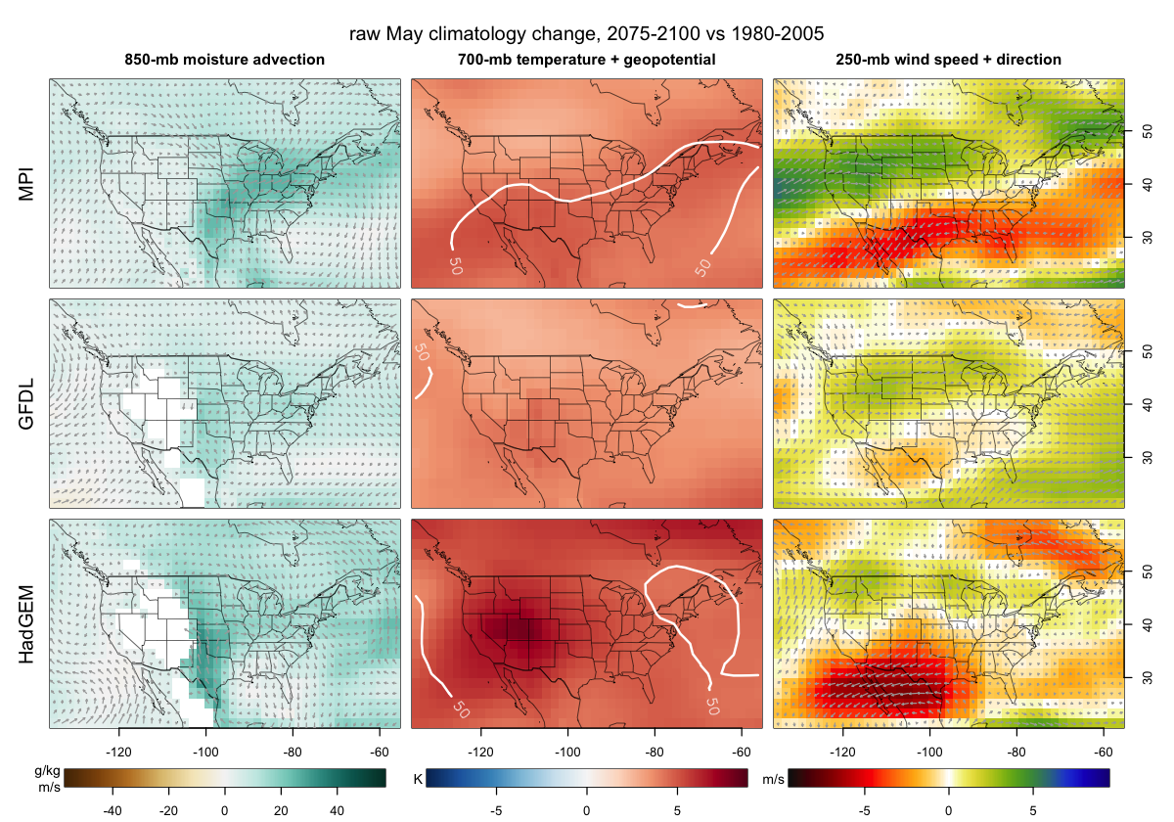
raw May climatology change 2075-2100 vs. 1980-2005
We have also examined future changes in these fields.
The general pattern of change is plausible and consistent with a priori expectations based on our understanding of the physical mechanisms at play in a warming climate in this location.
These changes are also consistent with our previous work and observations (Bukovsky et al. 2017).
Changes in these upper-level atmospheric conditions are also reflected in RegCM and WRF (not shown).

Slide 16
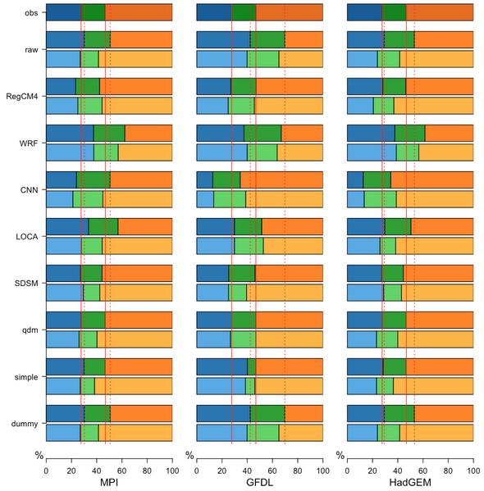
Future Change
In this case, the physically plausible changes in the upper atmosphere drivers of precip do NOT affect our assessment of the credibility based on the historical results.
We know whether or not a downscaled result is raining for the ‘right’ reason, and if it’s not, it’s simply not credible.
Regardless of any bias correction!!!
dry
moist
wet
obs
hist
rcp85
< trace
> 3mm
Notes:
any further bias correction would inherit our differential credibility for similar reasons

Slide 17
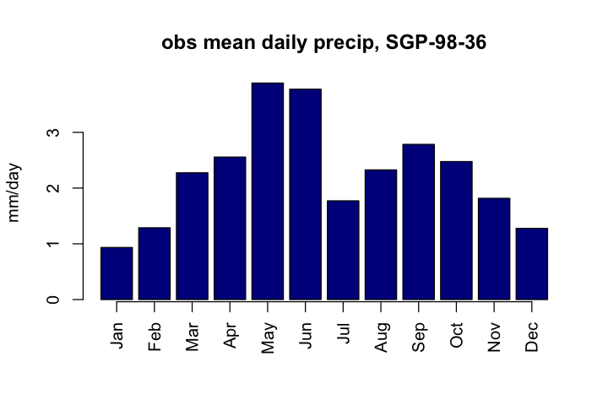
Average daily precipitation by month for the analysis location (36°N, 98°W) in Oklahoma and the period 1980-2004, from the gridMET gridded observational data product aggregated to a 0.25° grid. May is the wettest month.

