Slide 1
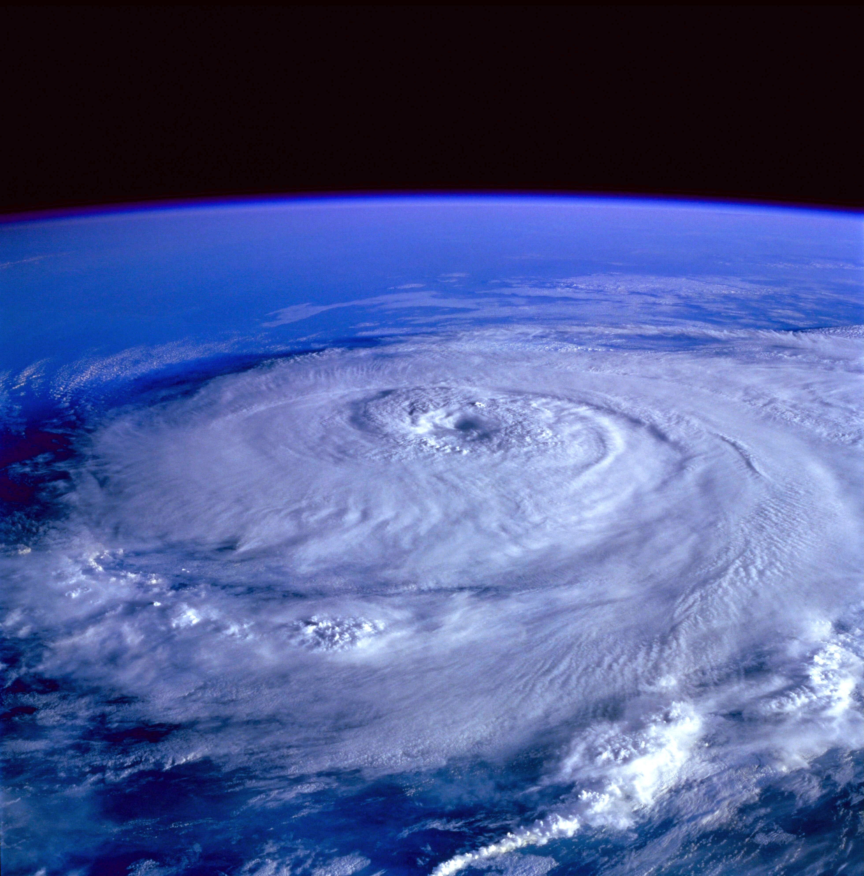
Increasing tropical cyclone outer size in the western North Atlantic
Karthik Balaguru,
Pacific Northwest National Laboratory
EESM PI Meeting, Aug 7, 2024

Slide 2
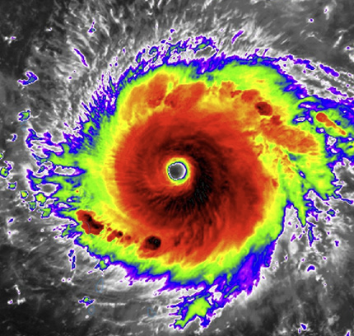
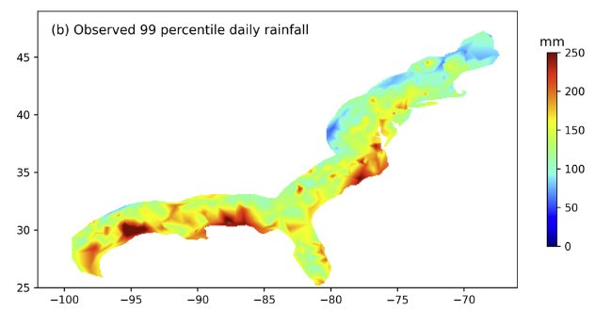
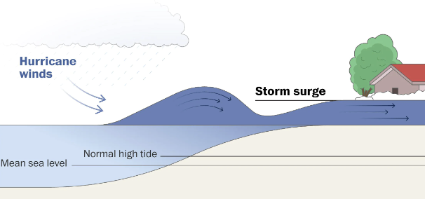
Why examine TC size?
Area and duration of
storm-force winds
Changes in various aspects of TCs have been considered in the past (eg. intensity, frequency, intensification rate, precipitation, forward moving speed, etc.)
However, potential changes in TC size haven’t been explored.
Likely due to the relatively short record of observed TC size.
2) Precipitation
(Xu et al, 2024)
Source: NOAA
3) Storm surge

Slide 3
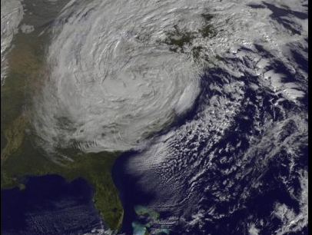
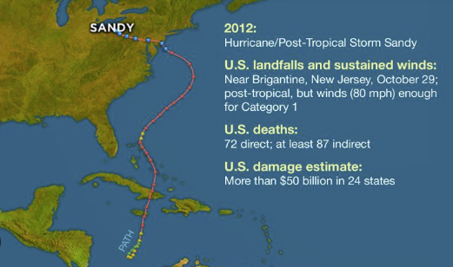
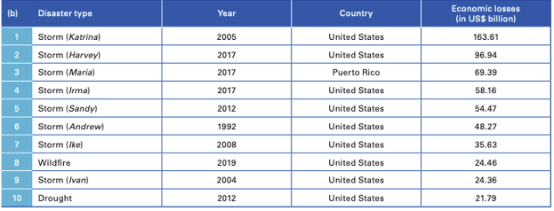
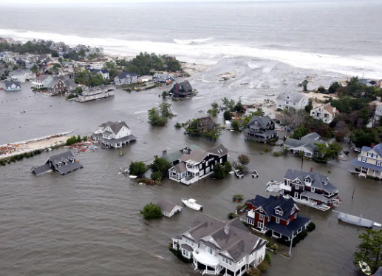
Sandy – A prime example
image source: NASA
source: WMO
image source: US Airforce

Slide 4
Outline
Observational changes in TC outer size and environment
Can climate models reproduce these changes?
Implications and future directions

Slide 5
1: Observations

Slide 6
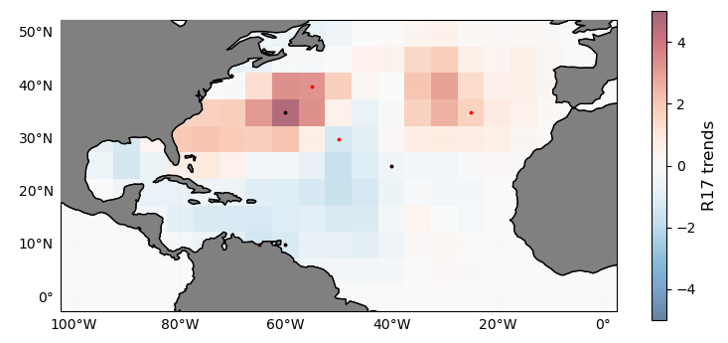
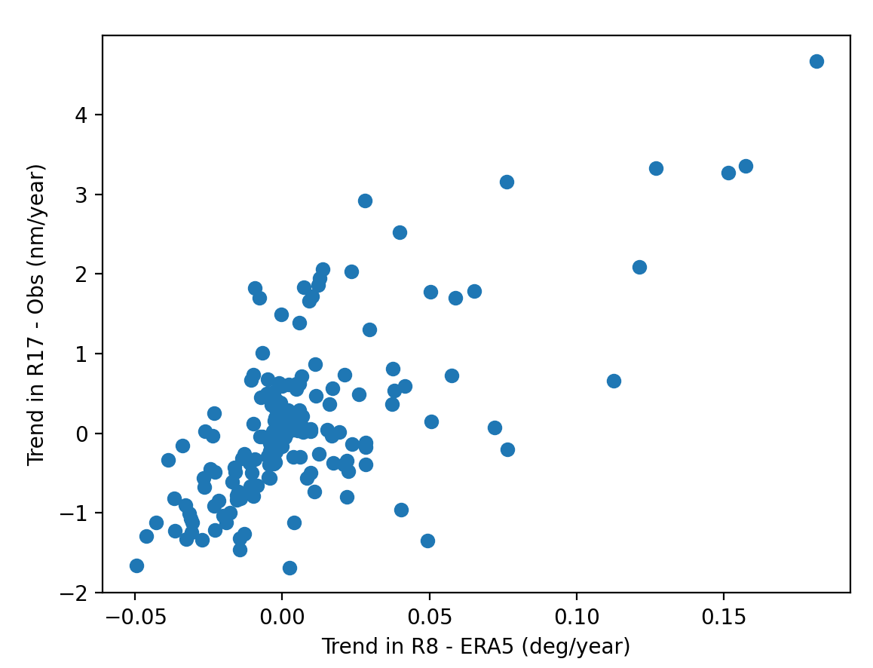
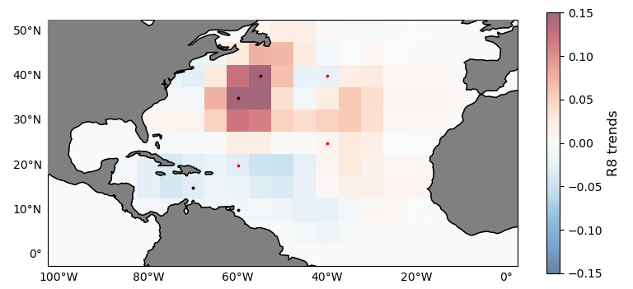
R17 trends Obs (2004-2022), HURDAT2
SyCLoPS: 100 hPa RH, DPSH, 850 hPa Temp
(Han and Ullrich, 2024)
pattern correlation: 0.69, variance explained: 48%
R8 trends (2004-2022), ERA5
To the west of 55W where size data is more reliable
pattern correlation: 0.79, variance explained: 62%
Storms tracked using TempestExtremes
(Ullrich et al, 2021)

Slide 7
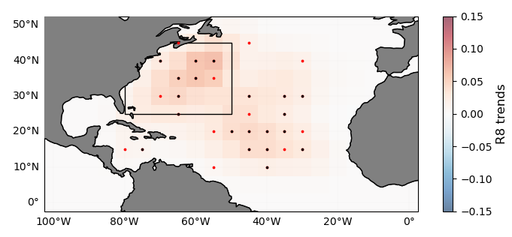
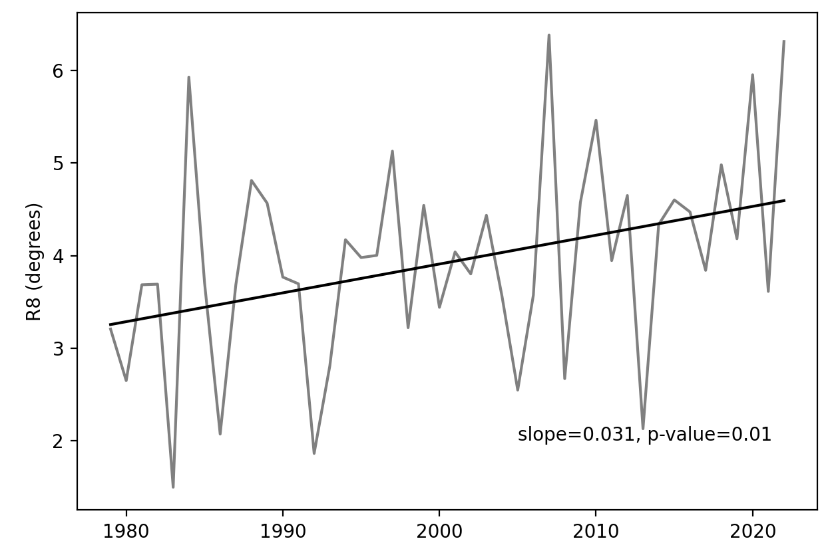
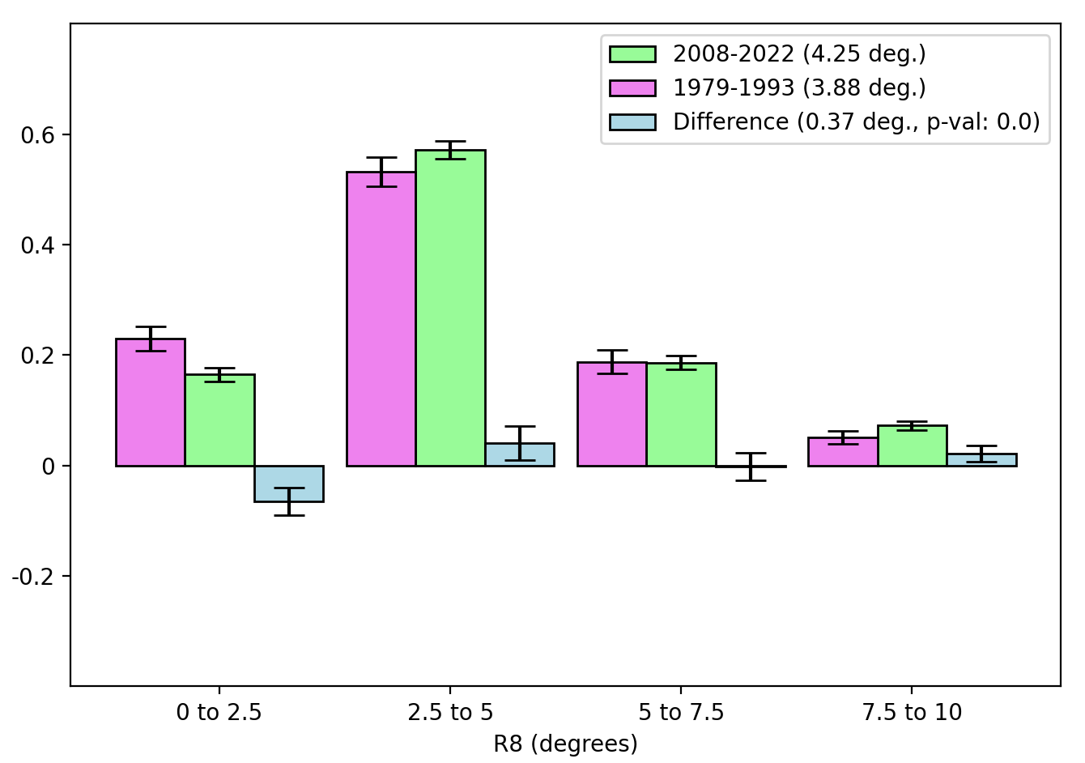
Trend = 0.031, p-value = ~0.01 based on the Mann-Kendall test
Compared to the early period, R8 increased by about
~10% over the later period.

Slide 8
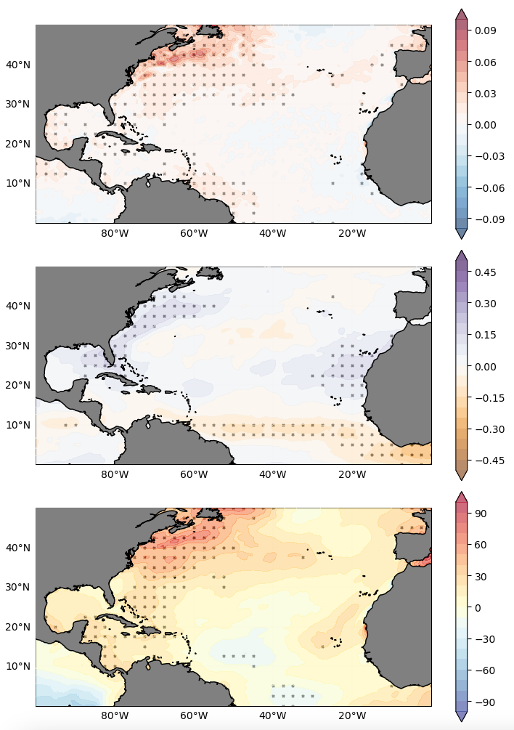
Environmental trends
ERA5 reanalysis (1979-2022)
Previous studies have indicated that storm outer size may be related to the thermodynamic state of the environment (Eg. Emanuel (1986), Khairoutdinov and Emanuel (2013), Wang and Toumi (2022), Wang and Chavas (2024)).
Trends in relative SST, mid-tropospheric relative humidity (RH600) and the gross moist instability (GMI) were examined.
Environment has become more favorable over the western North Atlantic, especially in the sub-tropics.
Relative SST trends
RH600 trends
GMI trends

Slide 9
2: Climate model

Slide 10
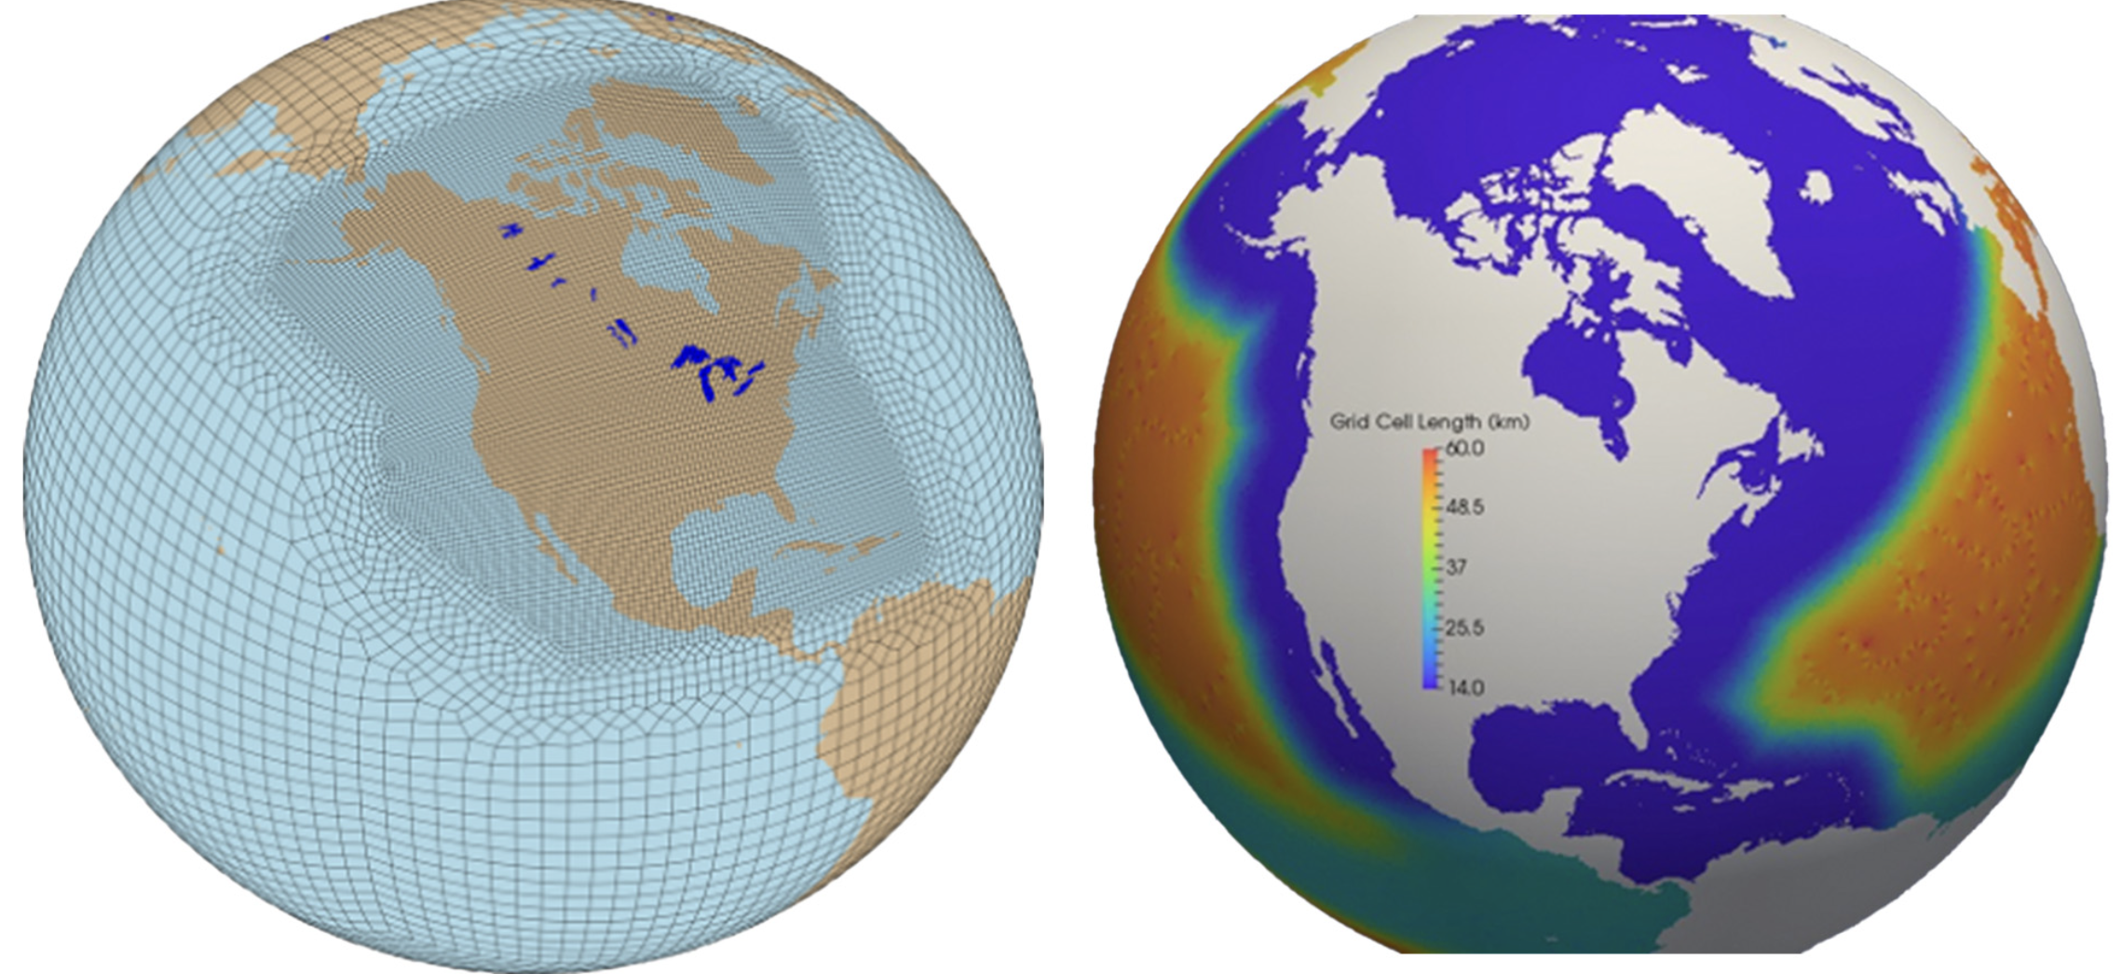
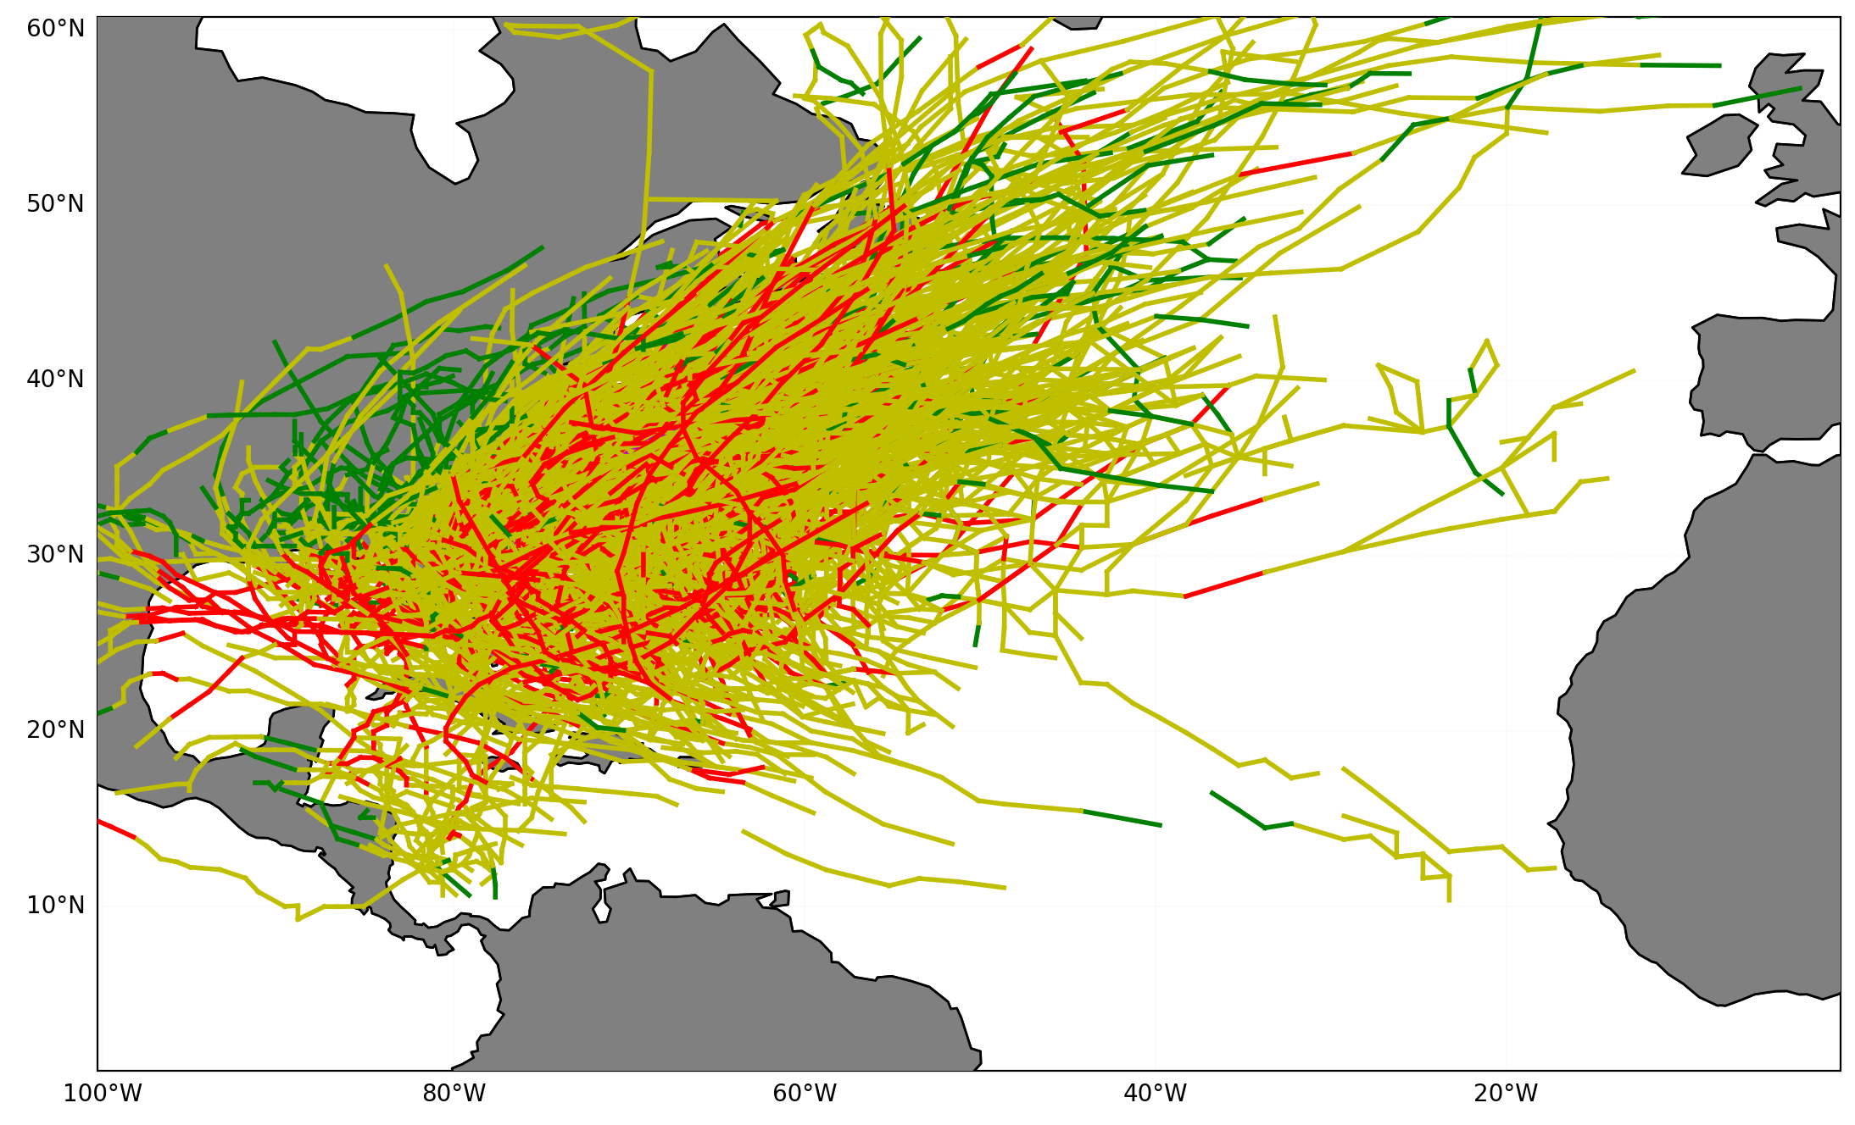
E3SM NARRM simulations
Atm and land: 25 -> 100 km
Ocn and sea-ice: 14 -> 60 km
Analyzed North American Regionally Refined Model (NARRM) simulations to support observations.
3-member ensemble of historical simulations (1850-2014) were used.
TCs were tracked in the model using TempestExtremes.
North Atlantic TC activity under-represented in NARRM.
But storms are produced in the Western Atlantic, reach a maximum intensity of Category 4.
Image source: E3SM.org

Slide 11
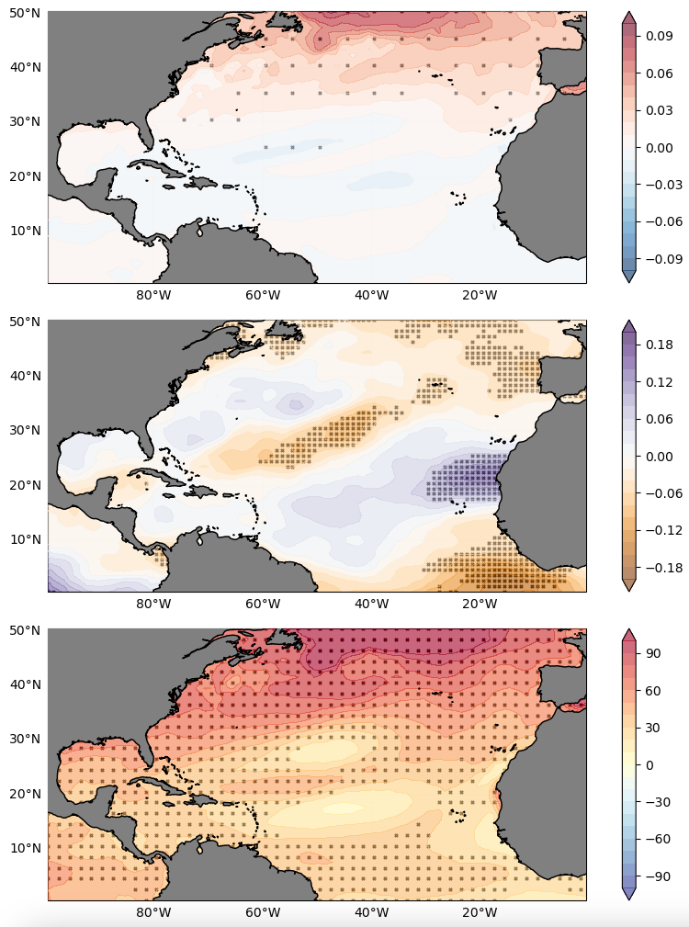
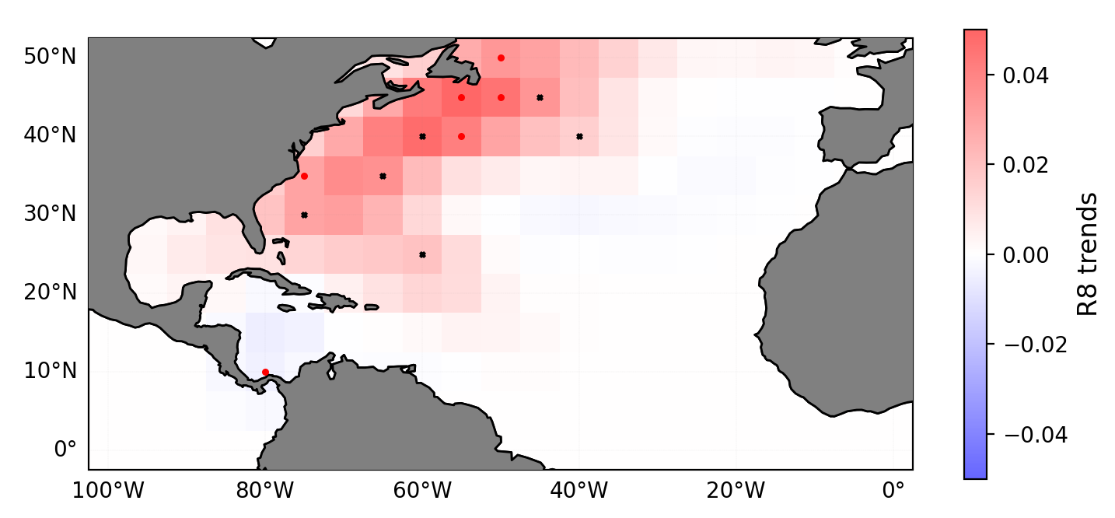
E3SM – simulations (3-member ensemble): 1979-2014
R8 trends
Relative SST
trends
RH600
trends
E3SM NARRM broadly captures the spatial pattern of trends in the environment and TC size.
GMI
trends

Slide 12
3: Future directions

Slide 13
a: Physical mechanisms
Past research suggests that storm size may be influenced by the environment.
There is also some evidence to indicate that storm size may be controlled by its initial state.
It remains unclear what determines the initial vortex size
Most previous studies used idealized settings (eg. uniform SST warming)
High-resolution modeling studies with more realistic settings are needed
Efforts such as storm-tracking in HighResMIP (eg. Roberts et al. 2019) should be encouraged to include metrics of TC size

Slide 14
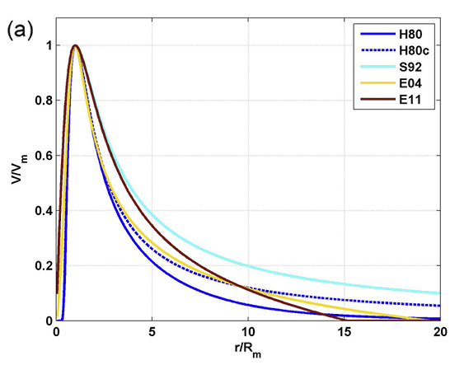
b: Impact assessment models
Storm surge - The single largest cause of death from TCs
Storm surge
Islam et al. (2021)
Intensity
Size
Translation
Bathymetry
In most parametric wind models, the radial profile is a function of central pressure deficit, maximum wind speed, radius of maximum wind and latitude.
Develop new models (eg. using ML/AI) for storm structure that can take the ambient environment into consideration.
Lin and Chavas (2012)

Slide 15
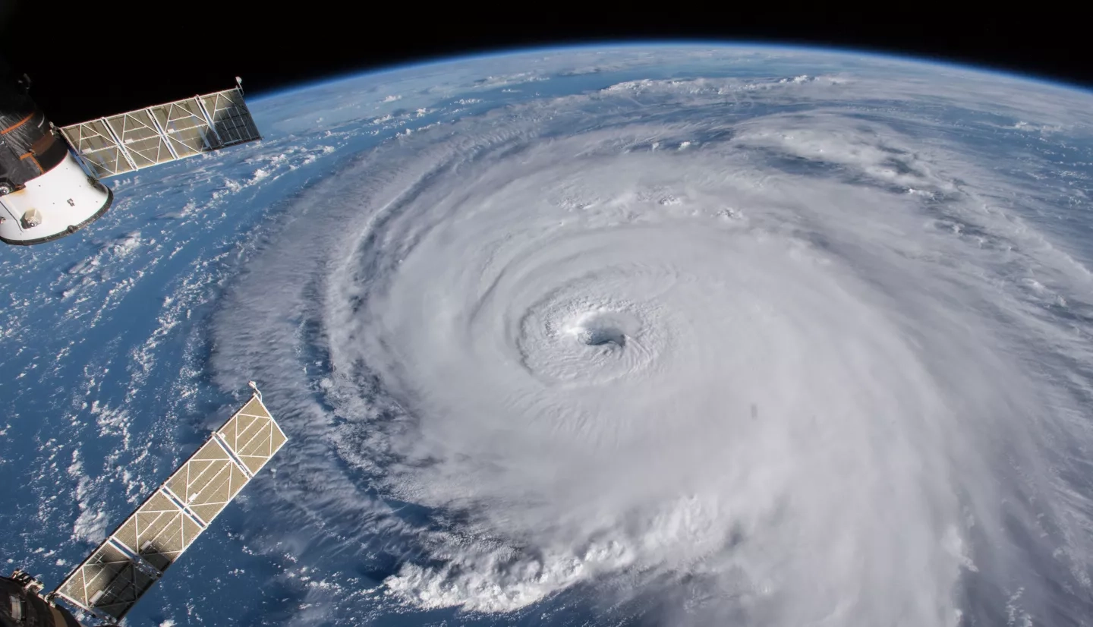
c: Datasets of storm size
NHC’s best track data includes TC size metrics since 2004 : ~20 years of data
Not sufficient for robust analysis
Here we attempted to address this using: HURDAT2 + ERA5 + TempestExtremes + SyCloPS
Develop new datasets of storm size, leveraging advanced AI and additional data, such as longer-term homogenous records of satellite observations.
Source: NASA

Slide 16
Thank you

