Slide 1
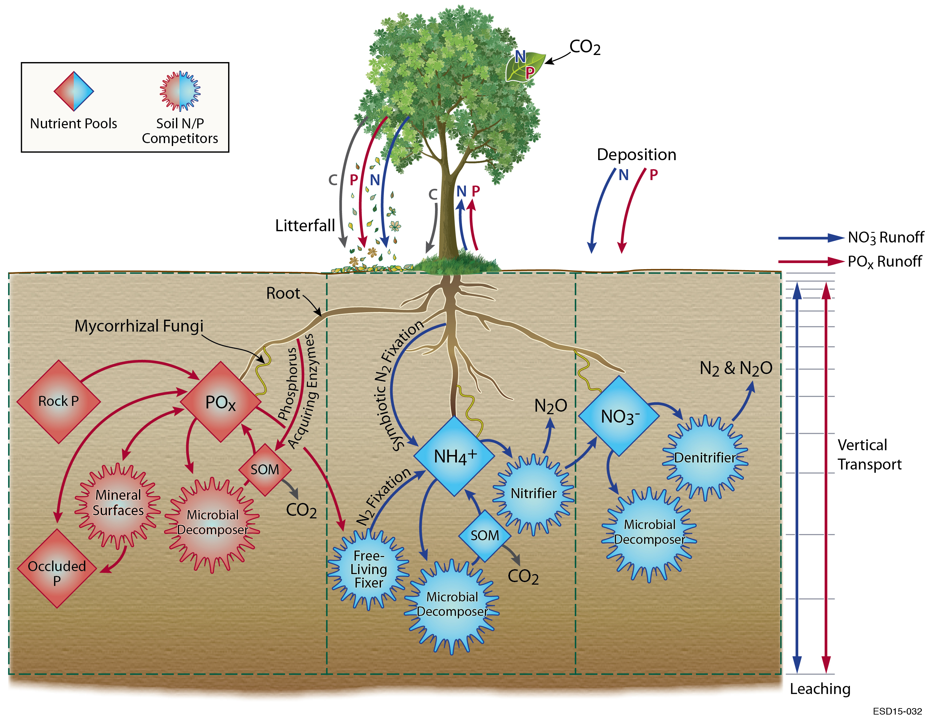
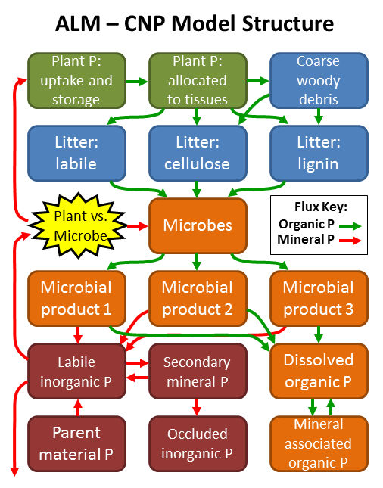
Biogeochemistry experiments
Question: What are the nitrogen (N) and phosphorus (P) effects on C-Climate and C-concentration feedbacks (gamma and beta) in the presence of Land Use and N and P deposition trajectories?
Hypothesis:
Climate
N, P
Carbon
Nutrient dynamics
CO2
limitations
Equilibrium Chemistry Approximation
Relative Demand
Notes:
RD: relative demand with plant N and leaf C storage pools
ECA: equilibrium chemistry approximation with plant N pools, and trait platificity in roots and leaves
Differences: how nutrient competition is represented; how nutrients control photosynthesis; how C, N, and P storage pools are represented

Slide 2
Biogeochemistry experiments
Experimental design:
  Follow C4MIP protocol with C-only, CN, and CNP, for each competition parameterization (RD and ECA)
    Controls: C1: (no down-regulation), C2 (fixed pft-specific vcmax down-regulation to match pft-integrated PI NPP as the mean of C3 and C5)
    C3: RD-CN; C4: RD-CNP
    C5: ECA-CN; C6: ECA-CNP
    For each C: control, BGC coupled, radiatively coupled and fully coupled for 1850 – 2100 (historical + RCP8.5)
  6 LR configurations x 4 scenarios x 250 yrs = 6,000 yrs
Notes:
RD: relative demand with plant N and leaf C storage pools
ECA: equilibrium chemistry approximation with plant N pools, and trait platificity in roots and leaves
Differences: how nutrient competition is represented; how nutrients control photosynthesis; how C, N, and P storage pools are represented

Slide 3
Biogeochemistry experiments
Simulation plan:
  Model configurations
    LR configuration + BGC in atmosphere, land, and ocean
    CPU requirement ~ 2 x water cycle LR ~ 10M core-hours per 100 years
  Model spinup
    Offline ALM spinup
    Coupled model spinup
  Computing strategy
    Cori and Edison: support DECK and water cycle experiments
    On Titan and Mira: bundling is need for throughput
Notes:
RD: relative demand with plant N and leaf C storage pools
ECA: equilibrium chemistry approximation with plant N pools, and trait platificity in roots and leaves
Differences: how nutrient competition is represented; how nutrients control photosynthesis; how C, N, and P storage pools are represented

Slide 4
Resources and planning
Compsets
Input data
Computational resources planning and monitoring
Diagnostic suites
Output variables and frequency
Postprocessing
Tools to run and monitor simulations

