Slide 1
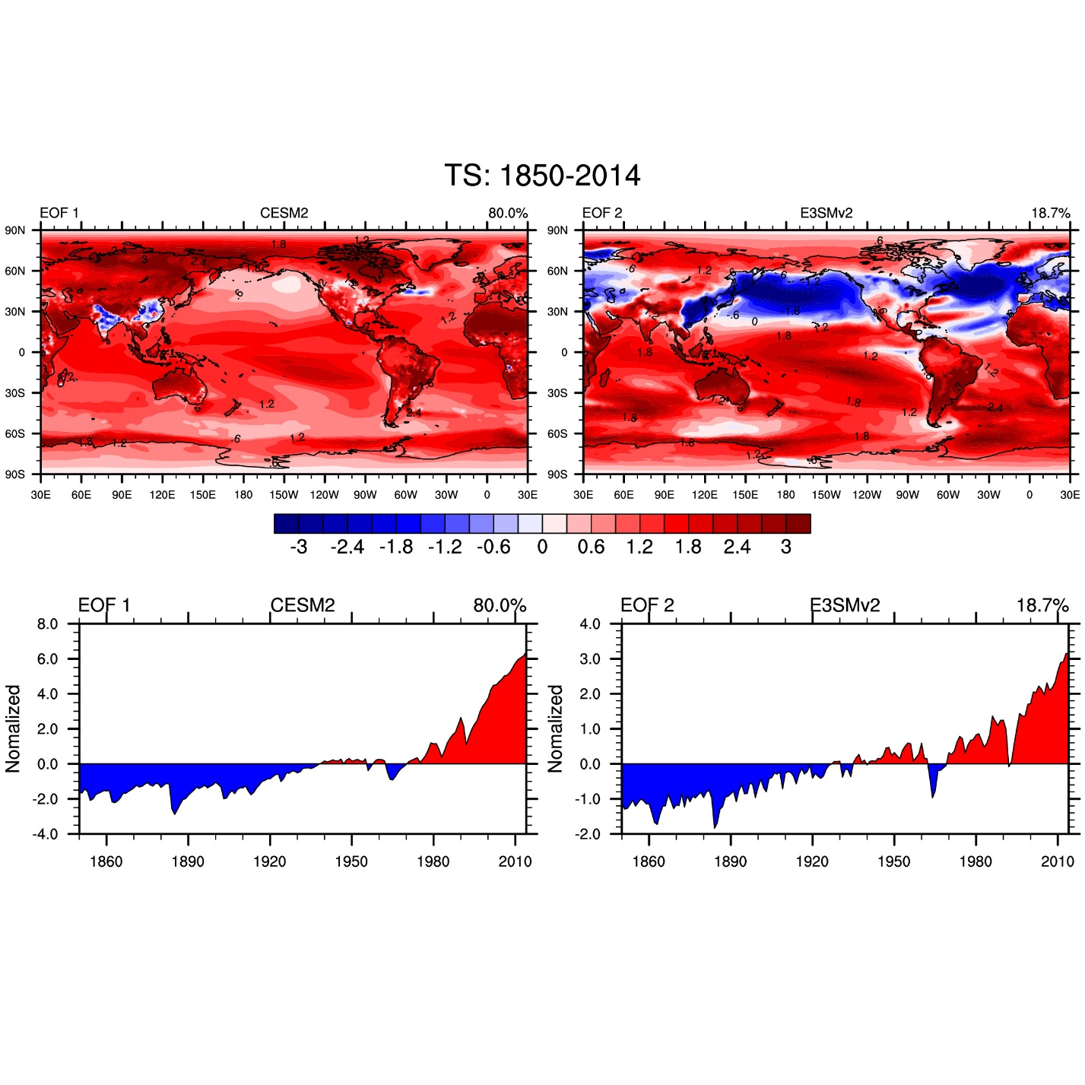
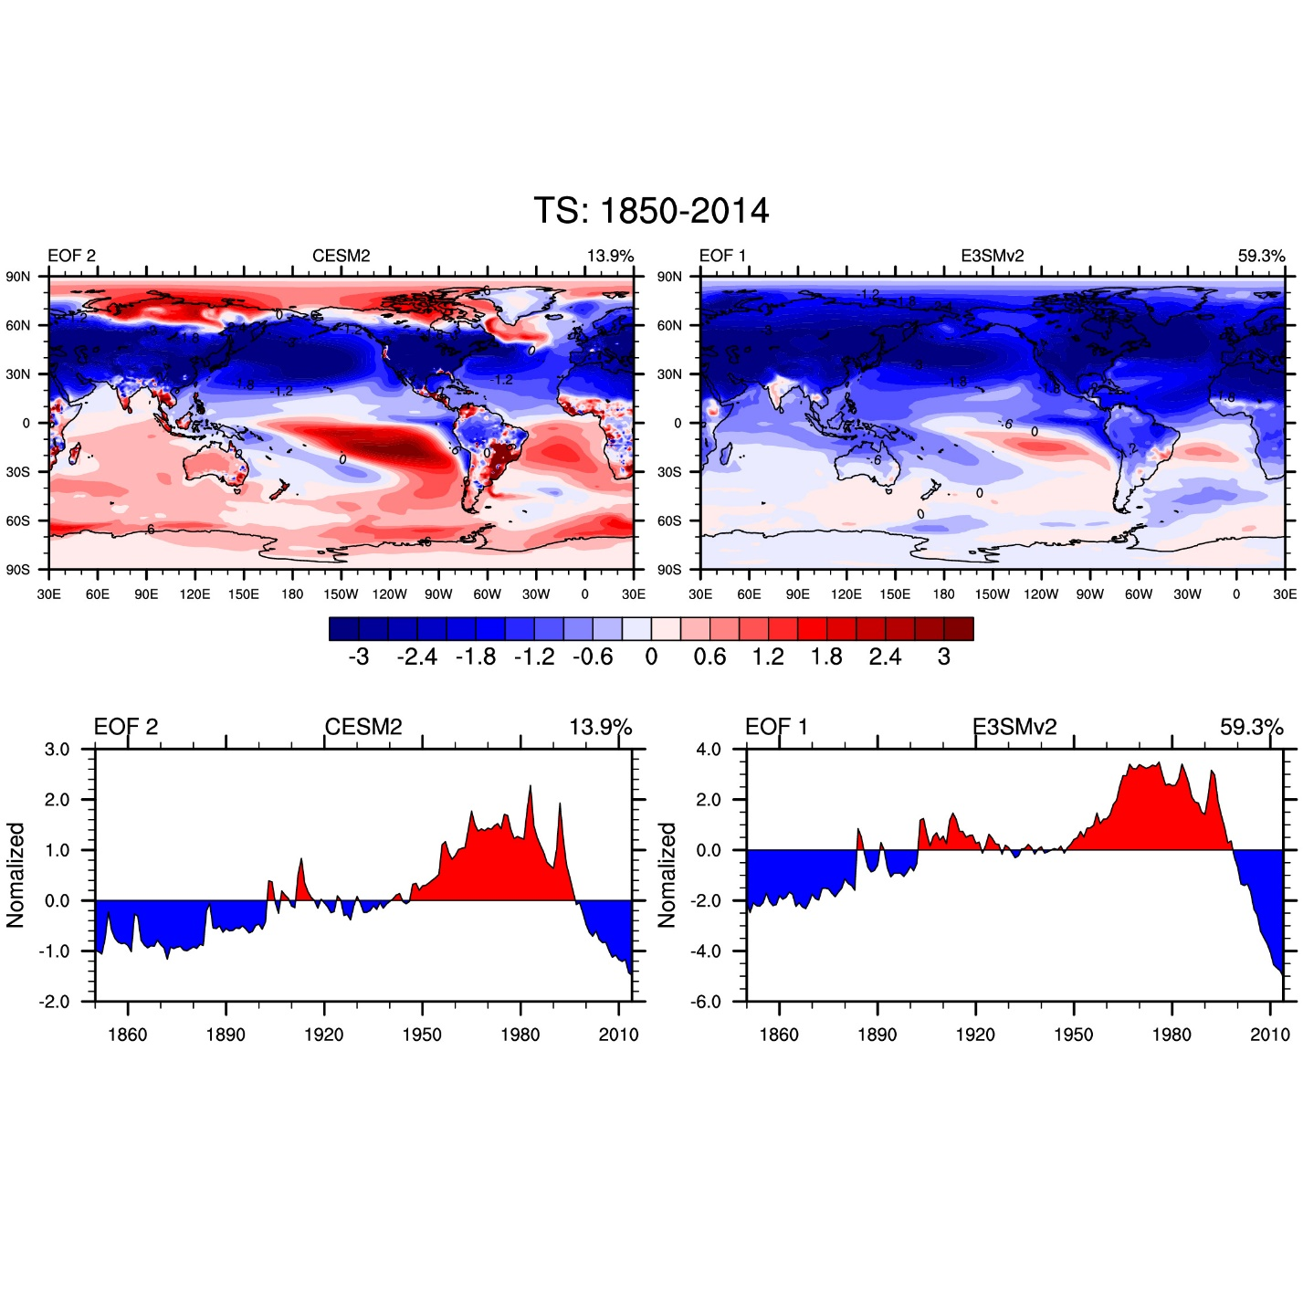
Role of AMOC in determining the surface climate response in E3SMv2 and CESM2
CATALYST: DOE/UCAR Cooperative Agreement
Regional and Global Climate Modeling Program
Aixue Hu, Gerald A. Meehl, Hui Li, Nan Rosenbloom, Luke Van Roekel, Gary Strand, Julie Caron, Carmela Veneziani, John Fasullo

Slide 2
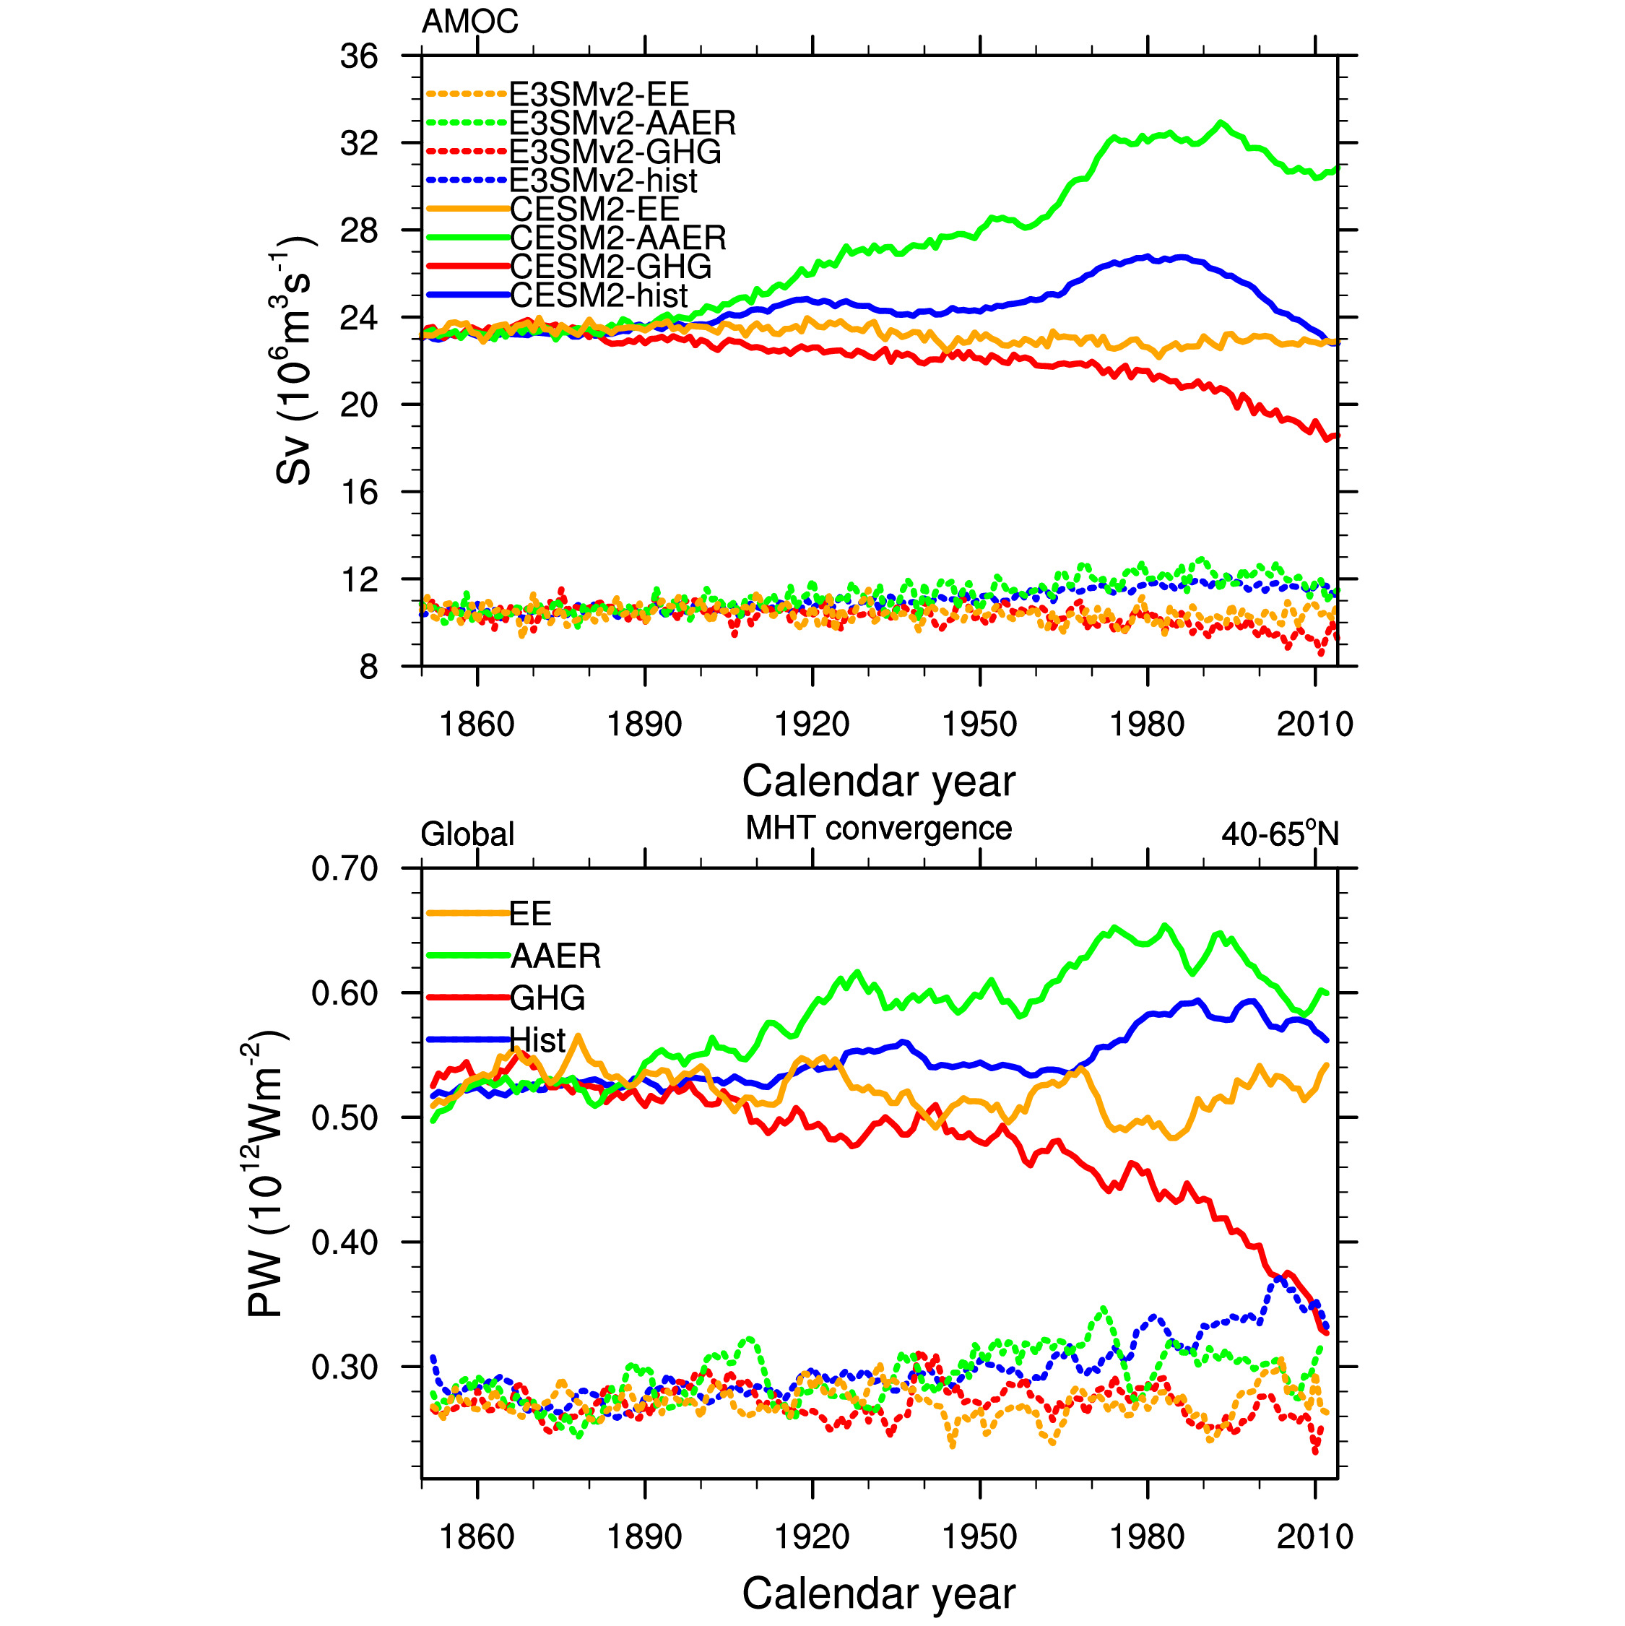
Global Mean Temp

