Slide 1
12-Month Roadmap and V2/V3 New Capabilities for ACME-atmos
Shaocheng Xie and Phil Rasch
Atmosphere Group

Slide 2
12-Month Roadmap for ACME-Atmos
Finishing off V1
Writing papers
Assessment + New diagnostics and tools
New capabilities and parameterizations for V2
New capabilities and parameterizations for V3
Running scripts, compsets, and bugfixes
Testing, integration, and maintenance

Slide 3
Finishing off V1
Tuning required for low- and high-res atmos models by the coupled team (Wuyin Lin and Po-Lun Ma)
Final details for ACME v1 (Philip Cameron-smith)
Files needed by DECK experiments
???
Toward a deeper understanding of V1 model features (Shaocheng Xie/Phil Rasch) – can be coordinated with paper writing
Demonstrate the benefits for running a higher vertical and horizontal resolution (Po-Lun Ma and Wuyin Lin, or others?)
Assess AIE in V1 atmos (Hailong Wang, Po-Lun Ma?)
Assess ENSO with V1 atmosphere (Rich Neale?)
Diagnose processes leading regional precipitation biases?
Code review and documentations (relevant code developers)

Slide 4
Paper Writing
28 papers planned.
All (?) are in JIRA
Most of the papers should be targeted to submit by 9/30/17 or earlier
Contact the lead PI if you feel you made significant contributions for being a co-author on that paper

Slide 5
New Diagnostics and tools
Diagnostics (???)
Tier 1b
Monsoon
ENSO
????
RRM (Erika Roesler)
COSP+ARM simulators (Yuying Zhang)
Short PPE simulations (Yun Qian)

Slide 6
New capabilities and parameterizations for V2/V3
Will be discussed next.

Slide 7
Running scripts, compsets, and bugfixes
Compsets (Philip Cameron-smith)
Useful scripts for running the model, managing, and diagnosing model output (Volunteers)

Slide 8
Testing, integration, and maintenance
Monitoring bugs found in CESM (Cecile Hannay)
Fixing bugs (Phil Rasch/Shaocheng Xie)
Building a prescribed sea ice capability for ACME? (Phil Rasch)
Slab Ocean Model?
Automating construction of a Data Atmosphere Model?

Slide 9
New features for ACME V2/V3 Atmosphere Model
(For Discussion)
Shaocheng Xie and Phil Rasch
Atmosphere Group

Slide 10
ACME V2/V3 Overview
V2:
Emphasize on computational architecture and performance improvements
Very limited new science development
Timeline
01 Jun 2018 New feature freeze
01 Sep 2018 ACME v2.0-alpha - all component-level functionality ready for coupled system testing and tuning
28 Feb 2019 ACME v2.0 (end of Y5Q1)
01 Jun 2020 ACME V2 code release
V3:
Developments driven by current V2 Science plan
Feature freeze Dec. 1, 2020 (????)
Budget Impact: the science and experiment plans need to be adjusted based on different funding scenarios - $10M, $15M, and $20M.
From ACME V2/V3 Plan

Slide 11
ACME V2 Science Questions
ACME V2 – Arctic (collaborate w HiLAT/RASM/NGEE-Arctic?)
Water cycle: What controls extreme moisture transport to the Arctic and its impacts on seasonal melting of sea ice? How may sea ice and other high latitude changes influence extreme events worldwide?
Biogeochemistry: How does surface heterogeneity, including sea-ice, snowpack, permafrost, and vegetation cover interact with changes in seasonality of temperature and precipitation to influence biogeochemistry and ecosystems in the Arctic?
ACME V2 – Tropics (w/ NGEE-Tropics)
Water Cycle: How does Amazon rainfall respond to GHG, aerosols, and LULCC in the future? How do soil-plant-atmosphere interactions influence water recycling in tropical forest and plant response to perturbations??
Biogeochemistry: What are the relative influence of plant phenology and vegetation dynamics of tropical forests on carbon-climate feedbacks?
From ACME V2/V3 Plan (Leung et al. 2017)

Slide 12
New Features for V2 Atmos
RRM for Arctic and Tropics (Erika Roesler)
Create Arctic Grid, develop mapping files, topography, initial condition files, BC files
Perform superficial assessment of simulation fidelity for F2000 forcing
Potential new science developments
BC/Dust in snow (Hailong Wang)
Ice nucleation – mixed-phase clouds, code is ready (Kai Zhang, Xiaohong Liu)
Convective gustiness – tropical precipitation and variability, code in the V1 (Po-lun Ma, Rich Neale, Bryce Harrop)
Improvements originally intended for V3 that appear to be ready early, be mature, that might benefit V2 science, e.g.
Coupling ocean DMS and MOA emissions with the atmosphere (Susannah Burrows, Philip Cameron-smith)
Skewness treatment in CLUBB to improve trade-cu to strato-cu transition (Po-Lun Ma, Vince Larson)
Diagnostics for Arctic and Tropics
Tier 1b
Other unique diagnostics specifically relevant to the Arctic and Tropics science questions
ACME V2 – Tropics (w/ NGEE-Tropics)
Water Cycle: How does Amazon rainfall respond to GHG, aerosols, and LULCC in the future? How do soil-plant-atmosphere interactions influence water recycling in tropical forest and plant response to perturbations??
Biogeochemistry: What are the relative influence of plant phenology and vegetation dynamics of tropical forests on carbon-climate feedbacks?

Slide 13
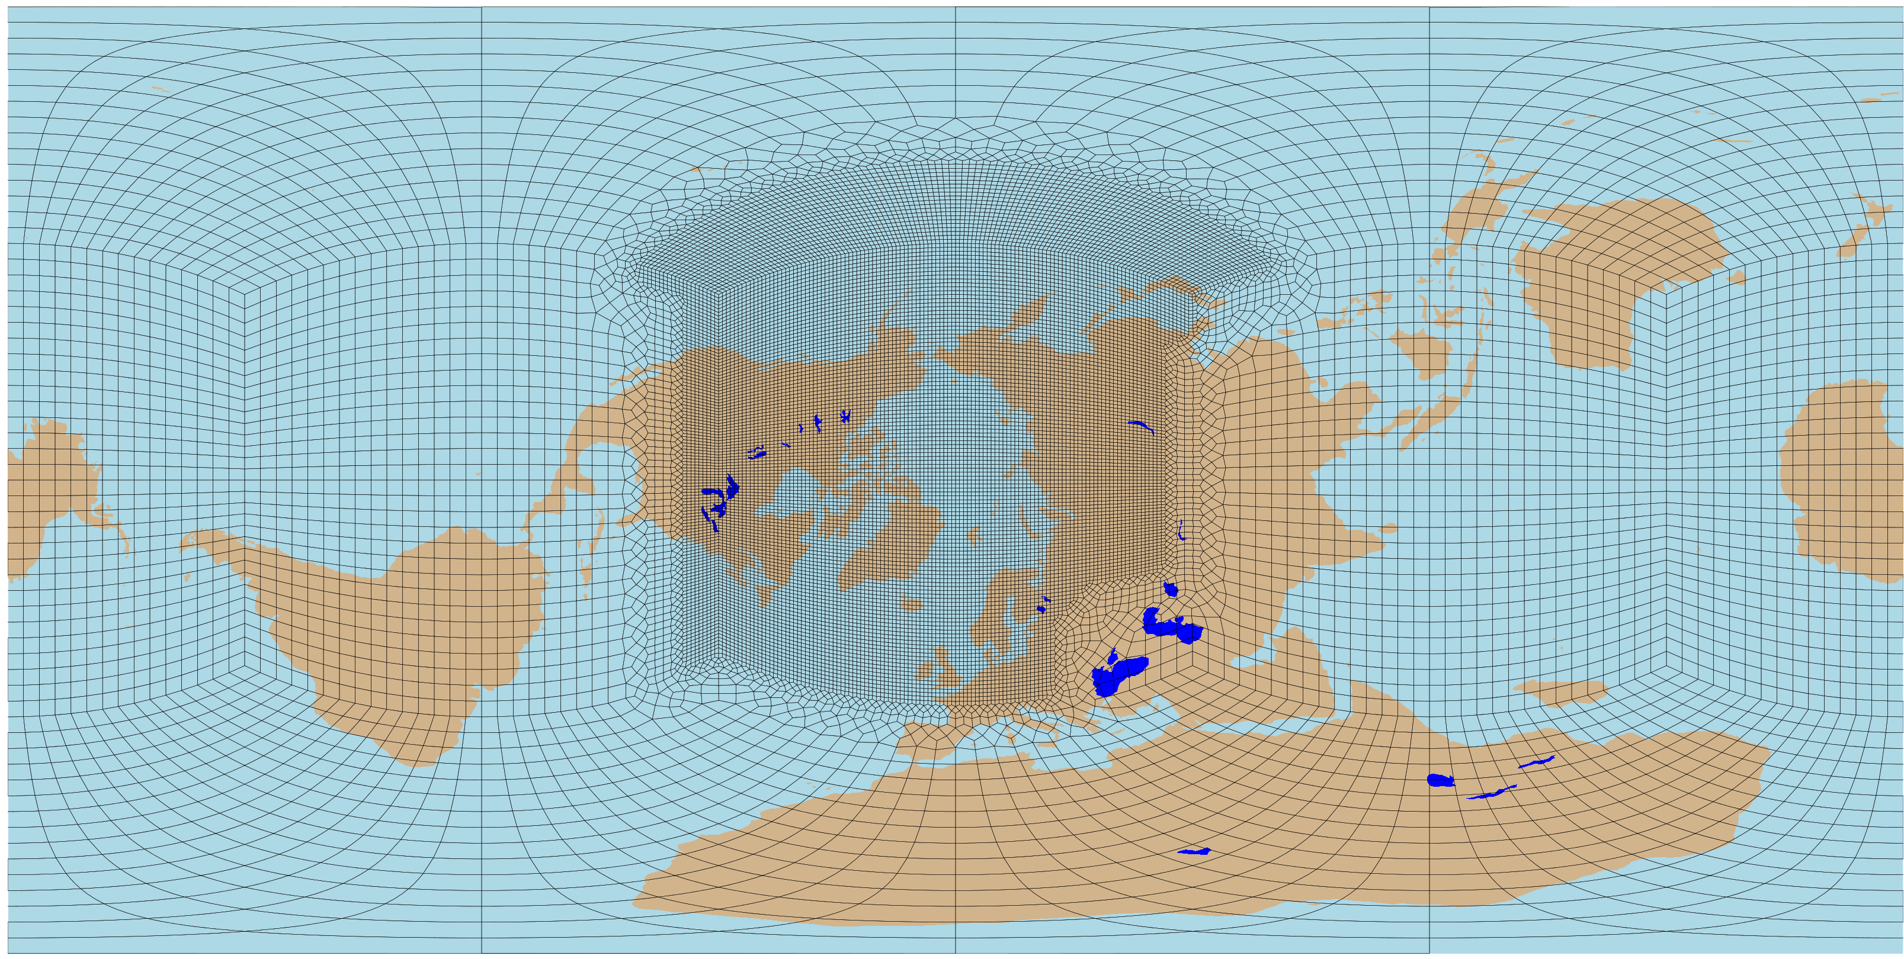
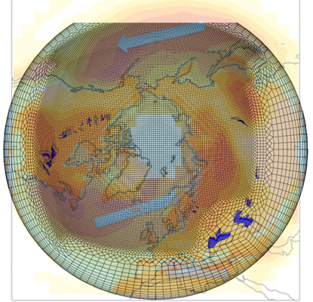
RRM-Arctic
An Arctic Grid for ACME with Storm Tracks v3
Number of Elements: 21,895
Resolution: 1 degree (low res) → 1/4 degree (high res)
Erika Roesler

Slide 14
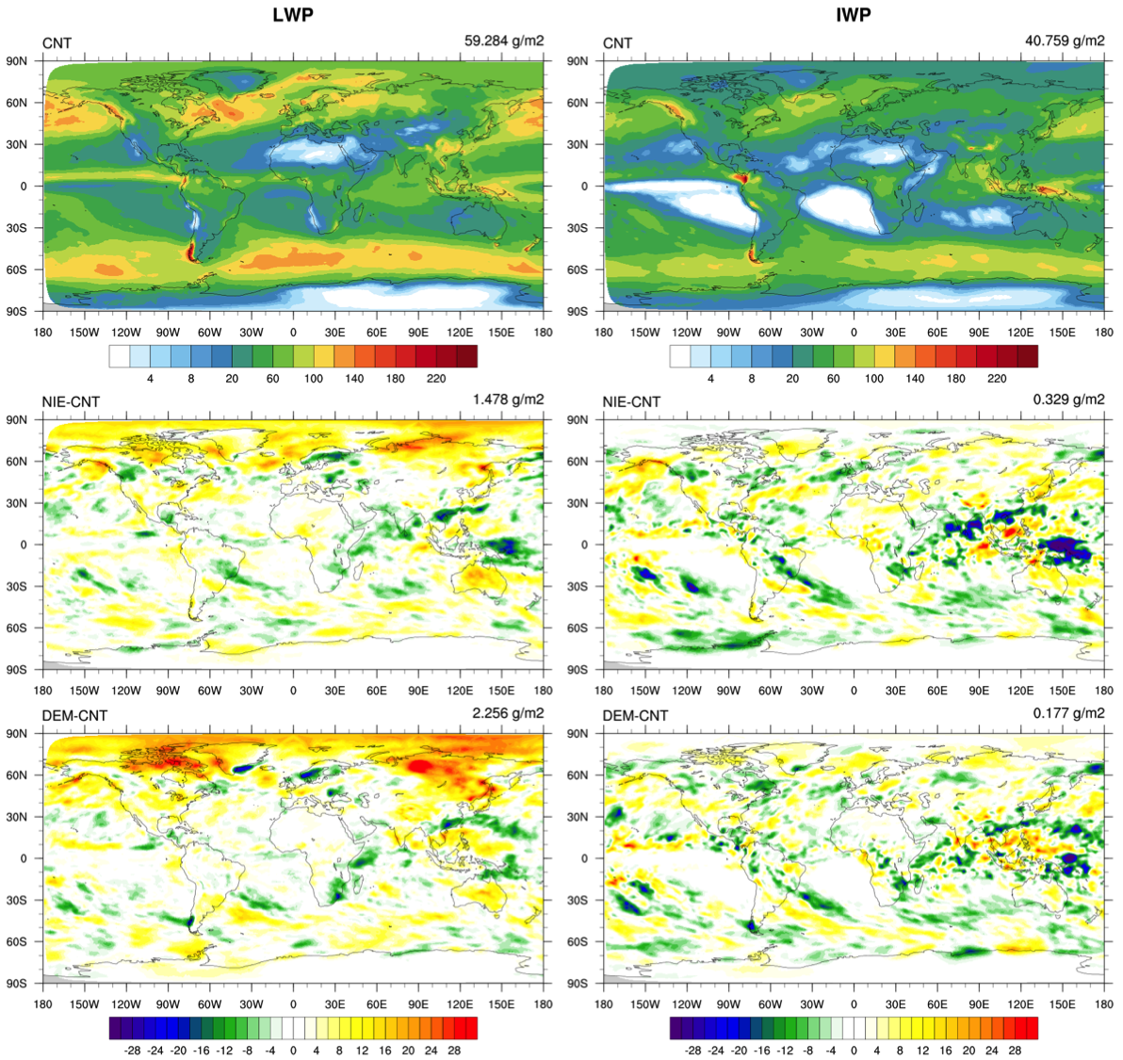
Arctic Mixed-phase Clouds Simulated with A New IN Scheme
ACME global testing with three ice nucleation schemes: Classical Nucleation theory (CNT, Wang et al. 2014); Niemand et al. (2012); DeMott et al. (2015)
LWP
IWP
CNT
(default)
Niemand -CNT
DeMott - CNT
Notes:
Use default FC5AV1C-04P2 compset
LWP increases in NH high latitudes with the Niemand and DeMott compared to CNT
LWP include rain and IWP include snow

Slide 15
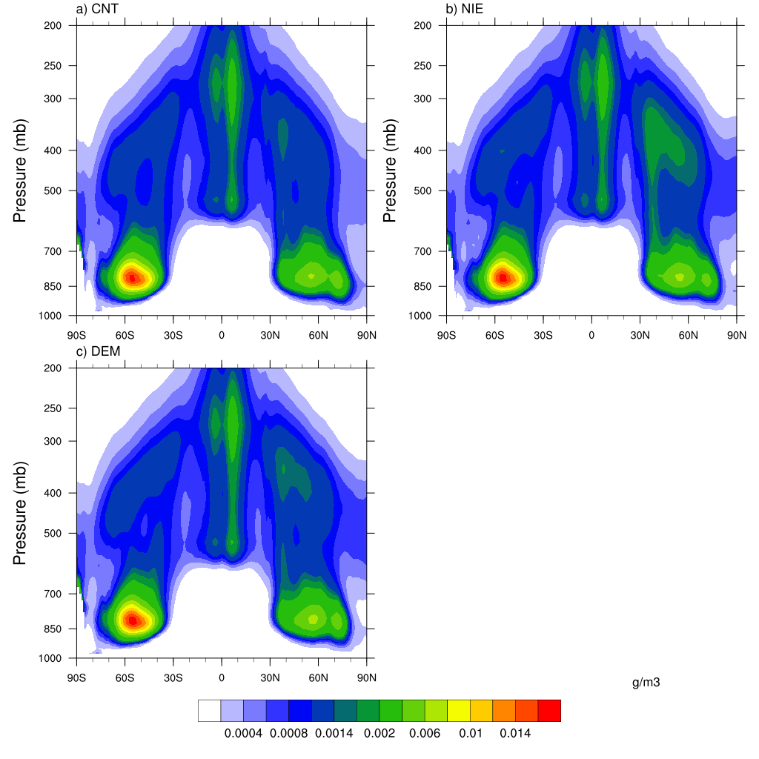
Arctic Mixed-phase Clouds Simulated with A New IN Scheme
ACME global testing with three ice nucleation schemes: Classical Nucleation theory (CNT, Wang et al. 2014); Niemand et al. (2012); DeMott et al. (2015)
Niemand
CNT (default)
DeMott
Cloud Ice Water Content
Notes:
IWC only include cloud ice, without include snow

Slide 16
Substantial impact of light-absorbing particles (LAPs) in snow/ice on radiation, temperature and water cycle
Increase in annual FSNS (W m⁻²)
Increase in 2-m air T(k)
Left: Arctic/global mean is 1.3 and 0.3 W m⁻², respectively; 40% from new treatments
Right: Arctic/global mean is 0.18 and 0.05 K, respectively; 50% from new treatments
Annual moisture flux (W m⁻²)
Annual SWE on ice (mm)
Annual SWE over land (mm)
Bottom: LAPs-induced increase in annual mean surface moisture flux and decrease in snow water equivalent (SWE) over sea ice and land
Wang et al. (in preparation)
Notes:
ACME model has been modified to treat both interstitial and within-hydrometeor (snow/ice grains) BC utilize new BC-in-snow optical properties that depend on snow grain size and BC particle size; integrate other aerosol improvements in CAM with LAPs treatment in CLM4.5/CICE

Slide 17
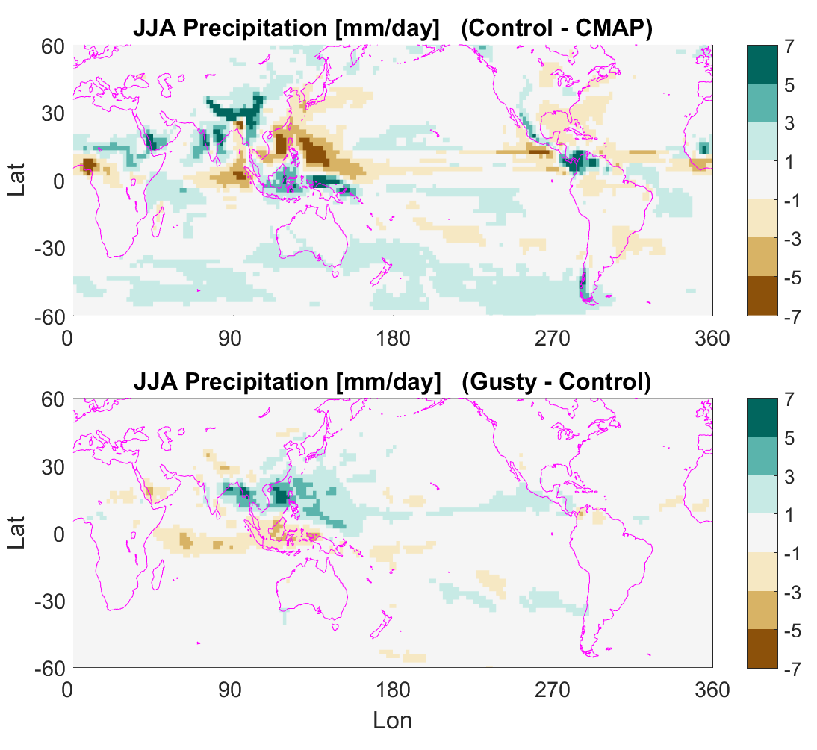
Tropical Precipitation Simulated with A Convective Gustiness Scheme
The parameterization is based on the Redelsperger (2000) empirical relationships between tropical convective activity and convective its associated mean near-surface wind.
Bryce Harrop et al. 2017

Slide 18
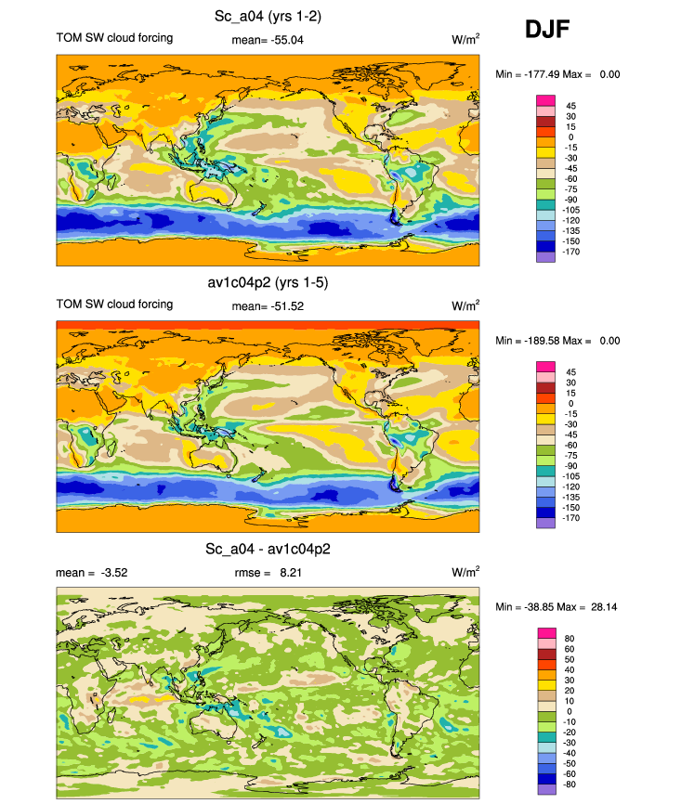
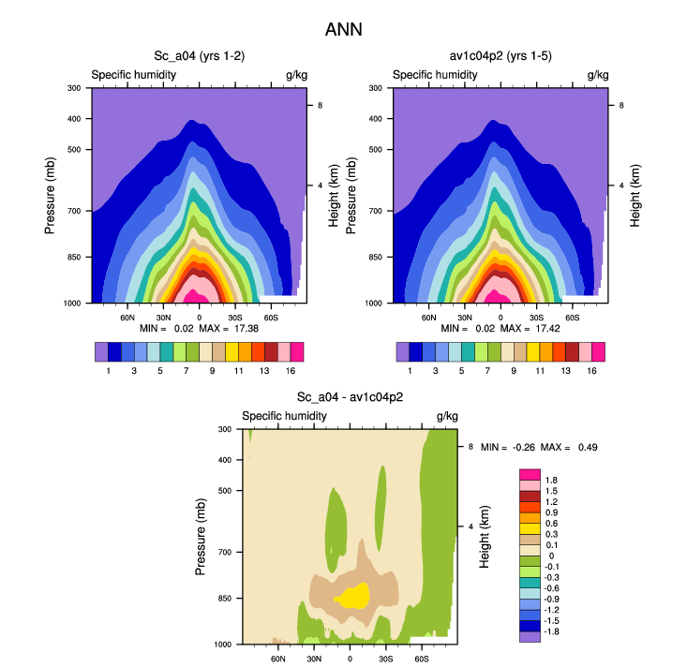
Skewness treatment in CLUBB to improve the Coastal Stratocumulus
ACMEV1 (AV1C04P2) + new tunings
ACMEV1 (AV1C04P2)
New - Default
Bias of vertical distribution of moisture in ACMEV1 (AV1C04P2) is also reduced.
Po-Lun Ma et al. 2017
Notes:
This slide shows that I have found the right way to increase coastal Sc. While in the past all our tunings result in primary brightening in the trade/shallow Cu regime, this is the first time that the primary response is the coastal Sc

Slide 19
ACME V3 Science Questions
Water Cycle – Moisture supply for precipitation over land
What controls the moisture sources and their spatial distribution for seasonal and extreme precipitation over land? How may they change in the future in response to perturbations?
What are the uncertainties associated with model resolution (from a few km to 100 km) and physics parameterizations?
BGC – Impacts of energy and landuse future on biogeochemistry and water availability
What are the impacts of different energy and landuse future on terrestrial biogeochemistry and water availability?
How might terrestrial-aquatic processes associated with the energy and landuse future combined with extreme events and regional sea level rise influence hypoxia in the coastal zone?
From ACME V2/V3 Plan (Leung et al. 2017)

Slide 20
Water Cycle V3 Features
Non-hydrostatic atmosphere dycore for convection permitting modeling with variable resolution configurations and MMF modeling (through ECP)
Eddy resolving ocean
Land subgrid heterogeneity with advanced hierarchical structure to capture and watershed modeling
Isotopic tracers or water tagging for quantification of moisture sources for land precipitation
Improved capability for:
Scale-aware parameterizations
Land-atmosphere interactions (e.g., lateral flow, plant hydraulics)
Air-sea interactions (e.g., response to buoyancy/wind stress forcing)
Response to forcing (e.g., aerosol-cloud-radiation interactions and effects of LULCC such as irrigation)
Notes:
How much data are available for isotopic modeling and evaluation?
LULCC – dynamic landunits
Need to improve representation of precipitation efficiency

Slide 21
Possible New Features for V3 Atmos
Things need to be considered for V3 scientific development:
Level of funding
$10M, $15M, and $20M
Strategies that leadership decide to use for next phase of ACME (how many staff, and must play to their strengths)
50% scientific developments, 25% infrastructure and integration; and 25% LCF machines/performances
Problems that we learn about as we gain experience with V1 and V2
Stratocumulus along the coast
Regional precipitation biases (e.g., lack of pr over Amazon), double ITCZ, diurnal cycle, MCSs and their propagation
ENSO
Surface wind stress
Surface warm biases over lands
Temperature bias near tropopause and in the stratosphere
AIE too strong?

Slide 22
Possible New Features for V3 Atmos
Convection (Shaocheng Xie, Phil Rasch, and Chris Golaz) – target to many outstanding model errors in V1 related to clouds and precipitation and their variability (stratocumulus, tropical precipitation, CRE, ENSO)
Scale-aware parameterizations
Alternates to CLUBB/ZM
CLUBB to deep, Innovations with ZM, EDMF, other candidates?
Microphysics in ZM
Convective gustiness (*** could be V2 ***)
Skewness treatment in CLUBB to improve trade-cu to strato-cu transition (*** could be V2 ***)
Elevation classes (Steve Ghan)
Non-hydrostatic Dycore (Mark Taylor)
Atmospheric Chemistry (Philip Cameron-smith)

Slide 23
Possible New Features for V3 Atmos
New aerosols/clouds (Hailong Wang)
Cloud microphysics
aerosol improvements
aerosol effects in convection
dust emission
convection effects on stratiform clouds, etc.
(anything particularly for AIE? – the new autocoversion scheme that is being tested at NCAR?)
Surface Model interactions (Susannah Burrows) (*** Could be V2 ***)
Connect Marine Organics through coupler
Couple DMS from Ocean to the Atmosphere
Modifications to Radiative Transfer Model (Phil Rasch)
Separate calculation of convective cloud from stratiform cloud
Modify cloud overlap assumptions in clouds
Add shell/core treatment for Aerosol Optics

Slide 24
Possible New Features for V3 Atmos (Cont.)
Improve Numerics (Phil Rasch, Mark Taylor)
Treatment of pressure gradient term
Change vertical coordinate
Revise dynamics to correctly deal with water energy
Improve treatment of total energy across model
More efficient tracer transport
Remap physics so it can occur at different resolution from dynamics

Slide 25
Possible New Features for V3 Atmos (Cont.)
RRM (Erika Roesler)
Other regions of interest
Non-hydrostatic dyncore, higher resolution
Satellite Simulators (Yuying Zhang)
GPM simulator for satellite observed brightness temperature and radar reflectivity
Aerosol simulator
ARM simulators
Tools for tuning
Short-Term PPE (*** not new ***)
CAPT (*** not new ***)
Diagnostics (Shaocheng Xie, Phil Rasch)
Monsoon Diagnostics
Global surface energy fluxes
???

Slide 26
Discussion Items
Reminder: Things need to be considered for V3 scientific development:
Level of funding
$10M, $15M, and $20M
Strategies that leadership decide to use for next phase of ACME (how many staff, and must play to their strengths)
50% scientific developments, 25% infrastructure and integration; and 25% LCF machines/performances
Problems that we learn about as we gain experience with V1 and V2
Stratocumulus along the coast
Regional precipitation biases (e.g., lack of pr over Amazon), double ITCZ, diurnal cycle, MCSs and their propagation
ENSO
Surface wind stress
Surface warm biases over lands
Temperature bias near tropopause and in the stratosphere
AIE too strong?

Slide 27
Discussion Items
Are we missing any efforts or features that can help address those outstanding errors in V1?
Surface wind stress
ENSO
AIE
Are we missing any efforts or features for the overall goal described in the V3 science drivers for Water Cycle?
Improved capability for:
Scale-aware parameterizations
Land-atmosphere interactions (e.g., lateral flow, plant hydraulics)
Air-sea interactions (e.g., response to buoyancy/wind stress forcing)
Response to forcing (e.g., aerosol-cloud-radiation interactions and effects of LULCC such as irrigation)

Slide 28
Discussion Items
There are too many topics proposed, even if we are fully funded. We need to prioritize the list and finalize a plan for discussion with ACME council
Atmospheric chemistry
A new autoconversion to improve AIE
Convection (selected activities)
Selected improvements in clouds/aerosols
Surface Model interactions
Selected improvements in radiative transfer model
Selected improvements in Numerics
Wind stress
Elevation class (?)
Non-hydrostatic dycore
RRM
Selected diagnostic tools
????
$10M list:
$15M list (add to the $10M list)
$20M list: (add to the $15M list)

Slide 29
Extra Slides
Notes:
Microbial and other processes addressed by NGEE
Unmanaged ecosystems
Dissolved oxygen - nitrogen

Slide 30
Biogeochemistry V3 Features
Improved modeling of processes that control the land carbon sink
Nitrogen cycle across earth system components for C-N modeling and connection to human activities
Ocean biogeochemistry (MARBL) and coupling with atmosphere
Representations of the energy-water-land nexus (e.g., land and water management)
Terrestrial carbon fluxes to inland waters
Carbon filtering across the terrestrial aquatic interface, coastal ocean processes and the ocean carbon cycle
Modeling natural and anthropogenic methane sources and sinks
Scenario development
From ACME V2/V3 Plan (Leung et al. 2017)
Notes:
Microbial and other processes addressed by NGEE
Unmanaged ecosystems
Dissolved oxygen - nitrogen

