Slide 1
Atmospheric System Research Overview for ACME
Ashley D. Williamson
Shaima L. Nasiri
ASR Program Managers
5 June, 2017
ACME meeting

Slide 2
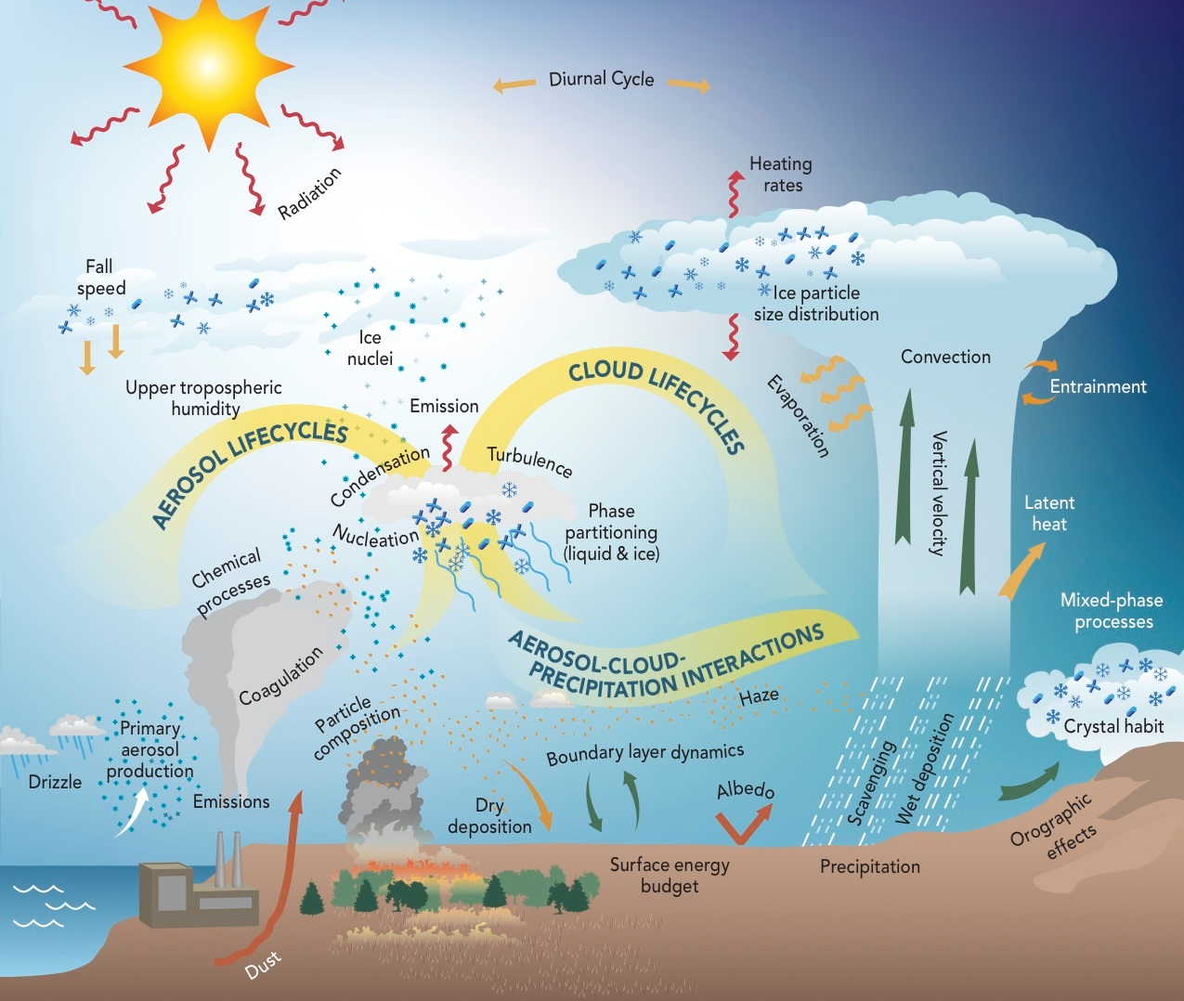
Atmospheric System Research (ASR)
ASR uses ARM observations, lab studies, and process models to address key uncertainties in processes associated with clouds and aerosols that affect the Earth’s radiative balance and hydrological cycle and limit the predictive ability of regional and global models.
https://asr.science.energy.gov/

Slide 3
ASR + ACME
ASR focuses on using observations to improve understanding of atmospheric processes
  Often at “native” scale
Multiple connections to modeling:
  Development of new parameterizations
  Testing of existing parameterizations and process representation
  Determination of missing processes
  Refining scale relationships
  Making multiscale a reality
ASR PIs are interested in ACME
  Open lines of communication
  Enable early adoption

Slide 4
ASR is organized into four working groups
The working groups represent ASR’s current research priorities
Aerosol Processes Working Group
  Nicole Riemer, University of Illinois
  Jim Smith, University of California, Irvine
Warm Boundary Layer Processes Working Group
  Rob Wood, University of Washington
  Yunyan Zhang, Lawrence Livermore National Laboratory
Convective Processes Working Group
  Anthony del Genio, NASA Goddard Institute for Space Studies
  Adam Varble, University of Utah
High Latitude Processes Working Group
  Gijs de Boer, University of Colorado
Notes:
Ask co-chairs to stand up

Slide 5
Aerosol processes working group
The Aerosol Processes working group seeks to improve the understanding of processes governing the spatial and temporal distribution of atmospheric particles and their chemical, microphysical, and optical properties. The goal is to reduce the uncertainty in climate radiative forcing due to aerosols.
Research topical areas include:
  new particle formation,
  the effects of aerosol composition, mixing state and physical properties on growth, aging, and removal processes
  the direct and indirect radiative impacts of optically absorbing aerosols, and
  identifying anthropogenic drivers that influence secondary organic aerosol concentrations and properties.

Slide 6
Warm boundary layer processes working group
The Warm Boundary Layer Processes working group seeks to improve understanding and model representation of processes controlling the structural and radiative properties of clouds, aerosols and their interactions with the underlying surface in the lowest few kilometers of the atmosphere.
Research topical areas include:
  characterization of boundary-layer and cloud dynamics,
  cloud and aerosol microphysics and their interactions,
  factors influencing cloud formation, and
  radiative processes
all of which together influence the vertical transfers of energy, moisture and atmospheric constituents.

Slide 7
Convective processes working group
The Convective Processes working group seeks to improve the understanding and model representation of convective cloud processes and properties including cloud cover, precipitation, life cycle, dynamics, and microphysics over a range of spatial scales.
Research topical areas include:
  convective vertical velocity and impacts on cloud microphysics and precipitation;
  transitions in cloud populations and mesoscale organization of convection; and
  interactions between cloud microphysics, aerosols, precipitation, and radiation.
Research approaches involve both direct observations and retrievals of environmental and cloud properties, as well as process development and improvement of convective parameterizations across the hierarchy of models.

Slide 8
High-latitude processes working group
The High Latitude Processes working group improves understanding and model representation of physical processes controlling the surface energy budgets in northern and southern high latitude regions.
This includes work to understand:
  cloud micro- and macrophysical properties, including phase partitioning and ice crystal properties;
  aerosol particle properties, including sources and transport, chemical and optical properties, and the role of aerosol particles in cloud structure;
  tropospheric states, including the role of clouds in atmospheric mixing and the role of meteorology and surface conditions on thermodynamic evolution;
  surface-atmosphere interactions, including elements impacting radiative and turbulent surface energy exchange.

Slide 9
ASR Science Focus Areas at DOE Labs
PNNL: Integrated Cloud, Land-surface, and Aerosol System Study (ICLASS) (new focus)
BNL-ANL: Influence of Aerosol and Cloud Processes on Climate (new focus and collaboration)
LLNL: SFA on Climate Change Research (joint SFA between RGCM and ASR)

Slide 10
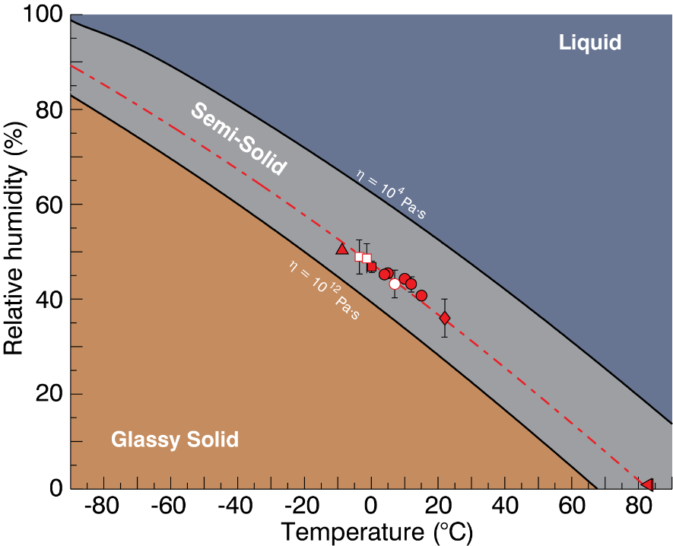
Phase diagrams for amorphous nanoscale organic aerosol
Motivation
High particle viscosity affects particle uptake of vapors, pollutant lifetime against oxidation or evaporation, and particle-cloud-climate interactions.
Observations of particle viscosity transitions are needed to develop, constrain, and improve the representation of aerosol phase in large scale models.
Approach
Develop novel quantitative viscosity measurement method for submicron aerosols.
Measure the temperature and RH onset of dimer coalescence to characterize the glass-to-liquid phase transition for particles.
Develop and constrain simple physical chemistry models of the phase-state diagram for organic aerosol.
For sucrose test aerosols, observed excellent agreement with macroscopic measurements.
Amorphous phase diagram of 100 nm sucrose aerosol
Impact
Defines a measurement and modeling framework for future development of well-constrained aerosol phase diagrams suitable for inclusion in climate models.
Extends viscosity measurements in the semi-solid regime to sub-200 nm particles. Approach can be applied to complex secondary organic aerosols.
Reference: Rothfuss, N. E and M. D. Petters. 2016a. "Coalescence-based assessment of aerosol phase state using dimers prepared through a dual-differential mobility analyzer technique" Aerosol Sci. Technol. 12, 1294-1305, doi:10.1080/02786826.2016.1221050 ; 2016b. “Characterization of the temperature and humidity-dependent phase diagram of amorphous nanoscale organic aerosol” Phys. Chem. Chem. Phys. 19, 6532-6545, doi:10.1039/c6cp08593h
Notes:
Background – experiments at PNNL have verified that for the most viscous particles, measurable differences occur in aerosol reactions, evaporation (lifetime), growth, and interaction with atmospheric water. These effects have been noted in several high impact publications since they are not represented in current models. Several approaches have been attempted to quantify the native viscosity of organic aerosol particles to evaluate these effects on real aerosols, but most are limited in reproducibility, viscosity or particle size range, or range of other important parameters. As part of a BER-funded project, Marcus Petters and his NC State group developed this elegant measurement technique applicable to organic aerosols over a key range of particle size and properties. The Aerosol Sci. & Technology measurement paper was highlighted by the journal editors as a “notable recent paper”.

Slide 11
Why do general circulation models overestimate the aerosol cloud lifetime effect?
Objective
Observation-based studies have shown that the aerosol cloud lifetime effect may be overestimated in climate models.
Determine the causes for increased liquid water path (LWP) in GCMs with increases in aerosols.
Approach
Compare a cloud resolving model (CRM) to the CAM single column model for a case of observed low level clouds at the ARM SGP site.
Use the LWP budget together with sensitivity studies to determine the causes of differences between the two models.
Normalized (LWP) predicted by CAM simulations with different autoconversion rates (red) and in the CRM model (blue) at different horizontal resolutions.
Impact
Enhanced entrainment at cloud top in the CRM allows more evaporation, outweighing the effects of decreases in autoconversion and accretion processes, and keeping LWP relatively constant with aerosol concentration.
GCM models need to allow increased mixing of dry air from above with increases in aerosols. This requires both increased vertical resolution and a scheme to allow aerosol number to directly impact cloud top mixing.
Zhou, C. and Penner, J. E.: Why do general circulation models overestimate the aerosol cloud lifetime effect? A case study comparing CAM5 and a CRM, Atmos. Chem. Phys., 17, 21-29, doi:10.5194/acp-17-21-2017, 2017.

Slide 12
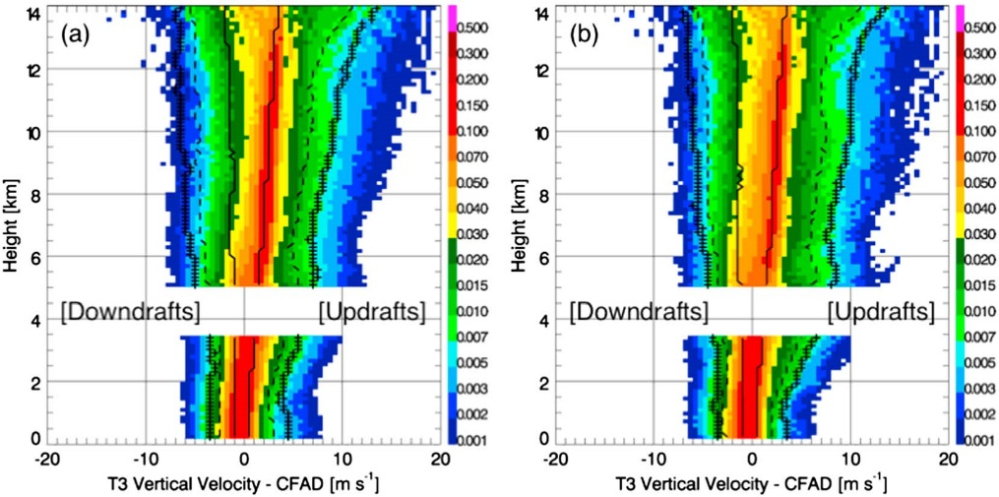
First Climatology of Vertical Velocity in Amazonian Clouds
Motivation
Current GCMs do not represent deep convection over the Amazon well
Observations of vertical velocity are needed to constrain and improve GCM parameterizations of deep convection
Approach
2 years of ARM radar wind profiler (RWP) data during GOAmazon are used to develop statistics on vertical velocities in Amazonian convection
Data are averaged over 1 or 3 hours to correspond to model grid cells of 20 km or 60 km resolution
Convective vertical velocity is related to corresponding environmental conditions
Frequency of vertical velocity by altitude for all clouds (left) and those with tops above 12 km (right).
Impact
Study provides the first climatology of vertical motion of Amazon clouds
Stronger vertical velocity profile behaviors are seen under higher convective available potential energy (CAPE) and lower low-level moisture conditions
Wet season regimes have higher domain-average mass flux profiles, attributed to more frequent convection that offsets weaker average convective cell vertical velocities
Reference: Giangrande SE, T Toto, MP Jensen, M Bartholomew, Z Feng, A Protat, C Williams, C Schumacher, and L Machado. 2016. "Convective cloud vertical velocity and mass-flux characteristics from radar wind profiler observations during GoAmazon2014/5." Journal of Geophysical Research: Atmospheres, 121(21), 10.1002/2016jd025303.

Slide 13
Rainfall during the Amazonian dry season is mainly controlled by non-local factors
Cloud Fraction Cumulus Days
Objectives
Understand what controls the transition from shallow-to-deep convection and formation of precipitation during the Amazonian dry season.
Determine why the number of precipitation events decreases as the dry season progresses.
Approach
Use data collected during the GOAmazon ARM campaign and contrast the diurnal cycles during 138 cumulus (no rain) days and 64 rainy days.
Study the progression of key variables during the dry season in the context of local and non-local precipitation events.
Cloud Fraction Rainy Days
Impact
Dry season daytime rainfall occurs during days with higher moisture content and cloudiness (figure) at low and mid-levels
Total dry season rainfall is primarily determined by the propagating storm systems
These factors can be incorporated into coarse resolution models to improve prediction of Amazonian dry season rainfall
Ghate. V. P., and P. Kollias, 2016: On the controls of daytime precipitation in the Amazonian dry season. J. Hydrometeor., 17, 1379-1397.
Notes:
Virendra Ghate – ANL; Pavlos Kollias – BNL
Figures show time-height mapping of the averaged diurnal cycle of cloud fraction calculated from 138 cumulus days and 64 precipitation days. The diurnal cycle of hydrometeor fraction during non-rainy cumulus days (top) and during rainy days (bottom) as reported by the combined observations of vertically pointing radar and lidars. The black line depicts the first cloud base height, while the magenta line shows the lifting condensation level (LCL). The nighttime cloud cover was higher during rainy days than during non-rainy days.
Dry season was defined as 1 June – 30 September. GO Amazon was in 2014 and 2015.
Cumulus Days (no rain) – 138; Daytime rain events – 64;
All results were statistically significant. The precipitation days had higher moisture at low and mid-levels, lower CIN and lower LCL than the cumulus days. We also looked at the continuity of rainfall to test if the rainfall comes in packages, and our conclusions were still the same. The number of nighttime rain events per month decreased during the progression of dry season, but the number of daytime rain events per month stayed the same.
https://asr.science.energy.gov/science/research-highlights/RNzIx/view

