Slide 1

Asynchronous warming and δ¹⁸O evolution of deep Atlantic water masses during the last deglaciation
Jiaxu Zhangª, Zhengyu Liu^{a,b}, Esther C. Brady^{c}, Delia W. Oppo^{d}, Peter U. Clark^{e}, Alexandra Jahn^{f}, Shaun A. Marcott^{g} & Keith Lindsay^{c}
ª Department of Atmospheric and Oceanic Sciences and Center for Climatic Research, University of Wisconsin-Madison
^{b} Climate and Global Dynamics Division, National Center for Atmospheric Research
^{c} Atmospheric Science Program, Department of Geography, Ohio State University
^{d} Department of Geology and Geophysics, Woods Hole Oceanographic Institution
^{e} Department of Geosciences, Oregon State University
^{f} Department of Atmospheric and Oceanic Sciences and the Institute of Arctic and Alpine Research, University of Colorado Boulder
^{g} Department of Geoscience, University of Wisconsin-Madison
(Zhang et al., 2017, Proc. Natl. Acad. Sci., doi:10.1073/pnas.1704512114)

Slide 2
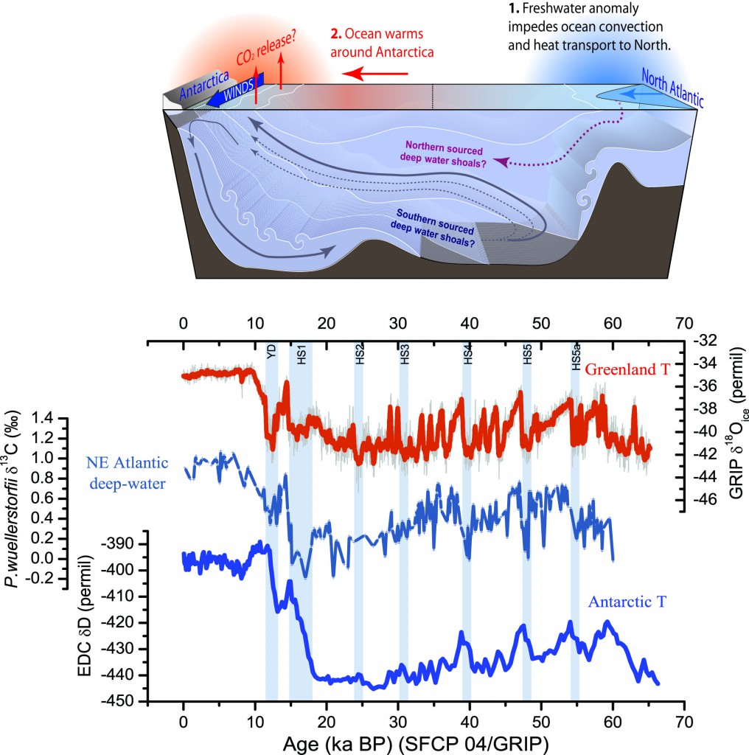
The last deglaciation (19-11 ka)
During the last deglaciation, the warming of the Earth was punctuated by a few abrupt cooling and warming events
Heinrich Stadial 1 (HS1, ~17.5 ka) event
ocean surface: bipolar seesaw effect
deep ocean: circulation? temperature? water masses?
Why do we care:
  atmospheric CO₂ changes
  assess model fidelity for future prediction
???
???
(From Luke Skinner research homepage)
Notes:
During the LGM, sea level was about 125 meters (about 410 feet) lower than it is today. The global mean temperature was 3-5 C cooler than present.

Slide 3
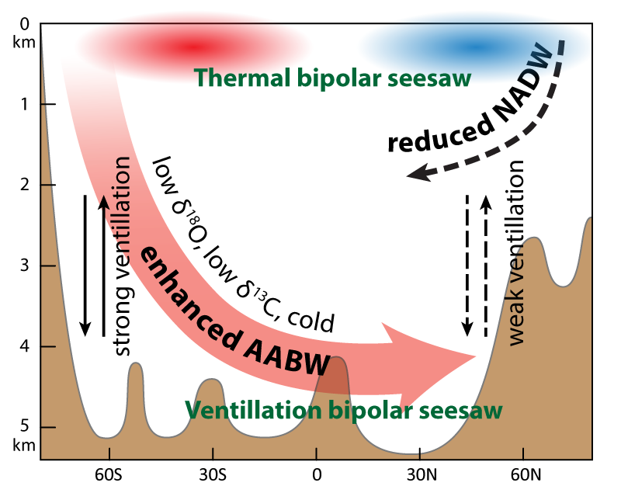
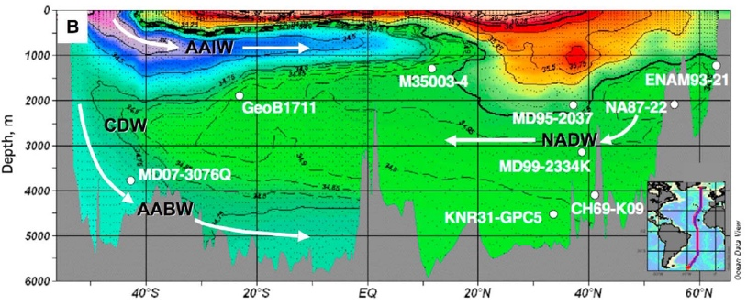
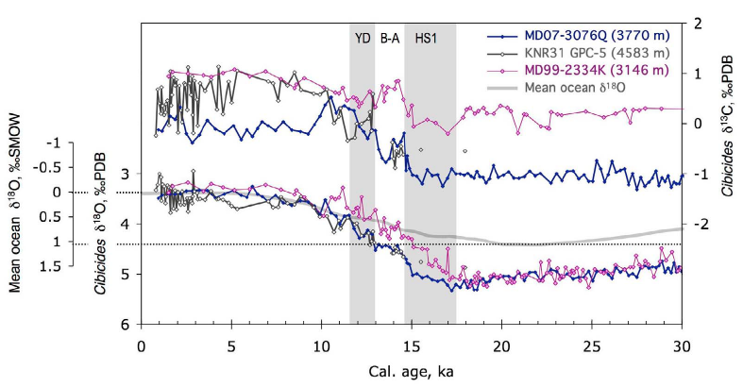
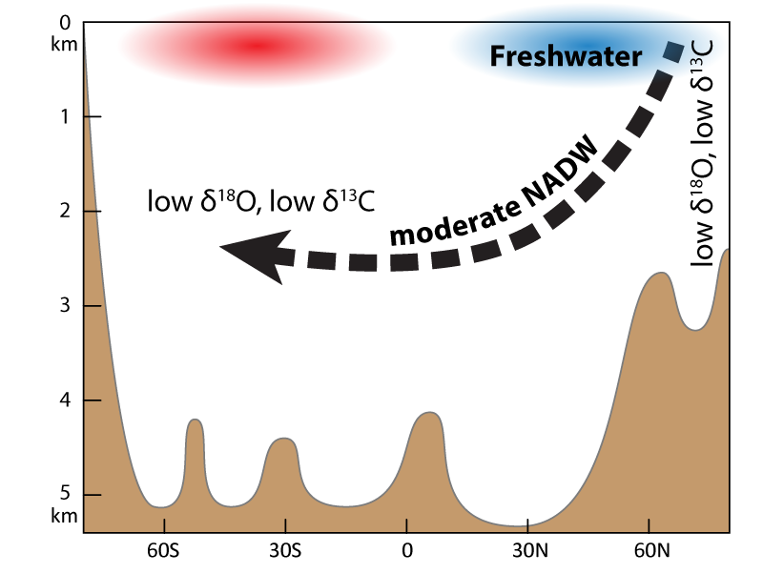
HS1 δ¹⁸O phasing: Southern- vs. Northern-source hypotheses
“Southern-source” hypothesis
MD99-2334K
(37.8°N, 3146 m)
MD07-3076Q
(44.2°S, 3770 m)
“Northern-source” hypothesis
(Waelbroeck et al. 2011)

Slide 4
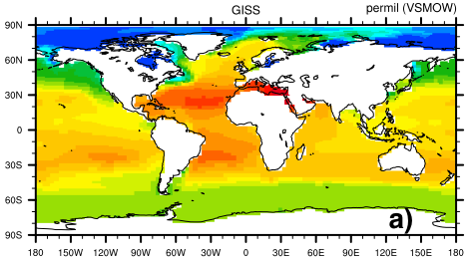
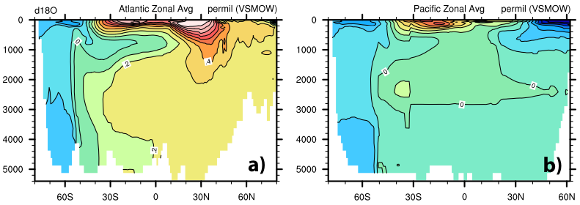
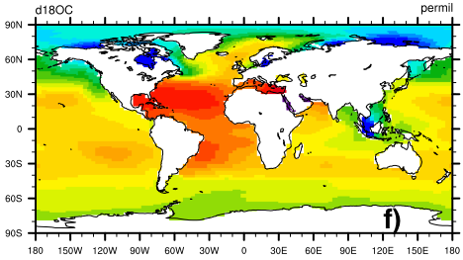
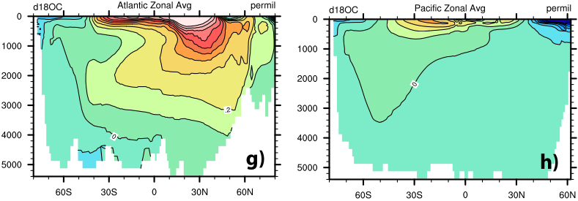
δ¹⁸O-enabled POP2 model
AAIW
GISS Observation
NADW
AABW
Atlantic
Pacific
iPOP2
Model is able to resolve AAIW, NADW and AABW water signatures.
The LGM global mean δ¹⁸O is 1.0‰ greater than present.
➔ Suitable for paleoclimate research purposes
Global mean δ¹⁸O (‰) | Observation | Model
Modern | 0.059 | 0.050
LGM (22 ka) | 1.0±0.1 | 1.05

Slide 5
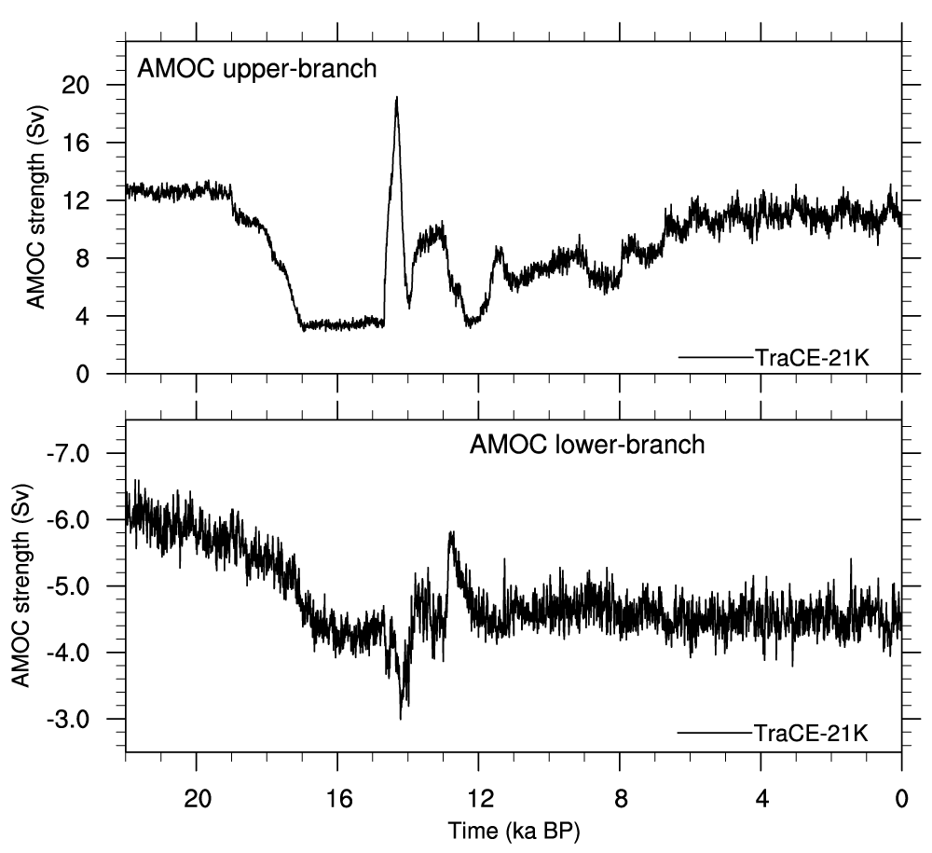
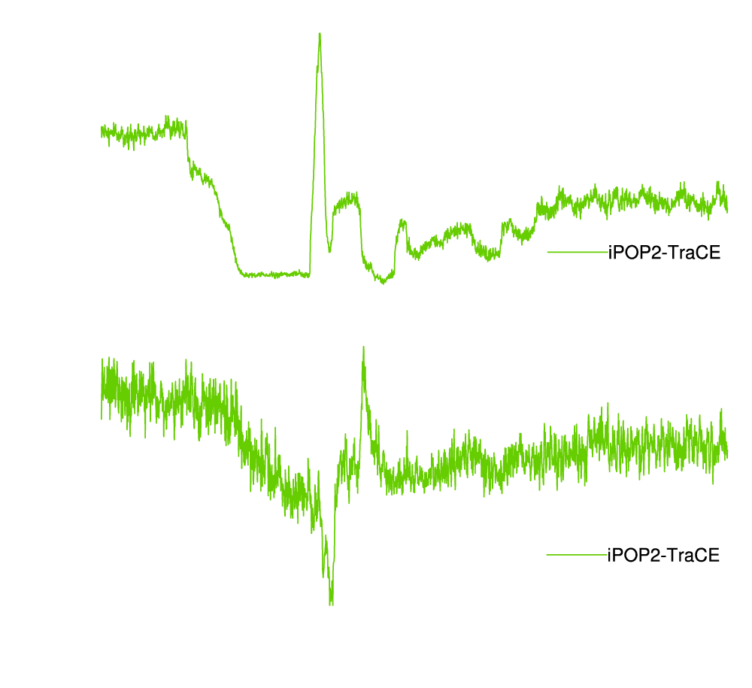
iPOP2-TRACE (22,000 yr) comparing with TRACE21
Model simulated AMOC intensity
TRACE21 (22 ka to present), fully coupled GCM (CCSM3) simulation forced by transient
  Insolation, greenhouse gases, land ice sheet, and meltwater flux
Hybrid surface boundary condition
  Monthly history files
  Heat flux + strong restoring SST
  Freshwater flux + weak restoring SSS

Slide 6
Deep circulation scenario
During the LGM: strong AABW formation, strong abyssal overturning, basin-wide expansion of AABW.
During HS1: both NADW and AABW formation decreased, with the former decreasing much more.
Notes:
During HS1, NADW formation reduced dramatically due to massive iceberg discharge and melting, while the AABW formation also decreased modestly due to surface warming and reduced brine rejection (Extended Data Fig. 1a and b; 3e and f). The deep NA therefore witnessed decreased ventilation by both northern and the southern sources, with the former decreasing much more. The deep NA became strongly isolated, and was slowly renewed by AABW through the abyssal overturning, which allowed for limited ¹⁸O-depleted meltwater penetration into the deep Atlantic.

Slide 7
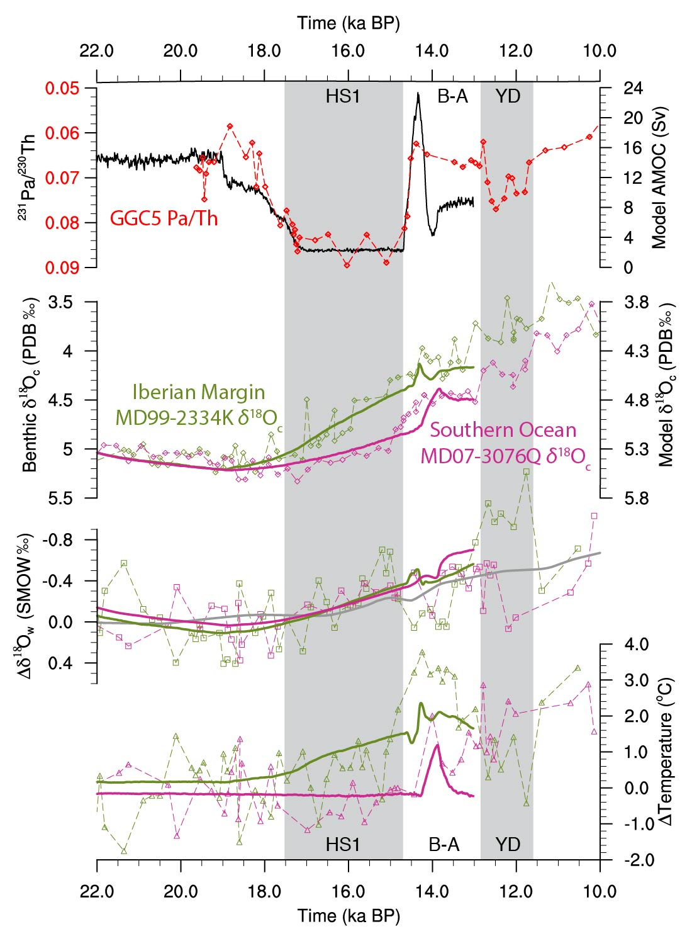
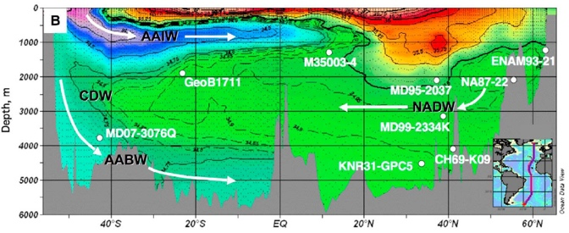
Contribution of δ¹⁸O_{w} and temperature
Iberian Margin MD99-2334K
(37.8°N, 3146 m)
A
B
Southern Ocean MD07-3076Q
(44.2°S, 3770 m)
C
The greater warming in the NA, rather than changes of the water δ¹⁸O, is the main cause of the observed lead of the deglacial NA benthic δ¹⁸O decrease over that of the SA.
D
Notes:
The decrease of NA δ¹⁸O_{w} is slightly greater as the NA site is closer to the meltwater source, but the difference is too small to explain the observed large differences in δ¹⁸O_{c} decrease between core sites.

Slide 8
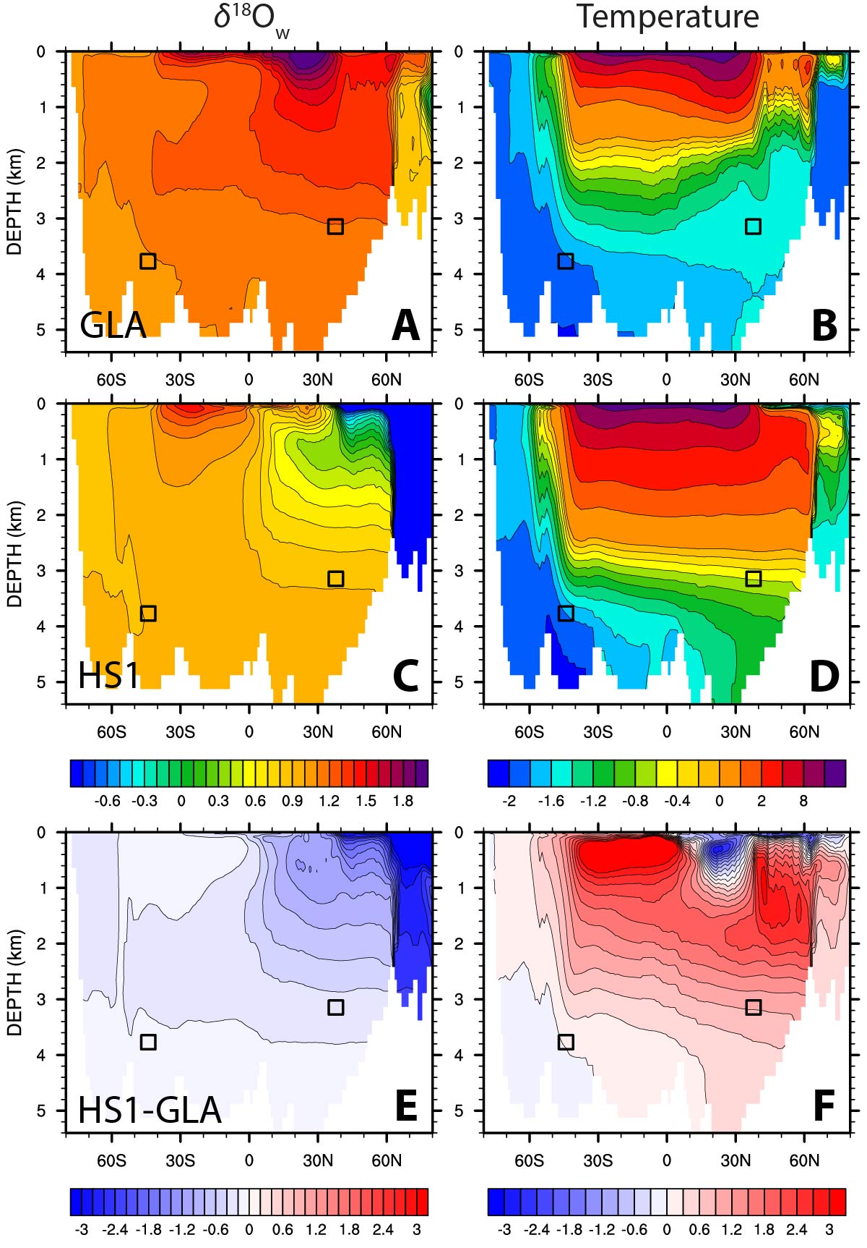
Atlantic zonal mean δ¹⁸O_{w} and temperature
What we learn from the model δ¹⁸O_{w}
Trapped in the upper NA and within the Nordic Seas
  collapsed deep-water formation and the associated Nordic Sea overflows.
Bottom occupied by AABW, limited penetration.
  → mild depletion in the whole deep Atlantic.
What we learn from the model temperature
NH cooling and SH warming: bipolar seesaw
NH subsurface warming centers at 1500 m, 1000 m deeper than that of the SH.
Tilted warming.
Why asymmetric deep warming?

Slide 9
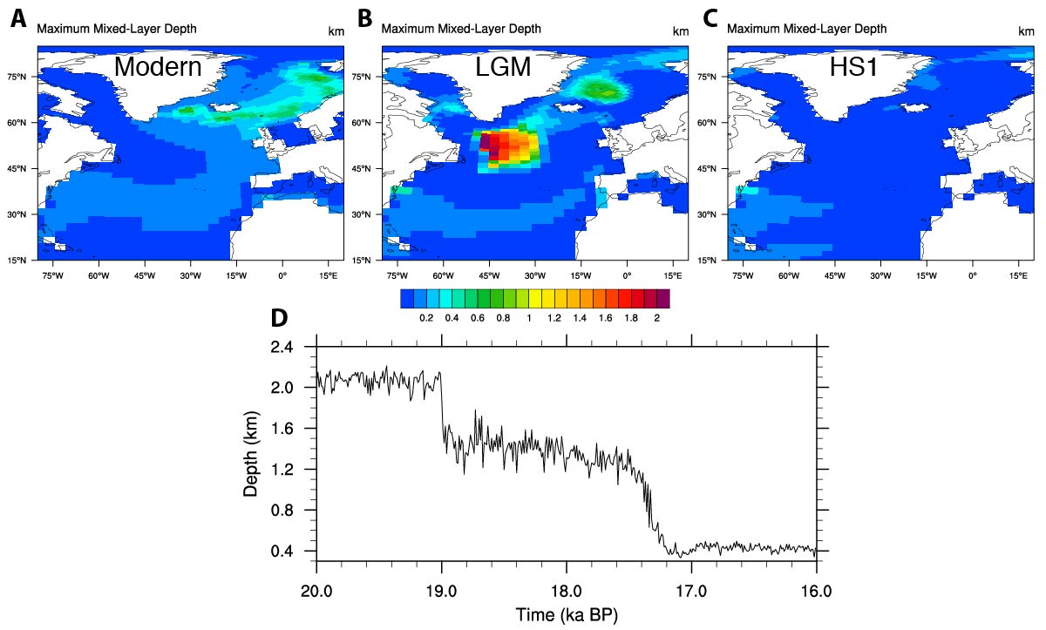
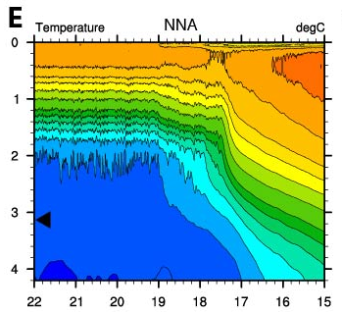
Q: Why N-warming, no S-warming?
Winter (DJF) maximum mixed layer depth
Strong atmospheric cooling
Sea surface
Deep convection
Warm

Slide 10
Summary
Isotope-enabled climate models are useful tools for paleoclimate studies.
Debate: Southern- vs. northern-sourced deep-water input during the HS1.
Transient ocean simulation of the past 22,000 years in iPOP2.
Major findings:
  Reduced AABW production and transport with a reduced AMOC.
  Early warming in the North Atlantic, no warming in the Southern Ocean → explains the lead of the northern benthic δ¹⁸O.
  Warming mechanism in the North Atlantic: Winter-time deep convection retreat → a mid-depth warming → enhanced vertical diffusive heat flux brings down heat to the deep ocean.

