Slide 1
The New ACME Diagnostics Package
June 7th 2017
Team: Chengzhu Zhang, Zeshawn Shaheen, Chris Golaz, Jerry Potter
Thanks to: Charles Doutriaux, Jim McEnerney, Jeff Painter, Denis Nadeau, Charlie Zender, Renata McCoy and Dean N. Williams
This work was performed under the auspices of the U.S. Department of Energy by Lawrence Livermore
National Laboratory under contract DE-AC52-07NA27344. Lawrence Livermore National Security, LLC. LLNL-Press-732384

Slide 2
Overview
A comprehensive diagnostics package that:
Developed in Python
Fully implements the functionality of AMWG diagnostics package
Is flexible for adding user-specified diagnostics
Delivers valuable diagnostics developed from ACME to the community
Maintains repo for most updated observational datasets, including remote sensing, reanalysis and in-situ datasets
Interacts effectively with the PCMDI's metrics package PMP and the ARM diagnostics package through a unified framework: Community Diagnostics Package (CDP).

Slide 3
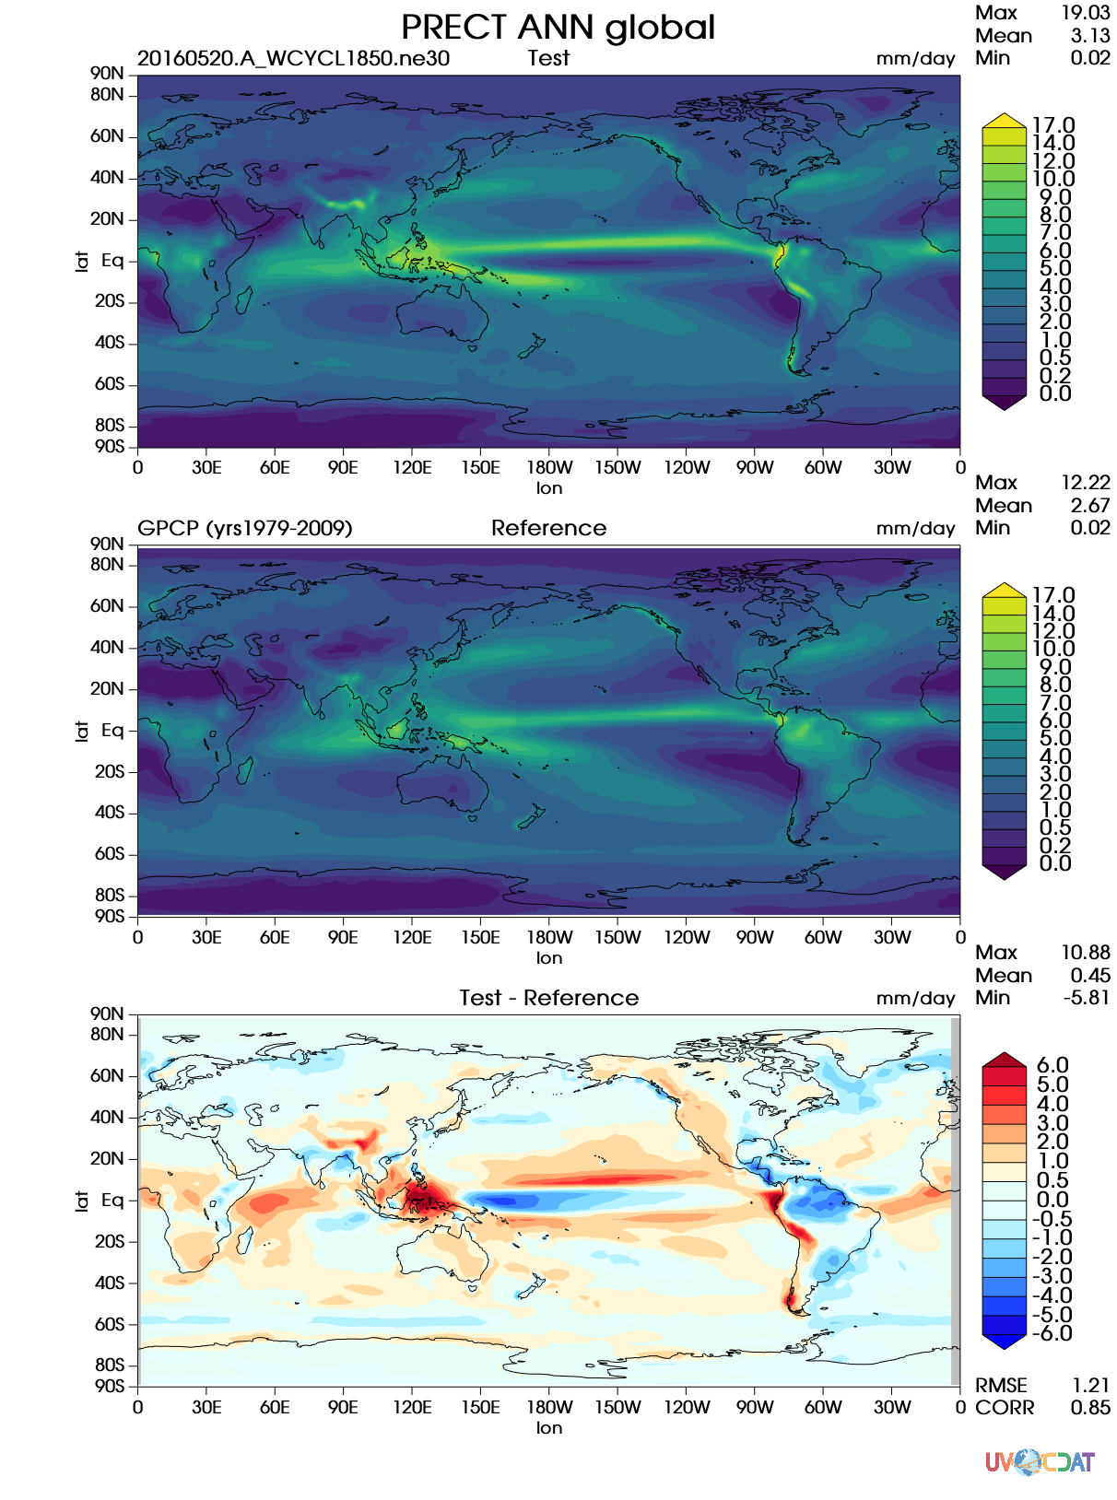
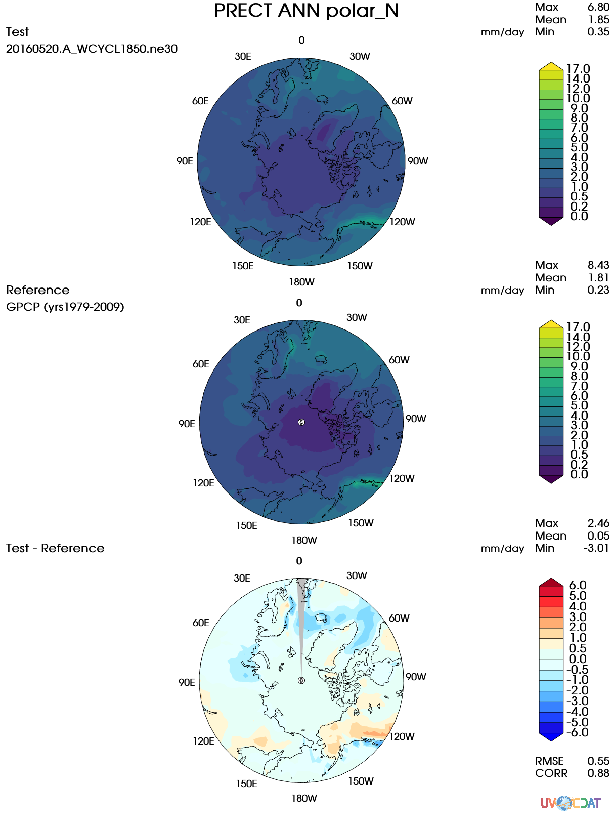
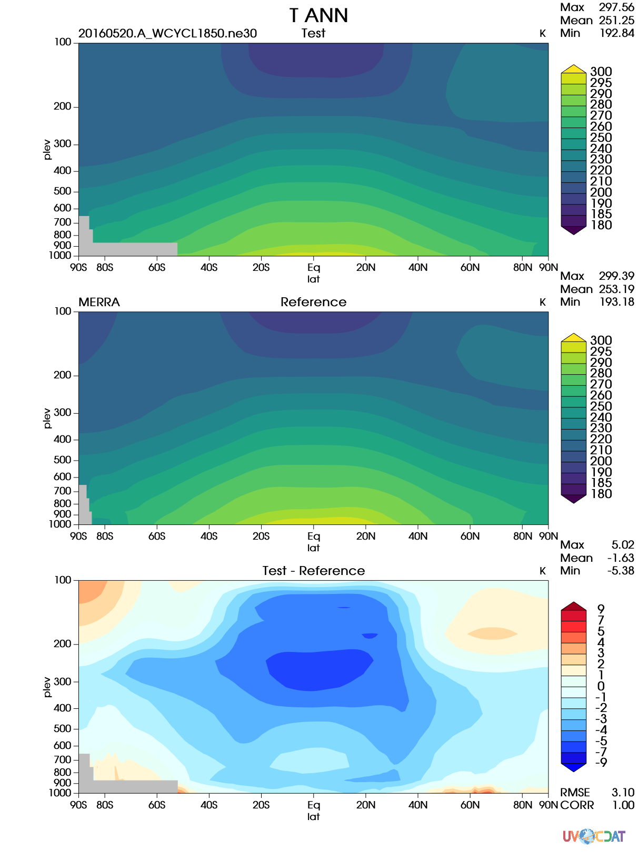
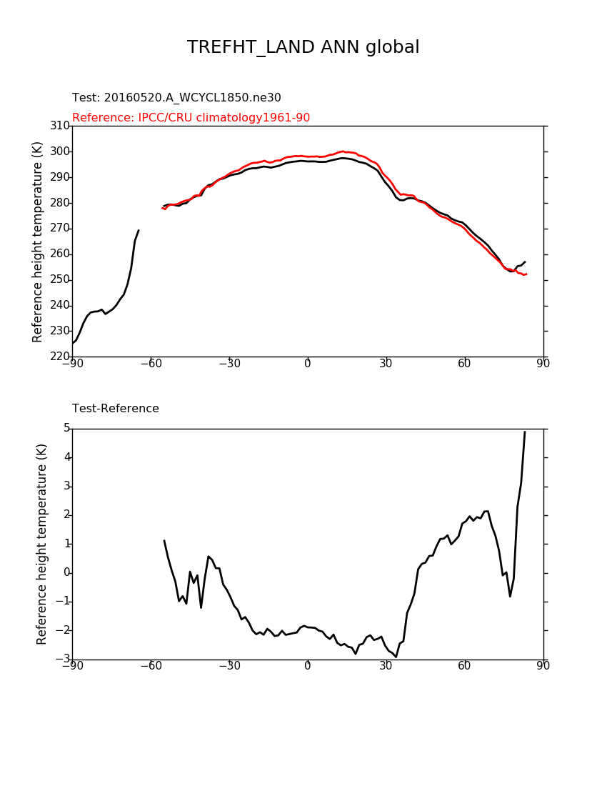
Current states
4 sets of diagnostics from AMWG with mod. vs obs., mod vs mod
Set5 Lat-Lon contour
Set7 Polar projection contour
Set4 Zonal Mean with height contour
Set3 Zonal Mean line

Slide 4
Current states
Reproduce and complete these sets: metrics matched, differences understood
Calculated metrics [RMSE, correlation] as scalars of model performance
NetCDF files can be downloaded from server side
Flexible architecture for implementing new diagnostics

Slide 5
Features: clean and simple design
acme_diags/
acme_diags_driver.py # main driver which calls individual drivers of each set
driver/ # individual driver for file I/O, calculation, save data and metrics
set5_driver.py
set7_driver.py
…
plot/ #plotting based on data and metrics
vcs/ #vcs graphing back end
set5.py
set7.py
…
cartopy/ #matplotlib/cartopy graphing back end
set5.py
set7.py
…
acme_parameter.py #Supported parameters for configuration
acme_parser.py #Supported command line options
acme_viewer.py #Create output viewer to view and share results.
derivations/…
metrics/…
Notes:
A clean code base can help us in a long run, this is easy to maintain and more accessible to other scienist like chris to join as developers to contribute this program.
200 lines of code for each individual driver
Calculation and plotting are cleanly decoupled.
Add plotting scripts

Slide 6
Features: flexible configuration
Run: acme_diags_driver.py -p myparams.py [-d mydiags.json]
A python script: myparams.py
reference_data_path = '/space1/obs_data_20140804/'
test_data_path = '/space/golaz1/ACME_simulations/' test_name = '20160520.A_WCYCL1850.ne30
_oEC.edison.alpha6_01 '
sets = [5]
diff_colormap = 'bl_to_darkred'
Seasons =[“ANN”, "DJF", "MAM", "JJA", "SON"]
backend = ‘vcs'
Parameters
Path to obs/model data
Set number (3, 4, 5, 7)
Variables
Seasons
Regions
Pressure levels
Regridding tool/method
more
Plotting:
Titles
Backend (vcs, matplotlib)
Output format(png,pdf,svg)
Colormap
more
A json script: mydiags.json
{ "set5":
[ { "case_id": "set5_GPCP",
"variables": ["PRECT"],
"ref_name": "GPCP",
"reference_name": "GPCP (yrs1979-2009)",
"regions": ["global”, "ocean_TROPICS","TRMM_region"],
"contour_levels": [0, 0.2, 0.5, 1, 2, 3, 4, 5, 6, 7, 8, 9, 10],
"diff_levels": [-6, -5, -4, -3, -2, -1, -0.5, 0, 0.5, 1, 2, 3, 4] }

Slide 7
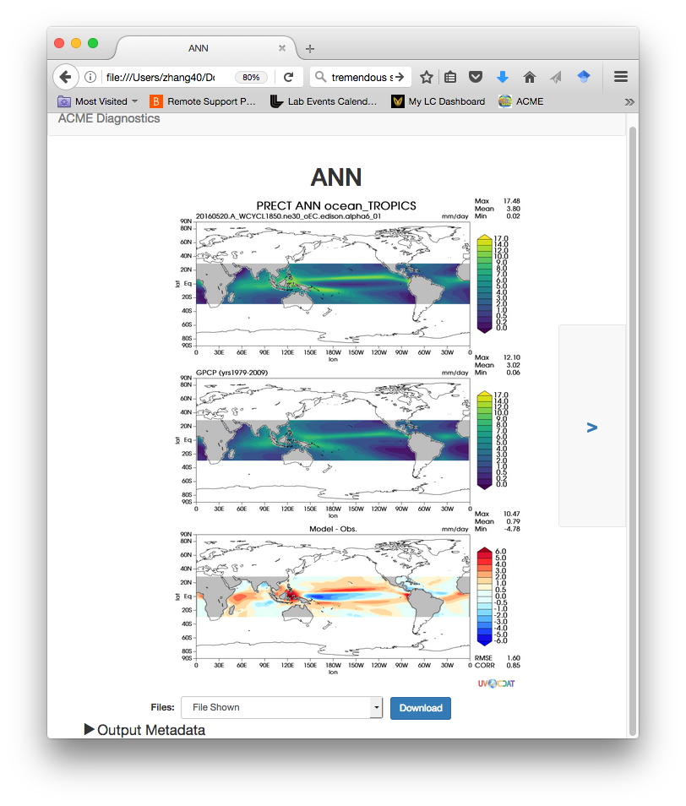
Example: GPCP with different regions

Slide 8
Features: flexible for derived variables
Derived variables: variable(s) needing preprocessing before calculation. i.e. total precipitation rate [PRECT]
PRECT = PRECL + PRECC
Unit conversion: into mm/day
Built-in derived variables list for ACME output, adjustable for CMIP conventions.
User expandable in configuration files

Slide 9
Installation and Running
One command to install:
conda install acme_diags -c acme -c conda-forge -c uvcdat
Edit scripts for configuration
Multiple Uses:
1.Defualt AMWG set run
acme_diags_driver.py -p myparam.py
2. Modify json file to have a subset of AMWG run
acme_diags_driver.py -p myparam.py –d modified_AMWG.json
3.Create customized json to include new observational data.

Slide 10
Documentation https://github.com/zshaheen/acme_diags
Quickstart guide for AIMS4
Installation, Basic Configuration, and Running
More Configuration
Defining Parameters and All Available Parameters
Adding User Diagnostics
List of Built-in Derived Variables
CDP Viewer documentation

Slide 11
Planned Features
Add additional diagnostics sets based ACME needs
Set 1 & 2 from AMWG
Atmospheric diags
Wind vectors, cloud diagnostics, aerosols…
Updated observational datasets
Parallel distributed running on a cluster, run faster
Integrate with ACME Workflow

