Slide 1
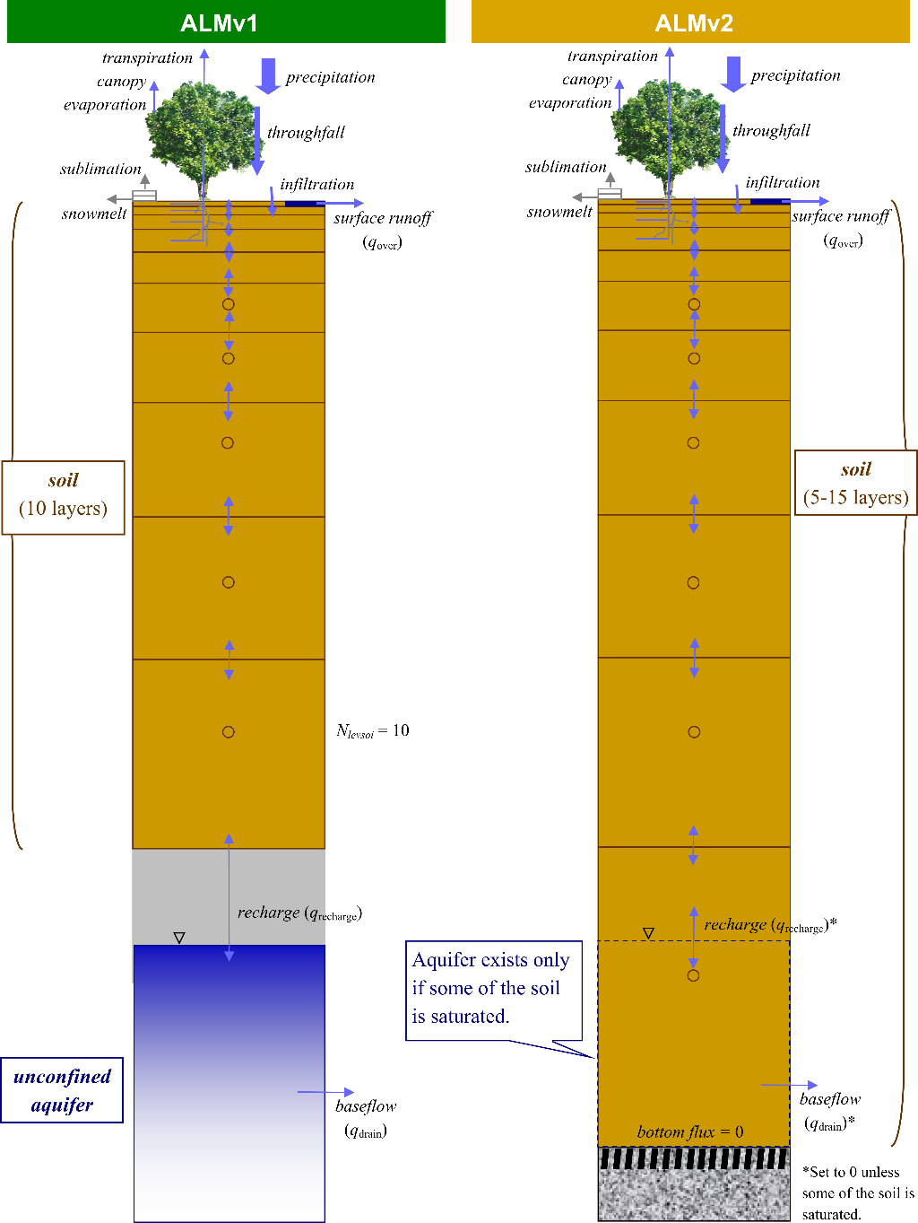
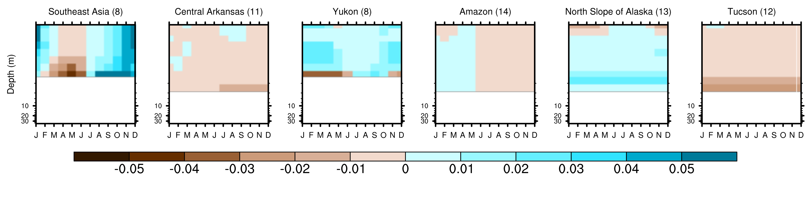
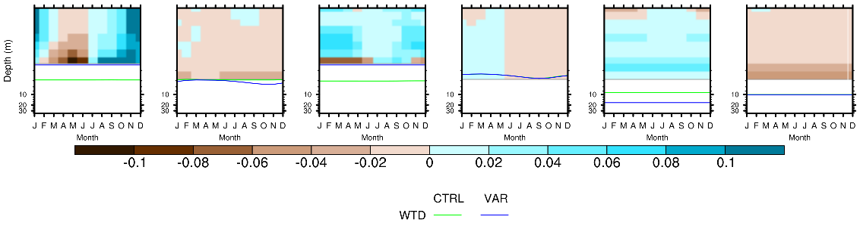
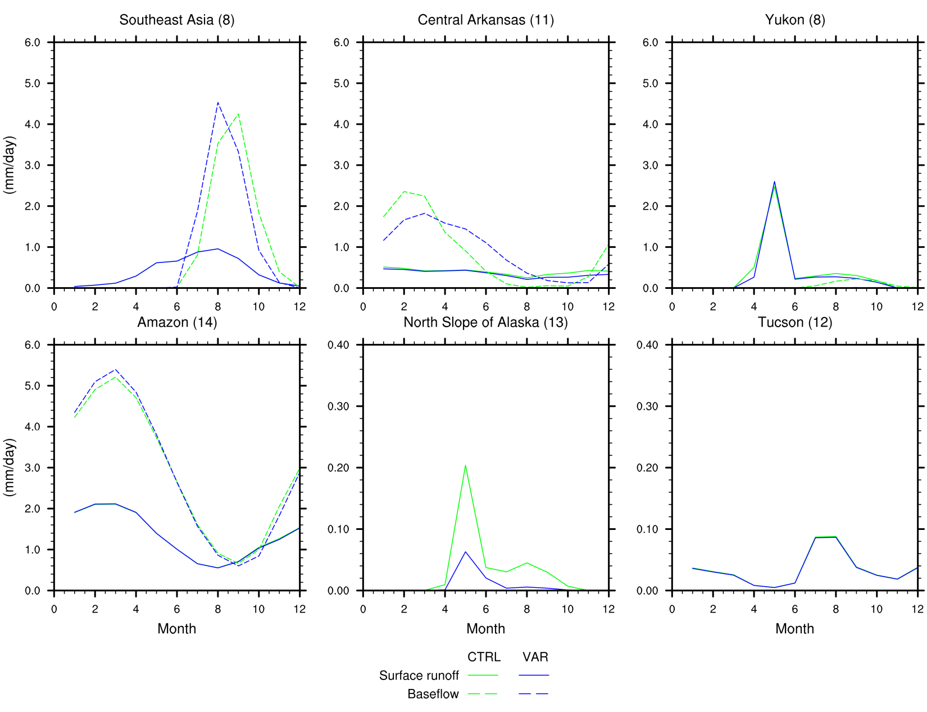
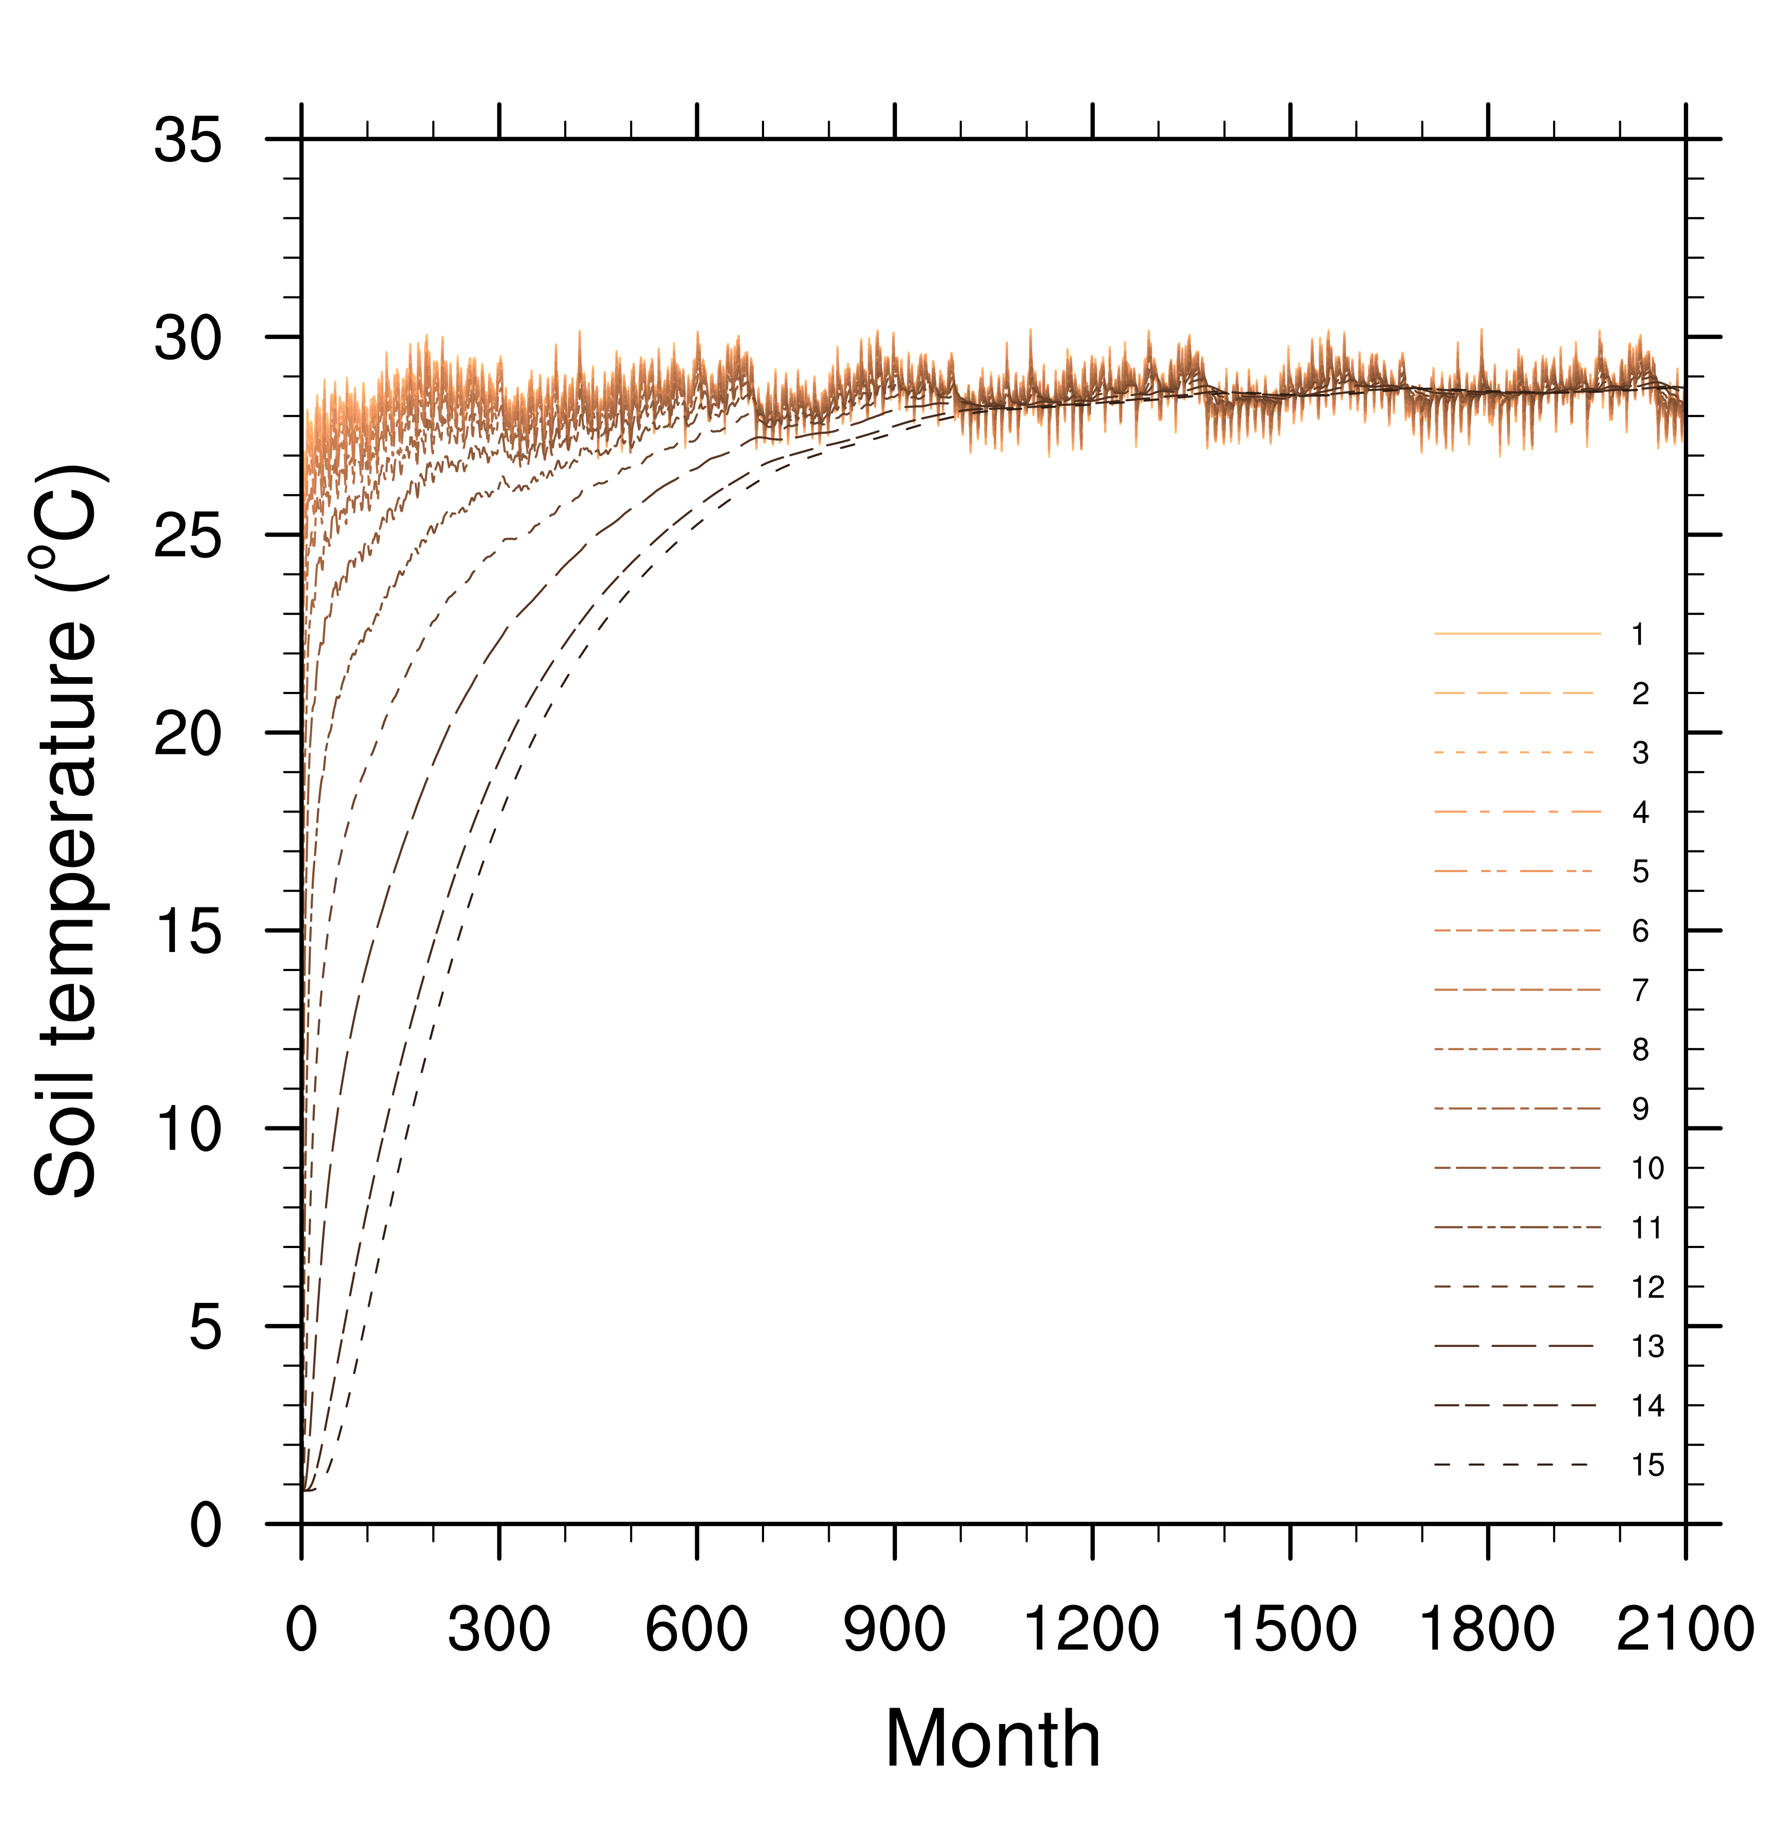
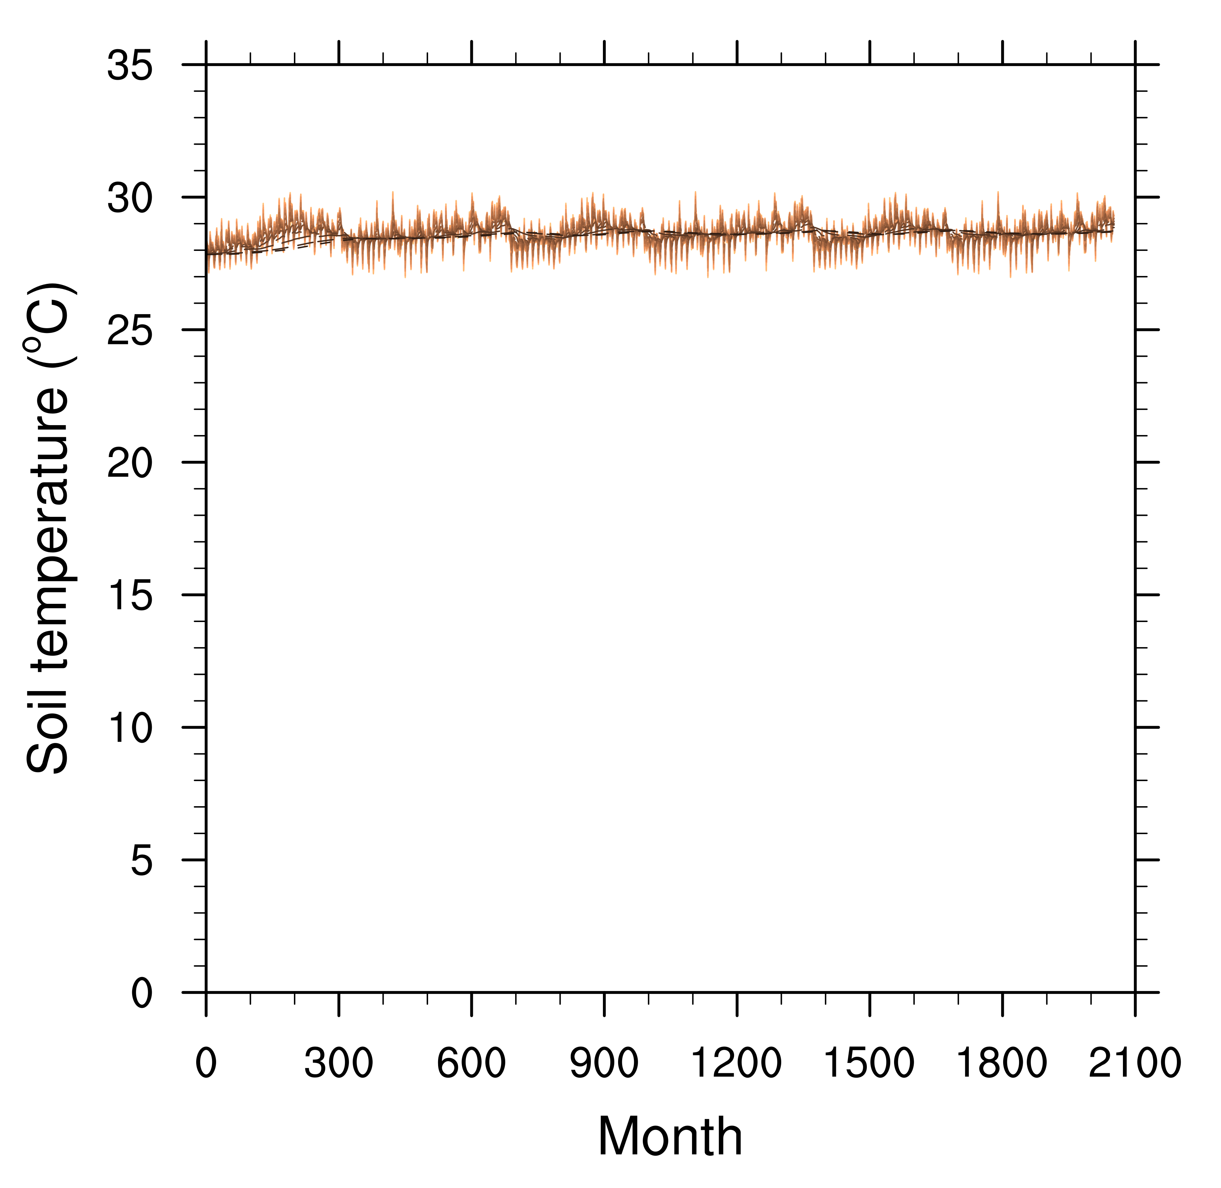
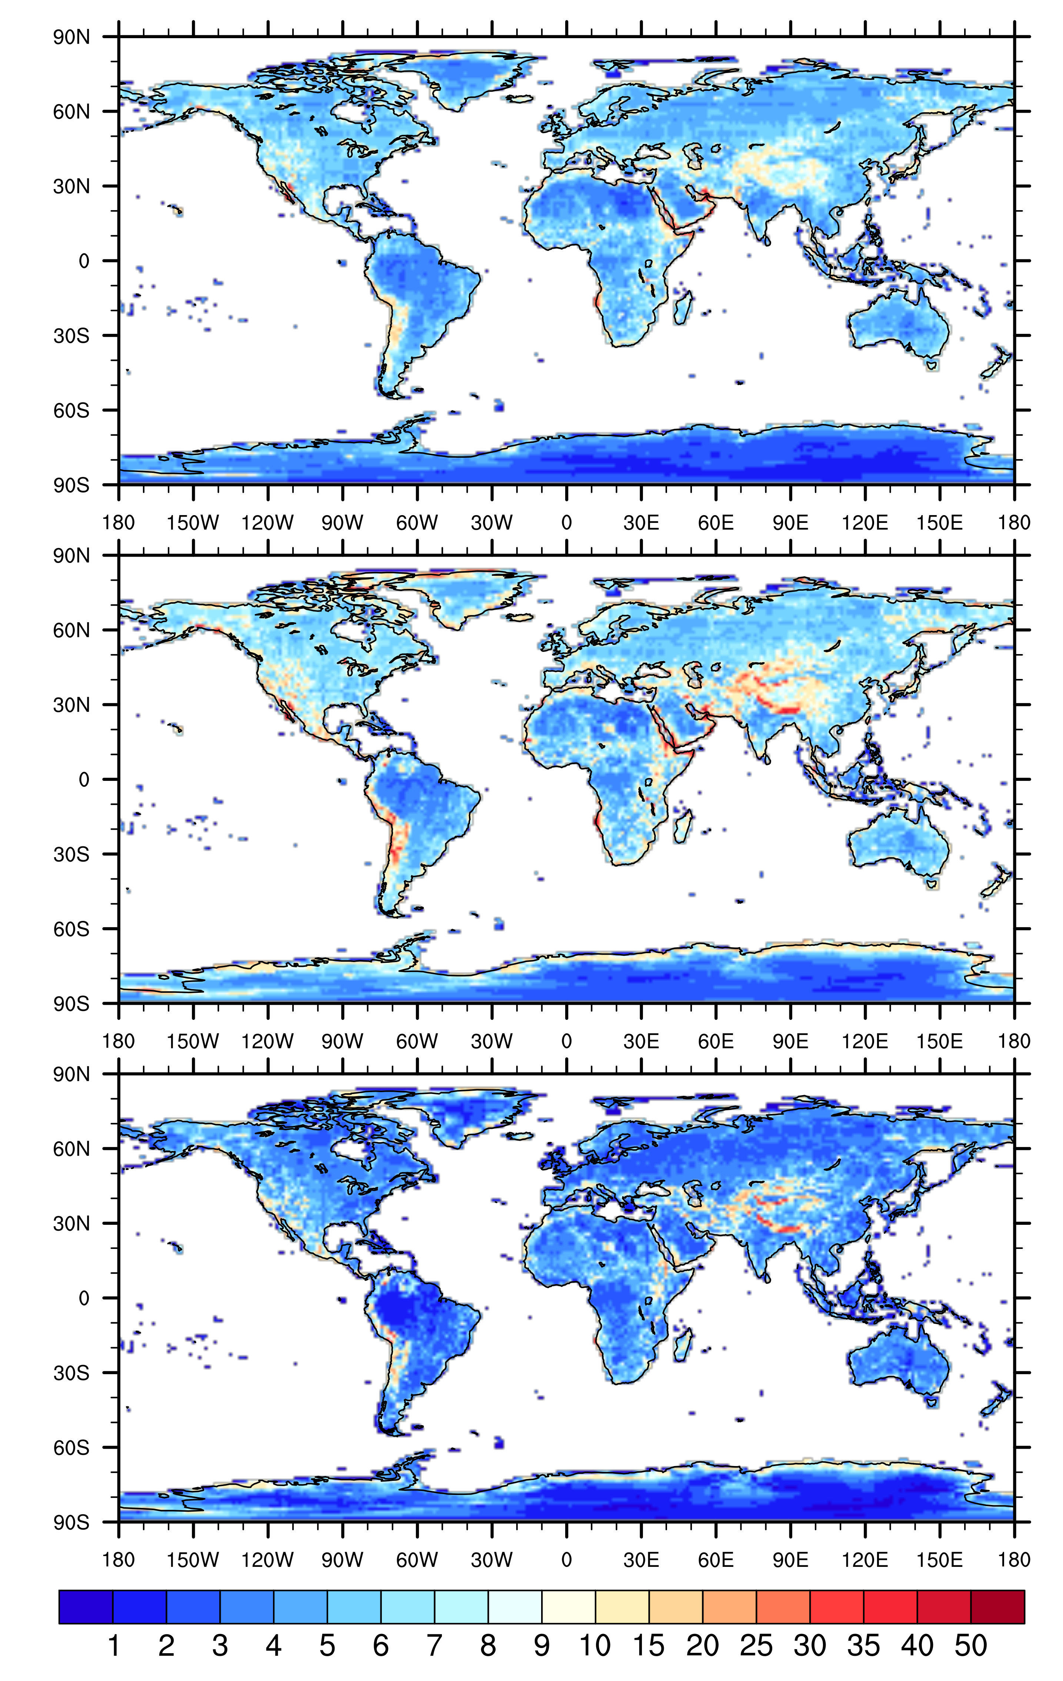

Variable soil thickness in ALM:
Implementation without elevation classes and
preparation for implementation with elevation
classes
Michael A. Brunke and Xubin Zeng
Objective
Results: Implementation without elevation
classes
Currently, the ACME Land Model (ALM), like most other land surface models, has a constant depth (~3.8 m) that is hydrologically active.
To compensate for this constant “soil” depth, a poorly-defined unconfined aquifer is included somewhere below this depth.
An alternative is to include variable soil thickness based on our global ~30 arcsec (or ~1 km) estimate of bedrock depth (Pelletier et al. 2016).
We have implemented this variable soil thickness into the ALM for inclusion into ACMEv2.
This implementation allows for the removal of the unconfined aquifer when turned on, since an unconfined aquifer would exist only if any of the soil column becomes saturated (Fig. 1).
Thermal properties (heat capacity and thermal conductivity) are also adjusted so that they are their bedrock values only within the actual bedrock and not anywhere below the hydrologically active layers.
◀ Figure 2: The change in the mean annual cycle of (top) volumetric soil moisture (Δθ, m³/m³) and (bottom) the fraction of saturation (Δf_{sat}) between VAR and CTRL at six locations with the number of hydrologically active layers in VAR indicated in parentheses. Also shown are the water table depths (WTD) in the two simulations.
Δθ
Δf_{sat}
Two simulations are compared here: CTRL without variable soil thickness (i.e., 10 layers everywhere) and VAR with variable soil thickness:
Soil moisture profiles most affected in locations where the soil column is made shallower (Fig. 2).
Water table depths are similarly simulated where the soil column is made deeper (Fig. 2, bottom).
Hydrologic fluxes are affected too. Baseflow is more affected than surface runoff (Fig. 3), because both amplitude and the timing of maximum baseflow are changed.
Figure 1: A graphical representation of the changes to soil hydrology made with the implementation of variable soil thickness. The brown layers represent the soil column.
Figure 3: The mean annual cycle in surface runoff and baseflow in VAR and CTRL at six locations.
Results: Preparation for elevation classes
Impact
Mapping atmospheric forcings onto elevation classes
We are interested in facilitating the implementation of elevation classes in ACME, because variable soil thickness would be better represented on elevation classes. For this to happen, near-surface and surface conditions and downward fluxes have to be mapped onto the elevation classes.
We use ERA-Interim data to test mappings, taking four ~0.7º x 0.7º grid cells as representing different elevation classes within each 2 x 2 matrix globally.
For instance, a simple physically consistent mapping of downward longwave (LW) radiation (LW_{d}) can be derived as:
δLW_{d} = LW_{u} (4δT_{a} / T_{a})
where LW_{u} is upward LW radiation, T_{a} is the 2-m air temperature, and δ represents the difference in quantity of the elevation class from the matrix mean quantity. The quantities without a δ represent the matrix mean.
The RMSDs of the predictions from our method are lower than persistence (i.e., using the grid average values for every elevation class).
Variable soil thickness is implemented into ALM, which
removes the poorly-defined unconfined aquifer and
rectifies the soil thermal properties so that they are the soil values above and bedrock values below the actual DTB.
ALM results are similar to what was seen in CLM4.5 (Brunke et al. 2016).
A more realistic cold-start temperature profile improves soil temperature spin-up with variable soil thickness.
We are facilitating the implementation of elevation classes by finding mappings of atmospheric forcings onto elevation classes. For instance, our method to map downward longwave radiation has lower RMSDs than persistence (i.e., using grid average values for all elevation classes). We are continuing to find mappings for the other quantities.
Layer
Figure 4: Temperature spin-up from cold start with the current initial condition of 274 K (left) and with a more realistic initial condition of 301 K (right).
Improving spin-up with variable soil thickness
Deep layer temperature takes ~114 years to come to equilibrium from cold start at some locations (e.g., in the Amazon, Fig. 5):
The cold-start temperature profile is unrealistically a constant 274 K everywhere.
Starting from a more realistic cold-start temperature (the mean annual air temperature, 301 K in the Amazon) at this location drastically shortens the spin-up time (Fig. 5, right).
Figure 5: RMSDs between mapped downward LW radiation by (top) our method as well as (middle) persistence and the actual ERA-Interim values. (bottom) RMSDs between our method and persistence.
For additional information, contact:
Michael A. Brunke
Research Scientist
The University of Arizona
(520) 626-7349
brunke@email.arizona.edu
climatemodeling.science.energy.gov/acme

