Slide 1
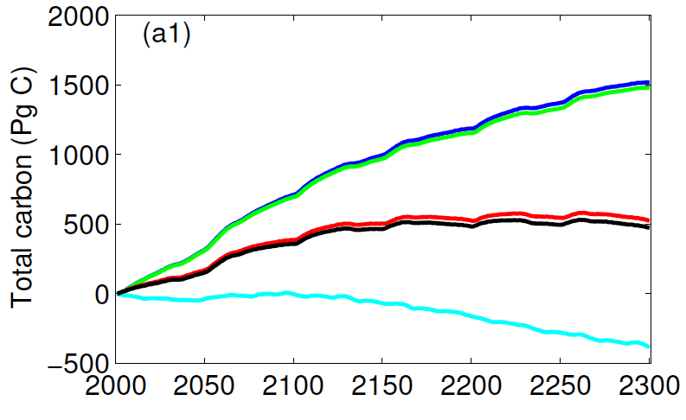
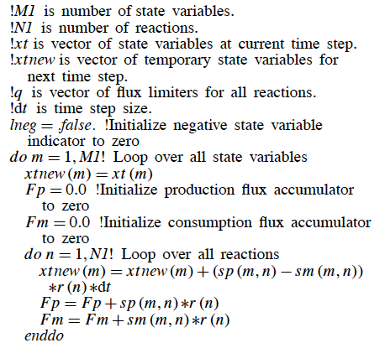
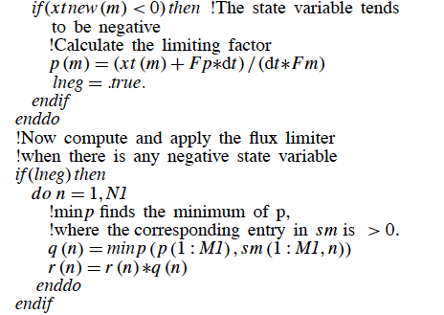
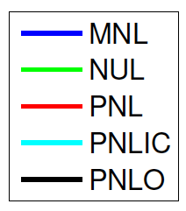
Formulation, implementation, and testing of an intermediate
complexity model for robust soil biogeochemistry modeling
Jinyun Tang (jinyuntang@lbl.gov) and William J. Riley
Lawrence Berkeley National Laboratory
Large BGC uncertainty from poor numerics
Stoichiometry based flux back-tracing solver
Each reaction of the the revised soil BGC model is written in the stoichiometric form
The negative stoichiometry is used to modify the reaction rates, so the solution
is non-negative and mass conservative
Significant divergence in predicted change in carbon stocks
In ALM-V0, the nitrogen immobilizers and mobilizers are coupled asynchronously, whereas the
conceptual model indicates the two should be coupled synchronously. This inconsistency leads
to large uncertainties of the predicted land carbon stocks under RCP4.5 CO₂ forcing (see below).
.
1900 Pg C
~
900 ppmv CO₂
Pseudo code for the flux back-tracing algorithm
Solution Attempts
Ideas
A reformulation of the soil BGC
The soil BGC module in ALM-v0 and ALM-v1 do not appropriately represent (1) litter decomposition,
(2) clay effect on soil carbon stabilization, or (3) dissolved organic carbon dynamics. Further,
the overall code implementation is non-modular. Therefore, a reformulation is proposed to enable
(1) systematic resolution of the numerical inconsistency, (2) better representation of soil BGC,
and (3) potential coupling to aquatic BGC. The new BGC will also allow a straightforward and
consistent extension to microbe explicit models.
Improving the nitrification-denitrification cycle
With the redefined model structure, the new soil BGC shall allow a straightforward extension to
better resolve the nitrification-denitrification cycle (NDC) with explicit microbes. The new NDC
module includes two guilds AOB (ammonia oxidizing bacteria), one guild NOB (nitrite oxidizing
bacteria), and one guild facultative DEN (denitrifier) bacteria, all of which are modeled using the
dynamic energy budget theory and ECA kinetics in presence of plants and soil minerals.
N₂O, N₂
Litter
Metabolite, cellulose, lignin
Litter
Metabolite, cellulose, lignin
NH₃, CO₂
AOB
NO₂⁻
NOB
Coarse woody debris
Fine woody branch, dead large wood, dead coarse root
DOM
NO, N₂O
DEN
NO₃⁻
Soil OM
Labile, slow, passive
Soil OM
Microbial, DOM, passive
N₂
Old soil BGC
New soil BGC
Revised nitrification-denitrification module
For additional information, contact:
Staff Member
Title
Institution or Organization
(555) 555-1234
staff.member@email.gov
climatemodeling.science.energy.gov/acme

