Slide 1
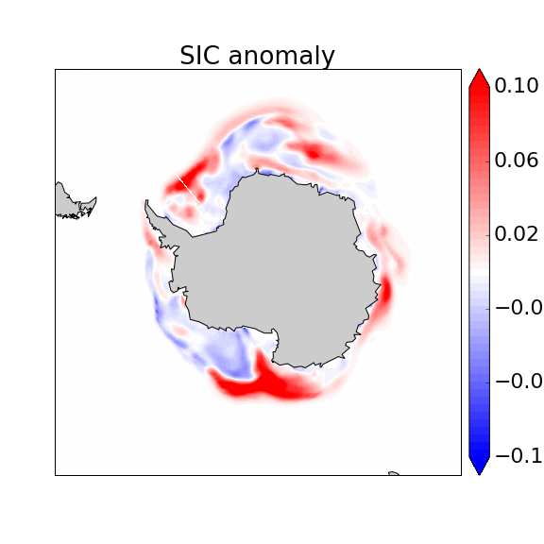
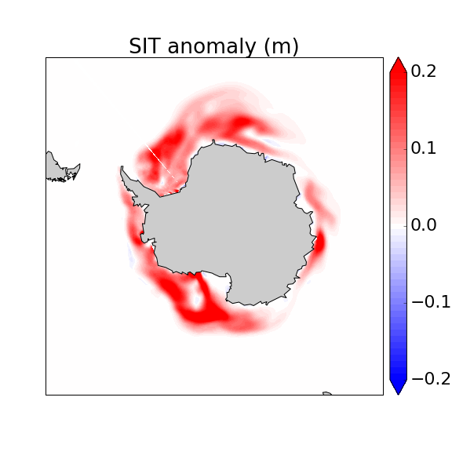
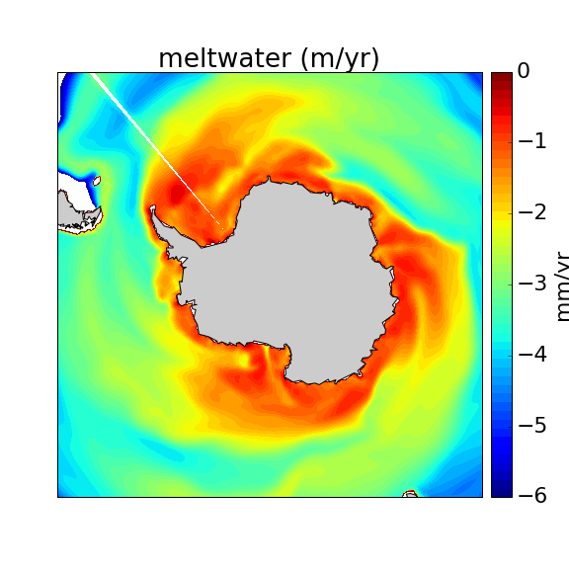
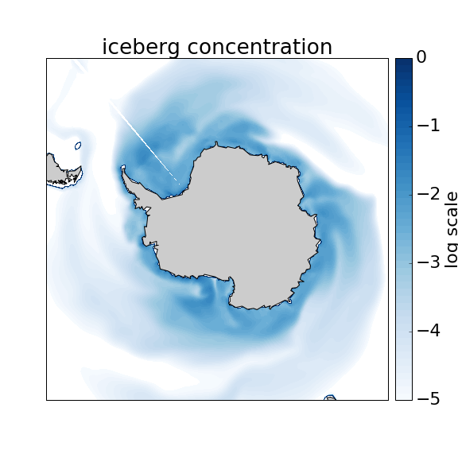
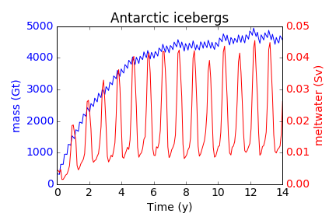
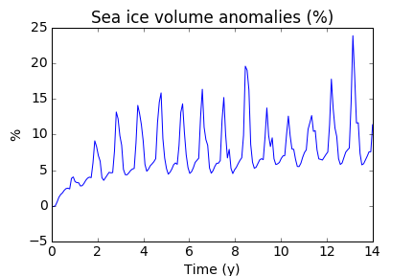
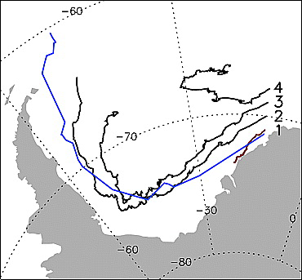
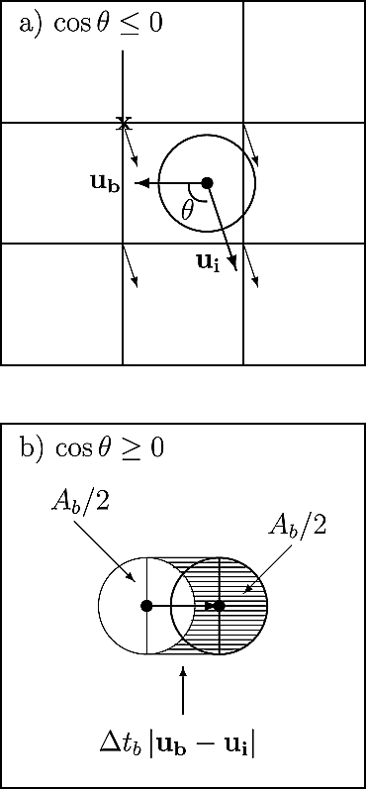
Icebergs for ACME
Darin Comeau, Elizabeth C. Hunke, Adrian K. Turner
Hypothesis
CICE Results
Summary:
Icebergs represent approximately half of the mass flux from the Antarctic ice sheet to the ocean, with basal melting comprising the other half. Calved icebergs transport freshwater away from the coast and exchange heat with the ocean, thereby affecting stratification and circulation, with subsequent indirect thermodynamic effects on the sea ice system. Icebergs also have a direct effect on sea ice through dynamic interaction, and occupy space that becomes unavailable for sea ice. Antarctic ice shelves have dynamic fronts, advancing into the ocean and retreating through calving events, which also affects the availability of open ocean for sea ice.
We are developing a parameterization for icebergs to be implemented in MPAS-Seaice, based upon an existing implementation in CICE standalone (results shown here), in two frameworks: Lagrangian and Eulerian. The Lagrangian framework will be useful in forecasting trajectories of particular ‘giant’ (>10 nautical miles) iceberg events, which may have highly localized impacts on ocean and sea ice, while the Eulerian framework allows us to model a realistic population of Antarctic icebergs without the computational expense of individual particle tracking.
Results from the iceberg parameterization implemented in CICE, as described in Developments. Spatial plots are averaged over the final year of a 14 year Eulerian framework simulation, initialized with no icebergs, with an annual calving rate of 1350 Gt/yr distributed evenly over all Antarctic coastal cells. Sea ice anomalies relative to a control run with no icebergs are shown for concentration (SIC) and thickness (SIT), as well as iceberg meltwater (logscale).
This capability, together with under ice-shelf ocean cavities and dynamic ice-shelf fronts, will allow for extremely high fidelity simulation of the southern cryosphere within ACME.
Time series for evolution of total Antarctic iceberg mass, meltwater, and sea ice volume anomalies for 14 year Eulerian berg simulation (CICE standalone). Sea ice volume anomalies are dynamically induced, and relative to a control run with no icebergs.
(1 Sv ~= 3.15 Gt/yr)
Left: Hindcast model trajectories (black) of a particular giant berg event, C7 (observations, blue), from March 1990 through December 1992, in Lagrangian framework in CICE (Hunke and Comeau 2011).
Annual iceberg concentration (logscale) after 14 year simulation in Eulerian framework in CICE.
Developments to Implement in MPAS-Seaice
Expected Impact
Iceberg size distribution:
Iceberg dynamics:
Iceberg thermodynamics:
Iceberg-sea ice dynamic interaction:
Dynamic effects on sea ice:
Regional freshwater forcing away from coast:
Coupling the land-ice / ocean interface:
References:
Icebergs originate through a prescribed calving flux. Icebergs in the Eulerian framework are divided into a size distribution based on observations (Gladstone et al 2001), following a delta distribution. As icebergs melt, the distribution changes with shrinking berg dimensions.
Icebergs typically move in a similar direction as sea ice, although much slower, and hence are an obstacle for the upstream sea ice field. Sea ice ridges behind bergs, leaving an open lead in front of the iceberg, facilitating increased sea ice production.
Iceberg movement is prescribed by the iceberg momentum equation, including forces from atmosphere, water, Coriolis, sea surface tilt, and sea ice (Lichey and Hellmer 2001):
Icebergs provide additional surface freshwater forcing to the ocean away from the coast, which leads to increased sea ice production. Surface meltwater leads to enhanced stratification in the upper ocean, leading to reduced vertical mixing between the surface mixed layer and deeper, warmer waters below, thereby reducing heat content at the surface. However, the effect of transporting this freshwater from the coast to areas less suitable for sea ice production results in a net decrease in sea ice volume (Stern et al 2016).
If the surrounding sea ice pack gets strong enough with a high concentration, the iceberg is ‘captured’ in the sea ice pack and transported with the sea ice velocity.
In addition to coupling the iceberg model within ACME to the land ice component for calving fluxes and ocean component for freshwater forcing and heat exchange, this capability will allow for dynamic ice-shelf fronts.
Icebergs melt and deteriorate according to parameterizations for three processes, basal melting, lateral melting, and wave erosion. The mass balance evolution for an iceberg with dimensions L,W,H is given by (Martin and Adcroft 2010):
Hunke, E. C., & Comeau, D. (2011). Sea ice and iceberg dynamic interaction. Journal of Geophysical Research: Oceans, 116(C5).
Lichey, C., & Hellmer, H. H. (2001). Modeling giant-iceberg drift under the influence of sea ice in the Weddell Sea, Antarctica. Journal of Glaciology, 47(158), 452-460.
Icebergs dynamically interact with sea ice depending on angle of relative motion . If moving in opposing directions, icebergs exhibit additional drag term in sea ice momentum equation to upstream sea ice (a). If moving in similar direction, sea ice ridges behind slower moving icebergs (b).
Gladstone, R. M., Bigg, G. R., & Nicholls, K. W. (2001). Iceberg trajectory modeling and meltwater injection in the Southern Ocean. Journal of Geophysical Research: Oceans, 106(C9), 19903-19915.
Martin, T., & Adcroft, A. (2010). Parameterizing the fresh-water flux from land ice to ocean with interactive icebergs in a coupled climate model. Ocean Modelling, 34(3), 111-124.
Stern, A. A., Adcroft, A., & Sergienko, O. (2016). The effects of Antarctic iceberg calving‐size distribution in a global climate model. Journal of Geophysical Research: Oceans, 121(8), 5773-5788.
For additional information, contact:
Darin Comeau
Postdoctoral Researcher
Los Alamos National Laboratory
(505) 665-4810
dcomeau@lanl.gov
climatemodeling.science.energy.gov/acme

