Slide 1
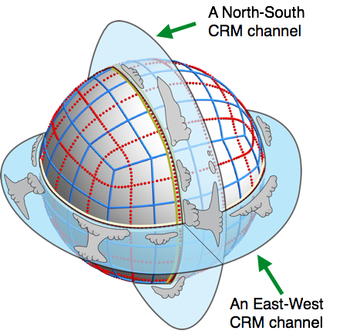
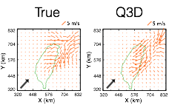
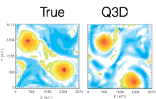
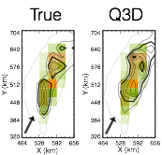
Quasi-3D Multiscale Modeling Framework for ACME
David Randall, Celal S. Konor and Joon Hee Jung
Colorado State University
Oblective
Construction of a version of ACME with Q3D MMF
Results from the simulations with Limited-Area version
Wind (Taiwan case)
Vorticity (Tropical cyclogenesis case)
Insert caption here…
Precipitation (Taiwan case)
Expected Impact
Outcome
A computationally efficient cloud-permitting version of ACME
Developments Required
Impact
Replace the physics parameterization in ACME with embedded CRMs
Use Vector-Vorticity Cloud-Resolving Models (VVMs)
in ACME dycore to form a global Q3D-MMF
Improved representation of cloud processes and convection in ACME
For additional information, contact:
Staff Member
Title
Institution or Organization
(555) 555-1234
staff.member@email.gov
climatemodeling.science.energy.gov/acme

