Slide 1
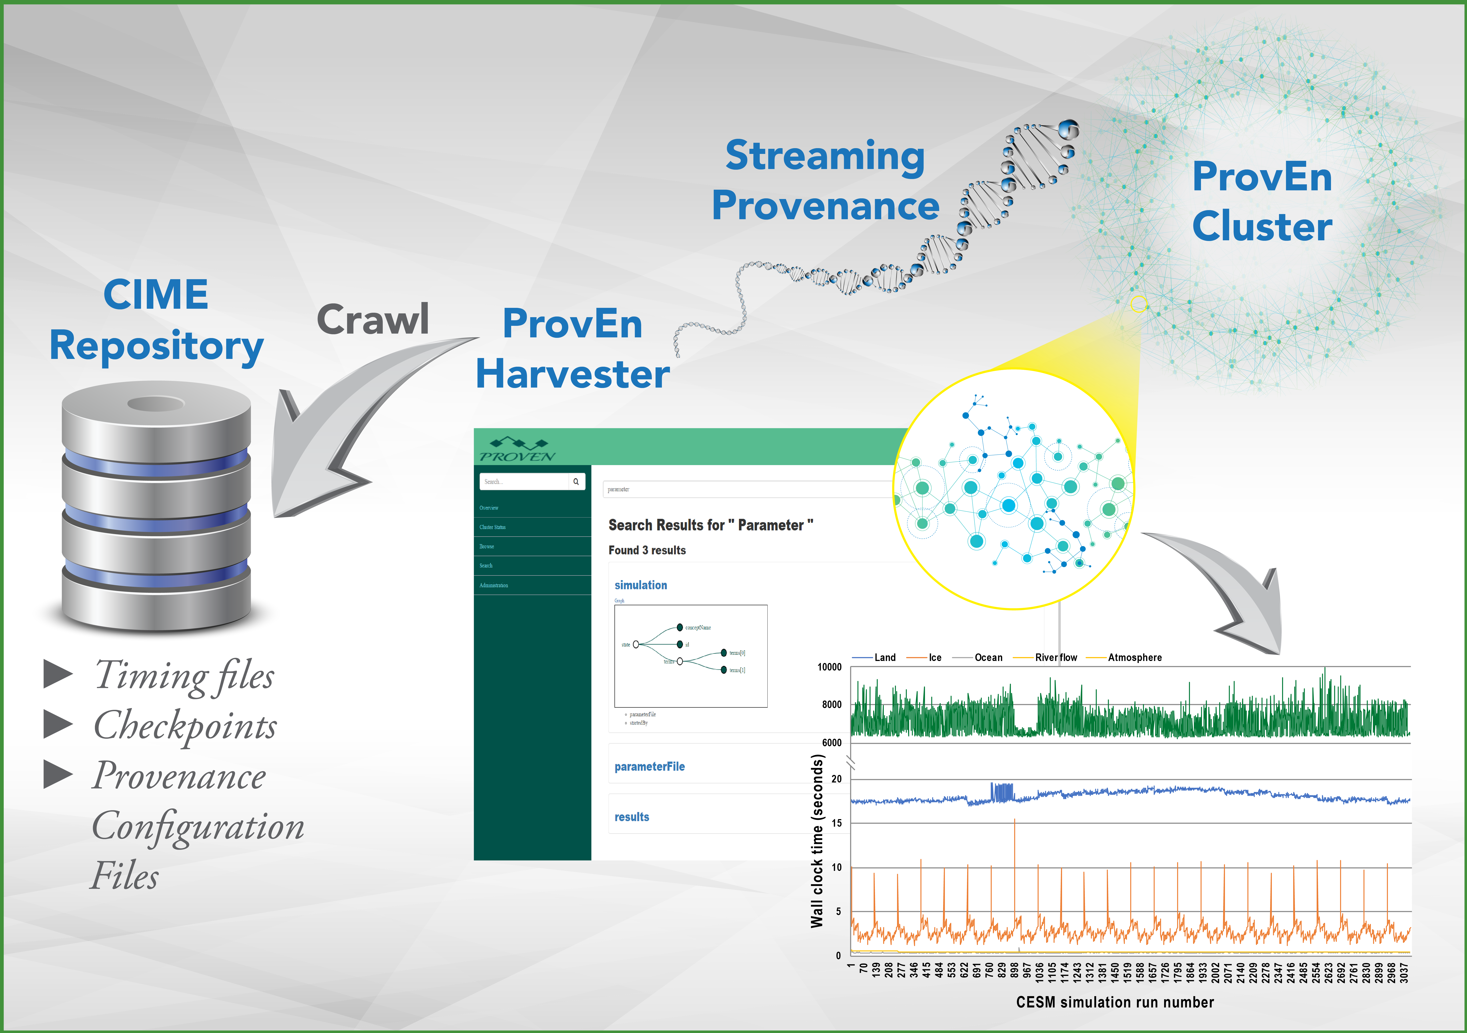
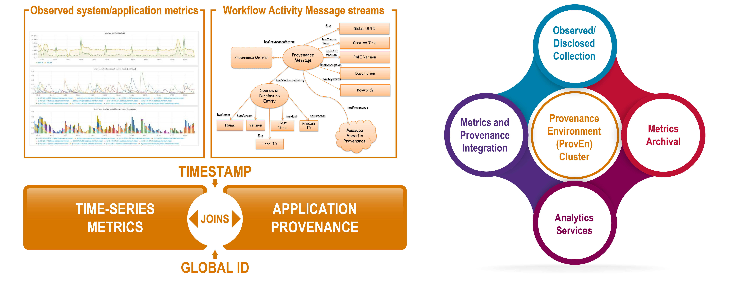
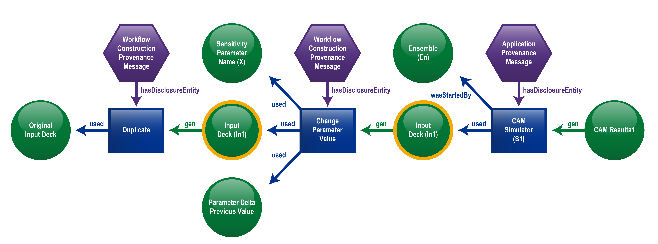
ACME Provenance using ProvEn
Bibi Raju, Eric Stephan, Todd Elsethagen
Pacific Northwest National Laboratory
Objectives
Investigate how workflow provenance can offer insights explaining what factors
contributed to simulation results.
Combine workflow provenance with performance metrics (for example timing data)
for anomaly detection.
Determine if reproducibility is possible by harvesting discrete information from previous
ACME simulation logs, configuration files, software descriptions, and compile settings.
Developments Required
Expected Impact
Outstanding Questions:
Is all discrete simulation information (input deck, data sources, workflows steps,
and expected output) in an accessible and computable form across ACME?
Can the discrete simulation information be structured and organized in a
standardized way?
Is enough known about the execution environment to rerun a simulation such as
resources needed and versions of code used in original simulation
experiment (numerical reproducibility)?
Integration with CIME:
Use CIME to generate the provenance data in sufficient detail and in required format
as needed by HArvest Provenance Interface (HAPI) to ingest into ProvEn.
Achieve simulation reproducibility by integrating with CIME
Publish simulation provenance that can be used for cross-comparison between
CIME workflows and other grid based provenance.
Performance tuning: ProvEn provides a means to federate time-series
application/system performance metrics data with ACME code traces
from each model component.
Provide scientists running simulations performance and diagnostics tools.
For additional information, contact:
Bibi Raju | Scientist
Pacific Northwest National Laboratory
(509) 375-3623 | bibi.raju@pnnl.gov
For additional information, contact:
Bibi Raju
Scientist
Pacific Northwest National Laboratory
(509) 375-3623
bibi.raju@pnnl.gov
climatemodeling.science.energy.gov/acme

