Slide 1
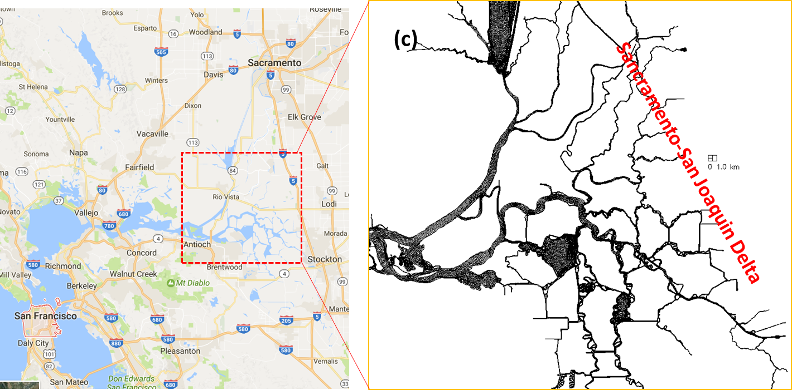
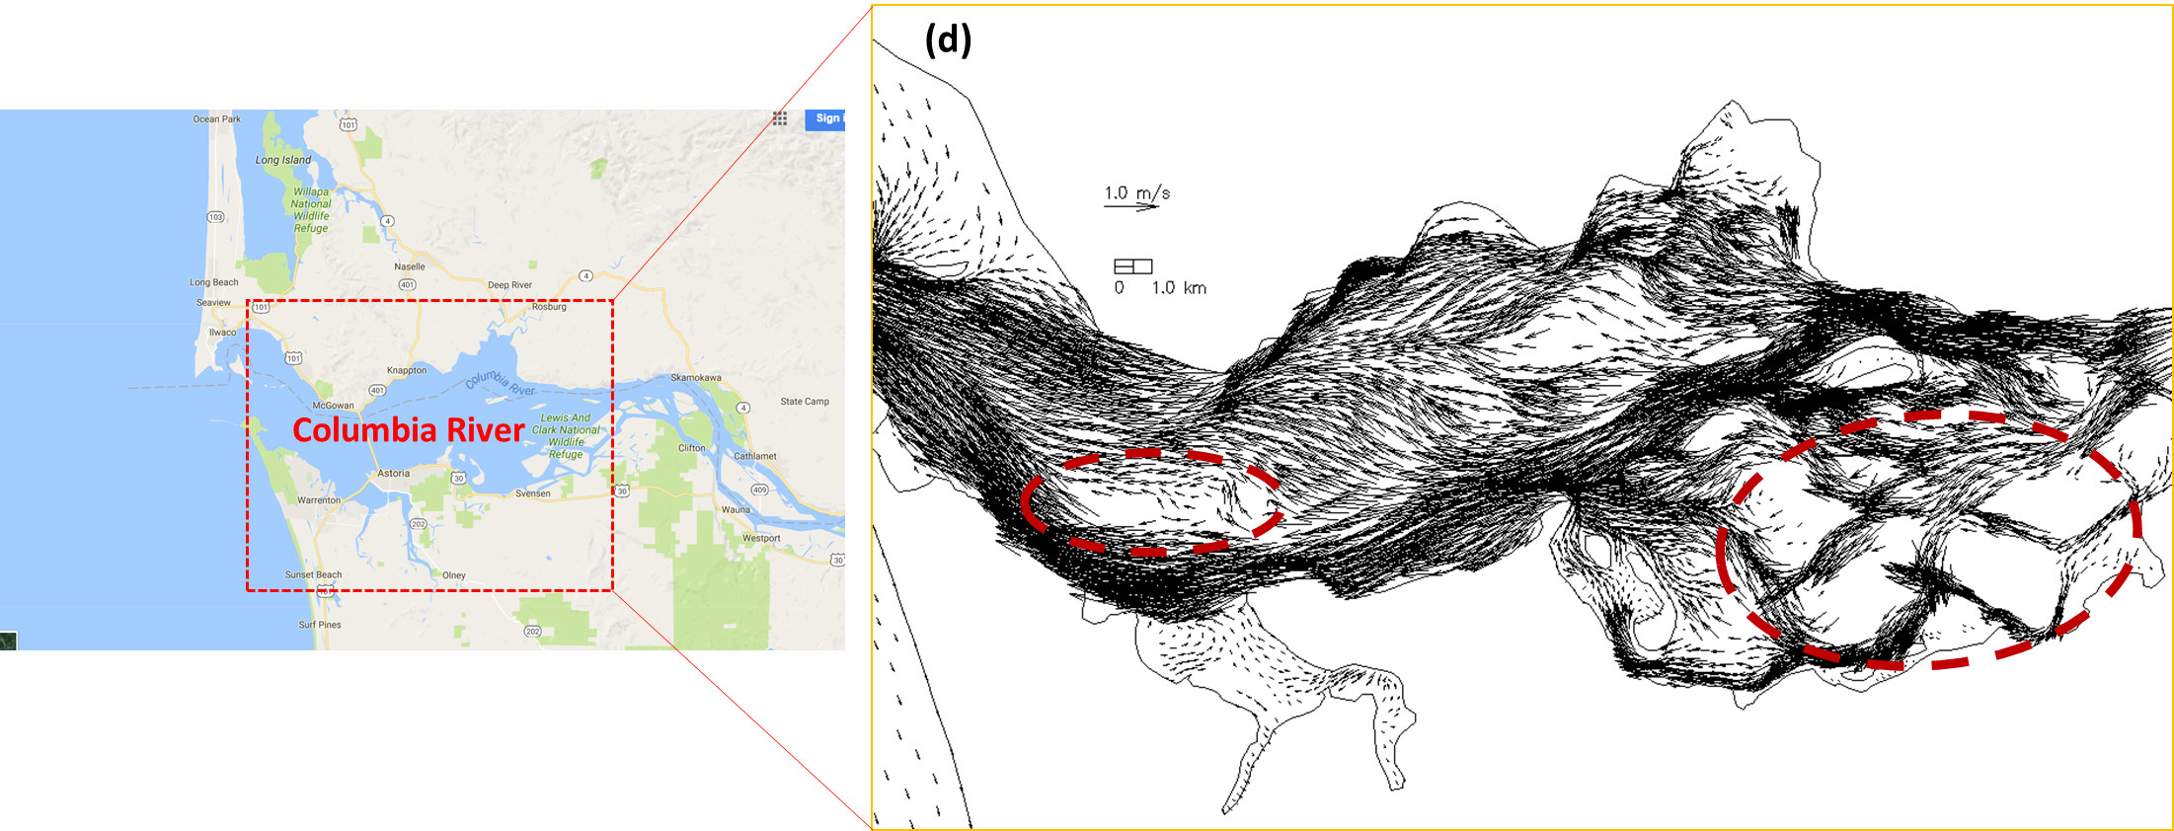
Implementation of a tide-estuary component into
MPAS-Ocean framework
Joseph Zhang
Hypothesis
MPAS-O as it stands has difficulty in the tide-estuary (TE) regime, because of
o Complex geometry which requires high resolution
o Strong nonlinear forcings
An ‘ideal’ TE model should strike a balance between often conflicting requirements
− Energy/potential vorticity conservation: desirable but may not be essential in TE
(as the system has enough dissipation)
− Stability/robustness/efficiency: essential
− Horizontal grid generation: orthogonality may be restricting
− Vertical grid configuration: important for many important processes
The BGC component of MPAS-O needs to be adjusted in the TE, particularly in the treatment of light availability and nutrient and carbon cycling
o Water-sediment exchange is important for the TE BGC
o The work required to address this challenge is presented by Z. Wang’s poster
Developments Required
We will develop an implicit TE model for MPAS-O (called ‘MPAS-OI’) that is online 1-way nested inside MPAS-O
MPAS-OI will strive to retain as many key properties of MPAS-O as possible while still catering to specific needs of TE
Two options for the momentum equation: (a) vector invariant form (as MPAS-O) for energy and potential vorticity conservation; (b) original form of momentum equation to facility Eulerian-Lagrangian (EL) treatment of advection
Horizontal grid: orthogonal hex-triangle pair
Vertical grid: ALE (as in MPAS-O) with ghost cell near bottom
Time stepping: semi-implicit for CFL terms. May need EL to enhance efficiency/robustness
Tracer transport: implicit, monotone TVD² (as in SCHISM) to tackle thin layer syndrome
Turbulence closure: 2.5 equation Generic Length-scale closure, first solved at cell edges
Vector invariant form: $u_{t}−fηv+wu_{z}=−g∇η+{\left(νu_{z}\right)}_{z}−∇K+F_{u}$
Original form: $u_{t}+\left(u∙∇\right)u=−g∇H+{\left(νu_{z}\right)}_{z}+G_{u}$
Grids illustrating the challenges in TE: (1) Complex geometry as found in (a) Danish Strait;
(b) Gulf of Bothnia. (c) Sacramento-San Joaquin Delta. (2) Strong forcings leading to highly energetic
systems as in (d) Columbia River (strong tidal inundations can be seen in the red circled areas).
Expected Impact
This project will enhance ACME's overarching goals and complement the expected version 2 developments by directly addressing two immediate needs in tide-estuary representation and coastal BGC in the global model
The new model fills in a critical knowledge gap in our understanding of the multi-scale processes in the oceans and TE’s
The project is also in line with ACME project’s long-term goal of seeking to include components required to simulate impacts of sea-level change and storm surge on coastal regions
For additional information, contact:
Joseph Zhang
PhD
Virginia Institute of Marine Science
(804) 684-7466
yinglong@vims.edu
https://acme-climate.atlassian.net/wiki/display/OCNICE/Development+of+a+tide-estuary+component+of+MPAS-O

