Slide 1
Status of High-Resolution ACME V1 Atmosphere
Wuyin Lin, Shaocheng Xie, Phil Rasch, Po-Lun Ma
With contribution from Y. Qian, H. Wan, S. Klein, C. Golaz, P. Cameron-Smith, Q. Tang, P. Caldwell, Y. Zhang, H. Wang, K. Zhang, S. Burrows, B. Singh, J. Bacmeister, R. Neal, C. Hannay, V. Larson, A. Gettelman, M. Taylor
Acknowledge: Many helps from performance team, particularly Azamat Mametjanov and Patrick Worley.

Slide 2
Outline
Challenges
Current Status
Summary and Future Work

Slide 3
Challenges for High Resolution Tuning
Model physics is yet scale-aware; significant efforts needed to re-tune the model at high-resolution.
Expensive tuning with limited resources and time.
Potential stability issues with substantially increased model resolution.

Slide 4
Model is sensitive to the resolution change
Precip Bias (ACME - GPCP)
ne30L72
Precip Bias (ACME - GPCP)
ne120L72
Larger precipitation bias in the tropical ocean
RESTOM > 7w/m2 in AV1C-00 before tuning

Slide 5
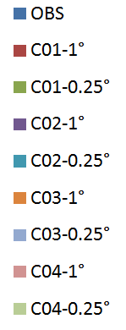
Well-Tuned at 1° Needs Re-tuning for 0.25°
OBS
1⁰
0.25⁰
SWCF (w/m2)
Notes:
Mean PRECT particularly resistant to tuning

Slide 6
Contrast of Computational Cost (Theoretically)
 | # elements | Physics time step | Dynmics time step | relative computational cost | Runtime
1⁰ (ne30) | 48602 | 1800s | 300s | 1 | 8.5 SYPD with 148 notes
0.25⁰ (ne120) | 777602 | 900s | 75s | 48x 0.5*16*2+ 0.5*16*4 | 0.56 SYPD with 2K notes
The ne30 coupled simulation cost: ~ 4.2 SYPD on 160 nodes
The ne120 coupled simulation cost: ~ 0.2-0.3 SYPD on 2K nodes
> 100 times more expensive in actual runs

Slide 7
Challenge: How to tune the model at a scale that can barely be afforded to run?

Slide 8
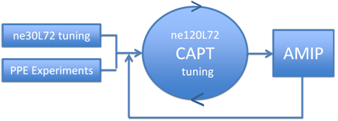
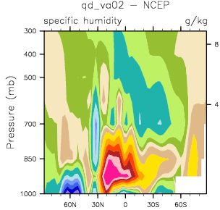
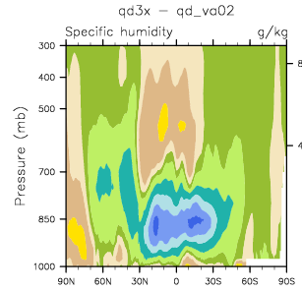
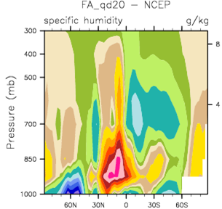
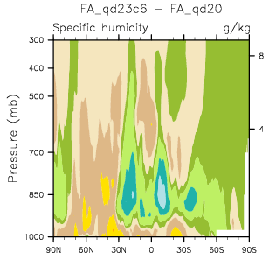
Short-term hindcasts used to effectively gauge the tuning response at high resolution - CAPT
Default - NCEP
Tuned - Default
91
CAPT
JJA AMIP
AMIP
41
18
Walltime
JJA CAPT
4
Specific Humidity
1350 nodes
4050
CAPT: Cloud Associated Parameterization Testbed
Notes:
The strategy for tuning using CAPT with two major benefits: at a fraction of cost compared to conventional tuning approaches, and capable of capturing the response mostly due to model physics, not only on cloud and precipitation, but also on the feedback on the large scale environment.

Slide 9
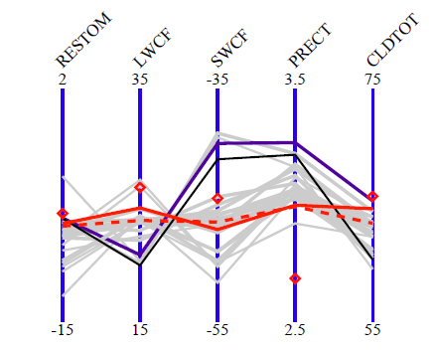
Tuning based on CAPT led to improved climate simulation
Obs
AC01
AC03
CAPT
CAPTf
AC03T
Global JJA mean stats from CAPT and AMIP runs. AC01 and AC03 use default. CAPTf and AC03T use same tuning parameters

Slide 10
Current Status

Slide 11
Can the high-res. model run stably?
The answer is YES!
It was an issue and instability could occur long into the simulations, a big uncertainty in tuning process.
Now all known issues resolved. Not a single failure that was revisited does not pass.
Achieved thru bug fix, adjustment in time stepping for dynamics subcycle, and machine specific treatments.

Slide 12
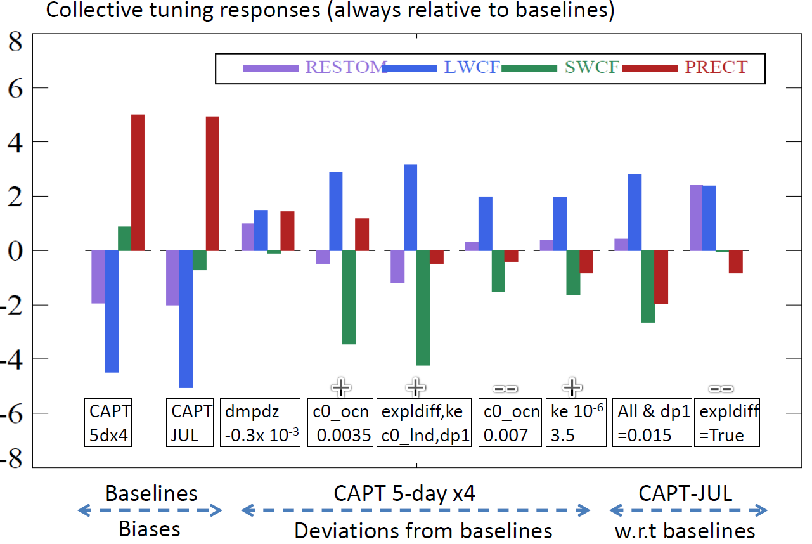
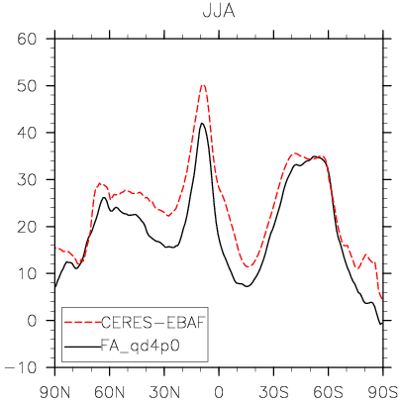
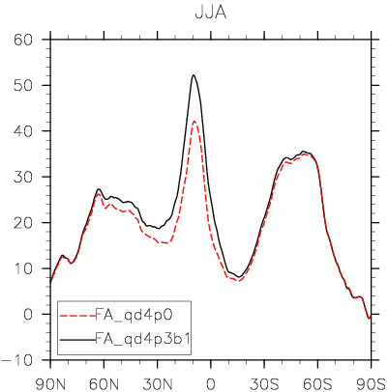
How well is the model tuned?
A robust path has been established, more tunings underway.
LWCF
Default
vs. obs
Preliminary tuned vs.
default

Slide 13
Tuning has reduced large model biases - Precip
CNTL - GPCP
NE120L72
TUNED - CNTL
Model bias has been largely reduced

Slide 14
Summary and Future Work
CAPT centric tuning is efficient and effective for high-resolution ACME model.
Tuning has improved energy budget and hydrologic cycle.
Continue the tuning of V1AC-04P using global and regional metrics.

Slide 15
Thank You!
Notes:
Evolve with ne30 tuning, guidance from PPE for initial parameter choices; cost saving, opposing season early on as safe guard before completing full long simulations, more manageable turnaround time.

