Slide 1
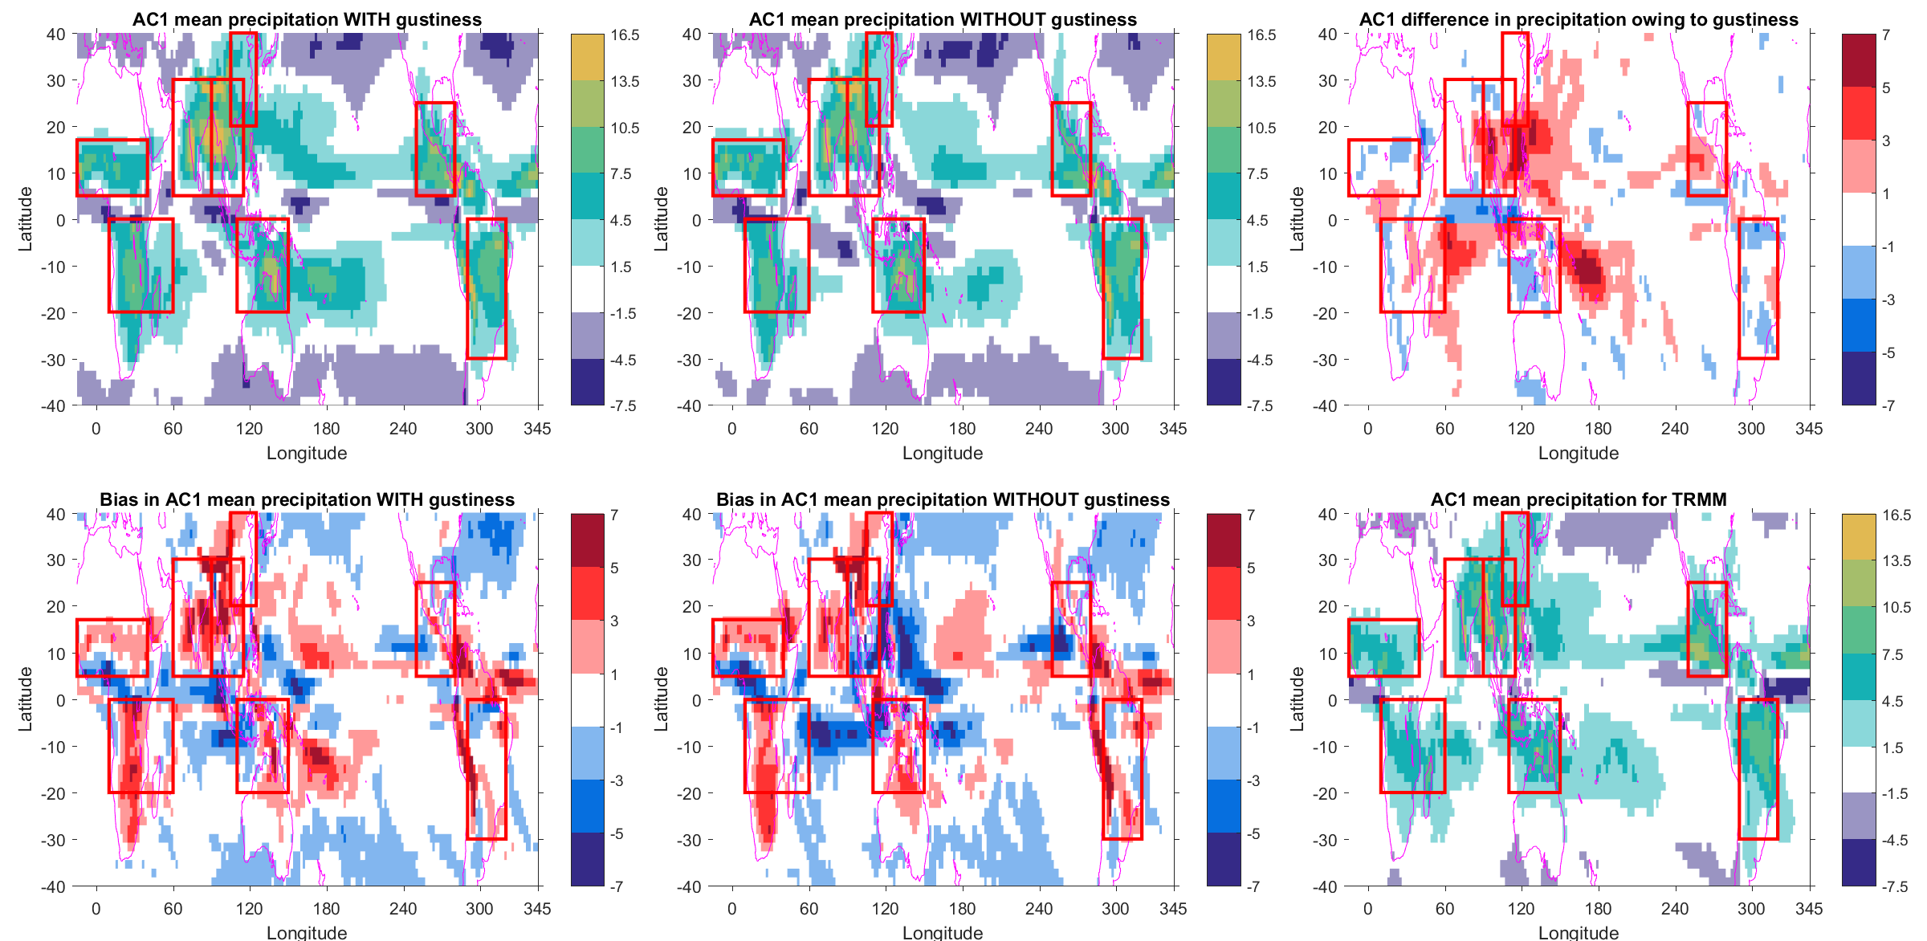
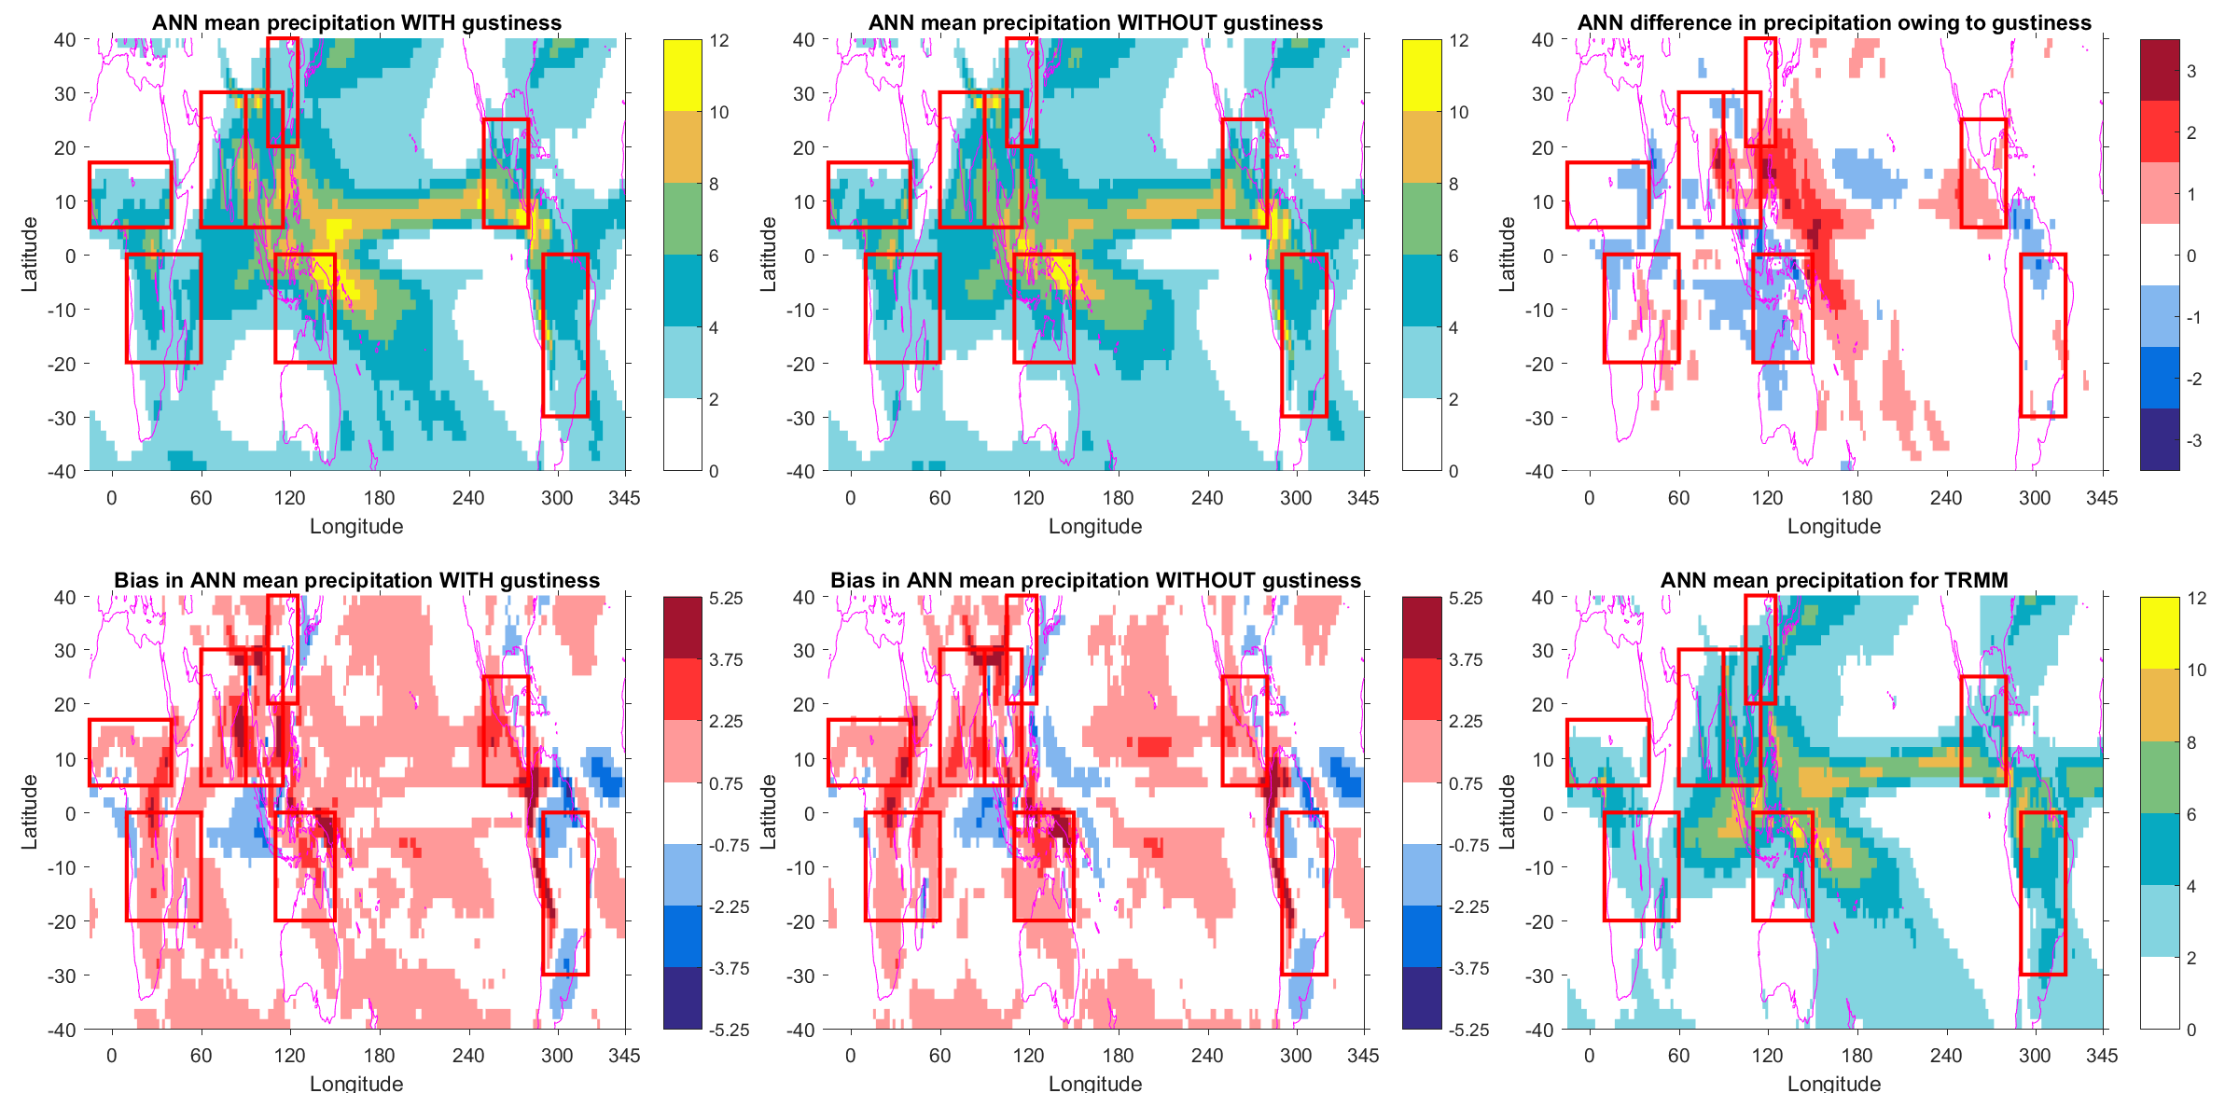
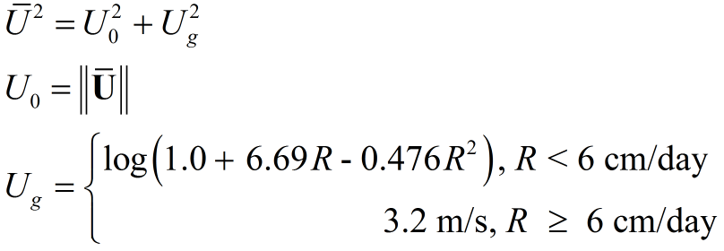
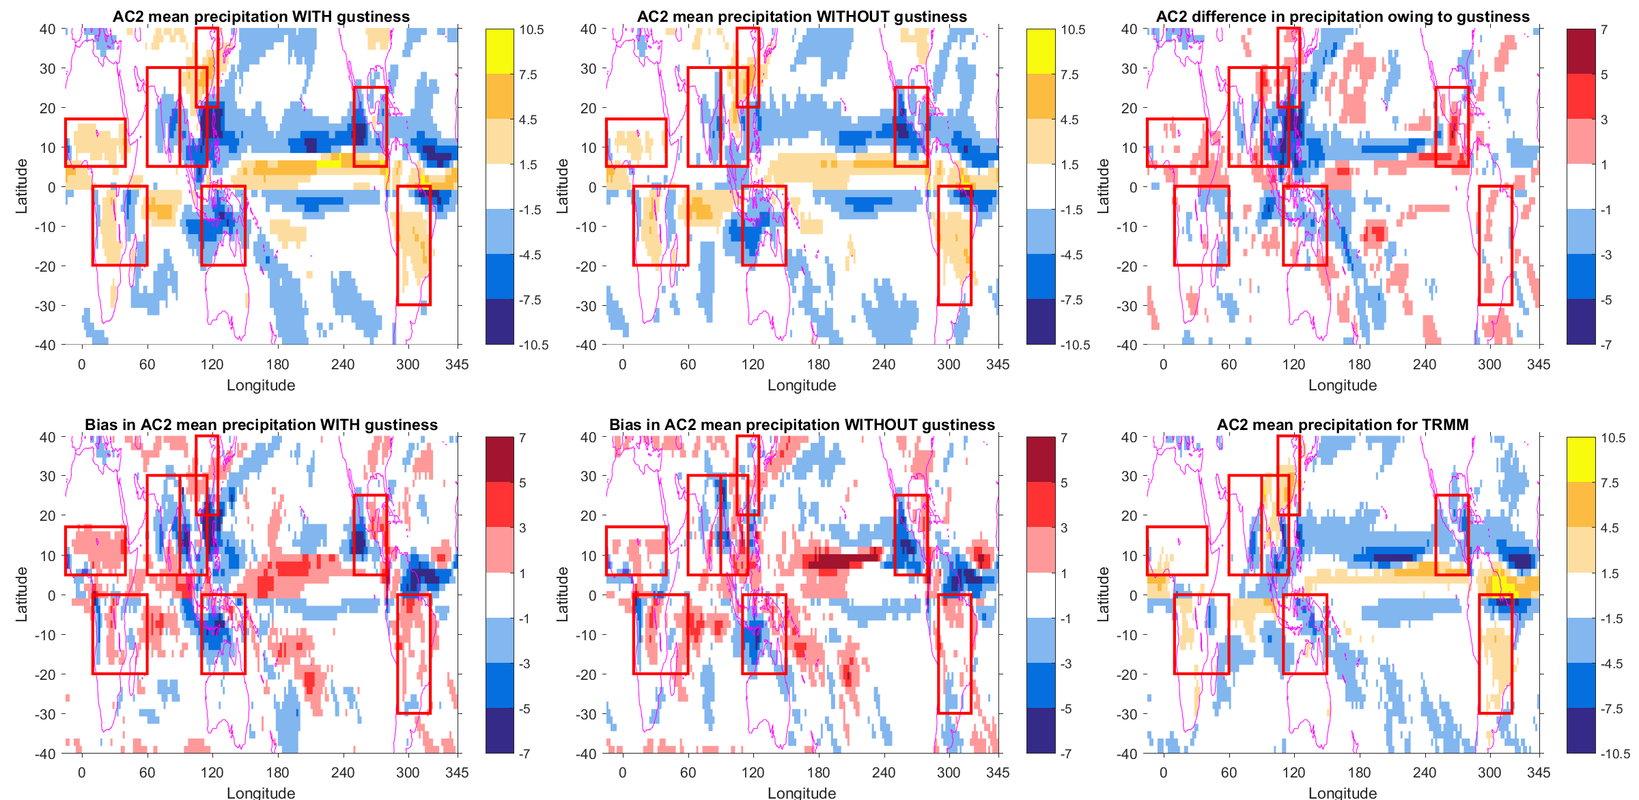
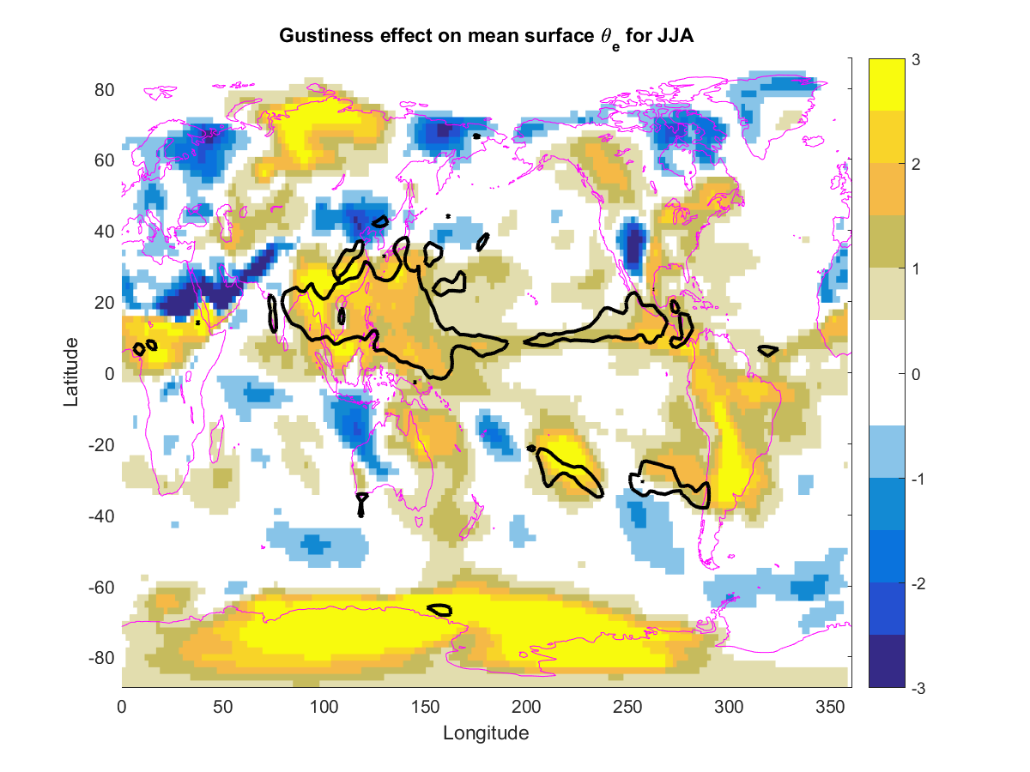
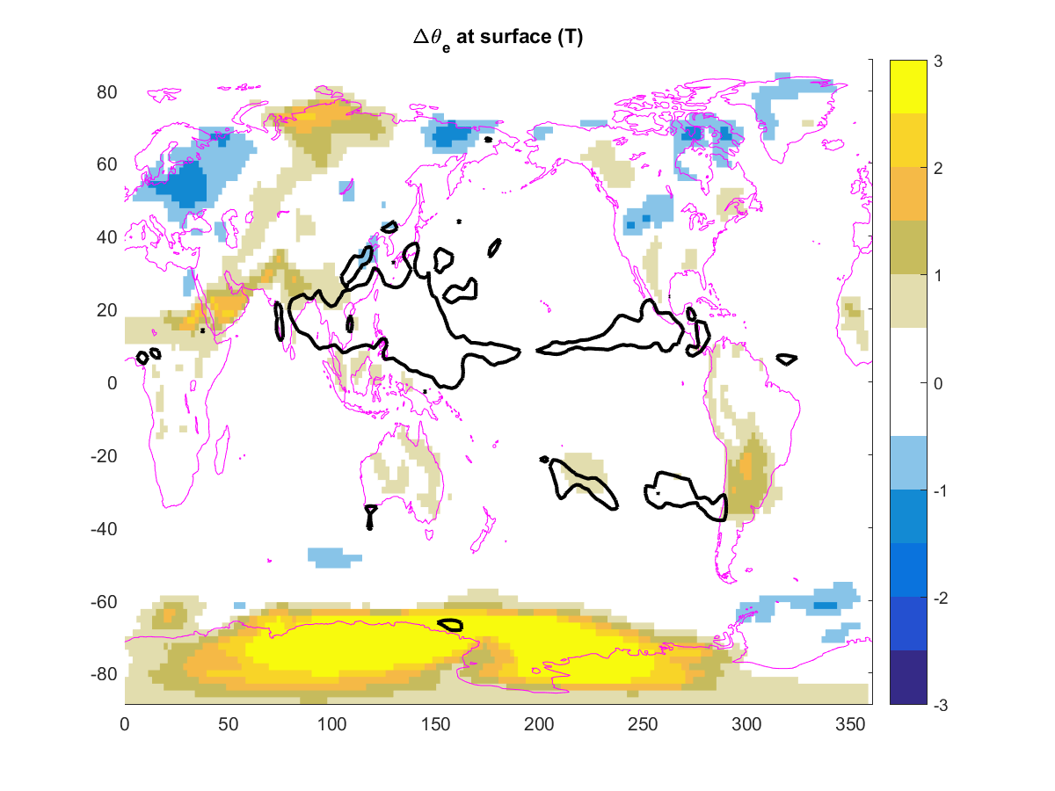
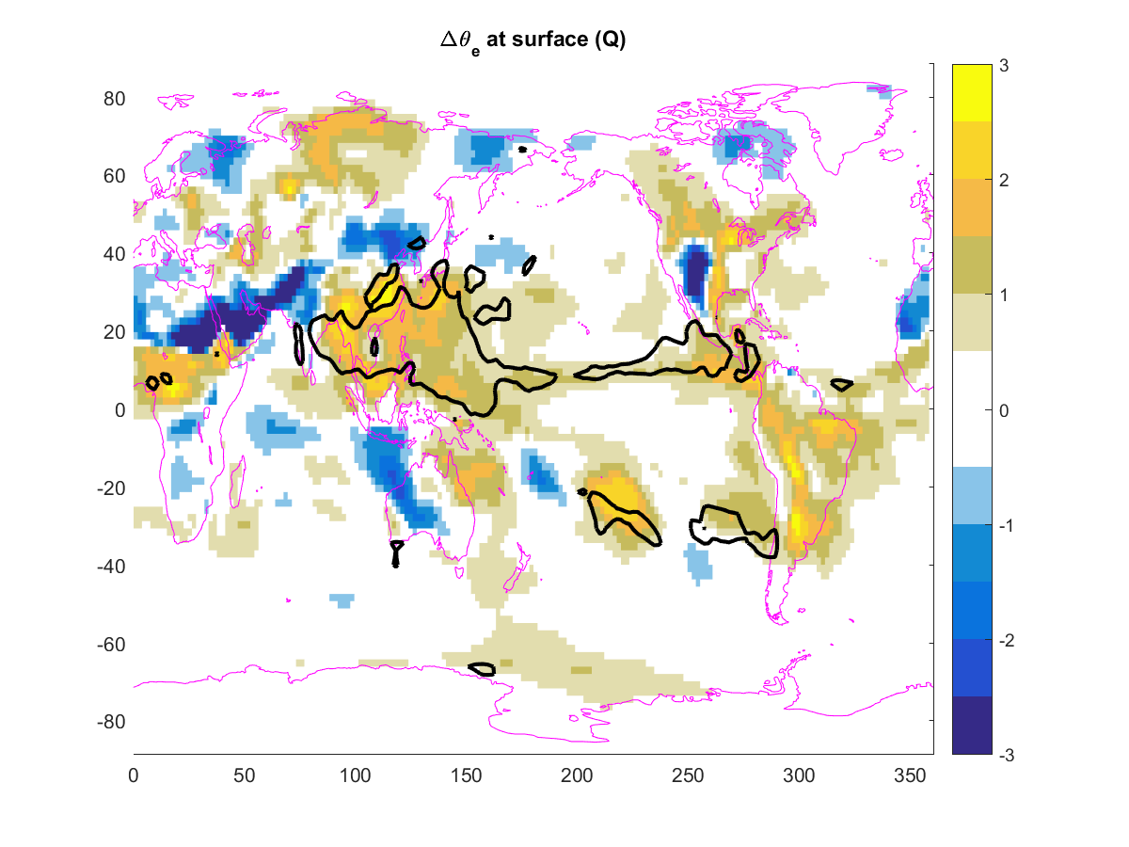
Investigating the role of gustiness on
monsoon circulations in the ACME v1 model
Bryce Harrop, Po-Lun Ma, Phil Rasch, Rich Neale, Cecile Hannay
1. Understanding monsoon circulations in the presence of convective gustiness
2. Seasonal variability
Modifications to latent heat flux in the ACME v1 model now include the effect of convective gustiness.
We seek an understanding of how this convective gustiness impacts the tropical monsoon systems.
We use simulations ap03 (with gustiness) and ap02 (without gustiness) which are tuning simulations based on AV1C-04 plus a fix to QFLX and removal of the CLUBB explicit diffusion.
Gustiness Parameterization
Adds an additional term to the value of wind used to compute the surface latent heat flux.
a
b
c
d
e
f
AC1 = JJAS – DJFM (right top)
AC2 = AM – ON (right bottom)
$\text{MPI}\text{ = }\frac{\text{Annual} \text{range} \text{of} \text{precipitation}}{\text{Annual} \text{mean} \text{precipitation}}$ (not shown)
a
b
c
(Top six panels) First annual cycle of precipitation (AC1) for simulations with and without gustiness (a & b), their difference (c), their biases against observations (d & e), and observations (f). (Bottom six panels) The same as top six panels except for the second annual cycle of precipitation (AC2). All values are given in units of mm/day.
d
e
f
Black text denotes disagreement on the sign of the change between the different observational datasets (GPCP, TRMM, CMAP)
3. Monsoon region bias changes
4. Impact of gustiness
 | Δ(annual precip) | Bias in ap02 | Result | ΔPCC | ΔRMSE (centered) |  | ΔAC1 | Bias in ap02 | Result | ΔPCC | ΔRMSE (centered)
Australia | -0.422 | 1.5476 | ↓ high bias | 0.009 | 0.0904 |  | -0.0747 | -0.1658 | ↓ low bias | 0.0457 | -0.3031
East China | 0.4361 | -0.1769 | ↑ low bias | 0.1101 | -0.0819 |  | 1.0076 | -0.3571 | ↑ low bias | 0.5087 | -0.7091
Global | 0.0792 | 0.3525 | ↑ high bias | 0.0214 | -0.0495 |  | -0.0435 | -0.0333 | ↓ high bias | 0.071 | -0.3143
India | -0.0056 | 1.3432 | ↓ high bias | 0.0208 | 0.0867 |  | 0.1451 | 1.1621 | ↑ high bias | 0.0396 | 0.1004
N. Africa | -0.1924 | 0.8847 | ↓ high bias | 0.0619 | -0.1213 |  | -0.1092 | 0.0051 | ↓ low bias | 0.1807 | -0.7184
N. America | 0.5049 | 0.694 | ↑ high bias | 0.0296 | -0.0048 |  | 0.6813 | -1.141 | ↑ low bias | 0.1389 | -0.3379
S. Africa | -0.0111 | 0.7882 | ↓ high bias | -0.0136 | 0.0061 |  | -0.2085 | -1.2173 | ↓ low bias | 0.0255 | 0.0461
S. America | -0.011 | -0.3379 | ↓ low bias | -0.0736 | 0.0618 |  | 0.2781 | -0.9837 | ↑ low bias | 0.0854 | -0.3866
Southeast Asia | 0.3829 | 0.8799 | ↑ high bias | 0.0088 | -0.0582 |  | 2.1084 | -1.5758 | ↑ low bias | 0.1244 | -0.6975
 | ΔAC2 | Bias in ap02 | Result | ΔPCC | ΔRMSE (centered) |  | ΔMPI | Bias in ap02 | Result | ΔPCC | ΔRMSE (centered)
Australia | 0.5373 | 0.8449 | ↑ high bias | 0.0718 | 0.0643 |  | 0.0014 | 0.3113 | ↑ high bias | -0.063 | 0.0919
East China | -0.1468 | -0.2162 | ↓ low bias | -0.1924 | 1.202 |  | 0.1119 | -0.0749 | ↑ low bias | 0.1053 | -0.0775
Global | -0.0202 | -0.0233 |  | 0.0269 | 0.1384 |  | -0.0103 | 0.0284 | ↓ high bias | 0.0334 | -0.0522
India | -0.0046 | -0.5281 | ↓ low bias | 0.0793 | -0.0009 |  | -0.1038 | -0.153 | ↓ low bias | -0.0091 | 0.0163
N. Africa | 0.5565 | 0.353 | ↑ high bias | 0.0844 | 0.0594 |  | 0.0727 | -0.3373 | ↑ low bias | 0.0066 | -0.046
N. America | 1.2417 | -1.7553 | ↑ low bias | 0.0459 | 0.4515 |  | 0.0794 | -0.4115 | ↑ low bias | 0.0367 | -0.0087
S. Africa | 0.2408 | -0.1948 | ↑ low bias | 0.0548 | -0.1741 |  | 0.0204 | -0.0253 | ↑ low bias | 0.0179 | -0.0257
S. America | -0.0757 | -0.2316 | ↓ low bias | -0.0071 | 0.0493 |  | 0.1125 | -0.3314 | ↑ low bias | 0.0299 | -0.0333
Southeast Asia | -1.9382 | 0.4354 | ↓ high bias | 0.1023 | 0.2817 |  | 0.1334 | -0.2871 | ↑ low bias | 0.0356 | -0.0613
Possible Sub-Heading:
[add “Approach” text and any supporting artwork in this location…]
Gustiness improves the first annual cycle of precipitation within the simulations, mostly over Asian monsoon system and over the tropical west pacific.
The second annual cycle shows reductions in model fidelity, with negative biases suggesting precipitation continues for too long into model autumn.
Global mean precipitation increases requiring additional tuning efforts to bring it in line with observed values.
Overall, however, gustiness improves the representation of the monsoon systems more often than it degrades it. This improvement is especially noticeable in the summer-winter seasonal cycle and monsoon precipitation index (MPI) – which incorporates both seasonal and average changes.
The increase in surface θ_{e} over the warm pool owing to gustiness (left panel) is driven by increases in surface humidity (lower right) instead of temperature (upper right). Black contours indicate a >1 mm/day increase in rainfall rate.
For additional information, contact:
Bryce Harrop
Post Doctorate RA
Pacific Northwest National Laboratory
(509) 375-2696
Bryce.Harrop@pnnl.gov
climatemodeling.science.energy.gov/acme

