Slide 1
BGC-Feedbacks SFA Interests and Capabilities in Arctic Science
W.J. Riley
F.M. Hoffman, J.R. Randerson, & the SFA team

Slide 2
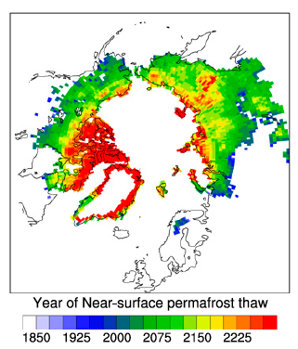
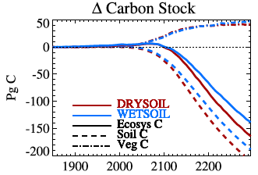
ALM Permafrost Prediction Capabilities
ALMv1 inherited many capabilities for high-latitude permafrost, vegetation, and BGC simulation
  The BGC SFA has a long history evaluating high-latitude dynamics
  ILAMB
Currently evaluating these metrics in ALMv1’s
Lawrence et al. 2015
Koven et al. 2016

Slide 3
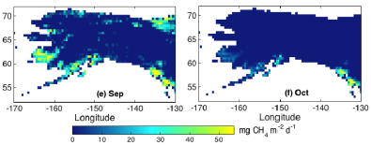
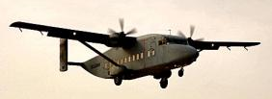
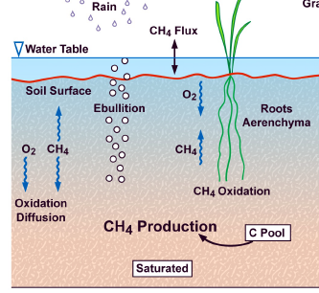
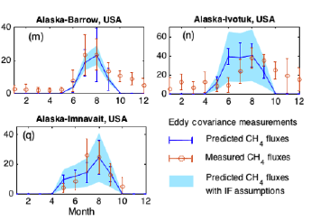
ALM CH₄ Modeling Capabilities
Evaluating ALM and other ESM land models’ predictions of CH₄ emissions against site, aircraft, and atmospheric inversions
Riley et al. 2011
Xu et al. 2016

Slide 4
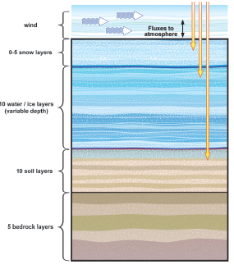
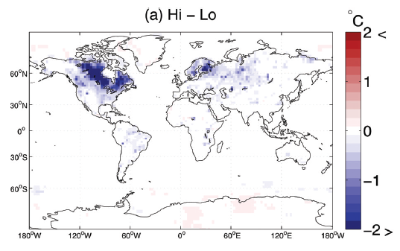
Lakes and Hydrology
ALMv1 inherits a tested 1D lake model (Subin et al. 2012a)
Characterization of surface water body structures and dynamics, and effects on surface energy budget and biogeochemistry
Change in DTR: High – Low lake area
Subin et al. 2012a
Subin et al. 2012b

Slide 5
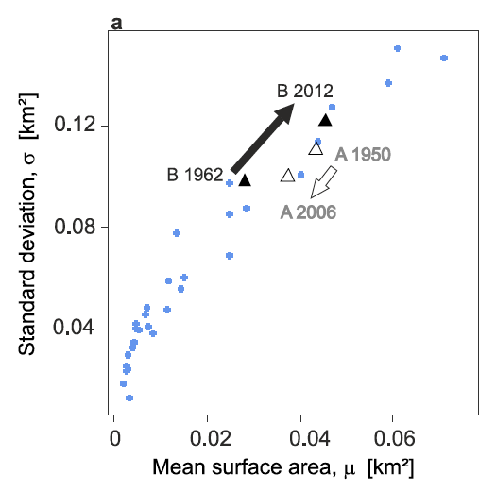
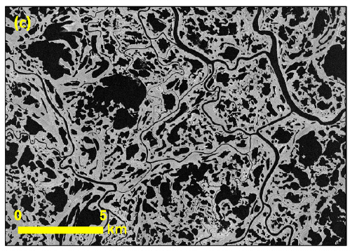
Lakes and Hydrology
High-latitude lake and surface water distributions are expected to change
  Integrate observationally-constrained models of lake dynamics
Muster et al. 2017a,b

Slide 6
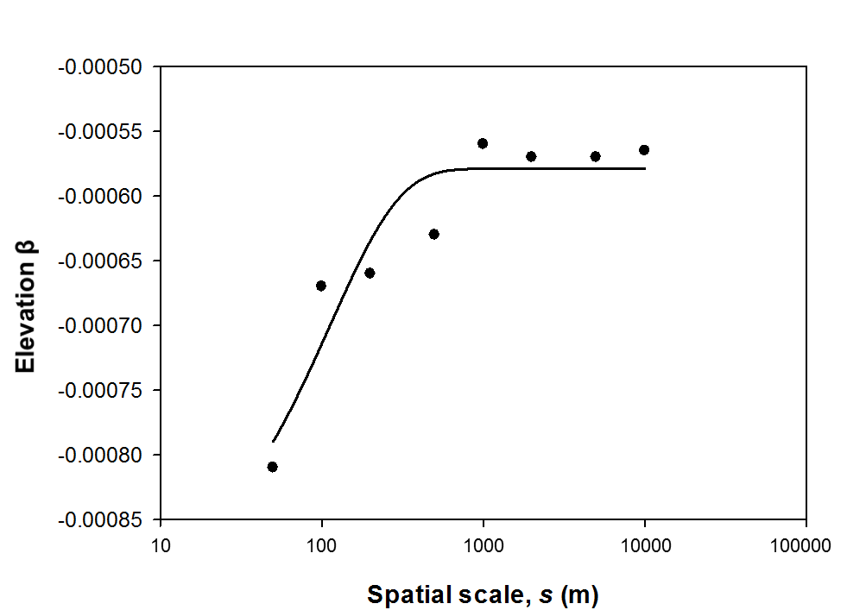
High-Latitude Soil Carbon
Using observations to evaluate ALM modeled soil carbon spatial structure and environmental controllers
Low
High
Elevation β
land cover β
Mishra et al.
β=-0.0009+0.0003(1-exp(-0.0089*s)
R² =0.83, P<0.004
200 m resolution

Slide 7
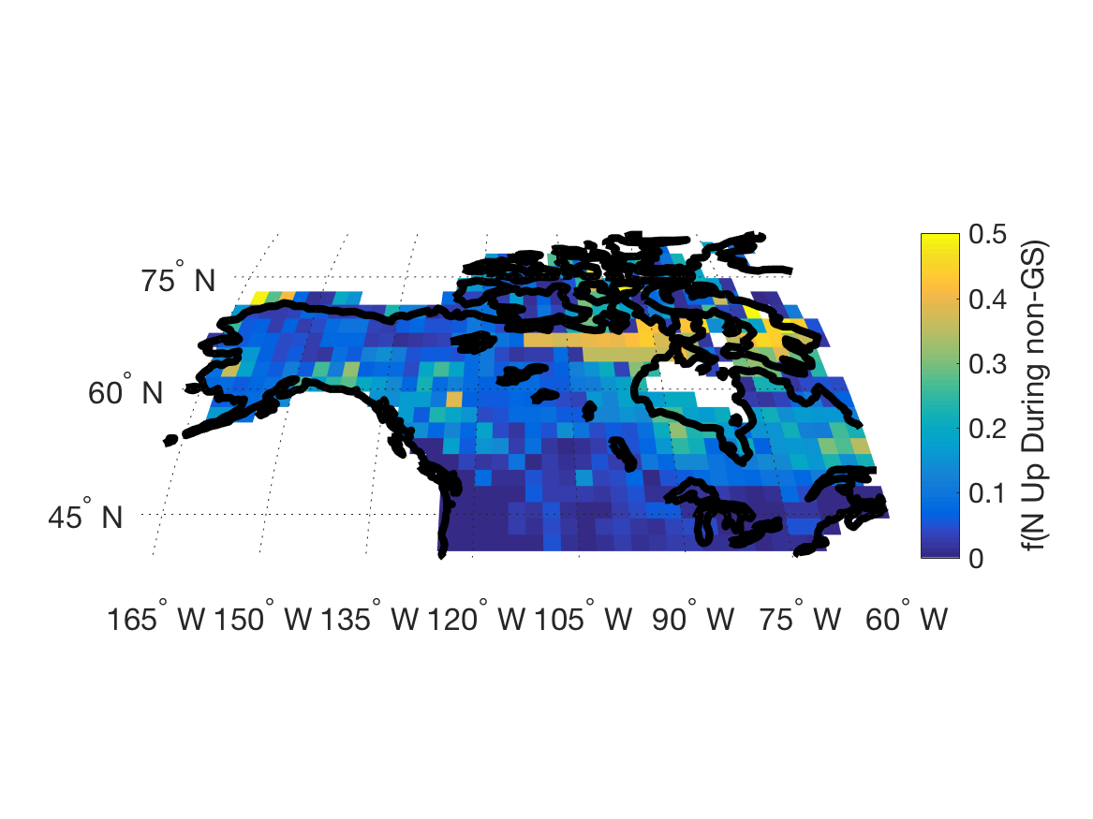
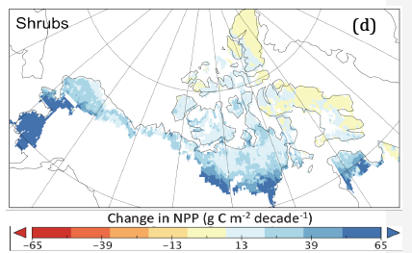
High-Latitude Vegetation
Coupled N and P limitations on plant growth and therefore, e.g., albedo, WUE and surface energy balance
  ALMv1-ECA-CNP, ALMv1-CTC-CNP
  ALM-FATES
    Shrubification, boreal forest changes, fire
ALMv1-ECA-CNP
2100 - 2010
Mekonnen et al.

