Slide 1
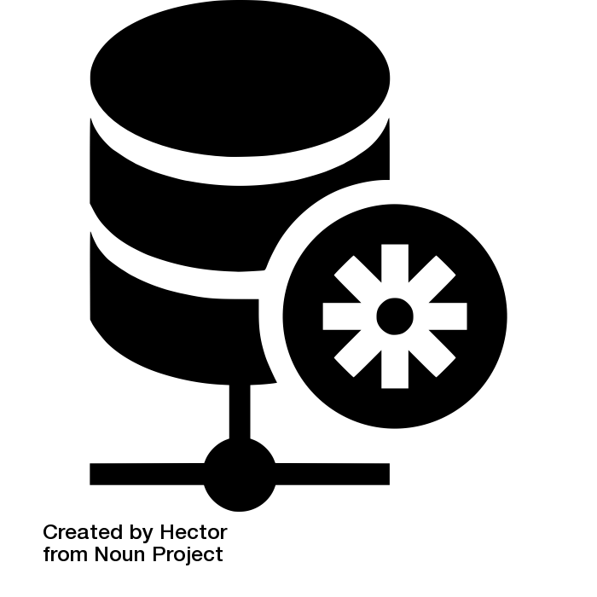
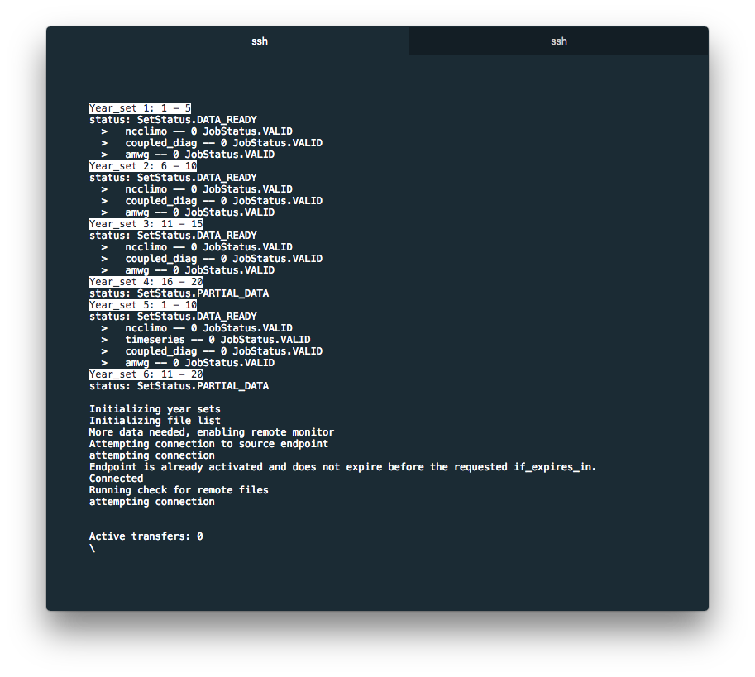
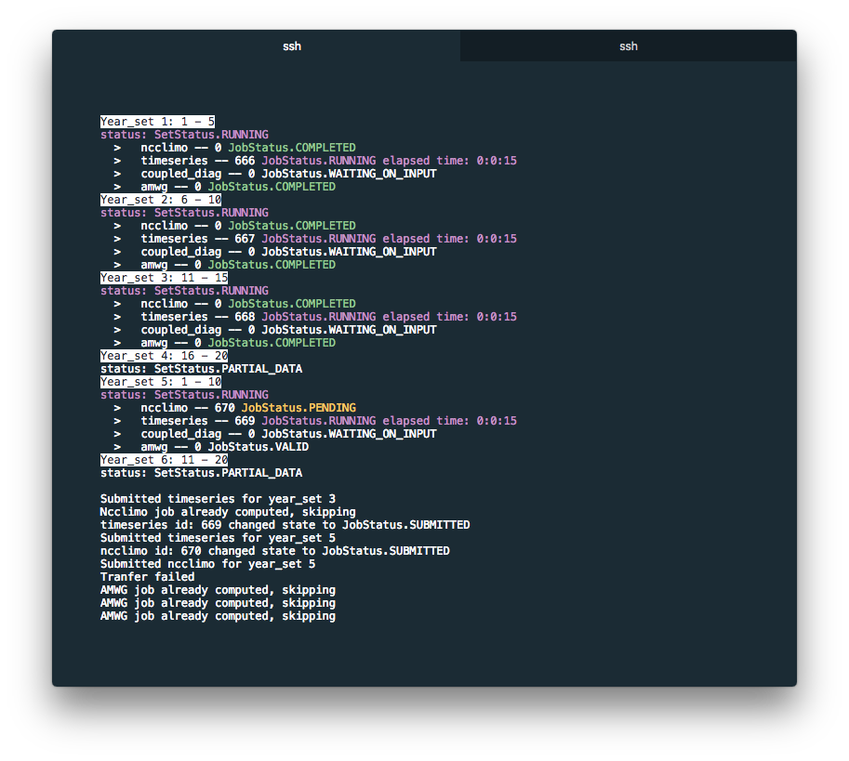
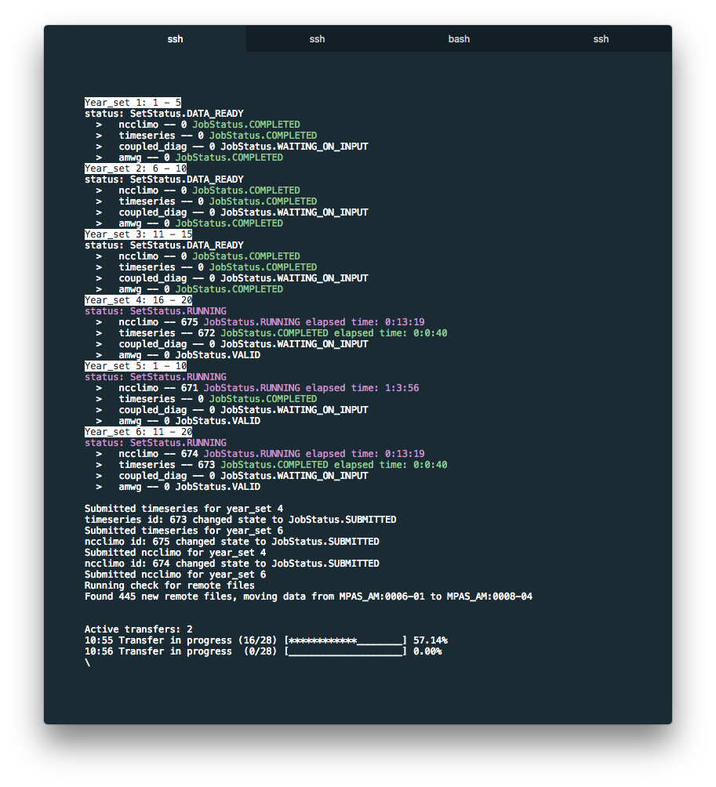
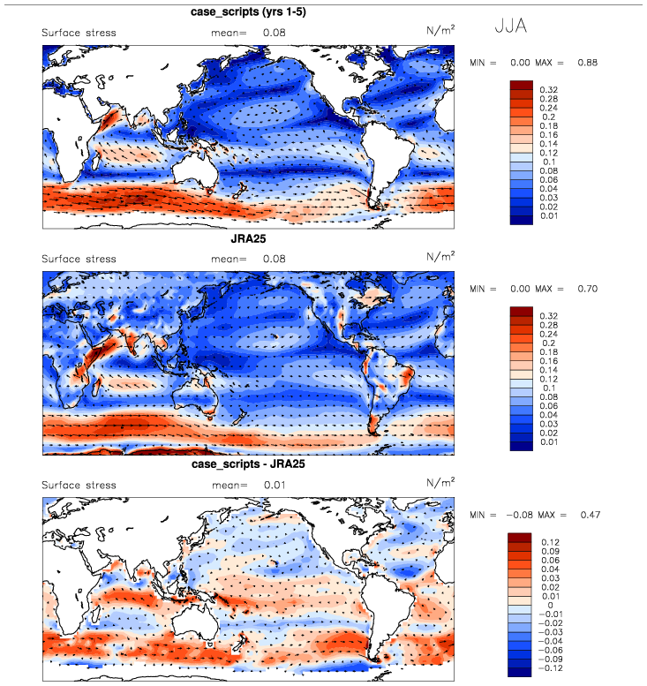
Automated Post Processing
Sterling Baldwin
Lawrence Livermore National Laboratory baldwin32@llnl.gov
Issue: Tedious Data Handling
System Design
After model data has been produced there are several post processing steps
that need to be run before the data can produce results. These post processing
steps can be tedious for scientists to run, time consuming to setup, and were not designed for
ease of use or portability. These post processing steps were targeted for automation:
Data transfer
Climatology generation
AMWG diagnostics
Time series variable extraction
Coupled Diagnostics
Computation center
Post processing server
Job Manager
Update file list
Ncclimo
cam.h0
AMWG
ncclimo
Time series
cam.h0
Coupled Diag
cam.h0
mpaso.hist.am
mpascice.hist.am
mpaso.rst
rpointer
streams
Globus DTN
Transfer new files
Globus DTN
Model run
streams
cam.h0
cam.h1
cam.h2
mpaso.hist.am.timeSeries
mpascice.hist.am.timeSeries
mpaso.rst
rpointer
ect.
Remote Monitor
streams
cam.h0
cam.h1
cam.h2
mpaso.rst
rpointer
ect.
Model Output
Post Processing Input
Job Processing
Solution: Automate Everything
The automated workflow was designed with the following requirements:
Run concurrently with the model
Extendable to new job types as needed
Portable to new environments
Highly user configurable
The automated workflow is designed to run concurrently with the model, monitoring and
transferring files as soon as they’re produced.
Once the data has been transferred, its broken into user defined set lengths, and run through
a user defined set of jobs. The default configuration uses ncclimo to produce climatologies
and time series files, which are used as input for the AMWG and coupled diagnostics. Both the
coupled diagnostics and AMWG are then self hosted and made available to the user for viewing
in the browser.
Data needed by the required jobs is specified through a list of user defined regular expressions,
allowing for the automated data transfer of any data type desired. All data is then stored in
directories based on its type.
Required jobs and data are identified
Once needed files are transferred their jobs are submitted
Future Work
Additional jobs have been targeted for automation. These include:
ESGF publication: publish all generated data to a private ESGF node.
Long term tape archiving: Store all model output to long term storage facilities.
Scratch space cleanup: After transfer and archive, remove model data from scratch
All pending jobs are submitted once their data is available
Output is hosted and available as soon as each diagnostic finishes
For additional information, contact:
Sterling Baldwin
Workflow programmer
Lawrence Livermore National Laboratory
baldwin32@llnl.gov
This work was performed under the auspices of the U.S. Department of Energy by Lawrence Livermore National Laboratory under Contract DE-AC52-07NA27344.
climatemodeling.science.energy.gov/acme

