Slide 1
ACME V2 RRM Arctic Atmosphere
Shaocheng Xie and Phil Rasch
Atmosphere Group
Arctic RRM
Ice Nucleation
Aerosols on Snow
DMS and Marine Organic Aerosols

Slide 2
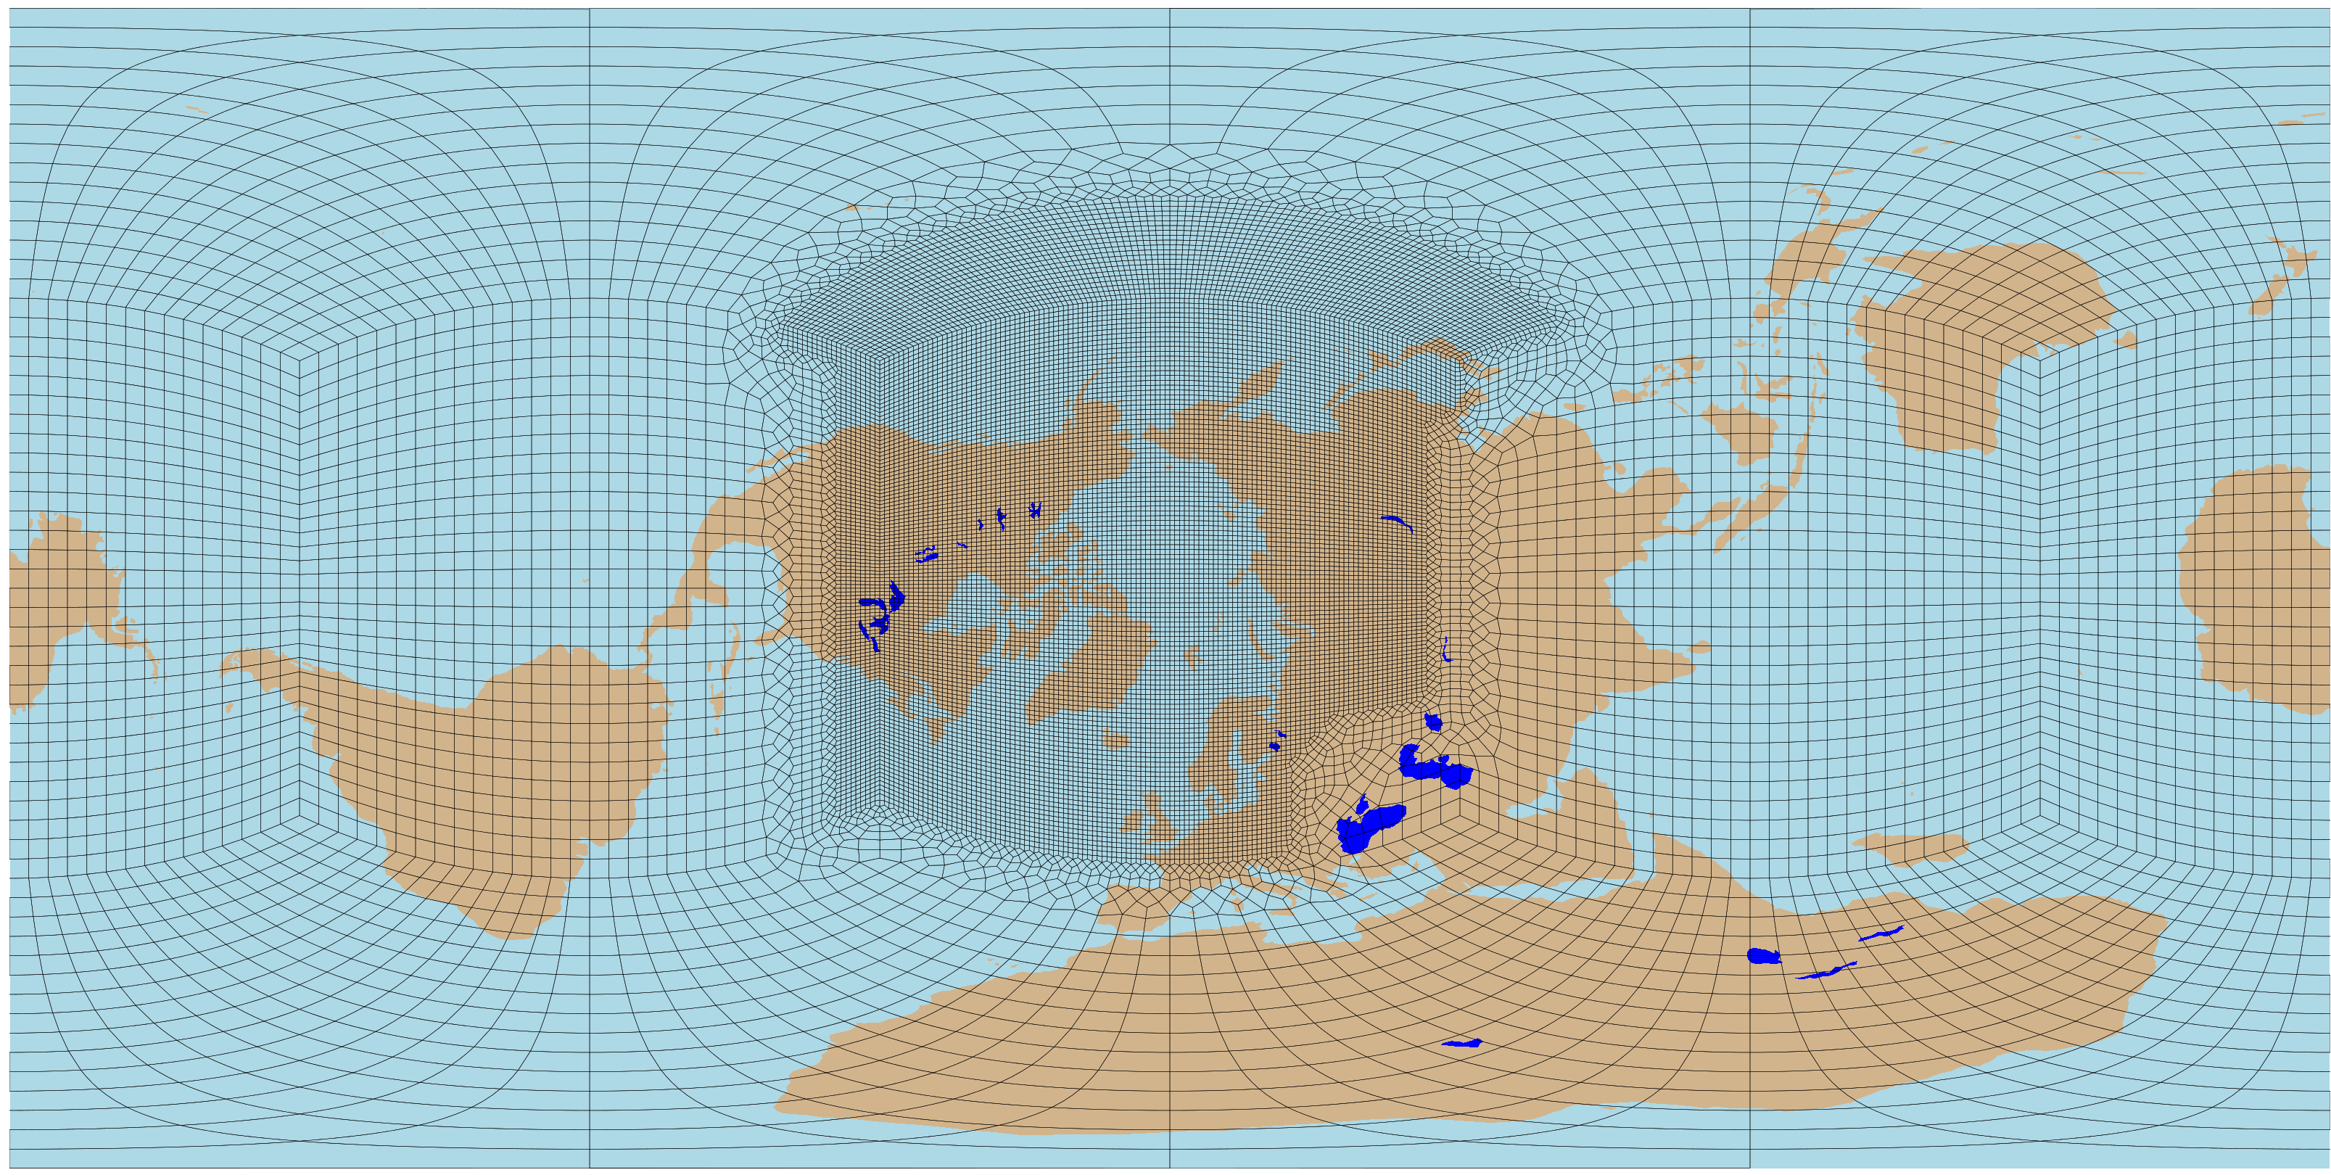
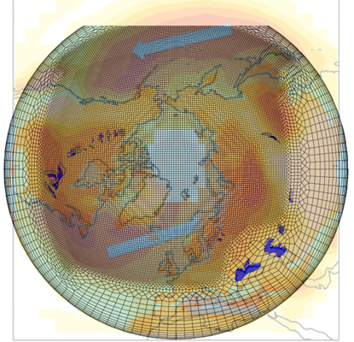
RRM-Arctic
An Arctic Grid for ACME with Storm Tracks v3
Number of Elements: 21,895
Resolution: 1 degree (low res) → 1/4 degree (high res)
Erika Roesler

Slide 3
Substantial impact of light-absorbing particles (LAPs) in snow/ice on radiation, temperature and water cycle
Increase in annual FSNS (W m⁻²)
Increase in 2-m air T(k)
Left: Arctic/global mean is 1.3 and 0.3 W m⁻², respectively; 40% from new treatments
Right: Arctic/global mean is 0.18 and 0.05 K, respectively; 50% from new treatments
Annual moisture flux (W m⁻²)
Annual SWE on ice (mm)
Annual SWE over land (mm)
Bottom: LAPs-induced increase in annual mean surface moisture flux and decrease in snow water equivalent (SWE) over sea ice and land
Wang et al. (in preparation)
Notes:
ACME model has been modified to treat both interstitial and within-hydrometeor (snow/ice grains) BC utilize new BC-in-snow optical properties that depend on snow grain size and BC particle size; integrate other aerosol improvements in CAM with LAPs treatment in CLM4.5/CICE

Slide 4
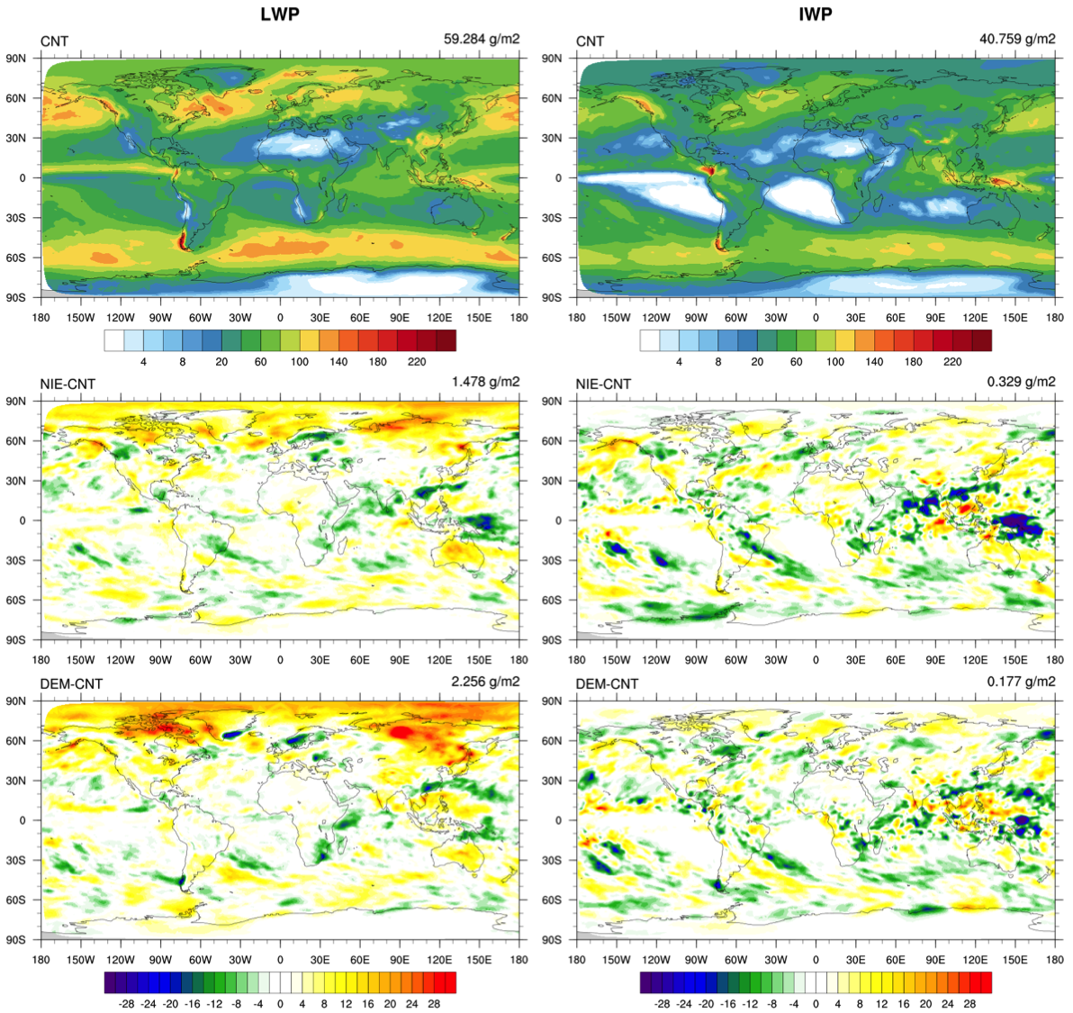
Arctic Mixed-phase Clouds Simulated with a new IN Scheme (Xiaohong Liu, Kai Zhang, et al)
ACME global testing with three ice nucleation schemes: Classical Nucleation theory (CNT, Wang et al. 2014); Niemand et al. (2012); DeMott et al. (2015)
LWP
IWP
CNT
(default)
Niemand -CNT
DeMott - CNT
Notes:
Use default FC5AV1C-04P2 compset
LWP increases in NH high latitudes with the Niemand and DeMott compared to CNT
LWP include rain and IWP include snow

Slide 5
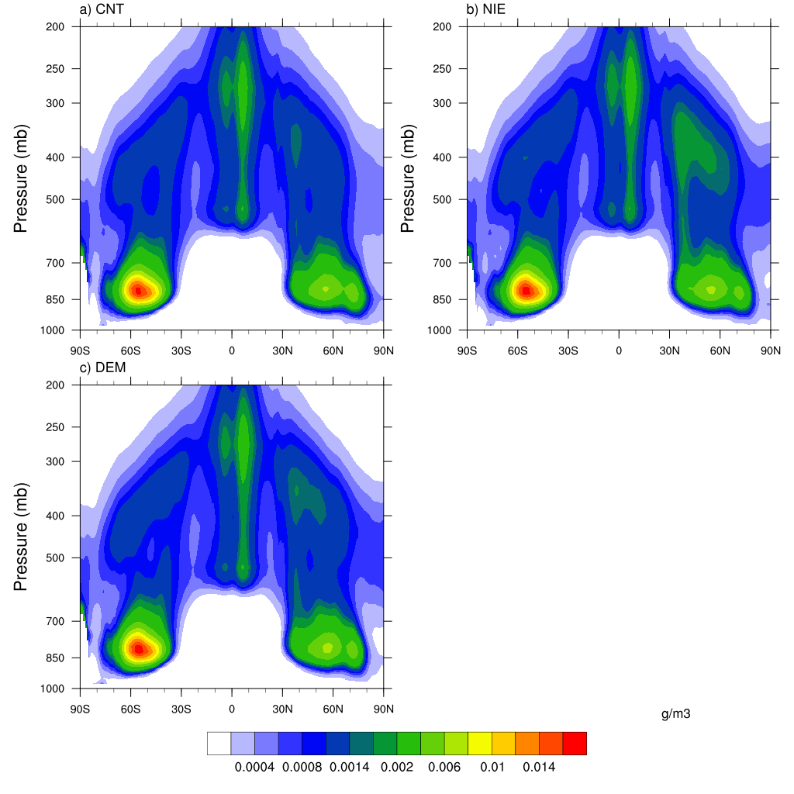
Arctic Mixed-phase Clouds Simulated with a new IN Scheme (Xiaohong Liu, Kai Zhang, et al)
ACME global testing with three ice nucleation schemes: Classical Nucleation theory (CNT, Wang et al. 2014); Niemand et al. (2012); DeMott et al. (2015)
Niemand
CNT (default)
DeMott
Cloud Ice Water Content
Notes:
IWC only include cloud ice, without include snow

