Slide 1
The Role of Convective Gustiness in Reducing Seasonal Precipitation Biases in the Tropical West Pacific
Bryce Harrop, Po-Lun Ma, Phil Rasch, Rich Neale, Cecile Hannay

Slide 2
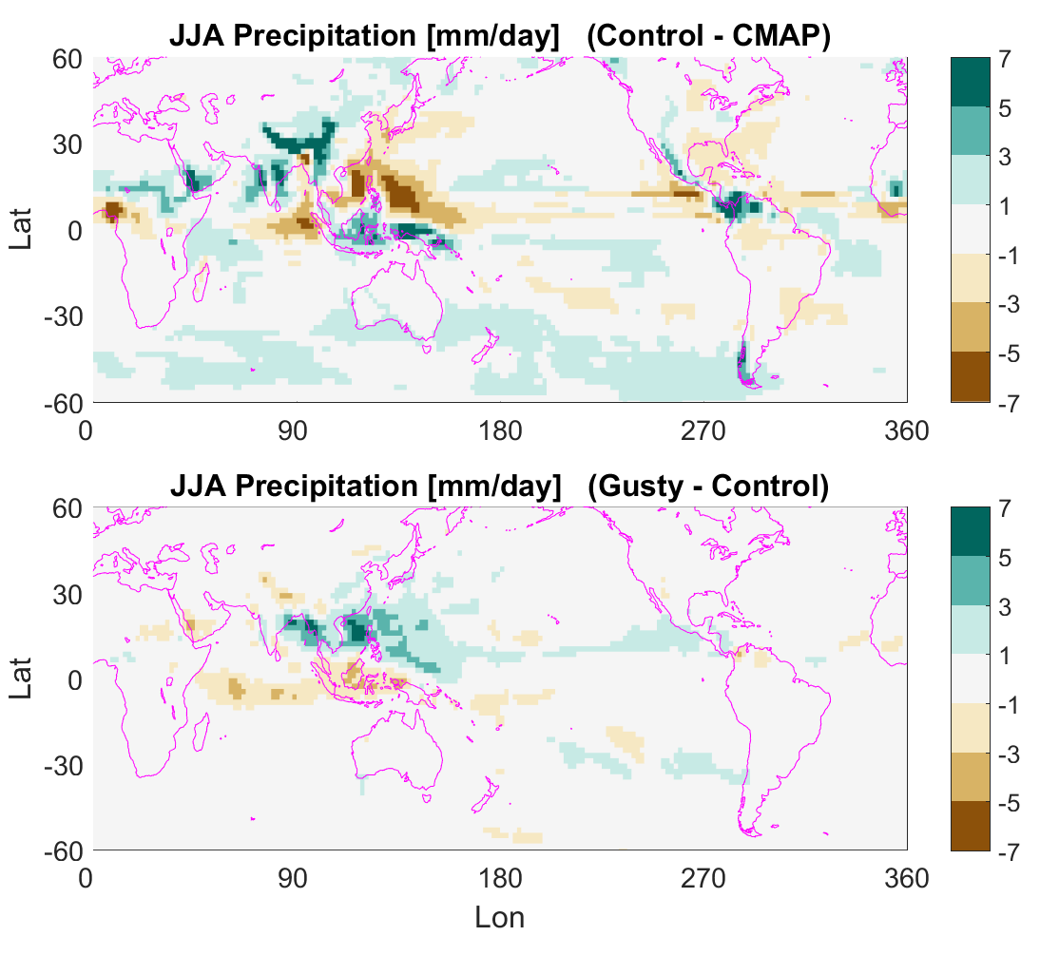
Effect of gustiness on precipitation
Difference in JJA precipitation owing to gustiness.
For all of the remaining slides, I will be looking at JJA.
The goal is to explain the northward shift of precipitation in the warm pool.
Notes:
ΔP is the change in total precipitation for JJA between gustiness and non-gustiness simulations.

Slide 3
Is the shift in precipitation important?
 | Δ(JJA – DJF) precip | Bias w/o gustiness | Result | ΔPCC | ΔRMSE (centered)
Australia | -0.0747 | -0.1658 | ↓ low bias | 0.0457 | -0.3031
East China | 1.0076 | -0.3571 | ↑ low bias | 0.5087 | -0.7091
Global | -0.0435 | -0.0333 | ↓ high bias | 0.071 | -0.3143
India | 0.1451 | 1.1621 | ↑ high bias | 0.0396 | 0.1004
N. Africa | -0.1092 | 0.0051 | ↓ low bias | 0.1807 | -0.7184
N. America | 0.6813 | -1.141 | ↑ low bias | 0.1389 | -0.3379
S. Africa | -0.2085 | -1.2173 | ↓ low bias | 0.0255 | 0.0461
S. America | 0.2781 | -0.9837 | ↑ low bias | 0.0854 | -0.3866
Southeast Asia | 2.1084 | -1.5758 | ↑ low bias | 0.1244 | -0.6975

Slide 4
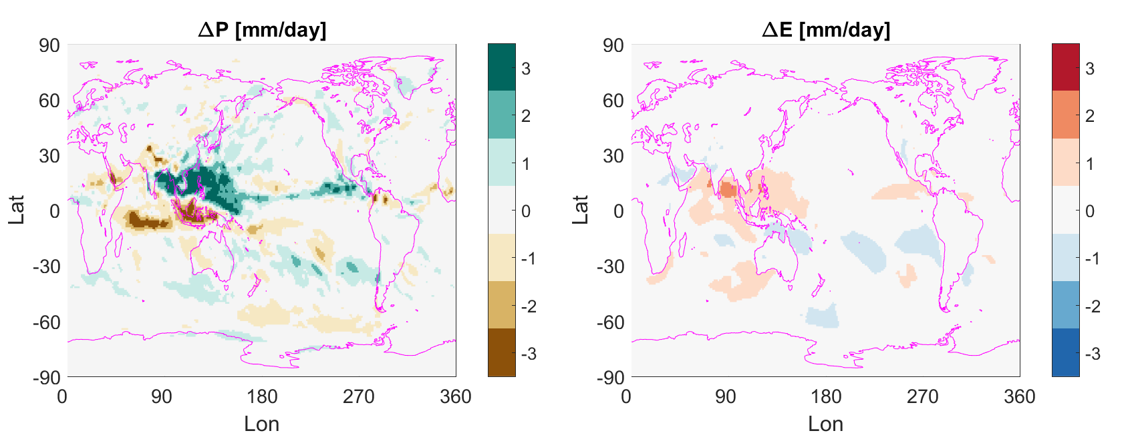
Effect of gustiness on precipitation
We want to understand how convective gustiness gives rise to the change in JJA precipitation seen above because it reduces the precipitation bias in the tropical West Pacific that is present without gustiness. The Southeast Asian monsoon region has the largest JJA-DJF precipitation bias of all the monsoon systems in the ACMEv1 model, but gustiness largely removes that bias.

Slide 5
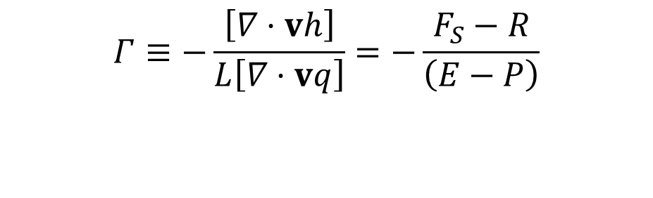
Normalized Gross Moist Stability (Γ)
  Cast in terms of moist static energy, it gives the ratio of MSE divergence to moisture divergence.
  In equilibrium, the relationship gives you the ratio of energy forcing in the atmosphere compared to E-P (both in W/m²).
  NGMS can be used as an amplification factor to describe the sensitivity of the moisture cycle to forcing changes.
$$\begin{matrix}Γ≡−\frac{\left[∇·vh\right]}{L\left[∇·vq\right]}=−\frac{F_{S}−R}{\left(E−P\right)}\end{matrix}$$
P, E, F_{S}, and R are in W/m²

Slide 6

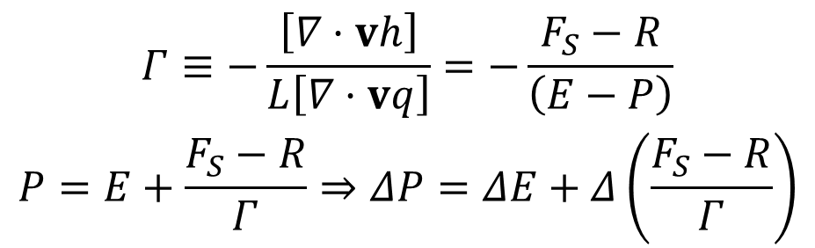



Normalized Gross Moist Stability (Γ)
  Cast in terms of moist static energy, it gives the ratio of MSE divergence to moisture divergence.
  In equilibrium, the relationship gives you the ratio of energy forcing in the atmosphere compared to E-P (both in W/m²).
  NGMS can be used as an amplification factor to describe the sensitivity of the moisture cycle to forcing changes.
$$\begin{matrix}Γ≡−\frac{\left[∇·vh\right]}{L\left[∇·vq\right]}=−\frac{F_{S}−R}{\left(E−P\right)} \\ P=E+\frac{F_{S}−R}{Γ}⇒ΔP=ΔE+Δ\left(\frac{F_{S}−R}{Γ}\right)\end{matrix}$$
P, E, F_{S}, and R are in W/m²

Slide 7
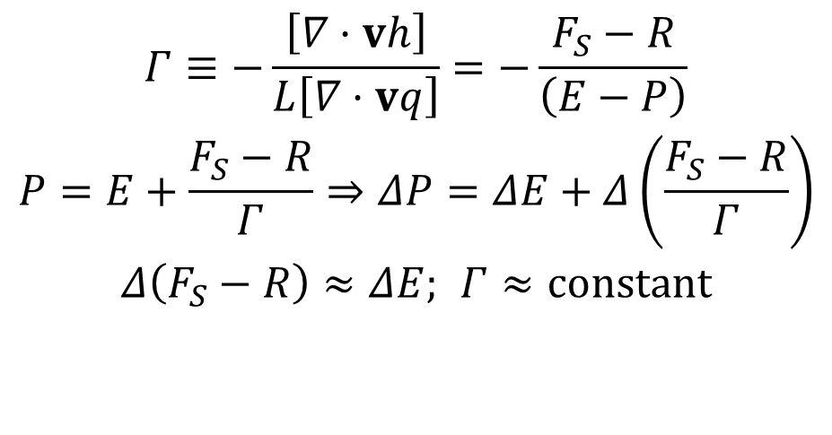
Normalized Gross Moist Stability (Γ)
  Cast in terms of moist static energy, it gives the ratio of MSE divergence to moisture divergence.
  In equilibrium, the relationship gives you the ratio of energy forcing in the atmosphere compared to E-P (both in W/m²).
  NGMS can be used as an amplification factor to describe the sensitivity of the moisture cycle to forcing changes.
$$\begin{matrix}Γ≡−\frac{\left[∇·vh\right]}{L\left[∇·vq\right]}=−\frac{F_{S}−R}{\left(E−P\right)} \\ P=E+\frac{F_{S}−R}{Γ}⇒ΔP=ΔE+Δ\left(\frac{F_{S}−R}{Γ}\right) \\ Δ\left(F_{S}−R\right)≈ΔE; Γ≈\text{constant}\end{matrix}$$
P, E, F_{S}, and R are in W/m²

Slide 8
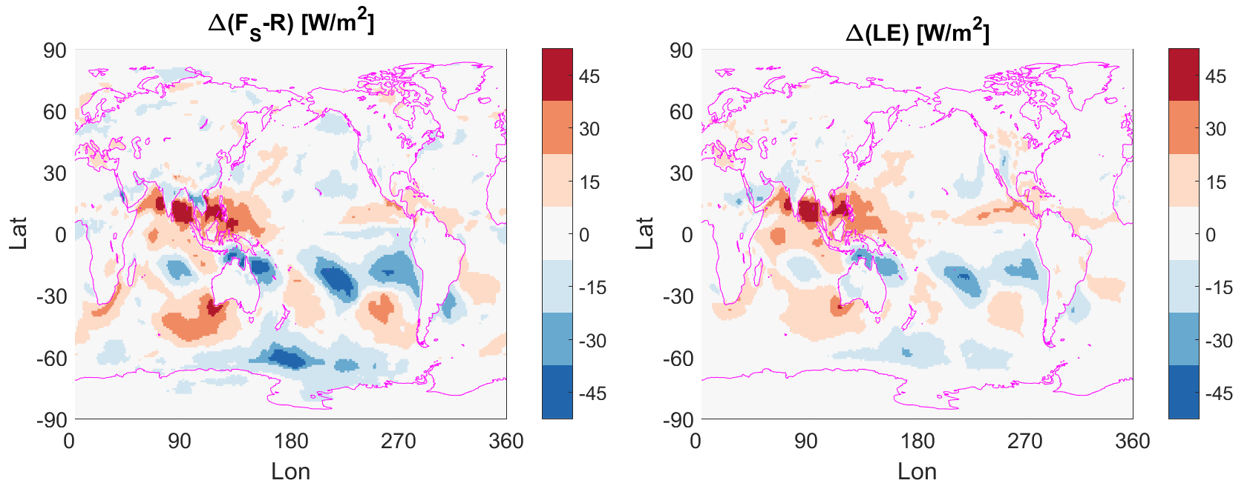

Normalized Gross Moist Stability (Γ)
$$Δ\left(F_{S}−R\right)≈ΔE$$
Is a good assumption? Yes.

Slide 9
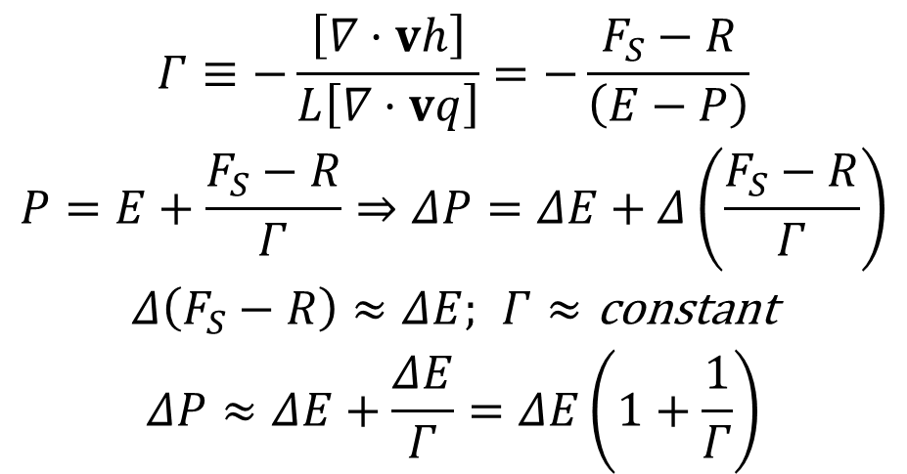
Normalized Gross Moist Stability (Γ)
  Cast in terms of moist static energy, it gives the ratio of MSE divergence to moisture divergence.
  In equilibrium, the relationship gives you the ratio of energy forcing in the atmosphere compared to E-P (both in W/m²).
  NGMS can be used as an amplification factor to describe the sensitivity of the moisture cycle to forcing changes.
$$\begin{matrix}Γ≡−\frac{\left[∇·vh\right]}{L\left[∇·vq\right]}=−\frac{F_{S}−R}{\left(E−P\right)} \\ P=E+\frac{F_{S}−R}{Γ}⇒ΔP=ΔE+Δ\left(\frac{F_{S}−R}{Γ}\right) \\ Δ\left(F_{S}−R\right)≈ΔE; Γ≈\text{constant} \\ ΔP≈ΔE+\frac{ΔE}{Γ}=ΔE\left(1+\frac{1}{Γ}\right)\end{matrix}$$
P, E, F_{S}, and R are in W/m²

Slide 10
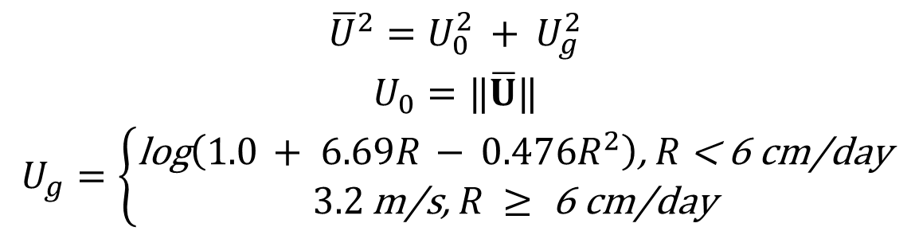
How is gustiness included in a model?
Gustiness Parameterization
Non-linearly adds an additional term (U_{g}) to the value of wind used to compute the surface latent heat flux (U₀). U_{g} is based on the work of Redelsperger et al. (2000).
$$\begin{matrix}{\overline{U}}^{2}=U_{0}^{2} +\text{​ }U_{g}^{2} \\ U_{0}=‖\overline{U}‖ \\ U_{g}=\left\{\begin{matrix}\text{log}\left(1.0 +\text{ ​}6.69R − 0.476R^{2}\right)\text{, }R\text{ < 6 }\text{cm}\text{/}\text{day} \\ 3.2 \text{m}\text{/}\text{s}\text{, }R ≥\text{ 6 }\text{cm}\text{/}\text{day}\end{matrix}\right.\end{matrix}$$
R is convective rain rate

Slide 11
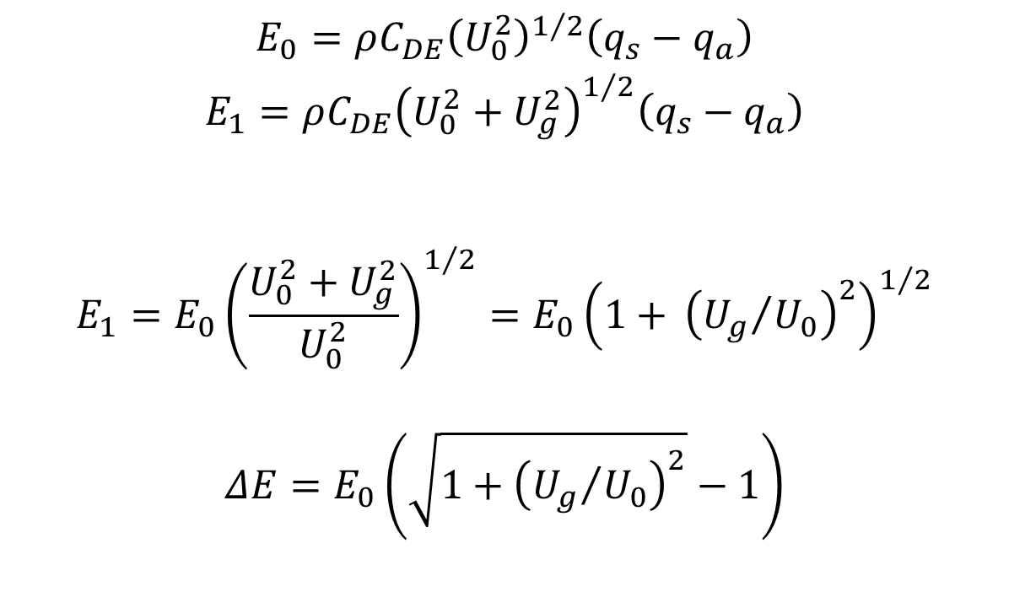
How does gustiness influence E?
$$\begin{matrix}E_{0}=ρC_{DE}{\left(U_{0}^{2}\right)}^{1/2}\left(q_{s}−q_{a}\right) \\ \begin{aligned}\begin{aligned}E_{1}=ρC_{DE}{\left(U_{0}^{2}+U_{g}^{2}\right)}^{1/2}\left(q_{s}−q_{a}\right) \\ \end{aligned} \\ \end{aligned} \\ \begin{aligned}E_{1}=E_{0}{\left(\frac{U_{0}^{2}+U_{g}^{2}}{U_{0}^{2}}\right)}^{1/2}=E_{0}{\left(1+\text{ ​}{\left({U_{g}}/{U_{0}}\right)}^{2}\right)}^{1/2} \\ \end{aligned} \\ ΔE=E_{0}\left(\sqrt{1+{\left({U_{g}}/{U_{0}}\right)}^{2}}−1\right)\end{matrix}$$
Notes:
Here subscript ‘1’ denotes the simulation with gustiness and the subscript ‘0’ denotes the control simulation. E₁ is the predicted QFLX before any feedbacks owing to gustiness actually take place. I have computed this with the JJA data using the lowest model level for U₀.

Slide 12
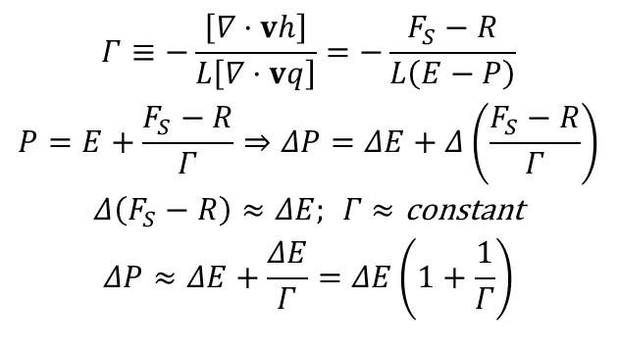
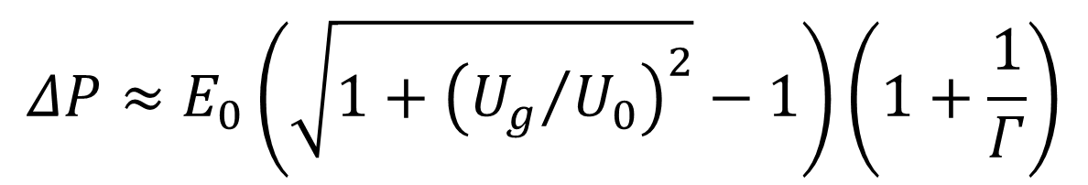
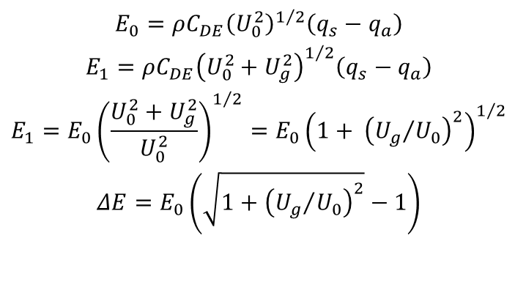
How does gustiness influence P?
$$\begin{matrix}Γ≡−\frac{\left[∇·vh\right]}{L\left[∇·vq\right]}=−\frac{F_{S}−R}{L\left(E−P\right)} \\ P=E+\frac{F_{S}−R}{Γ}⇒ΔP=ΔE+Δ\left(\frac{F_{S}−R}{Γ}\right) \\ Δ\left(F_{S}−R\right)≈ΔE; Γ≈\text{constant} \\ ΔP≈ΔE+\frac{ΔE}{Γ}=ΔE\left(1+\frac{1}{Γ}\right)\end{matrix}$$
$$\begin{matrix}E_{0}=ρC_{DE}{\left(U_{0}^{2}\right)}^{1/2}\left(q_{s}−q_{a}\right) \\ E_{1}=ρC_{DE}{\left(U_{0}^{2}+U_{g}^{2}\right)}^{1/2}\left(q_{s}−q_{a}\right) \\ E_{1}=E_{0}{\left(\frac{U_{0}^{2}+U_{g}^{2}}{U_{0}^{2}}\right)}^{1/2}=E_{0}{\left(1+\text{ ​}{\left({U_{g}}/{U_{0}}\right)}^{2}\right)}^{1/2} \\ ΔE=E_{0}\left(\sqrt{1+{\left({U_{g}}/{U_{0}}\right)}^{2}}−1\right)\end{matrix}$$
$$ΔP≈E_{0}\left(\sqrt{1+{\left({U_{g}}/{U_{0}}\right)}^{2}}−1\right)\left(1+\frac{1}{Γ}\right)$$

Slide 13
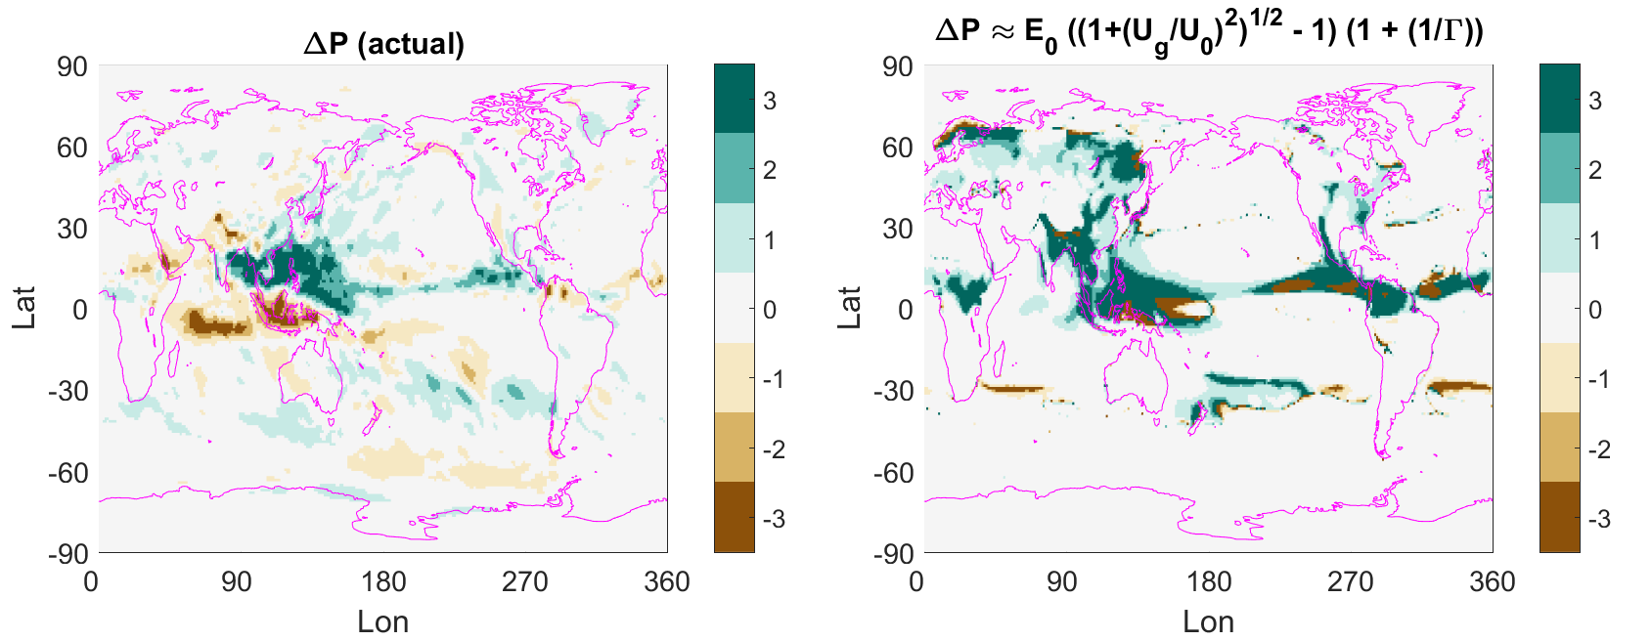
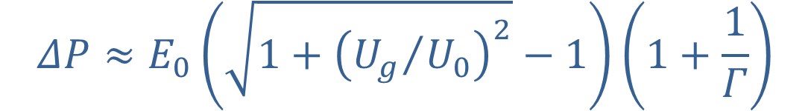
$$ΔP≈E_{0}\left(\sqrt{1+{\left({U_{g}}/{U_{0}}\right)}^{2}}−1\right)\left(1+\frac{1}{Γ}\right)$$

Slide 14
Where does the ΔP pattern come from?
Notes:
The brown splotches are along regions where there is little net energy divergence and Γ is close to zero. The uniform Γ was chosen to be 0.2, based on “visual approximation”

Slide 15
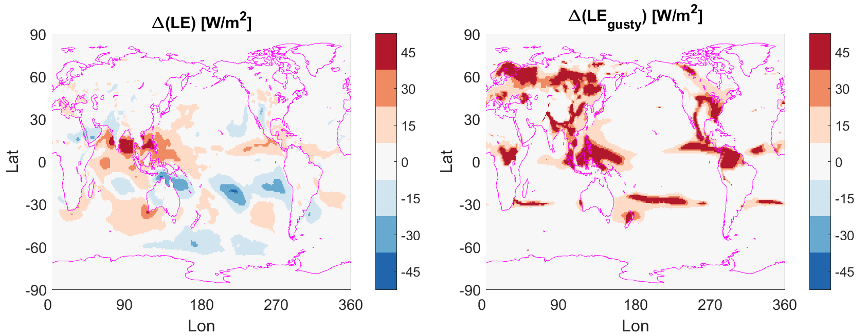
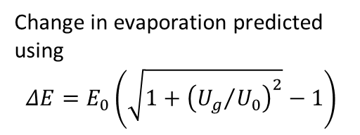
E changes owing to gustiness
Actual change in evaporation between simulations with and without gustiness
Change in evaporation predicted using
$$ΔE=E_{0}\left(\sqrt{1+{\left({U_{g}}/{U_{0}}\right)}^{2}}−1\right)$$
Notes:
On the left, the actual change in QFLX between the simulations with and without gustiness. On the right, the predicted change in QFLX using the ΔE equation.

Slide 16
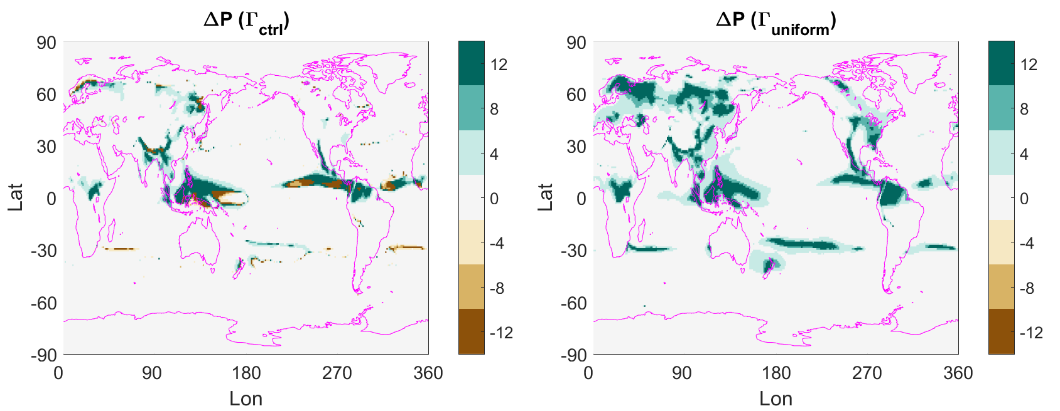
Where does the ΔP pattern come from?
Using a uniform value of Γ still produces a qualitatively similar pattern in predicted ΔP, so it must be the ΔE term.
Notes:
The brown splotches are along regions where there is little net energy divergence and Γ is close to zero. The uniform Γ was chosen to be 0.2, based on “visual approximation”

Slide 17
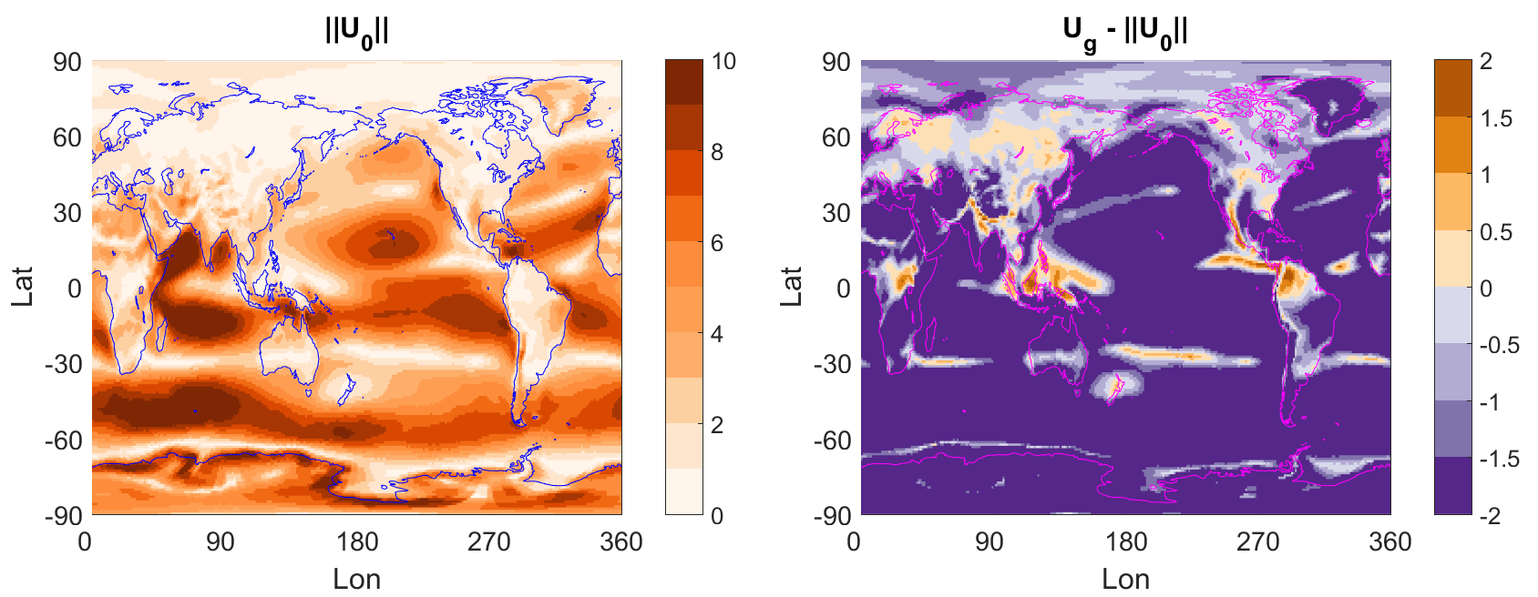
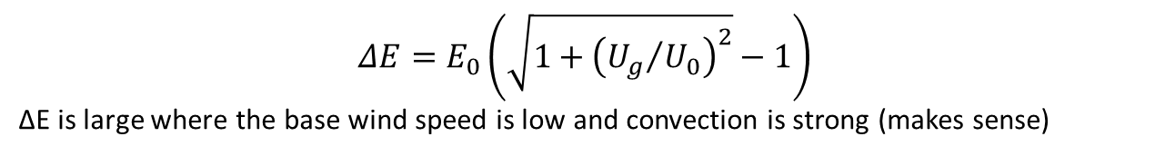
Where does the ΔP pattern come from?
$$ΔE=E_{0}\left(\sqrt{1+{\left({U_{g}}/{U_{0}}\right)}^{2}}−1\right)$$
ΔE is large where the base wind speed is low and convection is strong (makes sense)
Notes:
Wind speed owing to gustiness maxes out at 3.2 m/s according to the parameterization, so if the magnitude of the surface winds is already substantially greater than this, than the relative change will be weak.

Slide 18
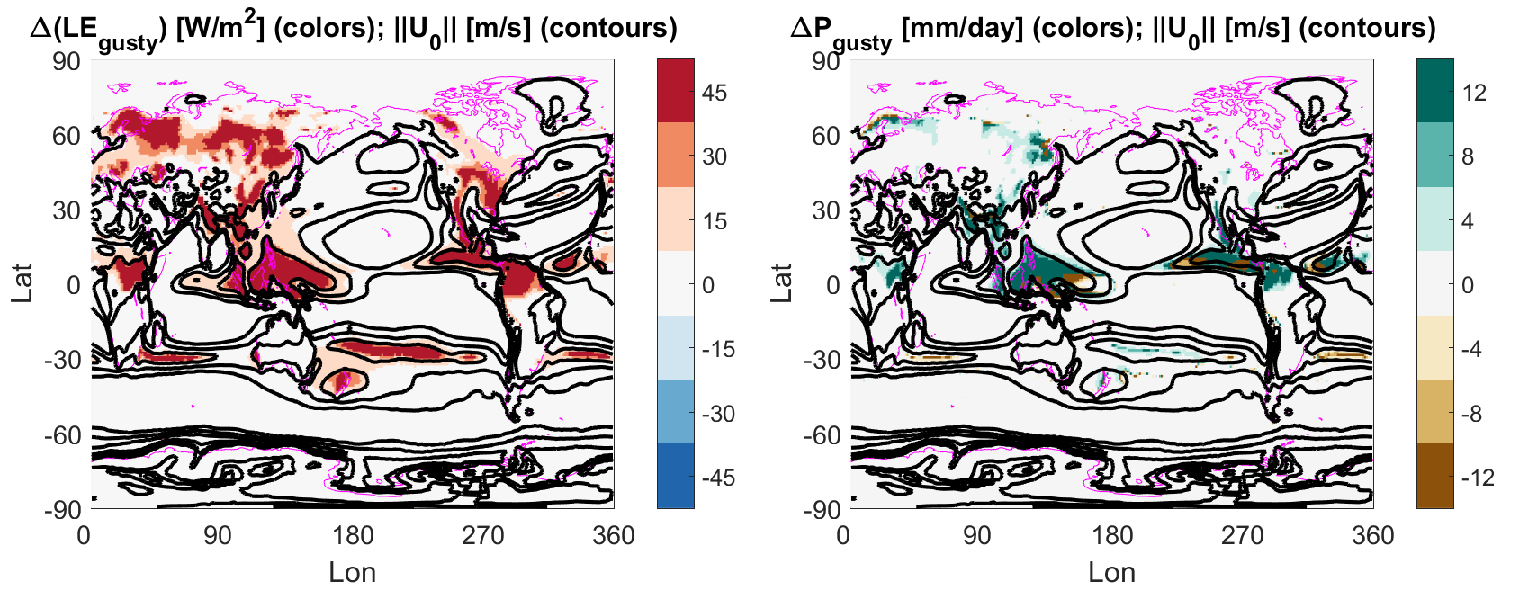
Where does the ΔP pattern come from?
The pattern in ΔP arises from the magnitude of U₀ – specifically, where U₀ is small.
Notes:
The change in evaporation is most sensitive to regions where the wind speed is low and convection is strong.

Slide 19
$$ΔP≈E_{0}\left(\sqrt{1+{\left({U_{g}}/{U_{0}}\right)}^{2}}−1\right)\left(1+\frac{1}{Γ}\right)$$
Going back to the predicted vs actual precipitation change, there is little reason for these to match exactly since we anticipate feedbacks to be important. The important point is that precipitation north of the maritime continent is predicted to increase, which could serve as the kick needed to initiate that feedback process.

Slide 20
Other ways to enhance evaporation
Brunke et al. 2008
Notes:
Mean JJA precip for CAM3 comparing control to CMAP and the skin temperature modified run to the control.

Slide 21
Summary
Convective gustiness maximizes its impact in regions that see convective precipitation and have weak large-scale winds. The region north of the maritime continent is in one such zone. The addition of convective gustiness produces a huge percentage change in evaporation at the surface, and the atmosphere responds to get rid of that additional MSE via convection. The increase in convection sets off a feedback process, owing to gustiness being prescribed as a function of convective precipitation, that ultimately drives the simulation towards a climate more representative of the true seasonal cycle in the Tropics.

Slide 22
Questions?

