Slide 1
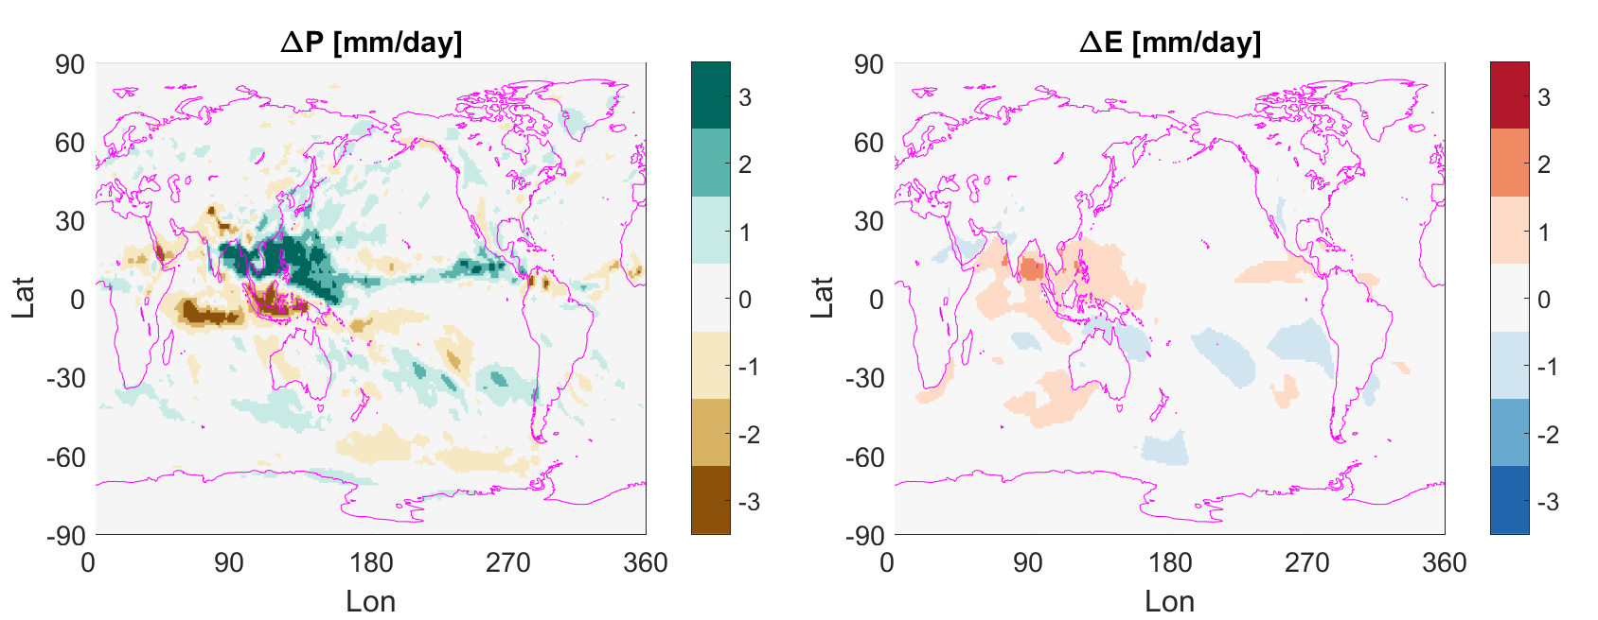
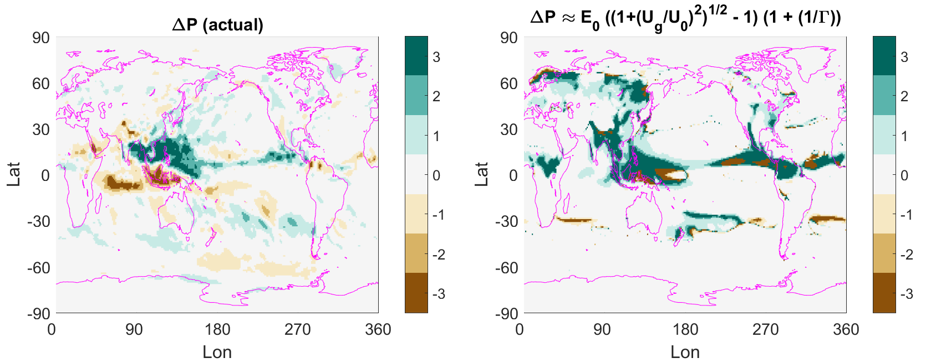
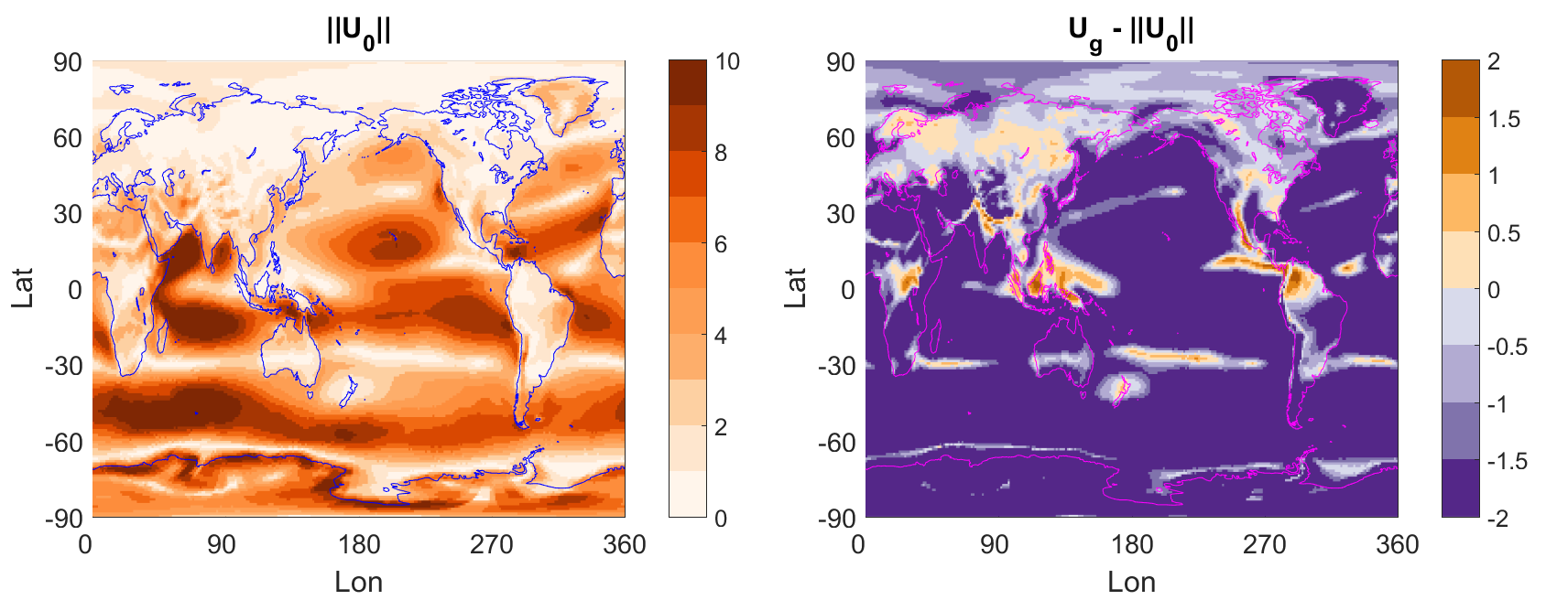
The Role of Convective Gustiness in Reducing Seasonal Precipitation Biases in the Tropical West Pacific
Bryce Harrop, Po-Lun Ma, Phil Rasch, Rich Neale, Cecile Hannay
(1) Objective
(2) Approach
Explain the increase in precipitation in the northern tropical west pacific.
Normalized Gross Moist Stability (Γ) framework:
NGMS is defined as the ratio of the column-integrated divergence of MSE to the column-integrated divergence of latent energy. It is a useful diagnostic framework for relating changes in the energy budget to changes in the moisture budget.
$$\begin{matrix}Γ≡−\frac{\left[∇·vh\right]}{L\left[∇·vq\right]}=−\frac{F_{S}−R}{L\left(E−P\right)} \\ P=E+\frac{F_{S}−R}{Γ}⇒ΔP=ΔE+Δ\left(\frac{F_{S}−R}{Γ}\right) \\ Δ\left(F_{S}−R\right)≈ΔE; Γ≈\text{constant} \\ ΔP≈ΔE+\frac{ΔE}{Γ}=ΔE\left(1+\frac{1}{Γ}\right)\end{matrix}$$
$$\begin{matrix}E_{0}=ρC_{DE}{\left(U_{0}^{2}\right)}^{1/2}\left(q_{s}−q_{a}\right) \\ E_{1}=ρC_{DE}{\left(U_{0}^{2}+U_{g}^{2}\right)}^{1/2}\left(q_{s}−q_{a}\right) \\ E_{1}=E_{0}{\left(\frac{U_{0}^{2}+U_{g}^{2}}{U_{0}^{2}}\right)}^{1/2}=E_{0}{\left(1+\text{ ​}{\left({U_{g}}/{U_{0}}\right)}^{2}\right)}^{1/2} \\ ΔE=E_{0}\left(\sqrt{1+{\left({U_{g}}/{U_{0}}\right)}^{2}}−1\right)\end{matrix}$$
$$U_{g}=\left\{\begin{matrix}\text{log}\left(1.0 +\text{ ​}6.69R − 0.476R^{2}\right)\text{, }R\text{ < 6 }\text{cm}\text{/}\text{day} \\ 3.2 \text{m}\text{/}\text{s}\text{, }R ≥\text{ 6 }\text{cm}\text{/}\text{day}\end{matrix}\right.$$
We want to understand how convective gustiness gives rise to the change in JJA precipitation seen above because it reduces the precipitation bias in the tropical West Pacific that is present without gustiness. The Southeast Asian monsoon region has the largest JJA-DJF precipitation bias of all the monsoon systems in the ACMEv1 model, but gustiness largely removes that bias.
$$ΔP≈E_{0}\left(\sqrt{1+{\left({U_{g}}/{U_{0}}\right)}^{2}}−1\right)\left(1+\frac{1}{Γ}\right)$$
Redelsperger et al. (2000)
(3) Results
(4) Impact
(Upper left) Actual change in precipitation owing to gustiness;
(upper right) predicted change in precipitation owing to gustiness (not accounting for feedback processes);
(lower left) climatological wind speed of lowest most model level; (lower right) difference in gustiness-induced wind speed and actual wind speed.
Convective gustiness maximizes its impact in regions that see convective precipitation and have weak large-scale winds. The region north of the maritime continent is in one such zone. The addition of convective gustiness produces a huge percentage change in evaporation at the surface, and the atmosphere responds to get rid of that additional MSE via convection. The increase in convection sets off a feedback process, owing to gustiness being prescribed as a function of convective precipitation, that ultimately drives the simulation towards a climate more representative of the true seasonal cycle in the Tropics.
For additional information, contact:
Bryce Harrop
Postdoc RA
Pacific Northwest National Laboratory
(509) 375-2696
bryce.harrop@pnnl.gov
climatemodeling.science.energy.gov/acme

