Slide 1
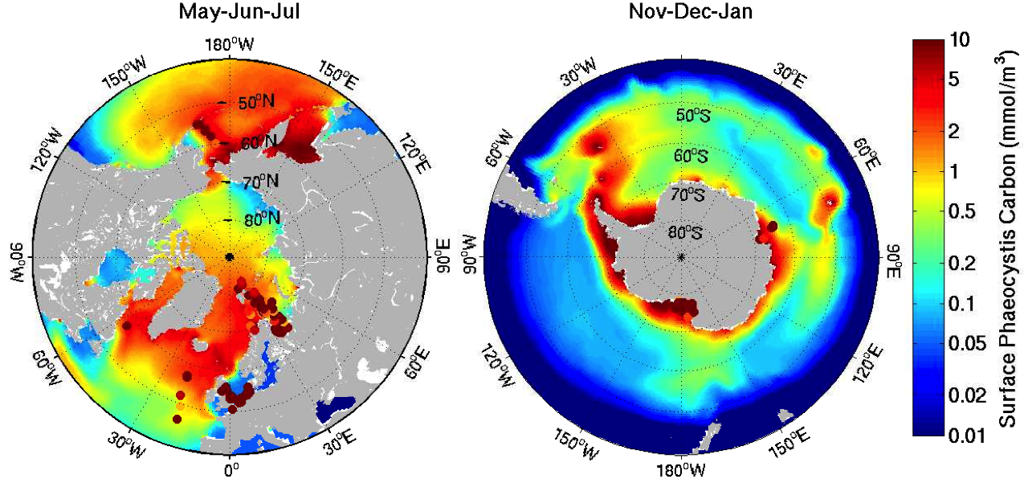
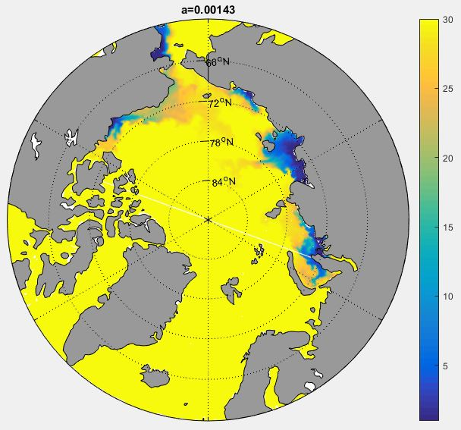
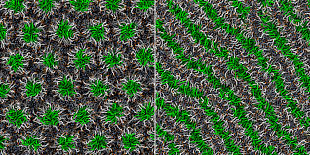
DOE Marine Biogeochemistry:
Overview of a Unique ESM Team
LANL, PNNL, LLNL, ORNL, JGCRI, SIO, IARC, NPS, NCAR, Universities
Coming: LBL, NCAR-ACD, Others
Hypothesis
Energy Department can lead in simulation of marine BGC feedbacks:
DOE ocean circulation specialists are currently pursuing advanced, variable mesh gridding -with singular intensity and experience plus a strong focus on software engineering. Meanwhile a team of marine biogeochemistry researchers networking across the department has worked for a decade developing a long-view strategy: Ocean-atmosphere-ice geocycling and interchange are viewed as unique niches for DOE. The concept is to fully exploit powerful inter-laboratory, interdisciplinary collaborations. Projects nucleated by our cross-cutting BGC team are now crystalizing into a spectrum of scientific contributions that stand alone across the international community. In the present poster we describe a key subset thereof, working from a classic carbon cycle foundation out to first-ever contributions in aerosol, cloud, sea ice, coastal and global microlayer processes.
Clockwise from upper left: % change in DMS flux, y2000 to (RCP 8.5) y2100 in a POP version with implicit cyanobacteria and Phaeocystis /// Ice algal CICE simulates pan-Arctic brine channel internal production, units mgC/m²d /// Explicit Phaeocystis distributions in CESM version, mmC/m³ /// Dynamic proteins in MPAS-O (QU120 grid), μM /// Schematic of OCEANFILMS adsorption-to-POA mechanism, CAM-ACME /// Carbohydrates increase brine channel tortuosity against artificial sea ice /// Surfactant controls film-salt residence time /// MD simulation of lipidic PEG, through a 2D phase transition /// Arctic mixed layer W/m2 given riverine CDOM dispersal/attenuation
Development
Already in Place: (DOE ESM components and packages in red)
State-of-the-art nutrient,light limited ecodynamics with multiautotrophic competition plus extra-carbon tracers, all housed within the MARBL porting frame /// Carbon cycle advected in MPAS-O and ACME at moderate resolution supports global surface ocean fixation /// Reduced sulfur organism classes embedded and tested including several Phaeocystis types and also cyanobacteria /// Offline parameterizations for major DOC biomacromolecular subcomponents –such as proteins, polysaccharides, several lipids, heteropolycondensates, humics, peptidoglycan, aminosugars /// Major species from this organic list operate online in MPAS-O driven by the MARBL carbon cycle /// Key biogenics now appear in dynamic marine aerosol source flux computations, with DMS offering earliest and best example /// Full exploration has been conducted for DMS-driven teleconnections in CESM and HiLAT versions /// OCEANFILMS interface chemistry package uses laboratory data to simulate adsorption of high molecular weight compounds to global bubble field and sea surface microlayer /// OCEANFILMS also conveys the adsorbed material into primary organic aerosol through ACME spray /// CAM tests conducted on short wave radiation effects of biogenics through POA /// Analogs to the above expanded into CICE Consortium global pack dynamics, with BGC coupling back to both ACME and CESM oceans /// Arctic river plume dilution now implemented, for sediment and organic chemistry under HiLAT aiming for BETR soil chemistry and MOSART hydrology /// Validation, optimization and prioritization of general marine BGC beginning from ILAMB
Now Needed: IDOE keywords in red)
Supplement traditional C with microbial loop /// Couple sulfur-organo-aerosol ccn to clouds with analysis of tele-connections /// Global 2D equation of state to underlie surfactant energetics (tension, interfacial pressure) /// Extensions into pack volume to ground ice brine interface dynamics, adsorptive storage, gelling, tortuosity /// Apply surface tension to transfer trace gases, momentum, heat and water vapor /// General evaluation of ice biotic response-feedbacks to global change –freezing inhibition, network plugging, pigments and radiation absorption with heat deposition /// River plume surge required to carry Arctic coastal code forward /// Coordinated validation for all plus continual assessment of priorities
Insert caption here…
Expected Impact
Topics here remain almost untouched by the mainstream community:
All these capabilities position DOE to capitalize uniquely: Globally distributed ccn composition and efficacy, (bio)macromolecular surfactants influencing all mass, momentum and energy exchange across marine interfaces, extensions of organic chemistry into bi-hemispheric pack ice brine channels, river plume reactions and optics linked to soil/land models. Regional- to planetary-scale feedbacks in such areas remain invisible to almost all other climate modeling groups. In most cases we can cite complete omissions and thus an extreme form of structural uncertainty. But requisite DOE mechanisms are in place because they have been incubated in a highly interdisciplinary, national-level scientific environment. Dedication by department (biogeochemistry) working group members has been no small factor. Though not pictured, we can also describe validation/prioritization of understudied climate system loops via DOE reduced-hierarchical approaches (e.g. JGCRI HECTOR).
Beyond early ACME versions:
Full assessment of marine biological-teleconnected feedbacks especially regarding new taxa and trophic levels, physicochemical surfactant effects from the microlayer to gas/spray/momentum/heat transfer, high latitude biogeochemistry and ice-internal structural factors. Also -volatile hydrocarbon generation, secondary organic aerosol and tropospheric halogen issues with atmospheric chemistry groups such as NCAR-ACD.
For additional information, contact:
DOE Chemistry@Interfaces Working Group
e.g. Scott Elliott, Susannah Burrows,
Shanlin Wang, Philip Cameron-Smith,
Nicole Jeffery, Mat Maltrud, Jon Wolfe
Primary for this poster: S. Elliott
sme@lanl.gov, (505) 606-0118
Publications: Several per year in AGU and relate venues, regular
appearances in high profile journals garnering significant press attention. Detailed lists from C@I group on request, see left.

