Slide 1


ACME Priority Metrics Package
A-PRIME
Kate Evans, Milena Veneziani, Salil Mahajan, Xylar Asay-Davis, Phillip J. Wolfram, Luke Van Roekel, Marcia Branstetter, Charlie Zender, Susannah Burrows, Mark Petersen
Thanks to the Office of Science BER ESM program for support!

Slide 2
Goal: Enable easy assessment of ACME beta and release simulations
Python based, top levels are shell scripts
Production version: sits in ACME/a-prime public github repo as of release (pending DOE Oak Ridge approval)
Development version is in ACME/PreAndPostProcessing Scripts
Performs a suite of popular and critical atmosphere, ocean and sea-ice analysis for early ID of model attributes
Compares to observations, where relevant and possible
Targets ACME1/AIMS @LLNL, edison @ NERSC, and rhea and titan @OLCF
Modified BSD License release this month (currently under review by DOE)

Slide 3
User workflow to try right now ☺
Grab latest repo from ACME/PreAndPostprocessingScripts
Cd into coupled_diagnostics directory, copy a default run script from the target machine version, e.g. run_OLCF_kate.csh
Alter script to provide target simulation output, years to analyze, and target location for analysis (default location should work)
Software performs postprocessing of raw data, provides website to view results on local user www space.
Can select different years for climos and time series, new years produce another set of plots and website
User can opt-out of climos creation, model-model comparison in some cases, more options underway

Slide 4
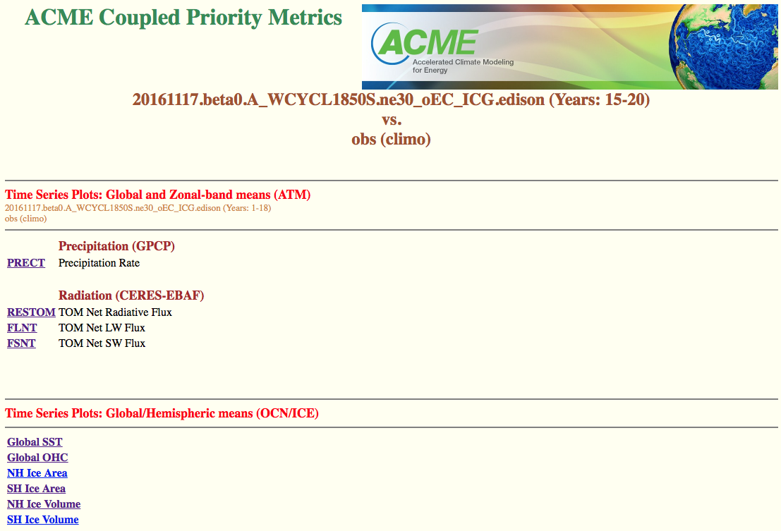
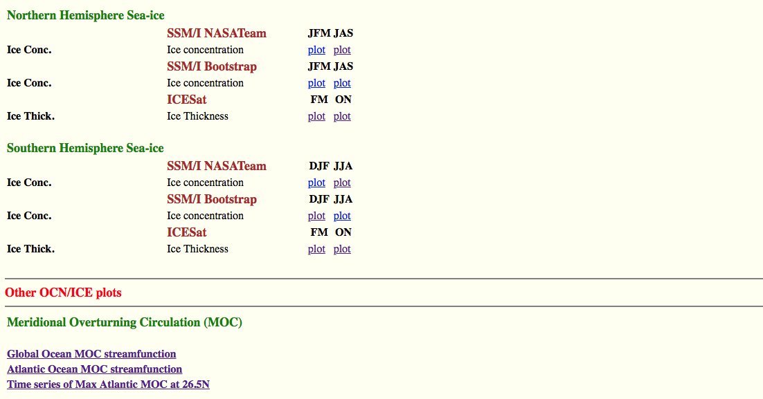
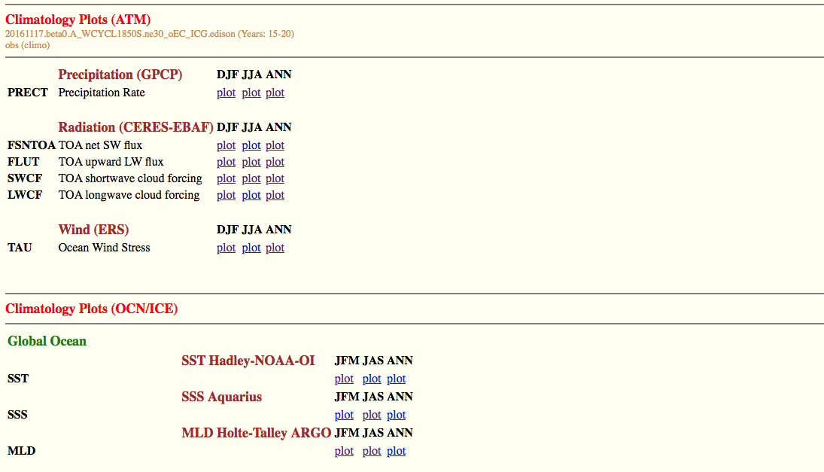
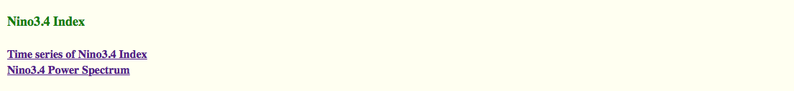
Website output

Slide 5
Under the hood, in coupled diags
run_LLNL.csh
List of setenvs for user
Top: Change for each use. E.g. output location, years to analyze, opt-in/out flags
Middle: user may changes sometimes, e.g. preprocessed v0 data info, resolution info, location of regridding, obs data
Bottom: User should not need to change, e.g. error checking, output info details
Code layout
/csh_scripts (controls nco commands, remapping, html)
/python (all analysis, atm and some ocean)
/MPAS-Analysis (sub dir of /python)
Submodule inserted within repo
engine for postprocessing of all MPAS data
More advanced, maintained by ocean ice team

Slide 6
1.0 release Modified BSD License, for ACME All Hands
Future Plans
Short term: Link other atmosphere/land diags
Tier 1A, top atm priorities
Tier 1B, host of analysis categorized by area of interest i.e. tropical convection, mid latitude dynamics
Incorporate automated postprocessing of time series, averaging etc. from LIVV
Where we could link to other efforts, longer term
Called within a larger workflow of a simulation
Called with basic runs used for testing?
Improve or connect to other web-based diagnostics (ours is very basic)
Improve error handling, where possible

