Slide 1
Bridging the Gap between Land and Food: Leveraging Food Balance Sheets to Enhance Food System Modeling
Xin Zhao
Pralit Patel, Page Kyle, Marshall Wise
Joint Global Change Research Institute (JGCRI)

Slide 2
Agriculture and food systems in MSD
Integrated Human and physical Earth system modeling
Spatial & temporal resolution
Processes
Key concepts for MSD. Reed et al. (2022)

Slide 3
Agriculture and food systems in MSD
Integrated Human and physical Earth system modeling
Spatial & temporal resolution
Processes
Agriculture and food systems
Sectors along the supply chain (primary and processing sectors)
Market supply and demand (production, storage, trade, bioenergy, feed, food, etc.)
Human: food demand and behaviors around the supply chain
Earth: physical inputs in agricultural production, e.g., land, water, nitrogen, etc.
Why challenging?
Key concepts for MSD. Reed et al. (2022)

Slide 4
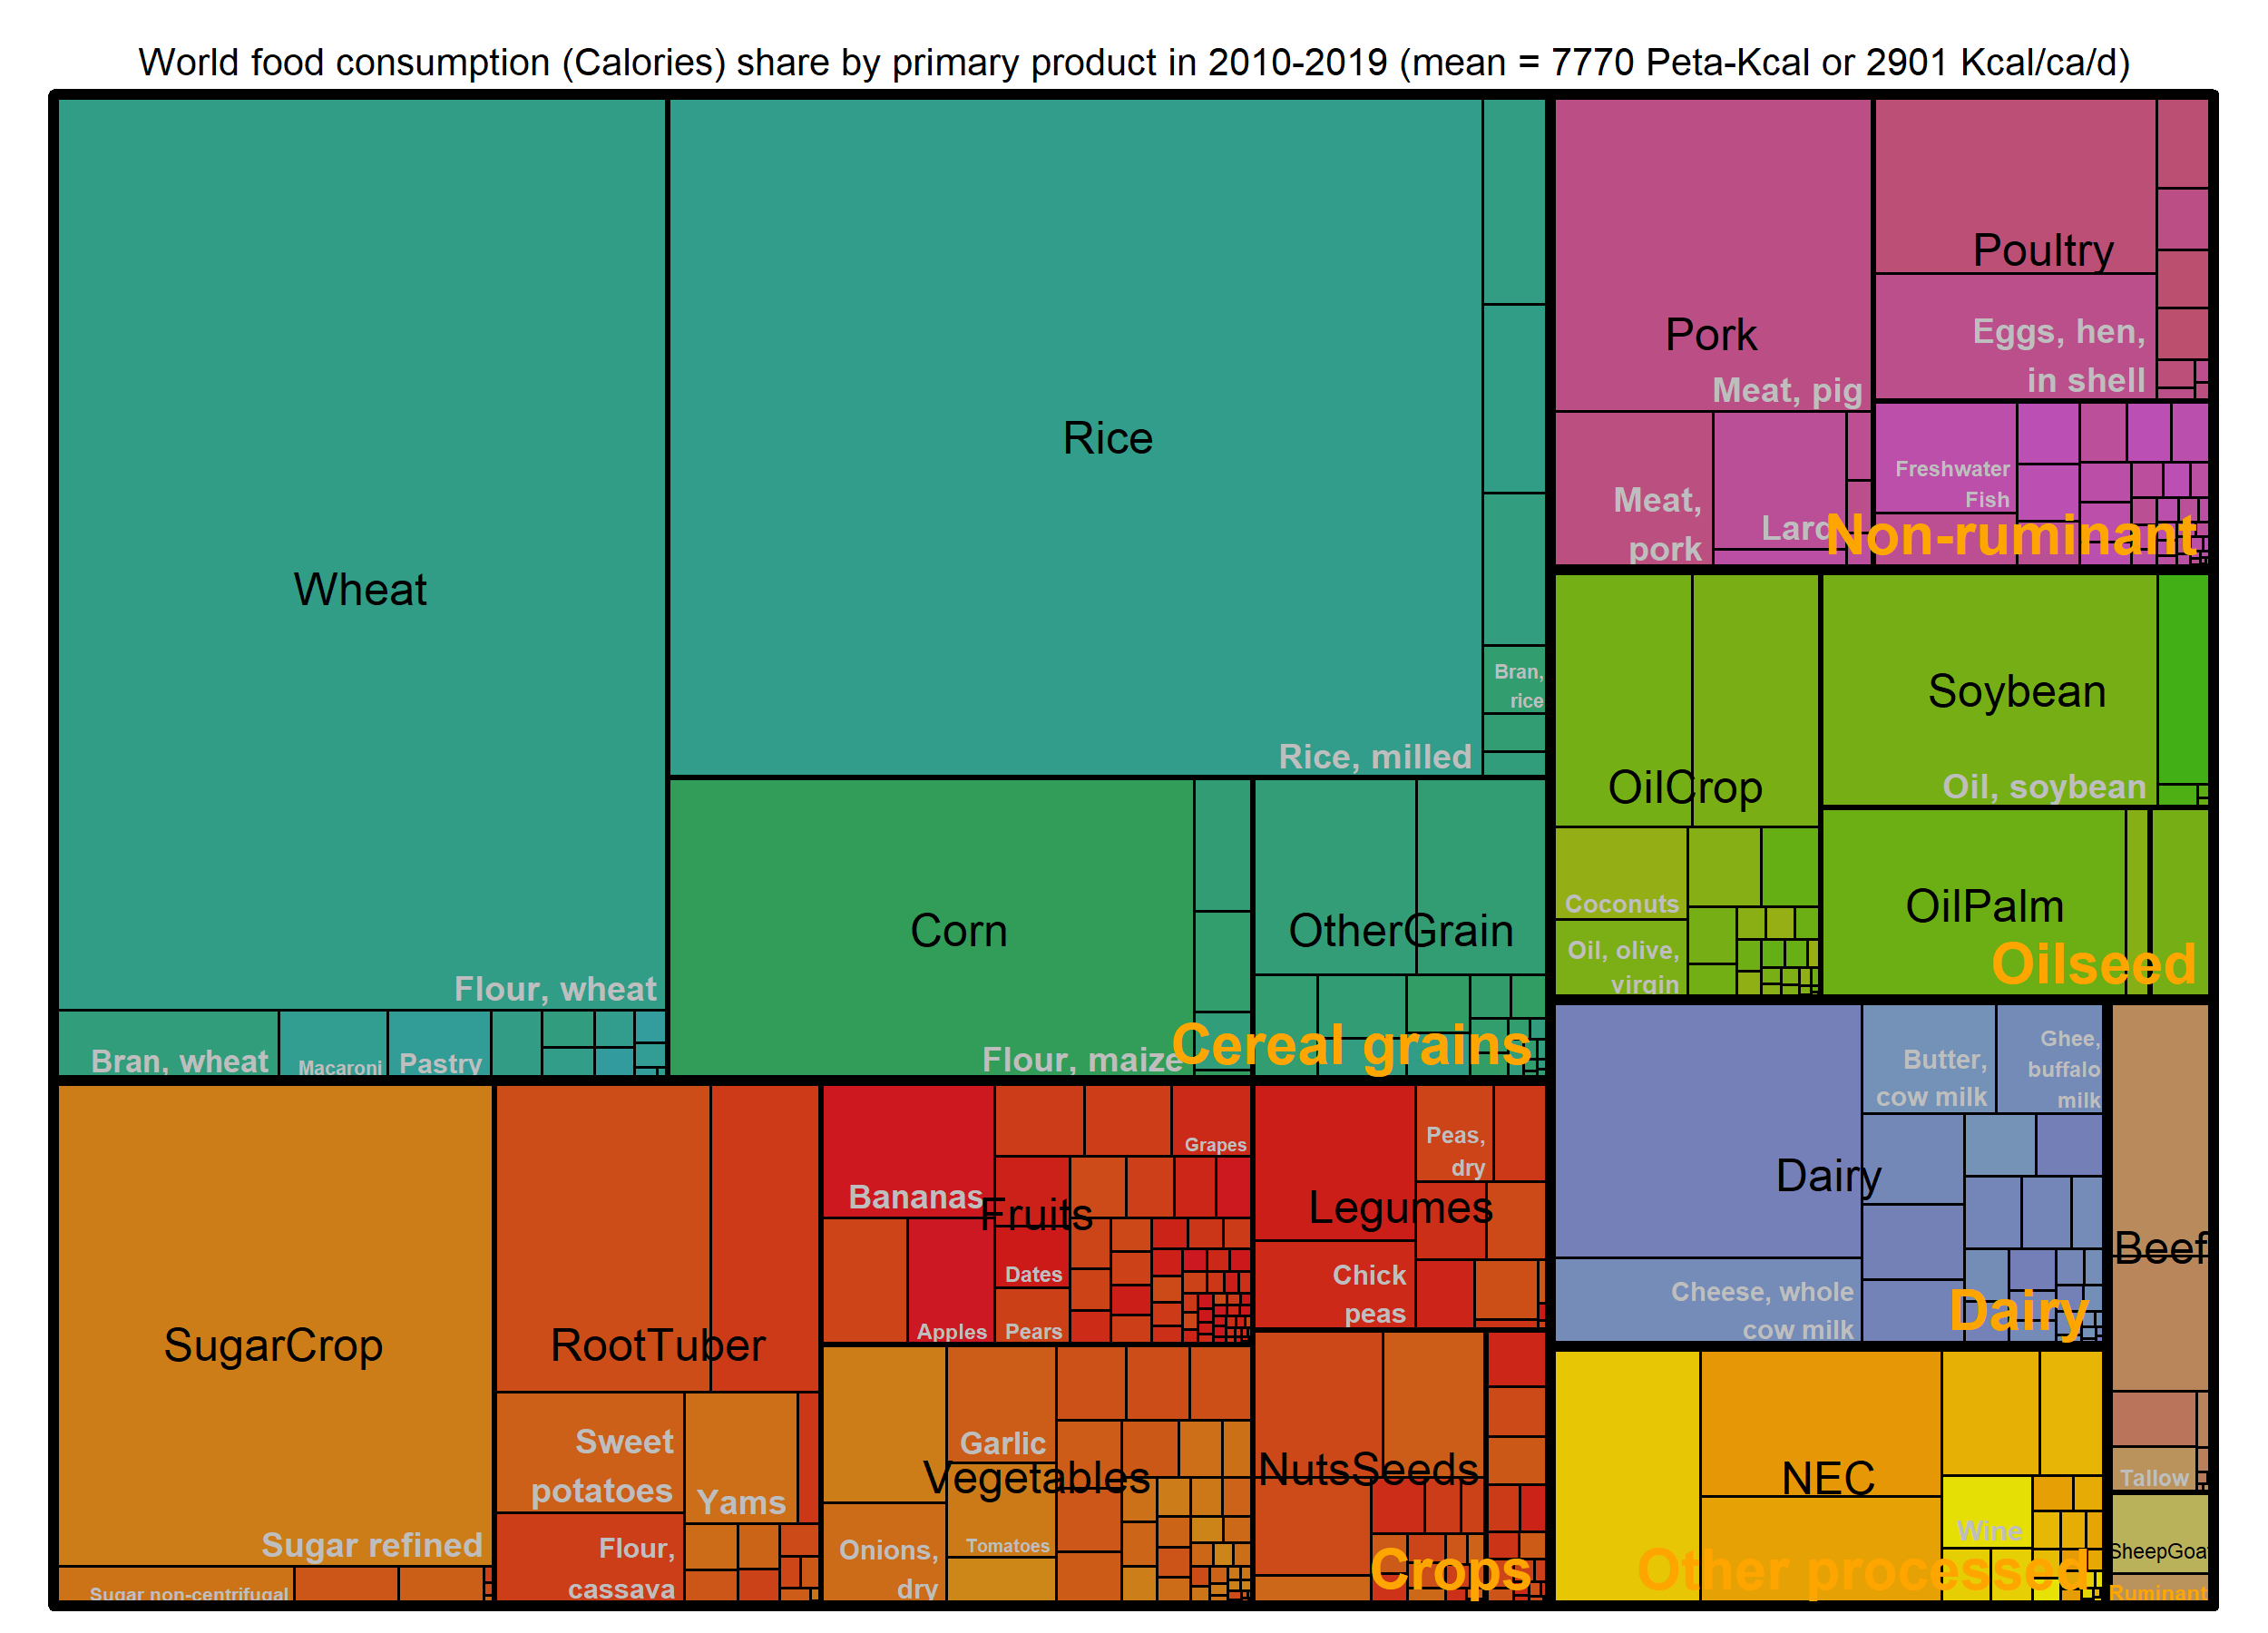
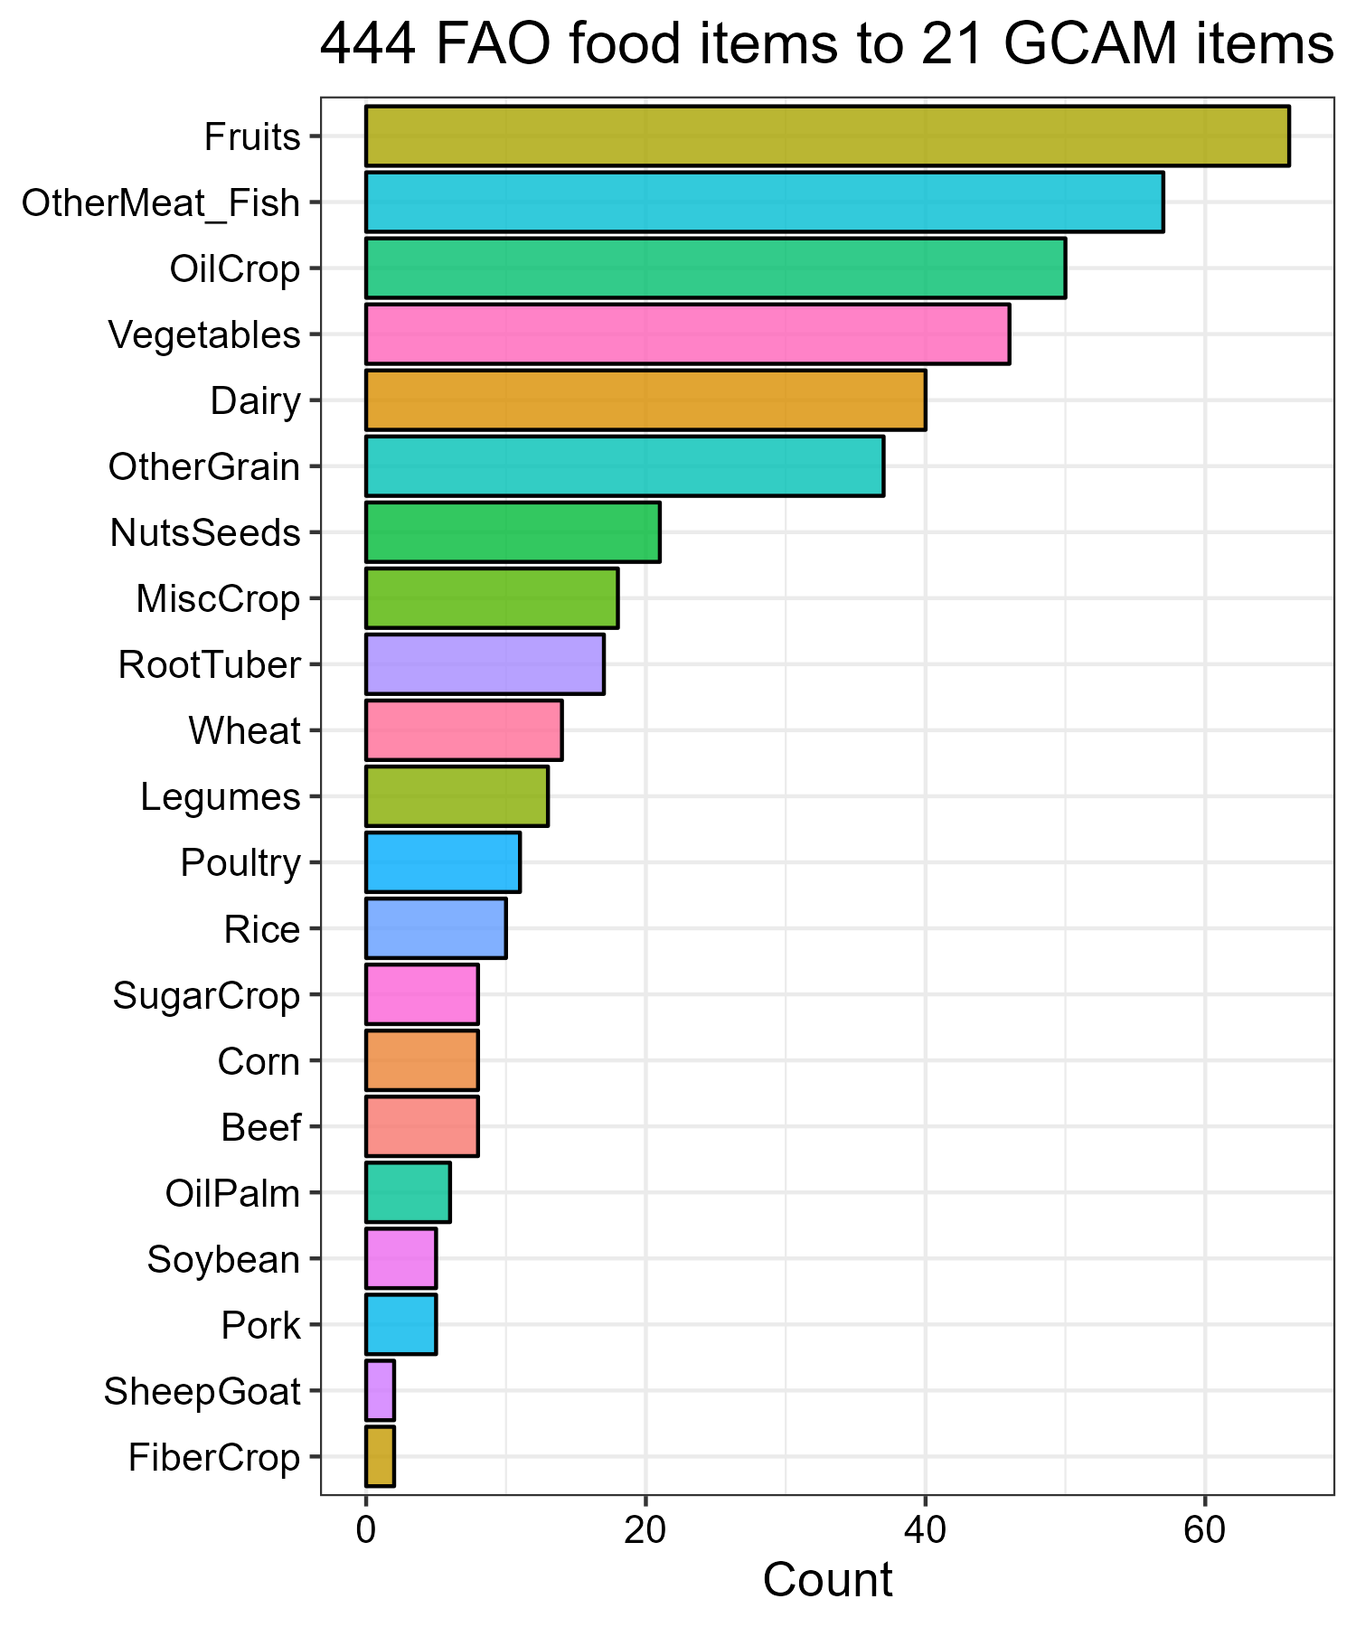
Food: 444 FAO food items by calories
World food consumption (2010 – 2019):
7770 Peta-Kcal per year or ~2900 Kcal/ca./day
Source: FAOSTAT and gcamfaostat

Slide 5
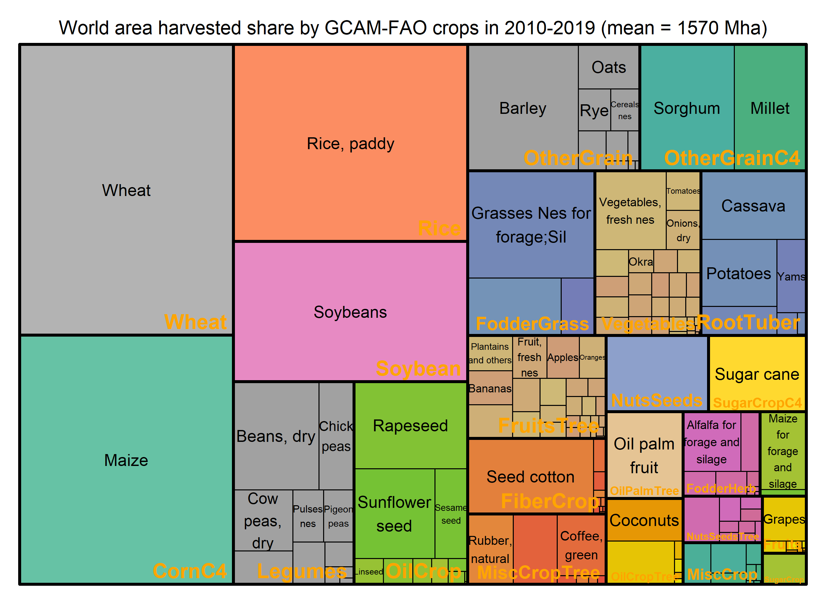
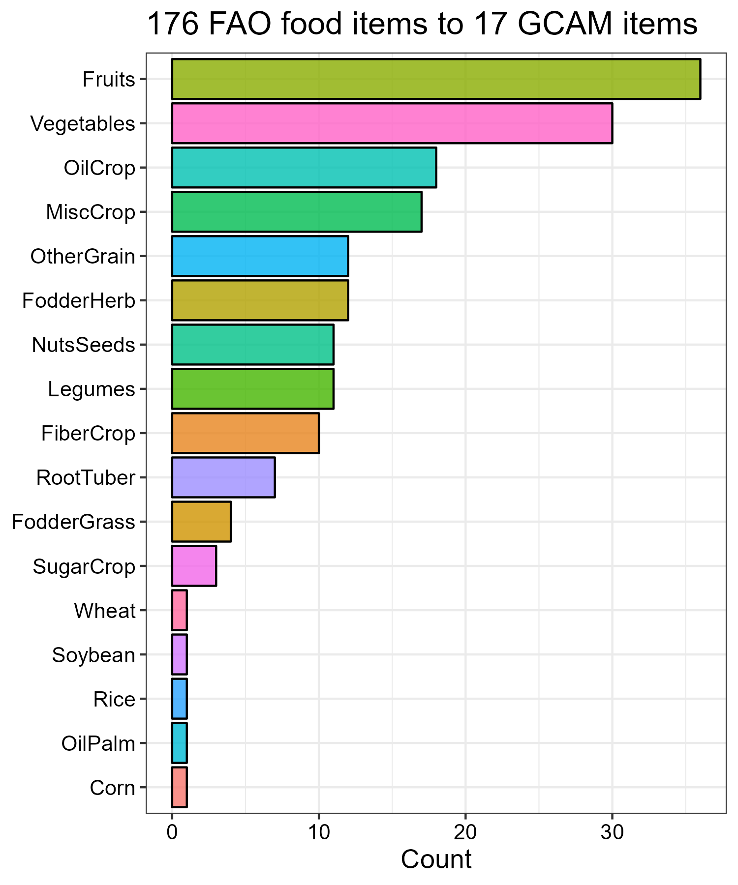
Land (harvested area): 176 FAO crops by hectares
World harvested area (2010 – 2019):
Mean = 1570 million hectares
Source: FAOSTAT and gcamfaostat

Slide 6
Challenges in connecting land to food
Primary land-based output is usually further processed
Models do not include the full processing chain
Supply utilization accounting (food balance sheet):
Processed food
Supply
Utilization

Slide 7
Challenges in connecting land to food
Primary land-based output is usually further processed
Models do not include the full processing chain
Supply utilization accounting (food balance sheet):
Land &
other inputs
Processed food
Supply
Utilization
Food Tons to Calories

Slide 8
Challenges in connecting land to food
Primary land-based output is usually further processed
Models do not include the full processing chain
Supply utilization accounting (food balance sheet):
Land &
other inputs
Processed Food
Processed food
Supply
Utilization
Food Tons to Calories

Slide 9
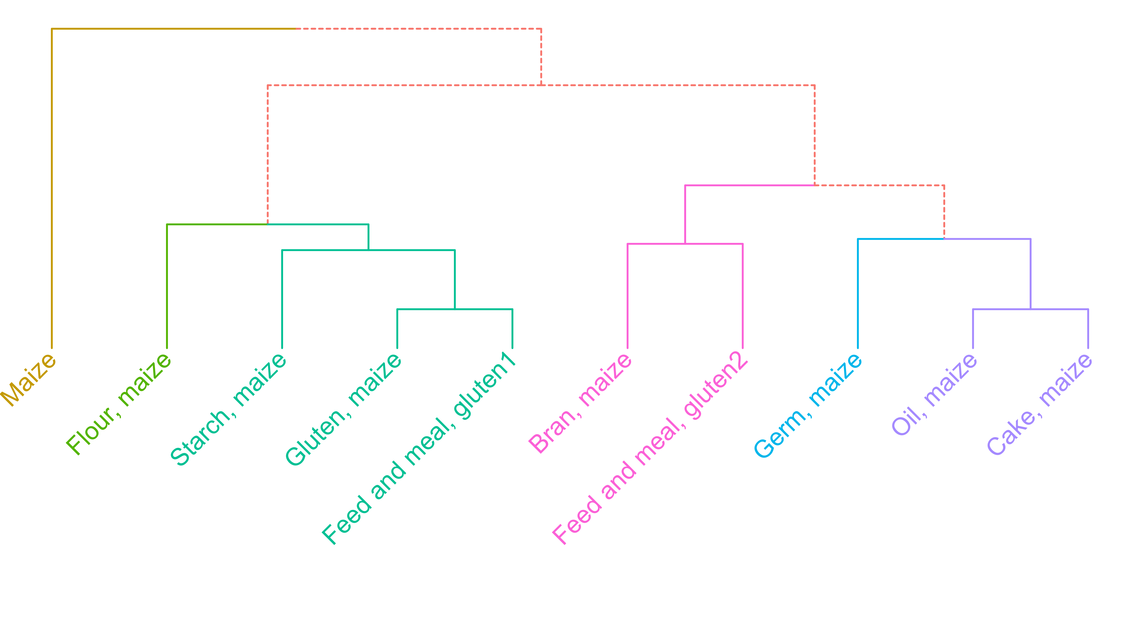
Maize example: Showing the depth of agri-food sectors
Supply utilization account (SUA) balances for all commodities

Slide 10
Vertical aggregation: Primary Commodity Equivalent
Extraction
rate
Starch
Gluten
Etc.
Maize
Extraction
rate
Flour
Germ
Bran

Slide 11
Vertical aggregation: Primary Commodity Equivalent
Extraction
rate
Starch
Gluten
Etc.
Consistency:
Space
Time
Supply - Utilization
Preserve:
Yield
Macronutrients
Maize
Extraction
rate
Flour
Germ
Bran

Slide 12
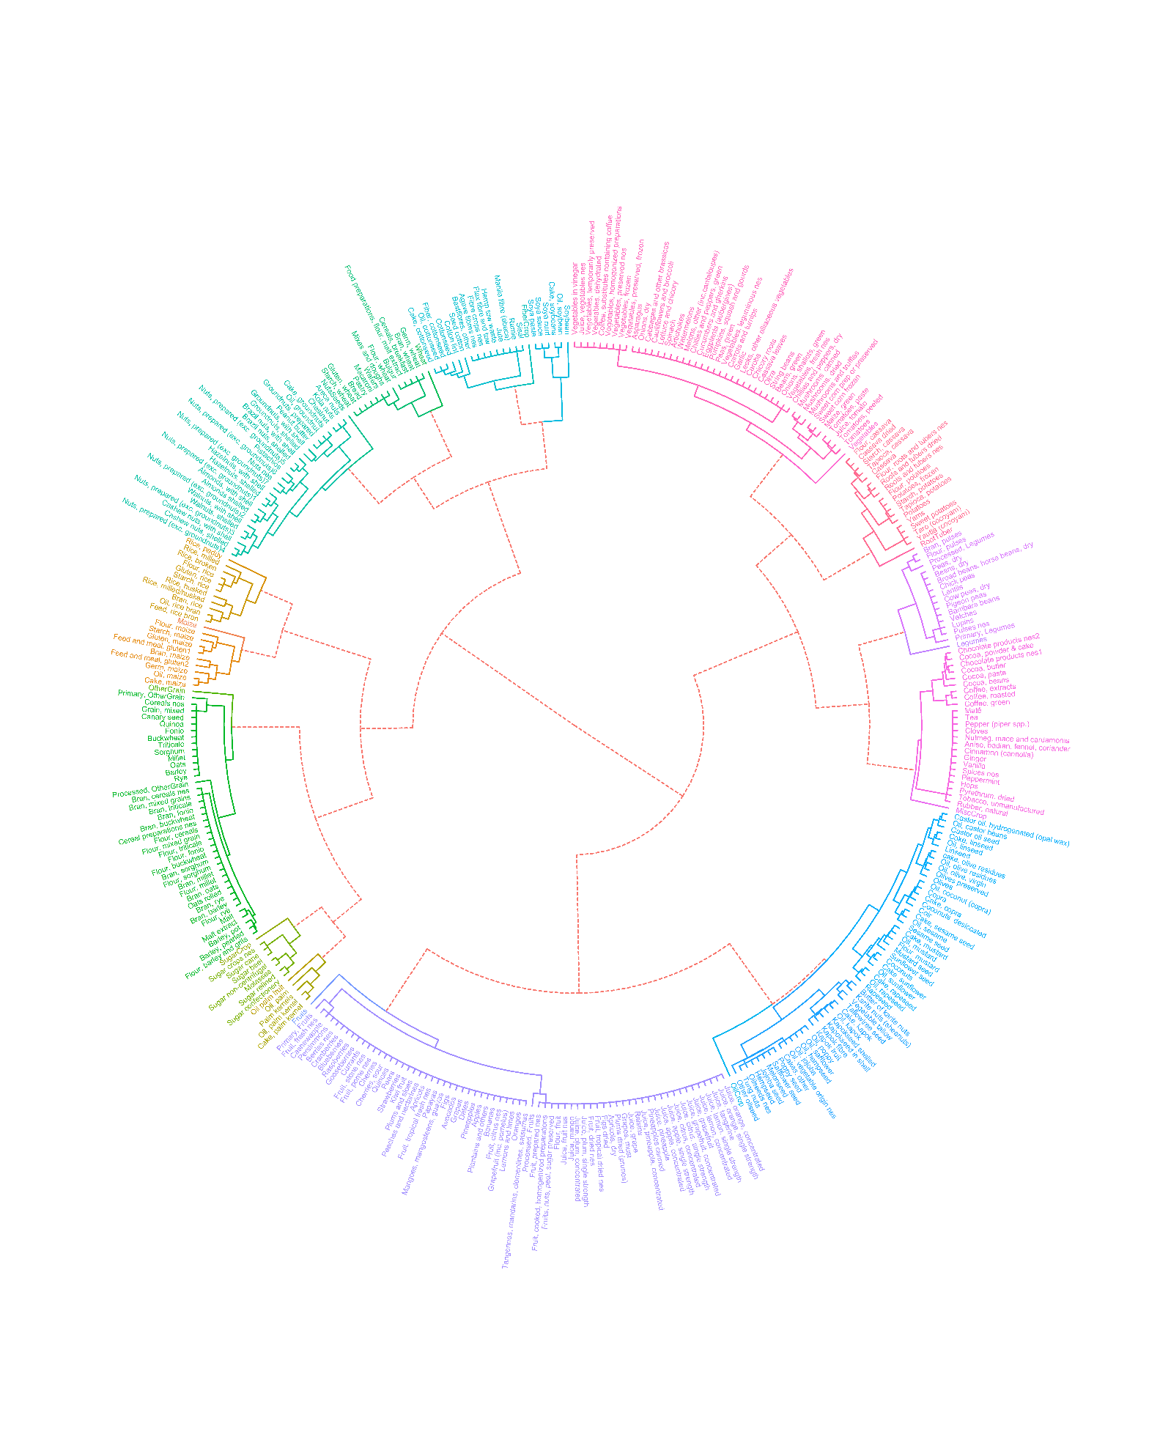
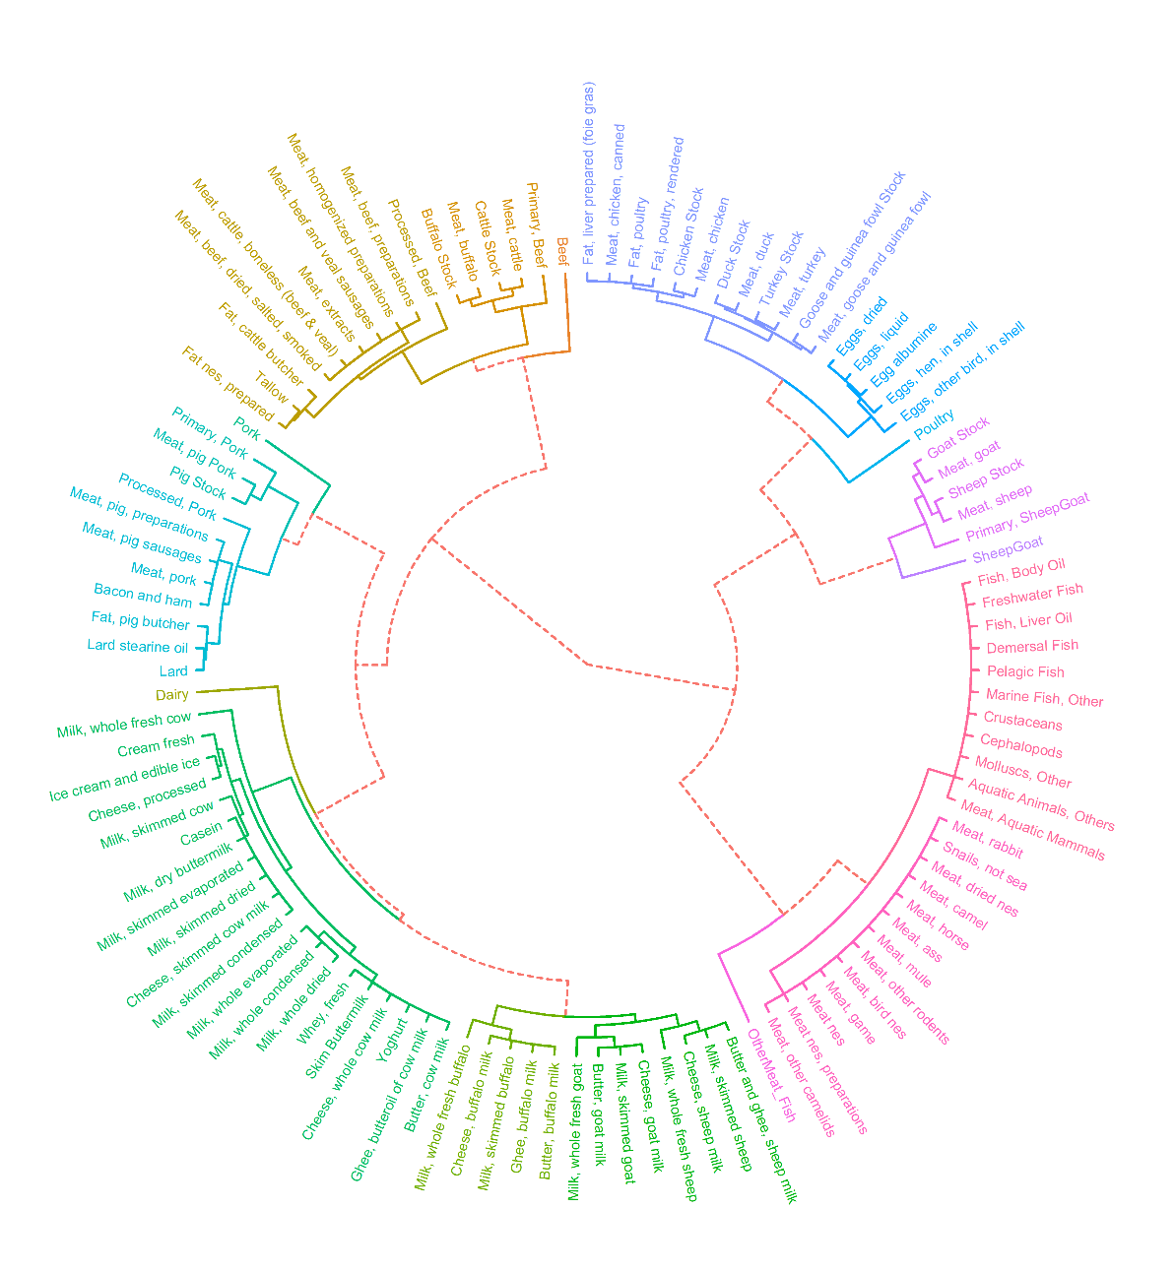
Food balance sheets: Nested mapping structure
17 GCAM crop commodities
6 GCAM livestock commodities
Fruits

Slide 13
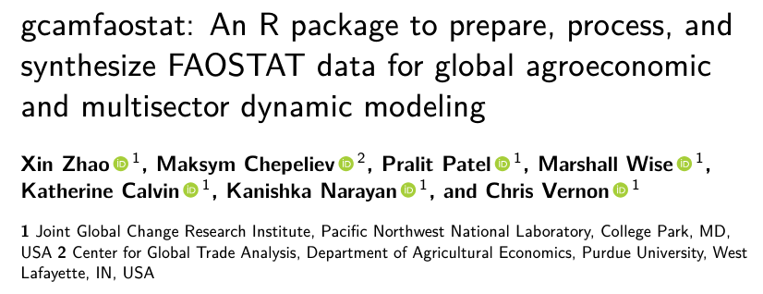
Summary
Representing food systems is important and data talk!
We developed a primary commodity equivalent approach that allows aggregating agriculture and food commodities along the supply chain
Transparent, reproducible, consistent, and flexible
Bridges the gap between agricultural inputs (e.g., land) and final consumptions (e.g., food)
Enhances data quality and scientific robustness in multisector global economic modeling
Enables further disaggregation of additional commodities and processing sectors
Accounts for storage and trade in secondary products
Food is more than calories
Macronutrients (protein and fat) & micronutrients
Improves the tracing of monetary and physical flows along supply chains
Value-added (labor & capital)
Energy, water, nutrients, waste, emissions, etc.

Slide 14
We acknowledge the support from the U.S. Department of Energy, Office of Science, as part of research in the Multi-Sector Dynamics, Earth and Environmental System Modeling Program

