Slide 1
Co-production as an approach to improve the impact of EESM research
Kripa Jagannathan ª, Smitha Buddhavarapu ª, Andrew Jones ª, Paul Ullrich ^{b, c}, and the HyperFACETS project team
ª Lawrence Berkeley Lab, ^{b} University of California Davis, ^{c} Lawrence Livermore Lab
EESM PI Meeting 2024
Aug 6-9, 2024

Slide 2
Overview
Value of Co-production
Foundational Capabilities on Co-production within DOE
HyperFACETS’s ~8 years experience in co-production
Three ways in which co-production can improve the impact of EESM research
Gaps and resource needs
2

Slide 3
1. Value of co-production for DOE research
3

Slide 4
Increased calls for Earth & Environmental Sciences to be “engaged” and societally “relevant”
Public calls for science to inform policy and action
Scientific community calling for a new “social” contract for science
Overall, more and more meetings, reviews, other discussions, both within and outside DOE, are focusing on how research needs to be more engaged and impactful
Impactful science-society collaborations
4

Slide 5
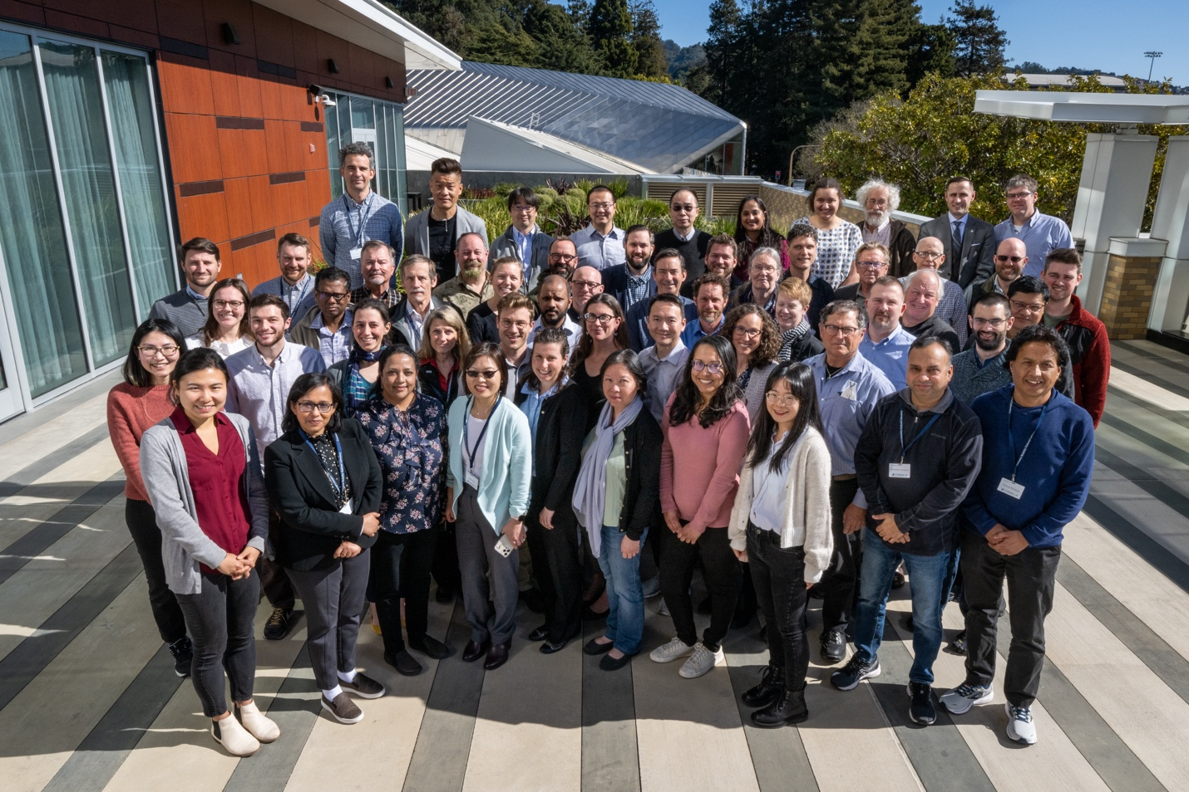
2. Foundational Capabilities on Co-production within DOE
HyperFACETS as a case study for co-producing fundamental EESM research
5

Slide 6
HyperFACETS Co-production Approach
Refine research questions & approach
Choose models, scales, decision-relevant metrics
2
1
3
Co-produce research plan
CO-PRODUCTION PROCESS
Facilitated by
BOUNDARY SPANNERS & SOCIAL SCIENTISTS
Iterate on approach & results
Identify research topics, broad questions & decision-relevant outputs
PRACTITIONERS (~ 30 Water, Energy, Land Managers from management agencies across US)
Prioritize key results for further analysis
RESEARCHERS (~ 40 Climate scientists, Earth system sci, Social sci, Hydrologists, etc.)
Identify climate-related decision-contexts
Identify scientific knowledge gaps for practice
Identify broad research goals and scope
Identify skills, available datasets and methodologies
Identify further areas of research
5
4
Finalize results & outputs
Feedback on other topics to investigate
Share results & outputs
Identify decision-applications for results
6
Notes:
In co-production, scientists work collaboratively and iteratively with decision-makers, practitioners, communities, and other knowledge-holders to conduct their research.
What is unique here is that we have a case of how the approach can be applied to projects/programs that probe fundamental earth and environment modeling research

Slide 7
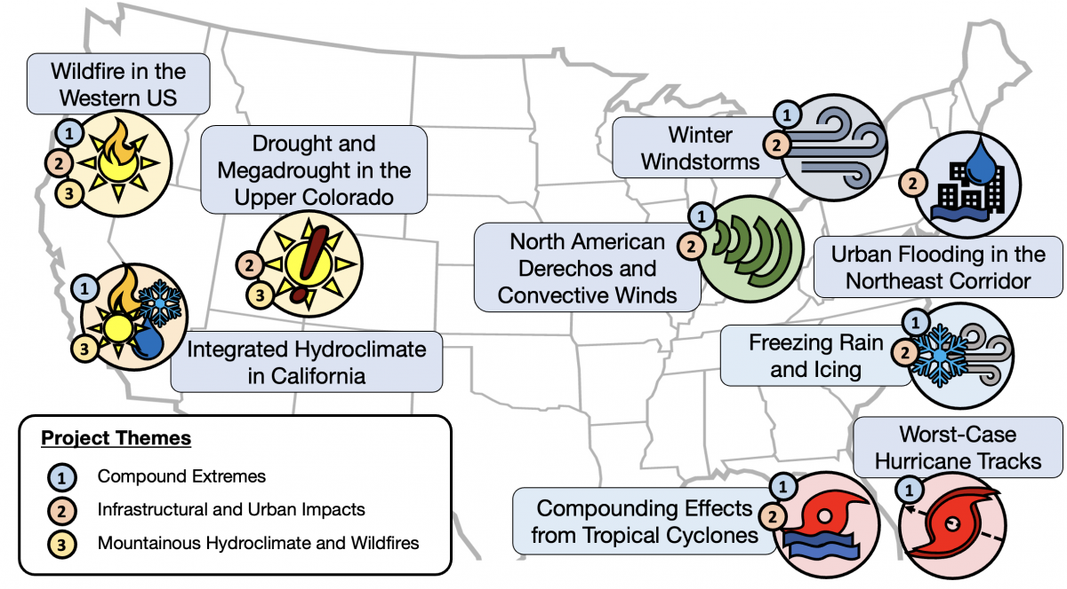
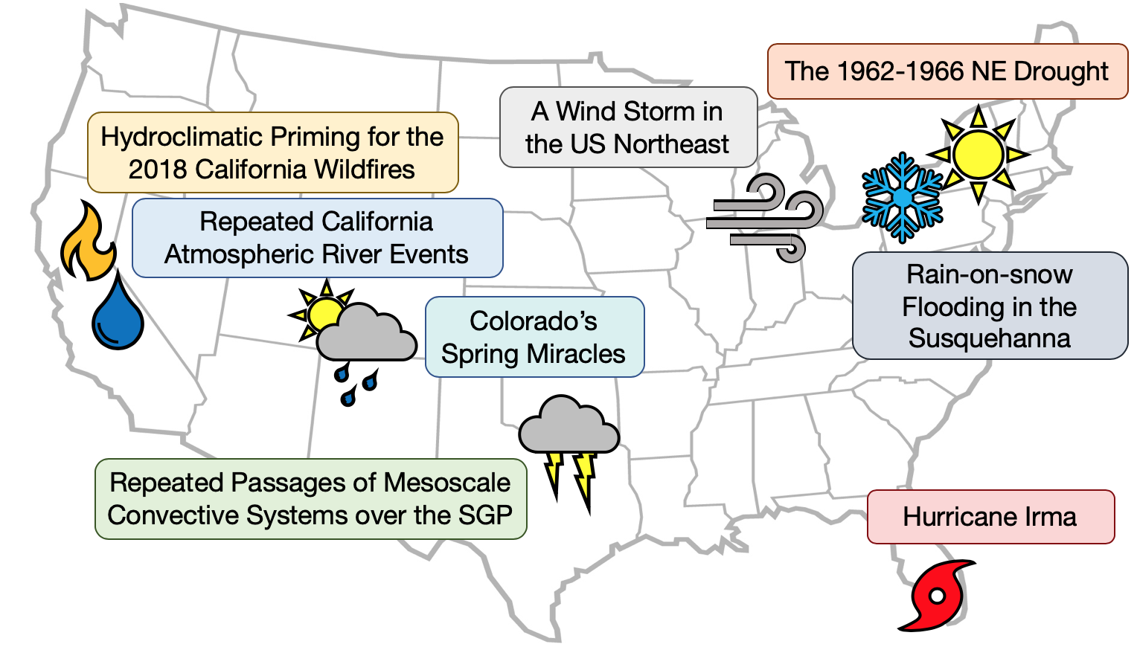
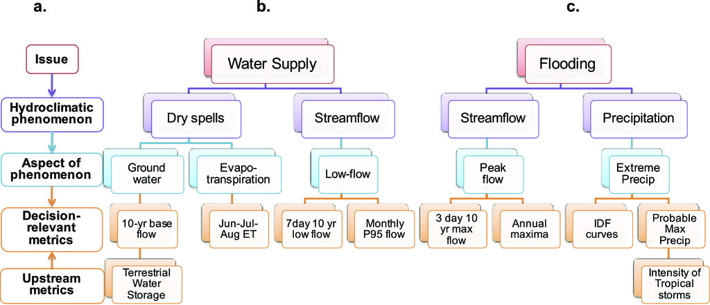
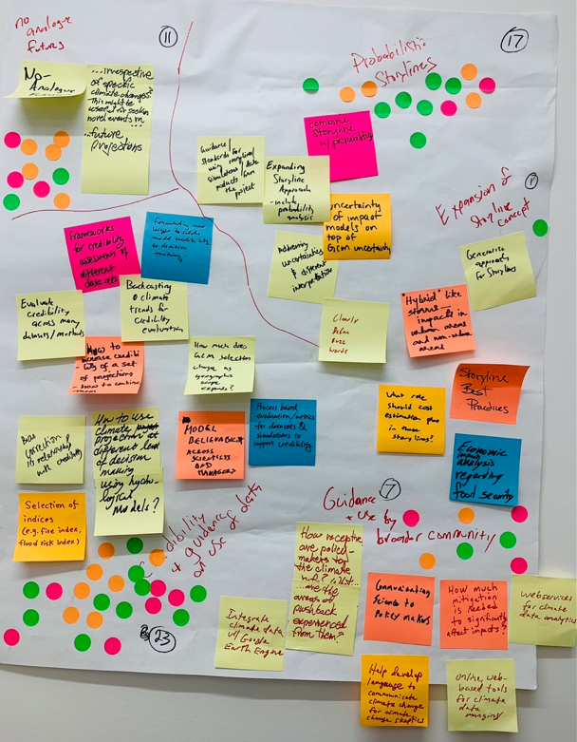
~8 years of iterative engagement activities
Phase 2 (2019-22)
2016 – 2017
2018 - 2019
2021 - 2023
Practitioner recruitment
Discussed decision-context, management challenges & knowledge gaps
Co-produced project goals (Workshop -1)
Finalized results of Phase -1 credibility analyses and discussed decision-applications of results (Workshop-3)
Based on practitioner input, Identified storylines as a key topic for the next phase proposal
Finalized Phase-2 storyline results and discussed decision-applications (Special spotlight Seminar)
Identified new storyline topics for next phase proposal
2017 – 2018
2019 - 2021
2023 - ongoing
Identified hydroclimatic phenomenon & decision-relevant climate metrics through quarterly Focus Group Discussions (FGDs)
Iterated on preliminary credibility evaluations and refined approach (Workshop-2)
Additional practitioner recruitment for storyline topics
Co-produced research plans for each storyline (Workshop-4)
Iterated on storyline research through quarterly FGDs and follow-up surveys
Co-produced research plans for new storylines (Workshop-5)
Interactive exercise to identify 3 cross-cutting research topics
Iterating on research through ongoing FGDs & surveys
Phase 1 (2016-19)
Phase 3 (2022-25)
5 workshops, ~50 focus group discussions, ~32 monthly spotlight seminars, ~30 surveys, & other informal conversations and meetings
7

Slide 8
3. Three ways in which co-production can improve the impact of EESM research
8

Slide 9
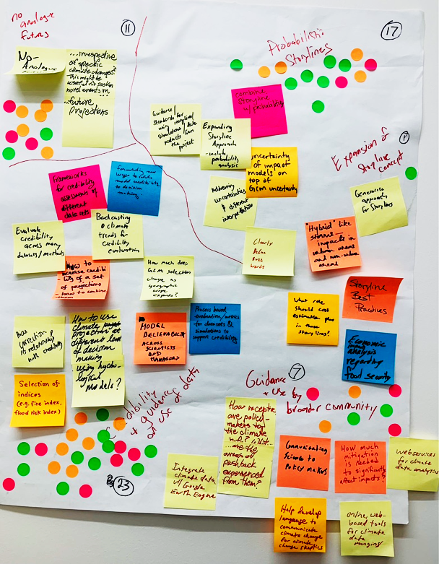
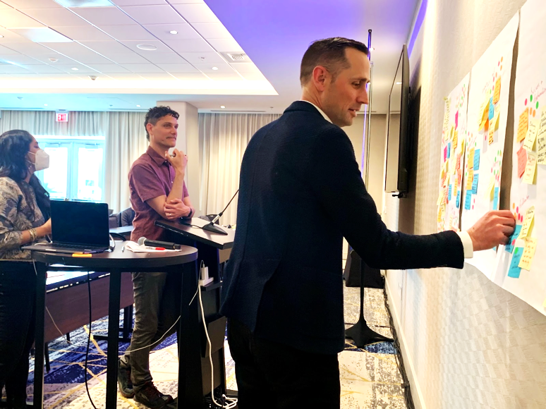
(1) By identifying fundamental research questions/directions that are both scientifically and societally impactful
Co-production enabled collective identification of research topics and questions. E.g. identification of metrics for credibility analyses (left), storyline events (middle), and cross-cutting topical areas (right)
9
Notes:
(a) Approaches to developing “probabilistic” storylines, (b) Scientific guidance for Model Linkages (i.e. linking climate data into other impact or management models) and (c) Model credibility and guidance on appropriate use of climate datasets.

Slide 10
(2) By improving the rigor and credibility of key modelling choices
Final outputs
Choose storm metrics
Choose characteristics of compound storms
Urban planners, emergency managers, reservoir operators, resilience managers, stormwater engineers, and other communities have grounded regional knowledge that helped scientists make these significant decisions
Maps
Data
Tools
Final results
Prioritize specific results for additional analyses
How intense are worst storms?
How likely are compound storms?
Intensity of worst-case storm increases
Back-to-back or compound storms more likely
Data analysis and preliminary results
Recreate past worst-case event with climate change
Choose which past event & which characteristic
Examine the worst possible future storm
Refine research question
Which models or simulations to choose
Which spatial or time scales to focus on
Select methods, approach & data
Whether to focus on storm tracks, storm frequency & intensity or flooding
Illustrative example of choices in the research process
Whether to focus on frequency of all extreme storms? Worst-case storms? Or predictors of storms ?
Develop broad research question
Identify problem
10
Notes:
2019 storm

Slide 11
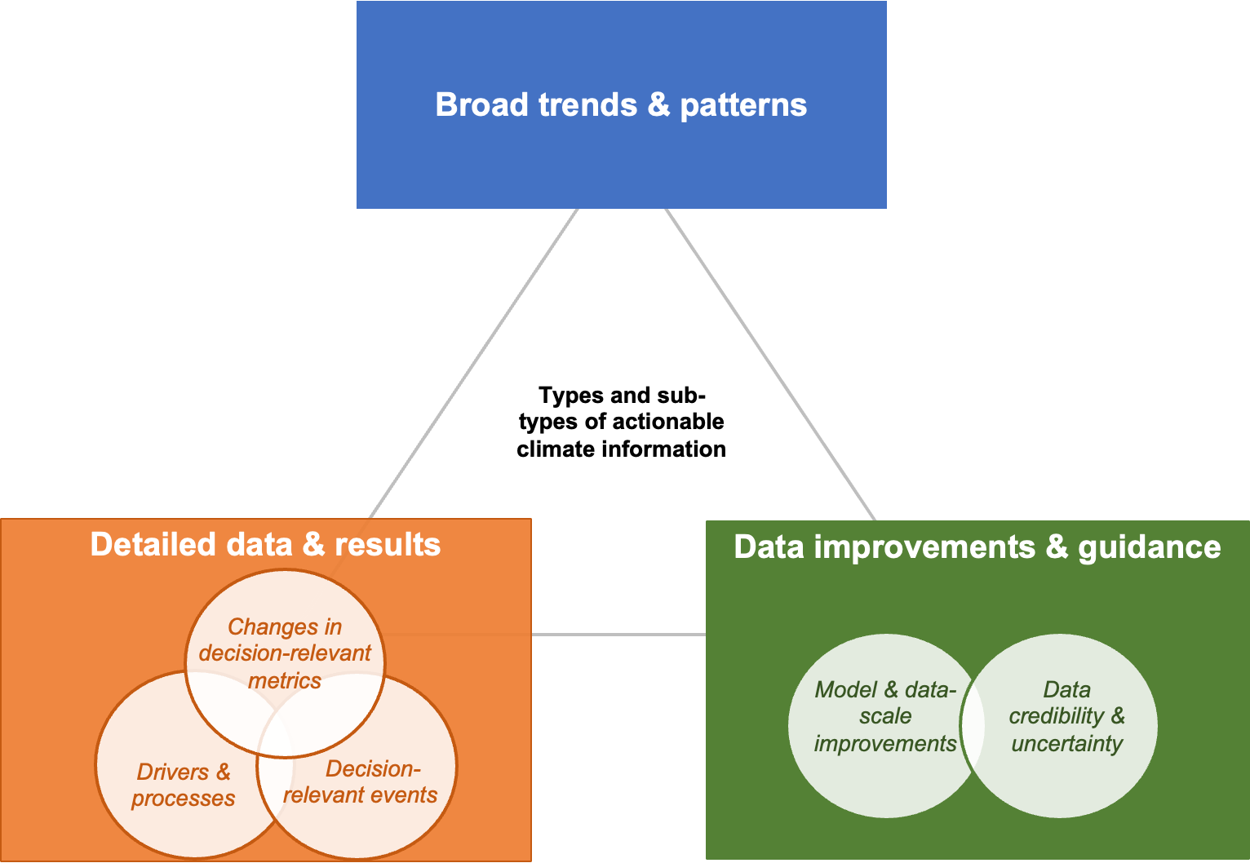
(3) By developing fundamental research on the “Science of Actionable Knowledge”
Typologies of actionable climate information
What is SOAK?
SOAK involves systematic investigations of the drivers and mechanisms of actionable knowledge development and its use.
Goes beyond case studies to provide generalizable frameworks for scaling-up collaborative science practices.
Through systematic inquiry and examination of the longitudinal co-production engagements of HyperFACETS, we were also able to make meaningful contributions to the SOAK literature
Compounding or cascading events
Accounting for variability
Model Performance and Skill
Record events
Characteristics of extreme events
Distribution curves of extreme events
Model selection
Sampling ensembles
11

Slide 12
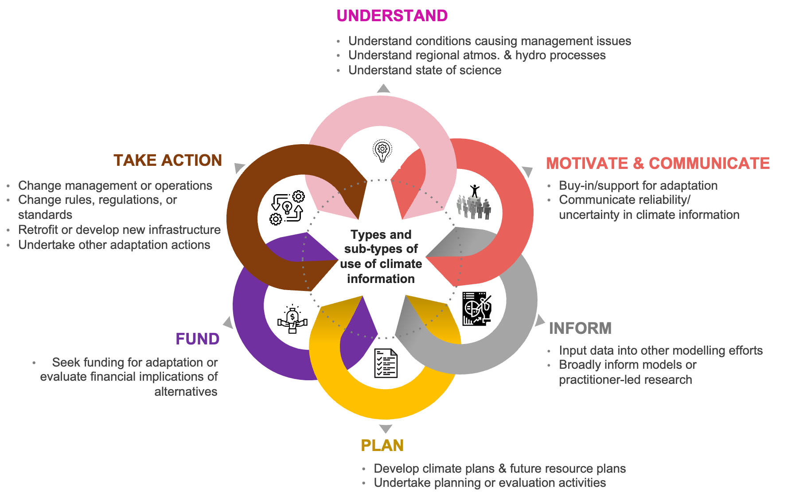
Typologies of “use of climate information”
Jagannathan, K., Buddhavarapu, S., Ullrich, P. A., Jones, A. D., & HyperFACETS Project Team. (2023). Typologies of actionable climate information and its use. Global Environmental Change, 82, 102732.
12

Slide 13
4. Resources needed for advancing co-production across BER
13

Slide 14
Resource Needs
New way of doing research, needs shift in mindset
Needs a clear and strategic direction from BER and scientists
Needs dedicated resources, time and expertise for conducting engagements
Engagements need not always be intensive, there are smaller meaningful opportunities but need to be done well and intentionally
Growing literature on co-production and similar practices need to be engaged with
Often engagement is done without attention to existing work and science on the topic
Growing evidence that this is not just valuable for society, it is also more rigorous and innovative science
Inclusion of diverse perspectives, Environmental Justice
14

Slide 15
Thank you ! kajagannthan@lbl.gov adjones@lbl.gov

