Slide 1
URBAN POPULATION, MORPHOLOGY, AND WATER DEMAND
Stephen Ferencz¹, Jim Yoon¹, Johanna Capone², Ryan McManamay³
¹Pacific Northwest National Labs,
²Virginia Tech, and ³Baylor University
Poster # 018 on Thursday

Slide 2
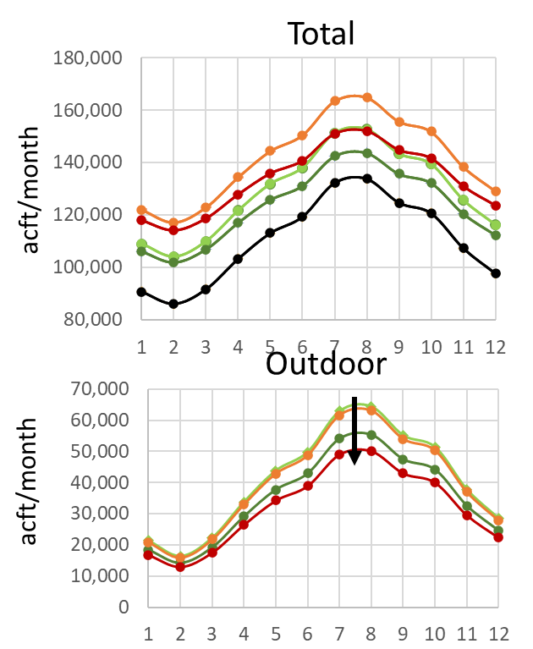
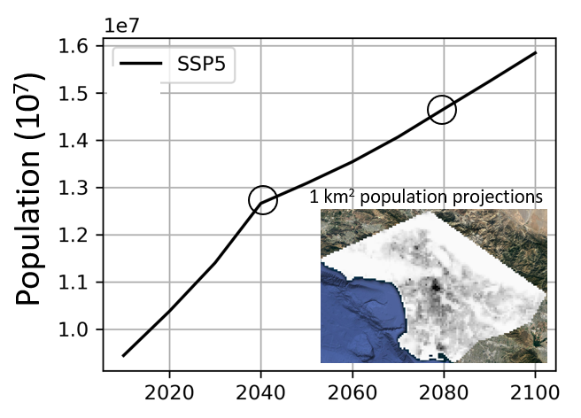
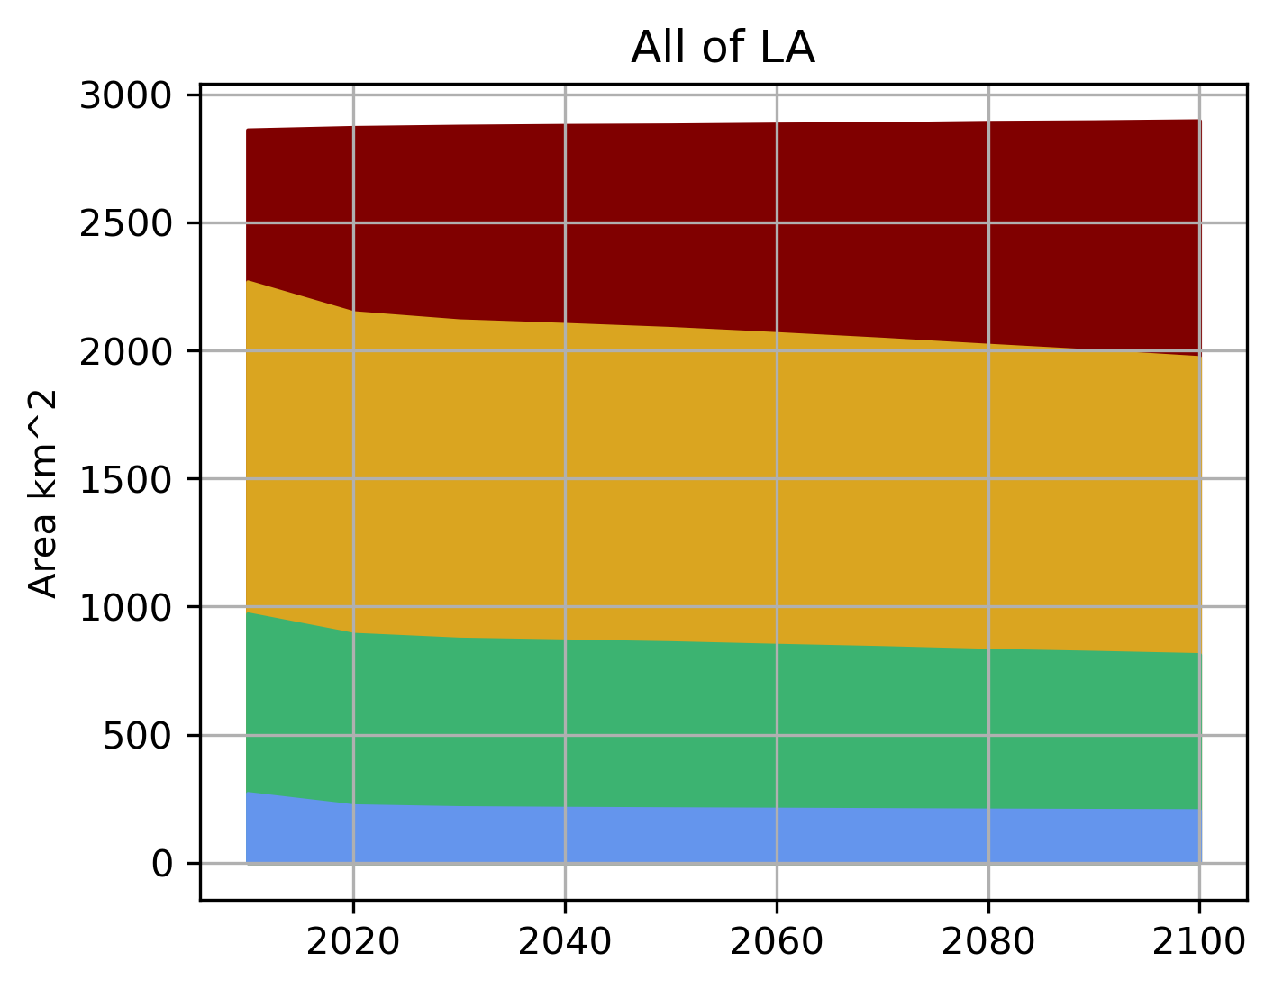
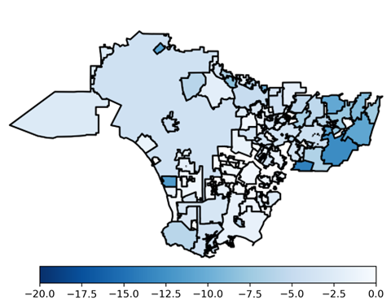
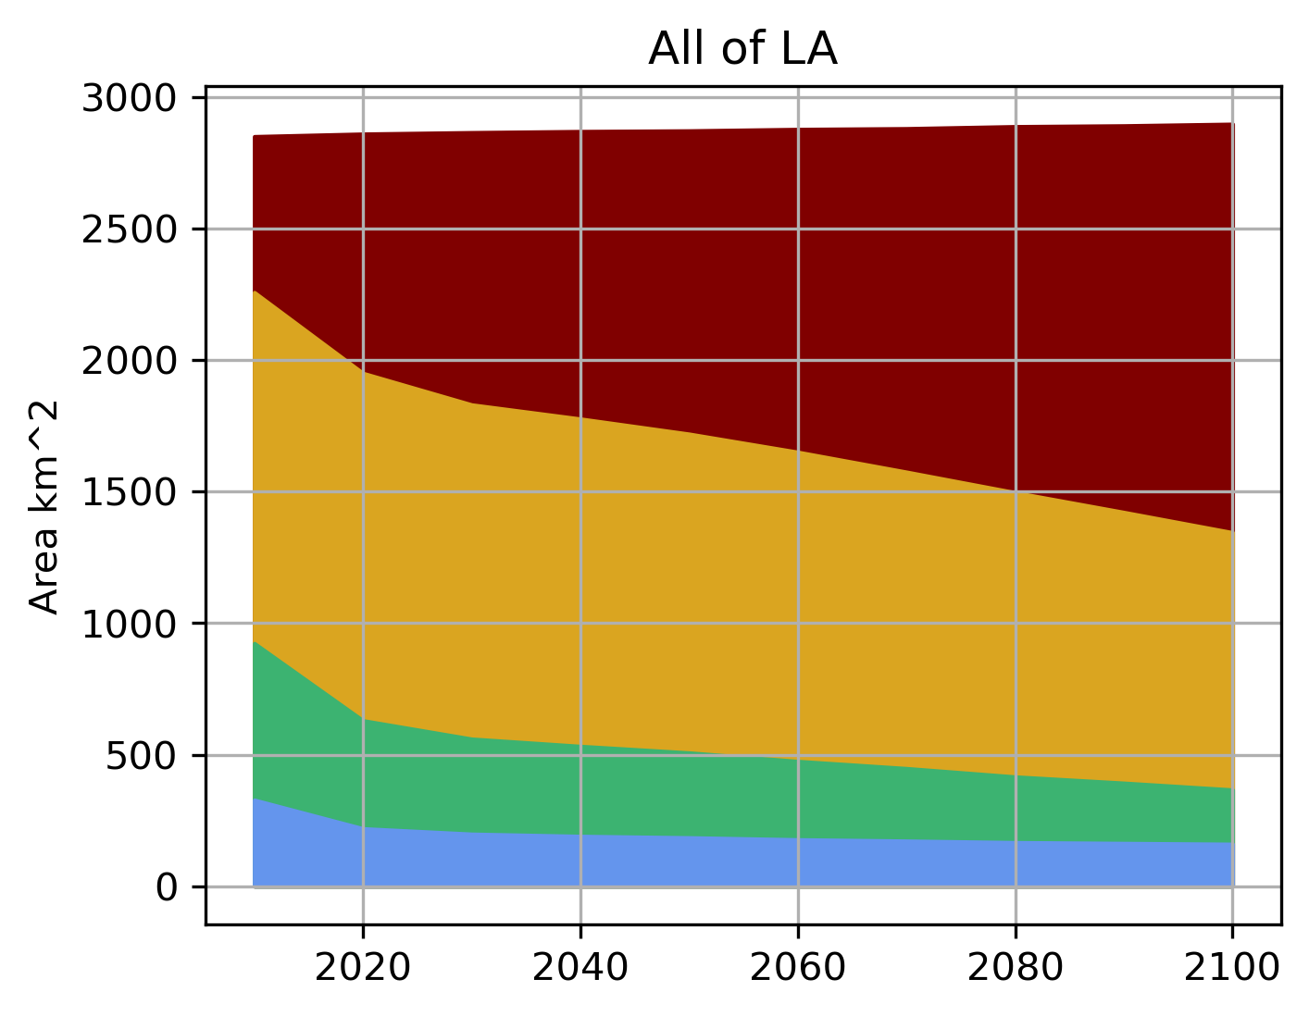
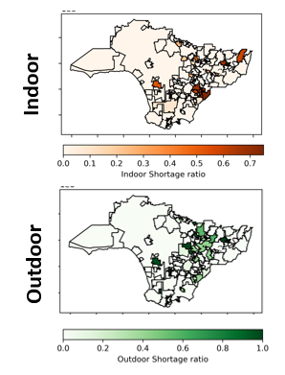
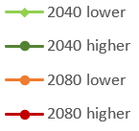
POPULATION, MORPHOLOGY, AND WATER DEMAND: LA CASE STUDY
Gridded Population and Urban Intensity Projections
Future Water Demand Projections
Urban Growth Model
Unit water demands
from observational
data
Population
% reduction
outdoor demand
Demand Scenarios
Water Supply Model
Supply
Scenarios
Water Supply
Characterization
Total
acft/month
Scenario
Outdoor
acft/month

Slide 3
GENERALIZED OVERVIEW OF CO-EVOLUTION OF MORPHOLOGY AND URBAN WATER DEMAND
Initial Conditions
ΔTime
Future Potential Morphologies
Population
Regulations
Water supply
Socioeconomics
Current demand
Factors influencing
morphology
Different morphology outcomes
influence future outdoor demand
f(population, indoor efficiency,
irrigated area, vegetation type,
climate, laws/regulations)
Research applications:
Urban water security (requires integration with a water supply model)
Better understanding evolution of regional multisectoral water demand
Urban heat (tradeoffs between urban irrigation and urban heat)
Cost-benefit analysis of difference regulatory or water supply scenarios
Notes:
What are the current and unique strengths and foundational capabilities of DOE for this topic?
What are the grand challenges in advancing the research on this topic?
What are the gaps in research / infrastructure / coordination that prevent advances?

Slide 4
MODELING THE CO-EVOLUTION OF URBAN POPULATION, MORPHOLOGY, AND WATER DEMAND & SUPPLY
Challenges and Research Gaps:
Urban morphology evolution under stagnating or declining population.
Urban growth/evolution projections that go beyond projecting development intensity. Expansion of current models or new downstream models.
Data for parameterizing highly resolved representations of urban water supply & demand for case studies in other regions.
Better representing the evolution of institutional and infrastructural responses to demand growth & shifting water availability.
Constraining future water availability though modeling broader regional demand growth, water supply, and climate scenarios.
Morphology
Water supply

