Slide 1
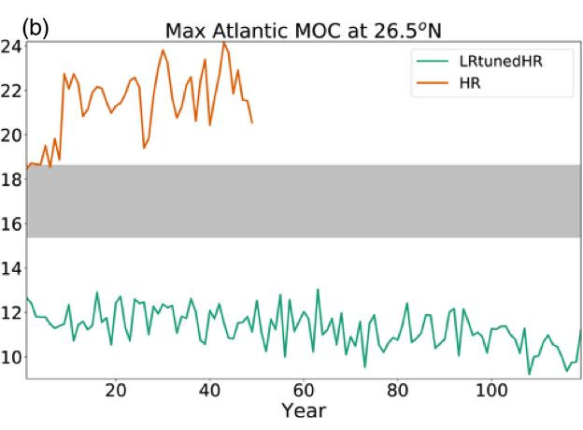
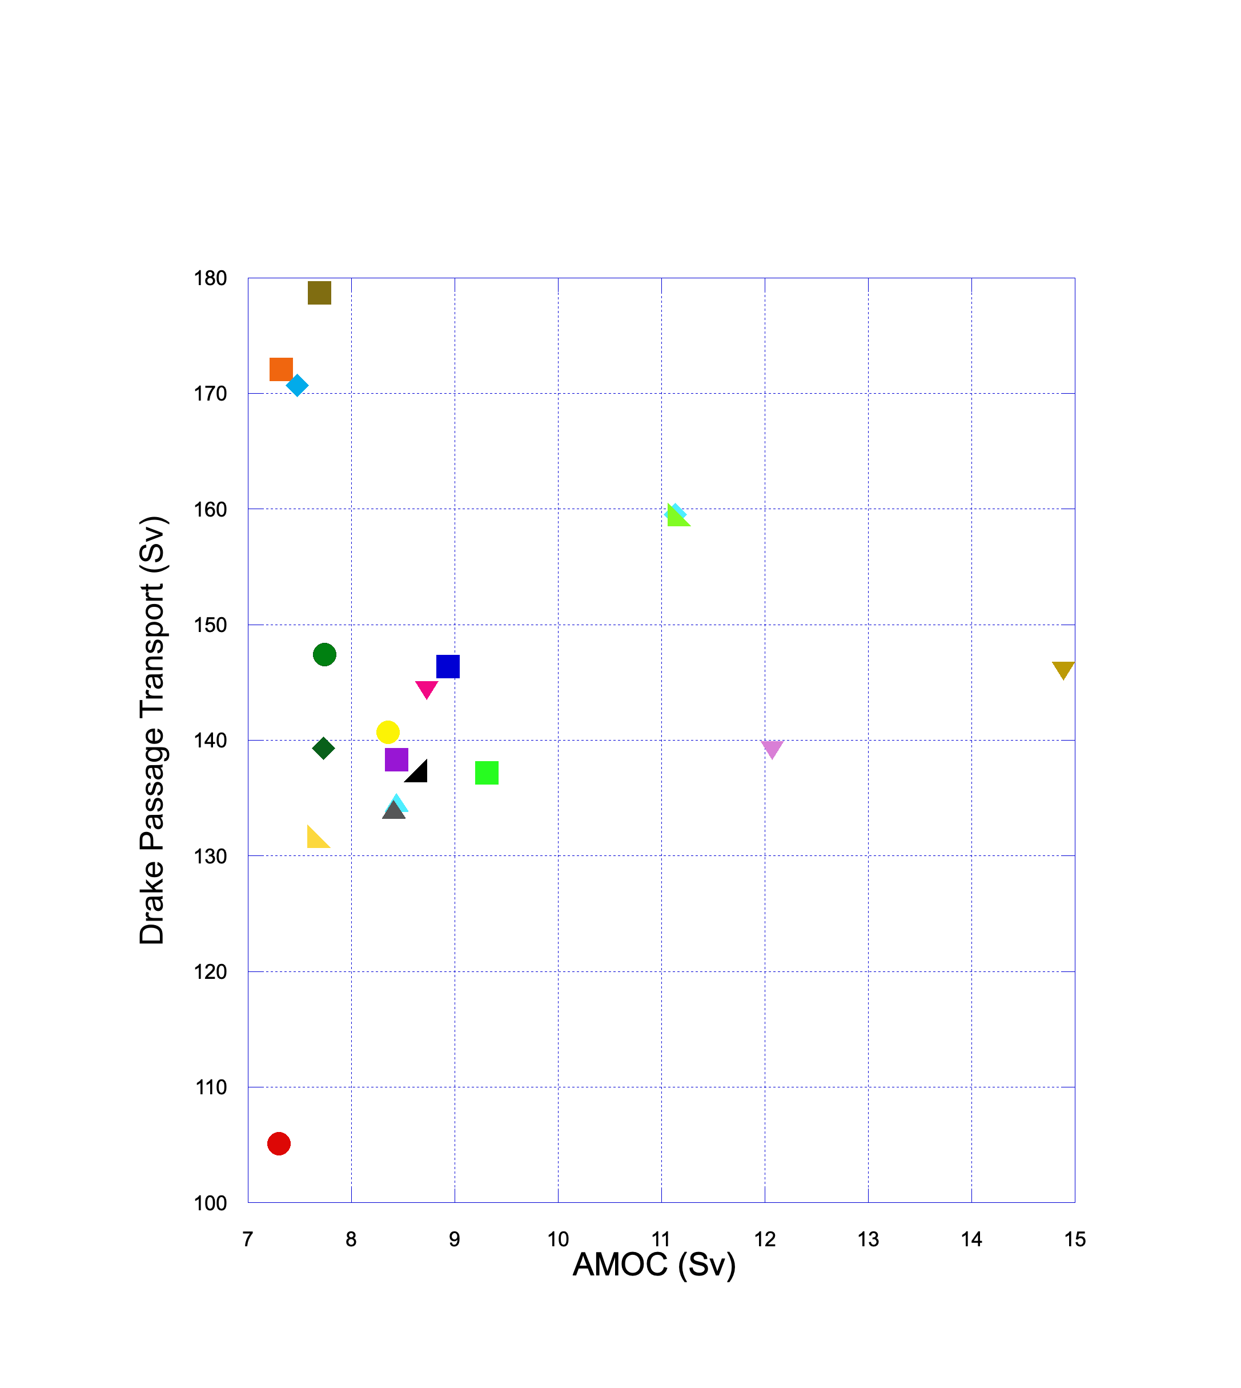
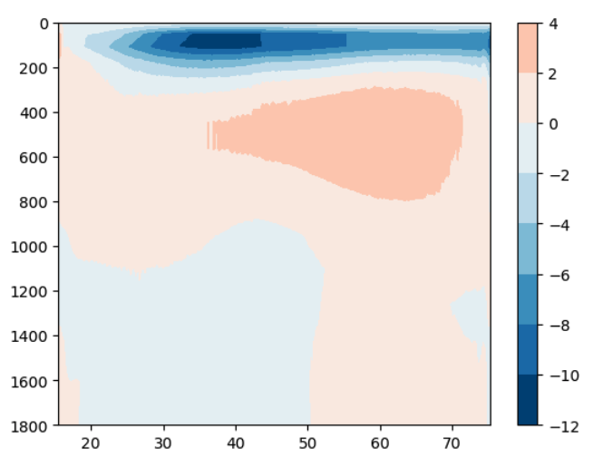
,
Mapping the sensitivity of AMOC in a hierarchy of configurations
Fully-coupled configurations
AMOC is a coupled phenomenon and has a long emergence timescale
Caldwell et al 2019
AMOC (50-60years)
FOSI simulations
Limited feedback but shorter emergence timescale and more samples. Persistent low AMOC but additional insights.
Idealized test case
Simplified dynamics; low cost and fast adjustment timescale.
Overturning Streamfunction
Surrogates
Requires large ensemble for training; Allows interpolation and extra samples

