Slide 1
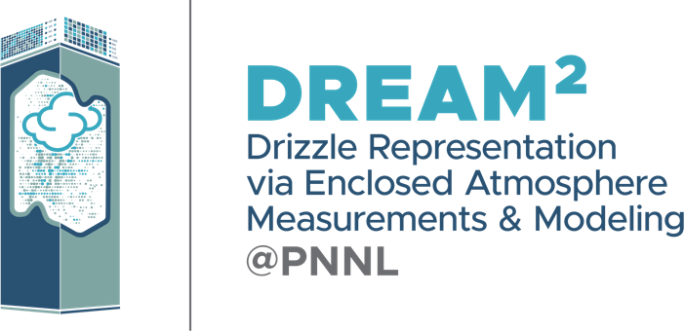

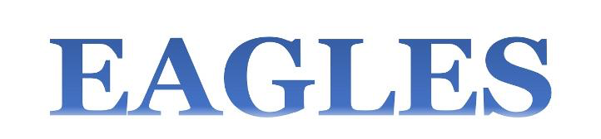
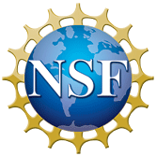

Improving ESM Process Representations
Using AI/ML
Andrew Gettelman, Po-Lun Ma, Susannah Burrows
Pacific Northwest National Laboratory

Slide 2
Summary and Outline
AI/ML approaches are percolating into parameterizations
Here, some E3SM Examples
Theme: Off-Line Training, Emulation of Complex Codes
Outline:
A better treatment of rain formation
Learning Aerosol Optics and Aerosol Activation
A broader view of AI/ML challenges and opportunities

Slide 3
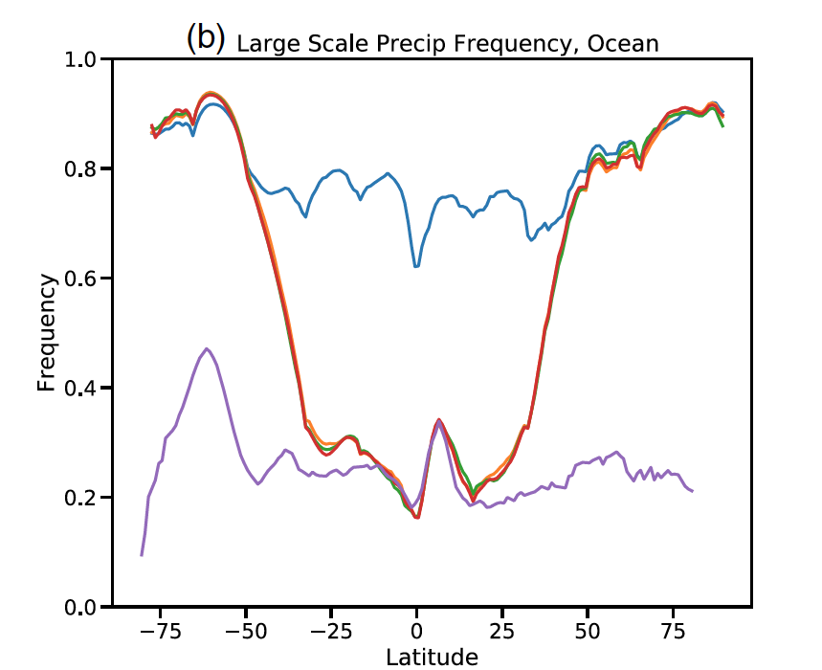
Machine Learning the Warm Rain Process
Initial CESM results
Emulator reproduces Bin code
Can we do the warm rain process better with ML?
Replace traditional GCM bulk rain formation with a bin model formulation for stochastic collection. This is too expensive for climate use. Emulate it with a neural network.
Results:
Bin code can improve rain formation results
Recover speed and results with neural network emulator
Embedded NN in the microphysics: maintains conservation with series of checks
Implemented first in CESM, now ported to E3SM (not in master)
TAU Bin
BIN code closer to Observations than Control
Gettelman et al 2021, JAMES

Slide 4
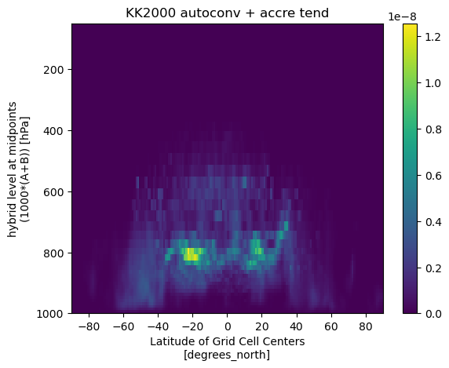
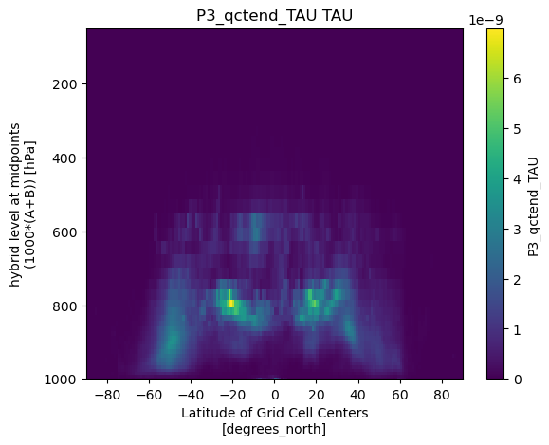
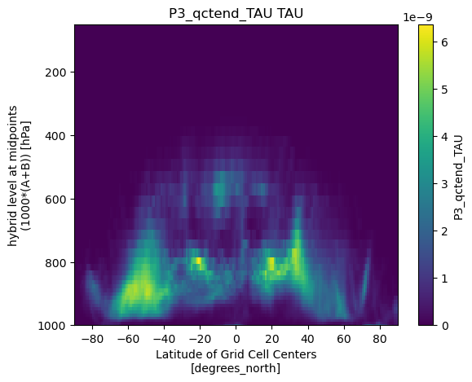
Emulator Running Interactively in E3SM
Bulk Rain Formation
Bin Rain Formation
Emulated Rain Formation
TAU and updated emulator (single NN) are running interactively in E3SM.
Emulator (from CESM) looks different than bin code in E3SM it is trying to emulate

Slide 5
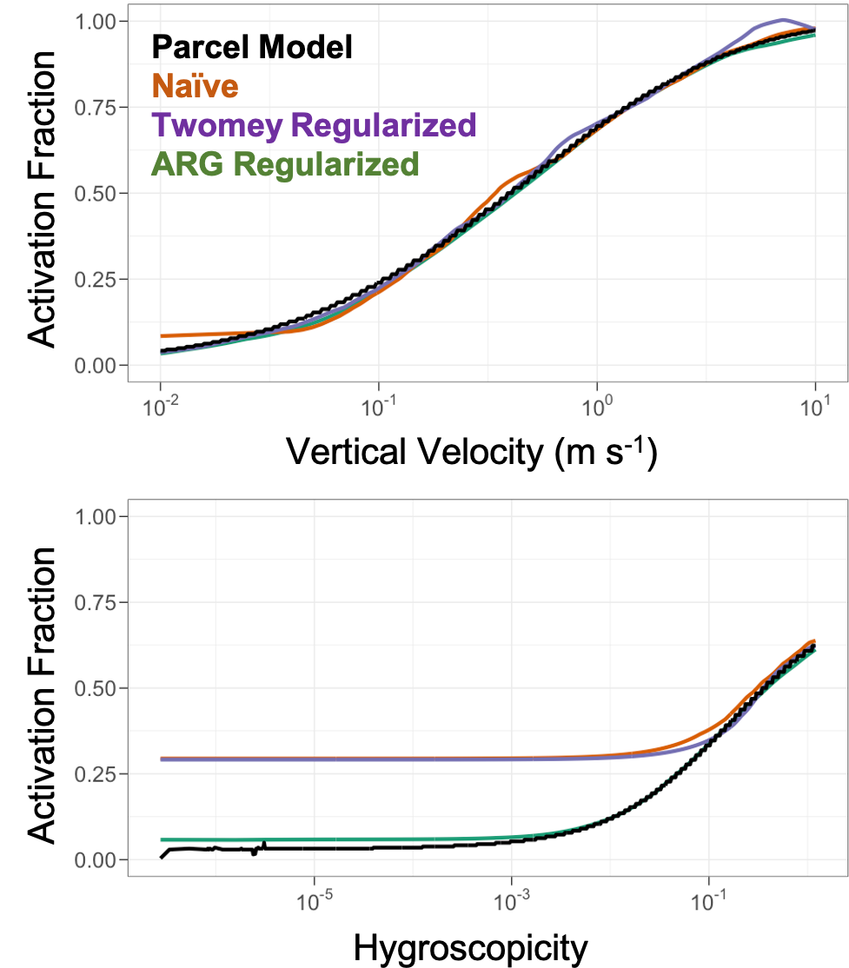
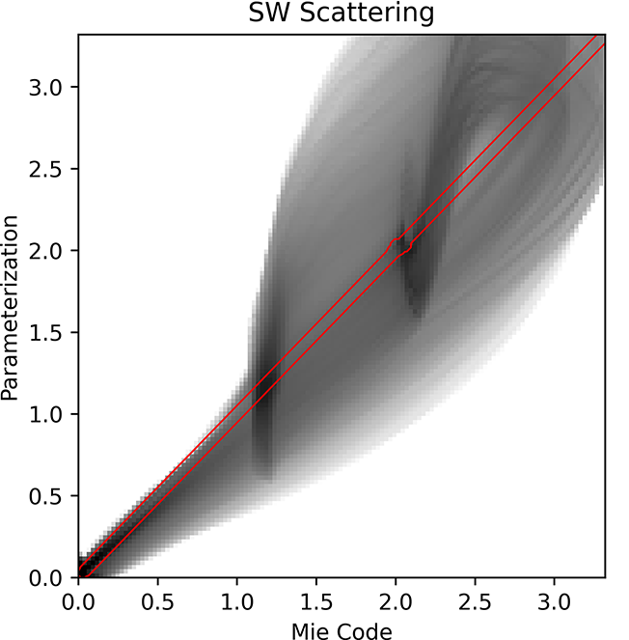
Machine Learning Aerosol Parameterizations
RIGHT: Machine Learning aerosol activation reproduces existing scheme when regularized (Silva, Ma et al 2021, GMD)
Left: Machine Learning aerosol optics better reproduces detailed Mie calculations than current parameterizations (Geiss, Ma et al 2023, GMD)
NN Range

Slide 6
Strategery: Paths Forward with AI/ML
Opportunities, Challenges, Gaps
Opportunity: AI Can simplify the model hierarchy for domain science
  Train parameterizations off detailed models to use across scales
  Use LLMs (ChatGPT, etc.) to do code translation between languages
    Python ←→ C++ ←→ Fortran (JAX and Julia also options)
Opportunity: Exploring ‘Foundation Modeling’ (mixed modeling) with AI/ML
  Need to partner with Industry (Google, Microsoft, NVIDIA): develop coherent relationships
    NeuralGCM type differential approaches (learning physics or components)
    Foundation emulators: GraphCast, FourCastNet, etc: learning the whole model solutions
    DOE offers expertise, computation, training data, interoperability. Industry: AI expertise, computation
  Foundation models may replace ‘core’ parts of models (dycore, thermodynamic state)
  Develop further models (aerosols, climate extremes, energy grid) from foundation models
  Will ML ‘eat the model’? (now learning the solution still relies on the IFS/Reanalysis)
Gap: AI and Observations: Simulators and Assimilation approaches
  Very relevant for ARM data: to better compare to models, and to help with data processing
Challenge/Gap: Robustness, Uncertainty, Interpretability (DOE can lead)

