Slide 1
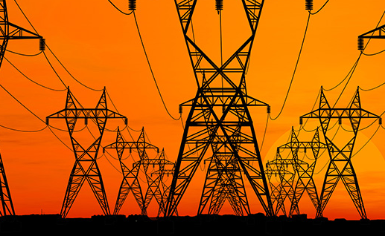
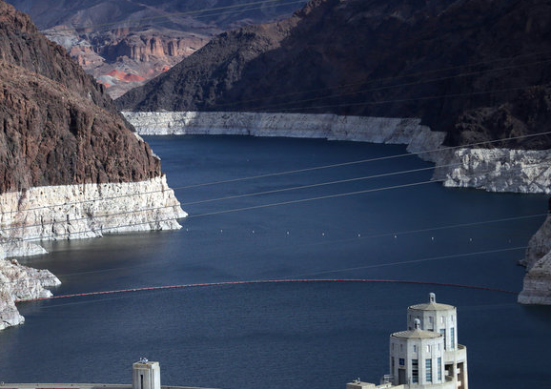




Climate Adaptation Increases the Cost of Decarbonization:
A case study that informs community engagement on model linkages
Energy-Water Nexus Connections (U.S. DOE, Energy Demands on Water Resources, Report to Congress on the Interdependency of Energy and Water, 2006.)
Andrew Jones, Julia Szinai, David Yates
Kripa Jagannathan, Smitha Buddhavarapu, Naresh Devineni
et al.
Lake Folsom, Jan. 2014 drought, Source: CA Dept. of Water Resources
How do water system interdependencies affect electricity system resilience under climate change?
Notes:
I’m presenting on behalf of my colleauges on this project, David Yates, Paty Hidalgo-Gonzalez, Dan Kammen, Ranjit Deshmukh and Andy Jones.

Slide 2
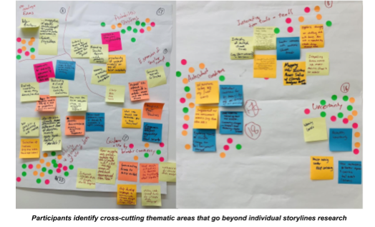
HyperFACETS
Cross-Cutting Engagement Themes
Guidance on use of model hierarchies / linkages

Slide 3


What are model “hierarchies”?
The linkage of climate models and data with impact/management models to assess the impacts of climate change on human systems.
Since we are not talking about actual hierarchies, we might want to rename the title to model linkages?
What is the goal of this work?
Use HyperFACETS and other examples to co-produce a common set of challenges and guidance for addressing climate and impact model and data linkages

Slide 4



Synthesis of working group discussions to-date
Different flavors of models and data:
  Climate model hierarchy: global models, regional models, regional refined global models, ML models driven by global/regional models
  Process-based ML models vs. statistical models
  Climate models connected with impact models
Different ways to evaluate credibility of different models:
  “Better” skill differs based on type of model, intended use or question to be answered, variable (extremes vs. average, application, location)
  One type of model (e.g. ML) can diagnose the behaviors of another type
Challenges:
  Temporal and spatial mismatch among models in hierarchy
  Error propagation and uncertainties across model hierarchies
  Communication of model outcomes and uncertainties

Slide 7
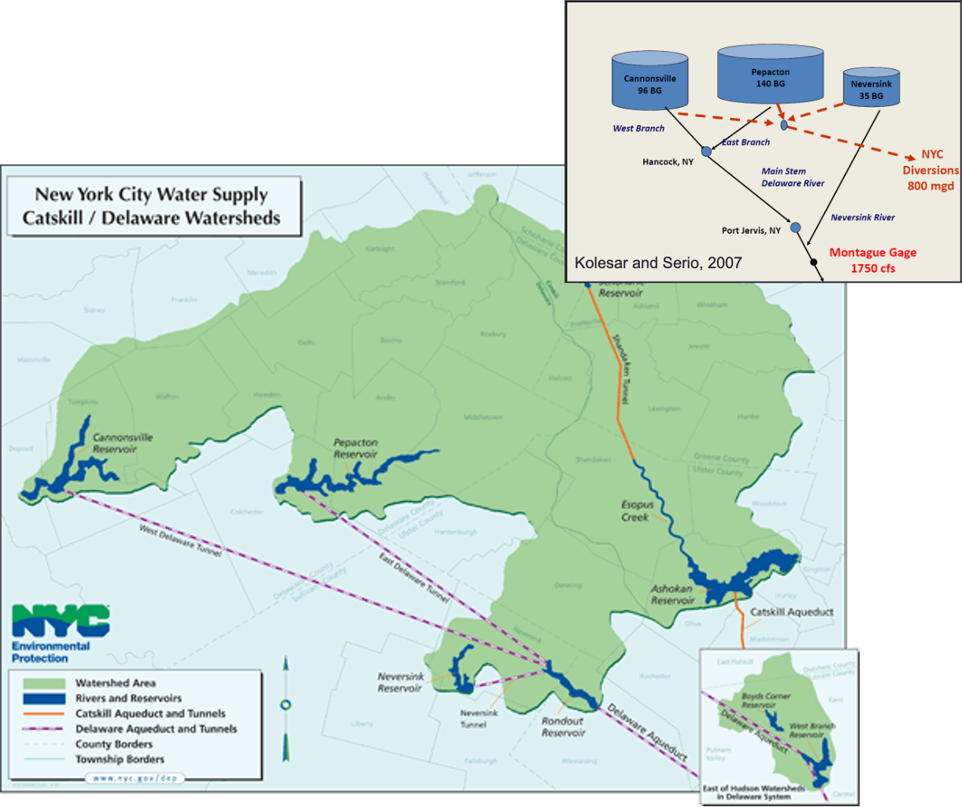
Case Studies
Climate Data
Drought-induced Water Stress
Hydrology Models
Streamflow
Reservoir Rule Curves (Operating Policy)
Reservoir Storages
Reservoir Releases
Water Demands
Evaporative Demand
Reservoir Models
Water Supply Risk Metrics
Water Policy
The Cannonsville, Pepacton and Neversink reservoirs provide up to 50% of the water to NYC and serve downstream ecosystem

Slide 8
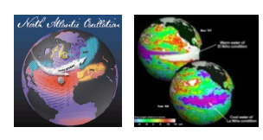
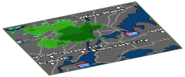
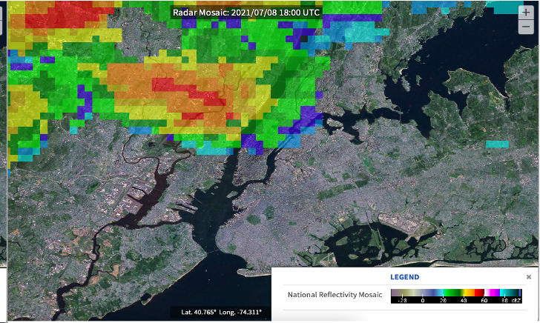
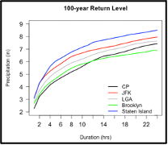
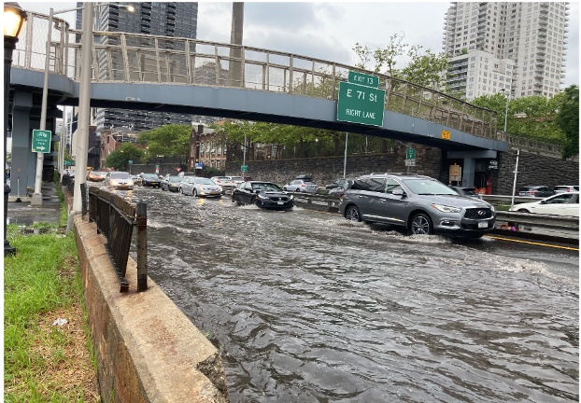
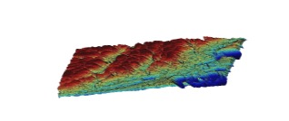
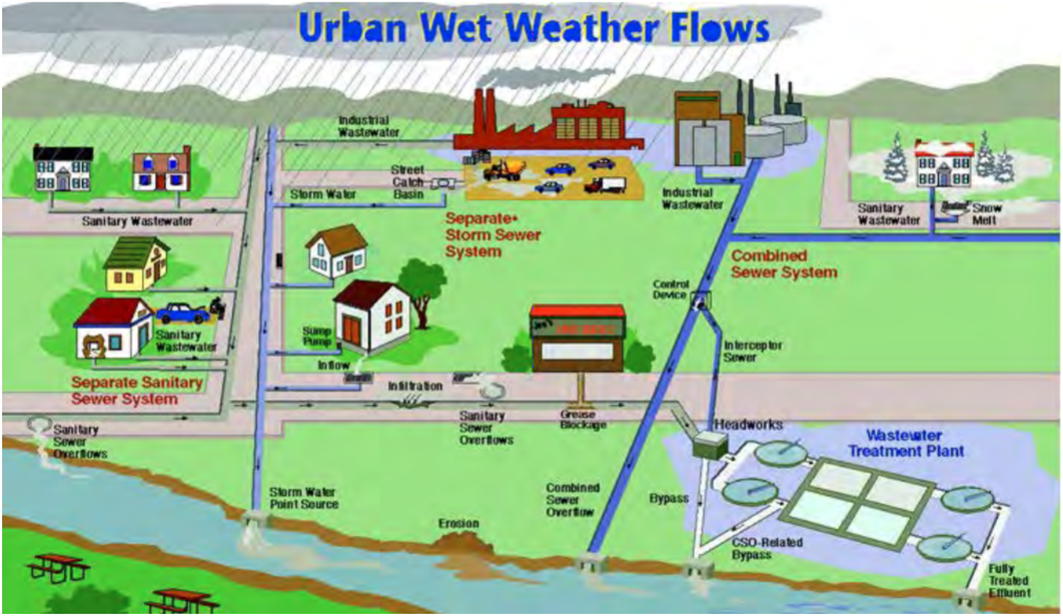
Case Studies
Climate Data
Urban Flood Scenarios
Outcomes will be useful in planning for storm emergencies and improving the design/analysis of infrastructure
Extreme Rainfall Simulations
IDF Creation
SWMM
HEC-RAS

Slide 9
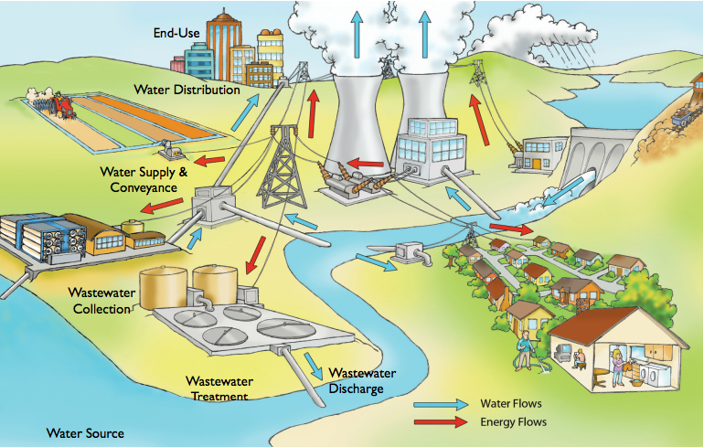
Water and energy system transformation to achieve decarbonization and resilience
Case Studies
Source: U.S. Dept. of Energy, Energy Demands on Water Resources, Report to Congress on the Interdependency of Energy and Water, 2006.
Notes:
As you have heard, around the world, and especially in the semi-arid California, water and energy systems are interdependent—electricity powers all stages of the managed water cycle, from groundwater pumping and the conveyance to treatment, distribution, and usage, and disposal of water. For example in CA a staggering 19% of electricity consumption is related to water. A large part of that is for water end-uses, like water heating in homes, which is very energy-intensive. Water is also used to generated electricity water, and in California about 15% of electricity generation comes from hydropower on average. These connections have commonly been referred to as the “energy-water nexus.”
However, both electricity and water systems are vulnerable to climate change. This photo here, of one of California’s largest reservoirs during the most recent drought, foreshadows one of the many effects that climate change could have on the state’s water and energy systems. In the most recent drought: Snowpack, which stores about a third of our water supplies was a fraction of average. Snowpack is the source of water for much of California’s hydropower, and so hydropower generation was about half its normal level. The electricity we would normally get from hydropower had to be made up, and was largely replaced by expensive and emitting natural gas. This cost the sate $2.5 billion and 24 M metric tons of emissions, or a 10% increase. That’s the same amount of carbon dioxide emissions as about 5 million cars on the road for a year.
At the same time, because of less available surface water, people turned to groundwater. This increased energy use related to groundwater pumping. All these effects were happening when I was working at an electric utility before graduate school, and got me interested how climate change makes both the energy and water systems more vulnerable. Once I started in grad school I learned that current research shows that droughts may become more frequent in the state under climate change, and but there are also a number of other impacts of climate change that may affect these two systems.

Slide 10
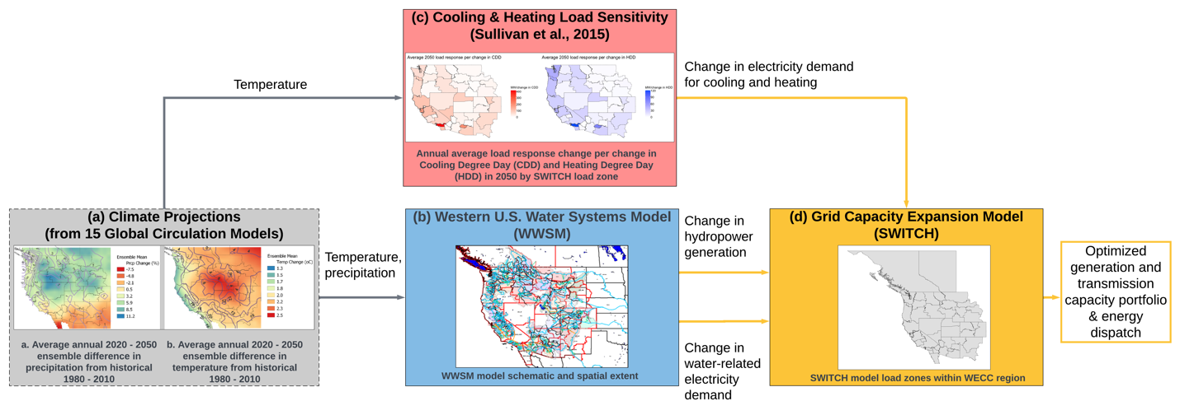
Climate-Water-Energy System Linkages

Slide 11
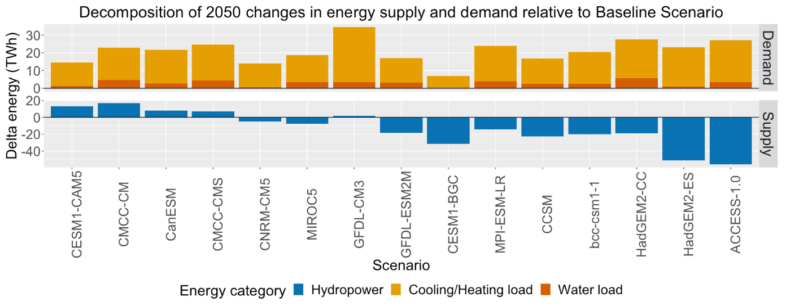
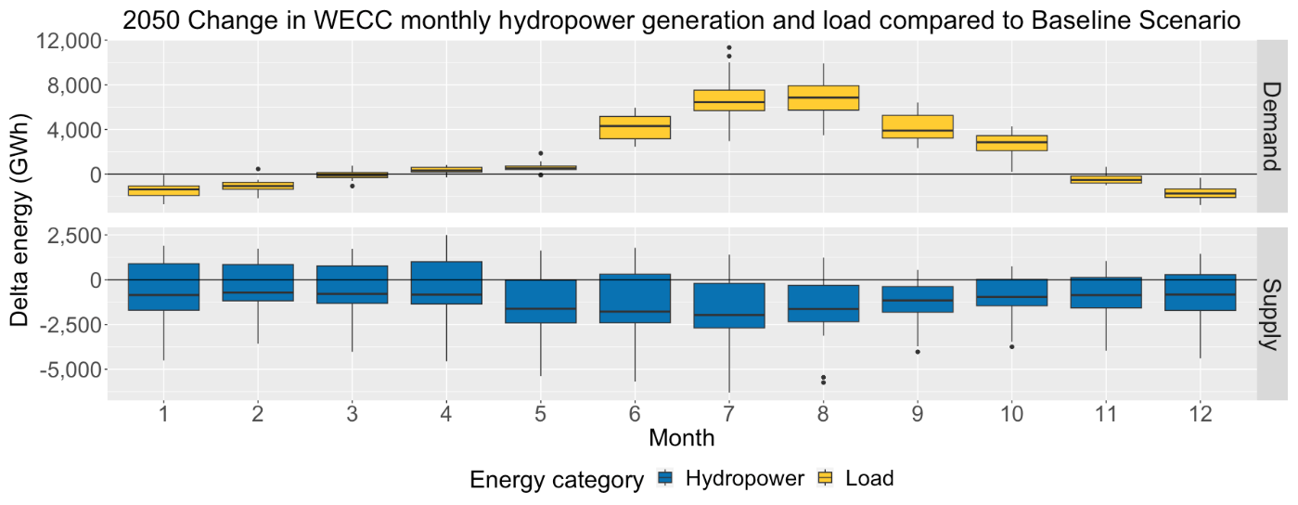
Electricity demand increases to varying degrees across all climate scenarios
Hydropower supply is more variable
Supply and demand imbalances tend to concentrate in summer months, compounding one another.

Slide 12
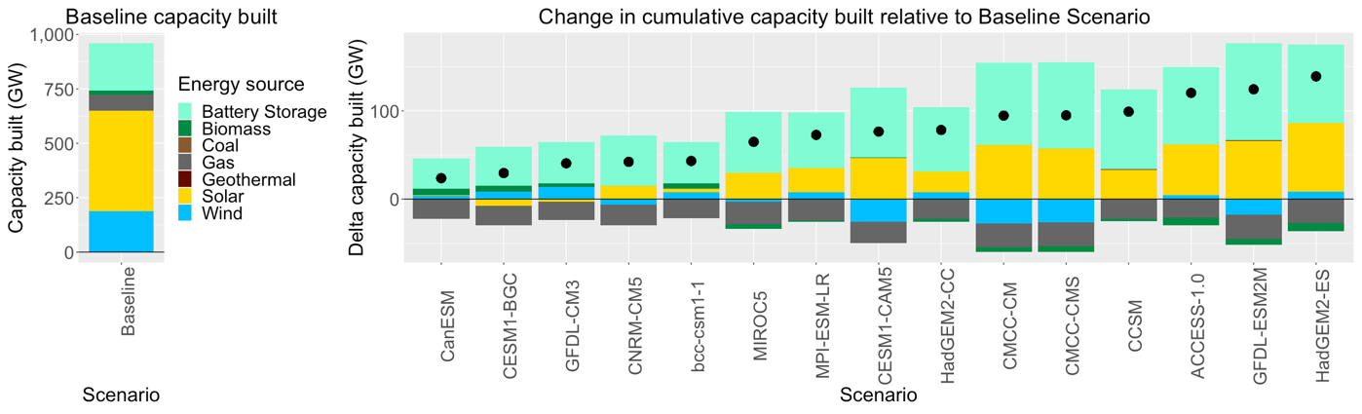
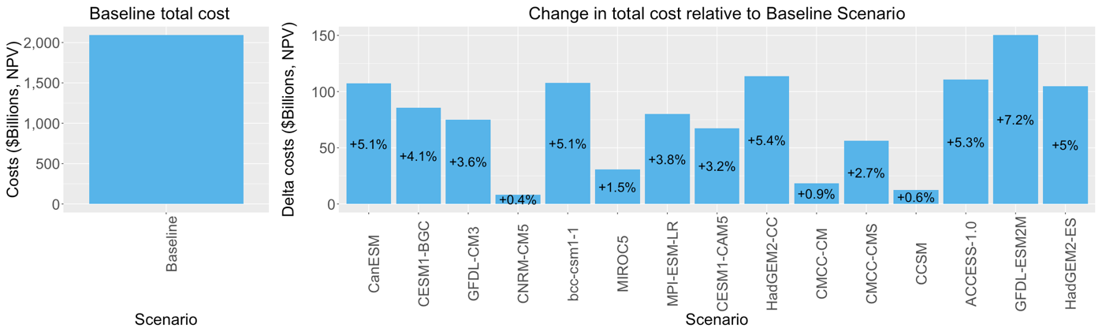
Additional capacity for adaptation can be substantial
Up to 139GW, which is 3X current peak demand in CA
Costs of adaptation vary significantly across climate scenarios

Slide 13
Learn more:
Szinai J.K., D. Yates, P. A. Sánchez-Pérez, M. Staadecker, D. M. Kammen, A. D. Jones, P. Hidalgo-Gonzalez (in review). Climate change and its influence on water systems increases the cost of electricity system decarbonization. Nature Communications
Yates, D., J. Szinai, A.D. Jones (2024). Modeling the Water Systems of the Western US to Support Climate-Resilient Electricity System Planning. Earth’s Future. https://doi.org/10.1029/2022EF003220
Buddhavarapu, S., K. Jagannathan, A.D. Jones (2023). HyperFACETS 2023 Workshop: Summary Report.

