Slide 1
EVALUATION OF FUTURE URBAN LAND EXPANSION USING A GLOBAL MULTISECTOR DYNAMICS MODEL
Kanishka B. Narayan (kanishka.narayan@pnnl.gov), Ryan McManamay, Brian C. O Neill, Pralit Patel, Marshall Wise, Jennie Rice, Chris Vernon and Tirthankar Chakraborty (TC)

Slide 2
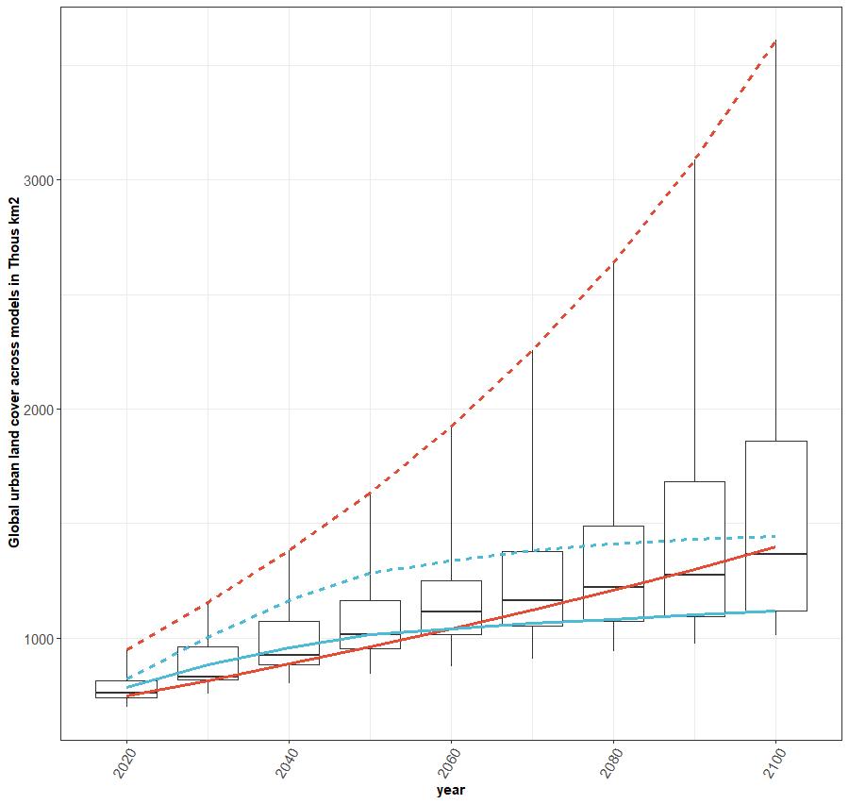
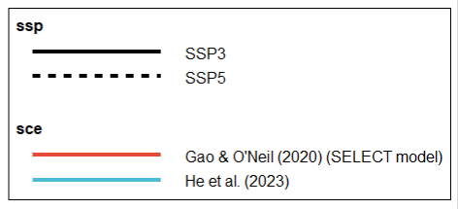
INTRODUCTION
Global urban land cover projections under alternative models

Slide 3
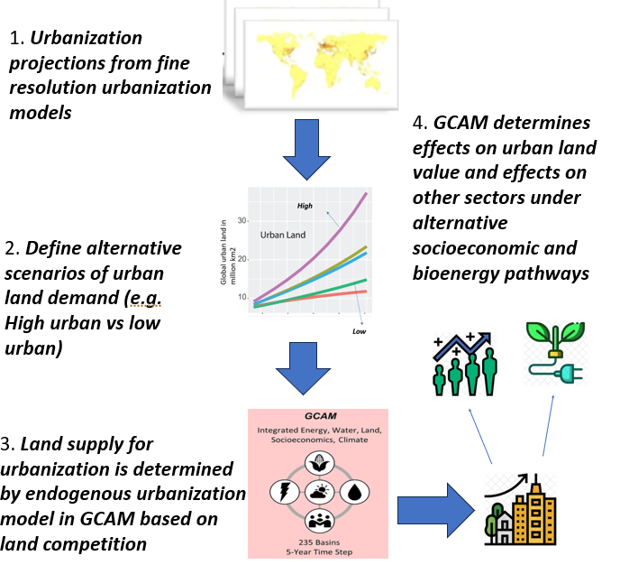
METHODS
A) Our approach

Slide 4
METHODS
A) Our approach
B) Endogenous land competition in GCAM
GCAM land module
Agricultural and Urban land
Forested land
Grazed land
Harvested cropland
Arable land
Urban land
Based on land competition the model calculates values of urban land in $/thous km2

Slide 5
SCENARIOS
Global urban land cover projections under alternative models
We implement two urbanization pathways-
Expanding urbanization- SELECT model
Saturating urbanization- He et al (2023)
These are implemented for two socioeconomic scenarios-
SSP3
SSP5
And we also implement two types of energy transitions
Baseline
High Bioenergy
Urban model (n=2) X Socio economic scenarios (SSP) (n=2) X Energy transition (Baseline or High bioenergy) (n=2)

Slide 6
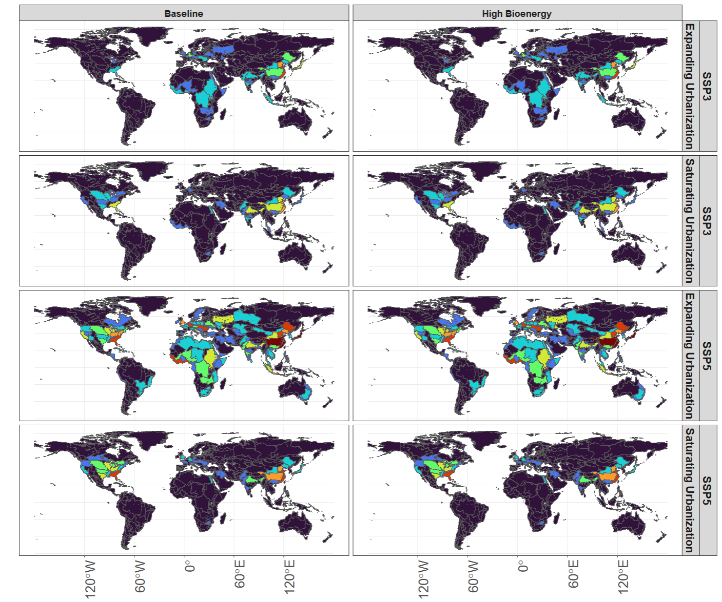
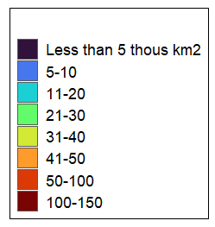
INCREASE IN URBAN LAND AT THE BASIN SCALE IN 2100
Increase in urban land cover by 2100 in thousand km2

Slide 7
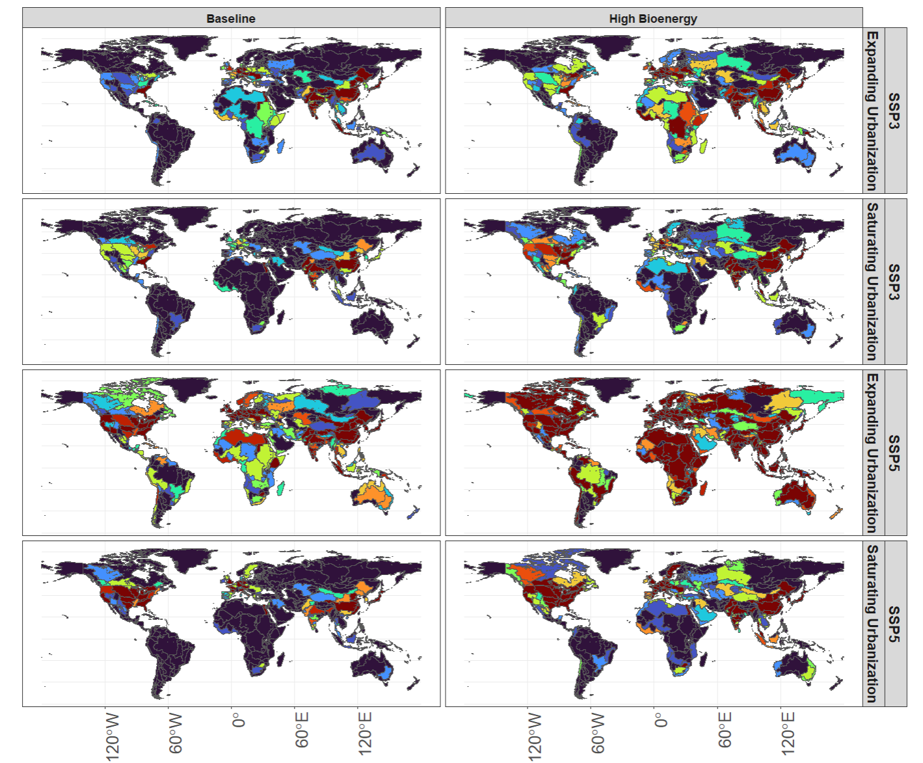
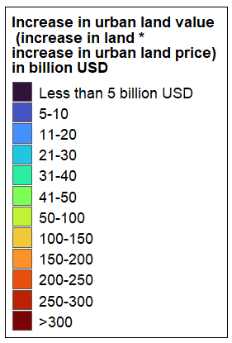
Since GCAM can now produce a projection of increase in the value of urban land based on land competition, we can evaluate total increase in urban land value at the basin scale

Slide 8
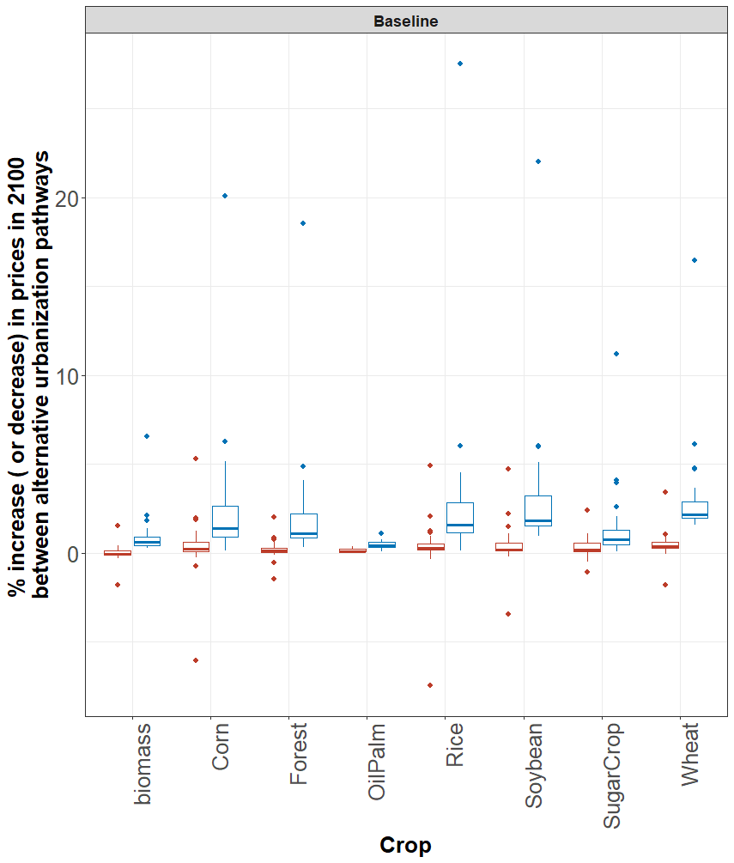
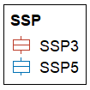
WHAT EFFECT DOES CHANGING URBANIZATION HAVE ON OTHER SECTORS?
Here we compute the difference in crop prices between expanding and saturating urbanization scenarios for every GCAM region in 2100
Boxplot= distribution of differences across regions
Color= SSP

Slide 9
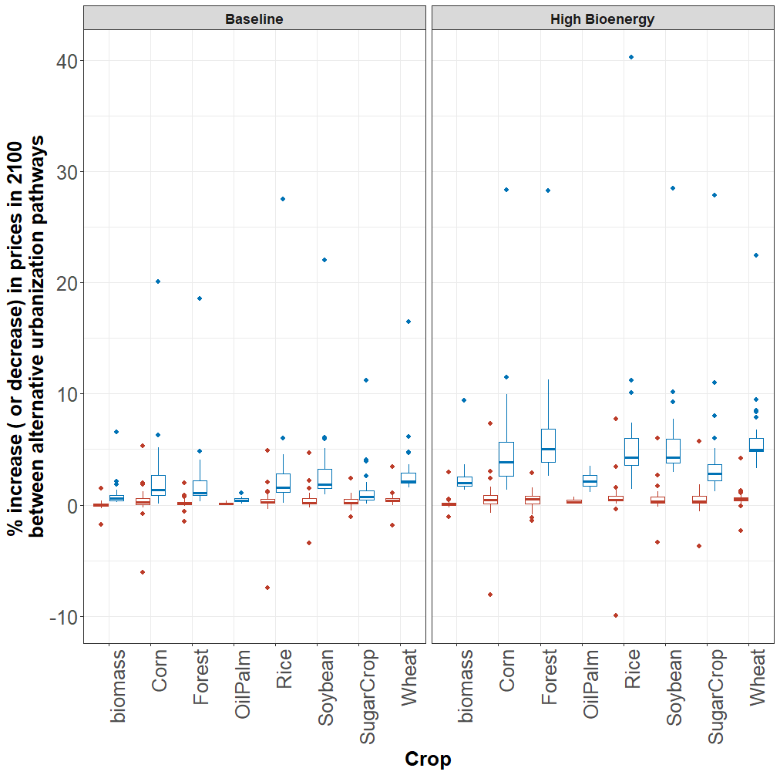
High bioenergy deployment combined with high socioeconomic pressures from SSP5, produce the largest effects when comparing urbanization scenarios

Slide 10
SUMMARY AND NEXT STEPS
We have found that alternative urbanization scenarios can produce large effects on the human system and urban prices themselves.
This is especially the case under scenarios where there is high bioenergy deployment
Results are regionally and sub-regionally heterogeneous. No linear relationship between the amount of future urbanization and increase in urban land value. Some basins always have high impacts regardless of the level of urbanization
There are several areas to improve this work-
A) Increasing urbanization scenarios (more than the two we currently use)
B) Downscaling these results with tools such as demeter to enable more comprehensive evaluation by other teams
C) Also implementing “endogenous demand” for urban land and coupling that with the energy model

Slide 11
THANK YOU!

