Slide 1


E3SM’s Sensitivity to Ocean Heat Transports: A Slab Ocean Model Study
Oluwayemi Garuba, Phil Rasch, Ruby Leung, Hailong Wang, Samson Hagos, Balwinder Singh
2024 EESM PI Meeting
Notes:
Stock image of cloud formations

Slide 2

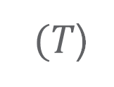
Simplification of the Dynamic Ocean model
Dynamic Ocean model
Static Slab Ocean Model
Ocean Mixed layer
Ocean Mixed Layer
$(T$)
Prescribed OHC
$$ρ(T,S)$$
Reaches equilibrium within 20 years!
Quick turnaround for regional refinement, equilibrium climate sensitivity, locking and overriding experiments.
Ocean Deep layer
Notes:
Simulates Ocean circulation and its associated lateral heat /salt transports and mixing between ocean mixed and deep layers
Exchanges fluxes with atmosphere, sea ice and river runoff models
Simulates time evolution ocean temperature and salinity fields
Prescribed with climatological ocean heat convergence (net impact of ocean heat transports) diagnosed from the full ocean model
Couples with atmosphere and sea ice model
Computes ocean mixed layer temperature

Slide 3
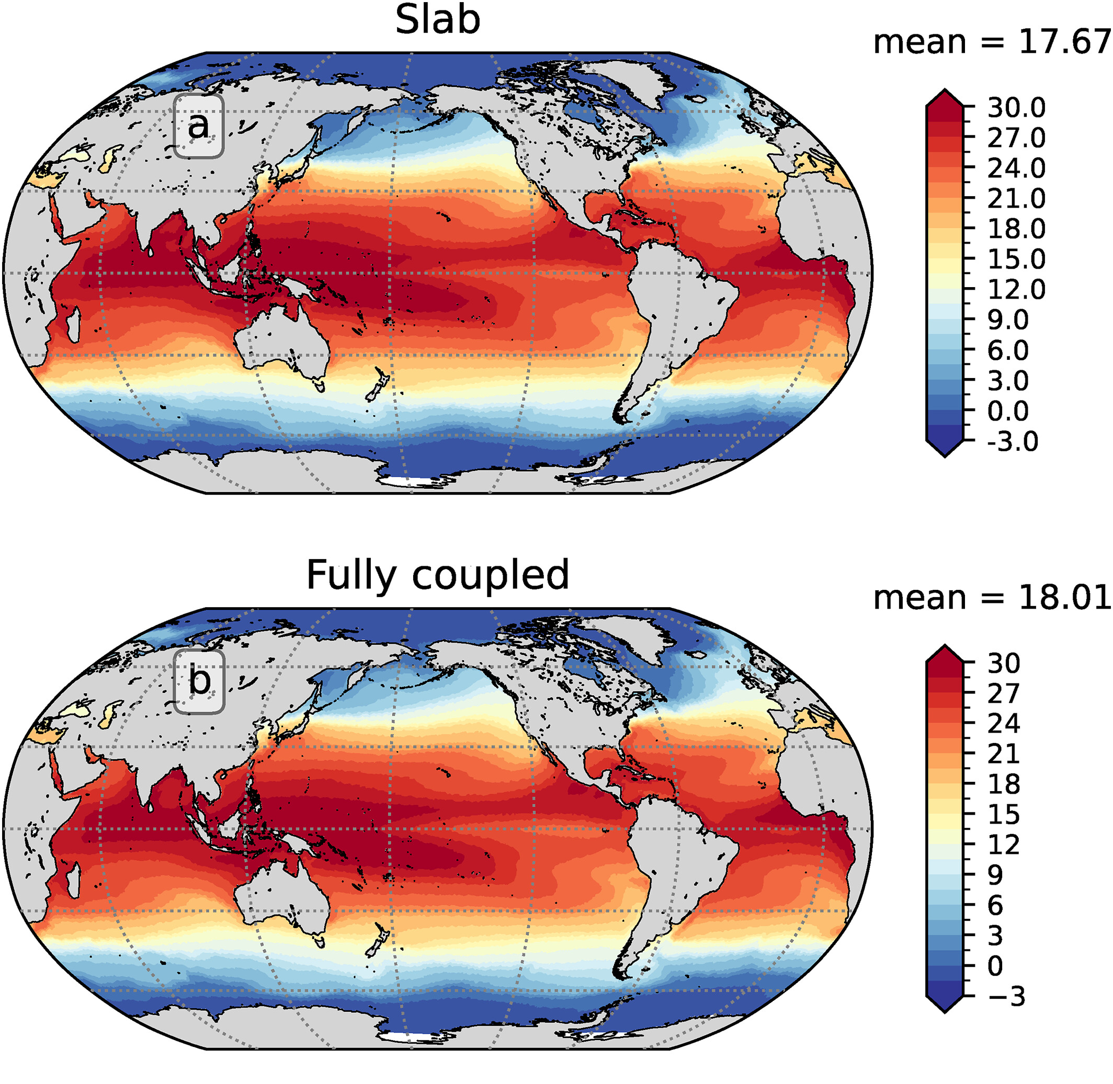
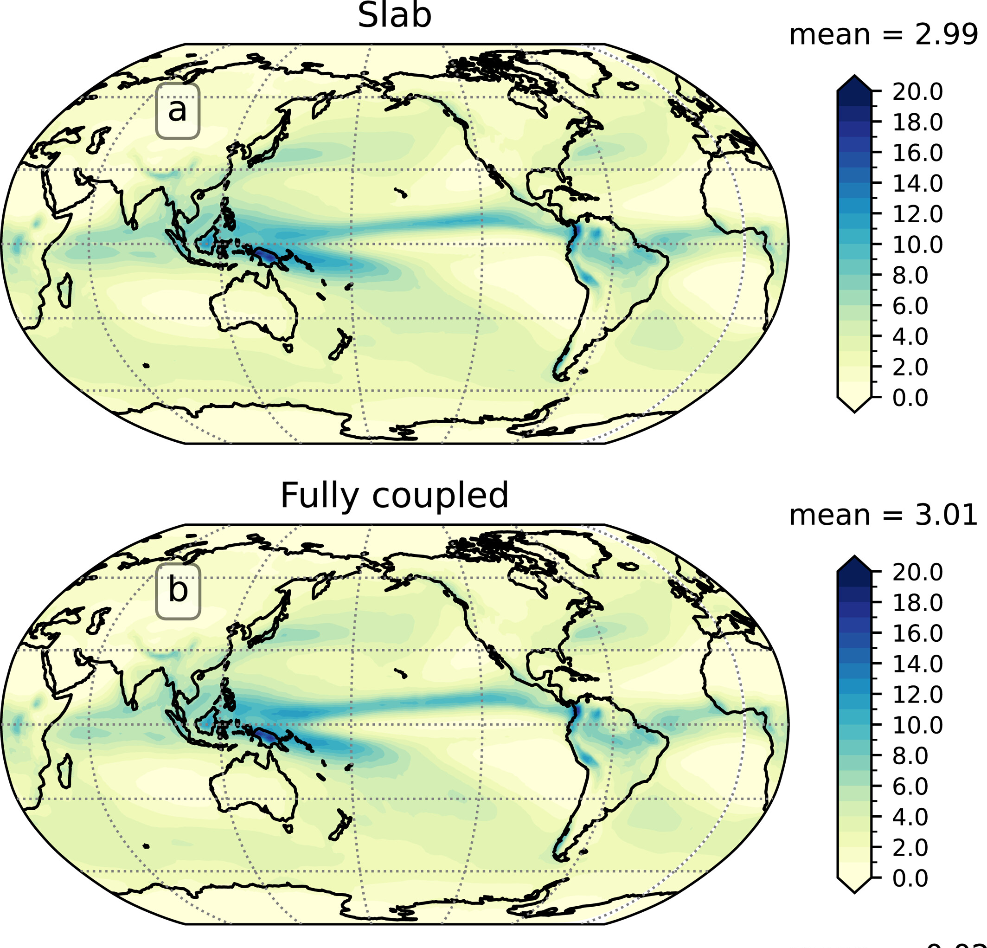
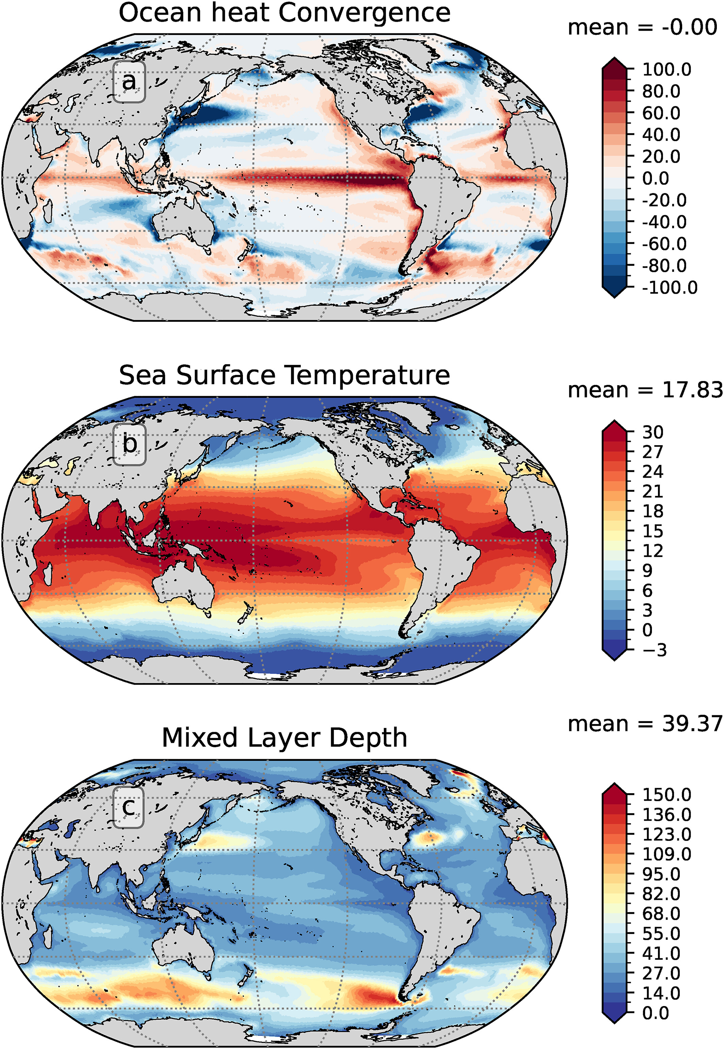
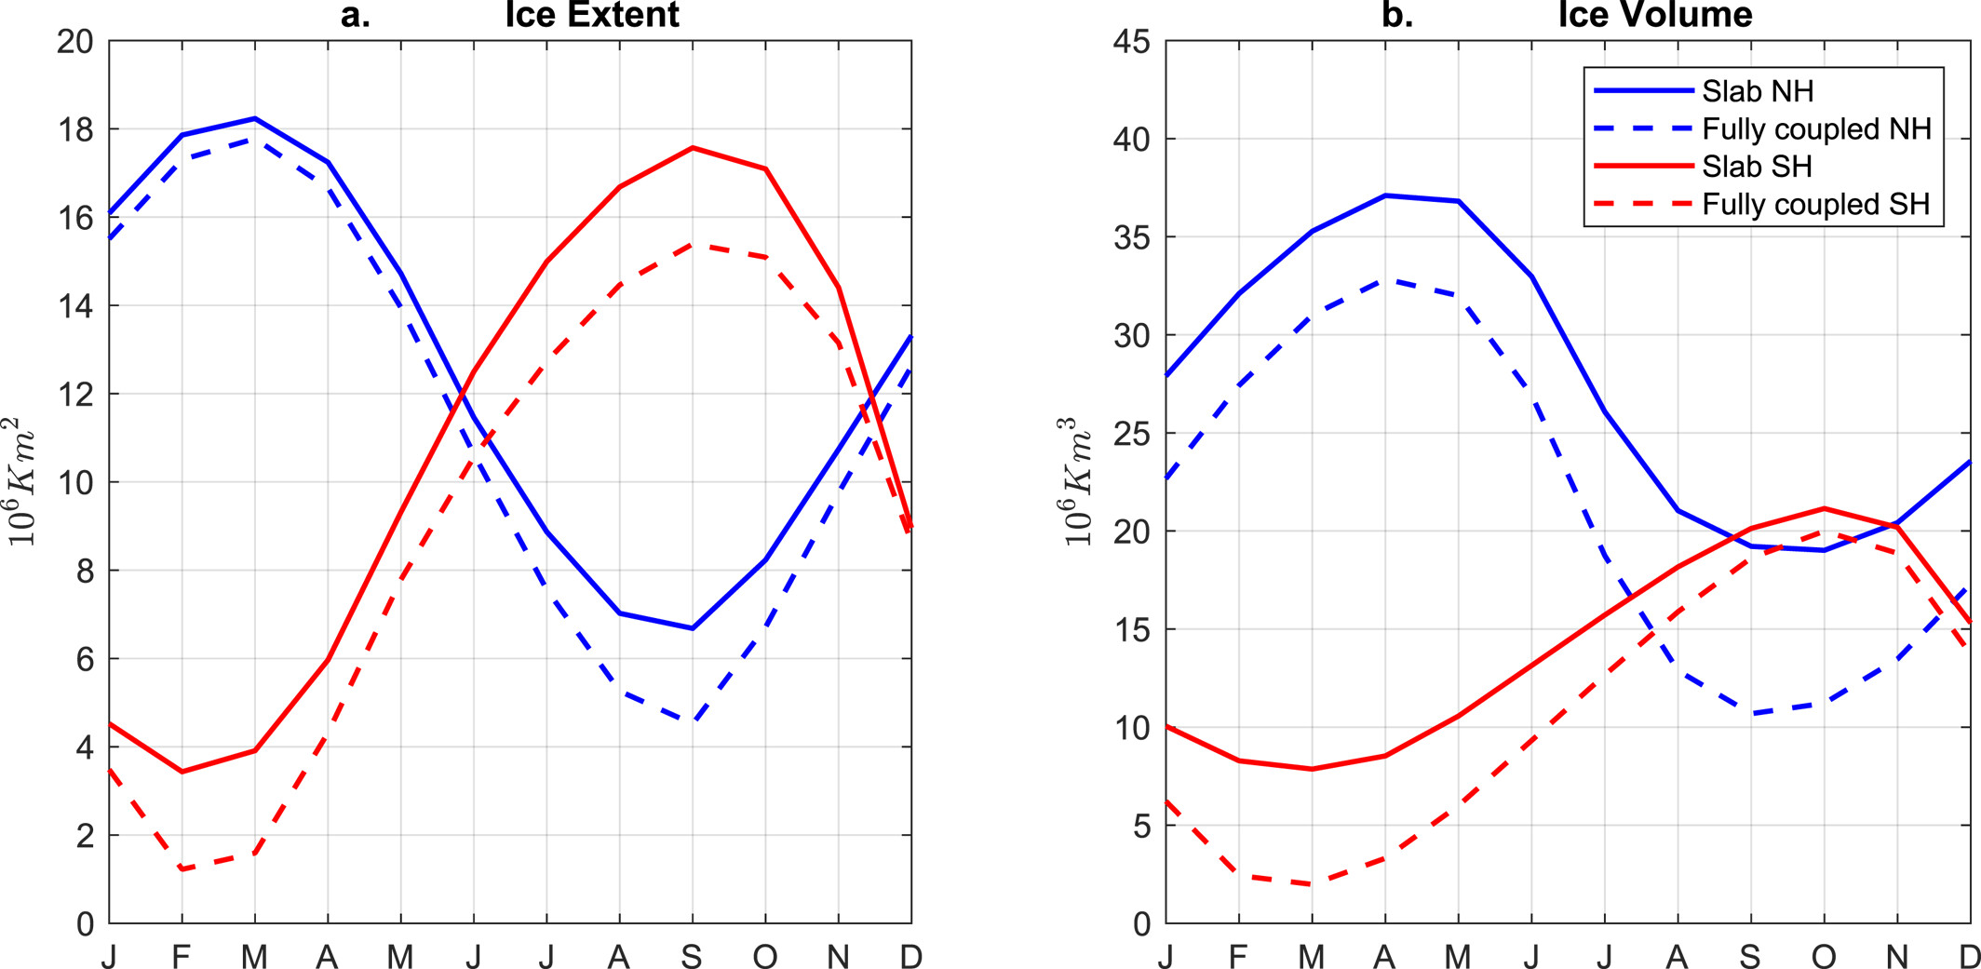
E3SMv2-SOM can reproduce the baseline climate of the fully coupled model it is derived from.
SOM forcing
Sea Surface temperature
Precipitation
Sea ice extent (left) and volume (right)

Slide 4
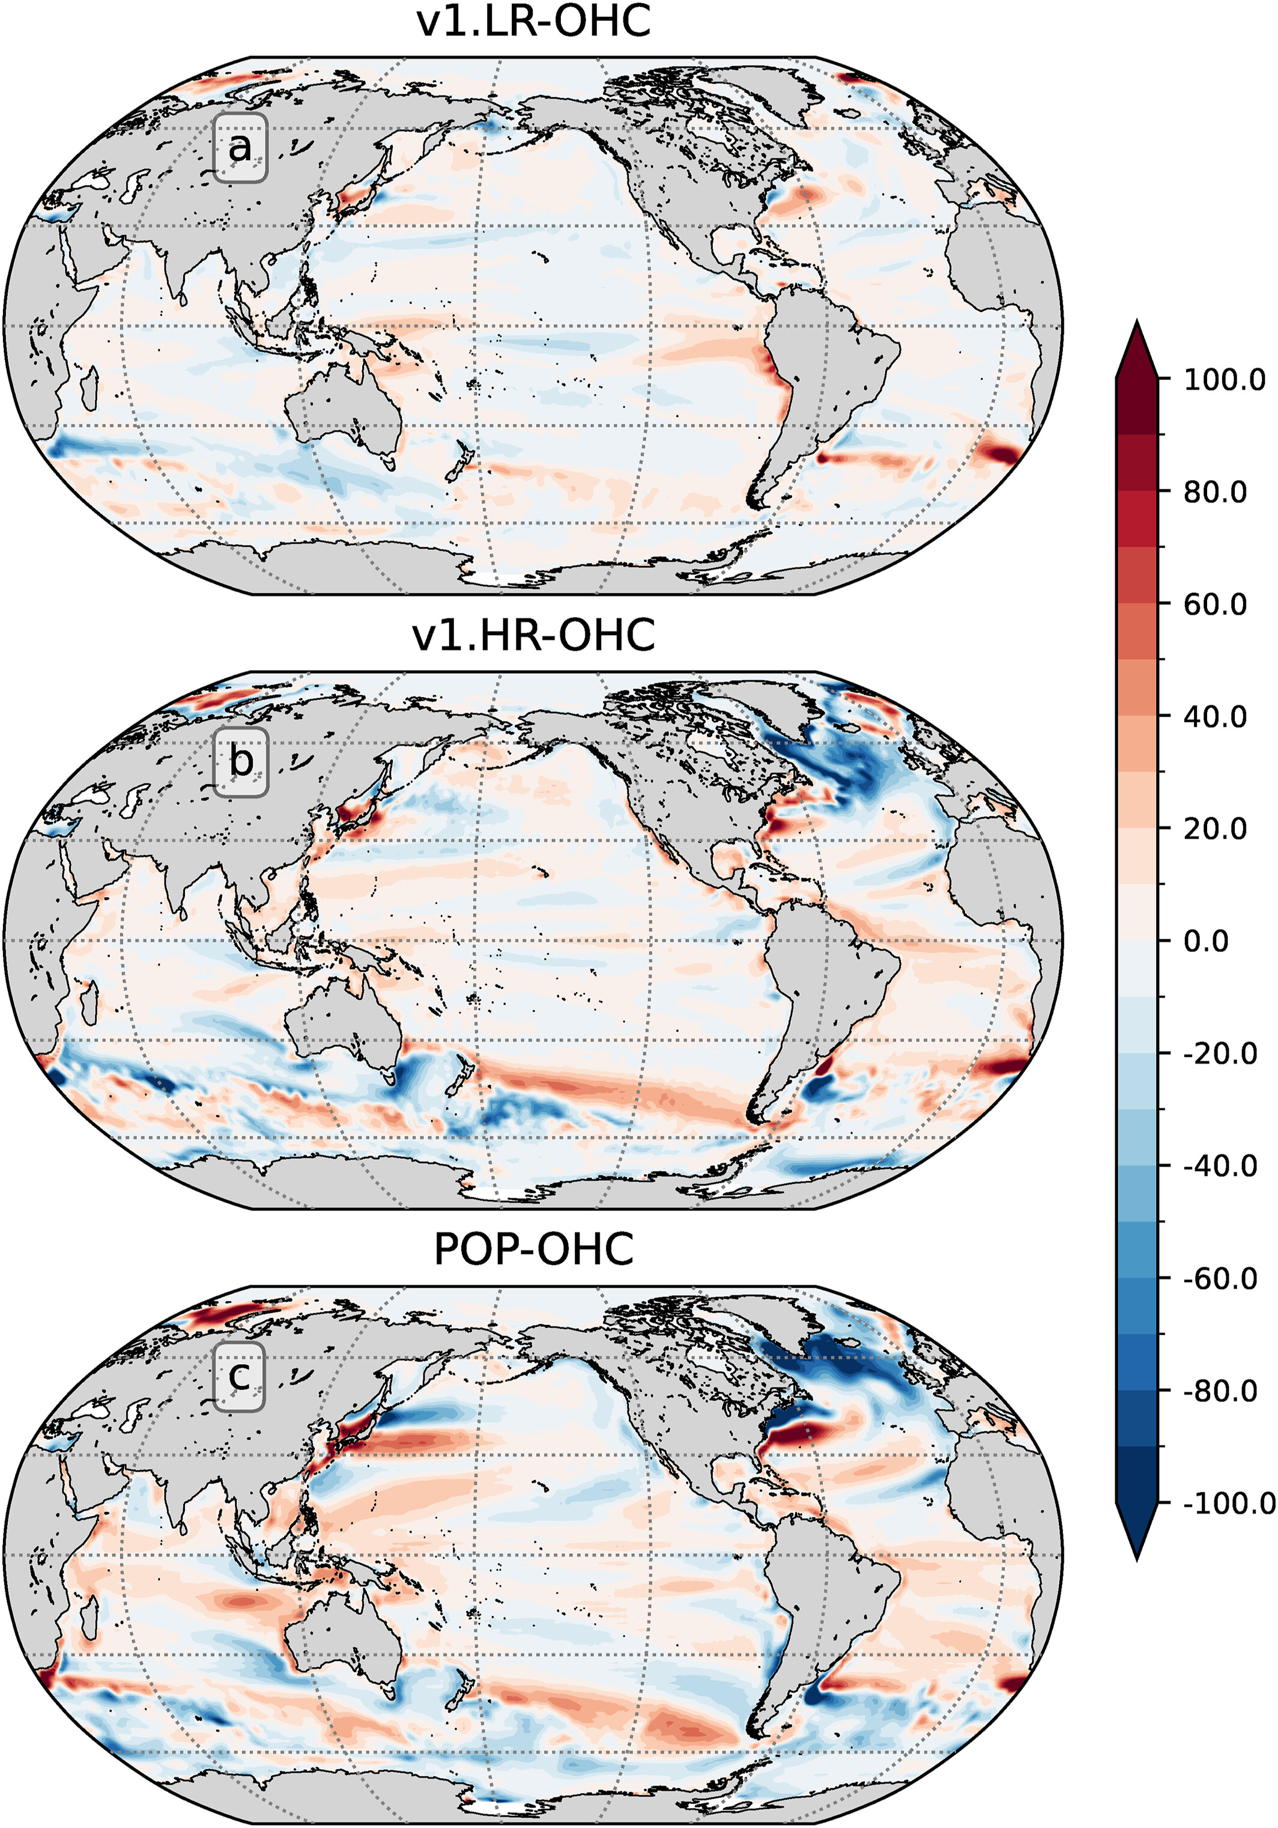
How does the E3SM baseline climate change with different ocean heat transport forcings?
Model: E3SMv2-SOM
Forcing:1850 atmospheric/land conditions
Ocean boundary condition and forcing:
  MLD and initial SST from v2.LR.piControl years 481-500 climatology;
  OHC derived from different fully coupled simulations with different ocean heat transport strengths
Experiments:
  1.Low-OHT
    SOM.v2.LR-OHC (OHC derived from the v2.LR.picontrol fully coupled)
    SOM.v1.LR-OHC (OHC derived from the v1.LR.picontrol fully coupled)
  2. High-OHT
    SOM.v1-HR-OHC (OHC derived from the v1.HR.control fully coupled)
    SOM.POP-OHC (OHC from the CESM 1 fully coupled)
Ocean heat convergence forcing difference

Slide 5
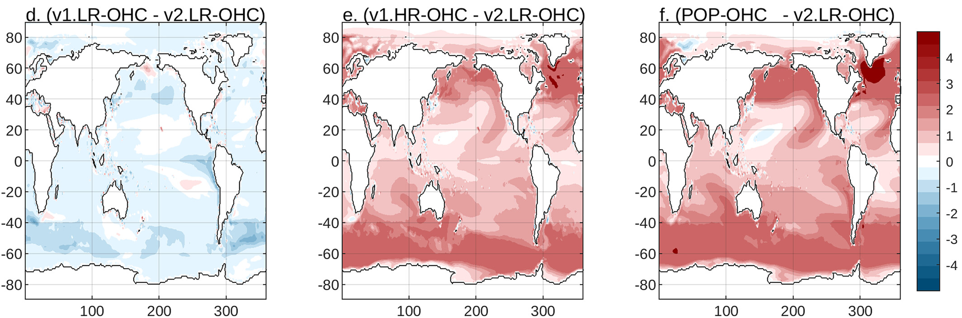
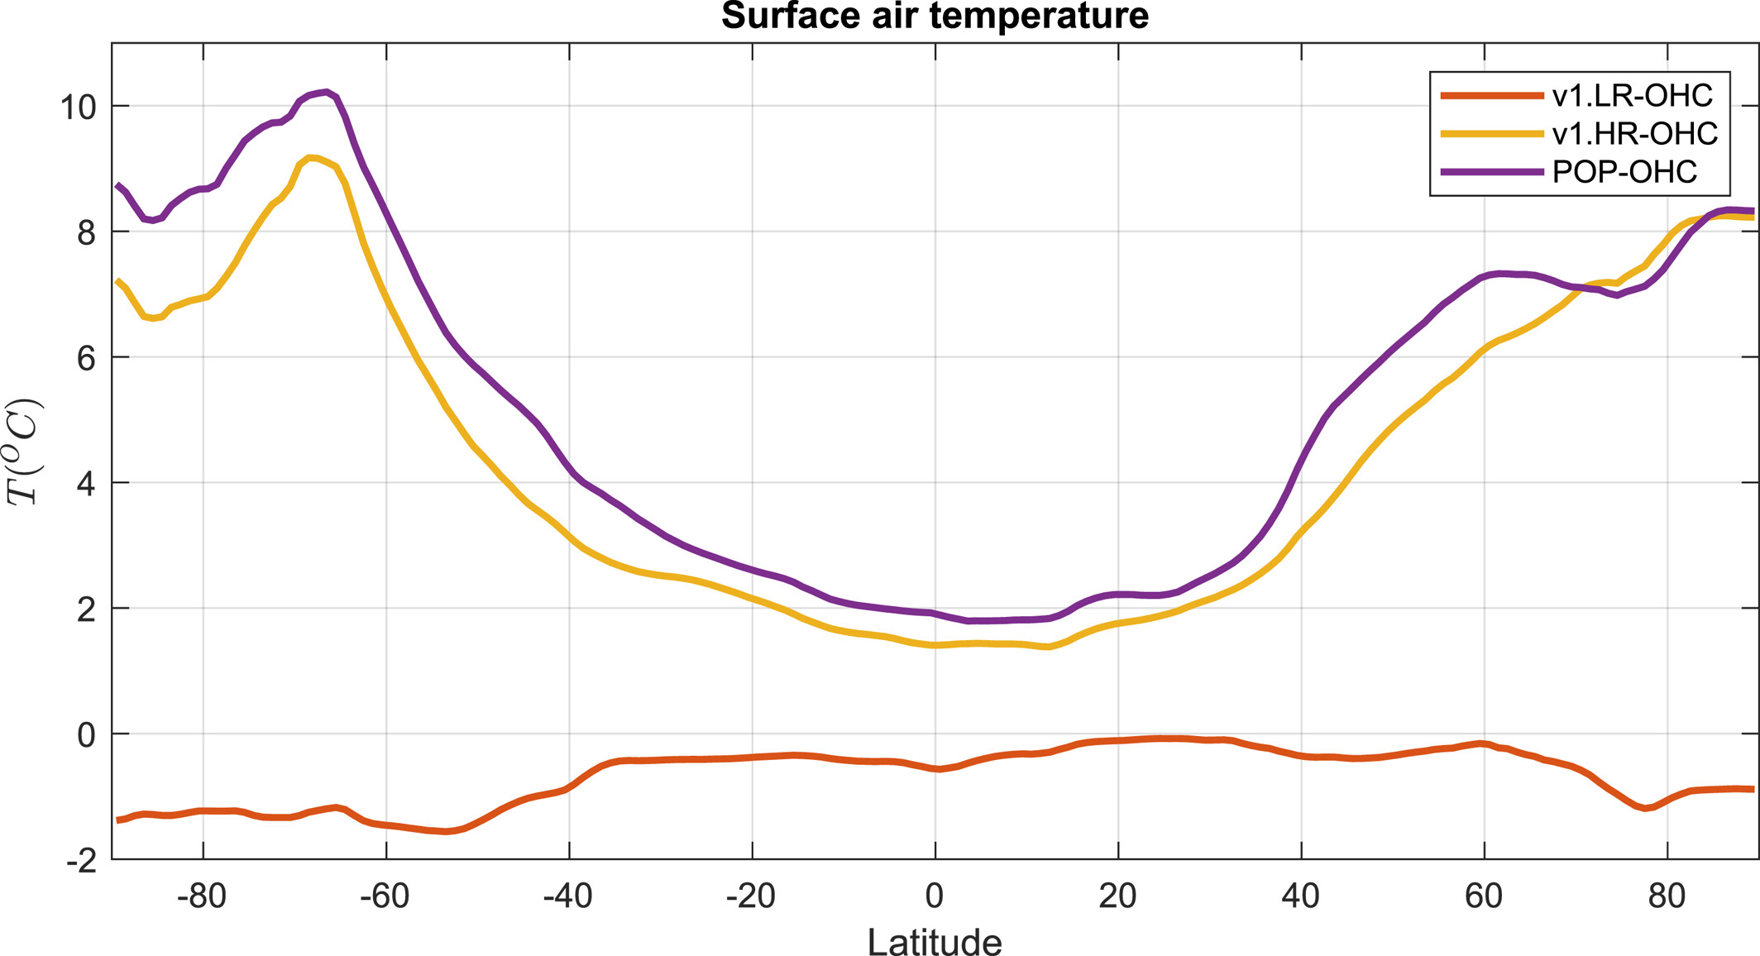

Sea surface temperature
Surface air temperature
~$∆$4ºC

Slide 6
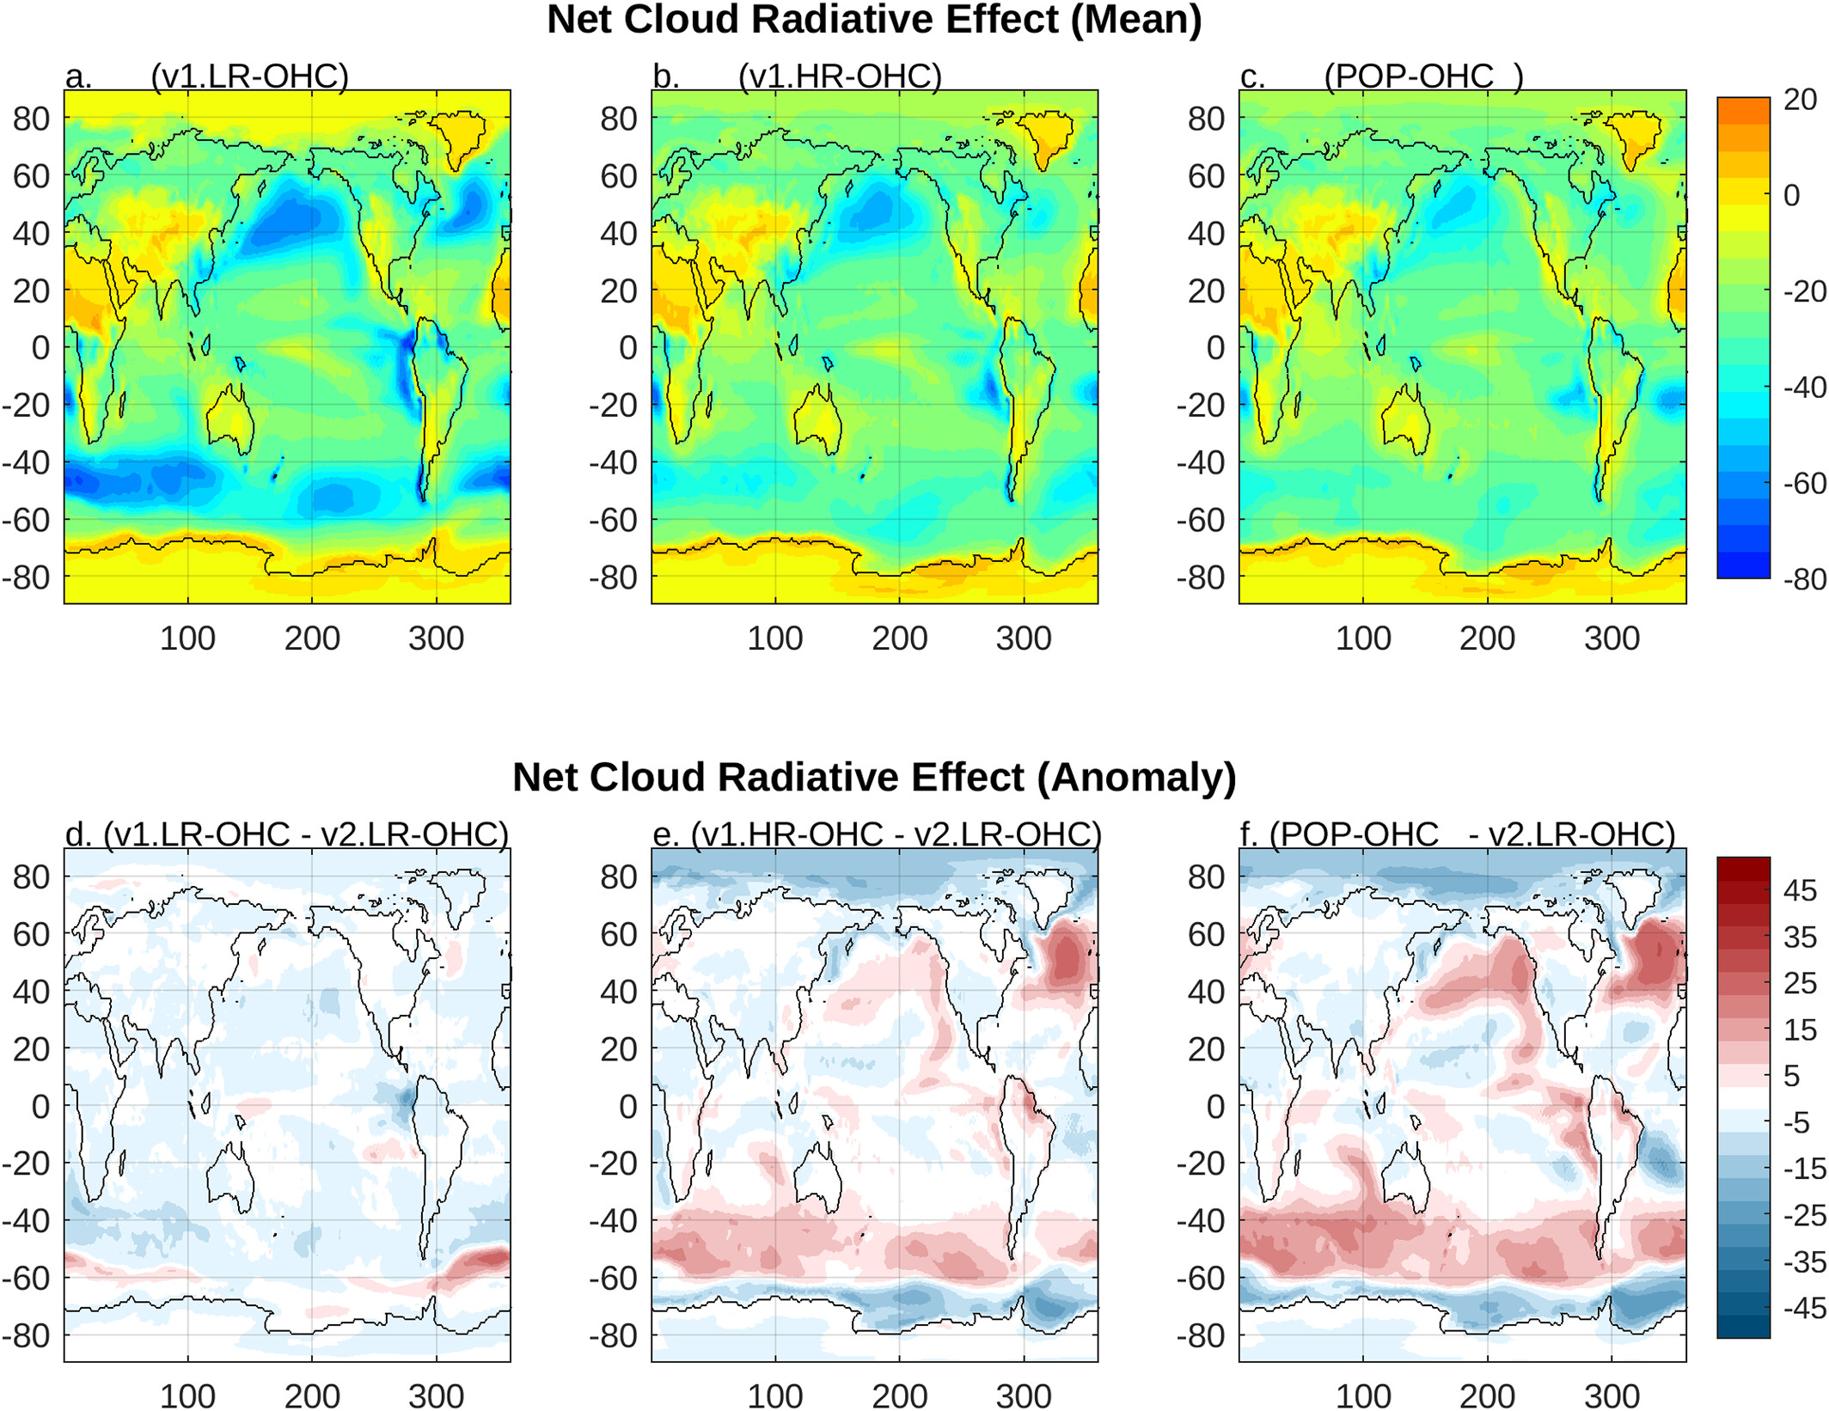
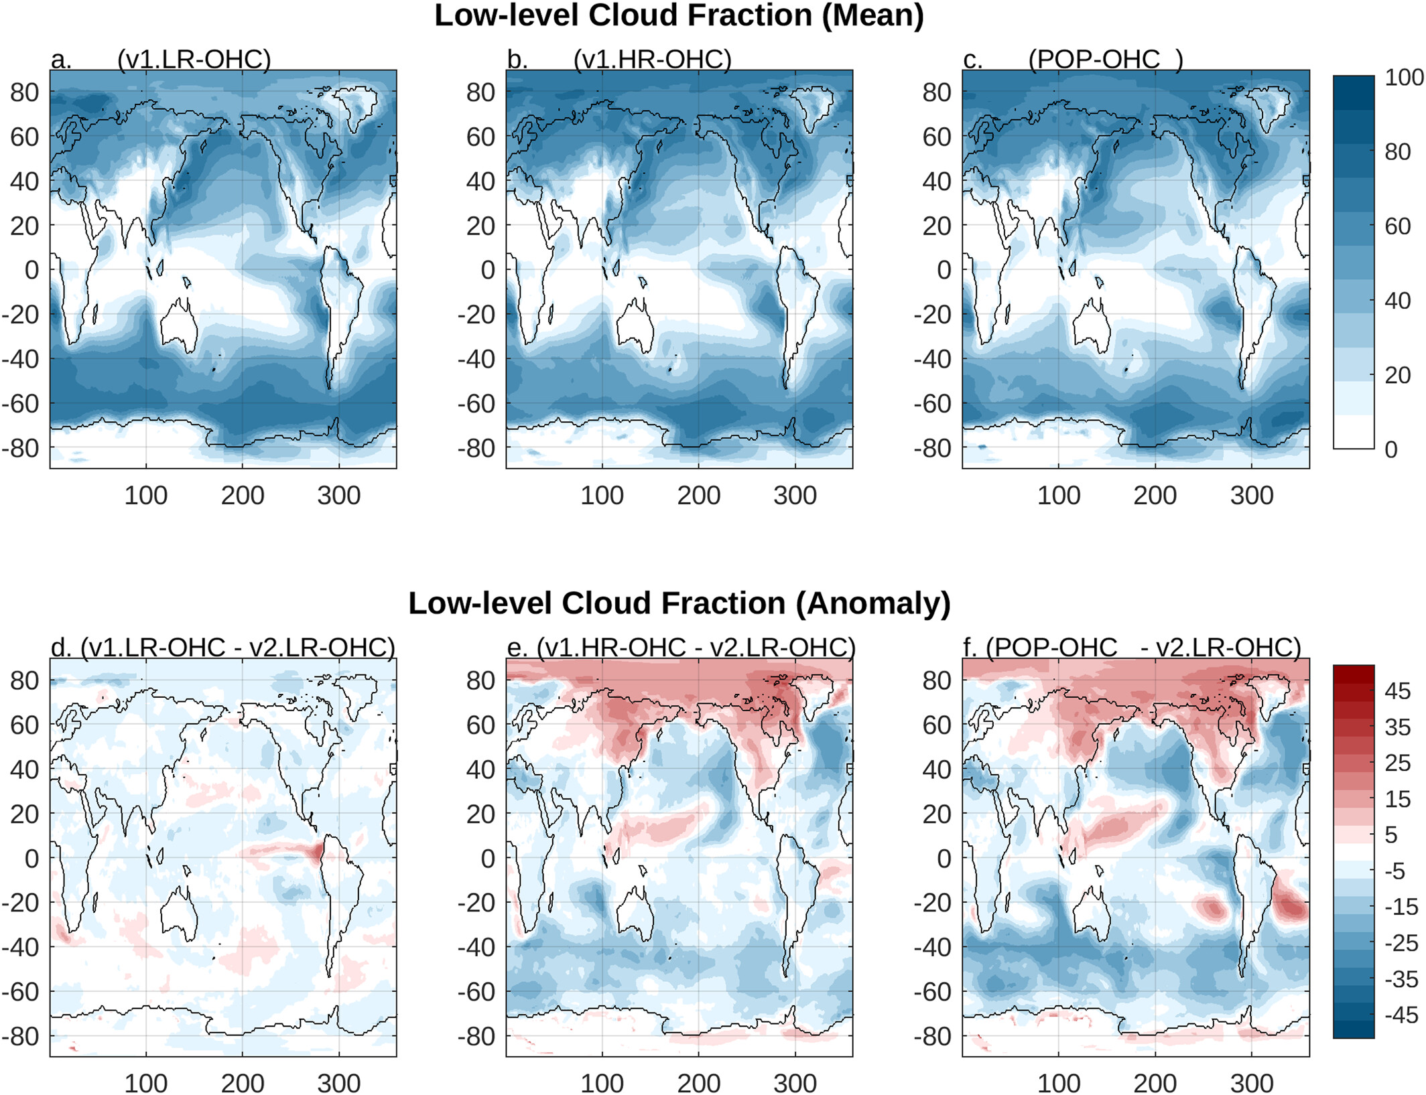
Large low-level cloud and shortwave cloud forcing response to ocean heat transports changes.

Slide 7
Research gaps and challenges in the use of the SOM
Gaps:
Explore the use of the SOM for tuning the E3SM
Explore the possible use of a more interactive SOM for studying climate variability on short time scales where slow ocean processes are not as impactful (e.g for initialized hindcast studies)
Explore the use of the SOM for disentangling the coupled climate response to regional mesh refinement in the atmosphere.
Challenge:
Develop a more interactive E3SM-SOM that is not only thermally coupled but also mechanically coupled with the atmosphere, or that can represent ocean mixed layer thickness variations

